Slide 1
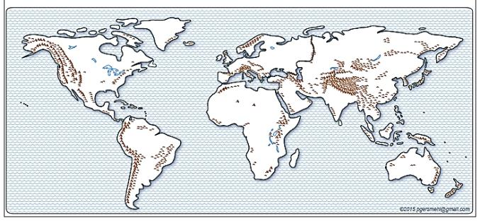

Background for Teachers
Content focus: Ancient cities
Purposes:
to increase skill in finding regions and patterns on maps
(regions and patterns of ancient cities)
to increase skill in describing associations
{and also human-environment interaction}
(association between ancient cities and temperature)
carol.gersmehl@gmail.com Sept. 2015
1

Slide 2
We will use simple maps
about world history and geography.
Use the map title and map key to talk about the
map topic
that is the focus of a thematic map.
(kinds of the topic, amounts of the topic)
(importance of this topic to people)
Use “location” phrases to describe
where
map topics are located
[inside, close to vs. far from,
in the middle or in a corner, on the edge;
on the north, south, west, or east side,
in a line, in a region].

Slide 3
We will use simple maps
to work on the following GLCEs.
6 – G1.1.1
Use maps, globes, and web based technology
to investigate the world at [several] scales.
6 – G1.1.2
Draw a sketch map or add information to an outline map
of the world or a world region.
6 – G1.3.1
Use the fundamental themes of geography
(location, place, human environment interaction, movement, region)
to describe regions or places on earth.

Slide 4
This PowerPoint focuses on
ancient cities.
First, we will use a few pictures
to compare a present-day large city
with three ancient cities.
Second, we will analyze where
ancient cities were located.

Slide 5
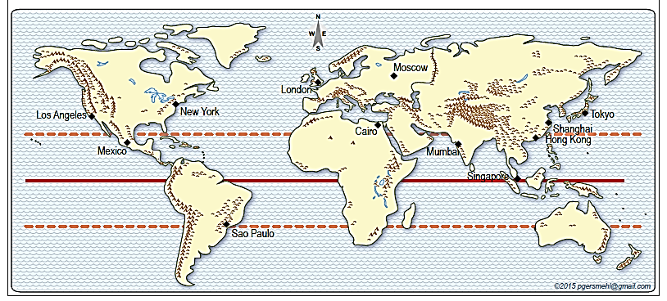
This map shows really big cities (urban areas)
in 2010.

Slide 6
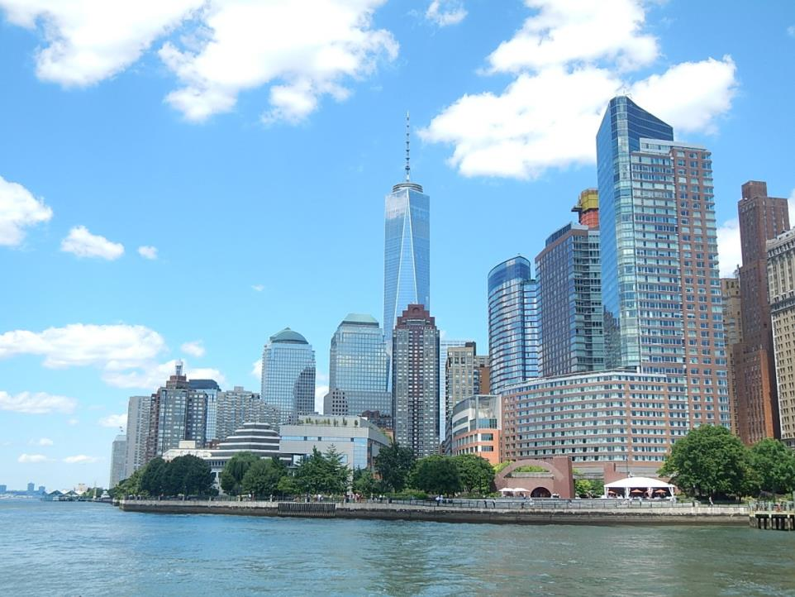
New York City (Downtown-Lower Manhattan) July 2015

Slide 7
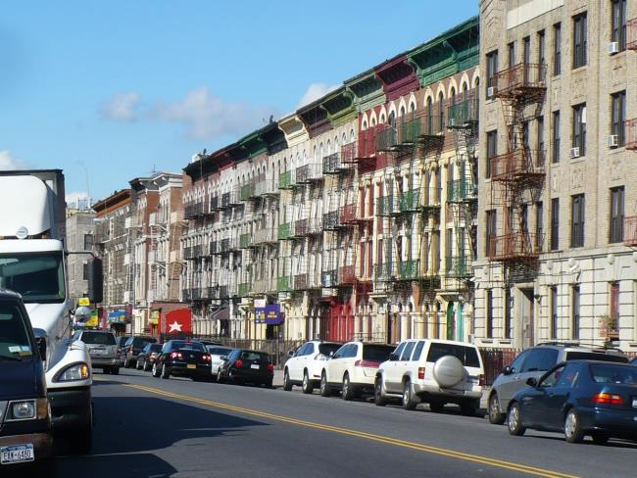
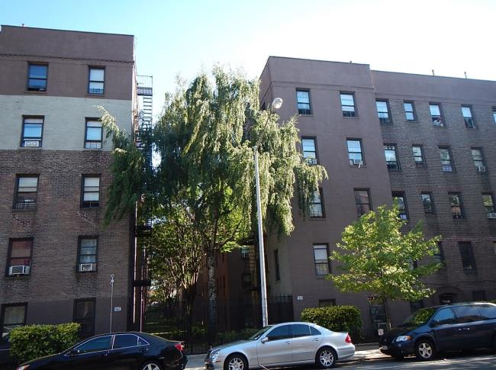
New York City
(Lower Manhattan
residential)
New York City
(Northern Queens
residential)

Slide 8
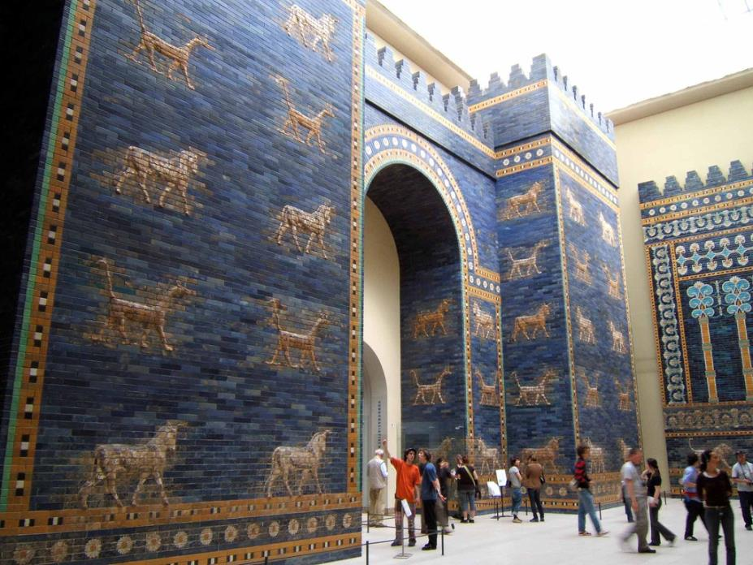
575 BCE: Babylon in Mesopotamia Ishtar Gate
This is a restoration built in Berlin, Germany.
See references and credits on slide 10.

Slide 9
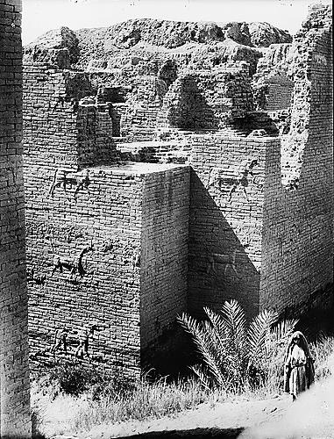
575 BCE: Babylon in Mesopotamia Ishtar Gate
The restoration was based on this excavation of the ancient gate. See references and credits on slide 10.

Slide 10
References and Credits:
Ishtar Gate in ancient Babylon:
https://en.wikipedia.org/wiki/Ishtar_Gate 575 BC King Nebuchadnezzar II
https://commons.wikimedia.org/wiki/File:Ishtar_Gate_at_Berlin_Museum.jpg
https://upload.wikimedia.org/wikipedia/commons/e/e3/Ishtar_Gate_at_Berlin_Museum.jpg
CREDIT: By Rictor Norton [CC BY 2.0 (http://creativecommons.org/licenses/by/2.0)], via Wikimedia Commons
Excavation of ancient ruin:
https://en.wikipedia.org/wiki/File:Ishtar-gate-%D8%A8%D9%88%D8%A7%D8%A8%D8%A9-%D8%B9%D8%B4%D8%AA%D8%A7%D8%B1.jpg public domain

Slide 11
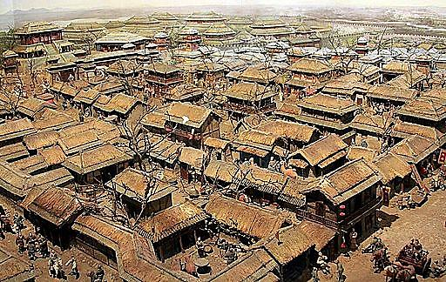
200 BCE: Linzi in China (a regional capital city)
Find both “Residential” and “Downtown” areas.
See references and credits on slide 13

Slide 12
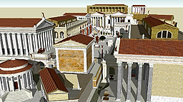
100 CE: Rome, The Forum
Compare this ancient “Downtown” to a modern “Downtown.”
See references and credits on slide 13.

Slide 13
References and Credits:
Rome: Roman forum model 100 AD
https://en.wikipedia.org/wiki/Ancient_Rome#/media/File:Roman_forum_sketch_up_model.png
https://commons.wikimedia.org/wiki/File:Roman_forum_sketch_up_model.png
--
https://commons.wikimedia.org/wiki/File%3ARoman_forum_sketch_up_model.png
https://upload.wikimedia.org/wikipedia/commons/8/81/Roman_forum_sketch_up_model.png
CREDIT: A derivative work of a 3D model by Lasha Tskhondia - L.VII.C. [CC BY-SA 3.0 (http://creativecommons.org/licenses/by-sa/3.0)], via Wikimedia Commons
Linzi, China 200 BC
https://en.wikipedia.org/wiki/Ancient_Linzi
https://en.wikipedia.org/wiki/File:Linzi_model_2010_06_06.jpg#/media/File:Linzi_model_2010_06_06.jpg
--
https://commons.wikimedia.org/wiki/File%3ALinzi_model_2010_06_06.jpg
https://upload.wikimedia.org/wikipedia/commons/f/fa/Linzi_model_2010_06_06.jpg
CREDIT: By Rolfmueller (Own work) [CC BY-SA 3.0 (http://creativecommons.org/licenses/by-sa/3.0) or GFDL (http://www.gnu.org/copyleft/fdl.html)], via Wikimedia Commons

Slide 14
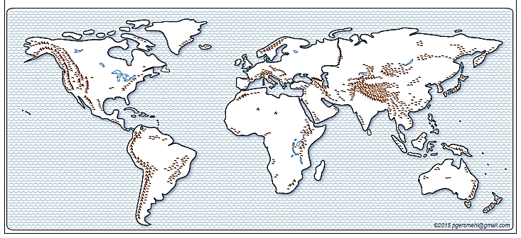

Where were the really big ancient cities?
Ancient: 430 BCE, 100 CE, 500 CE

Slide 15
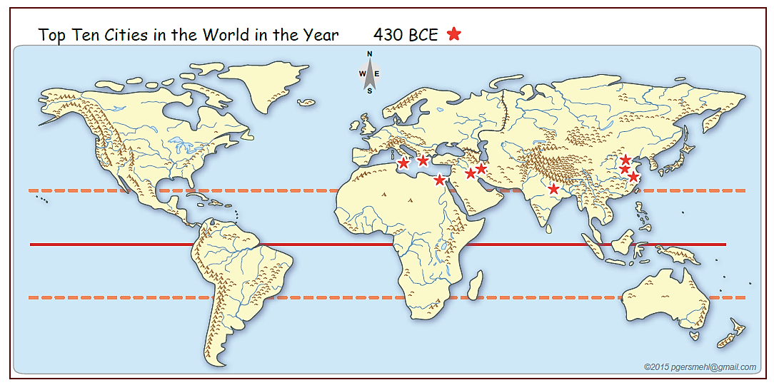
Long ago:
430 BCE
Look for Region, Pattern
Tropic N
Equator
Where
did large numbers of people live in the past?
Tropic S
Region: Draw a box around a group of similar places. Describe location of box.
Pattern: Are ancient cities spread evenly throughout the world? Arrangement:
Look for a line; draw a line. Describe the location of the line.

Slide 16
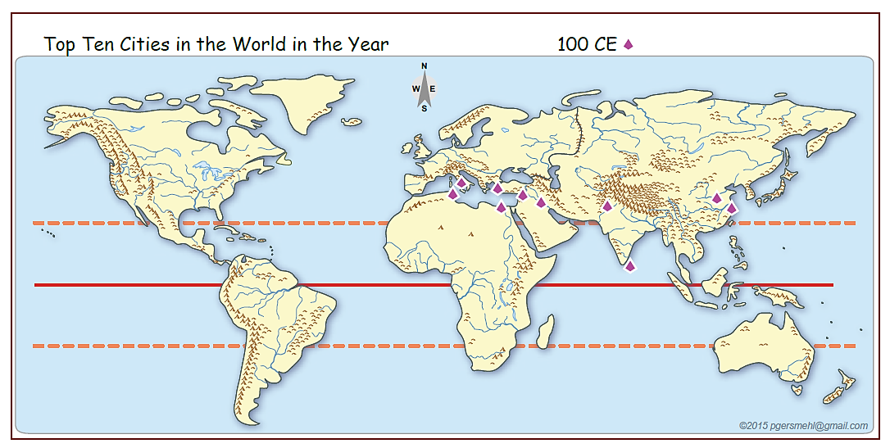
Long ago:
100 CE
Look for Region, Pattern
Tropic N
Equator
Where
did large numbers of people live in the past?
Tropic S
Region: Draw a box around a group of similar places. Describe location of box.
Pattern: Are ancient cities spread evenly throughout the world? Arrangement:
Look for a line; draw a line. Describe the location of the line.

Slide 17
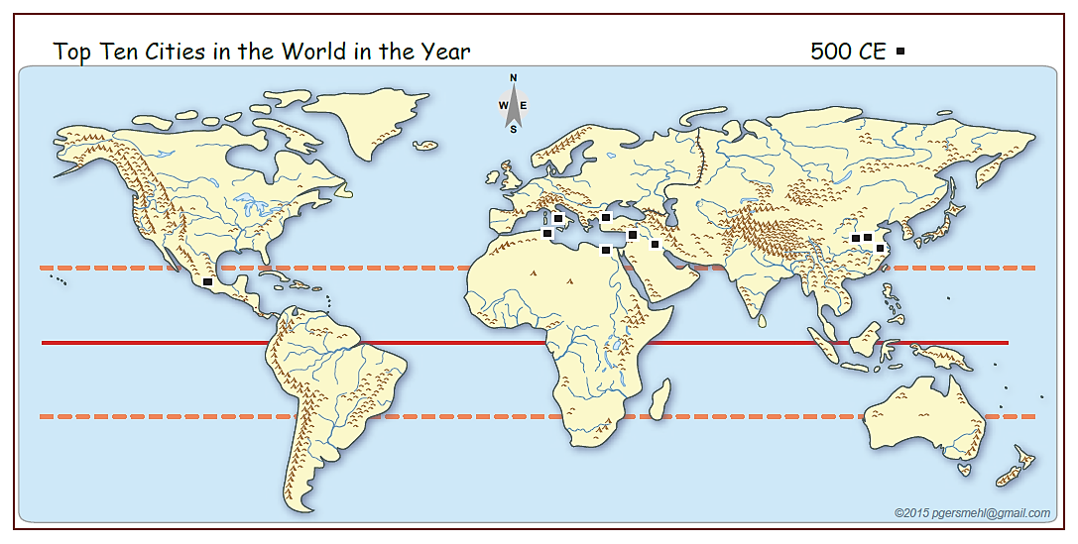
Long ago:
500 CE
Look for Region, Pattern
Tropic N
Equator
Where
did large numbers of people live in the past?
Tropic S
Region: Draw a box around a group of similar places. Describe location of box.
Pattern: Are ancient cities spread evenly throughout the world?
Look for a line; draw a line. Describe the location of the line.

Slide 18
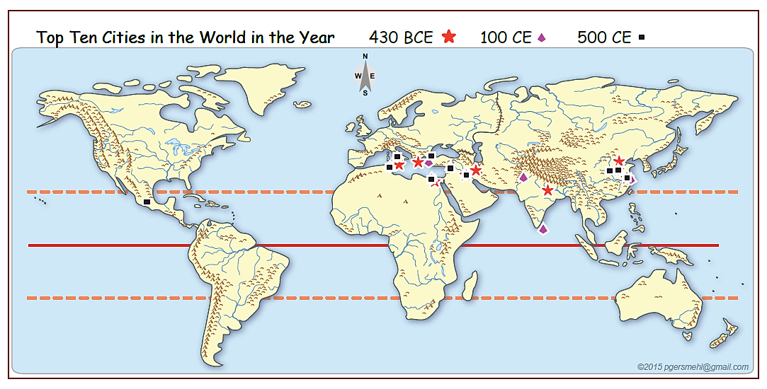
Long ago:
430 BCE, 100 CE, 500 CE
Tropic N
Equator
Where
did large numbers of people live in the past?
Tropic S
Why there?

Slide 19
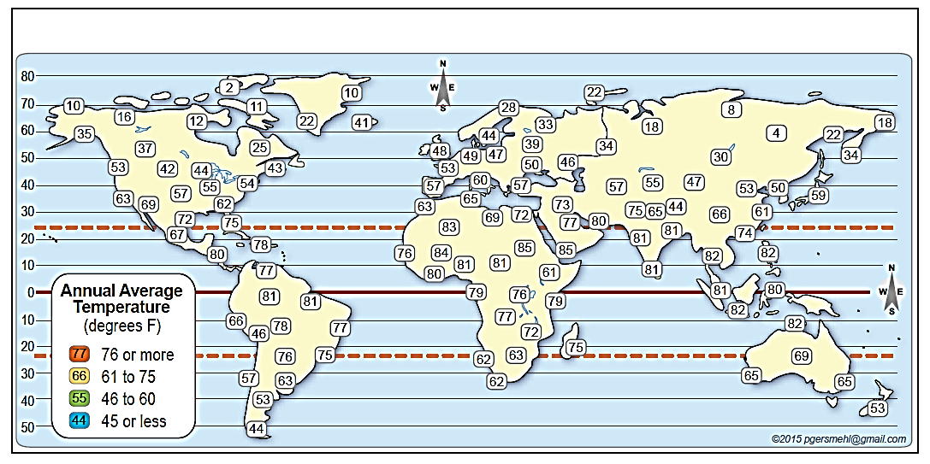
What are some possible reasons
that might explain why ancient cities
show a region or pattern?
Temperature
(average annual)
Equator
O
X
Warmest: Mark the warmest temperatures with an O.
Coldest: Mark the coldest temperatures with an X.
The numbers show average annual temperatures.

Slide 20
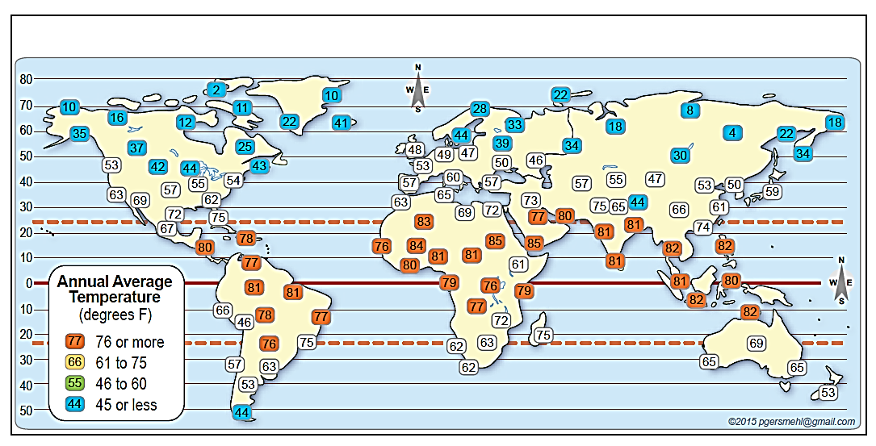

Use region or pattern “vocabulary”
to describe what you see
when you color a set of temperatures.
Temperature
X
X
X
X
X
X
X
X
X
X
X
X
X
X
X
X
X
X
X
X
X
X
X
X
X
X
O
O
X
O
O
O
O
O
O
O
O
O
O
O
O
O
O
O
O
O
O
O
O
O
Equator
O
O
O
O
O
O
O
O
O
X
X
Pattern: Are the coldest temperatures spread evenly throughout the world?
Look for a line; draw a line. Describe the location of the line.
Are the warmest temperatures spread evenly throughout the world?
Look for a line; draw a line. Describe the location of the line.

Slide 21
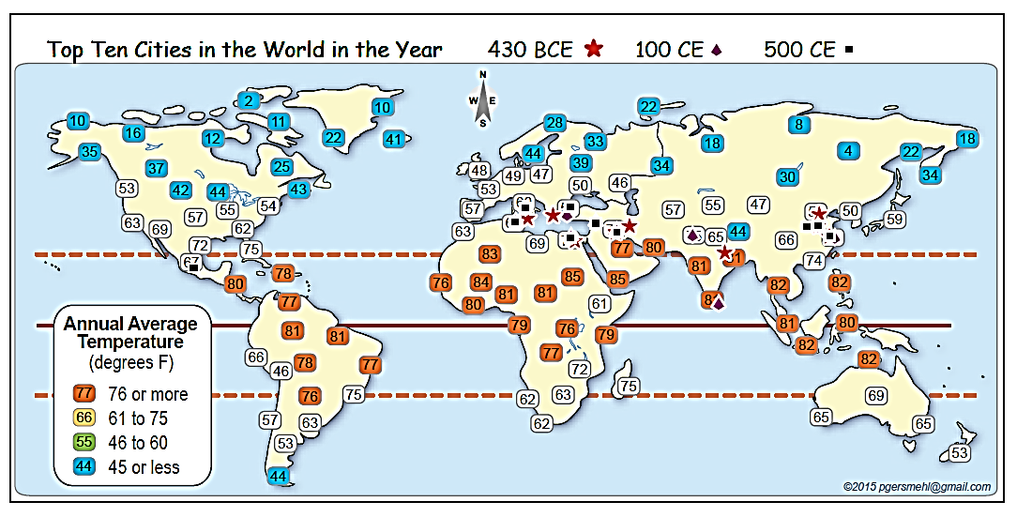
Temperature and largest ancient cities.
Equator
Association:
What temperatures are associated with
(occur together with)
the region or line of the largest cities?

Slide 22
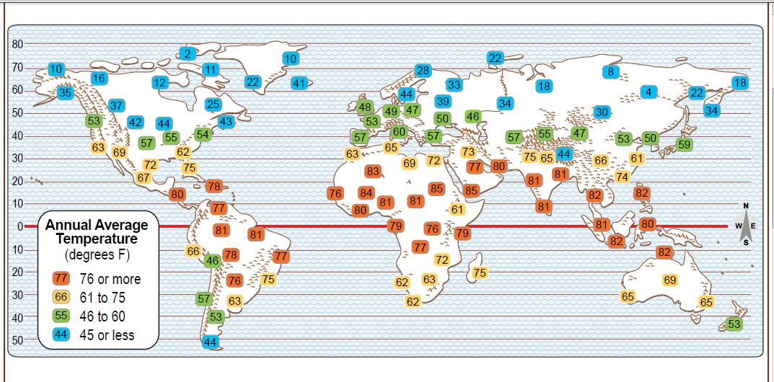
Temperature
Equator
Transition: Describe a sequence along a route.
Find the arrows that point away from the Equator.
How does temperature change as
we move away from the Equator?

Slide 23
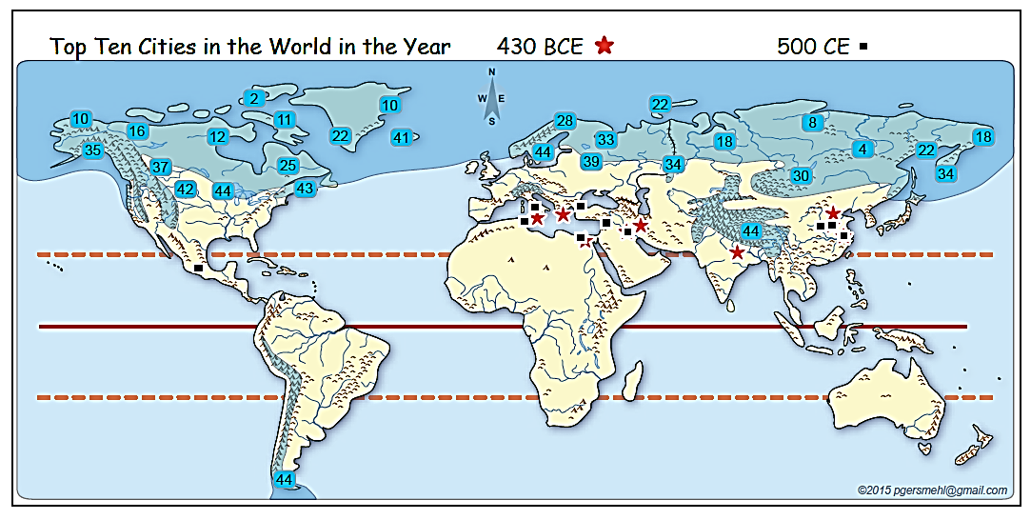
Temperature (average annual)
and Short Growing Season
Dark
shading
means
short
growing
season.
Equator
Describe associations among temperature, growing season,
and location of ancient cities.
What occurs together?

Slide 24
Sources:
Data sources for 2010 population:
https://en.wikipedia.org/wiki/World_population -- using UN data
http://esa.un.org/wpp/excel-data/population.htm -- UN data
http://www.ecology.com/world-population-continent/ -- using Population Reference Bureau data
Data sources for Year 1 population:
http://www.ggdc.net/maddison/maddison-project/home.htm
http://www.rug.nl/research/ggdc/data/maddison-historical-statistics
http://sasi.group.shef.ac.uk/worldmapper/display.php?selected=7
Data source for largest ancient cities:
Tertius Chandler, Four Thousand Years of Urban Growth: An Historical Census
See Excel table (AncientCities _430BC&100-400-800AD_Data.xls) about largest ancient cities:
Maps: We use layers in the “clickable PDF” called
AncientCities & Temperature_World clickable.pdf
Sept. 2015 carol.gersmehl@gmail.com Michigan Geographic Alliance

Slide 25
Copyright 2015, Carol Gersmehl
Teachers who saw this presentation at a workshop
or downloaded it from our internet site have permission
to make a copy on their own computers for these purposes:
1. to help them review the workshop,
2. to show the presentation in their own classrooms,
at sessions they present at teacher conferences,
or to administrators in their own school or district,
3. to use individual frames (with attribution)
in their own class or conference presentations.
For permission for any other use,
including posting frames on a personal blog
or uploading to any network or website,
contact carol.gersmehl@gmail.com

