Slide 1
Geographical Themes:
Ideas to Help Us
Organize Knowledge
Let’s pick a simple topic – houses.
People live in different kinds
of houses in different places.

Slide 2
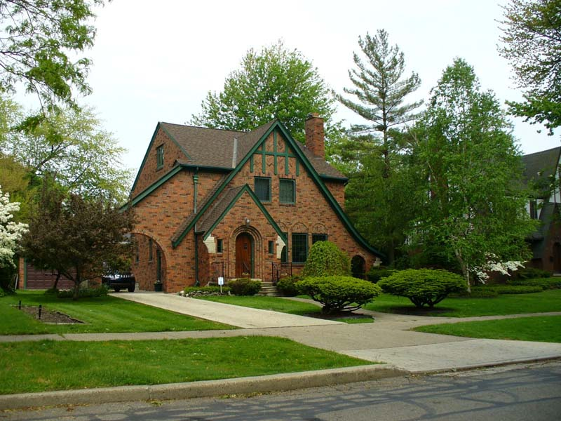
Many people in the United States
live in “single-family houses”
like this one near Detroit.

Slide 3
Some people live in “rowhouses,”
like these in Washington, DC.

Slide 4
Some people live
in high-rise apartments.

Slide 5
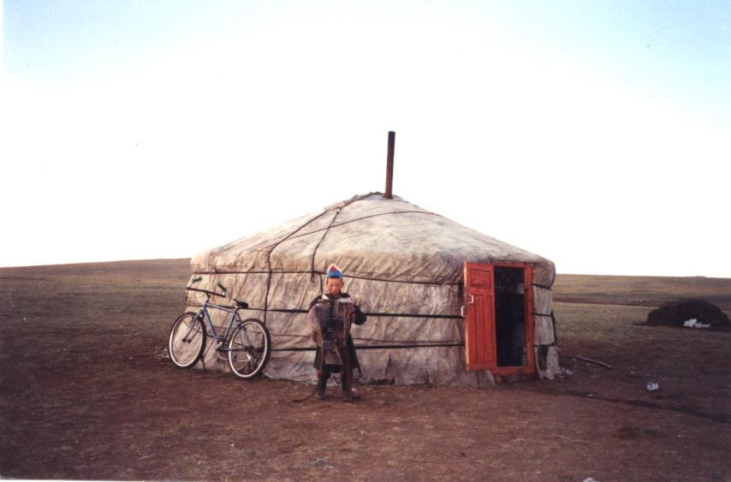
Some people live in tents
made of cloth or animal skins.

Slide 6
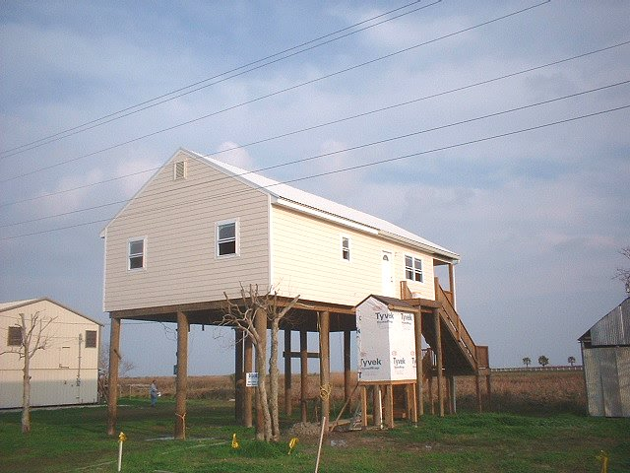
Some people build their houses
up on stilts to avoid floods.

Slide 7
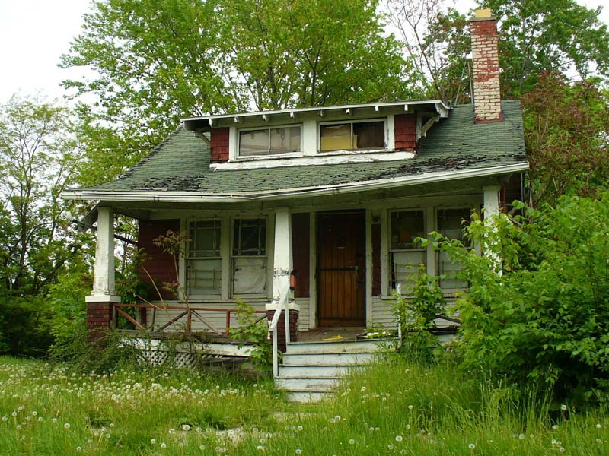
And in some places,
houses are abandoned.

Slide 8
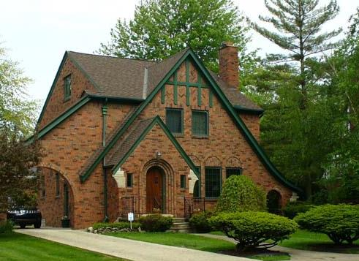
And in some places,
houses are abandoned.
Interestingly,
that abandoned house
is only one mile away
from the first picture.

Slide 9
And in some places,
houses are abandoned.
How would a geographer
start a study of houses
in an urban area,
in another state,
or around the world?

Slide 10
Five themes
Geographers seek to understand
Human-Environment
Interaction
Many
academic disciplines
look at that!
Theme #1
Geography’s Focus
is on how people interact
with their environments
in different places.
“Environment”
includes other people
and their cultures – tools,
food, houses, roads,
games, art, religion, . . .

Slide 11
Geographers seek to understand
Human-Environment
Interaction
Of course
they overlap,
contribute
to each
other, etc.
DUH!
The “entrance ticket” to a geographic inquiry is
Location
Theme #2
Our second theme
restricts the aim
to encourage
rigorous
inquiry.
DISCIPLINE FOCUS QUESTION
science process how?
history time when?
geography space where?
aesthetics, beauty, so what?
ethics, etc. fairness

Slide 12
Geographers seek to understand
Human-Environment
Interaction
The “entrance ticket” to a geographic inquiry is
Location
The concept of location has two complementary aspects
Place
(conditions)
Movement
(connections)
Themes #3 and 4
are like the two blades
of a “thinking scissors”–
they work together.

Slide 13
Geographers seek to understand
Human-Environment
Interaction
The “entrance ticket” to a geographic inquiry is
Location
The concept of location has two complementary aspects
Place
(conditions)
Movement
(connections)
What we observe at a place –
temperature, rainfall,
rock type, language,
behavior, income, . . .
. . . are results of movement –
solar energy, clouds,
tectonic plates, immigrants,
political influence, trade . . .

Slide 14
Geographers seek to understand
Human-Environment
Interaction
The “entrance ticket” to a geographic inquiry is
Location
The concept of location has two complementary aspects
Place
(conditions)
Movement
(connections)
What we observe at a place –
temperature, rainfall,
rock type, language,
behavior, income, . . .
. . . are results of movement –
solar energy, clouds,
tectonic plates, immigrants,
political influence, trade . . .
And vice versa. Most movements are due to conditions:
Wind – air moves away from high air pressure,
Trade – consumers want things made in other places,
Migration – people move away from dangerous places, . . . .

Slide 15
Geographers seek to understand
Human-Environment
Interaction
The “entrance ticket” to a geographic inquiry is
Location
The concept of location has two complementary aspects
Place
(conditions)
Movement
(connections)
Geographers organize facts about conditions and connections by using
Region
and other mental ideas
to organize information
Conditions at places and
connections between places
are the “facts” of geography

Slide 16
So, when you see something like a house,
your first question (as a geographer) is: “Where is it?”
Then: “What’s it like there?” “What’s it connected to?”
AND
“What kind of spatial thinking can help me understand it?”

Slide 17
Copyright 2015, Phil Gersmehl
Teachers who saw this presentation at a workshop
or downloaded it from our internet site have permission
to make a copy on their own computers for these purposes:
1. to help them review the workshop,
2. to show to colleagues or administrators,
3. to show the presentation in their own classrooms
or at sessions they lead at teacher conferences,
4. to use individual frames (with attribution)
in their own class or conference presentations.
For permission for any other use,
including posting frames on a personal blog
or uploading to any network or website,
contact pgersmehl@gmail.com

