Slide 1
Copyright 2015, P Gersmehl
A Wake-up Call
Learning About
“The Environment”

Slide 2
Once upon a time,
some teachers were thinking about
a Michigan Grade Level Content Expectation:
GLCE 6 – W1.2.2 and 7 – W1.2.1
Explain the importance of the natural environment
. . . in different locations

Slide 3
Once upon a time,
some teachers were thinking about
a Michigan Grade Level Content Expectation:
To meet this standard,
students need to understand
the idea of “environment.”
GLCE 6 – W1.2.2 and 7 – W1.2.1
Explain the importance of the natural environment
. . . in different locations

Slide 4
Teachers can show pictures,
and talk about them,
and have students
write about them.

Slide 5
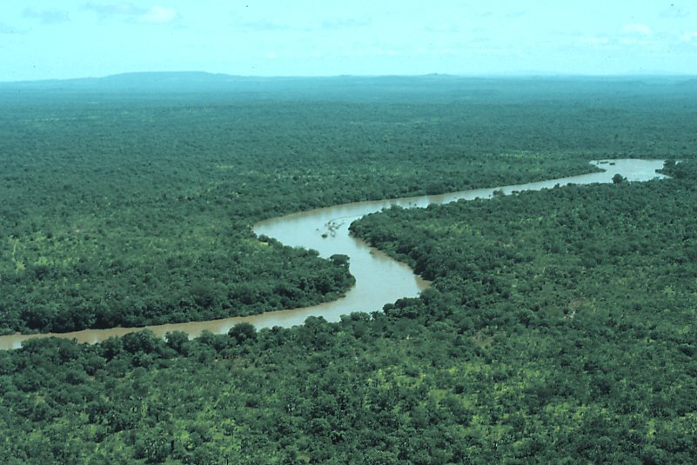
Rainforest
There are places where
it rains almost every day
(near the equator).

Slide 6
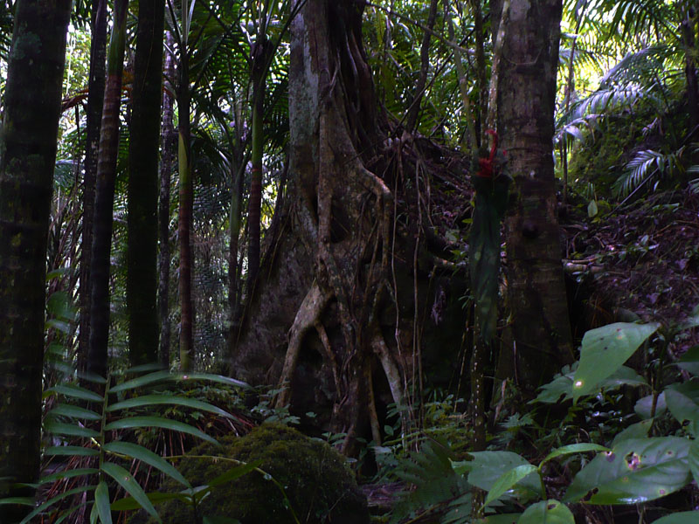
Trees grow big
in a rainforest.
Rainforest

Slide 7
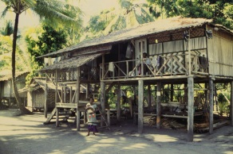
People who live
in rainforests
often build
their houses
out of wood.

Slide 8
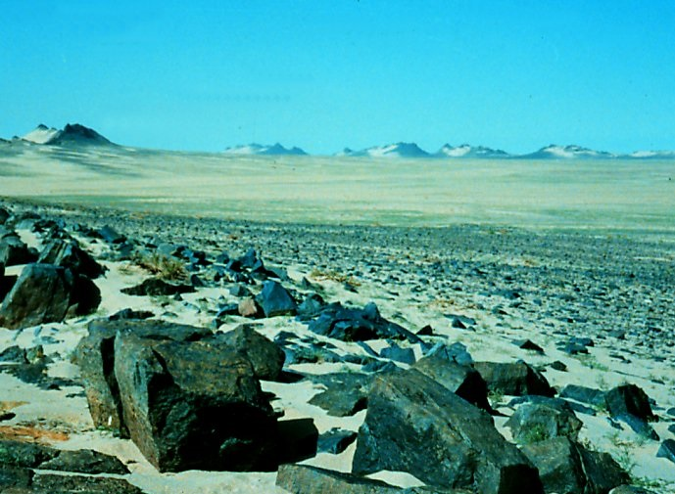
Desert
There are places where
it hardly ever rains
(near the Tropic lines).
Fact: trees need
water to grow.

Slide 9
Desert
What
could you use
to build a house
if you lived here?

Slide 10
Desert
People who live
in deserts
are not likely
to build houses
out of wood !

Slide 11
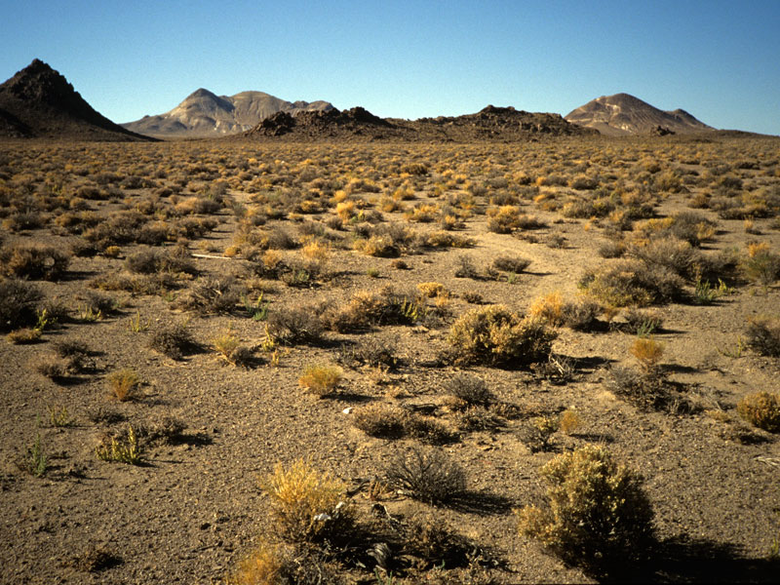
An abstract idea like
“environmental adaptation”
(or “human-environment relationships)
can be hard to teach
with examples that come
only from a local community.
That is a serious flaw in the
“expanding horizons” approach
to social-studies curriculum!

Slide 12
Pictures of other places
can help students build
visual vocabulary,
especially if we ask
good questions about them.
But unless we attach these images
to some kind of map,
students will not learn
where they are.

Slide 13
Maps are more abstract
than photos.
It is therefore both harder
and more important
to ask questions
about maps.
We can’t just say . . . .
“Study this map” OR
“As you can see on this map . . “

Slide 14
A Wake-up Call

Slide 15
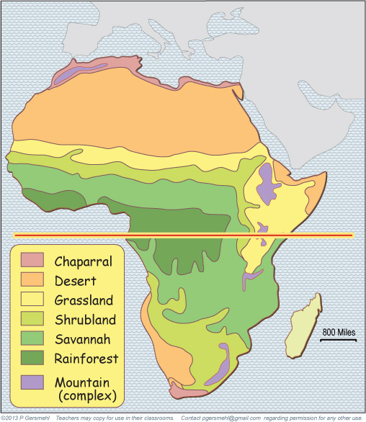
And here
is a desert.
Here is
a typical textbook map
of “the regions in Africa.”
Here is the
rainforest.

Slide 16
Here is
a typical textbook map
of regions in Africa.
We asked students to
“study the pattern
of environments.”

Slide 17
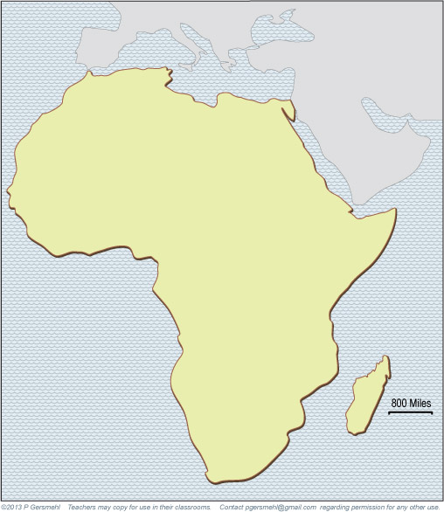
Here is
a typical textbook map
of regions in Africa.
We asked students to
“study the pattern
of environments.”
Weeks later,
a test asked
a simple question:
Divide this blank map
into 3-6 regions
and write a short phrase
to describe each region.

Slide 18
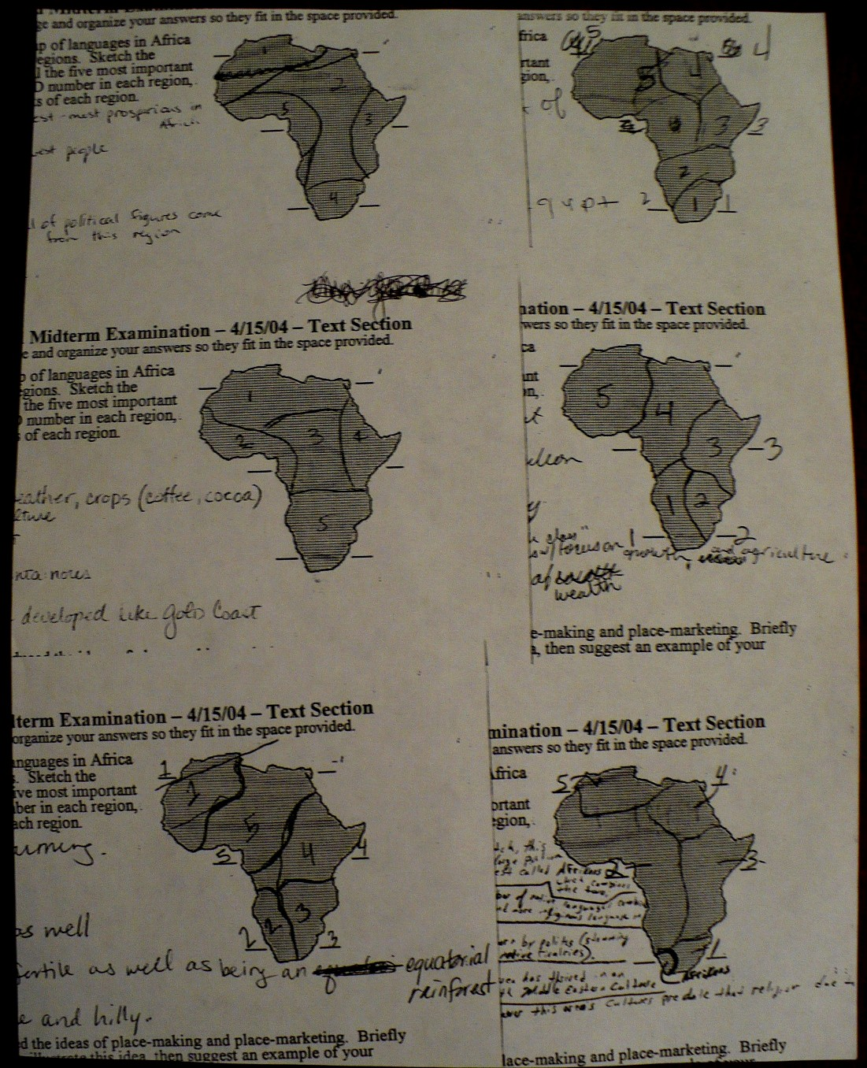
Here are some
of their answers:

Slide 19
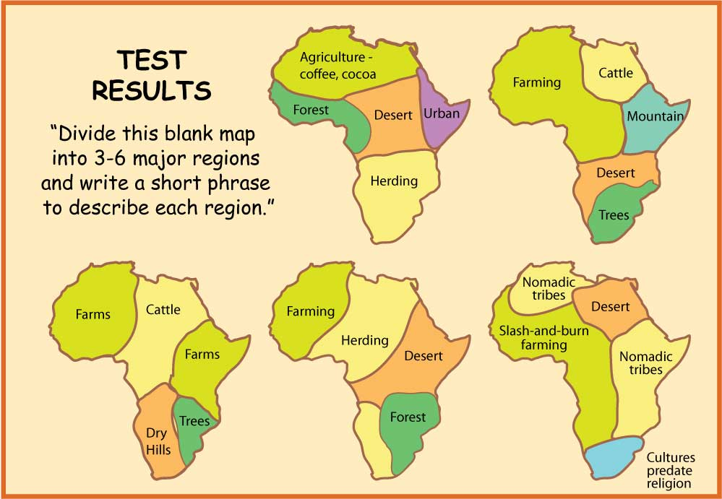
I’ve redrawn them
with the colors
of the study map.
But first . . .
let me pause for a minute
so we can think about why
simple memorization
of environmental patterns
does not work very well.

Slide 20
But first . . .
let me pause for a minute
so we can think about why
simple memorization
of environmental patterns
does not work very well.
Conclusion?
The human brain
does NOT store
map images
accurately.
And these students
did not learn how
to “study” maps
in school.

Slide 21
Knowledge of this map
can help us understand . . .
Libya
Egypt
Mali
Nigeria
Sudan
Somalia
Soweto

Slide 22
Knowledge of this map
can help us understand . . .
Libya
Egypt
Mali
Nigeria
Sudan
The former President of Nigeria –
he was a Christian, of the Ijaw tribe,
home near the coast, son of canoe-makers,
with a university degree in fisheries biology,
and early experience as a lecturer
and wildlife management official.
What in that background will help
in dealing with an Islamic radical group
in the northern part of a divided “country”
with borders drawn by British colonialists?
Somalia
Soweto

Slide 23
It is impossible
to put these issues
into their context
if your mental map
looks like these!
But first . . .
let me pause for a minute
so we can think about why
simple memorization
of environmental patterns
does not work very well.

Slide 24
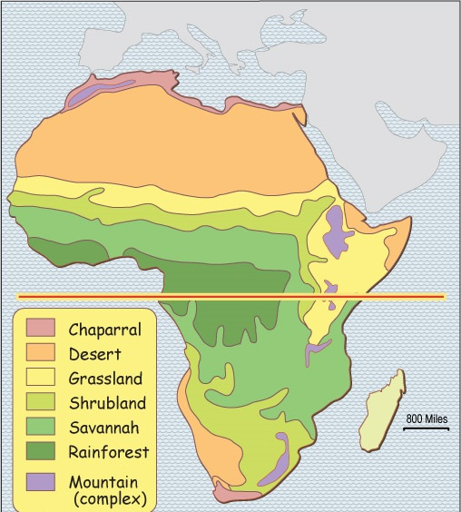
Conclusion?
You can’t just say
“study this map.”
You must ask questions,
or model the inquiry
(or both!).
Developing these inquiry skills
is an important goal.

Slide 25
Copyright 2015, Phil Gersmehl
Photos by Rick Bein, Gray Tappan, and Phil Gersmehl
Teachers who saw this presentation at a workshop
or downloaded it from our internet site have permission
to make a copy on their own computers for these purposes:
1. to help them review the workshop,
2. to show to colleagues or administrators,
3. to show the presentation in their own classrooms
or at sessions they lead at teacher conferences,
4. to use individual frames (with attribution)
in their own class or conference presentations.
For permission for any other use,
including posting frames on a personal blog
or uploading to any network or website,
contact pgersmehl@gmail.com

