Slide 1
Spatial Reasoning
9 Books on 9 Tables
P Gersmehl
Michigan
Geographic
Alliance
2014

Slide 2
To understand
how children “see” a map,
we have to understand
how human brains encode
spatial information.
Spoiler alert
We do it in several
different ways.

Slide 3
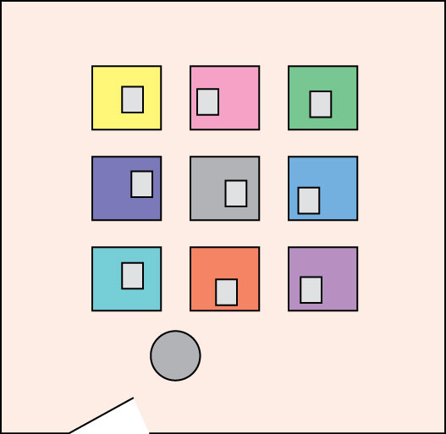
Imagine a room
with 9 books
on 9 tables.
There is
a treasure
under this book.
Here is the door.
PS This is you!

Slide 4
How will you remember
where the treasure is?

Slide 5
You may be thinking
The treasure is:
- near my right hand
- on the orange table,
- in middle of first row,
- book in front middle of its table,
- on door side of room,
. . .
How will you remember
where the treasure is?

Slide 6
Spoiler alert:
your brain
automatically thinks
of several of these,
all at once (in parallel),
but unless you try,
you are likely to be
consciously aware
of only one.
You may be thinking
The treasure is:
- near my right hand
- on the orange table,
- in middle of first row,
- book in front middle of its table,
- on door side of room,
. . .
How will you remember
where the treasure is?

Slide 7
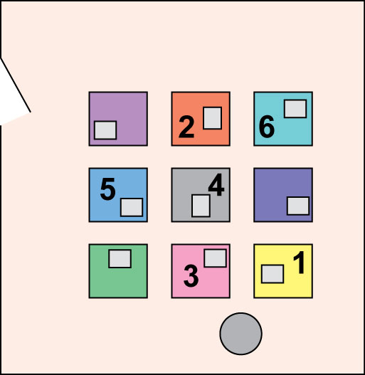
Then you go to another room.
The question
is simple:
Which table has
the treasure?
The answer, however, is not simple.
It depends on which mode
of spatial thinking you use.

Slide 8
1. Aura – right hand touch
2. Association – color
3. Sequence – middle
of row in front of you
4. Analogy – book in
same position on table
5. Sequence 2 – middle
of row on door side of room
And what if
- tables were different sizes?
- books were different colors?
6. Analogy 2 – book in
same position on its table
as the table is in the room

Slide 9
Note to assessment writers –
if you didn’t think of this one,
you could be writing map questions
that the brightest students in the room
are very likely to get wrong.
Think about it!
If you want an explanation,
here’s that “super-analogy” –
In the first room, the treasure
was under a book that was located
in the front middle part of a table,
and that table, in turn, was located
in the front-middle of the group
of nine tables in the room.
Now, the treasure could be on table 6, where the book is located
in the top right corner of the table
that is in the top-right corner
of the group of tables
(the “same position”).
1. Aura – right hand touch
2. Association – color
3. Sequence – middle
of row in front of you
4. Analogy – book in
same position on table
5. Sequence 2 – middle
of row on door side of room
And what if
- tables were different sizes?
- books were different colors?
6. Analogy 2 – book in
same position on its table
as the table is in the room

Slide 10
Here’s a typical situation where this principle is important –
a colorful map from a popular primary-school atlas.
PROBLEM
Copyright rules prohibit distributing
this powerpoint with the map –
find a map with tiny pictures
of animals in Africa.
You won’t have trouble finding one –
our collection has more than twenty,
from every major educational publisher.
We’ll look at how kids “see” this map
in a minute – after a summary.

Slide 11
The big point for teachers:
Different children may encode
information from a map
in different ways.
In other words, they do
different kinds of spatial thinking with different degrees of “skill” (and they develop at different rates).

Slide 12
The big point for teachers:
Different children may encode
information from a map
in different ways.
In other words, they do
different kinds of spatial thinking with different levels of “skill” (and they develop at different rates).
With proper guidance,
every child can learn how to do
all kinds of spatial thinking
better!

Slide 13
Remember:
Kids don’t just
“get information”
from a map.

Slide 14
Copyright 2015, Phil Gersmehl
Teachers who saw this presentation at a workshop
or downloaded it from our internet site have permission
to make a copy on their own computers for these purposes:
1. to help them review the workshop,
2. to show to colleagues or administrators,
3. to show the presentation in their own classrooms or at sessions they lead at teacher conferences,
4. to use individual frames (with attribution) in their own class or conference presentations.
For permission for any other use,
including posting frames on a personal blog or uploading to any network or website,
contact pgersmehl@gmail.com

