Slide 1
spatial reasoning
REVIEW
Educational implications
of modern neuroscience:
a review of research
for social studies teachers
P Gersmehl
Michigan
Geographic
Alliance
2014

Slide 2
He called them
“a prioris”
(They’re in our heads
before we start learning.)
Kant said:
Humans have several “built-in” ways
of organizing information from experience:
Temporally
Quantitatively
Spatially
Causally

Slide 3

Unfortunately,
“brain science”
has become
a kind of buzzword.

Slide 4
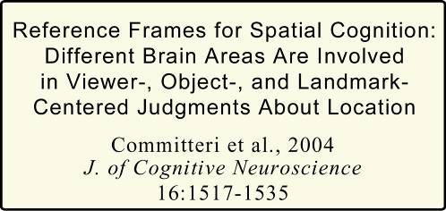
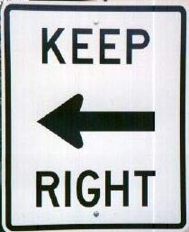
Where is the
“front”
?
??
of me, you,
this model,
this room, . . .
But if we look at
the brain-scanning research
(not just the opinion blogs)
it says
“Kant was right.”

Slide 5
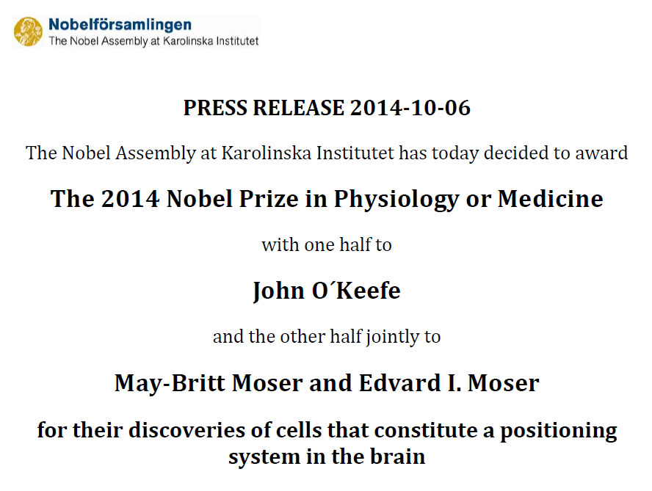
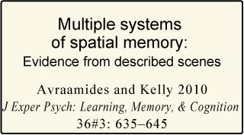
Brain-scanning says
“Kant was right.”

Slide 6
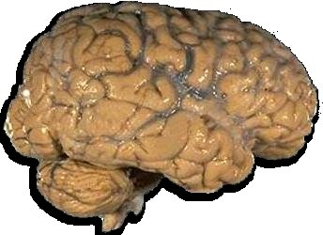
Recent Research (> 3500 studies since 1990)
shows that the human brain has distinct networks
that do specific kinds of spatial thinking.
shows that the human brain has several distinct networks
that do specific kinds of spatial thinking.
Analogy
Comparison
Aura
(Influence)
Region
Sequence
(Transition)
Pattern
(Shape)
Association
(Correlation)
Hierarchy

Slide 7
bright or dark
large or small
noisy or quiet
crowded or empty
dirty or clean
Recent Research (> 3500 studies since 1990)
shows that the human brain has distinct networks
that do specific kinds of spatial thinking.
Analogy
Comparison
Aura
(Influence)
Spatial Comparison
Region
Sequence
(Transition)
Stand in one place
and try to describe what you see.
Is it:
large or small
bright or dark
noisy or quiet
dirty or clean
?
Pattern
(Shape)
Association
(Correlation)
Hierarchy

Slide 8
bright or dark
large or small
noisy or quiet
crowded or empty
dirty or clean
Recent Research (> 3500 studies since 1990)
shows that the human brain has distinct networks
that do specific kinds of spatial thinking.
Stand in one place and try to describe what you see.
Would you say that the place is:
Analogy
Comparison
Aura
(Influence)
Spatial Comparison
Region
Note how much easier it is to say:
“compared to [a place I know], this is . . .”
Sequence
(Transition)
larger or smaller
brighter or darker
noisier or quieter
dirtier or cleaner
Pattern
(Shape)
Association
(Correlation)
Hierarchy

Slide 9
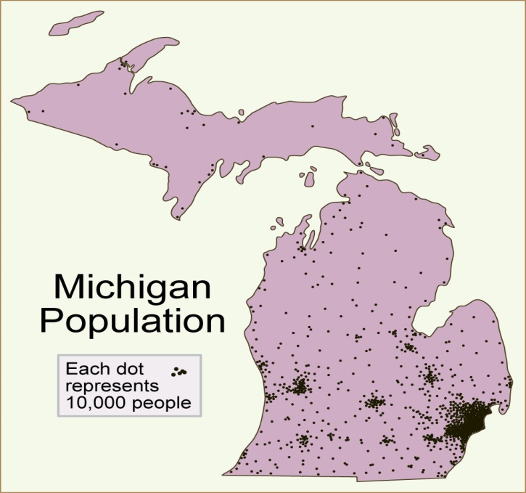
Recent Research (> 3500 studies since 1990)
shows that the human brain has distinct networks
that do specific kinds of spatial thinking.
Analogy
Comparison
Aura
(Influence)
Spatial Comparison
UP is half as big as LP
Region
Sequence
(Transition)
LP has more people than UP
Most people are in S part of LP
Pattern
(Shape)
Association
(Correlation)
Density goes down faster
going N from Macomb
than going W or S
Hierarchy

Slide 10
Recent Research (> 3500 studies since 1990)
shows that the human brain has distinct networks
that do specific kinds of spatial thinking.
Analogy
Comparison
Aura
(Influence)
Spatial Comparison
UP is half as big as LP
Region
Sequence
(Transition)
Your brain
does this automatically,
(it had survival value)
but you are not likely
to remember it
unless you verbalize it.
LP has more people than UP
Most people are in S part of LP
Pattern
(Shape)
Association
(Correlation)
Density goes down faster
going N from Macomb
than going W or S
Hierarchy

Slide 11
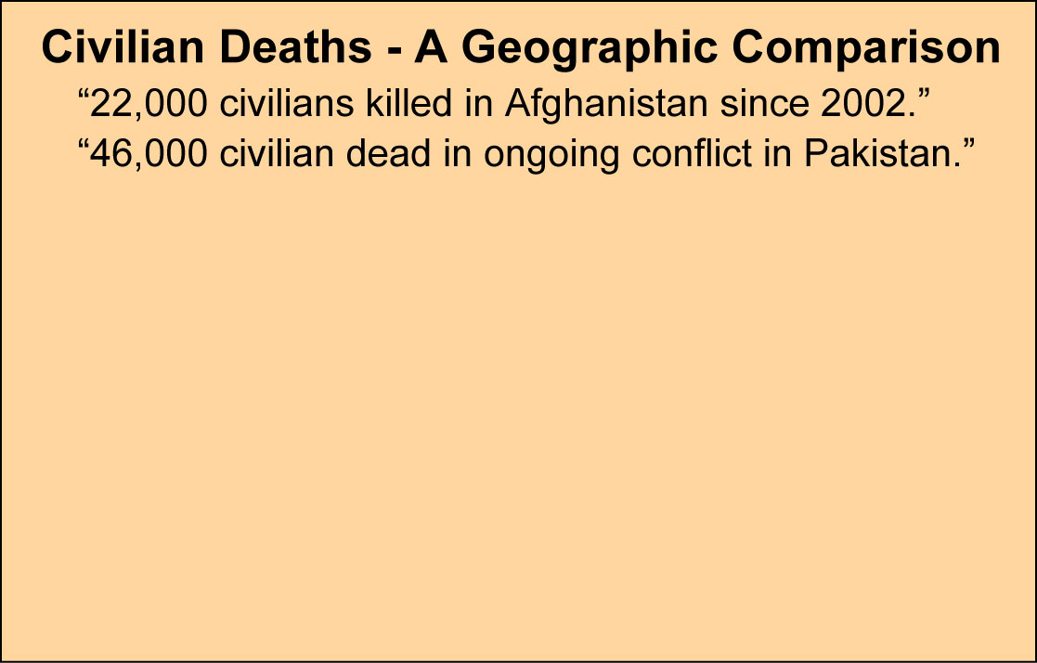
Recent Research (> 3500 studies since 1990)
shows that the human brain has distinct networks
that do specific kinds of spatial thinking.
Analogy
Comparison
Aura
(Influence)
Spatial Comparison
bigger, more, colder, etc.
Region
Sequence
(Transition)
Pattern
(Shape)
Association
(Correlation)
Hierarchy

Slide 12
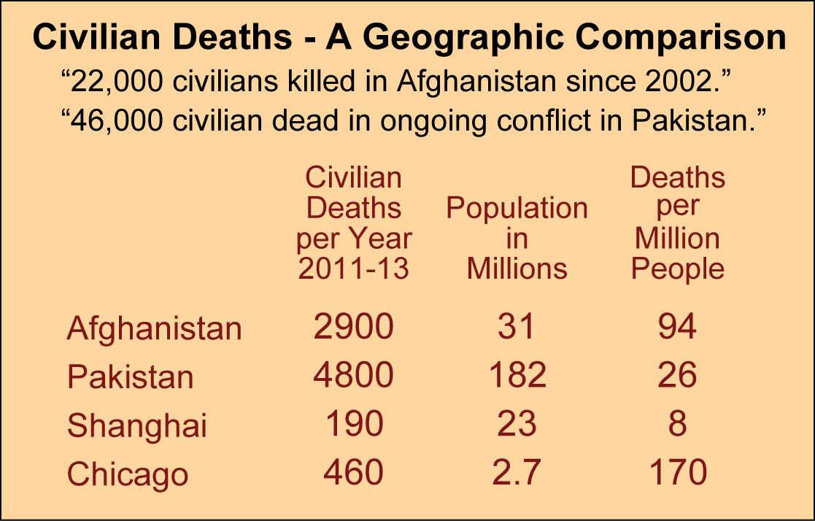
Recent Research (> 3500 studies since 1990)
shows that the human brain has distinct networks
that do specific kinds of spatial thinking.
Analogy
Comparison
Aura
(Influence)
Spatial Comparison
bigger, more, colder, etc.
Region
Sequence
(Transition)
Takehome
activity idea:
Encourage children
to make
comparisons
Pattern
(Shape)
Association
(Correlation)
Hierarchy

Slide 13
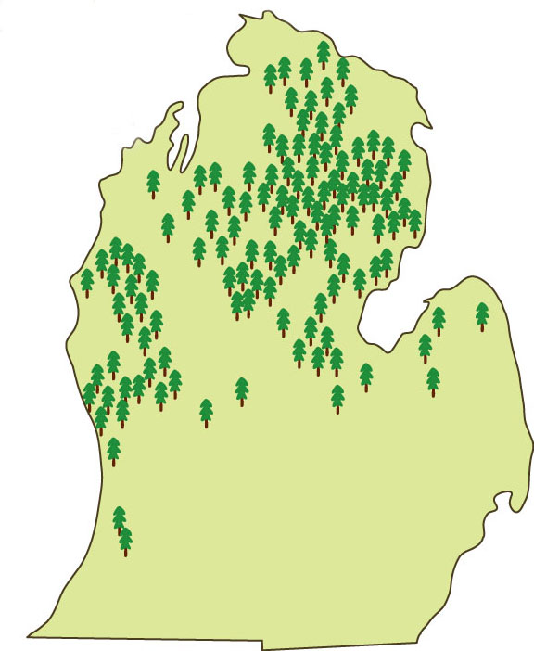
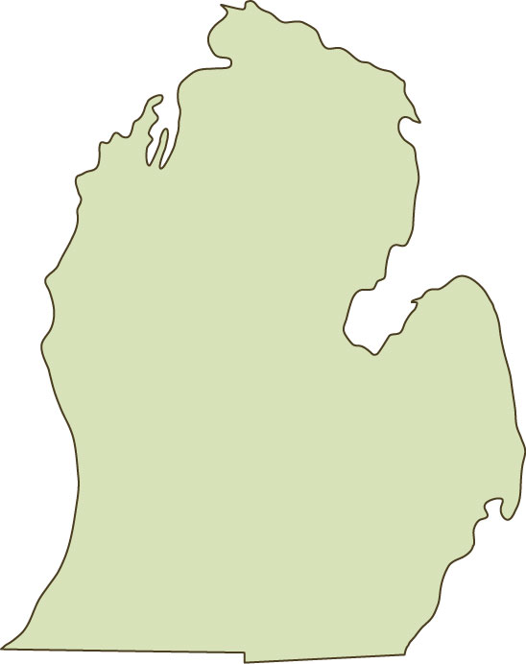
Recent Research (> 3500 studies since 1990)
shows that the human brain has distinct networks
that do specific kinds of spatial thinking.
Analogy
Comparison
Aura
(Influence)
Region
a group of similar places
Region
Sequence
(Transition)
Michigan’s
“Pine Belts”
Takehome
activity idea:
Have kids
draw lines
around regions
on dot maps.
Pattern
(Shape)
Association
(Correlation)
Hierarchy

Slide 14
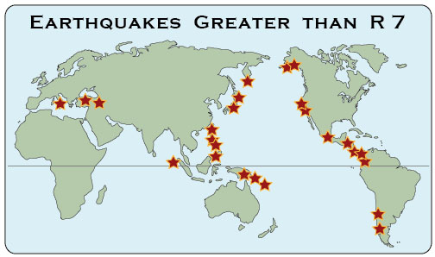
Recent Research (> 3500 studies since 1990)
shows that the human brain has distinct networks
that do specific kinds of spatial thinking.
Analogy
Takehome
activity idea:
Have kids
give names
to patterns
they see.
Aura
(Influence)
Comparison
Spatial Pattern
in a bunch, line, arc, ring,
or other arrangement
Region
Sequence
(Transition)
Pattern
(Shape)
Association
(Correlation)
Hierarchy

Slide 15
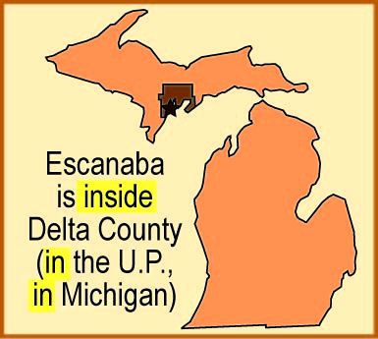
Recent Research (> 3500 studies since 1990)
shows that the human brain has distinct networks
that do specific kinds of spatial thinking.
Spatial Hierarchy
smaller
things
inside
larger
areas
Takehome
activity idea:
Have kids
name a big
area that
something
is inside.
Analogy
Comparison
Aura
(Influence)
Region
Sequence
(Transition)
Pattern
(Shape)
Association
(Correlation)
Hierarchy

Slide 16
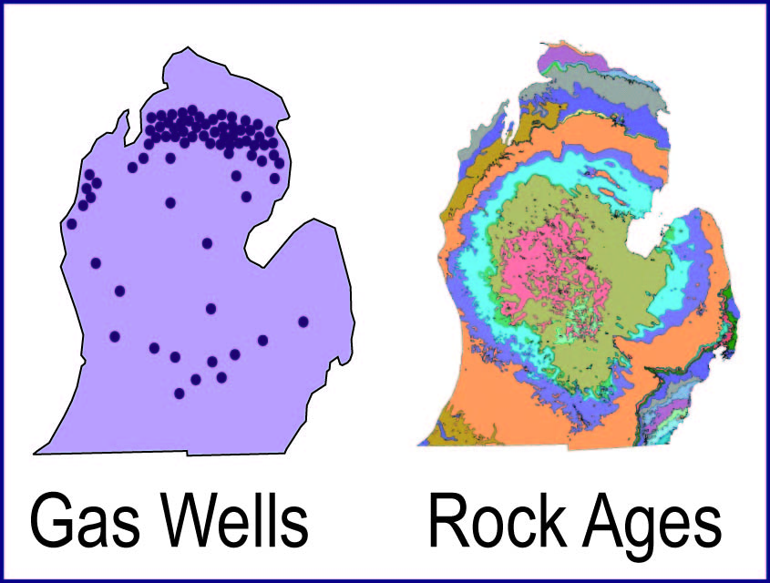
Recent Research (> 3500 studies since 1990)
shows that the human brain has distinct networks
that do specific kinds of spatial thinking.
Analogy
Over a lifetime . . .
the more mental maps
you have in your head,
the easier it becomes
to learn from maps
(by “seeing”
spatial associations)
Spatial Association
things that occur together
Aura
(Influence)
Comparison
Region
Takehome
activity idea:
Use the
clickable
pdf maps.
Sequence
(Transition)
Pattern
(Shape)
Association
(Correlation)
Hierarchy

Slide 17
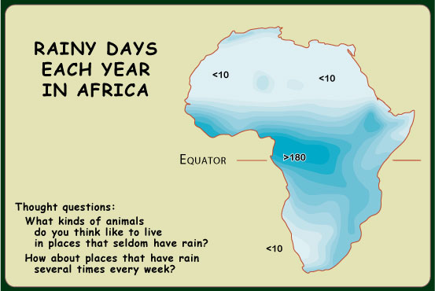
Recent Research (> 3500 studies since 1990)
shows that the human brain has distinct networks
that do specific kinds of spatial thinking.
Sequence (between)
Transition
(how things change
between two places)
Analogy
Comparison
Aura
(Influence)
Region
Sequence
(Transition)
Pattern
(Shape)
Association
(Correlation)
Hierarchy

Slide 18
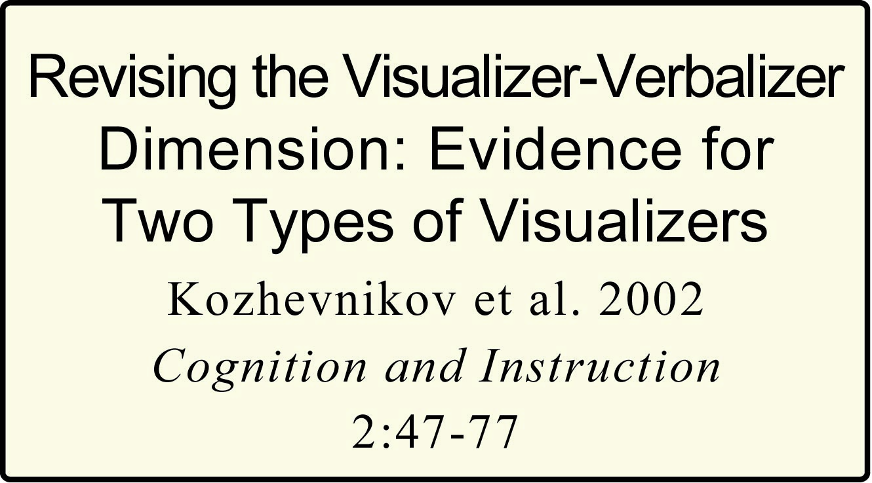
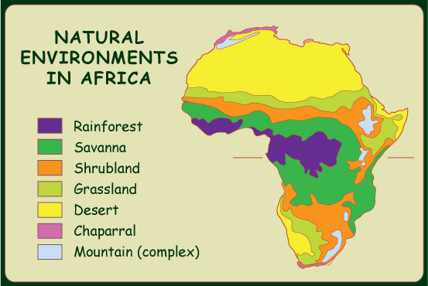
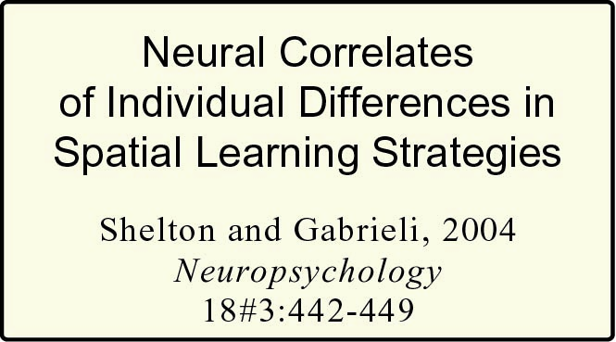
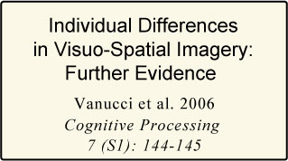
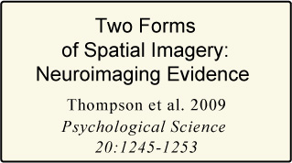
Recent Research (> 3500 studies since 1990)
shows that the human brain has distinct networks
that do specific kinds of spatial thinking.
Region
Sequence (between)
Transition
(how things change
between two places)
Analogy
Comparison
Aura
(Influence)
Region
Sequence
(Transition)
Sequence
Pattern
(Shape)
Association
(Correlation)
Hierarchy

Slide 19
Recent Research (> 3500 studies since 1990)
shows that the human brain has distinct networks
that do specific kinds of spatial thinking.
Region
Sequence (between)
Transition
(how things change
between two places)
Analogy
Comparison
Aura
(Influence)
TEACHER
WARNING:
INDIVIDUAL
DIFFERENCES
AHEAD
Region
Sequence
(Transition)
Sequence
I could cite
similar studies
for any pair
on the list.
Pattern
(Shape)
Association
(Correlation)
Hierarchy

Slide 20
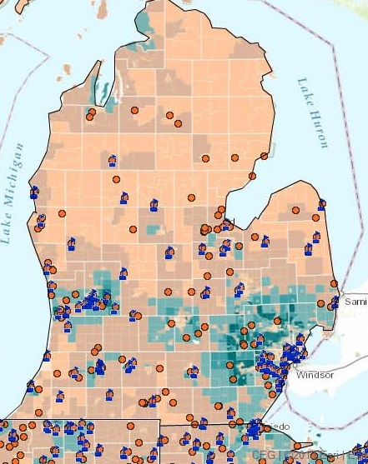

Recent Research (> 3500 studies since 1990)
shows that the human brain has distinct networks
that do specific kinds of spatial thinking.
Analogy
Comparison
Aura
(Influence)
Aura
near, within area of influence
Region
Takehome
activity idea:
Have kids
name places
“under the
influence”
Sequence
(Transition)
Pattern
(Shape)
Association
(Correlation)
Hierarchy
Any mode can be simple or complex.
For example, this map shows schools
within 2 miles of toxic waste sites.

Slide 21
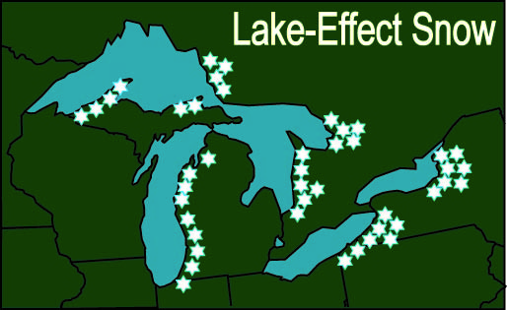
Recent Research (> 3500 studies since 1990)
shows that the human brain has distinct networks
that do specific kinds of spatial thinking.
Analogy
Comparison
Aura
(Influence)
Analogy
in a similar position
Region
Sequence
(Transition)
Pattern
(Shape)
Association
(Correlation)
Hierarchy
M
B

Slide 22
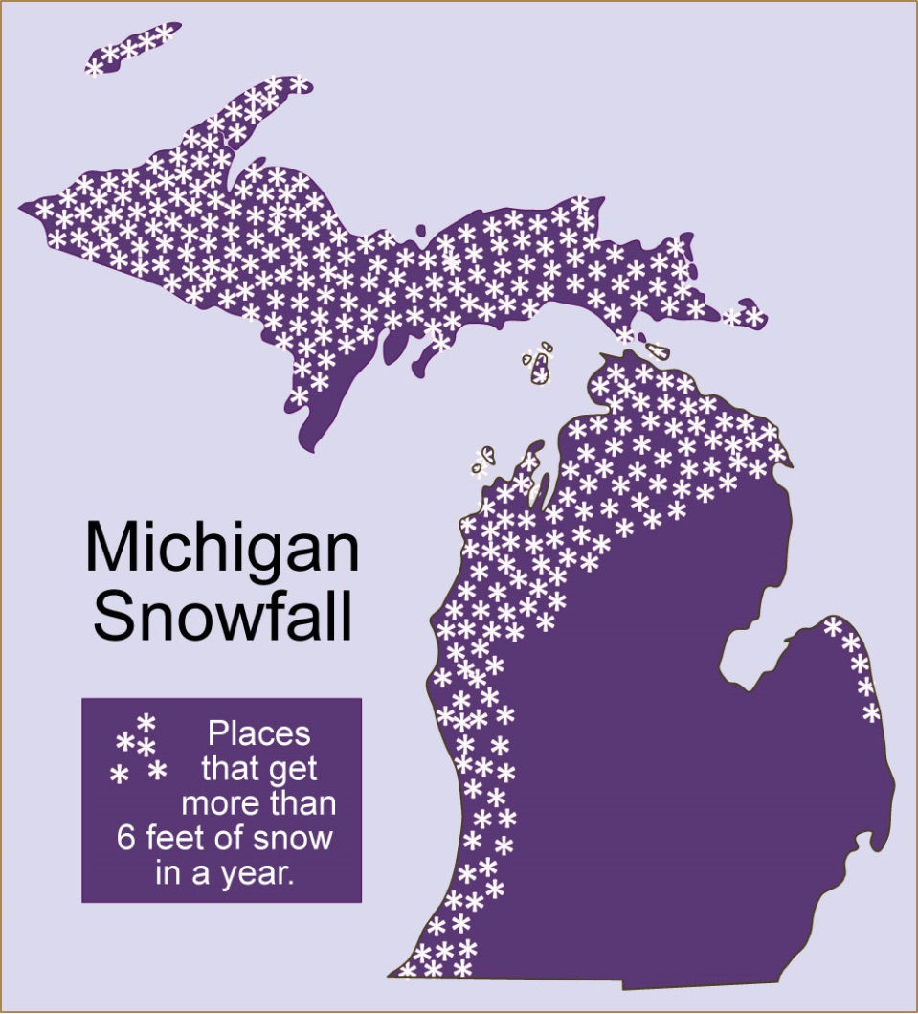
Recent Research (> 3500 studies since 1990)
shows that the human brain has distinct networks
that do specific kinds of spatial thinking.
Analogy
Comparison
Aura
(Influence)
The map of snow
is a good illustration
of a really key idea:
a person can use
different modes
of spatial reasoning
with the same map.
Region
Sequence
(Transition)
Pattern
(Shape)
Association
(Correlation)
Hierarchy

Slide 23
Recent Research (> 3500 studies since 1990)
shows that the human brain has distinct networks
that do specific kinds of spatial thinking.
Analogy
In short, these modes of spatial thinking
are like the muscles in your arm - - -
You use different combinations of muscles
to play a piano, saw a board,
throw a baseball, . . .
Likewise, you are likely to use
different modes of spatial reasoning
to “read” maps of different topics.
Comparison
Aura
(Influence)
Region
Sequence
(Transition)
Pattern
(Shape)
Association
(Correlation)
Hierarchy
B
AND . . . it takes practice to learn
how to do any of them well!

Slide 24
Principle 1. The human brain has several
“built-in” ways of organizing spatial information.
Principle 2. Different people may have different
preferred modes of spatial thinking.
(They “see” different things, even on the same map.)
Principle 3. With guidance, every person can learn
how to do every kind of spatial thinking better.
Principle 4. Using several modes of thinking
increases the odds that a map will be remembered.
It’s learning
how to learn.

Slide 25
Principle 1. The human brain has several
“built-in” ways of organizing spatial information.
Remember. Concentrating
on the modes of thinking
that you find most useful
could be discriminatory!
Principle 2. Different children may have different
preferred modes of spatial thinking.
(They “see” different things, even on the same map.)
Principle 3. With guidance, every child can learn
how to do every kind of spatial thinking better.
Principle 4. Using several modes of thinking
increases the odds that a map will be remembered.

Slide 26
Copyright 2015, Phil Gersmehl
Teachers who saw this presentation at a workshop
or downloaded it from our internet site have permission
to make a copy on their own computers for these purposes:
1. to help them review the workshop,
2. to show to colleagues or administrators,
3. to show the presentation in their own classrooms
or at sessions they lead at teacher conferences,
4. to use individual frames (with attribution)
in their own class or conference presentations.
For permission for any other use,
including posting frames on a personal blog
or uploading to any network or website,
contact pgersmehl@gmail.com

