Slide 1
Making a Climagraph That Also Shows Water Balance

Slide 2
Start
with a
Frame.

Slide 3
Add labels
for the
12 months.

Slide 4
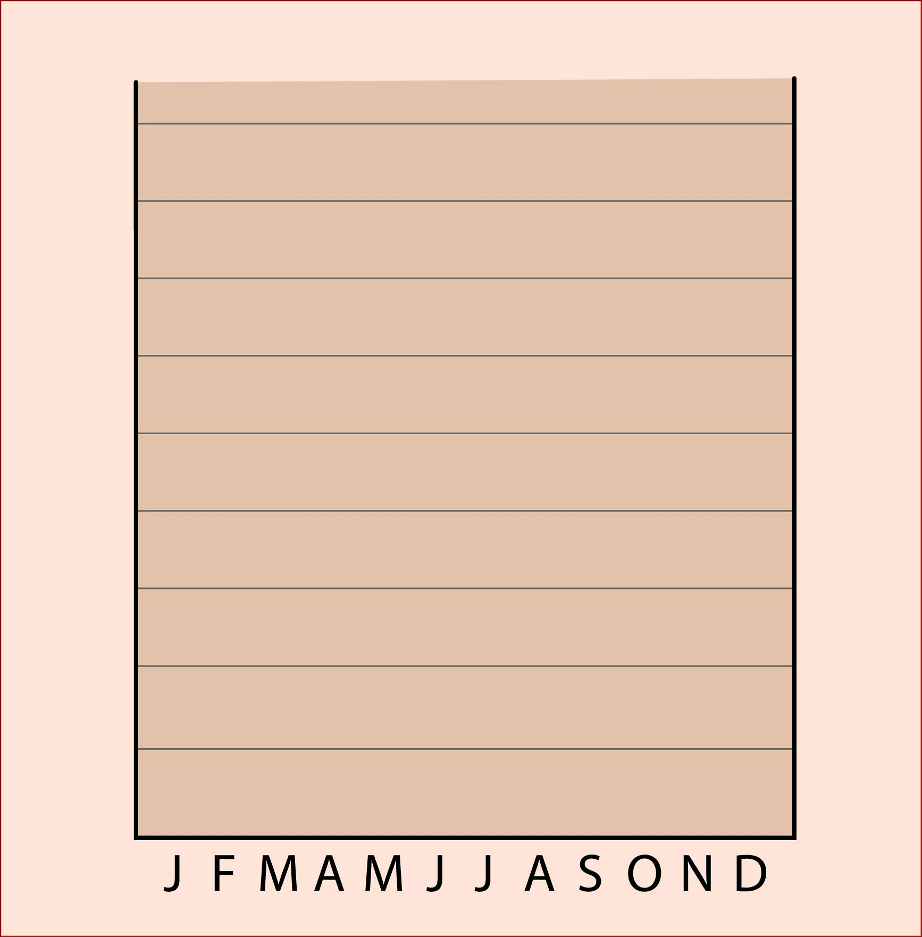
Add some guidelines
for
temperature.

Slide 5
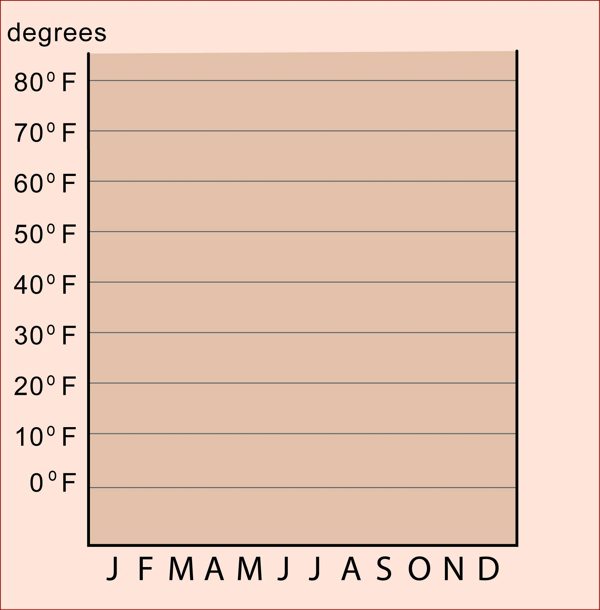
And then
label the
guidelines.

Slide 6
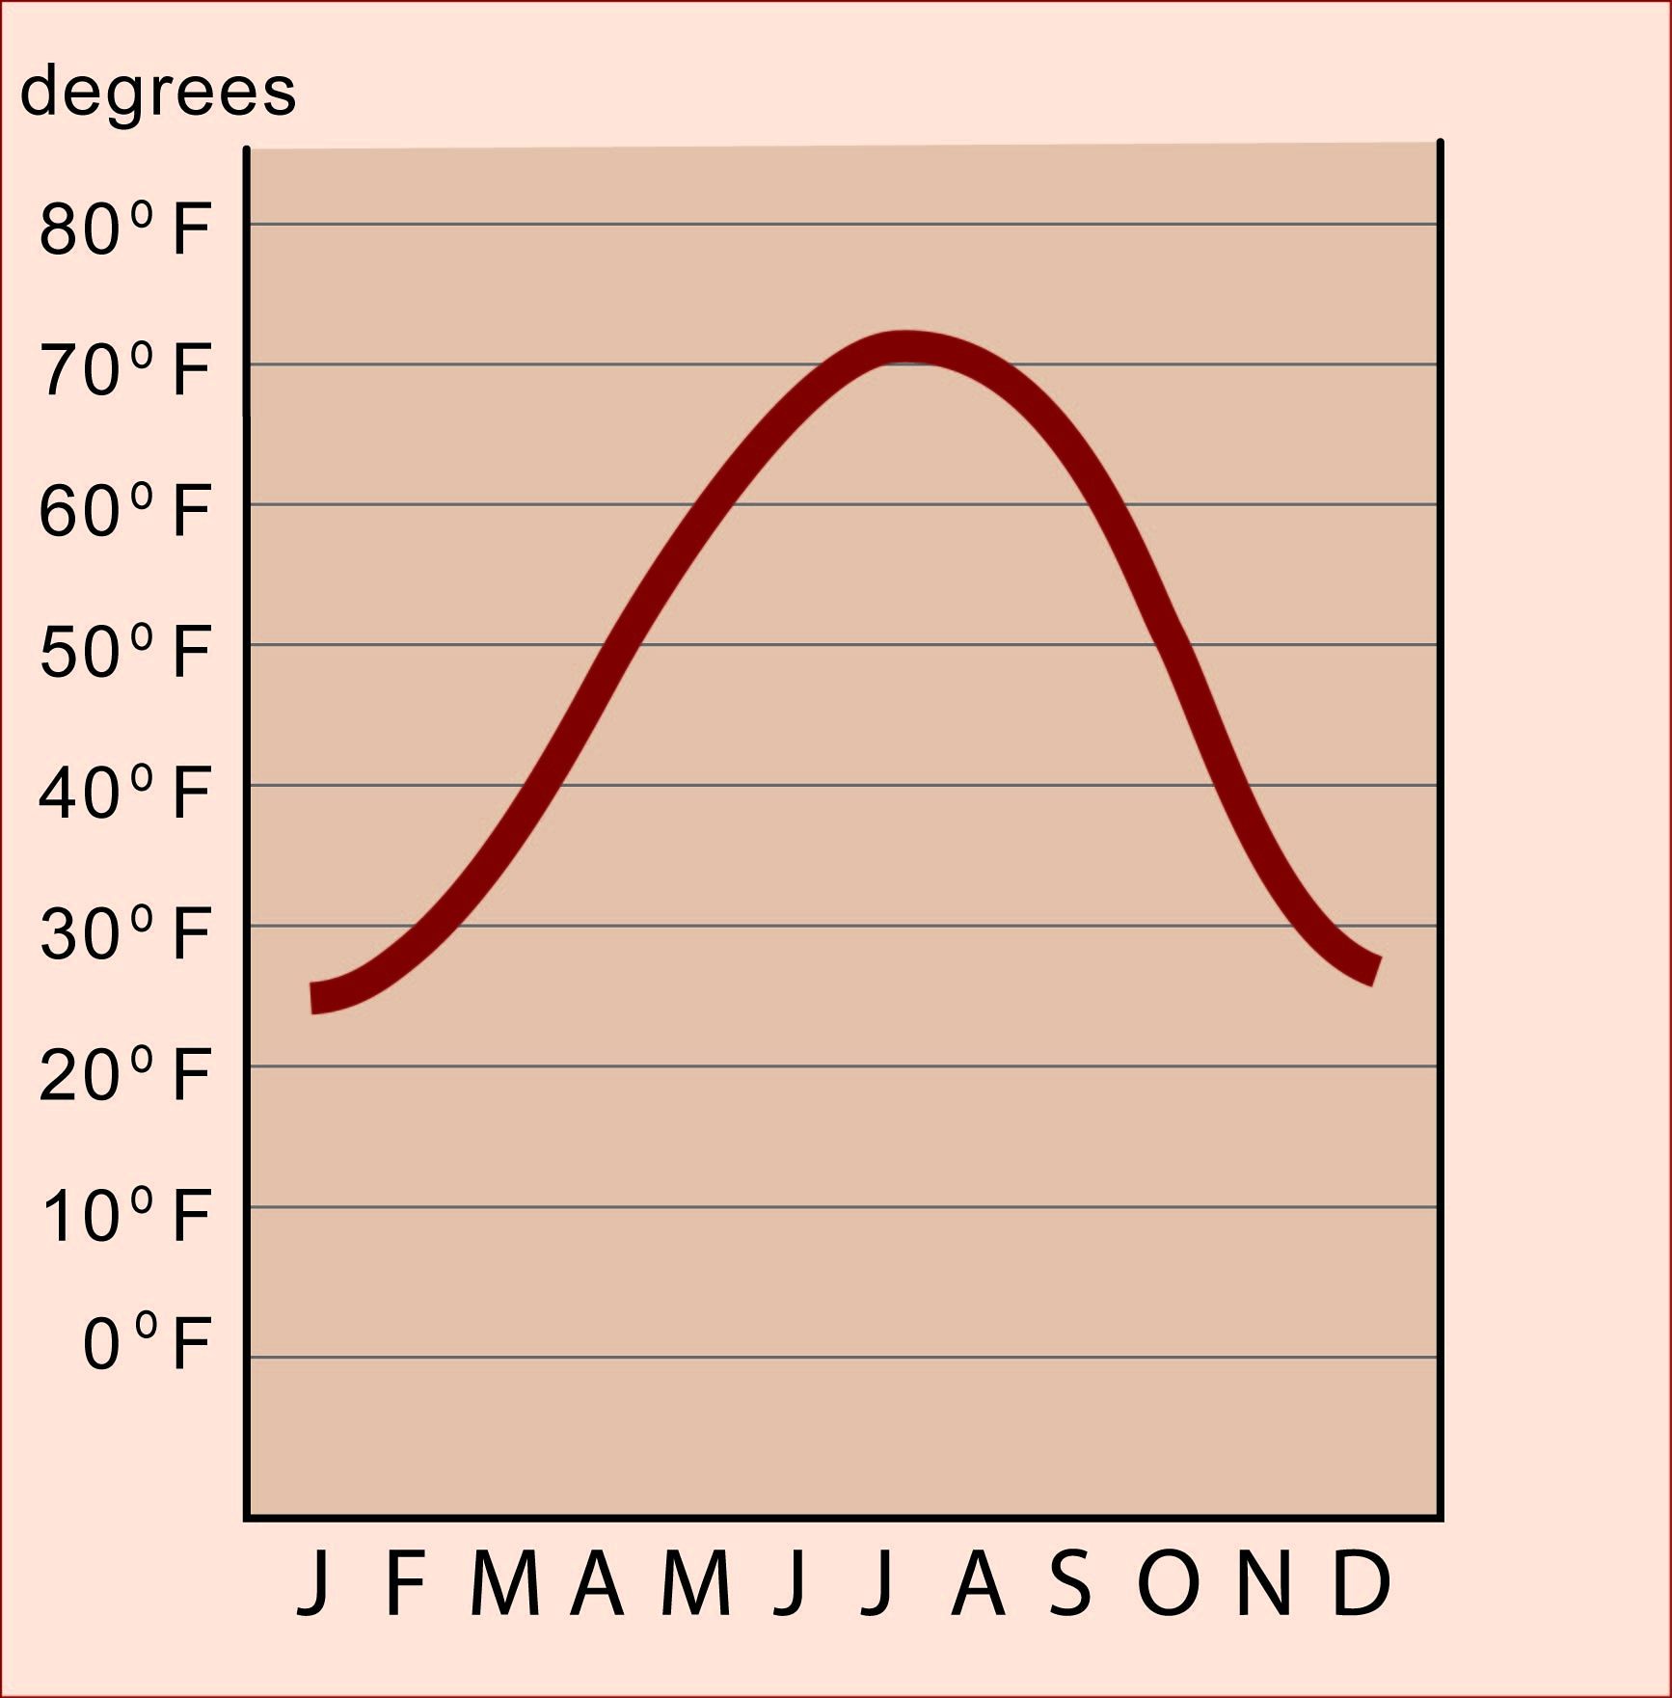
Draw a
curved line
to show
temperature

Slide 7
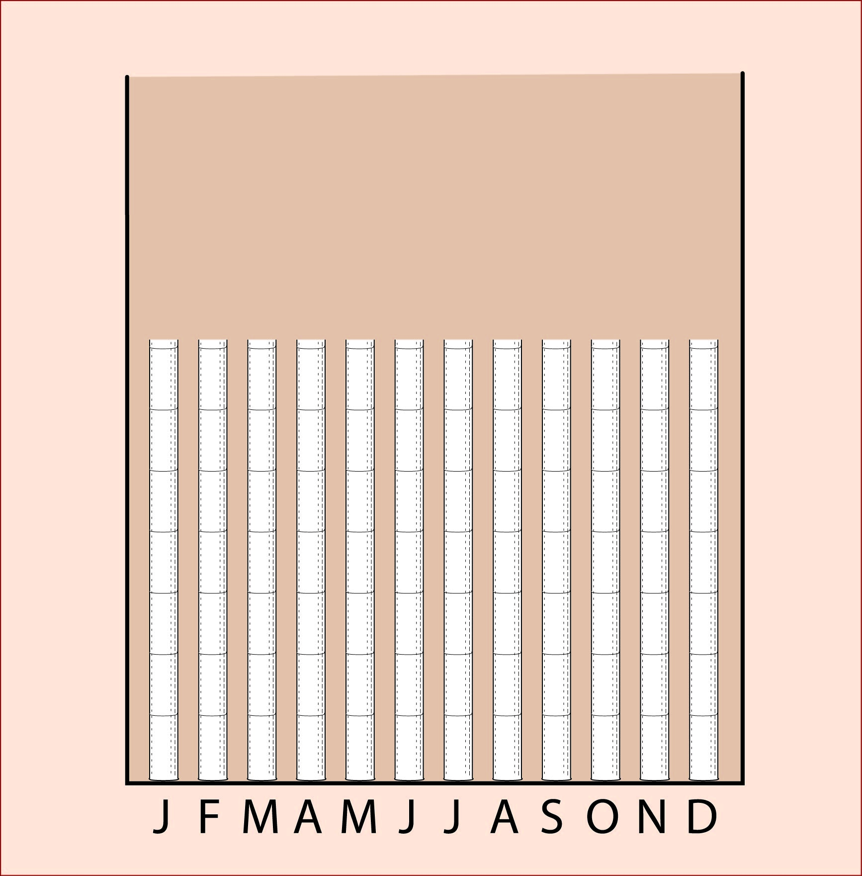
You could
draw some
“rain gauges”
to show
precipitation.

Slide 8
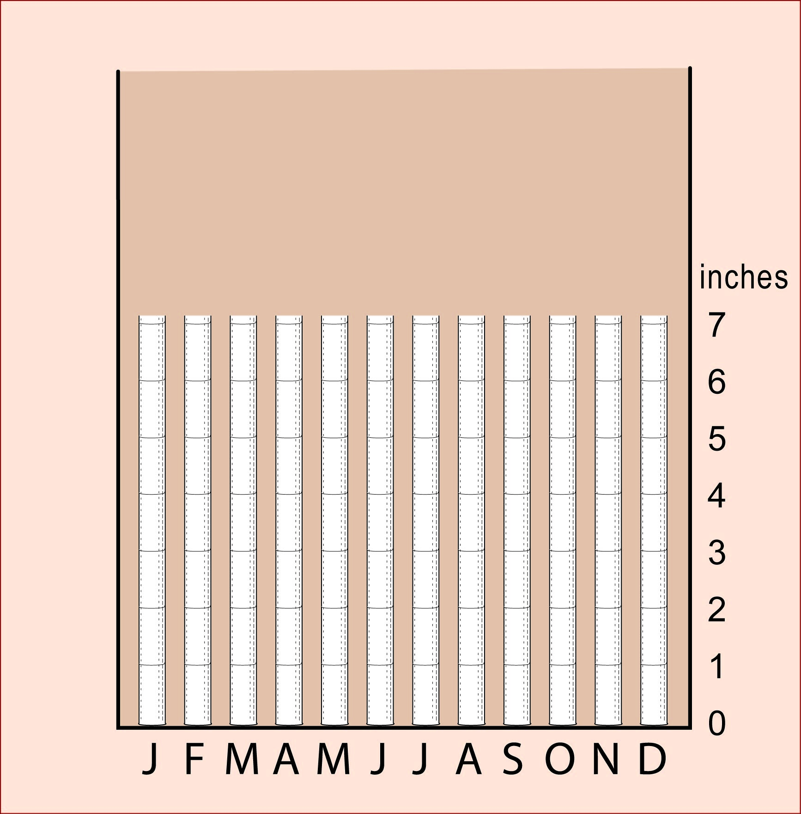
Add a
scale
to show
amounts.

Slide 9
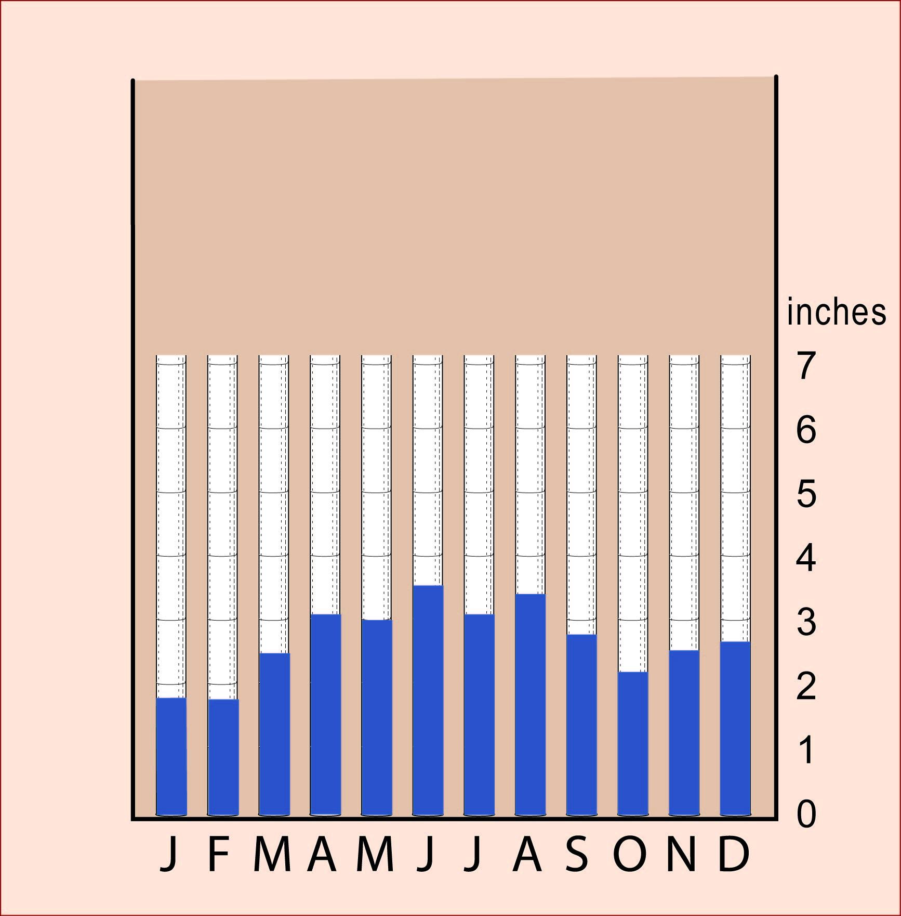
Then fill each bar
to the right depth
for that month.

Slide 10
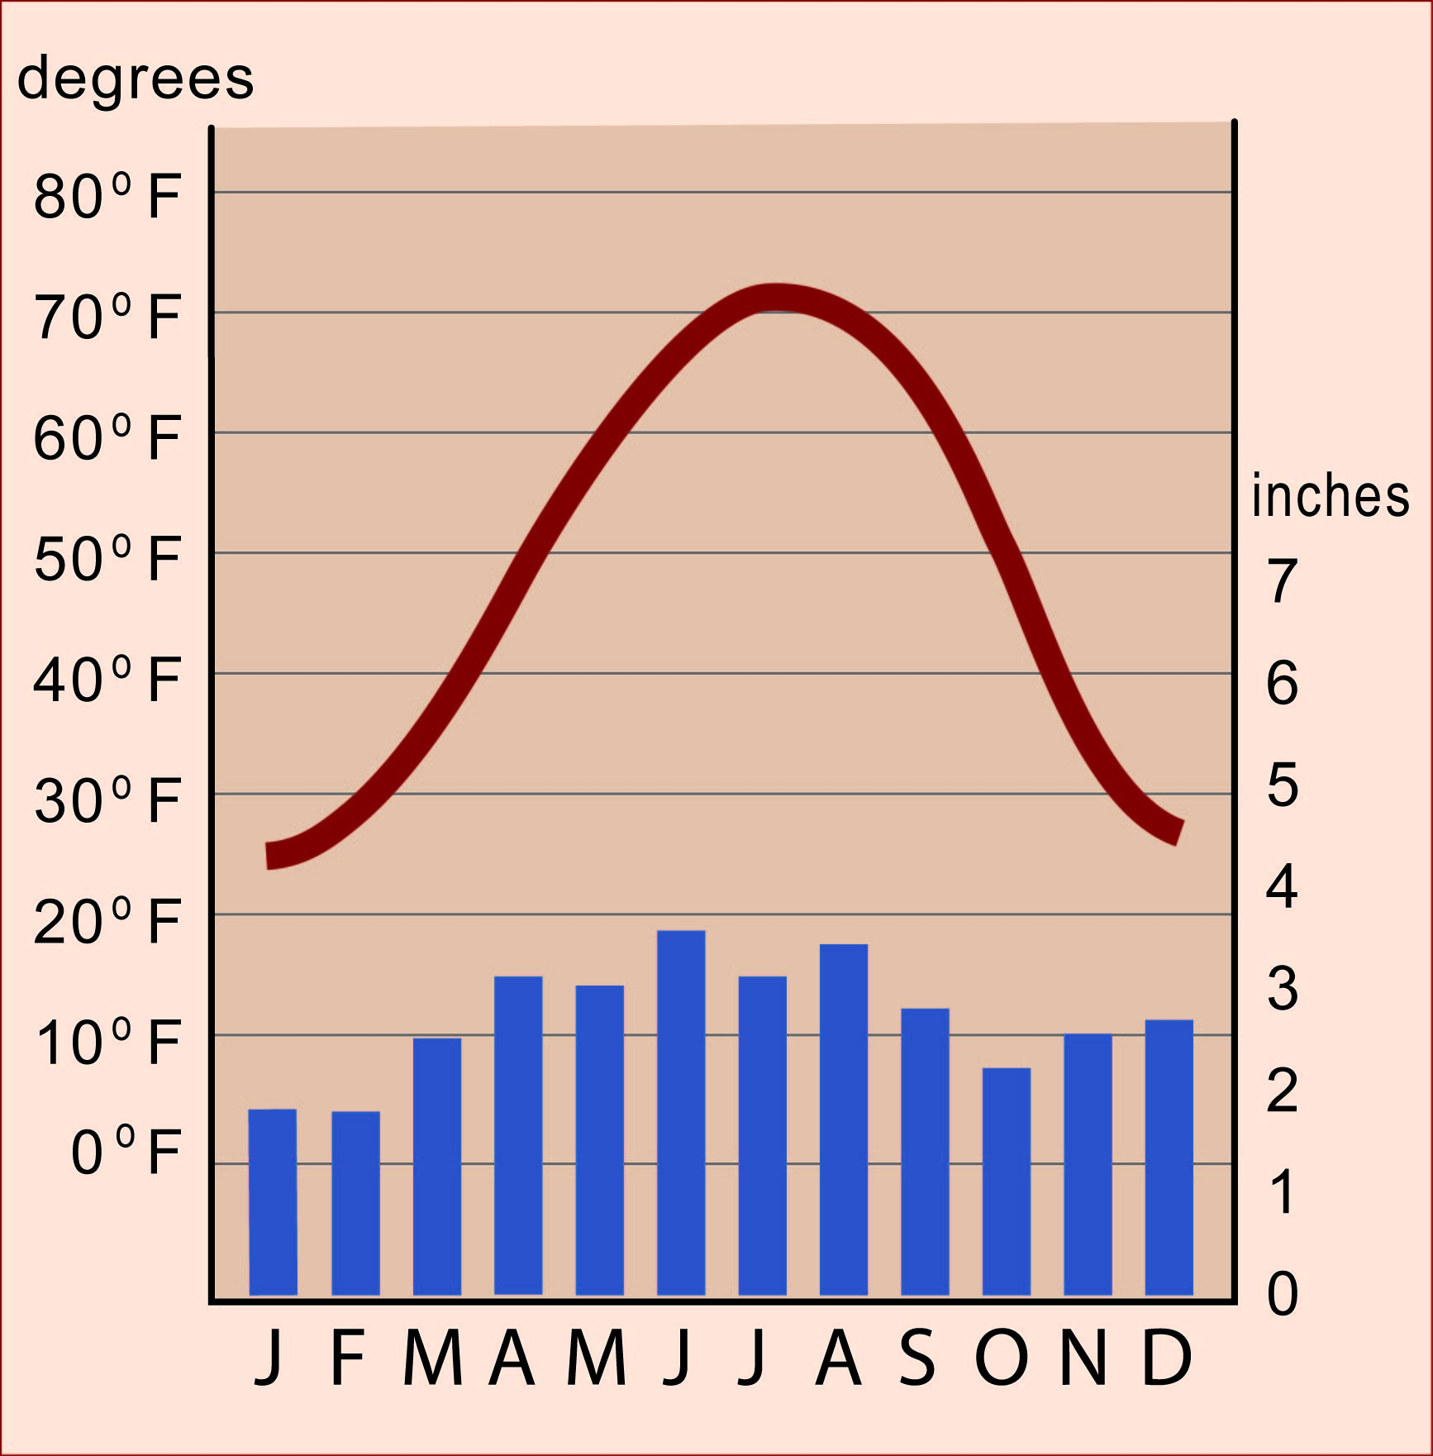
Put them together
and you have
your climagraph.
There is,
however,
a way
to make
it better.

Slide 11
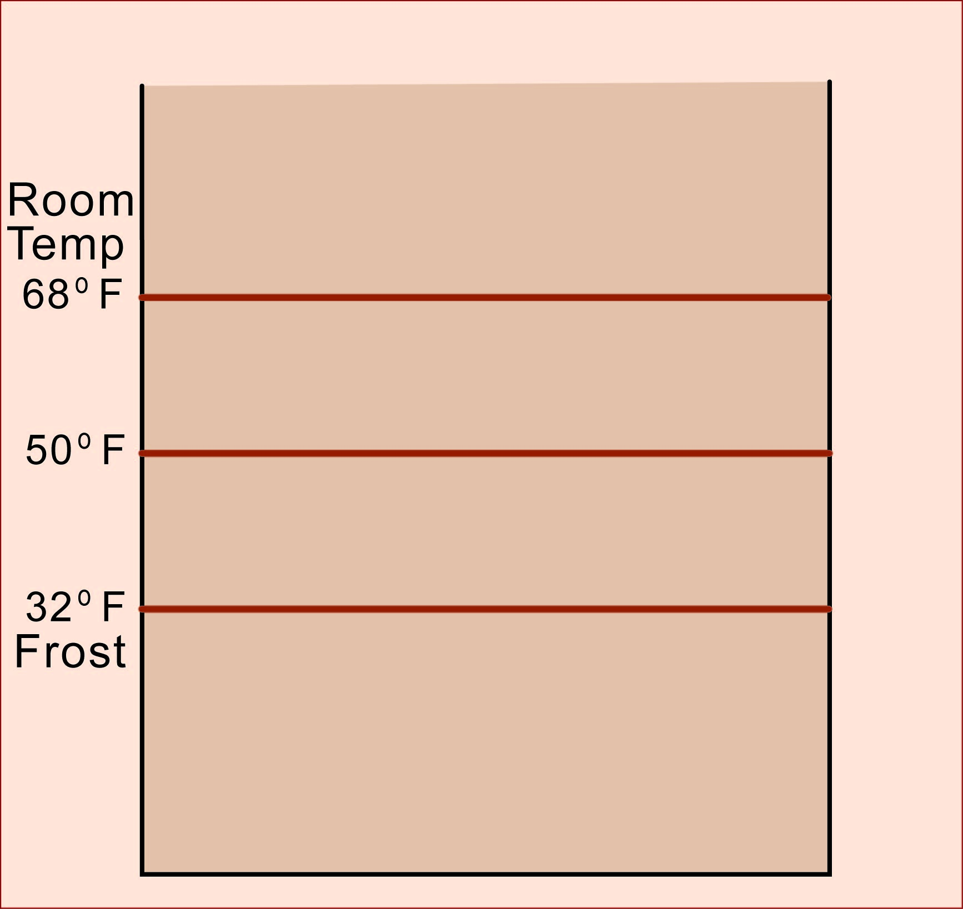
Start with just
three guidelines
to indicate only
the most important
temperatures.

Slide 12
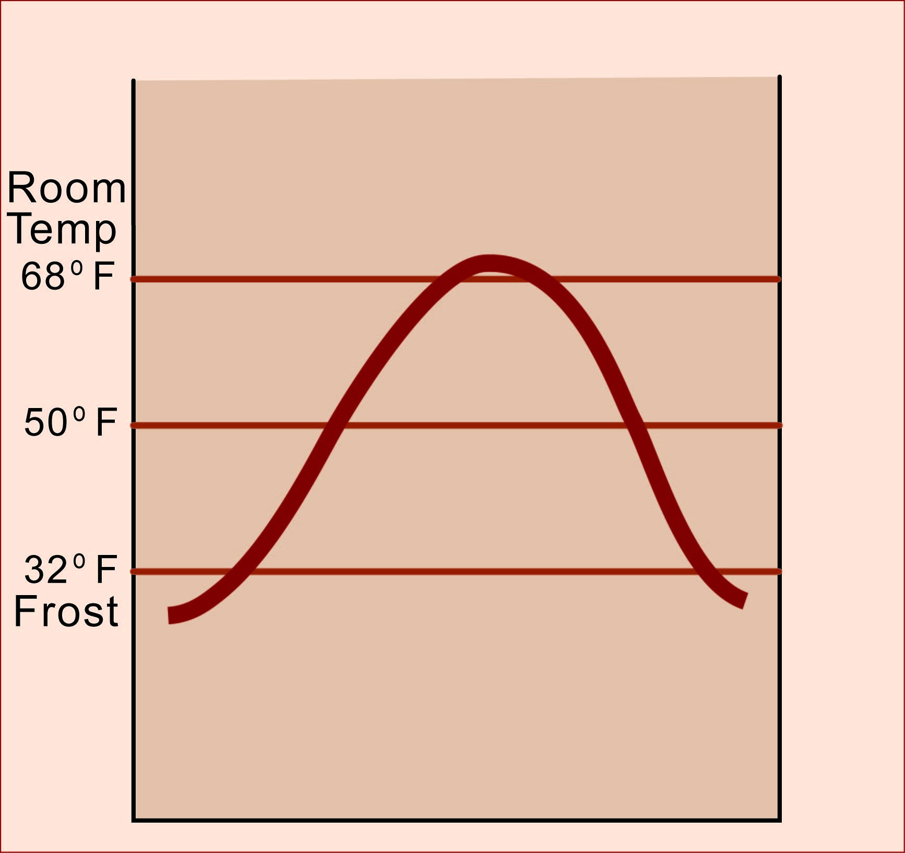
Add the
temperature curve –
You can easily see
that this place has
two months that are
below freezing
and two above
room temperature.

Slide 13
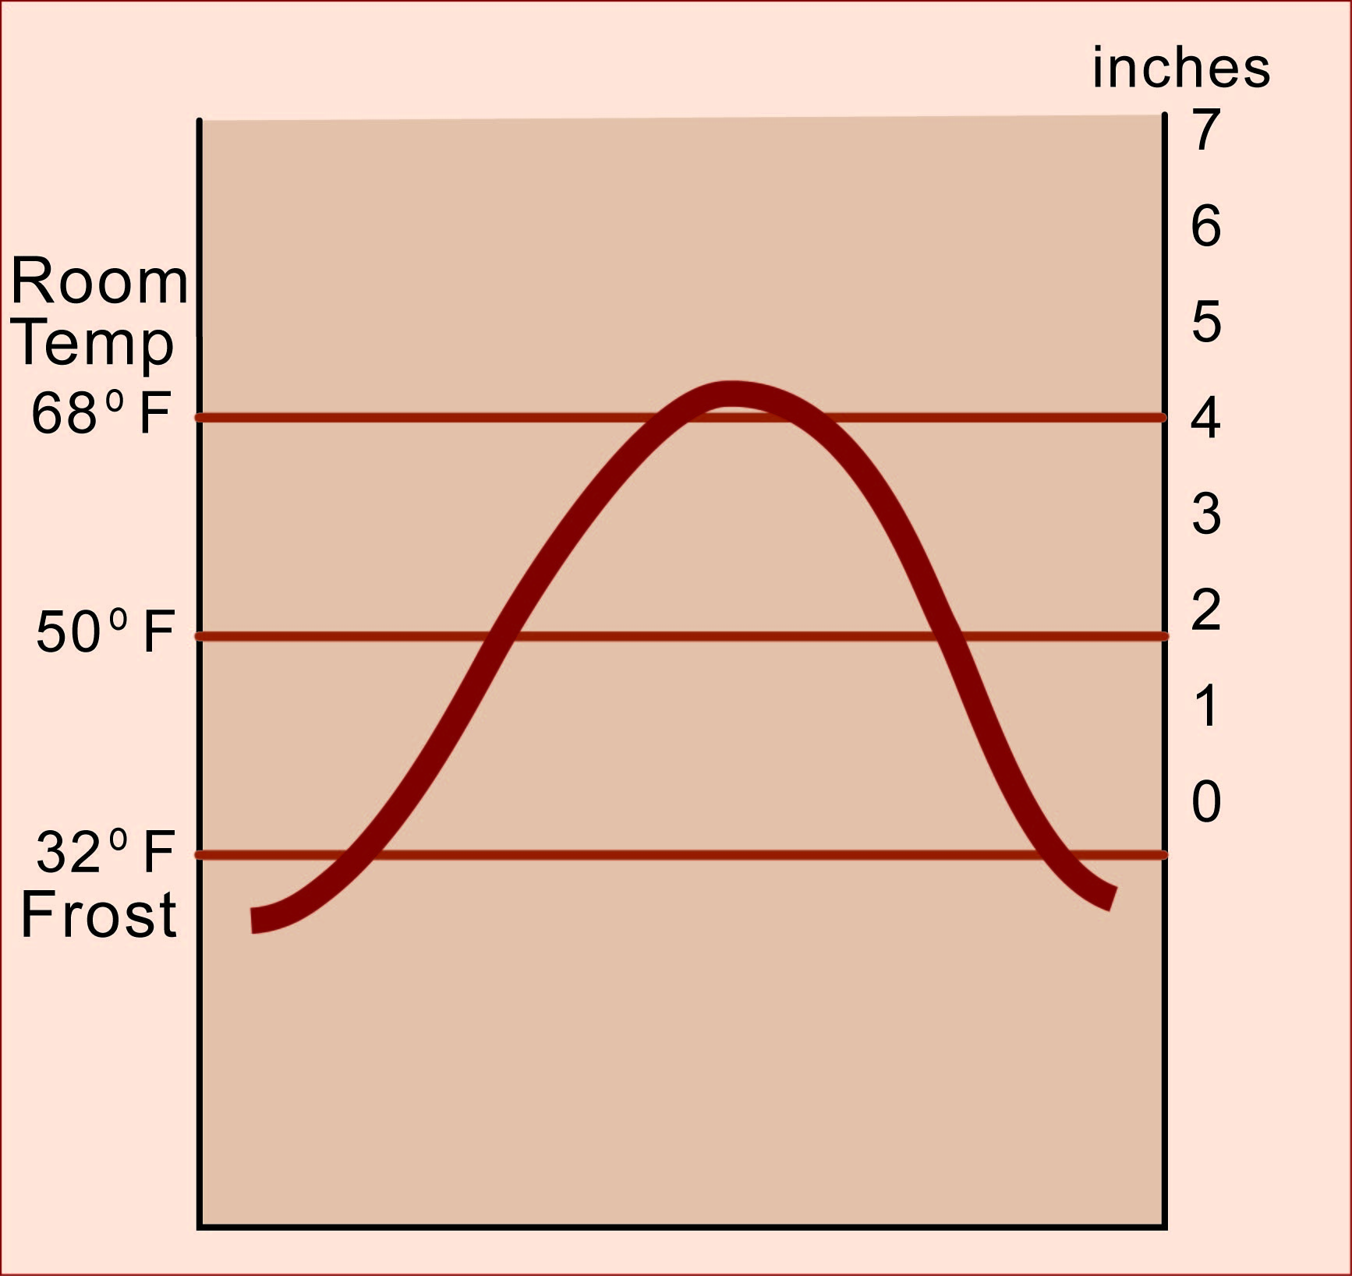
Add a
carefully matched
precipitation scale.

Slide 14
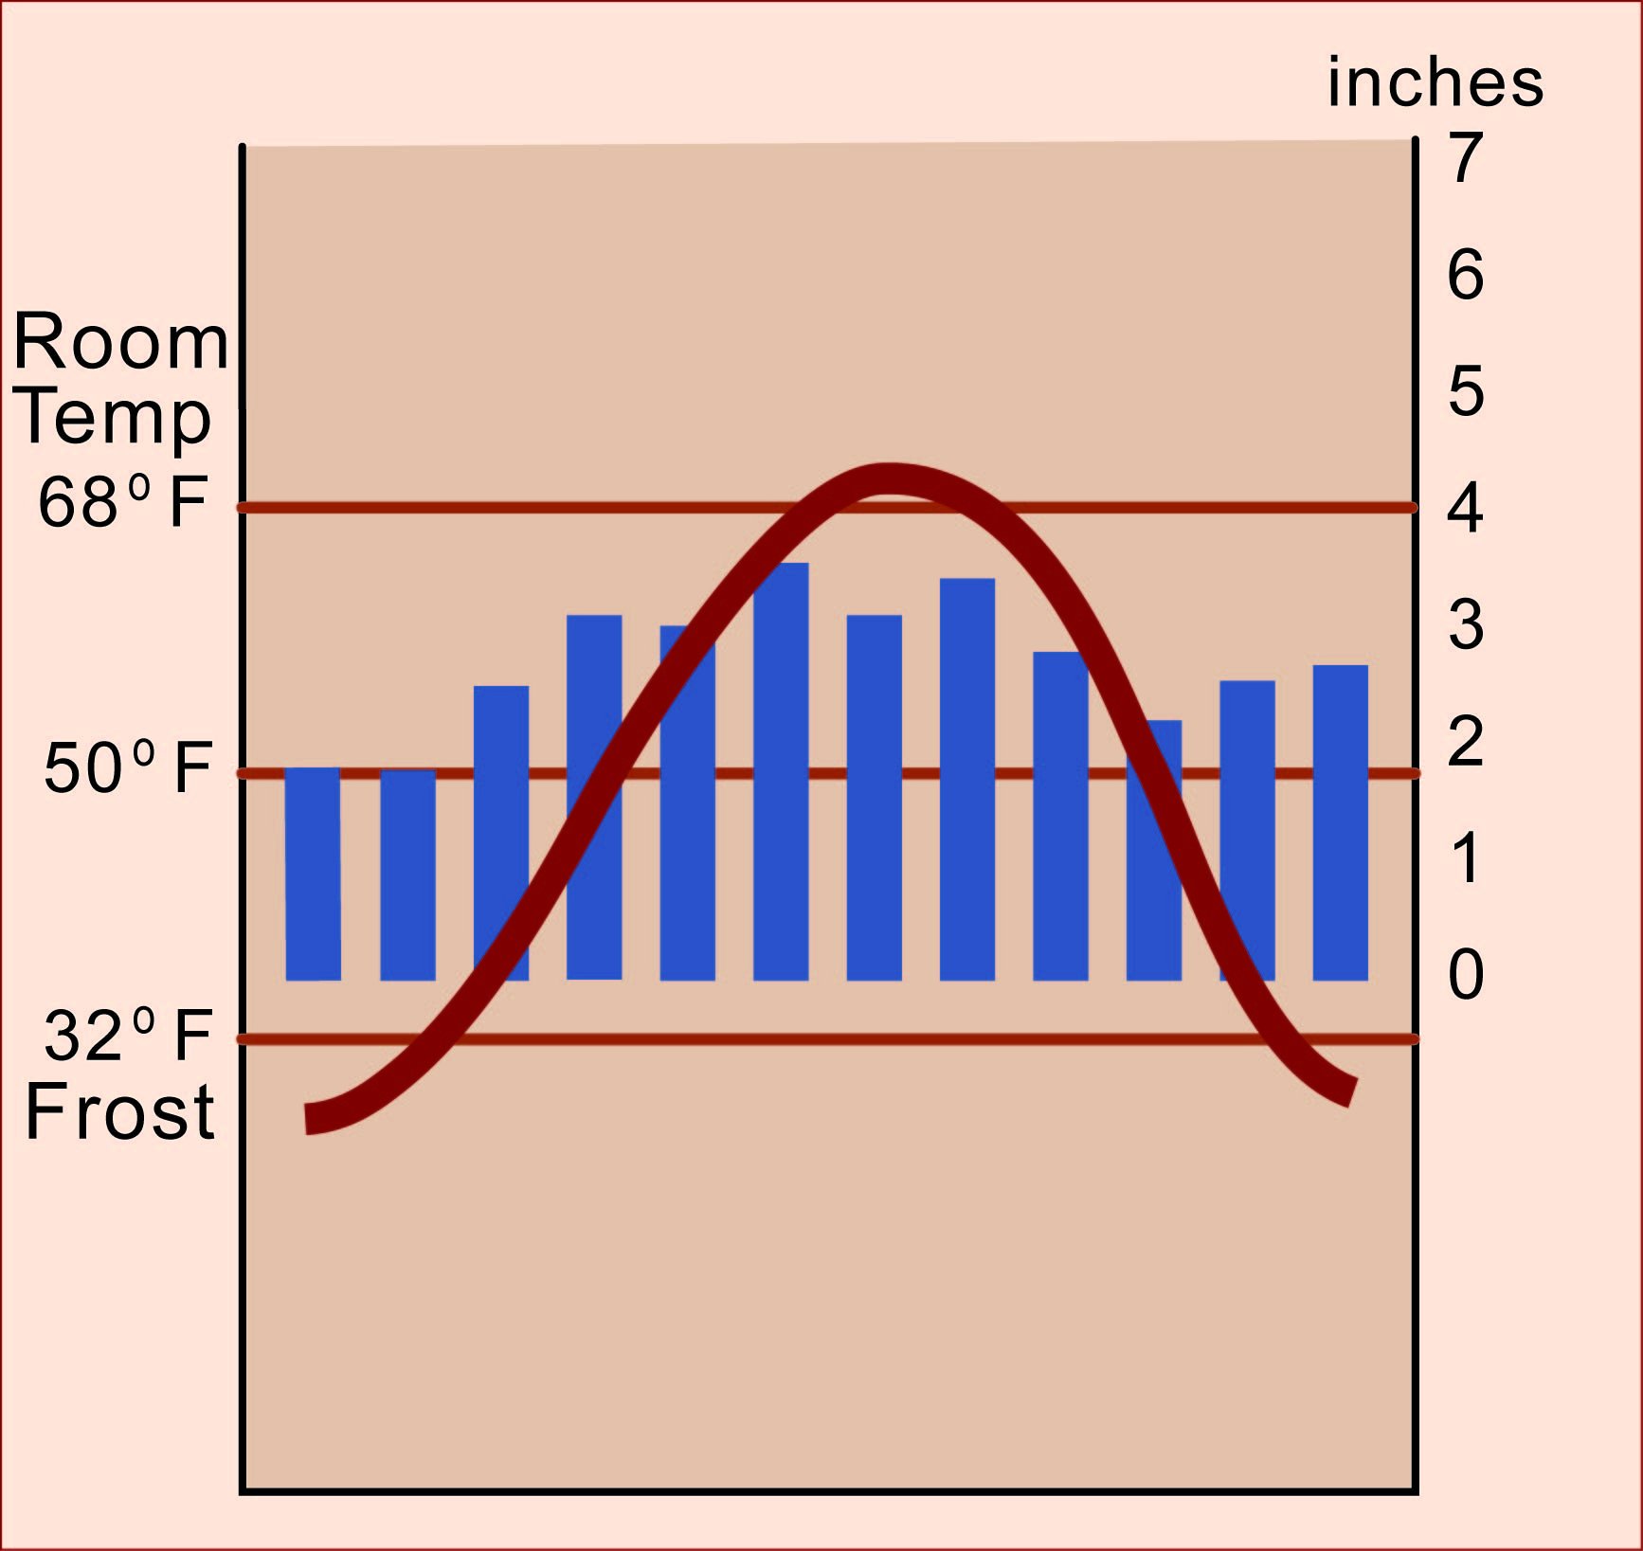
Then draw the
precipitation bars
to fit that scale.

Slide 15
If the bar for a month
does not reach up
to the temperature line,
there is a moisture deficit.
In many places
(like this one),
plants can survive
a short water deficit
by taking water
out of the soil.

Slide 16
If the bar for a month
extends up higher
than the temperature line,
there is a moisture surplus.
This is the water
that refills the soil
and flows away
to make rivers
and lakes.

Slide 17
This graph shows the climate of Detroit.
This city has a significant water surplus
in winter and spring. Then, in summer,
it has a short season of water deficit, when plants have to take water out of soil storage.

Slide 18
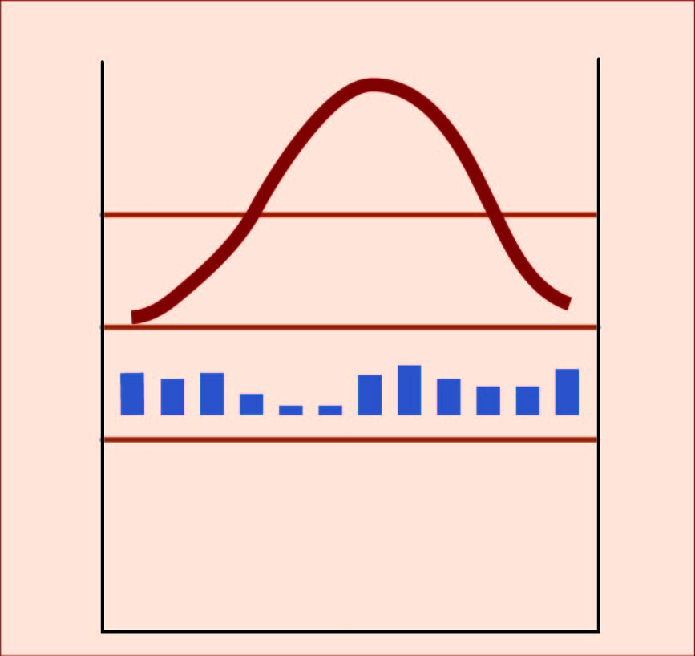
A city like Phoenix, Arizona,
has a significant water shortage
in every month of the year
That’s why it is a desert!

