Slide 1
Locating the Capital
The Geography
of the
Third Great Compromise

Slide 2
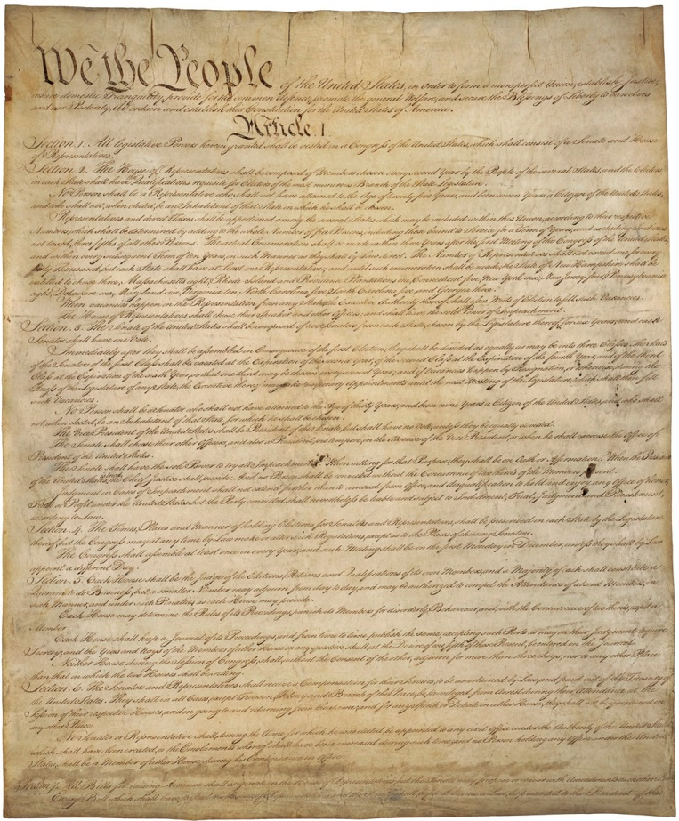
The year is 1790.
The Constitution has been adopted.
The country survived as a union
because of two great compromises:
1. different representation in Senate and House
2. counting only 3/5 of the slaves.

Slide 3
Three years later,
a third compromise is desperately needed
to address a difficult question
that the Constitutional Convention
was unable to answer:
Where should we put the capital?

Slide 4
Popular history books
tell an interesting story
about how Thomas Jefferson invited
Alexander Hamilton and James Madison
to his house for dinner, and together
they worked out the great compromise.

Slide 5
We will use this question
as an organizing theme
to explore the geography
of the young country.
Then we will use ideas
from that geographic analysis
to explore why the compromise
worked out in the way it did.
Finally, we will note how this compromise
(plus its refusal to answer a question)
eventually led to the Civil War
and continues to influence voting today.

Slide 6
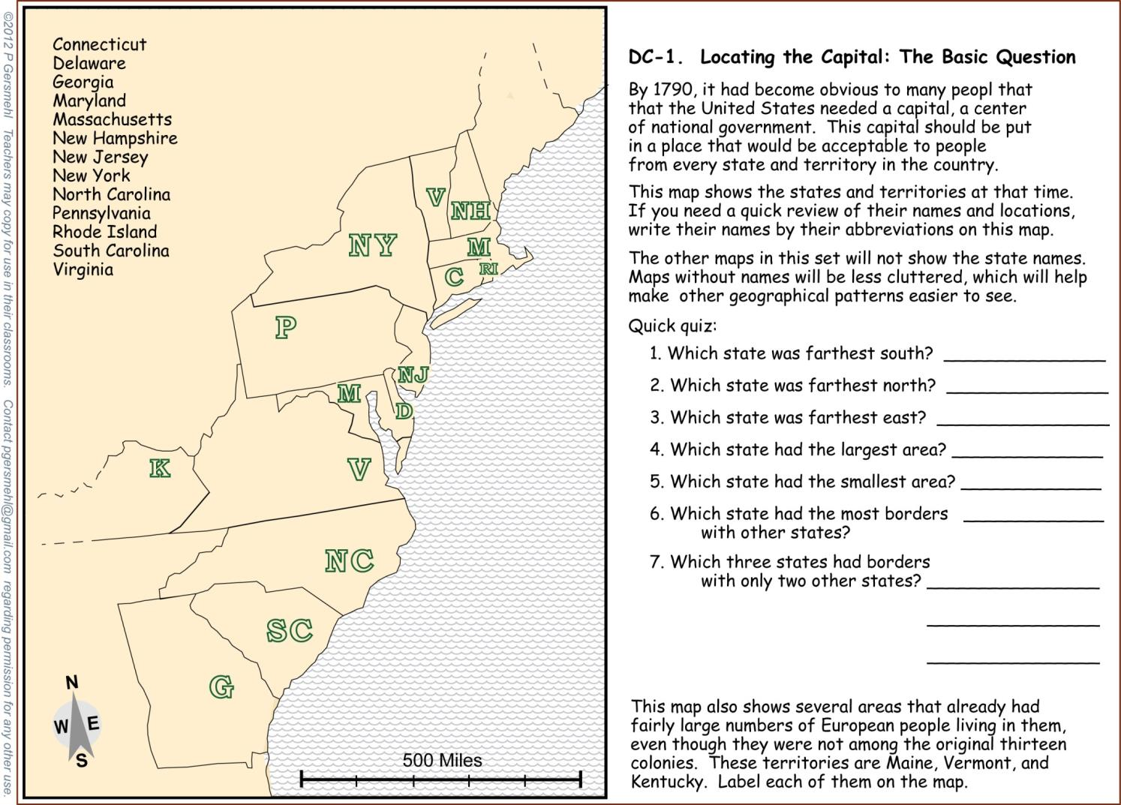
Each group will get some maps
each with a set of instructions.
The instructions address
some of the GLCEs and
Common Core standards.

Slide 7
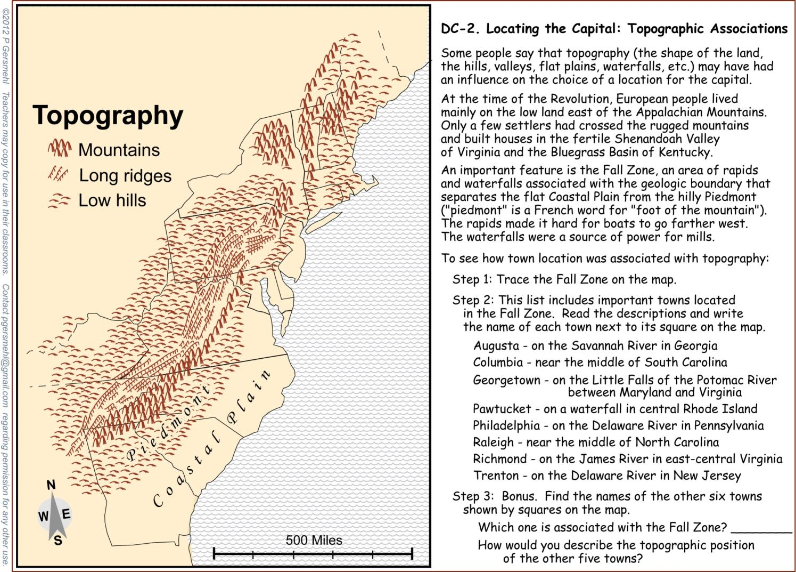
Each map will provide
information about a specific aspect of colonial geography.
The instructions focus on specific skills of spatial reasoning.

Slide 8
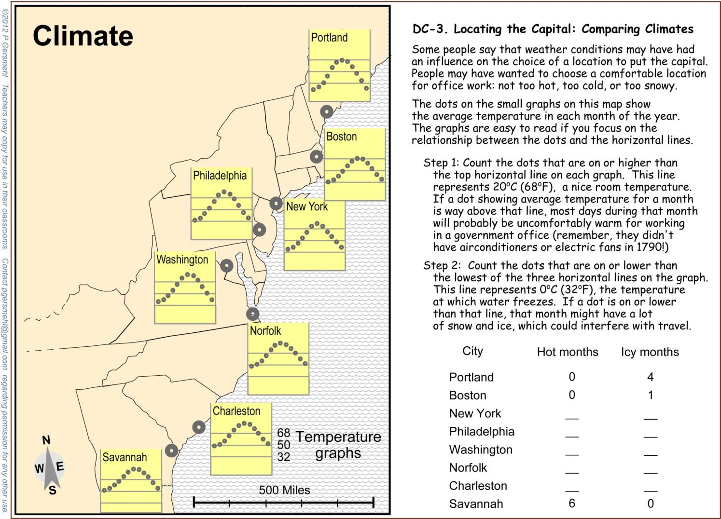
One group gets a climate map
and counts how many months
might be too hot or too cold
for comfortable work in an office
(before air-conditioning!).

Slide 9
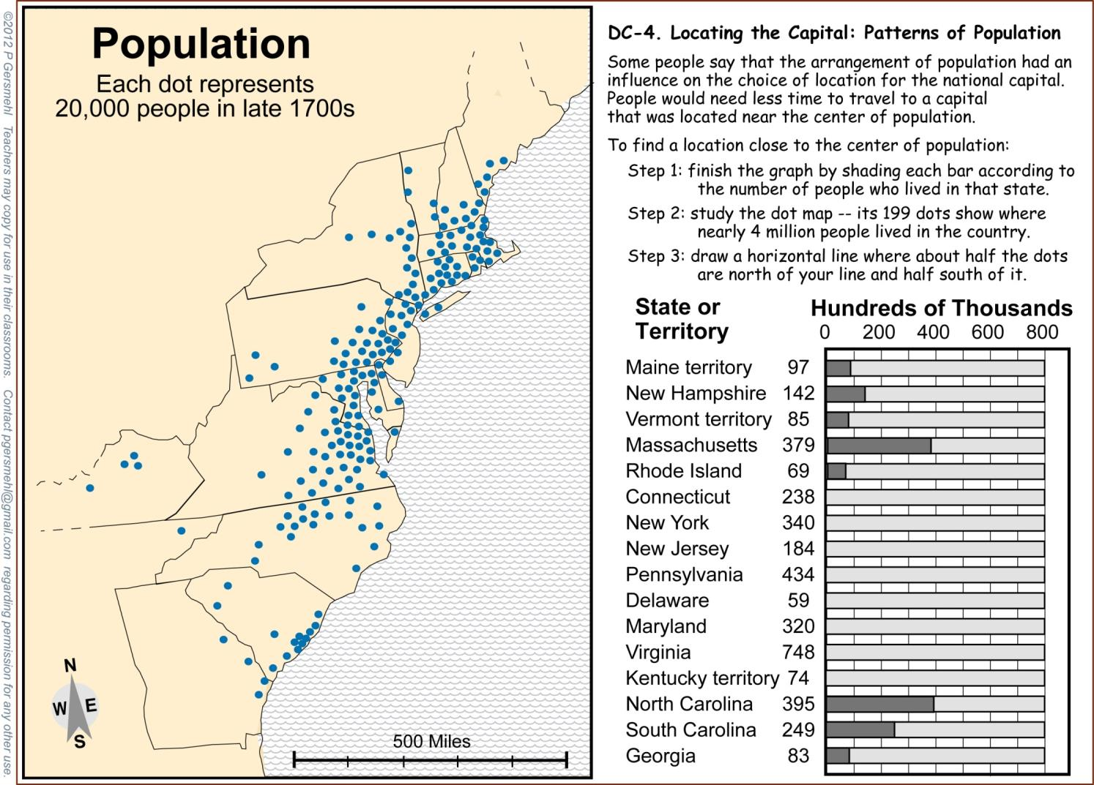
One group finishes a graph
based on data in a table,
and then marks a place
on a population map.

Slide 10
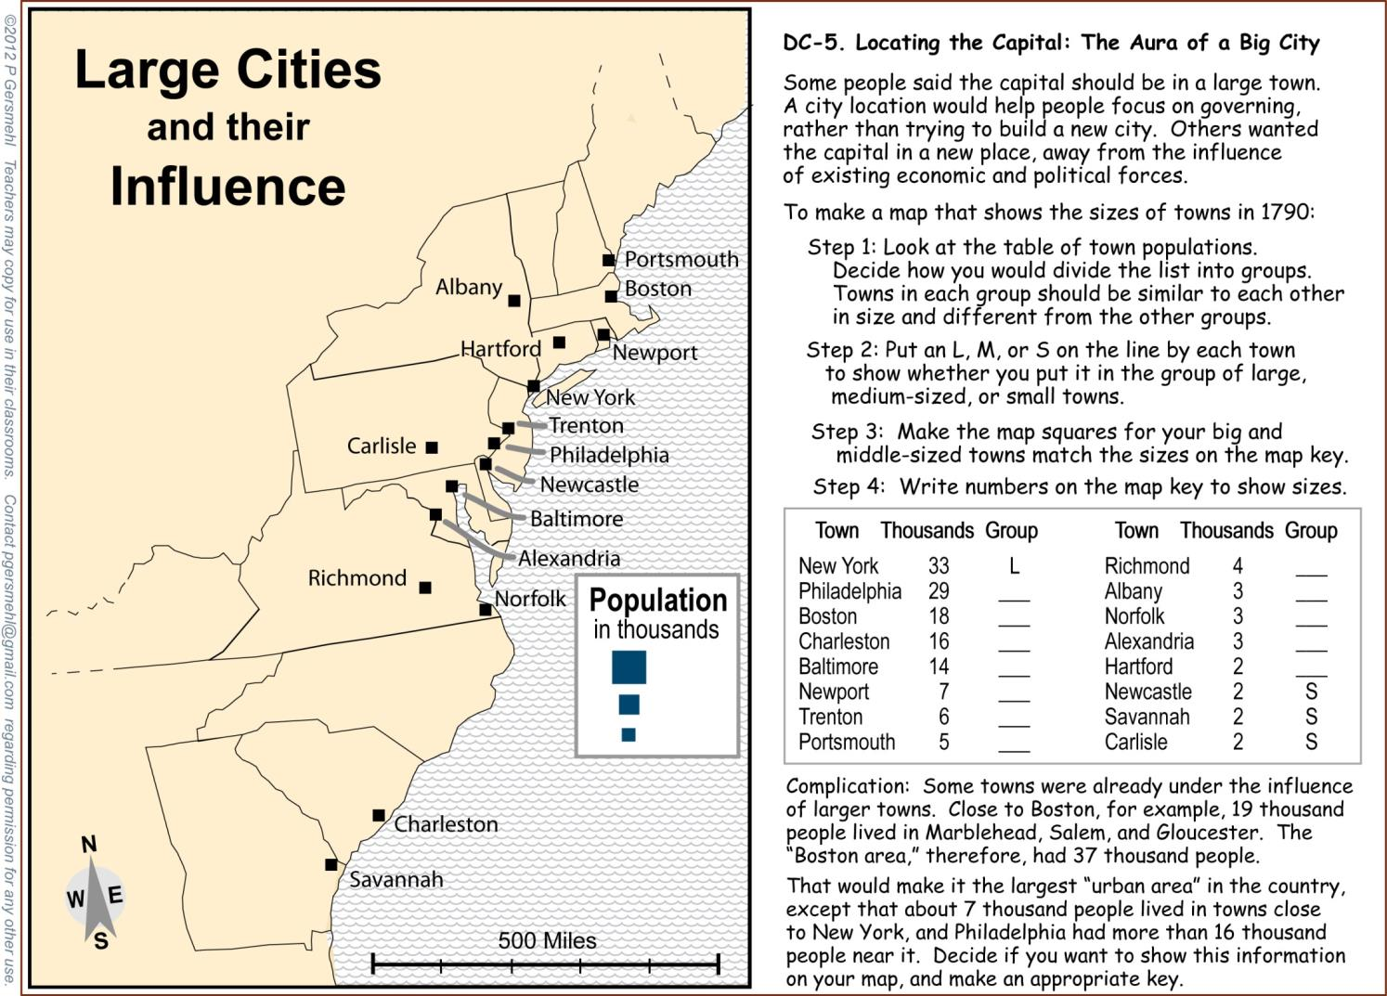
To evaluate the influence
of the major cities, one group
will put cities into size groups
and then transfer information
from the table to a map.

Slide 11
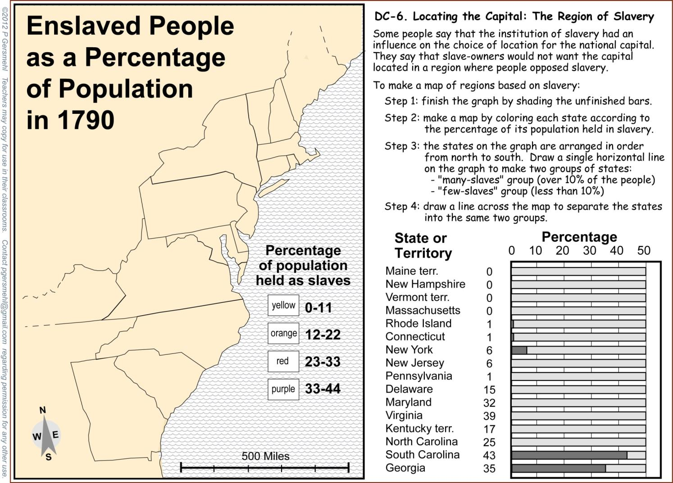
One group will make a map
showing the region of slavery,
by finishing a bar graph
and then coloring the states
using data from the graph.

Slide 12
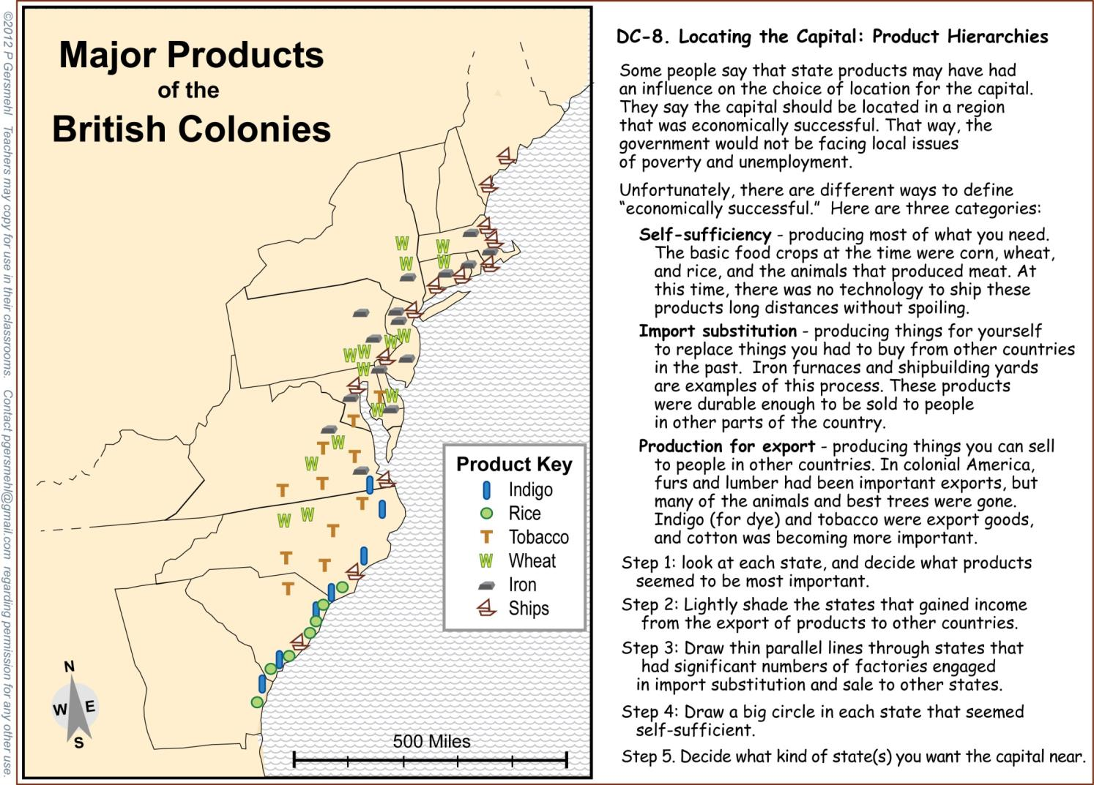
To evaluate economic health,
a group will classify states
based on information
from a map of products.

Slide 13
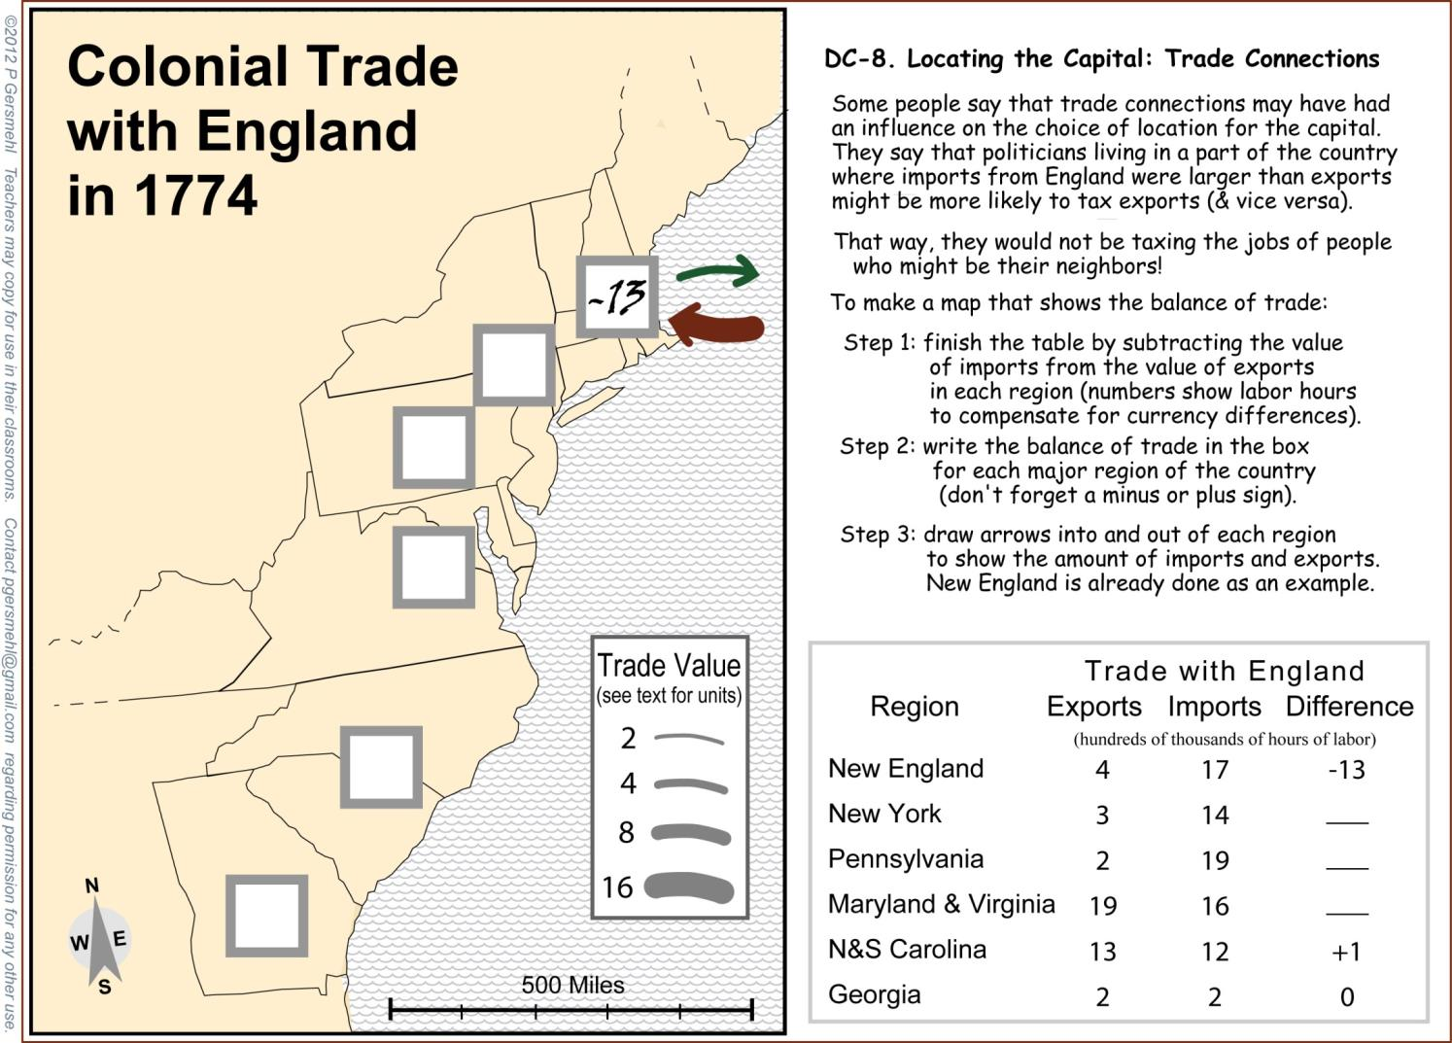
To see which states
were making lots of money,
one group will finish a map
showing the balance of trade.

Slide 14
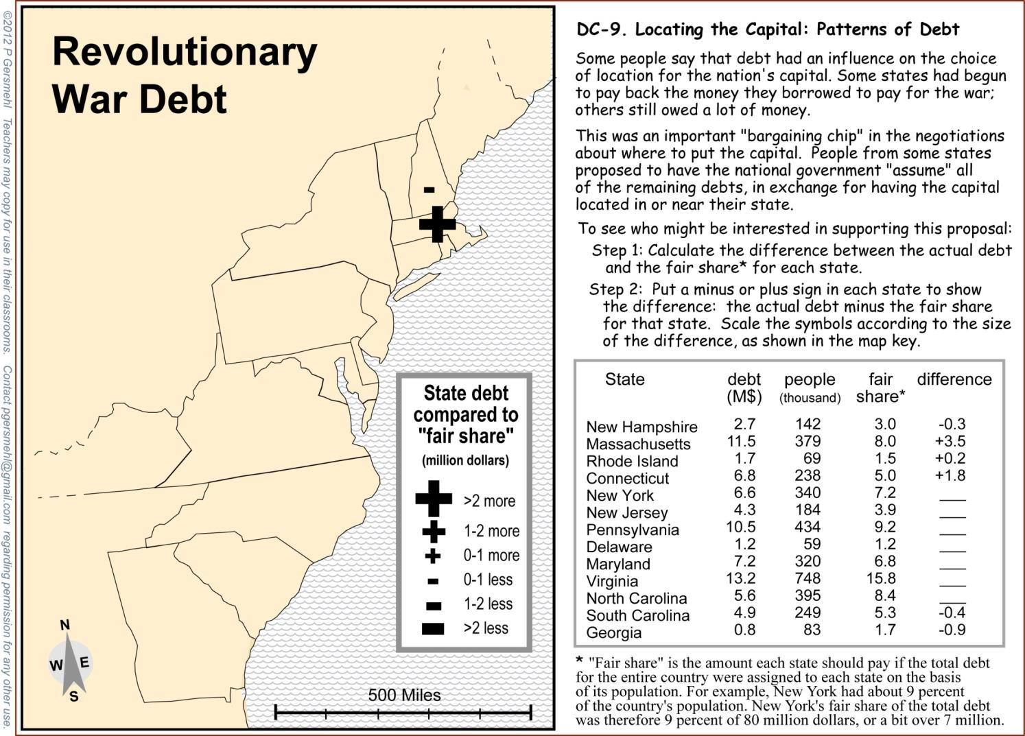
Finally, a group finishes a map
to see which states would gain
if the federal government
cancelled their debts.

Slide 15
Then,
each group tries to choose
the best location for the capital
based on the information
on their map and graph.

Slide 16
Finally,
the groups get together,
compare information,
and try to choose
a compromise location
for the national capital.

Slide 17
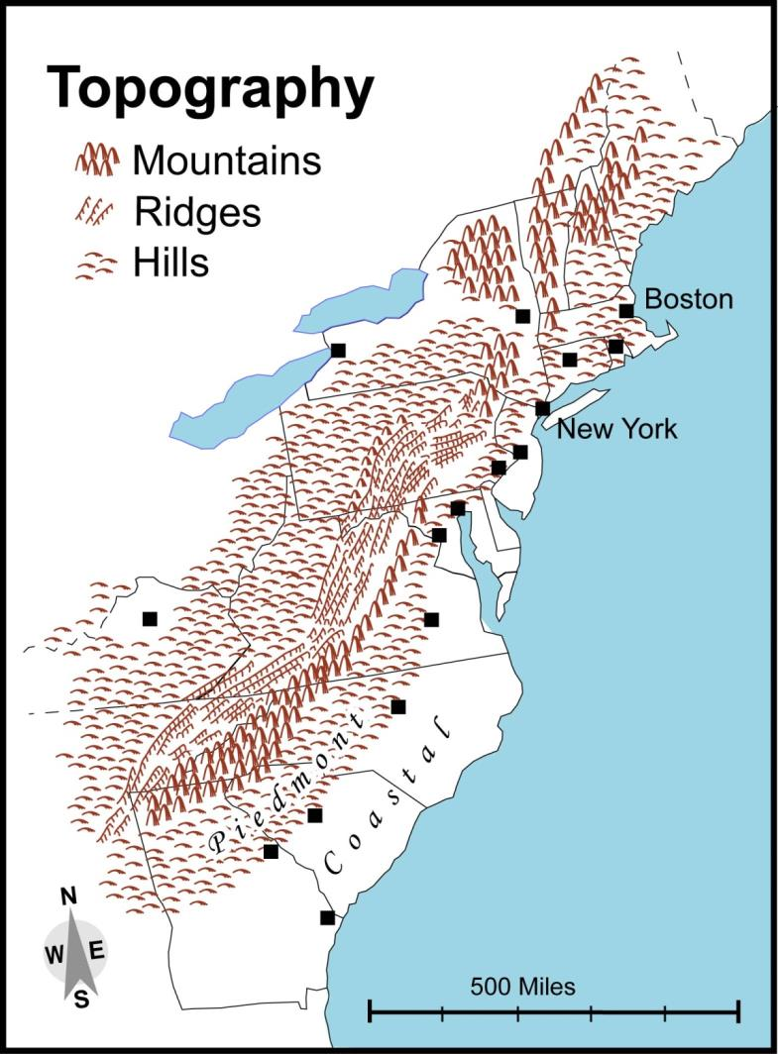
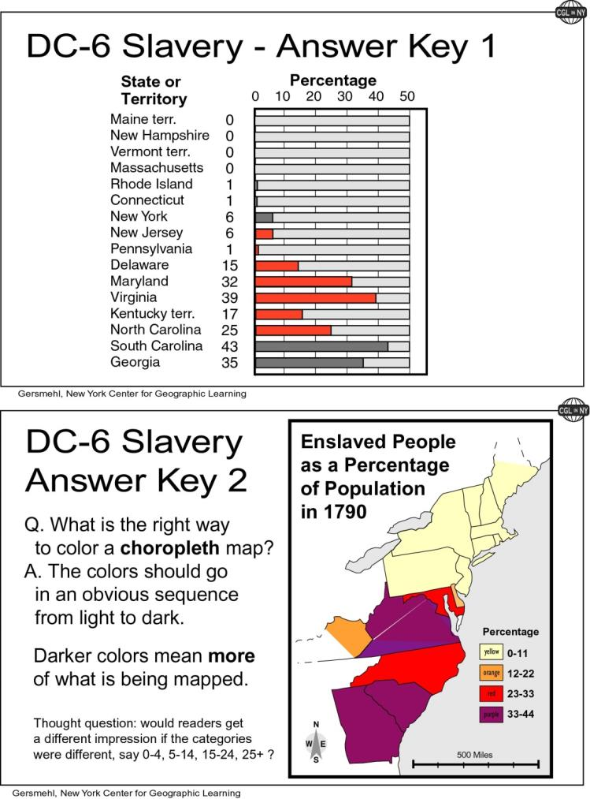
The teacher packet
will include visuals
for skill demonstration
and the “right answers.”

Slide 18
And when it is all done,
we can try to identify
what message we should learn
from the Great Compromise.
Specifically, we will see
whether we can apply
any of that message
to the present Congress,
which seems unable
to compromise!

