Slide 1
the “Fireworks” Diagram
A graphic illustration
of the basic structure
of each regional module
in the MGA model curriculum

Slide 2
We will illustrate
this scaffold diagram
by looking at the unit
on South America.

Slide 3
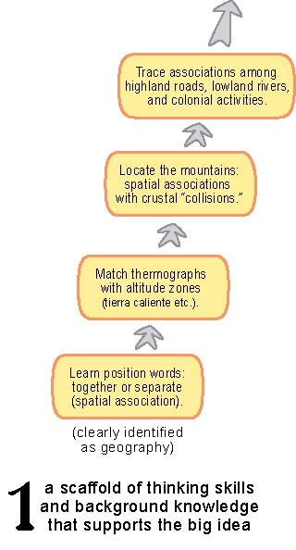
The first step
(in a logical sequence)
is a “rocket”
of basic concepts

Slide 4
Each module starts with a different
way of looking
at a map.
The launch pad
is a primary lesson
on spatial association
(things that go together).

Slide 5
The rocket rises
by looking at
two important
geographic
associations:
elevation and
temperature,
and elevation
and minerals.
These lessons
do not necessarily
have to be done
in this order.

Slide 6
Still later,
students examine
associations
of elevation,
roads, fields,
empires, and
colonization.

Slide 7
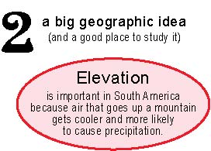
At the “top”
is the big idea
that permeates
the whole unit
on South America
------------------
the importance
of elevation
as a cause.

Slide 8
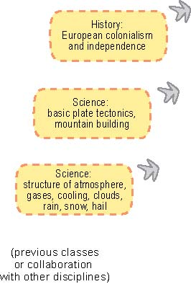
The “scaffold”
is supported
by some lessons
in other subjects: science, history,
civics, math

Slide 9
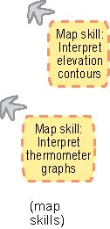
There are also
some map skills
that must be
mastered
at some time.
These can be part
of this module
or another one.

Slide 10
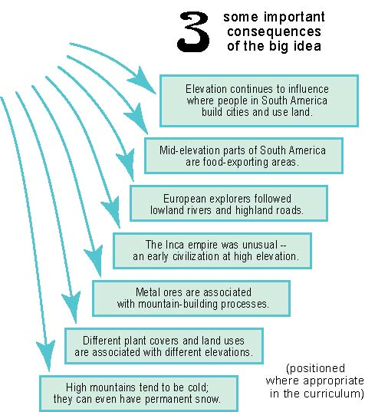
Like fireworks
on the 4th of July,
the big idea
“explodes”
into a number
of consequences.

Slide 11
Like fireworks
on the 4th of July,
the big idea
“explodes”
into a number
of consequences.
These can be part
of this module
or inserted
wherever they fit
in the curriculum.
Others fit better
in later grades,
where they can
help students refine
their analytical skills.
Some fit better
in earlier grades,
where they can link
with language arts
or math lessons.

Slide 12
It could be the “teaser”
that starts the lesson,
or a summary activity,
or an individual inquiry.
The final element
is a question
that can be
discussed
at any time.

