Slide 1
spatial reasoning
REVIEW
Educational implications
of modern neuroscience:
a review of research
for social studies teachers
P Gersmehl
Michigan
Geographic
Alliance
2014

Slide 2
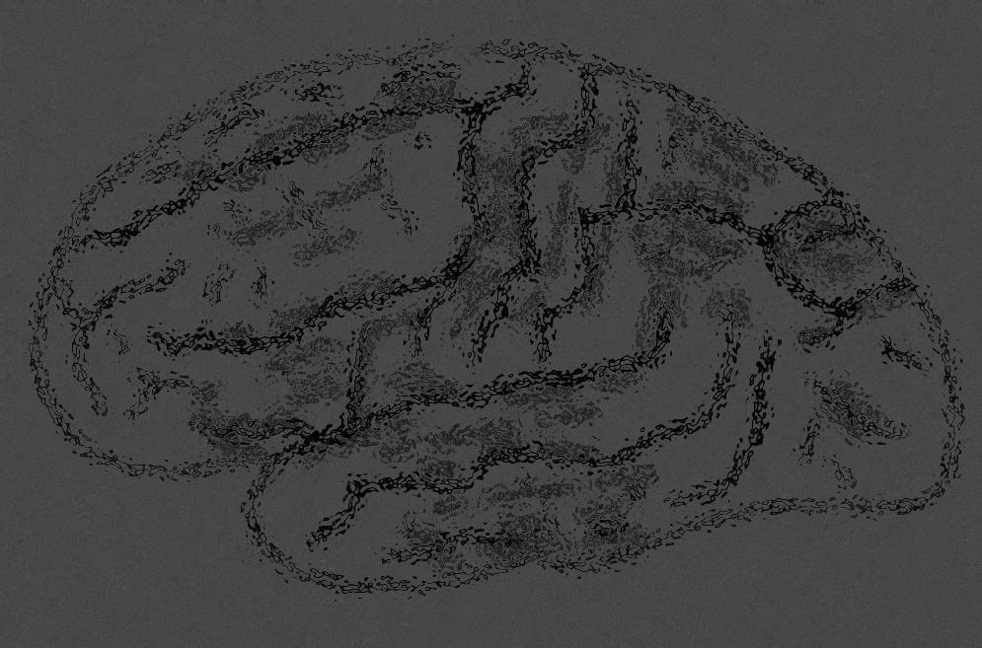
He called them
“a prioris”
Centuries ago, Immanuel Kant said:
Humans have several “built-in” ways
of organizing information from experience:
(They’re in our heads
before we start learning.)
Temporally
Quantitatively
Spatially
Causally

Slide 3
He called them
“a prioris”
Centuries ago, Immanuel Kant said:
Humans have several “built-in” ways
of organizing information from experience:
(They’re in our heads
before we start learning.)
Temporally
Quantitatively
HISTORY
Spatially
Causally
MATH
GEOGRAPHY
SCIENCE

Slide 4
He called them
“a prioris”
Centuries ago, Immanuel Kant said:
Humans have several “built-in” ways
of organizing information from experience:
(They’re in our heads
before we start learning.)
Temporally
Quantitatively
HISTORY
Spatially
Causally
MATH
GEOGRAPHY
SCIENCE

Slide 5
He called them
“a prioris”
Dualism
Descartes et al.
(They’re in our heads
before we start learning.)
Centuries ago, Immanuel Kant said:
Humans have several “built-in” ways
of organizing information from experience:
behaviorism
utilitarianism
logical positivism
functionalism
experientialism
progressivism
Temporally
empiricism
existentialism
constructivism
post-
modernism
nihilism
Quantitatively
HISTORY
Spatially
cultural
relativism
Causally
MATH
GEOGRAPHY
SCIENCE

Slide 6
He called them
“a prioris”
These “isms”
have one idea
in common
Dualism
Descartes et al.
(They’re in our heads
before we start learning.)
Centuries ago, Immanuel Kant said:
Humans have several “built-in” ways
of organizing information from experience:
The
Human Brain
is a
Blank
Slate
behaviorism
utilitarianism
logical positivism
functionalism
experientialism
progressivism
Temporally
empiricism
existentialism
constructivism
post-
modernism
nihilism
Quantitatively
HISTORY
Spatially
cultural
relativism
Causally
MATH
GEOGRAPHY
SCIENCE

Slide 7

Then, . . . along came
new brain-scanning technologies.
They changed
how we look
at human brains.
Unfortunately,
“brain science”
has become
a kind of buzzword.

Slide 8
But if we look at
the brain-scanning research
(not just the opinion blogs)
it says
“Kant was right.”
What the mind contributes is a set
of abstract conceptual frameworks
that organize our experience –
space, time, . . . causation, . . .
S Pinker, The Stuff of Thought, p160
And that has implications
for how we teach
social studies.

Slide 9
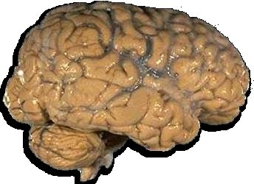
Recent Research (> 4500 studies since 1990)
shows that human brains have distinct networks
that organize spatial information in different ways.
shows that the human brain has several distinct networks
that do specific kinds of spatial thinking.
Analogy
Comparison
Aura
(Influence)
Region
Sequence
(Transition)
Pattern
(Shape)
Association
(Correlation)
Hierarchy

Slide 10
Recent Research (> 4500 studies since 1990)
shows that human brains have distinct networks
that organize spatial information in different ways.
shows that the human brain has several distinct networks
that do specific kinds of spatial thinking.
Analogy
Comparison
Aura
(Influence)
More/less
Near
Like
Region
Sequence
(Transition)
Between
In group
Pattern
(Shape)
Association
(Correlation)
Hierarchy
Aligned,
clustered
With
Inside

Slide 11
Recent Research (> 4500 studies since 1990)
shows that human brains have distinct networks
that organize spatial information in different ways.
Analogy
Comparison
Aura
(Influence)
Spatial Comparison
Region
Sequence
(Transition)
Stand in one place
and try to describe what you see.
Is it:
large or small
bright or dark
noisy or quiet
dirty or clean
?
Pattern
(Shape)
Association
(Correlation)
Hierarchy

Slide 12
bright or dark
large or small
noisy or quiet
crowded or empty
dirty or clean
Recent Research (> 4500 studies since 1990)
shows that human brains have distinct networks
that organize spatial information in different ways.
Analogy
Comparison
Aura
(Influence)
Spatial Comparison
Region
Note how much easier it is to say:
“compared to [a place I know], this is . . .”
Sequence
(Transition)
larger or smaller
brighter or darker
noisier or quieter
dirtier or cleaner
Pattern
(Shape)
Association
(Correlation)
Hierarchy

Slide 13
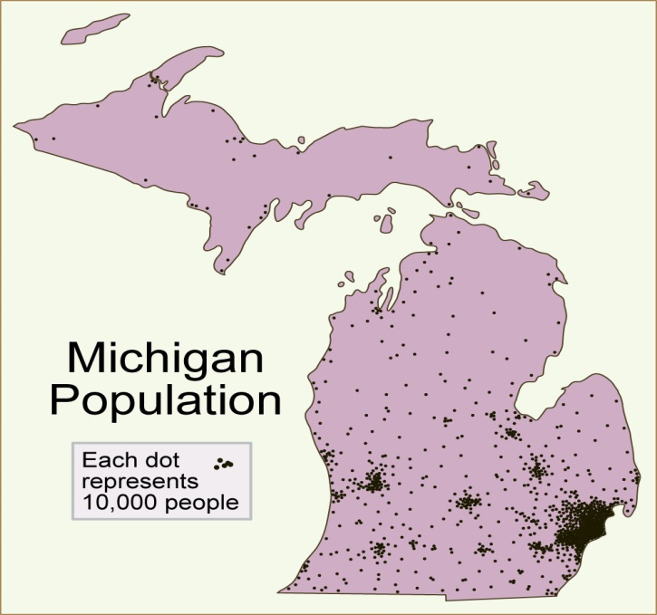
Maps can help us compare places.
Let’s look at
a simple map.
What should kids
be able to see
- in 2nd grade?
- in 6th grade?
- in high school?

Slide 14
Maps can help us compare places.
SIZE
Compare the peninsulas
UP is half as big as LP
NUMBER
LP has more people than UP
Most people are in S part of LP
REGION
Density goes down faster
going N from Detroit
than going W
GRADIENT
(TRANSITION)

Slide 15
Maps can help us compare places.
UP is half as big as LP
Your brain
has specific networks that
do all this, automatically,
(and more - it helps you survive)
but you are not likely
to be aware of them all
unless you verbalize them.
LP has more people than UP
Most people are in S part of LP
Density goes down faster
going N from Detroit
than going W

Slide 16
Students have to learn
how to use those networks.
Let’s look at
a middle-school
current-events topic
with deep historic roots.

Slide 17
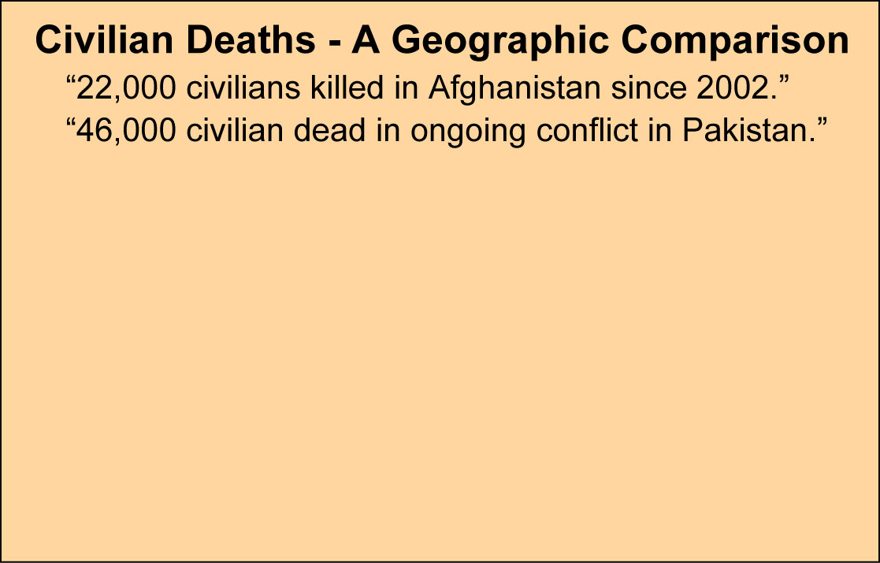
Recent Research (> 4500 studies since 1990)
shows that the human brain has distinct networks
that do specific kinds of spatial thinking.
Analogy
Comparison
Aura
(Influence)
Spatial Comparison
bigger, more, colder, etc.
Region
Sequence
(Transition)
QUESTION:
Which place
is more dangerous
for a civilian?
Pattern
(Shape)
Association
(Correlation)
Hierarchy

Slide 18
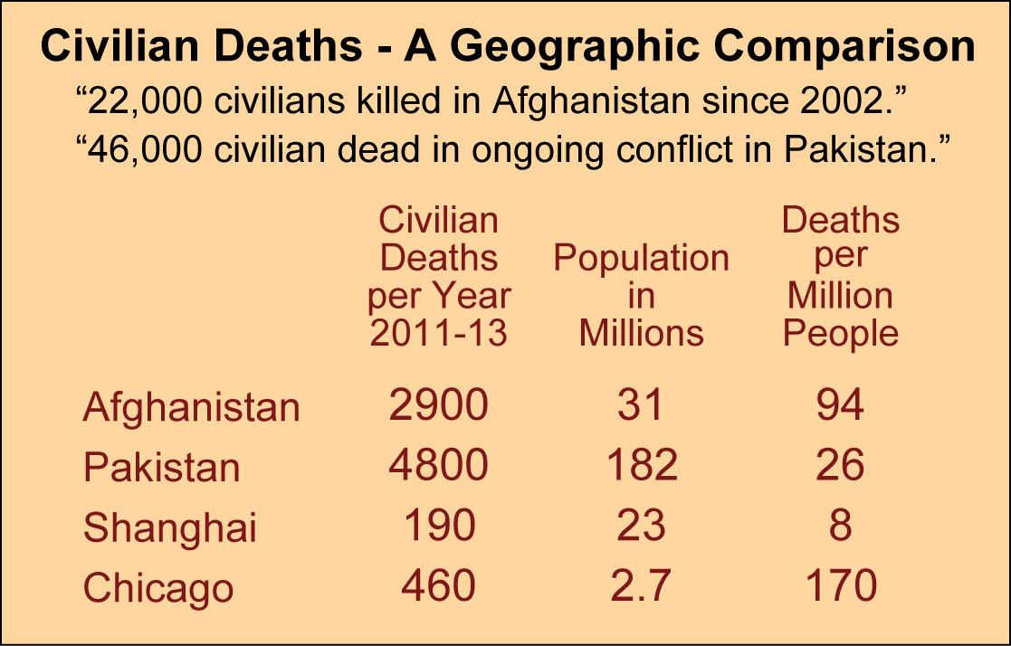
Recent Research (> 4500 studies since 1990)
shows that the human brain has distinct networks
that do specific kinds of spatial thinking.
Analogy
Comparison
Aura
(Influence)
Spatial Comparison
bigger, more, colder, etc.
Region
Sequence
(Transition)
Takehome
activity idea:
Encourage children
to make
comparisons
Pattern
(Shape)
Association
(Correlation)
Hierarchy

Slide 19
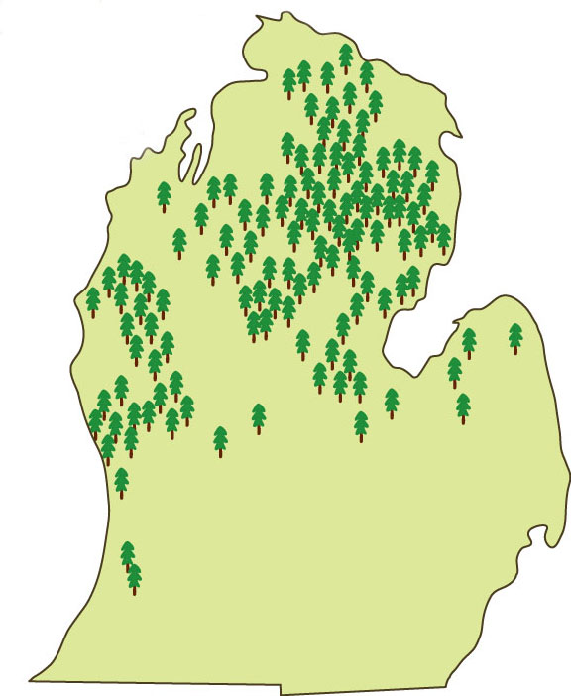
Recent Research (> 4500 studies since 1990)
shows that the human brain has distinct networks
that do specific kinds of spatial thinking.
Analogy
Comparison
Aura
(Influence)
Region
a group of similar places
Region
Sequence
(Transition)
Pattern
(Shape)
Association
(Correlation)
Hierarchy

Slide 20
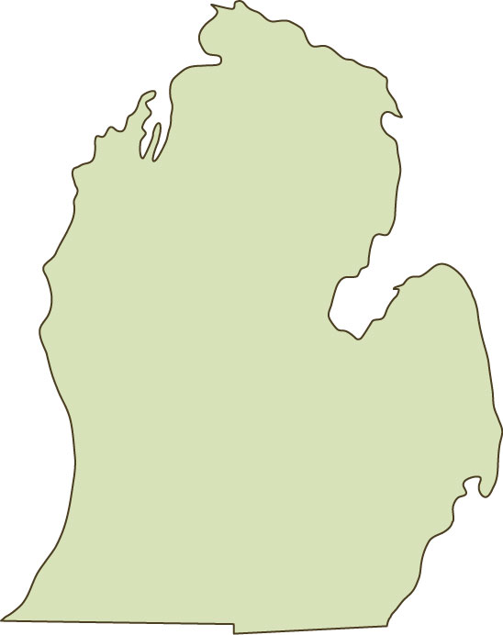
Recent Research (> 4500 studies since 1990)
shows that the human brain has distinct networks
that do specific kinds of spatial thinking.
Analogy
Comparison
Aura
(Influence)
Region
a group of similar places
Region
Sequence
(Transition)
Michigan’s
“Pine Belts”
Takehome
activity idea:
Have kids
draw lines
around regions
on dot maps.
Pattern
(Shape)
Association
(Correlation)
Hierarchy

Slide 21
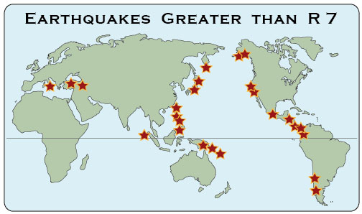
Recent Research (> 4500 studies since 1990)
shows that the human brain has distinct networks
that do specific kinds of spatial thinking.
Analogy
Aura
(Influence)
Comparison
Spatial Pattern
in a bunch, line, arc, ring,
or other arrangement
Region
Sequence
(Transition)
Pattern
(Shape)
Association
(Correlation)
Hierarchy

Slide 22
Recent Research (> 4500 studies since 1990)
shows that the human brain has distinct networks
that do specific kinds of spatial thinking.
Analogy
Takehome
activity idea:
Have kids
give names
to patterns
they see.
Aura
(Influence)
Comparison
Spatial Pattern
in a bunch, line, arc, ring,
or other arrangement
Region
“Ring of Fire”
Sequence
(Transition)
Pattern
(Shape)
Association
(Correlation)
Hierarchy

Slide 23
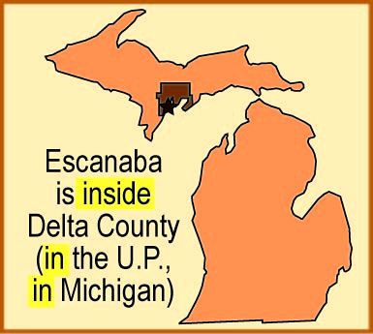
Recent Research (> 4500 studies since 1990)
shows that the human brain has distinct networks
that do specific kinds of spatial thinking.
Spatial Hierarchy
smaller
things
inside
larger
areas
Takehome
activity idea:
Have kids
name a big
area that
something
is inside.
Analogy
Comparison
Aura
(Influence)
“Inside
the UP”
Region
Sequence
(Transition)
Pattern
(Shape)
Association
(Correlation)
Hierarchy

Slide 24
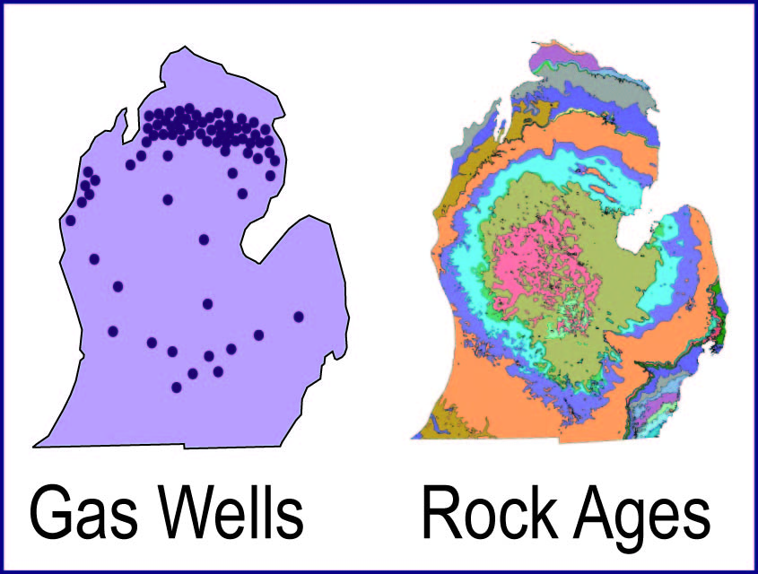
Recent Research (> 4500 studies since 1990)
shows that the human brain has distinct networks
that do specific kinds of spatial thinking.
Analogy
Over a lifetime . . .
the more mental maps
you have in your head,
the easier it becomes
to learn from maps
(by “seeing”
spatial associations)
Spatial Association
things that occur together
Aura
(Influence)
Comparison
Region
Sequence
(Transition)
Takehome
activity idea:
Use the
clickable
pdf maps.
Pattern
(Shape)
“with the
Antrim
Shale”
Association
(Correlation)
Hierarchy

Slide 25
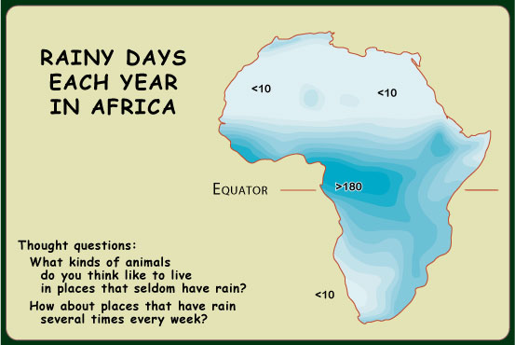
Recent Research (> 4500 studies since 1990)
shows that the human brain has distinct networks
that do specific kinds of spatial thinking.
Sequence (between)
Transition
(how things change
between two places)
Analogy
Comparison
Aura
(Influence)
Region
Sequence
(Transition)
Pattern
(Shape)
Association
(Correlation)
Hierarchy

Slide 26
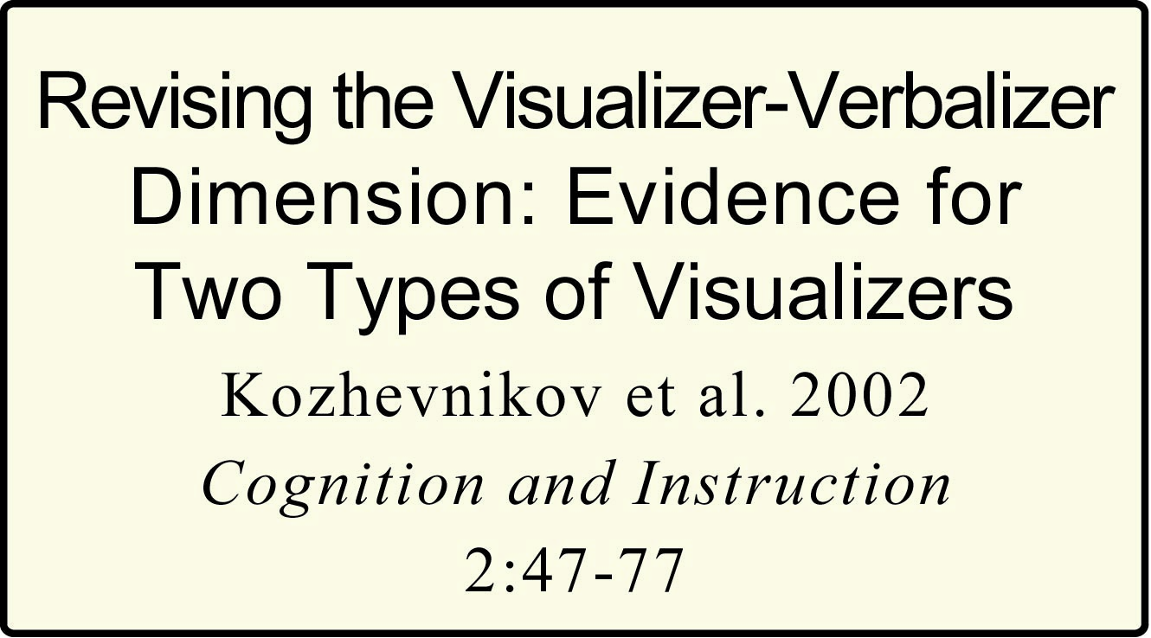
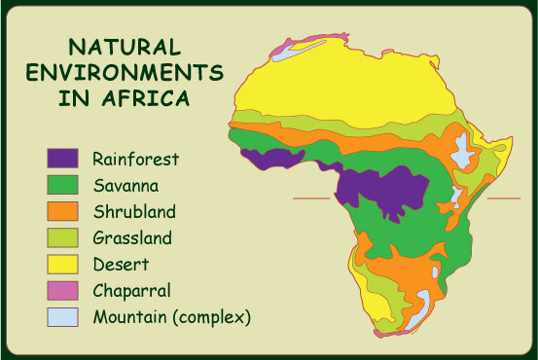
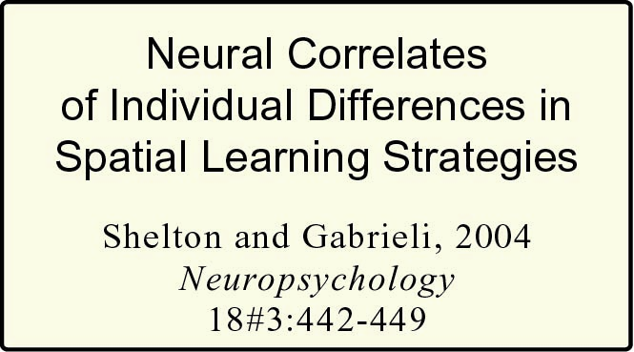
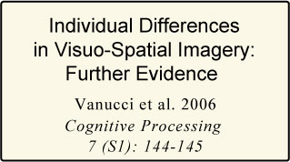
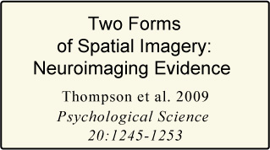
Recent Research (> 4500 studies since 1990)
shows that the human brain has distinct networks
that do specific kinds of spatial thinking.
Region
Sequence (between)
Transition
(how things change
between two places)
Analogy
Comparison
Aura
(Influence)
Region
Sequence
(Transition)
Sequence
Pattern
(Shape)
Association
(Correlation)
Hierarchy

Slide 27
Recent Research (> 4500 studies since 1990)
shows that the human brain has distinct networks
that do specific kinds of spatial thinking.
Region
Sequence (between)
Transition
(how things change
between two places)
Analogy
Comparison
Aura
(Influence)
TEACHER
WARNING:
INDIVIDUAL
DIFFERENCES
AHEAD
Region
Sequence
(Transition)
Sequence
I could cite
similar studies
for any pair
on the list.
Pattern
(Shape)
Association
(Correlation)
Hierarchy

Slide 28

Recent Research (> 4500 studies since 1990)
shows that the human brain has distinct networks
that do specific kinds of spatial thinking.
Analogy
Comparison
Aura
(Influence)
Aura
near, within area of influence
Region
Takehome
activity idea:
Have kids
name places
“under the
influence”
Sequence
(Transition)
“close to the
powerplant”
Pattern
(Shape)
Association
(Correlation)
Hierarchy

Slide 29
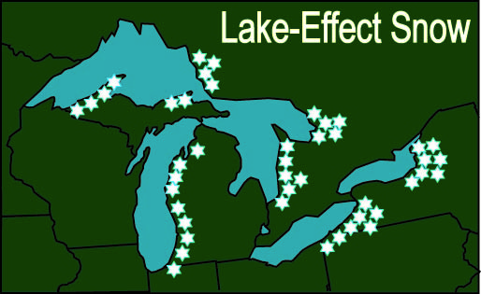
Recent Research (> 4500 studies since 1990)
shows that the human brain has distinct networks
that do specific kinds of spatial thinking.
Analogy
Comparison
Aura
(Influence)
Analogy
in a similar position
Region
Sequence
(Transition)
Takehome
activity idea:
Have kids
make
analogies
Pattern
(Shape)
“like
Buffalo”
Association
(Correlation)
Hierarchy
M
B

Slide 30
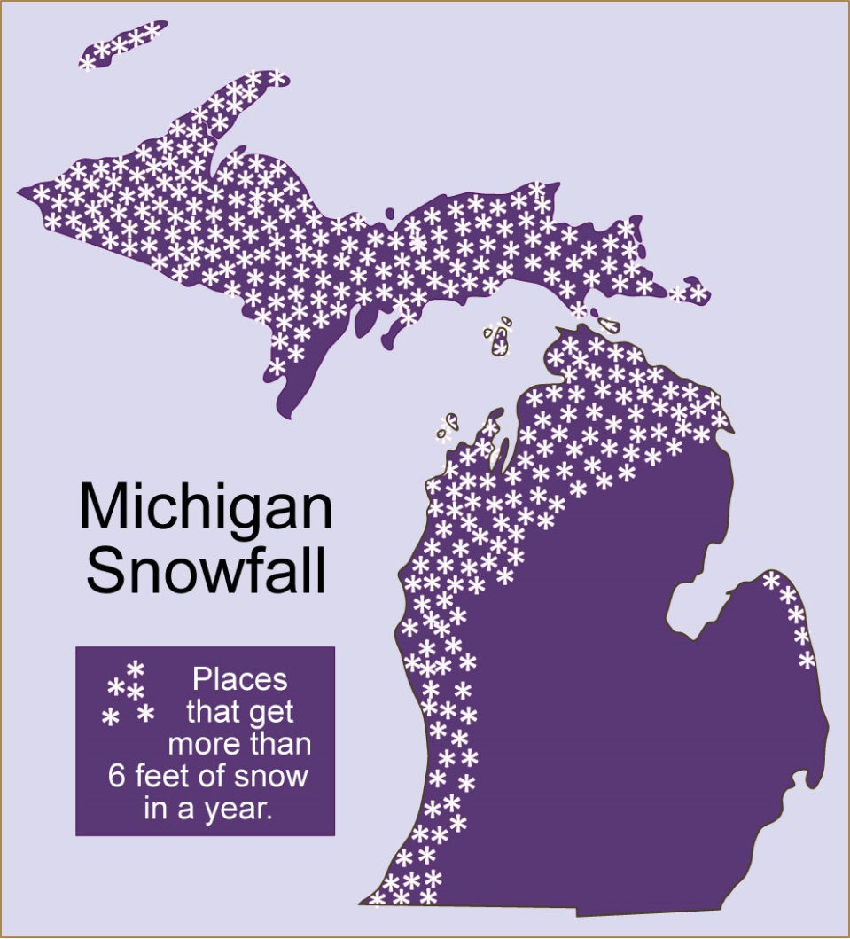
Recent Research (> 4500 studies since 1990)
shows that the human brain has distinct networks
that do specific kinds of spatial thinking.
Analogy
Comparison
Aura
(Influence)
The map of snow
is a good illustration
of a really key idea:
a person can use
different modes
of spatial reasoning
with the same map.
Region
Sequence
(Transition)
Pattern
(Shape)
Snow region
Association
(Correlation)
Hierarchy
Lake influence
Like Buffalo
Biased to west

Slide 31
Recent Research (> 4500 studies since 1990)
shows that the human brain has distinct networks
that do specific kinds of spatial thinking.
Analogy
In short, the modes of spatial thinking
are like the muscles in your arm - - -
You use different combinations of muscles
to play a piano, saw a board,
throw a baseball, . . .
Likewise, you are likely to use
different modes of spatial reasoning
to “read” maps of different topics.
Comparison
Aura
(Influence)
Region
Sequence
(Transition)
Pattern
(Shape)
Association
(Correlation)
Hierarchy
B
AND . . . it takes practice to learn
how to do any of them well!

Slide 32
Principle 1. The human brain has several
“built-in” ways of organizing spatial information.
Principle 2. Different people may have different
preferred modes of spatial thinking.
(They “see” different things at first, even on the same map.)
Principle 3. With guidance, every person can learn
how to do every kind of spatial thinking better.
Principle 4. Using several modes of thinking
increases the odds that a map will be remembered.
It’s learning
how to learn.

Slide 33
Principle 1. The human brain has several
“built-in” ways of organizing spatial information.
Remember. Concentrating
on the modes of thinking
that you find most useful
could be discriminatory!
Principle 2. Different children may have different
preferred modes of spatial thinking.
(They “see” different things, even on the same map.)
Principle 3. With guidance, every child can learn
how to do every kind of spatial thinking better.
Principle 4. Using several modes of thinking
increases the odds that a map will be remembered.

Slide 34
Copyright 2015, Phil Gersmehl
Teachers who saw this presentation at a workshop
or downloaded it from our internet site have permission
to make a copy on their own computers for these purposes:
1. to help them review the workshop,
2. to show to colleagues or administrators,
3. to show the presentation in their own classrooms
or at sessions they lead at teacher conferences,
4. to use individual frames (with attribution)
in their own class or conference presentations.
For permission for any other use,
including posting frames on a personal blog
or uploading to any network or website,
contact pgersmehl@gmail.com

