Slide 1
Copyright 2015, P Gersmehl
A Wake-up Call
Learning About Places:
Maps and Memory

Slide 2
How can teachers
give students
factual knowledge
about places?
One way
is to show pictures,
talk about them,
have students
write about them.

Slide 3
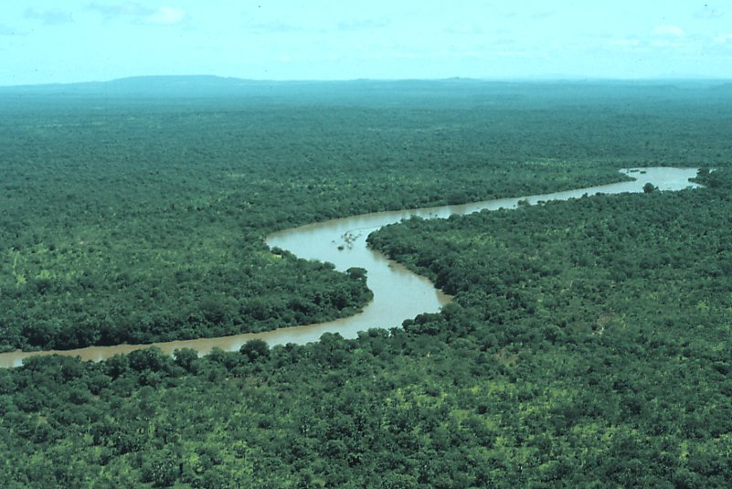
Rainforest
In some places,
it rains almost every day.

Slide 4
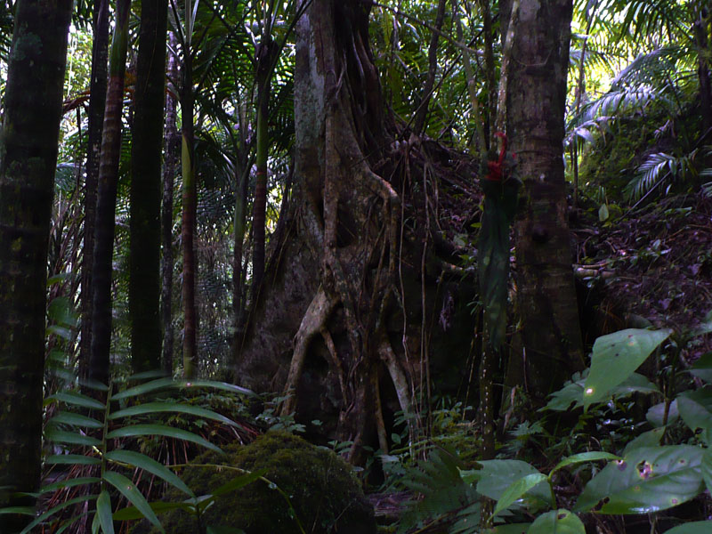
Trees grow big
in a rainforest.
Rainforest

Slide 5
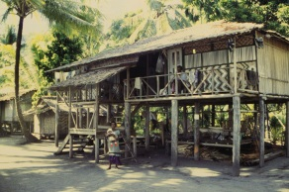
People
in rainforests
often build
with wood.

Slide 6
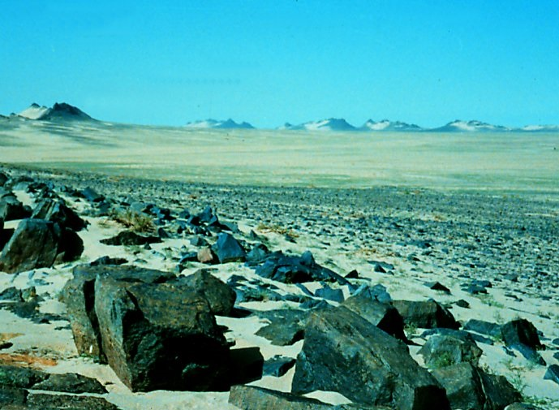
Desert
In some places,
it hardly ever rains.
Science Fact: trees need water to grow.

Slide 7
Desert
What
could you use
for building
if you lived here?

Slide 8
Desert
People who live
in deserts
are not likely
to build houses
out of wood !

Slide 9
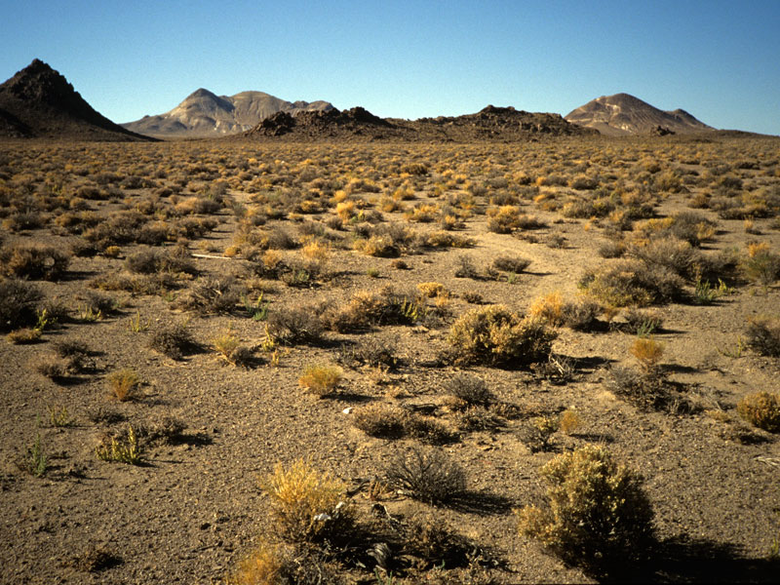
Pictures can help students
build visual vocabulary
about places,
especially if we ask
good questions about them.
But unless we link the images
to some kind of map,
students will not learn
where they are.

Slide 10
PROBLEM:
Maps are more abstract
than photos.
It is therefore both harder
and more important
to ask questions
about them.

Slide 11
A Wake-up Call

Slide 12
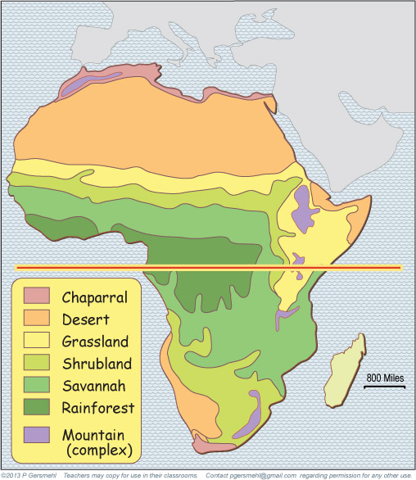
And this
is a desert.
Here is
a typical textbook map
of “the regions in Africa.”
Here is the
rainforest.

Slide 13
Here is
a typical textbook map
of regions in Africa.
We asked students to
“study the pattern
of environments.”

Slide 14
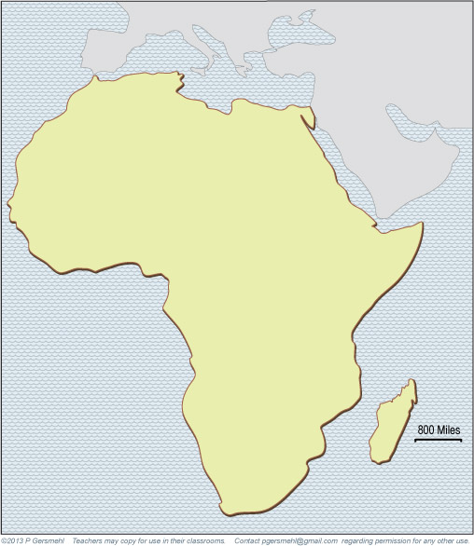
Here is
a typical textbook map
of regions in Africa.
We asked students to
“study the pattern
of environments.”
Weeks later,
a test asked
a simple question:
Divide this blank map
into 3-6 regions
and write a short phrase
to describe each region.

Slide 15
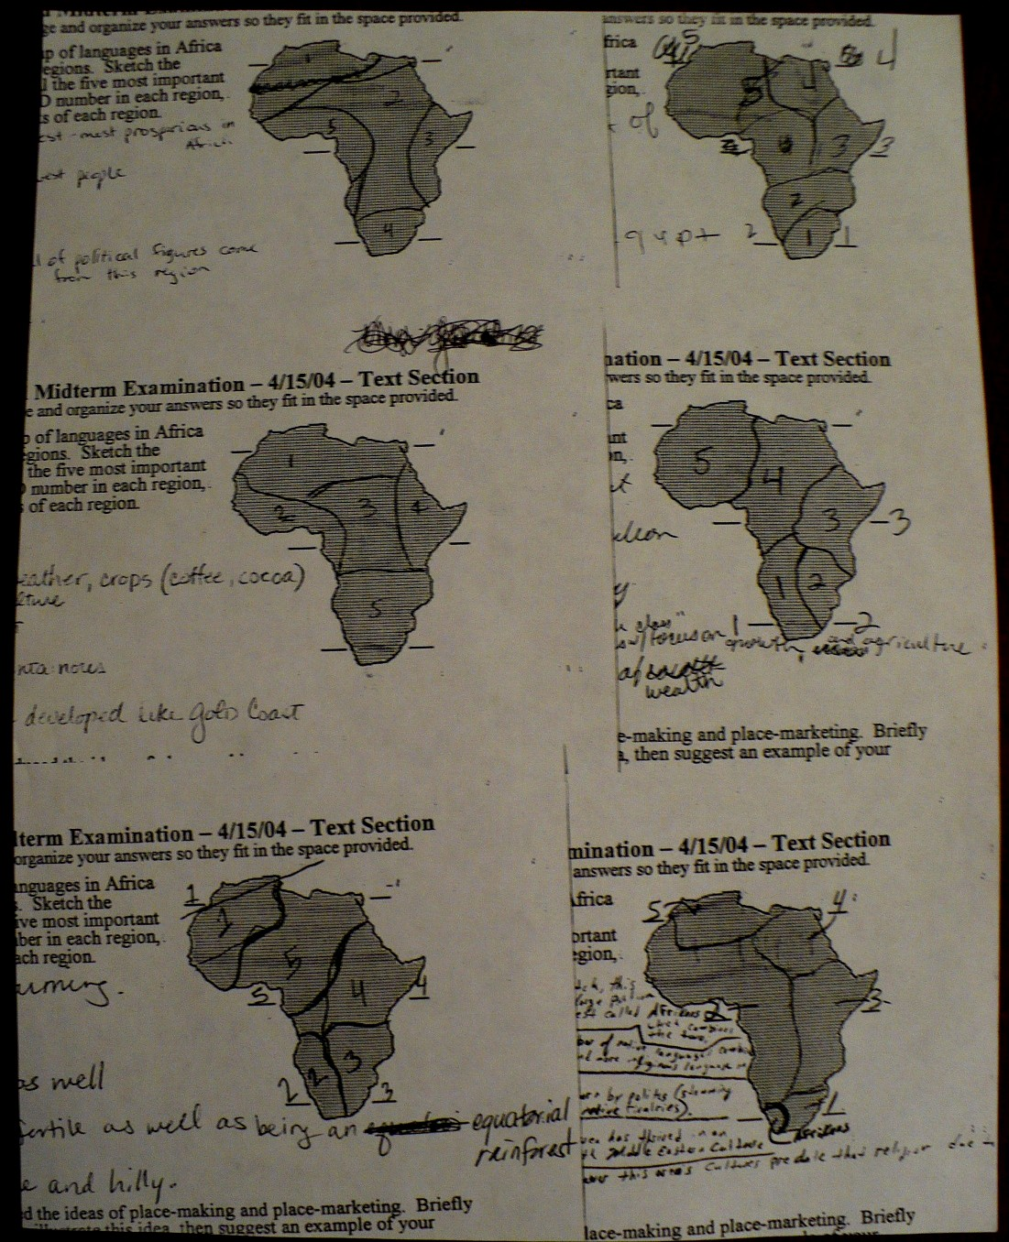
Here are some
of their answers:

Slide 16
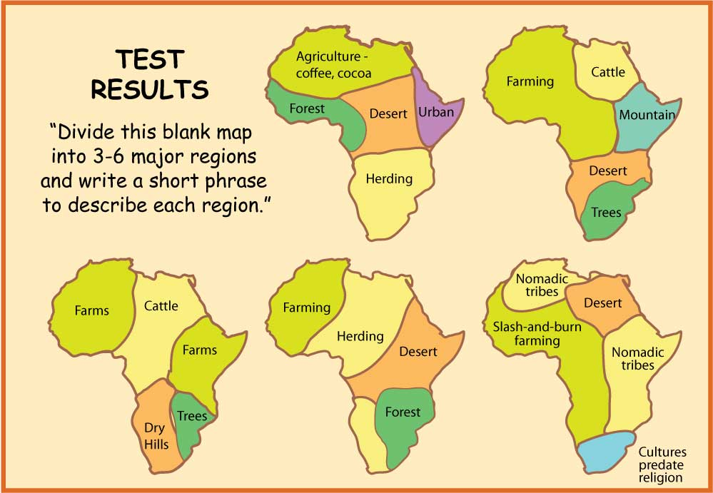
I traced them
and added
the colors
of the study map.
But first . . .
let me pause for a minute
so we can think about why
simple memorization
of environmental patterns
does not work very well.

Slide 17
I traced them
and added
the colors
of the study map.
But first . . .
let me pause for a minute
so we can think about why
simple memorization
of environmental patterns
does not work very well.
Fact:
The human brain
does NOT store
map images
accurately.
And these students
did not learn how
to “study” maps
in school.

Slide 18
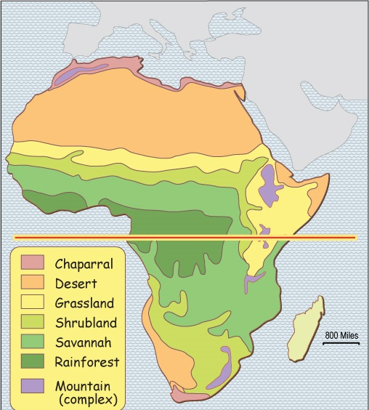
Conclusion?
You can’t just say
“study this map.”
You must ask questions,
or model the inquiry.
(or both!).
Developing these inquiry skills
is an important goal.

Slide 19
Copyright 2015, Phil Gersmehl
Photos by Rick Bein, Gray Tappan, and Phil Gersmehl
Teachers who saw this presentation at a workshop
or downloaded it from our internet site have permission
to make a copy on their own computers for these purposes:
1. to help them review the workshop,
2. to show to colleagues or administrators,
3. to show the presentation in their own classrooms
or at sessions they lead at teacher conferences,
4. to use individual frames (with attribution)
in their own class or conference presentations.
For permission for any other use,
including posting frames on a personal blog
or uploading to any network or website,
contact pgersmehl@gmail.com

