Slide 1
combinations
A geographic “big idea” with many consequences in south asia
Combinations of conditions can help us understand
many of the geographic features in South Asia,
including patterns of mountains, rainfall, river flow,
British colonialism, cotton production, railroads,
trade, population, post-colonial partition,
and modern territorial disputes.

Slide 2
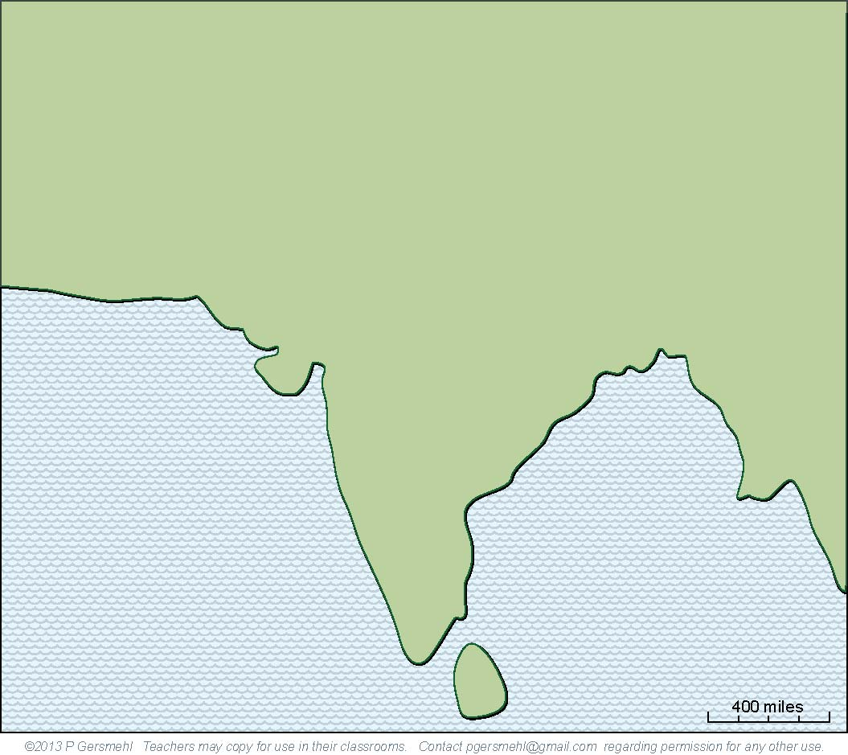
The subcontinent
of South Asia is
almost half as large
as Europe.

Slide 3
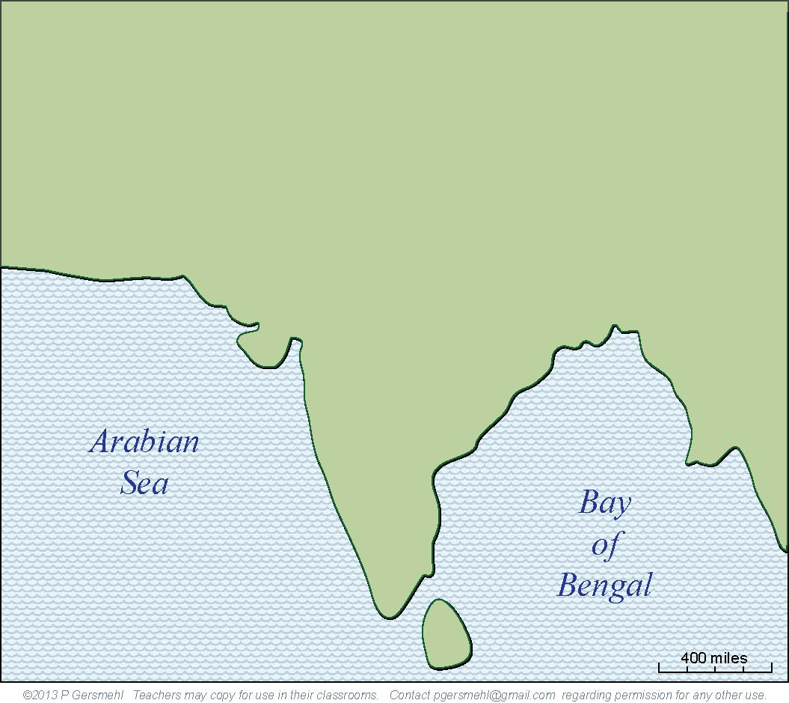
Like Europe, South Asia
is basically a large peninsula.
It extends out from Eurasia
into the Indian Ocean, where
it separates the Arabian Sea
from the Bay of Bengal.

Slide 4
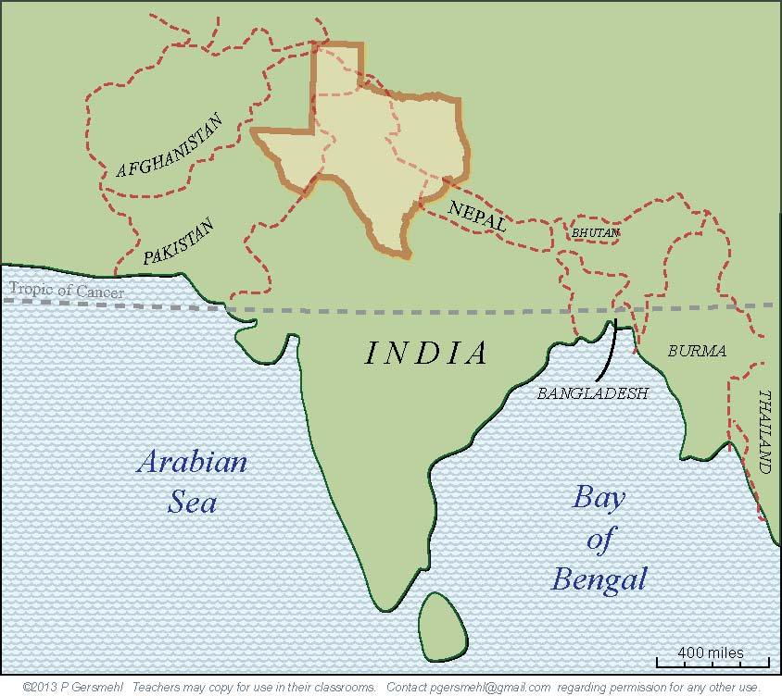
Here is Texas,
at the same scale
and proper latitude.
You could put about eight states
as big as Texas into South Asia,
but most of this region
is closer to the equator
(and therefore hotter)
than South Texas.

Slide 5
Geologically,
South Asia
is a separate
crustal plate
(a moving piece
of the earth’s
outer “shell”)
In fact,
it used to be
connected to
Antarctica,
Australia,
and Africa.

Slide 6
Geologically,
South Asia
is a separate
crustal plate
(a moving piece
of the earth’s
outer “shell”)
Now, it is moving
northward
at a rate
of about
2 inches
per year.

Slide 7
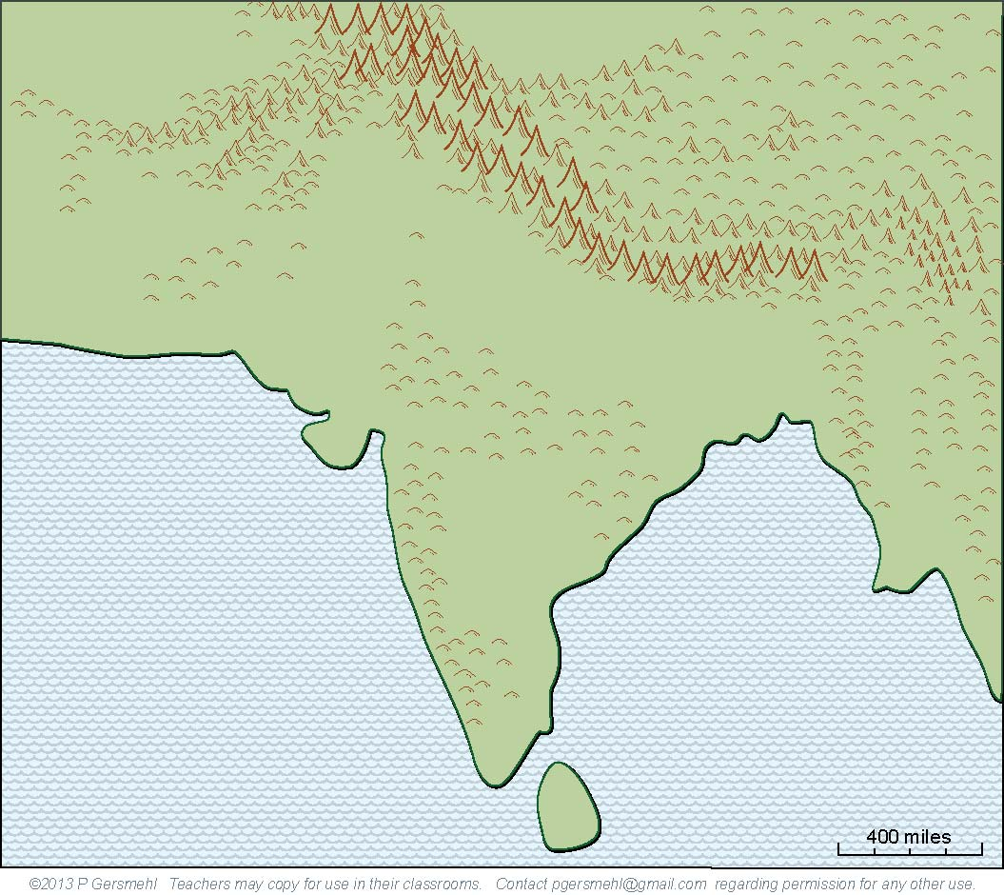
That is very fast
(for a geologic process).
It is fast enough
to push up
the highest
mountain range
in the world.

Slide 8
The Himalaya Mountains
average more that four miles high.
The highest peaks are
almost twice as high
as the tallest mountains
in Colorado or California.

Slide 9
That is high enough
to block the jet stream,
the west-to-east flow of air
high in the atmosphere.
The jet stream has to go
around the mountains.
This combination of conditions
jet stream + mountains
is responsible for triggering
the famous Indian monsoon.
Definition: a monsoon is
a seasonal reversal of wind direction
that brings heavy rain in summer
and very dry weather in winter

Slide 10
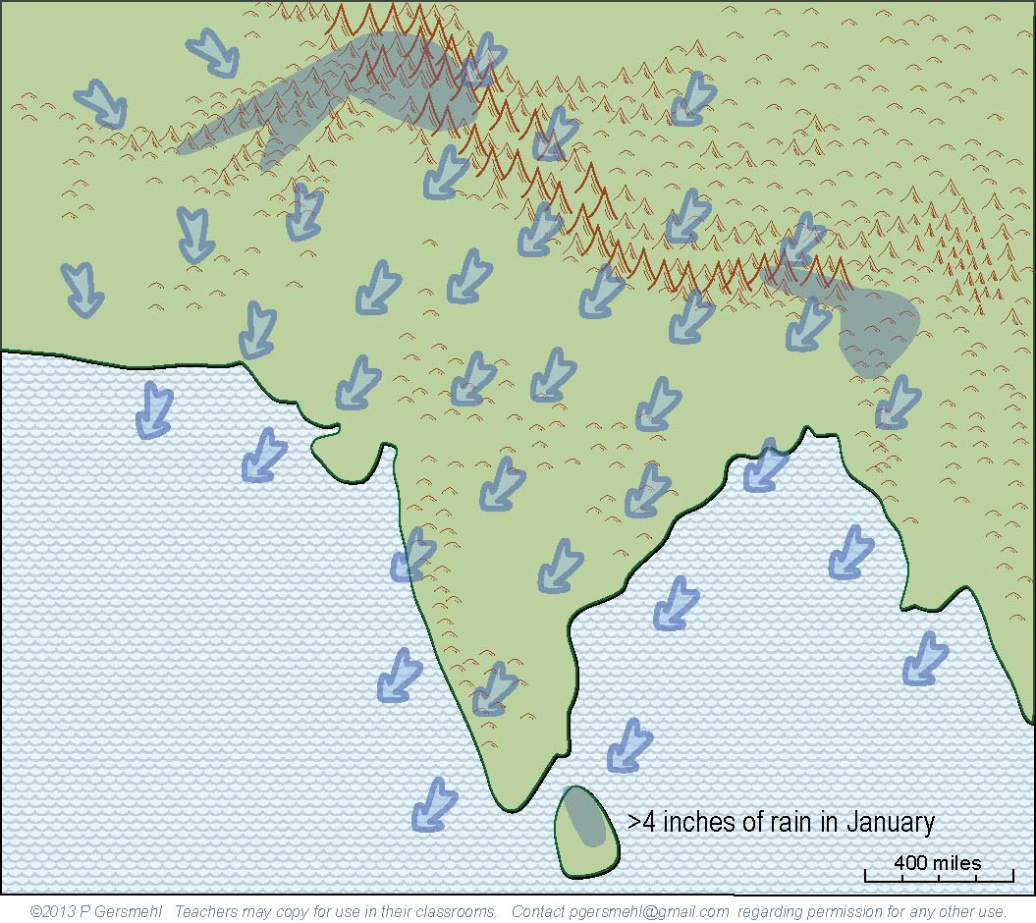
Here is how the monsoon works:
1. In winter, the continent is cold.
2. The jet stream is pushed to
the south side of the mountains.
3. Air pressure is high, and
4. Winds blow toward the southwest,
from the land to the ocean.
NOTE:
The cold air is up north.
Remember, most of India
is closer to the equator
than Texas, so India itself
is really quite warm
as well as dry in “winter.”
As a result, it rains or snows
only on the offshore islands
and a few high mountains.
Most of the subcontinent
is extremely dry.

Slide 11
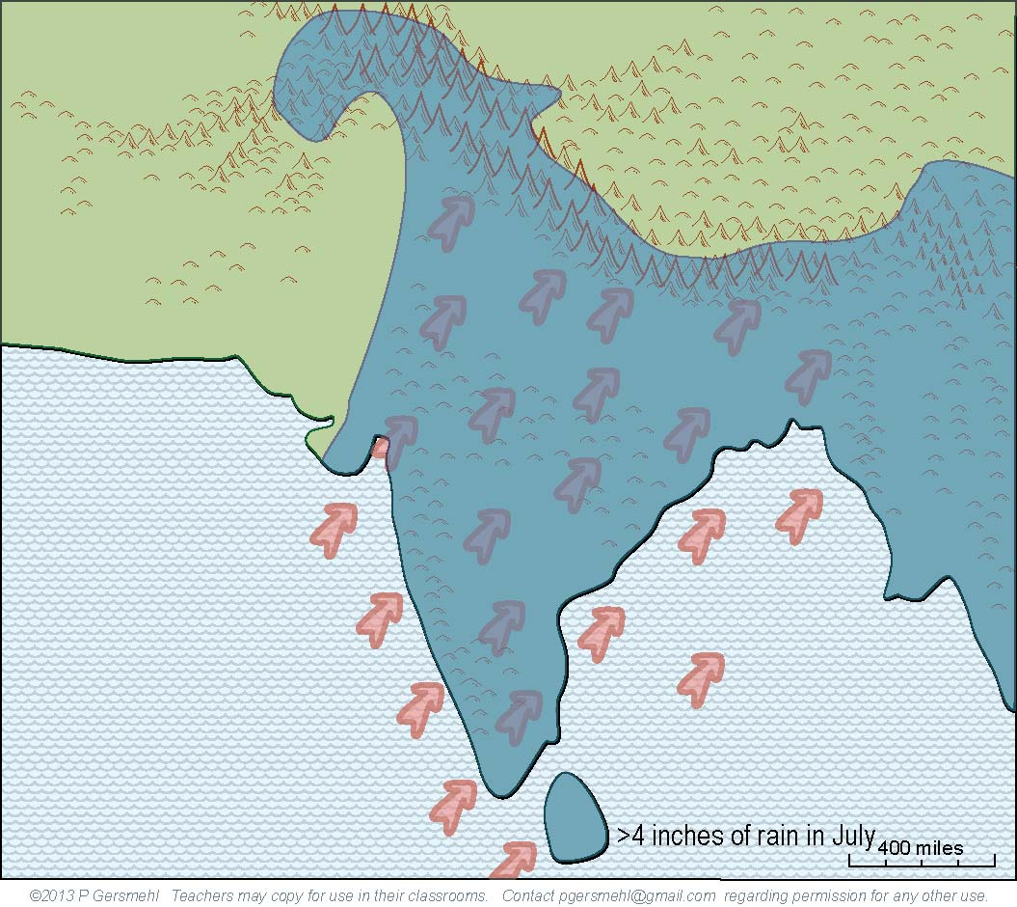
Some places can get
thirty feet of rain in mid-summer –
twice as much as Atlanta, Boston,
Chicago, and Houston put together.
Then:
1. In summer, the continent is warm.
2. The jet stream flows around
the north side of the mountains.
3. Air pressure is low, and
4. Winds blow toward the northeast,
from the ocean to the land.
As a result, heavy rains
fall on most of the land,
especially on the hills
and high mountains.

Slide 12
Here is another look at the winter map
of wind and rain, without all the
explanations.

Slide 13
Where the jet stream
(blowing from west to east) “piles up” against
the high mountains,
air is pushed downward
and makes a desert.
Here is another look at the summer map.
Note how this area
remains dry.

Slide 14
This combination
of conditions
makes this area
one of the hottest
and driest deserts
in the world.
Satellites have recorded
surface temperatures
above 155 degrees!
Hold that thought
for a few minutes.

Slide 15
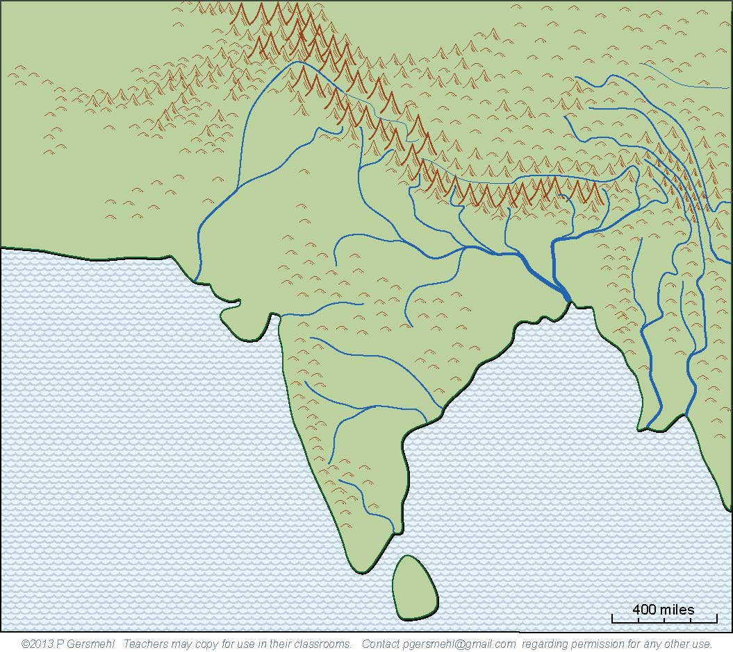
The heavy summer rains
combine with the high mountains
to make some really big rivers.
And remember, since the rains
come in less than half the year,
these rivers tend to flood in summer
and almost disappear in winter.

Slide 16
Did you notice over here,
where several large rivers
flow parallel to each other?
What could cause that?
If your hypothesis is
that the crustal collision
made these parallel
ranges of mountains,
you are right.
Parallel ridges separated by deep canyons
make travel very difficult in this region.

Slide 17
The combination
of a bone-dry desert,
the world’s highest mountains,
and the parallel canyons
form a very effective
“natural fence”
around South Asia.
With travel difficult,
overland trade almost impossible,
and even military action unlikely,
it is not surprising
that South Asia developed
a kind of cultural independence.
This region had
its own religion – Hinduism –
and many unique cultural ideas,
including the caste system,
and distinctive styles
of art, music, cooking,
theater, and dance.

Slide 18
There is one big exception
to this idea of cultural isolation.
The combination of peninsular shape
and seasonally reversing winds
made it possible for sailors to cross the Arabian Sea and Bay of Bengal
(even way back in Roman times).
These traders carried
silks and fine pottery from China,
glass, cloth, and iron from Rome,
spices from Arabia and Indonesia,
and gold and ivory from Africa.
At the time of the Islamic caliphs
(say around the year 900)
their role as intermediaries
in the trade between Europe and China
made Arabian and South Asian cities
among the richest in the world.

Slide 19
Then Spain finally reconquered Gibraltar.
Europeans began
to sail around the world,
making colonies overseas
and factories at home.
A different combination
of conditions gave
South Asia a new role.

Slide 20
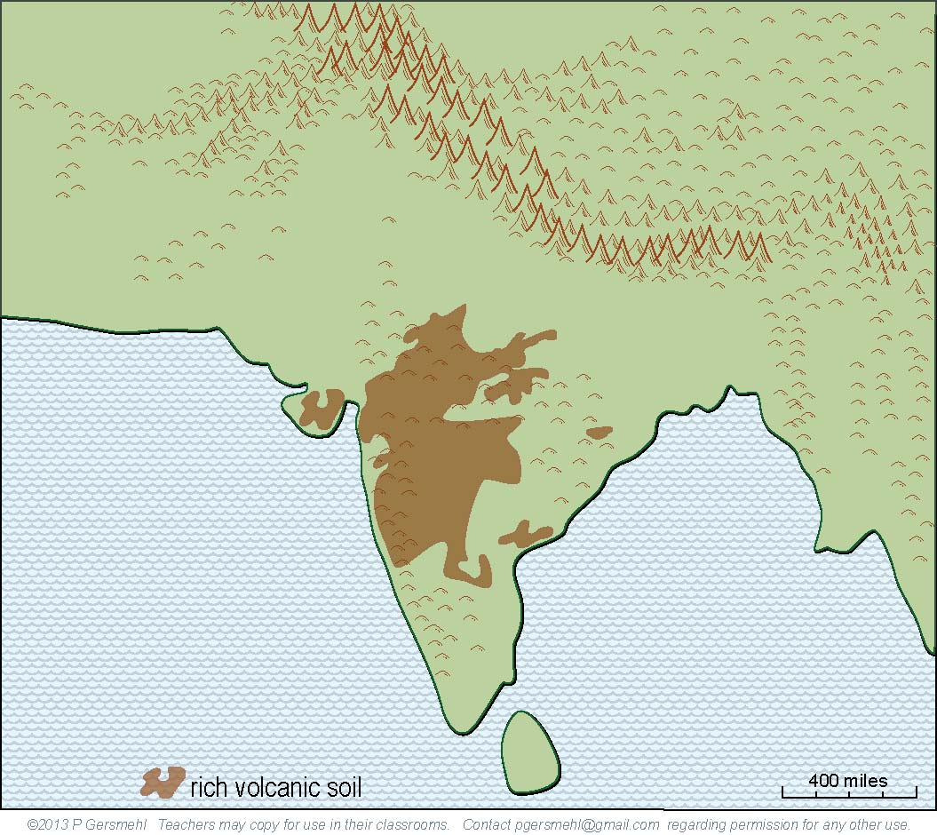
Remember that
the crustal plate
is moving northward.
As it crossed a hot spot
deep inside the earth,
volcanoes erupted
and spread lava
over a large area.

Slide 21
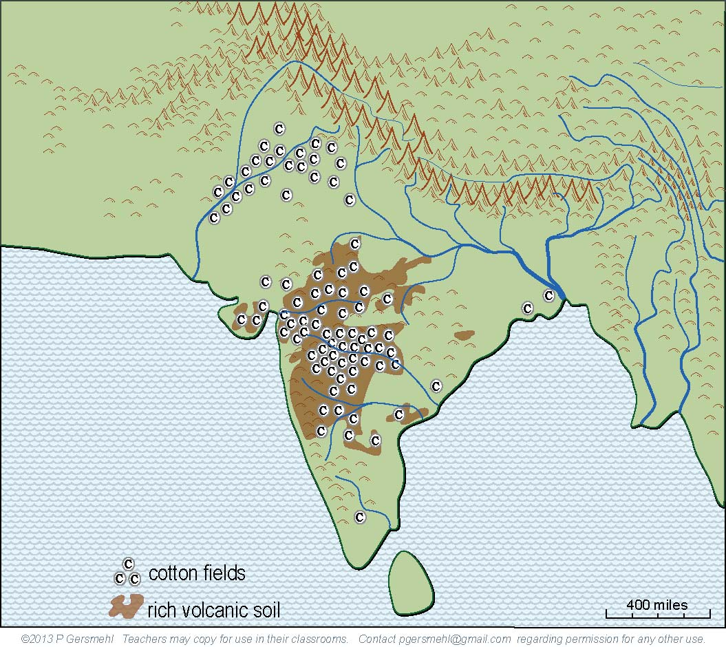
When combined with
a long growing season
and monsoon rain,
these volcanic
and floodplain soils
make excellent fields
for crops like cotton.
With its powerful navy,
England conquered
South Asia and made
it into a colony.
And England needed
a lot of cotton
for its new factories.

Slide 22
After a very long struggle (you can read about Gandhi
and other resistance leaders
on the internet),
South Asia finally
gained independence.
But there was a problem.
The clickable mini-atlas
has three primary documents
that help explain the issue.

Slide 23
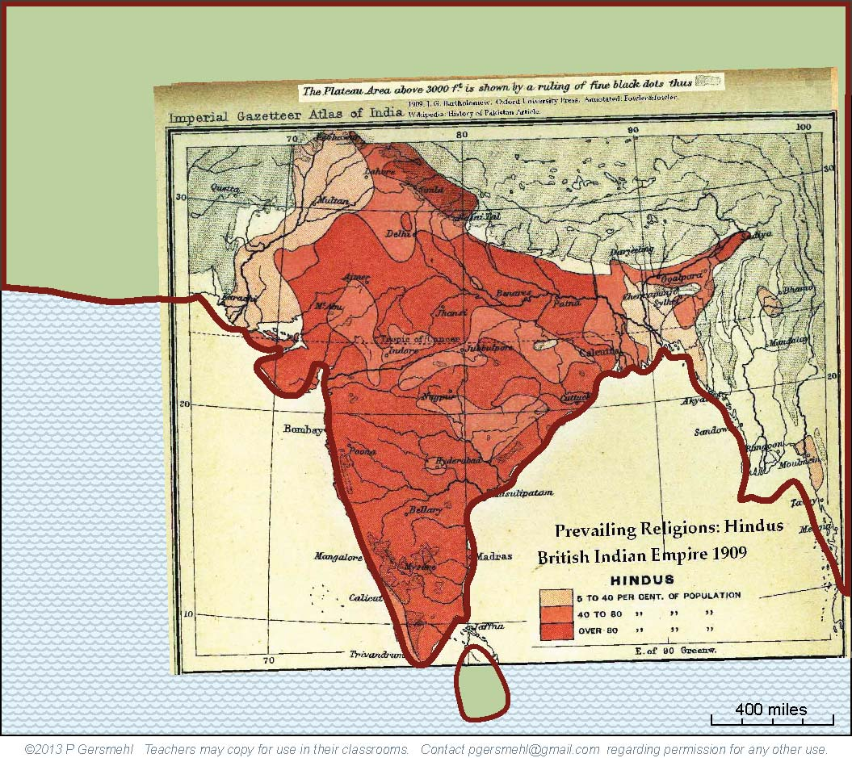
This old map
(from the Imperial
Gazetteer of India)
shows the areas
of South Asia
where Hinduism
was the main religion.
Note that Hindus
are less than
40 percent
of the population
in several places.
Note that Hindus
were less than
40 percent
of the population
in several places.

Slide 24
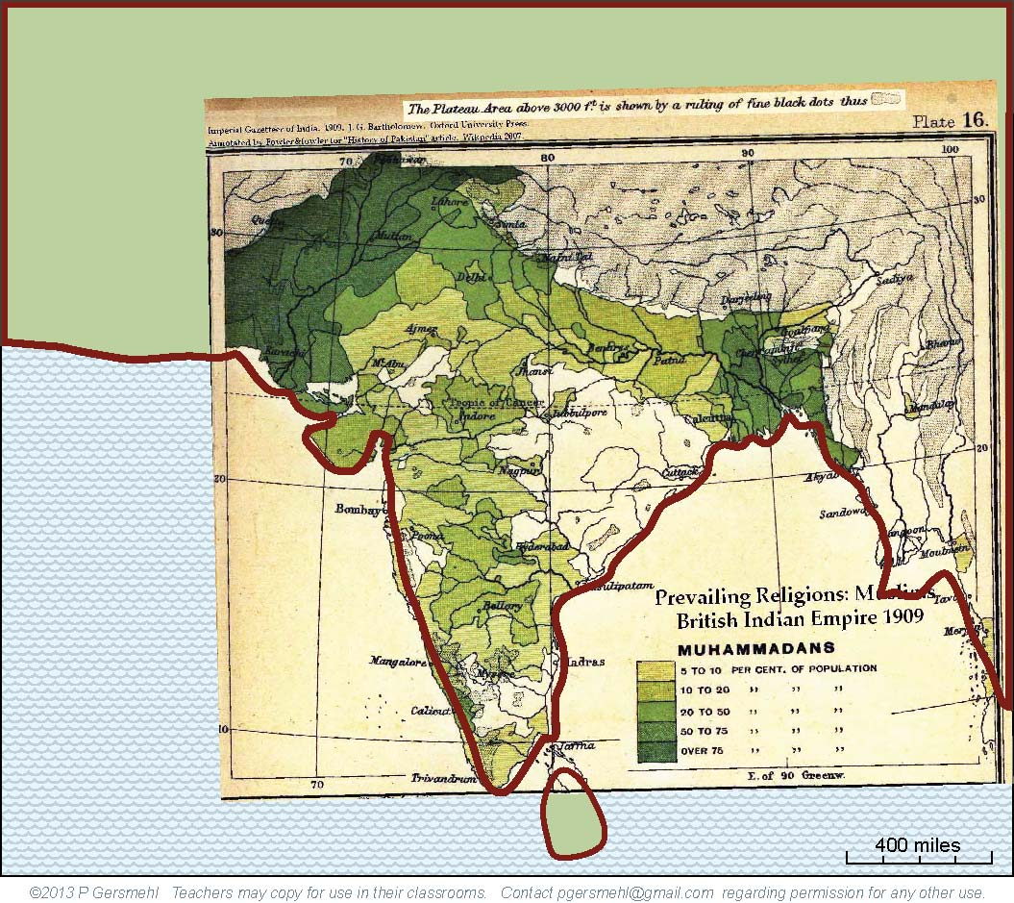
This old map
(from the same
Imperial Gazetteer)
shows the areas
where Islam was
the main religion.

Slide 25
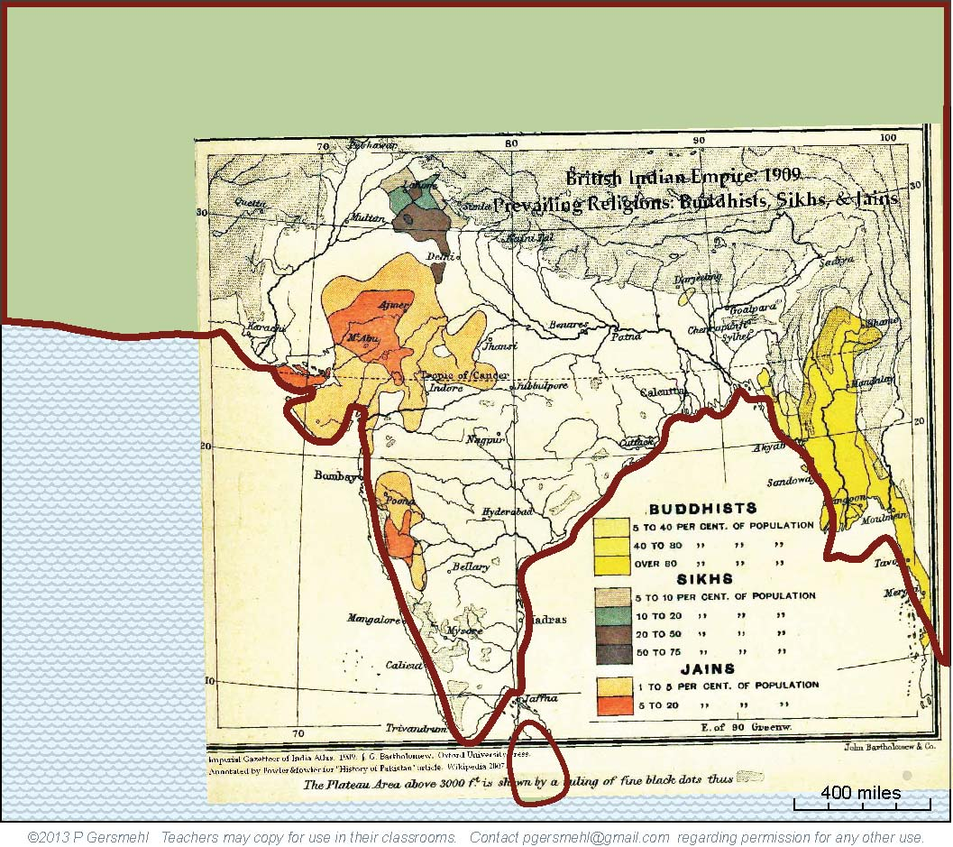
Islam and Hinduism
were the most important
religions in the region,
but other religions
were locally important
in several areas.

Slide 26
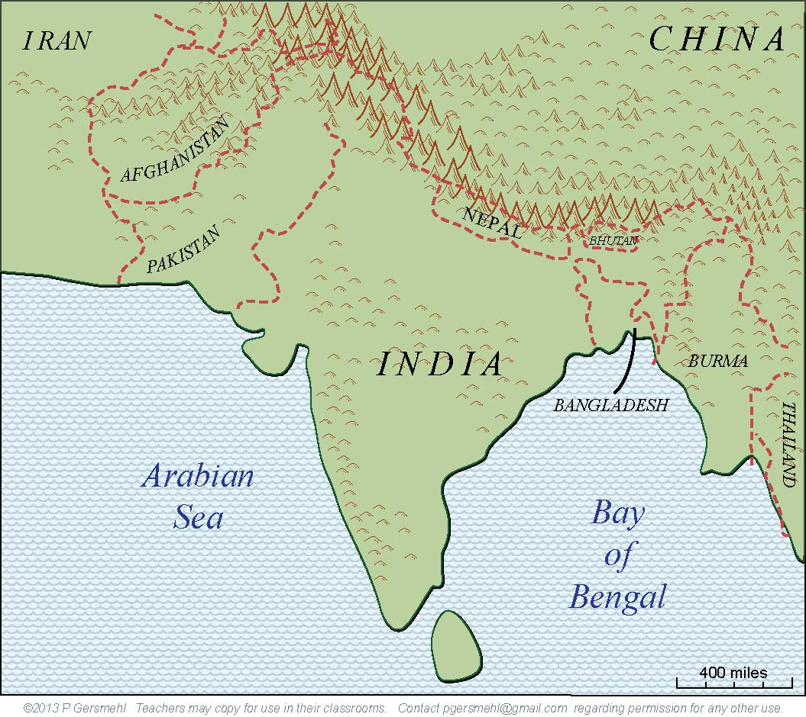
The political leaders
tried to solve the problem
of religious differences
by “partitioning” the area
into several separate countries.

Slide 27
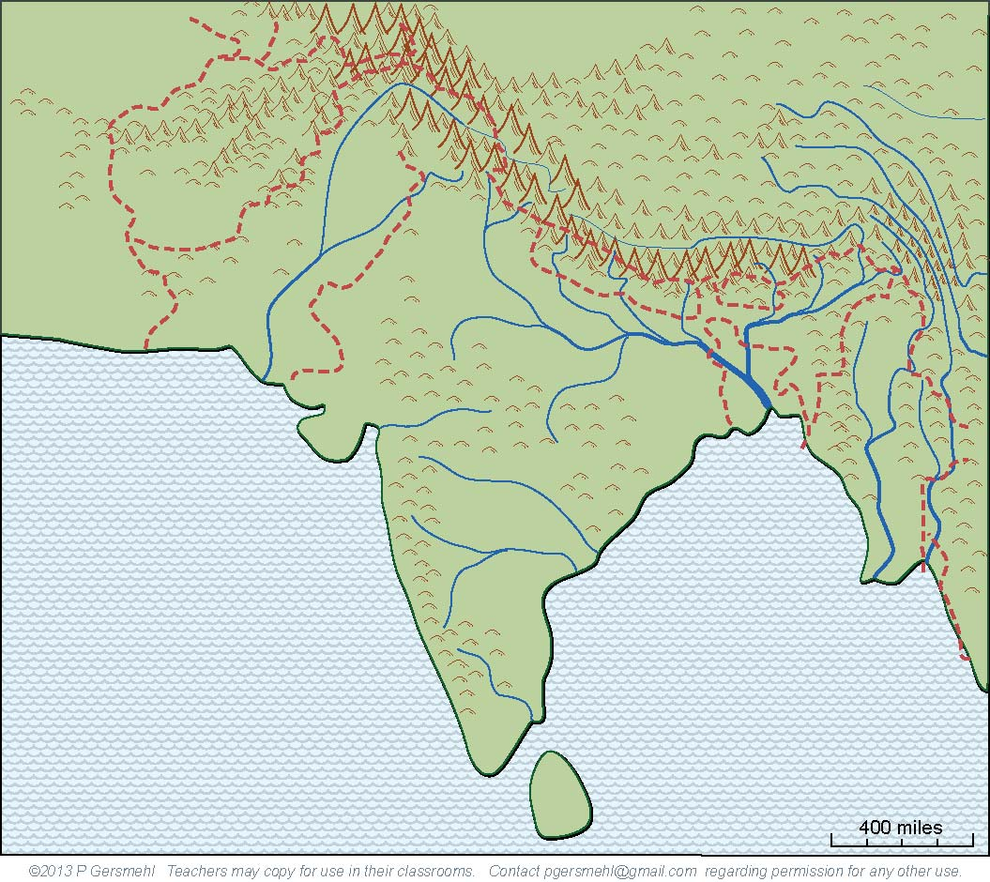
Unfortunately,
the resulting borders
do not pay much attention
to things like language
or the flow of water.
For example, every major river
in the region starts in one country
and goes through another
on its way to the ocean.

Slide 28
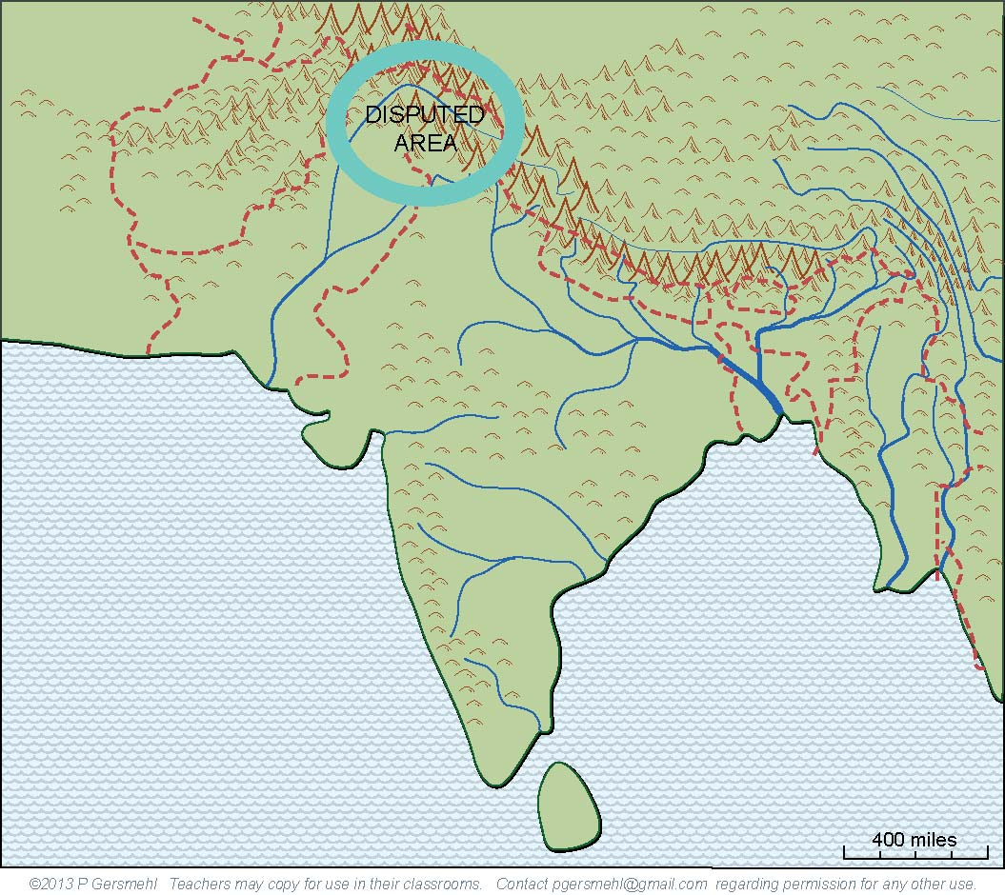
The area called Kashmir
is the focus of one dispute
over how the land and water
should be divided.
Part of the border
is deliberately left off of this map –
a university colleague of mine,
a well-known expert on South Asia,
was barred from traveling in this area
because he drew one of the borders
in the wrong place on one of his maps.

Slide 29
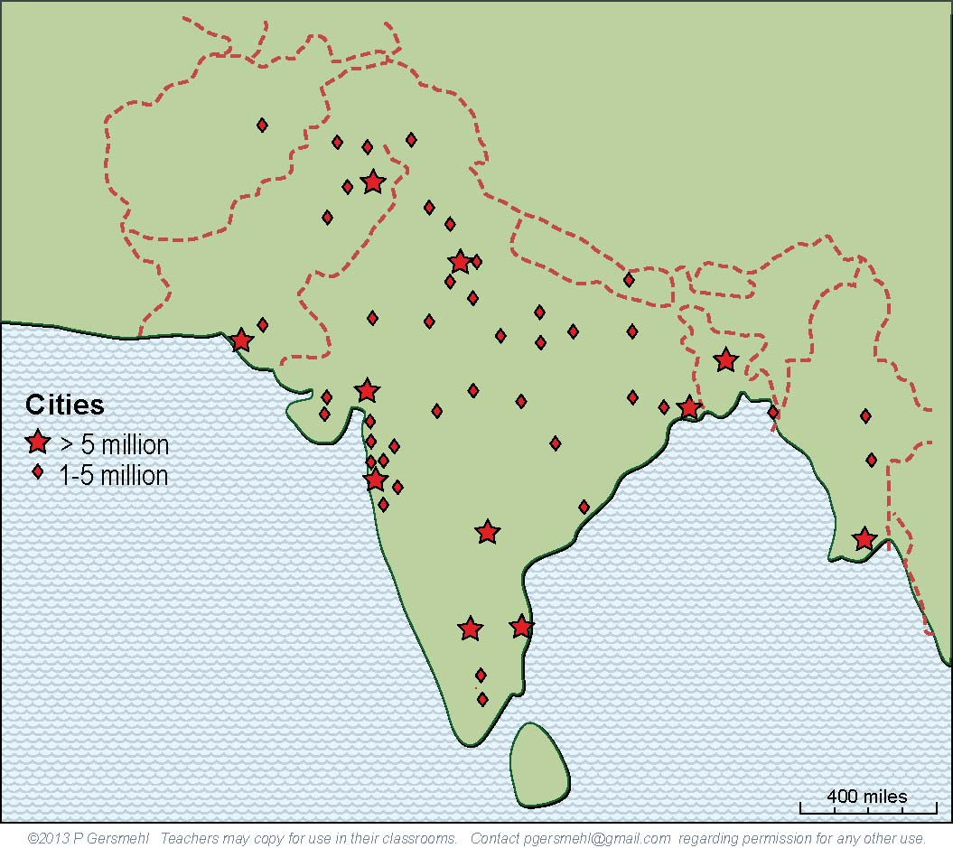
South Asia today is a region
that has more than a billion people
(more than 4 times as many as the U.S.)
and a rapidly growing economy.

Slide 30
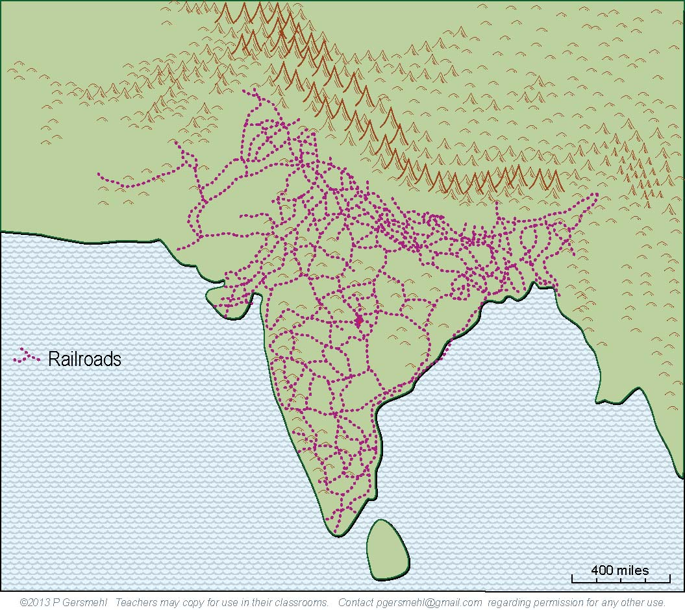
Unlike some other colonial regions,
South Asia “inherited”
two valuable legacies -
a superb railroad network
and strong technical universities.
As a result, South Asia today
has become a prominent “player”
in several hi-tech industries,
such as software design,
movie and music production,
and computer-telecom help desks.

Slide 31
Summary
South Asia has some important combinations of geographic conditions:
1. Monsoons and mountains combine to make large rivers.
2. Mountains and deserts combine to make transportation difficult,
which in turn allowed the area to develop independently.
3. Volcanic soils and monsoons combine to make good cotton fields.
4. Cotton and military isolation combined to make South Asia
a very desirable colony for England during the colonial era.
5. Post-colonial borders that divide the watersheds of major rivers
make water management and pollution control difficult.
6. Deep religious differences between and within countries
combine with nuclear weapons to create tensions.
7. Good engineering schools and English language ability
combine to support hi-tech industries and call centers.
(Think Bollywood!)

Slide 33
questions section

Slide 34
The How does the size
of South Asia compare
with Europe?

Slide 35
What do you call
a landform that
sticks out into an ocean,
like a large nose or thumb?

Slide 36
Here is Texas,
at the same scale
and proper latitude.
What are some consequences
of the fact that most of India
is closer to the equator
than Texas?

Slide 37
Geologically,
South Asia
is a separate
crustal plate
(a moving piece
of the earth’s
outer “shell”)
We think of it
as part of Asia,
but what land
was connected
to it in the
geologic past?

Slide 38
Geologically,
South Asia
is a separate
crustal plate
(a moving piece
of the earth’s
outer “shell”)
How fast
is this part
of the crust
moving?

Slide 39
What is the main
consequence
of this “collision”
between
crustal plates?

Slide 40
How do the Himalayas compare
with the highest mountains
in the United States?

Slide 41
How can a mountain range
help cause the wind reversal
called the monsoon?
Definition: a monsoon is
a seasonal reversal of wind direction
that brings heavy rain in summer
and very dry weather in winter

Slide 42
Describe the situation in winter:
1. air temperature?
2. position of the jet stream?
3. air pressure?
4. wind direction?
5. rainfall?

Slide 43
Describe the situation in summer:
1. air temperature?
2. position of the jet stream?
3. air pressure?
4. wind direction?
5. rainfall?

Slide 44
What happens
where the jet stream “piles up” against
the high mountains?

Slide 45
What is the result
in this area when
the jet stream “collides”
with the high mountains?

Slide 46
What happens in this area
when the monsoon winds
hit the slopes of the Himalayas?
Why is it important to know
that the summer monsoon
lasts only half of the year?

Slide 47
What causes these rivers
to flow parallel to each other?
What is the main effect of that?

Slide 48
What is the consequence
of this combination
of a bone-dry desert,
the world’s highest mountains,
and the parallel canyons?
Describe some of the
unique cultural features
that developed as a result.

Slide 49
What is the big exception
to the rule about cultural isolation
in South Asia?
What commodities were carried
in each direction?
What were some consequences
of those trading links?

Slide 50
What happened
after Spain finally reconquered Gibraltar?
How did this affect
South Asia?

Slide 51
How can the motion
of the crustal plates
cause the formation
of a large body
of rich volcanic soil?

Slide 52
Describe how
this volcanic soil
helped make India
a very valuable colony
for Great Britain?

Slide 53
Describe how Gandhi
and other resistance leaders
finally helped India
gain independence.

Slide 54
What is the
significance
of this old map
showing the areas
where most people
follow Hinduism?

Slide 55
What is the
significance
of this old map
showing the areas
where most people
follow Islam?

Slide 56
What is the
significance
of this old map
showing the areas
where most people
follow Buddhism,
Jainism, or Sikhism?

Slide 57
What was the name
of the process of dividing
South Asia into several
independent countries?

Slide 58
What are some problems
caused by the fact
that the country borders
were drawn primarily
on the basis of religion?

Slide 59
Describe the nature
of the dispute
over the region
called Kashmir.

Slide 60
How large is the population
of South Asia today, compared
to the United States?

Slide 61
Describe two valuable “legacies”
that South Asia “inherited”
from the British colonists.
What are some modern industries
that are favored by this history?

Slide 62
What unique geopolitical problem
faces the people in the region
that is called South Asia?

