Slide 1
Region
A geographic “BIG IDEA” that can help us organize our knowledge about
North America

Slide 2
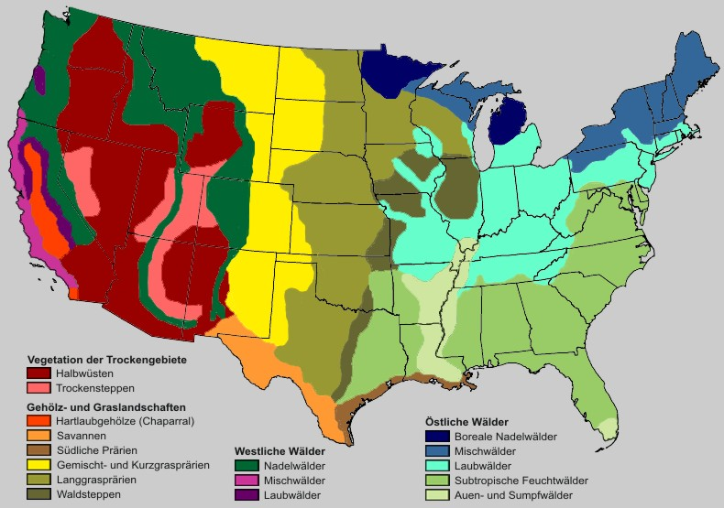
Definition: a region is a group of places
that are like each other
and close to each other
If you draw a line around the places,
the result is a regional map.
Why do we make regional maps?
Because it is usually easier to remember
the general shape of a region,
rather than the locations
of many individual places.
Let’s look at how to make
a simple regional map
to help us remember
the environments
in North America.

Slide 3
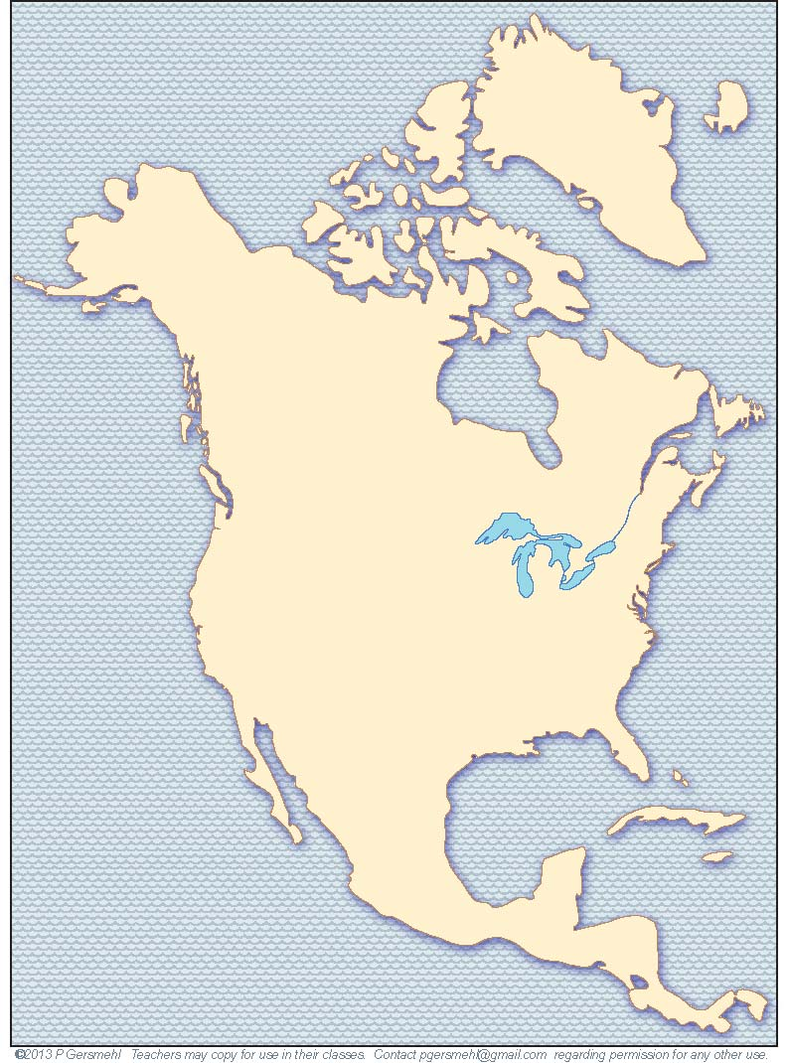
The continent
of North America
extends almost
from the Equator
to the North Pole.

Slide 4
The southern tip
is about 7 degrees
of latitude away
from the equator.
That’s only
about 500 miles.

Slide 5
The top of Greenland
is about the same
distance (500 miles)
from the North Pole.

Slide 6
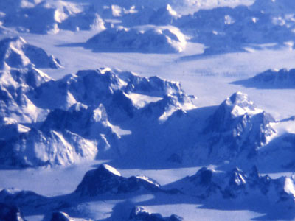
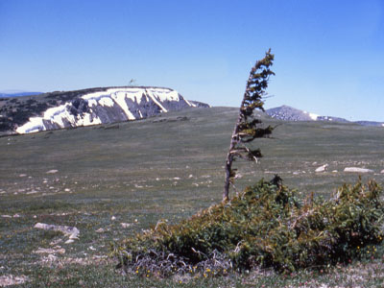
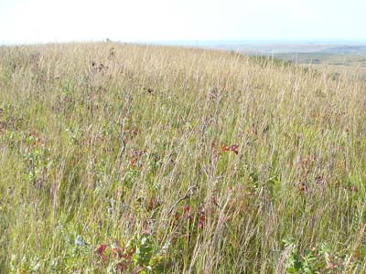
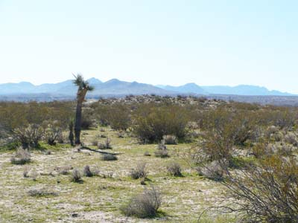
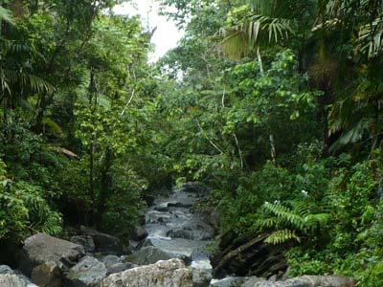
As a result, North America
has a wide range of
natural environments,
including:
- frozen ice caps
- wind-swept tundras
- waving grasslands,
- hardwood forests,
- tropical deserts,
- dense rainforests.
This presentation
is about how
we can draw
a few simple lines
to help organize
our knowledge
of these regions.

Slide 7
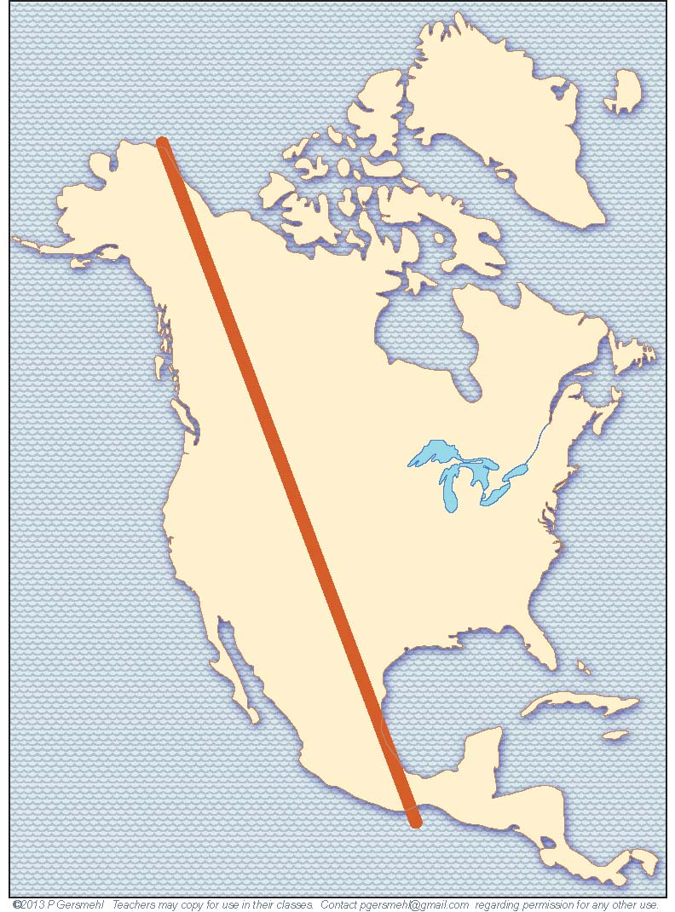
The first line starts
at the northern tip
of Alaska
(near a tiny town
called Barrow).
It goes
on a long diagonal
across the continent
to the east coast
of central Mexico.

Slide 8
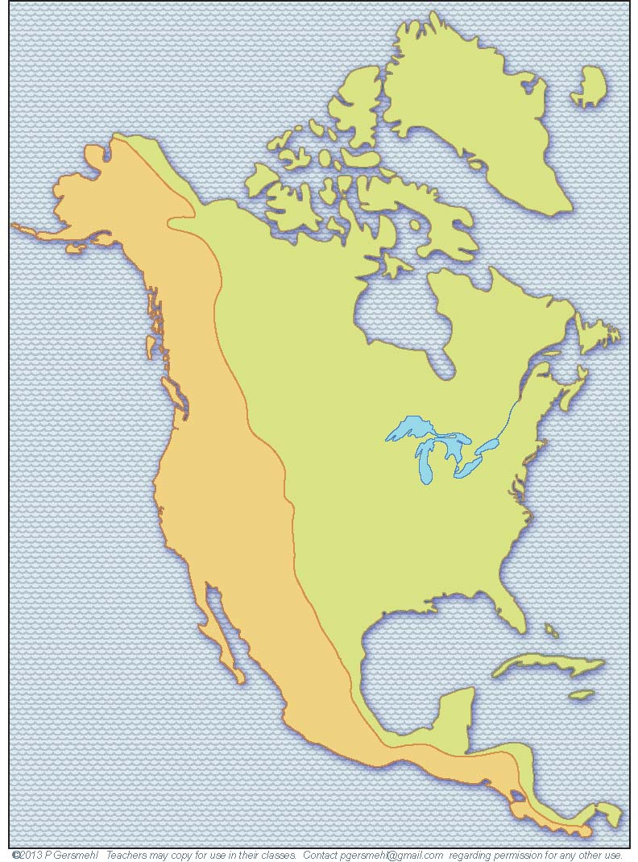
This line is a
generalization.
It traces
the general position
of a basic division.

Slide 9
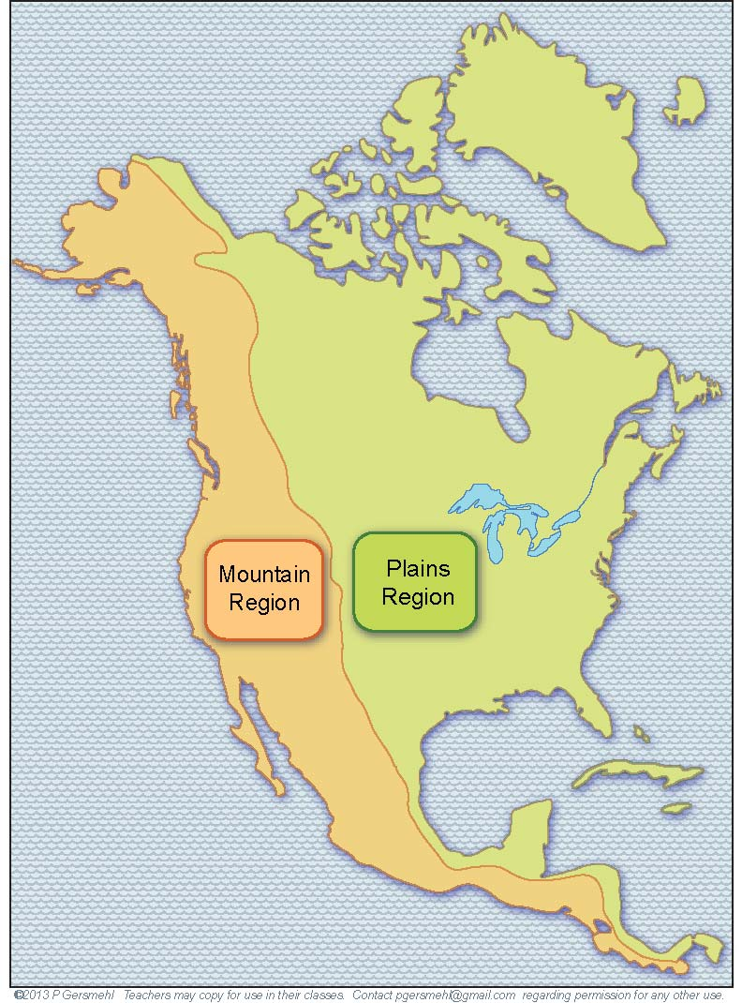
This line separates the continent
into two broad regions:
1. a Western Mountain Region
of younger rocks, higher land,
and steeper slopes, and
2. an Eastern Lowland Region
of older rocks, low hills,
and large, nearly flat plains.

Slide 10
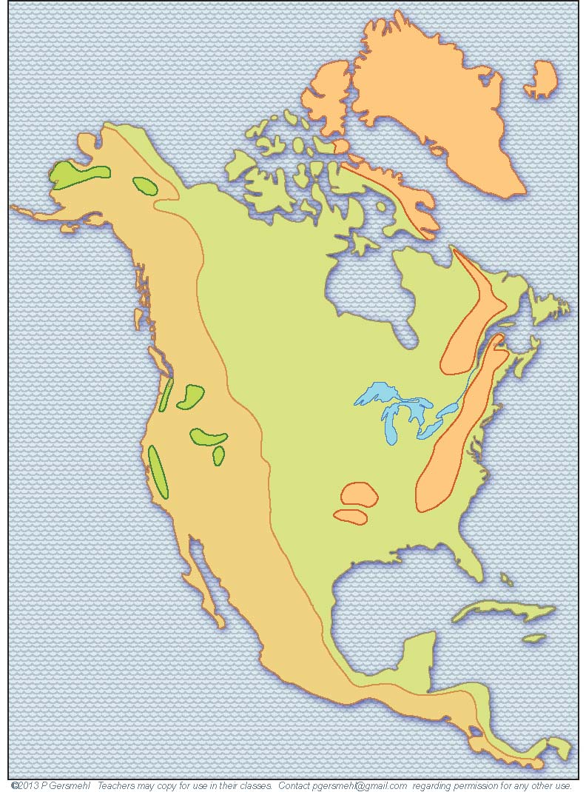
In the real world,
regional generalizations
usually have exceptions.

Slide 11
Here are three
important exceptions
in the West.
Willamette Valley
(end of the Oregon Trail)
Snake River Plain
(potatoes for French fries)
Central Valley of California (most diverse and productive
food-growing area in the country)

Slide 12
Important exceptions
in the East:
The cold highlands
of Greenland
(and nearby islands)
The Appalachian “Mountains”
(western edge of the 13 colonies)
and many scattered
areas of low hills
(left by the glaciers that
covered half the continent).
The Ozark “Mountains”
in Missouri and Arkansas

Slide 13
You do not (NOT)
need to remember
the exact position
of these exceptions.
You can always
find that information
on a detailed map.

Slide 14
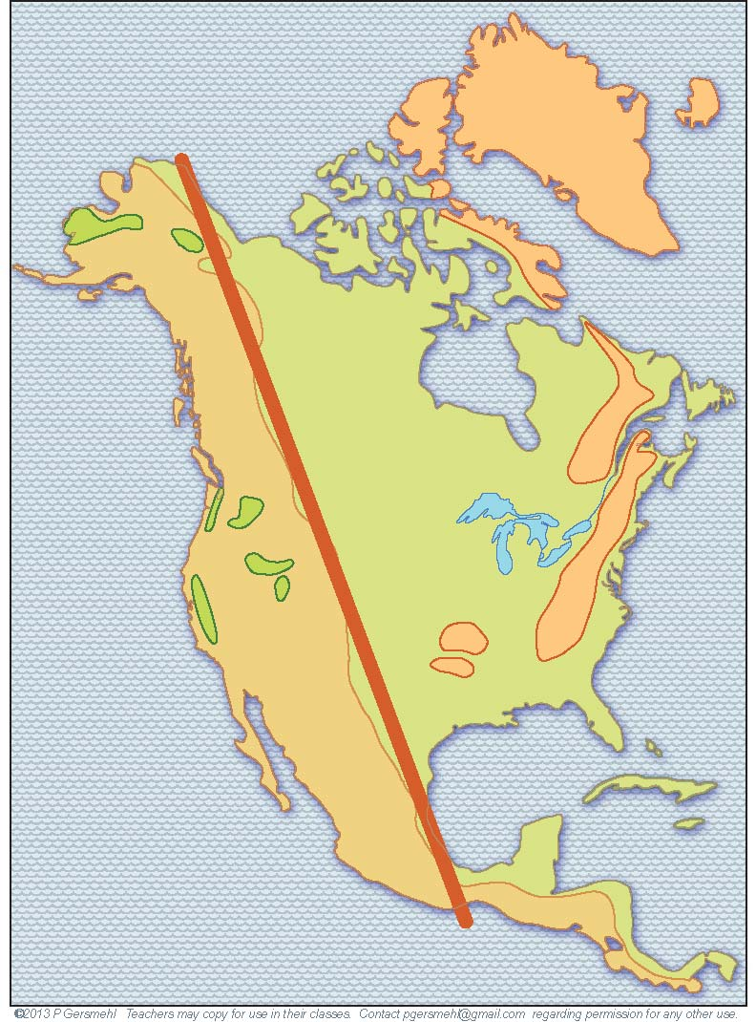
You should, however,
remember the line that
divides the continent
into these two regions:
1 - mountain West
and
2 - lowland East
(with a few exceptions
in each region!)

Slide 15
And you should
be able to draw
a dividing line
in your mind
when you see
a blank map
on the Internet,
in a newspaper,
or on TV.

Slide 16
The second line
runs east-west
through the northern
edge of the Great Lakes.

Slide 17
The second line
runs east-west
through the northern
edge of the Great Lakes.
Very few farms
Many
farms
North of this line,
it can freeze in June,
and the growing season
is therefore too short
for most food crops.
This line stops when it reaches
the mountains, where high peaks
are usually cold
while low valleys
can be warm.

Slide 18
This actual line is
also a little more
complicated.
It goes a bit north
along the east coast
and in the dry land
near the mountains,
and it “sags” south
over the Great Lakes
and the Adirondacks.

Slide 19
You could remember a simple east-west line
or a “sagging hammock”
through the Great Lakes.
Just remember
that any line is just
a generalization.

Slide 20
Our third
important line
runs due north
from the southern
tip of Texas.

Slide 21
This line divides
the rainy East
from the semi-arid
Great Plains.
Definition: a semi-arid place is
not very rainy, but not completely dry;
“semi-arid” means “half-dry”
Here again, the western region
is complicated.
Most valleys
are very dry
while peaks
are covered
with forests
(and even snow).
Technically,
this line separates
places that have
more precipitation
than trees need
from places
that have less.

Slide 22
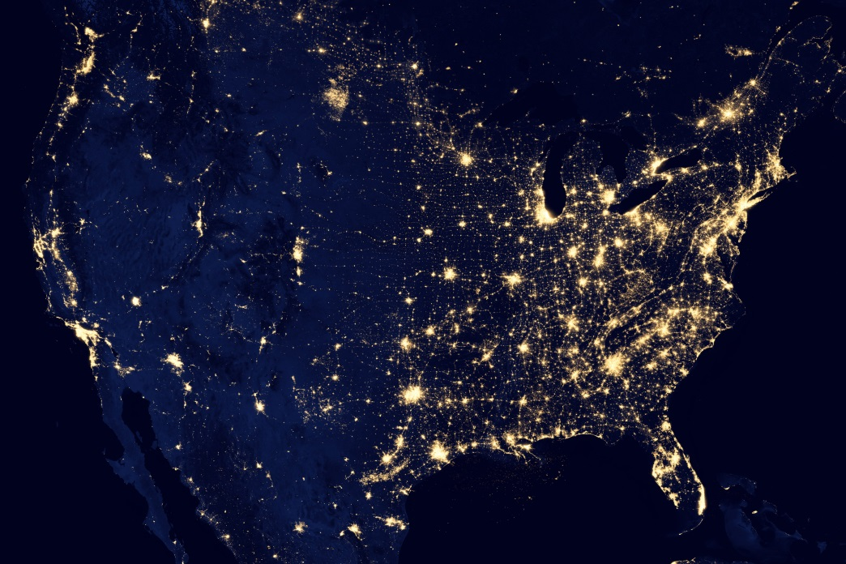
Note how the last
two lines that we drew
seem to outline the area where many people live
in North America
(and have lights in
their houses and cities).
The rest of the continent
is darker, except for
a few urban areas.
Vancouver,
Canada
Seattle
Denver
These two
places are
oil fields.
These two
light places
are oil fields.
San Francisco
Los Angeles
Phoenix
and Tucson
Night-time image
from NASA satellite

Slide 23
Our last
important line
runs east-west
through the middle
of the farming region.

Slide 24
This line marks where
the frost-free season
is 7 months long.
North of this line,
people pay more
for heating than
for air-conditioning.
South of the line,
air-conditioning
is more important
than heating.

Slide 25
This line is also
very important
in U.S. history.
South of this line
the growing season
is long enough
for cotton.
This crop is valuable,
but growing cotton
takes a lot of labor
(much more than corn or wheat).
Many landowners
bought slaves.
Many landowners
used slaves.

Slide 26
Slavery, the Civil War,
Reconstruction, and
the boll weevil invasion
had long-lasting effects.
As a result,
this line still marks
important differences
in immigration history,
the Great Migration,
military investment,
economic growth,
political voting,
and even religion.

Slide 27
That’s it – four lines
that we drew to divide
North America
into six regions:

Slide 28
That’s it – four lines
that we drew to divide
North America
into six regions:
1. western mountain region
1

Slide 29
That’s it – four lines
that we drew to divide
North America
into six regions:
2
1. western mountain region
2. northern cold region
1

Slide 30
That’s it – four lines
that we drew to divide
North America
into six regions:
2
1. western mountain region
2. northern cold region
3
3. Great Plains grass region
1

Slide 31
That’s it – four lines
that we drew to divide
North America
into six regions:
2
1. western mountain region
2. northern cold region
3
3. Great Plains grass region
1
4. southern cotton/pine region
4

Slide 32
That’s it – four lines
that we drew to divide
North America
into six regions:
2
1. western mountain region
2. northern cold region
3
3. Great Plains grass region
5
1
4. southern cotton/pine region
5. farm and factory region
4
5. Great Lakes farm region

Slide 33
That’s it – four lines
that we drew to divide
North America
into six regions:
2
1. western mountain region
2. northern cold region
3
3. Great Plains grass region
5
1
4. southern cotton/pine region
5. farm and factory region
4
5. Great Lakes farm region
6. Central American
and Caribbean
hot and hilly region
6

Slide 34
2
Can you remember
what each region
is like?
3
5
1
4
6

Slide 35
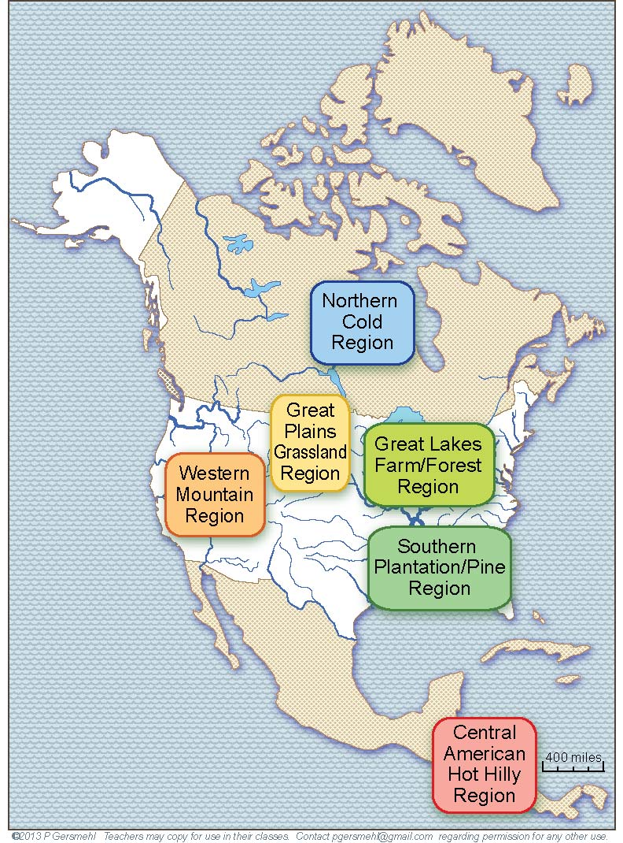
Here is another way
to show the regions.
Can you remember
where to draw
the general lines?

Slide 36
Here is another way
to show the regions.
Can you remember
where to draw
the general lines?

Slide 37
And that is how
you can use
a few lines
to organize
a lot of information.

Slide 38
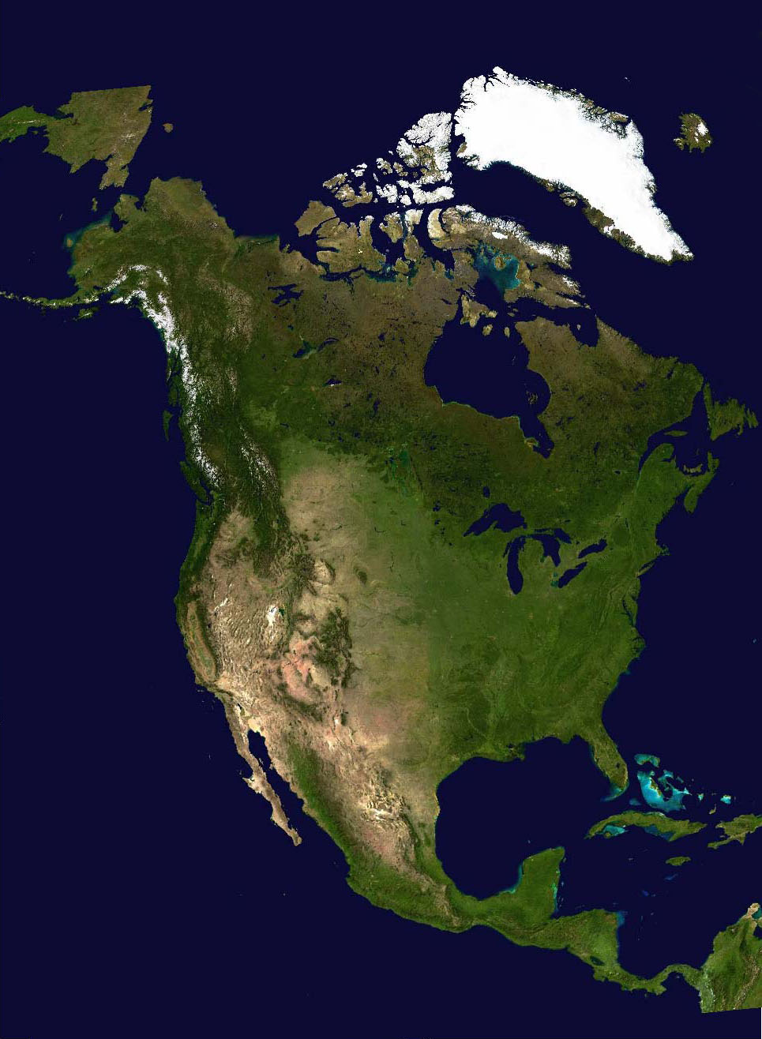
Here, we draw
the same four lines
on a satellite image.

Slide 39
Remember, a geographic region
is not a “real thing” out there.
It is what we get when we draw lines
to put similar places together into groups
(in order to make them easier to remember).
If we use different ways of deciding
what places are similar to each other,
then we get different regions.
As a result, we can make maps
of many different kinds of regions:
rock regions, forest regions, hunting regions,
crop regions, industrial regions, language regions,
sports regions, political regions, tourist regions,
food regions, voting regions, even religious regions.

Slide 40
Here is an example:
some people want
the map to show
a hot, dry region called
the Arid Southwest.

Slide 41
If you think
that makes things
easier to remember,
fine, . . . but
On the other hand
you might think it is
easier and more accurate
to remember that deserts
fill most of the low lands
between the mountains
from Mexico to Canada,
and high mountains have
enough rain for trees
even in dry Arizona.

Slide 42
You can choose!
In our maps,
we will use
these six regions
when we compare
other continents
to North America.

Slide 43
Here are
some photos
and key facts
about each region.

Slide 44
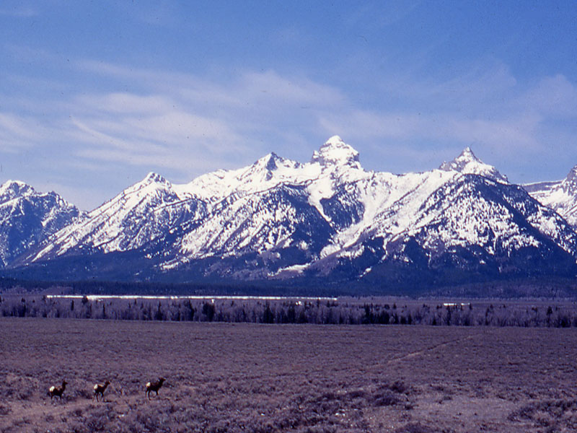
Western Mountain Region
younger rocks, earthquakes, high mountains,
dry lowlands, rainy slopes with forests,
snow on the highest peaks, ski resorts,
metal mines, scattered cities, national parks

Slide 45
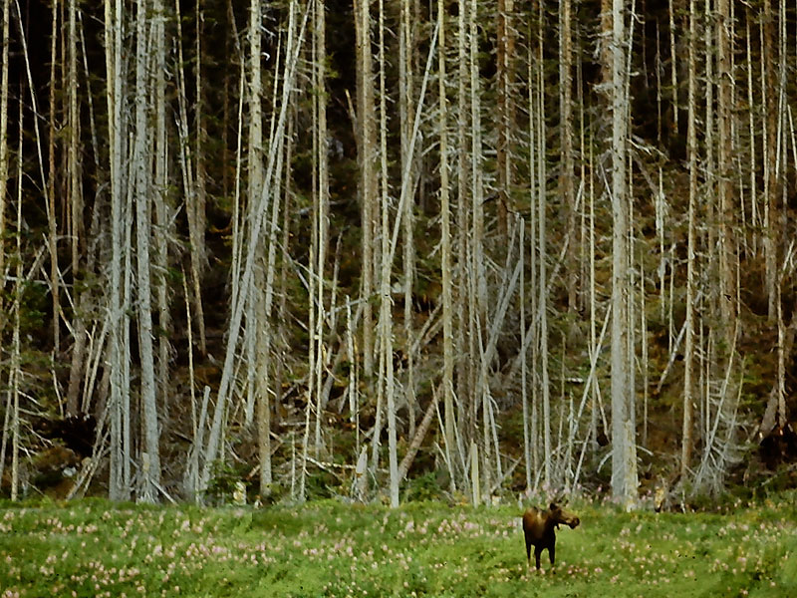
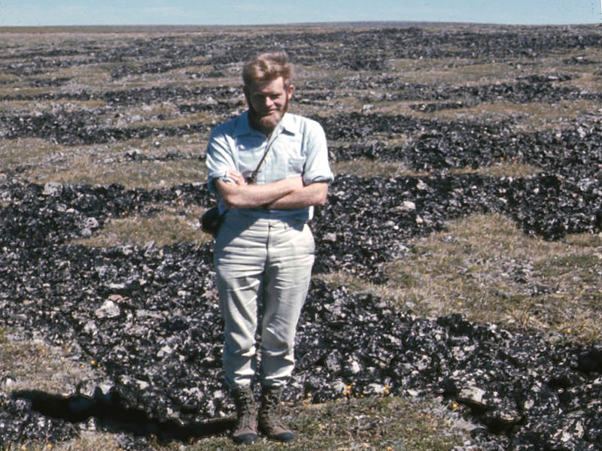
Northern Cold region
older rocks, low hills or plains, many lakes,
dense forests of slow-growing needleleaf trees OR
treeless tundra in places with really short summers,
very few people, few roads, some mines, oil wells

Slide 46
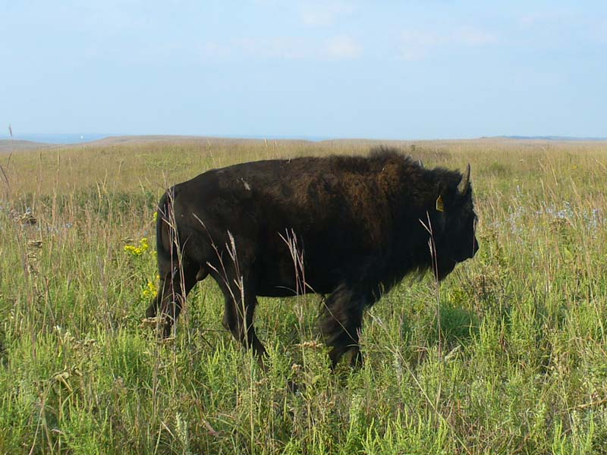
Great Plains Grassland Region
young rocks, flat plains or low hills, dry creeks,
occasional tornadoes, grassland, bison (buffalo), cattle ranches, wheat fields, a few irrigated areas, scattered towns, oil wells

Slide 47
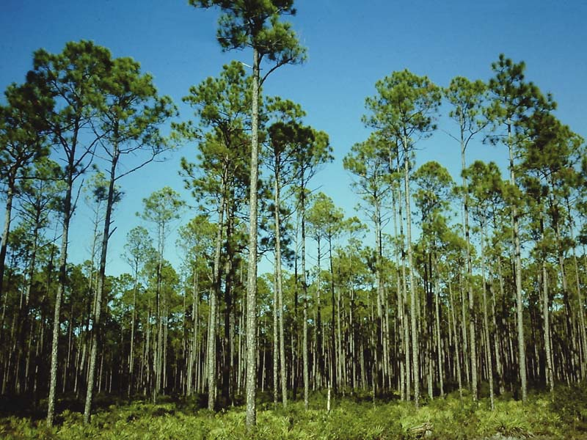
Southern Plantation / Pine Region
long summers, mild winters, fast-growing forest,
red soil, cotton plantations, slavery, Civil War,
sharecroppers, boll weevil, planted pines,
paper mills, some new factories (e.g., cars)

Slide 48
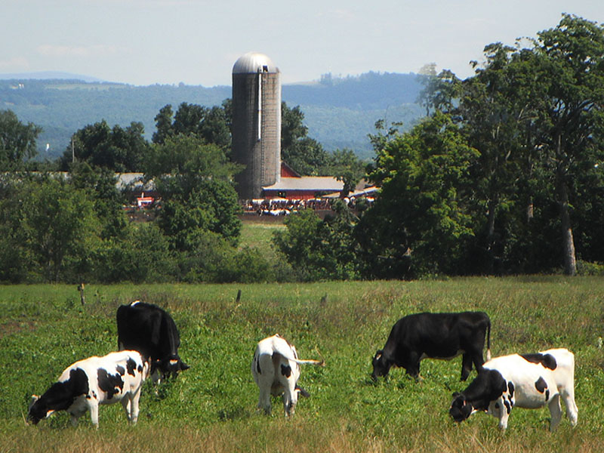
Great Lakes Forest/Farm/Factory Region
warm summers, cold winters, plains or low hills,
hardwood forest, corn fields, dairy cows,
cities on rivers or next to Great Lakes,
many small towns with factories

Slide 49
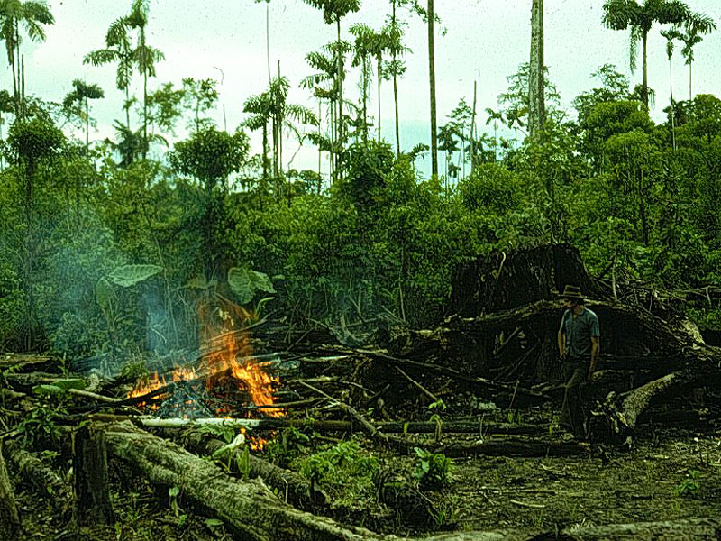
Caribbean/Central American Region
no freezing season, forested hills, beach resorts,
coffee plantations, many small countries
(it’s much harder to think of just one picture,
this one shows slash-and-burn farming in the forest)

Slide 50

Here are the daytime and
night-time satellite images again.
Can you “see” the regions
in your mind?
Click and we’ll draw them again.

Slide 51
Here are the daytime and
night-time satellite images again.
Can you “see” the regions
in your mind?
Click and we’ll draw them again.
Remember,
this is a big
oil field!

Slide 53
An optional section
about map comparison

Slide 54
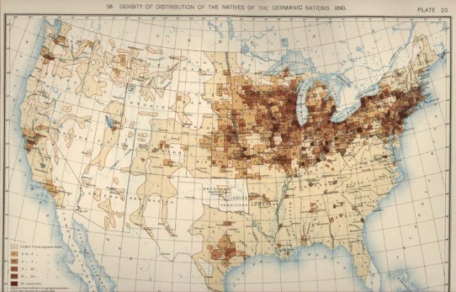
We said these lines were associated
with many other things in U.S. history.
Here is a map of German immigrants in 1898.
Click to draw some of the regional lines:

Slide 55
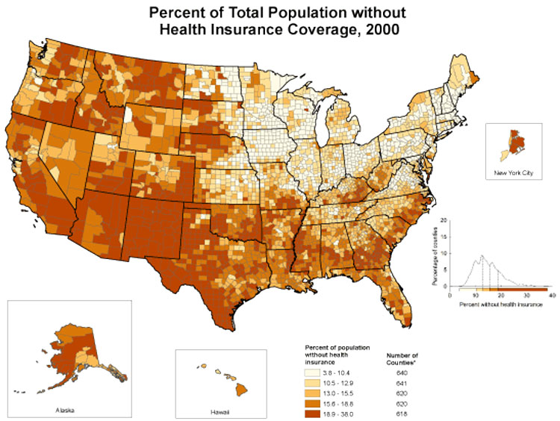
Here is a map of people
who did not have health insurance in 2000.
Click to draw some of the regional lines:

Slide 56
And here is a map of what people call a fizzy soft drink:
http://www.mediabistro.com/alltwitter/soda-pop-coke-twitter-map_b25188
(We can’t show these maps, because of copyright rules.)
While you are on the internet, look at religion:
http://www.glenmary.org/rcms2010
or high school graduation:
http://www.raconline.org/racmaps/mapfiles/education.png
or life expectancy:
http://www.dailymail.co.uk/news/article-2003691/Obesity-smoking-blame-life-expectancy-falls-poorest-US-counties.html
or any of a thousand other regional maps . . . .

Slide 57
When you are comparing regional maps like these,
it is important to note differences as well as similarities.
Remember:
We make regional maps when we put similar places together.
(And we decide what is a similar place!)
Even so, many other things are associated with:
- high and rugged mountains
- places that are too cold for farms
- places that are warm enough but too dry for trees, and
- places with enough rain and a growing season that is long enough for cotton
(and therefore probably had slavery, was part of the Confederacy,
went through Reconstruction, and so forth)
In other words, these four lines help us organize a lot of information.
This is why we recommend memorizing where these lines go.

