Slide 1
Analogous Places
in
South America
and the
United States
Skip to
question
section.

Slide 2
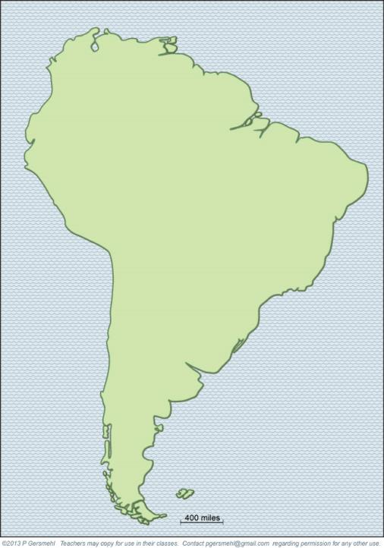
Here is
a simple
basemap
of South
America.

Slide 3
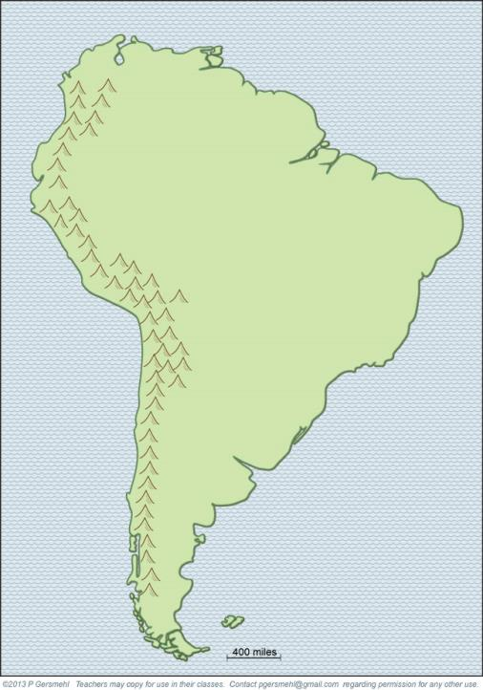
Here is
a simple
basemap
of South
America.
The high
Andes
Mountains
form a wall
near the
west coast.

Slide 4
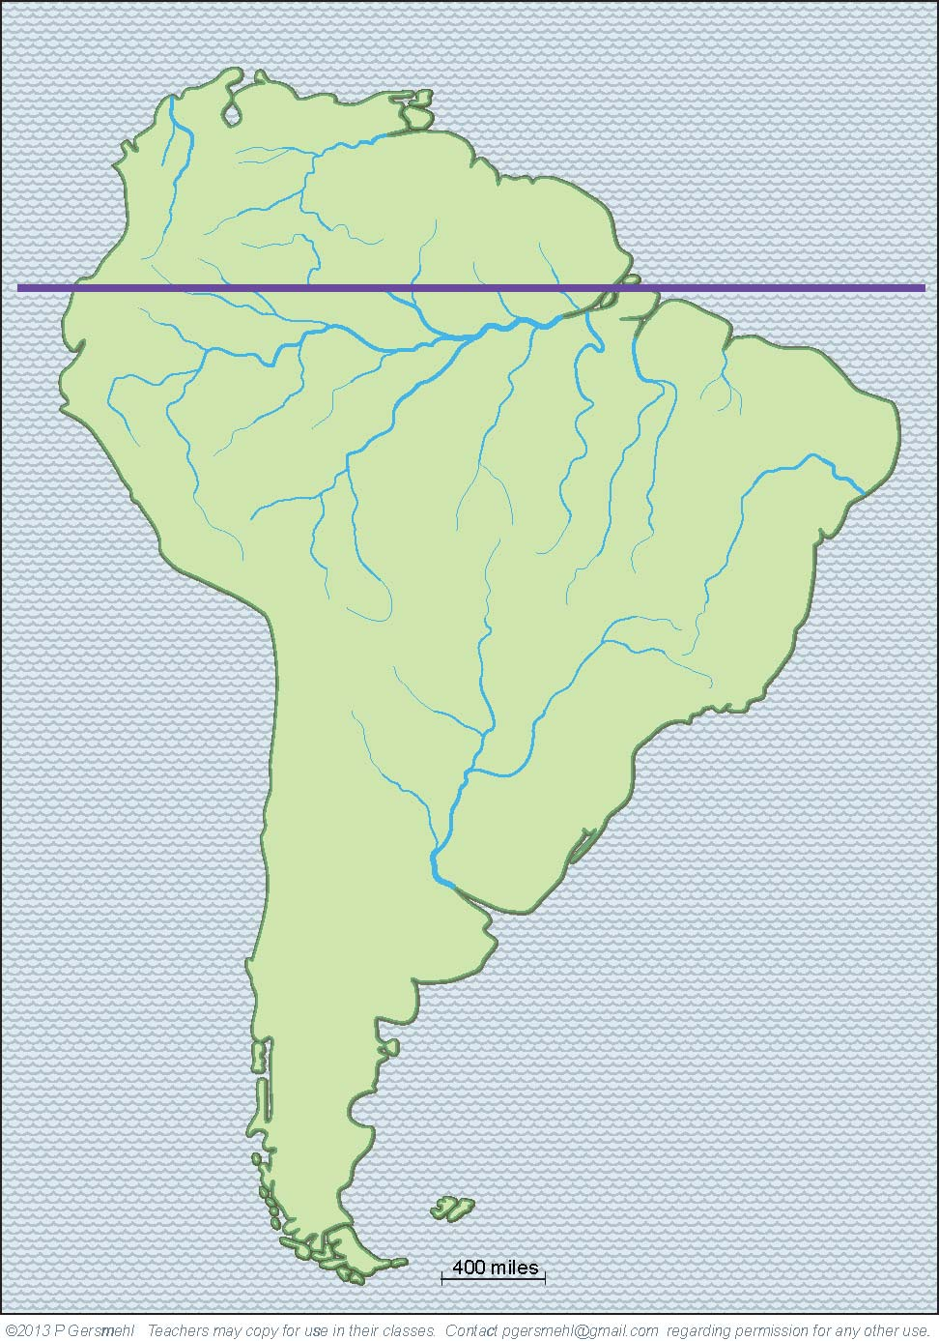
Here is
a simple
basemap
of South
America.
The
equator
crosses
the mouth
of the
Amazon
River
That fact is pure luck.
It’s a happy accident, however,
because it makes it very easy
for us to remember the location
of the biggest river on the planet
(and also to find the equator
if a map does not show it).

Slide 5
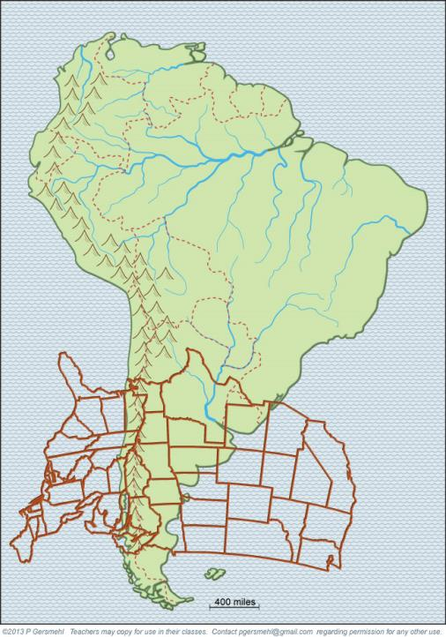
To help us make
comparisons,
here is the
United States
at the same size
and proper
latitude.
It’s “upside-down”
because this part
of South America
is south of
the Equator.

Slide 6
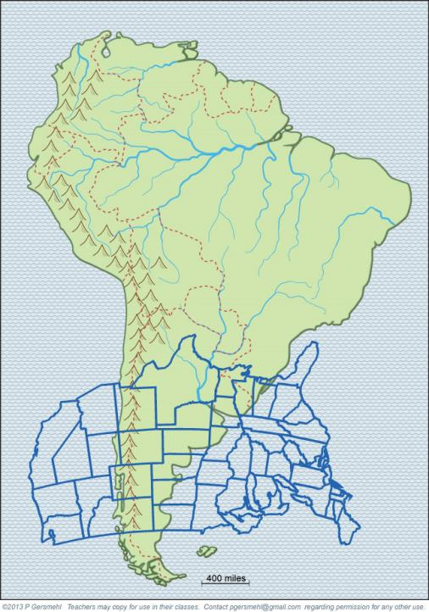
If we flip it
east-west,
we can see
how the
climates
line up
in the two
regions.

Slide 7
Coastal
Brazil
is like
Florida
(think Rio!)

Slide 8
Paraguay
is like
coastal
Texas –
with hot and humid
summers
and warm
winters.

Slide 9
Uruguay
is like
Mississippi
and Arkansas

Slide 10
Argentina’s
“heartland”
is like
Kansas
corn in the rainier east,
wheat in the drier west

Slide 11
Patagonia
is like eastern
Montana –
cool and dry.

Slide 12
Patagonia
is like
eastern
Montana –
cool and dry.
The central
coastal area
of Chile
is like
California.

Slide 13
Finally,
Cape Horn
is like
the coast
of Alaska.

Slide 14
But
no place
in the 50
states
is like the
rainforest
near the
equator.

Slide 16
QUESTIONS section
Notes:
Discussion section

Slide 17
What range
of high
mountains
runs near
the west
coast?

Slide 18
What
big river
enters
the ocean
near the
Equator?

Slide 19
Why does it help comparison,
to put the
United States
here rather than
in the middle?
Why is the
United States
“upside down”
for this comparison?

Slide 20
Why did
we “flip” it backwards
to make the
comparison
better?

Slide 21
What area
is like
Florida
-
and why?

Slide 22
What country
is like
south
Texas –
and why?

Slide 23
What small country
is like
Mississippi
and Arkansas?

Slide 24
What
country
is like
Kansas?
corn in the rainier east,
wheat in the drier west

Slide 25
What area
is like eastern
Montana –
cool and dry?

Slide 26
Patagonia
is like
eastern
Montana –
cool and dry.
The central
coastal area
of Chile
is like
California.
Why is that
important?

Slide 27
What state
is most like
Cape Horn?
Why?

Slide 28
Why does
the U.S.
have no
place that
is like the
equatorial
rainforest?

