Slide 1
LATITUDE
A geographic “big idea” with many consequences in
AfricA
Latitude is a big idea that helps us understand
many other geographic features in Africa,
including patterns of rainfall, natural vegetation,
animals, fires, floods, crops, early civilizations, trade,
languages, slavery, and diseases like malaria.

Slide 2
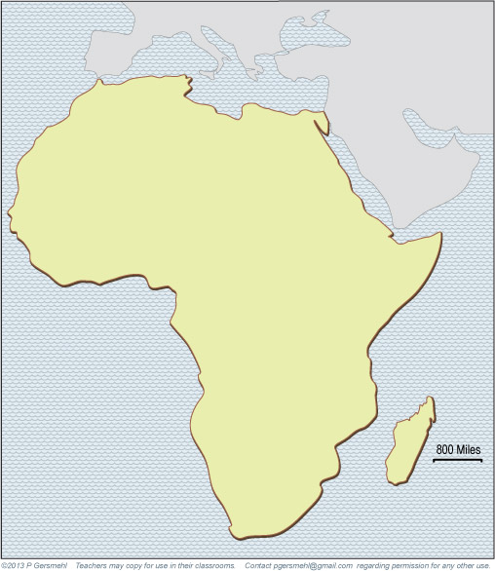
Africa is the
second largest continent
(three times as big as the U.S.)

Slide 3
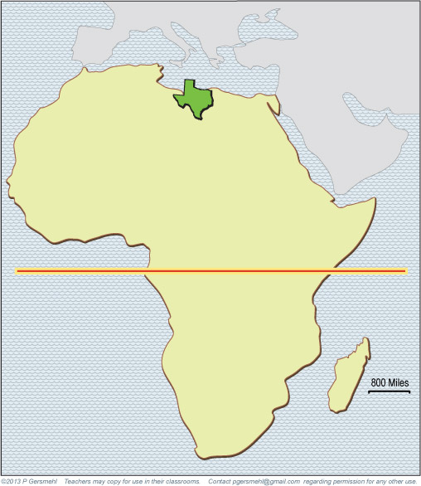
Here is Texas, at the correct size and latitude.
Most of Africa is
closer to the equator
than any part of
the United States.
Equator

Slide 4
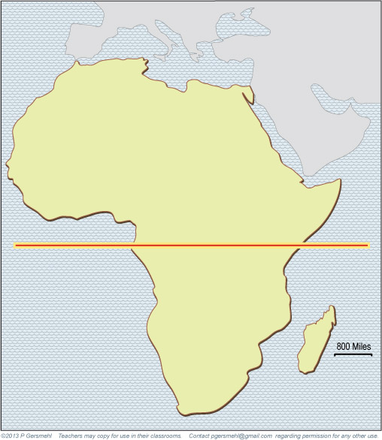
This means that Africa
is a good place to study
the effects of latitude,
because any process
that depends on latitude
will occur twice in Africa,
once north and once south
of the equator.
North
Equator
The equator runs through
the middle of Africa.
The equator runs through
the middle of Africa.
The continent extends
almost the same distance
north and south
of the equator.
South

Slide 5

For example,
there is a belt of rainy weather
that forms where the sun is
almost straight up in the sky.
This Equatorial Rainy Belt
is always close to the equator,
but it moves a few degrees of latitude
north and south in different seasons.
Click to see how.

Slide 6
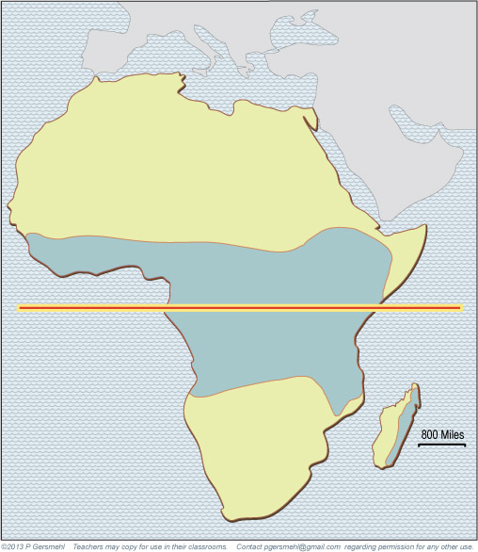
In March,
the Rainy Belt is
near the equator.
The blue area gets more
than 4 inches per month.

Slide 7
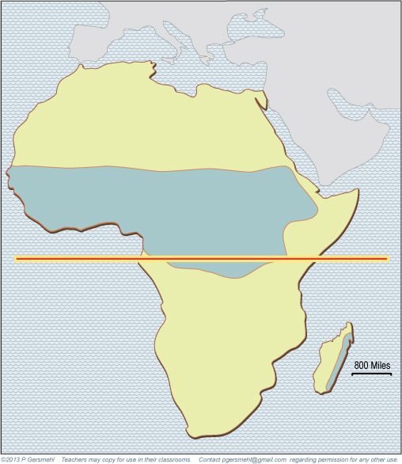
In June,
the Rainy Belt is
north of the equator.
The blue area gets more
than 4 inches per month.

Slide 8
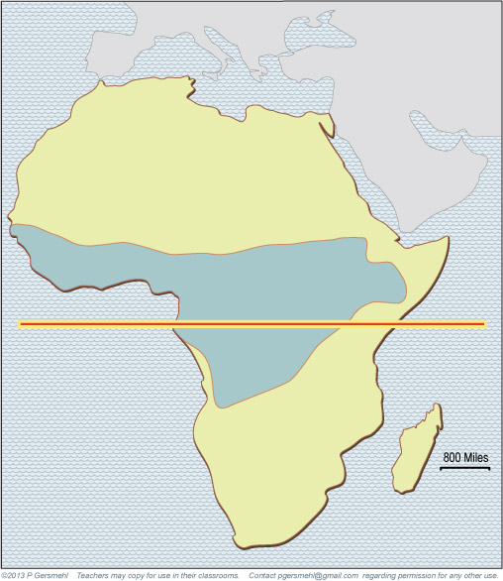
In September,
the Rainy Belt is
back near the equator.
The blue area gets more
than 4 inches per month.

Slide 9
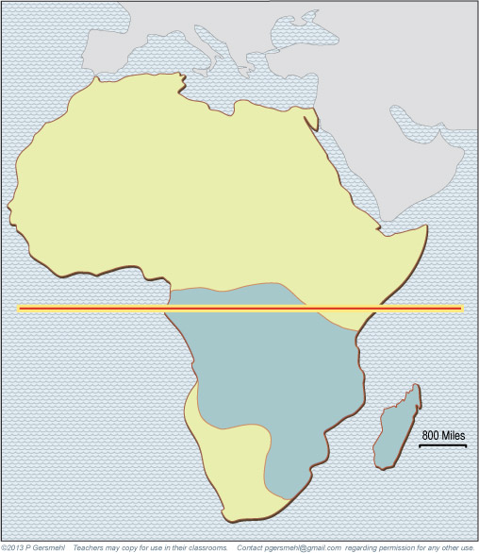
In December,
the Rainy Belt is
south of the equator.
The blue area gets more
than 4 inches per month.

Slide 10
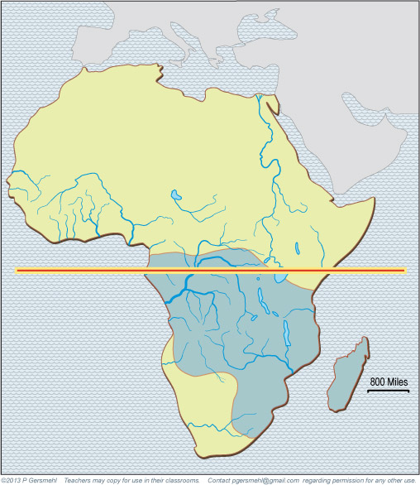
The Zambezi River
tends to make floods
when the Rainy Belt
is south of the equator.

Slide 11
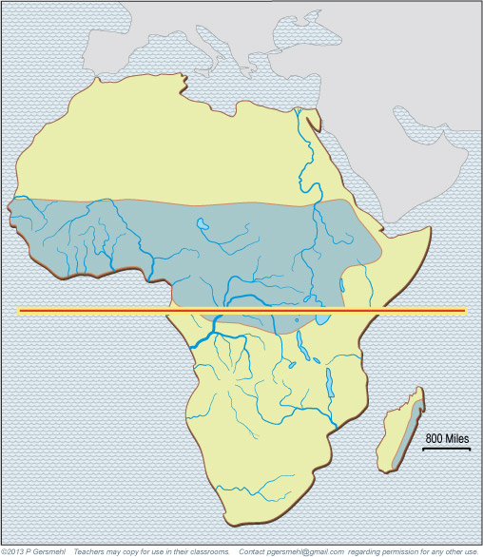
When the Rainy Belt moves north,
the famous Nile River of Egypt
and the rivers of West Africa
(like the Niger) are likely to flood.
In summer,
the famous Nile River of Egypt
and the Niger of West Africa
are likely to flood.
In your history books,
you probably read that
floods were important
for the development
of ancient civilizations.

Slide 12
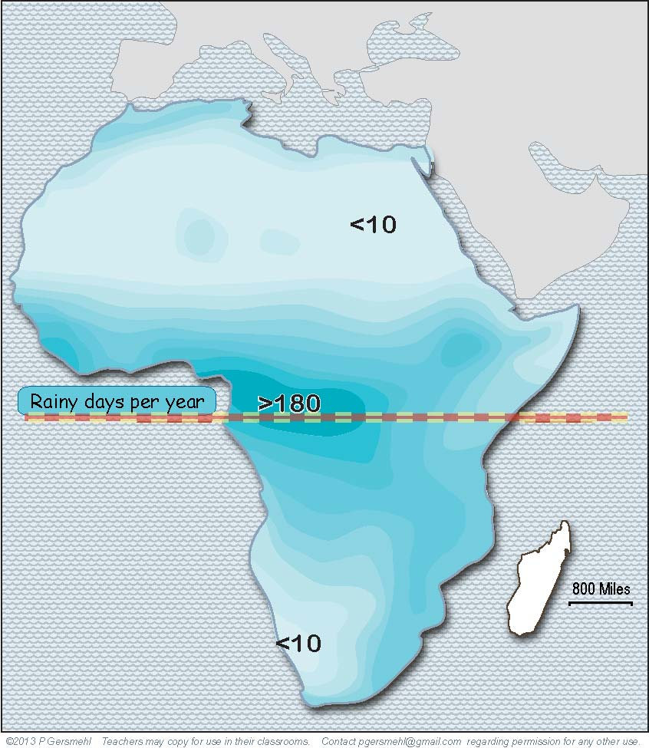
At low latitudes
(near the
equator),
it is hot
and rainy
in every
month.
The important thing
to remember is that
the number of
rainy days per year
depends on latitude.

Slide 13
Near the
Tropic of
Cancer
and the
Tropic of
Capricorn,
it hardly
ever rains.
Near the
Tropic of
Cancer
and the
Tropic of
Capricorn,
it hardly
ever rains.
The important thing
to remember is that
the number of
rainy days per year
depends on latitude.

Slide 14
Near the
Tropic of
Cancer
and the
Tropic of
Capricorn,
it hardly
ever rains.
And in
between,
the number
of rainy days
depends
mainly
on latitude.
The important thing
to remember is that
the number of
rainy days per year
depends on latitude.
Farther from
the equator
means
fewer days
of rain.

Slide 15
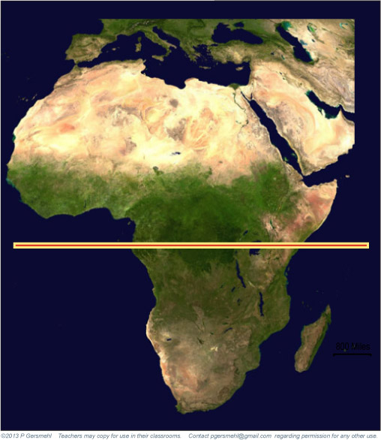
Desert
Grassland
Rainforest
A satellite image
clearly shows the effect
of the different numbers
of rainy days
at different latitudes.

Slide 16
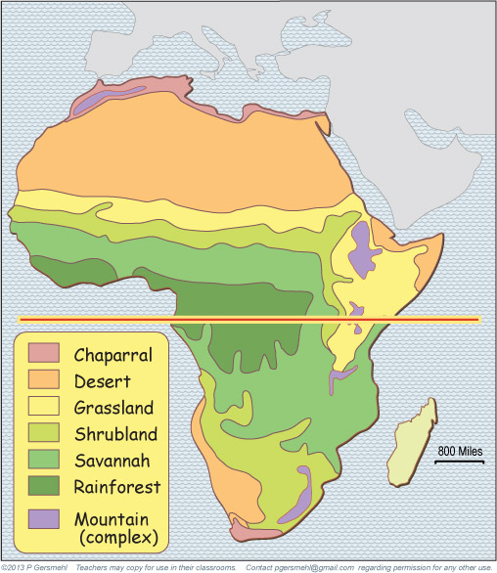
The latitude bands
are also very obvious
on a map of ecoregions.
The main thing
that “messes up”
the east-west
alignment of
natural regions
is the cooler
highland areas
of east Africa.
Desert
Grassland
Rainforest

Slide 17
The influence of latitude
is especially obvious
when we examine
the places where fires
are likely to occur
in different seasons.

Slide 18
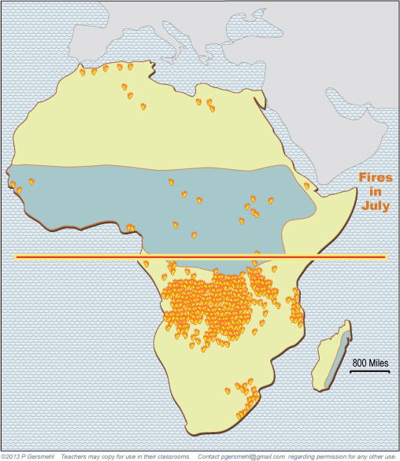
In July, when the
Equatorial Rainy Belt
is north of the equator,
there are a lot of fires
in the shrublands
south of the equator.

Slide 19
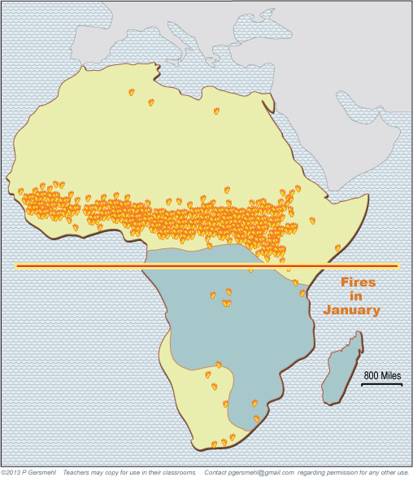
In January, when the
Equatorial Rainy Belt
is south of the equator,
fires are more common
north of the equator.

Slide 20
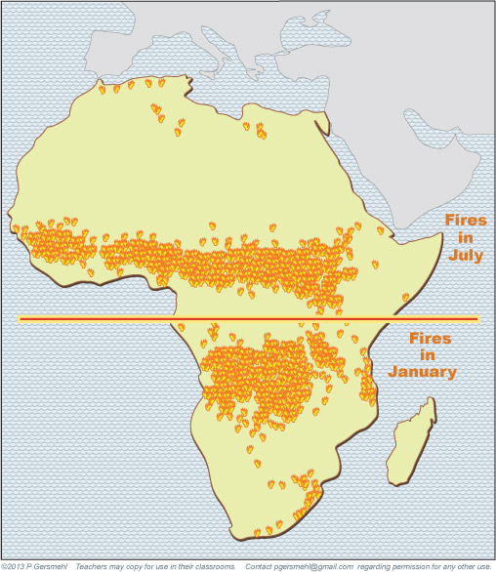
If we show both fire maps
at the same time, we see
two basic principles:
1. The desert areas
near the Tropic of Cancer
do not have enough plants
to provide fuel for a wildfire.
2. The rainforest areas
near the Equator
have so much rain,
the trees growing there are too wet to burn.

Slide 21
The influence of latitude
is also obvious
when we look at where
different kinds of animals
are likely to be found.

Slide 22
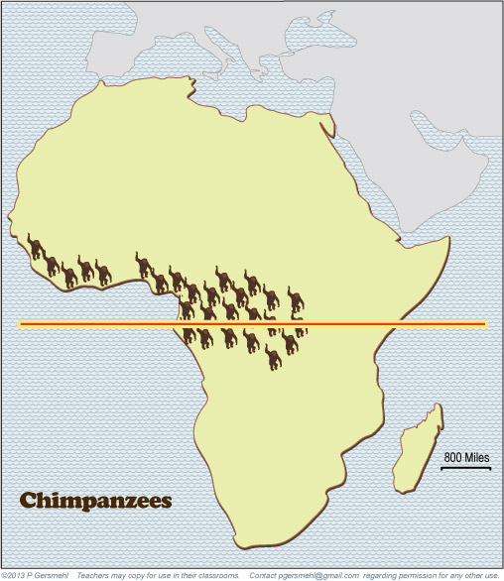
Chimpanzees, gorillas, and many kinds of birds
live in the tall trees
near the equator.

Slide 23
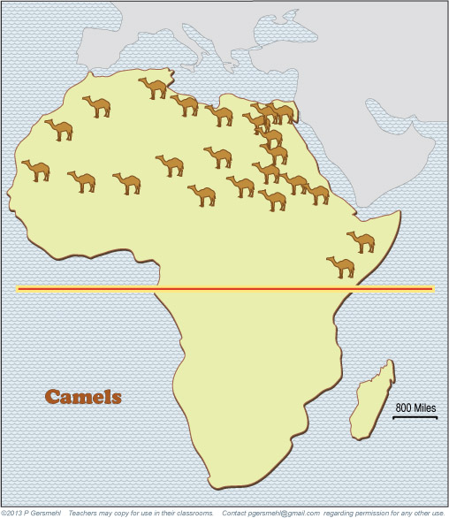
Camels are by far
the largest animals you
might see in the desert
near the Tropic of Cancer.

Slide 24
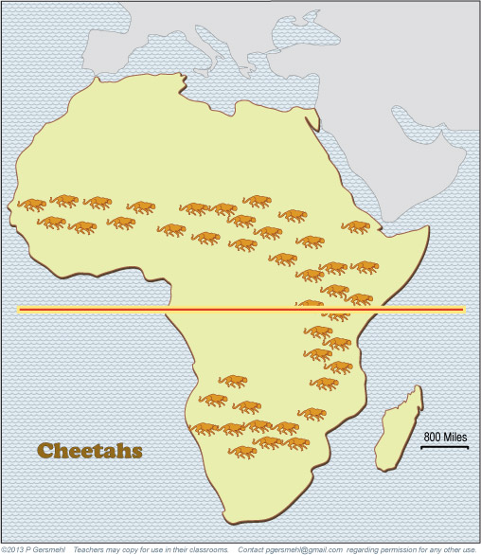
Grasslands and savannas
are the home of many
famous large animals,
including giraffes, zebras,
antelope, elephants,
lions, and cheetahs.

Slide 25
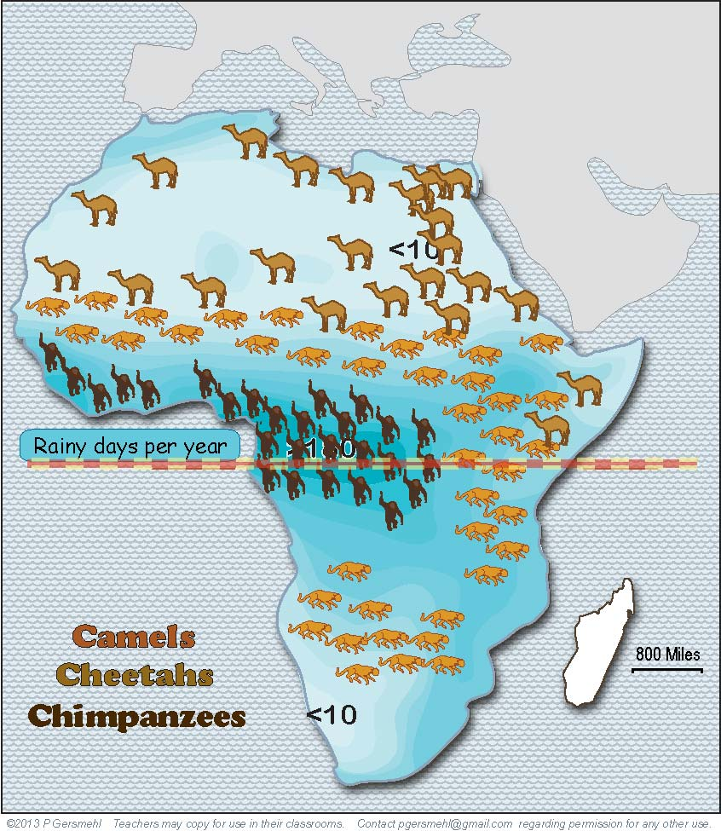
Put all the animals
on the map of rainy days,
and you can see how
different animals live
at specific latitudes.
The highlands
of east Africa
are cooler
and drier than
the lowland
rainforest.

Slide 26
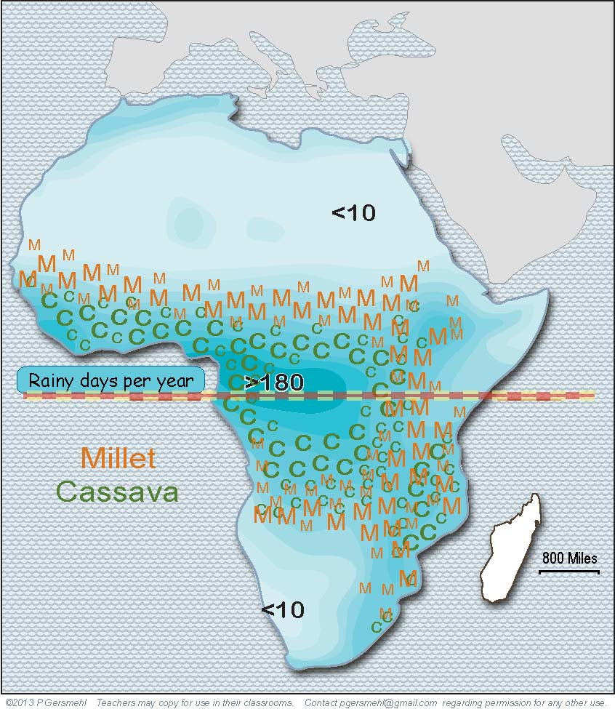
The main food crops
also tend to grow
at specific latitudes
(where each crop gets
the amount of rain it needs).

Slide 27
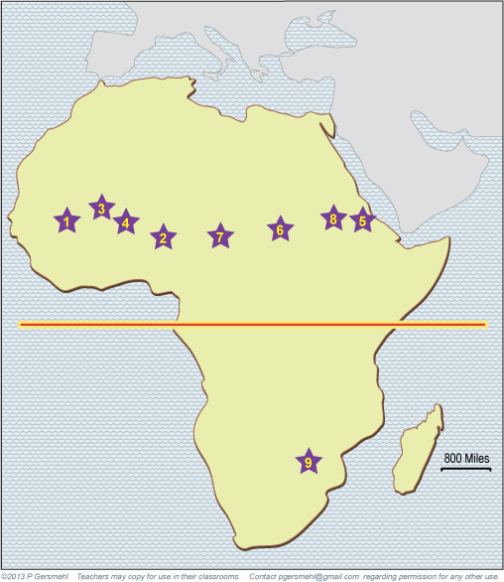
In the past, people
lived in the latitudes where they could hunt,
grow food, or raise cattle.
This line of stars
shows the capitals
of ancient empires.

Slide 28
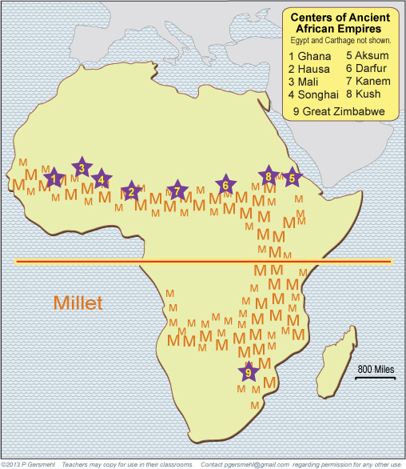
The ancient empires
all had their centers
in the grasslands
near fields of millet.

Slide 29
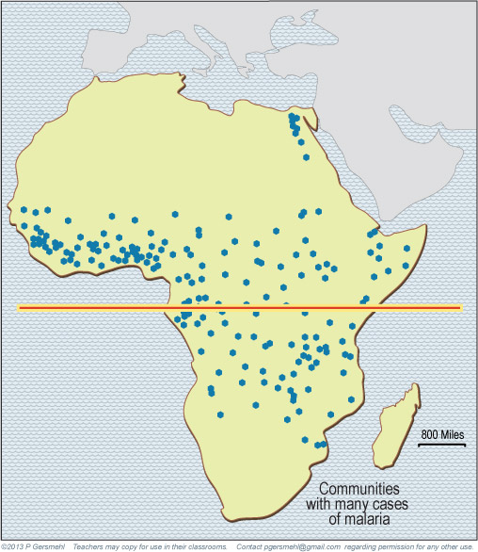
That is just dry enough
to avoid the diseases
(like malaria)
that are common
in rainier places.

Slide 30
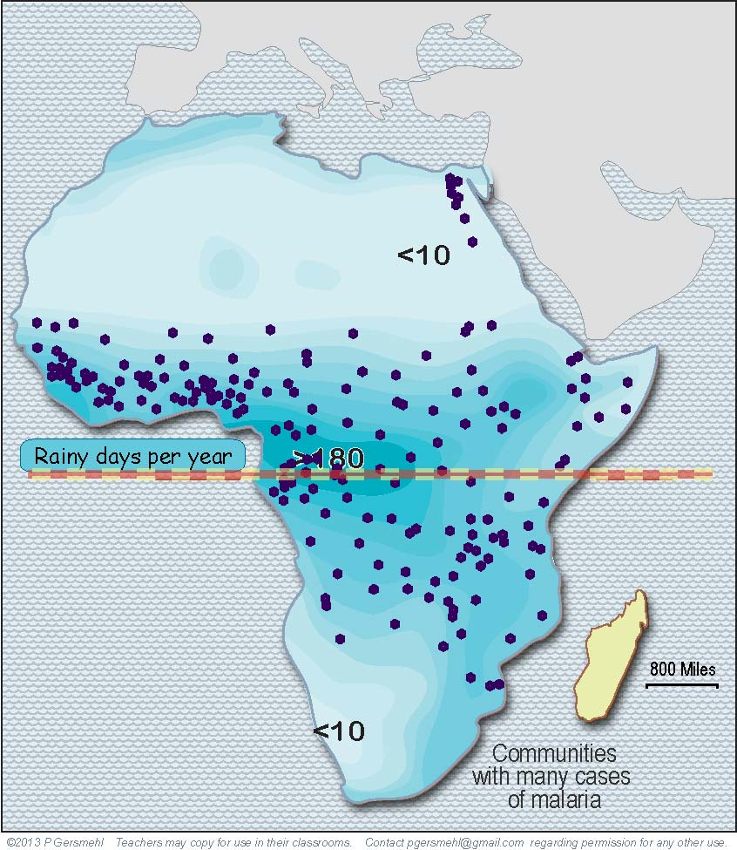
The floods of the Nile
made the soil better,
but they also allowed
malaria mosquitoes
to live in a desert.
Malaria is transmitted
by mosquitoes that live
in the latitudes that have
long rainy seasons.
(It makes sense, no?)

Slide 31
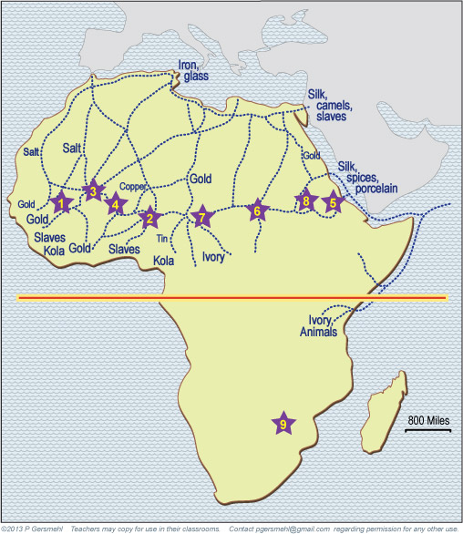
to India
1000 miles
The ancient cities
were the centers
of trading networks
that reached all the way
to India and China.

Slide 32
Not surprisingly,
they used camel caravans
to carry the trade goods.

Slide 33
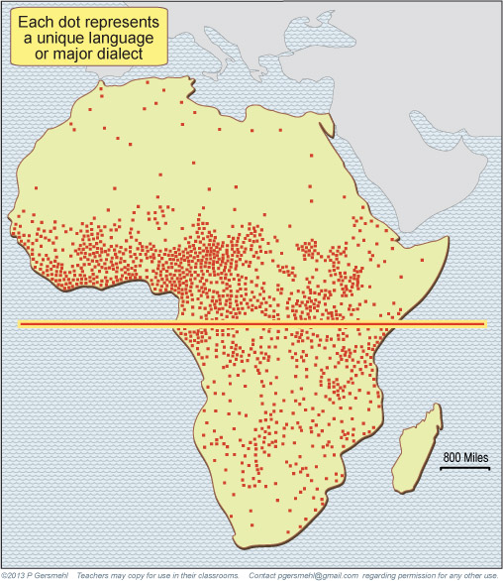
One very interesting
influence of latitude
is on human languages.

Slide 34
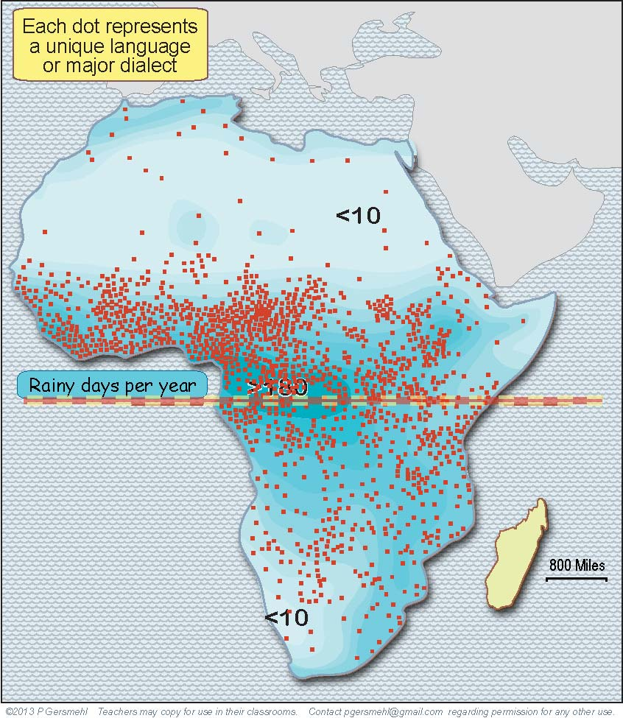
In rainy environments,
people could find almost
everything they needed
close to home.
When people don’t travel,
the languages of each
community is likely
to become different.

Slide 35
Dryland people were lucky
to have horses and camels,
because they had to travel,
often very long distances,
in order to find food
and to trade for things
they couldn’t get at home.
To do their trading,
they needed to have
at least one language
that they could use
over a large area.

Slide 36
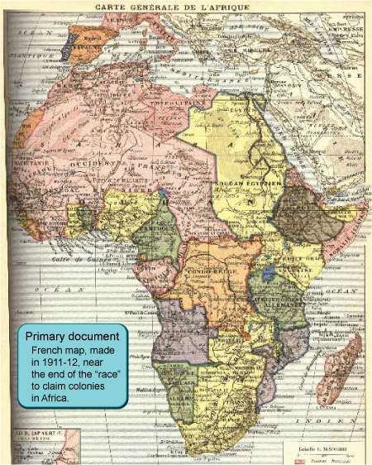
The language map
is especially important
when we “fast forward”
to look at the slave trade
and colonial claims.

Slide 37
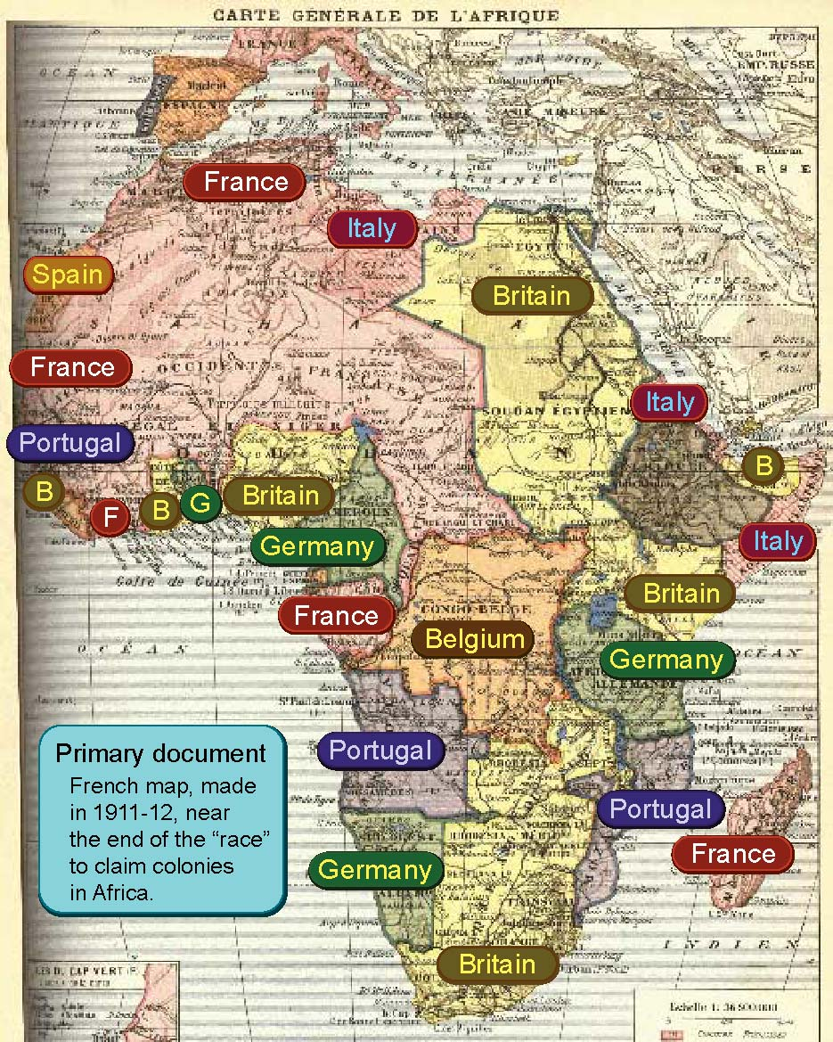
Seven different
European countries
claimed colonies
in different parts
of Africa.
It is plausible
that it was easier
to capture slaves
in areas where
people lived
in small groups and spoke
many different
languages.

Slide 38
When European countries
divided Africa into colonies,
they did not pay much attention
to the natural dividing lines
between environments
or language regions.
Why might that
be a problem?

Slide 39
The natural borders
between environments
and language regions
run mainly east-west
(following lines of latitude),
but the colonial borders
often go north-south,
especially in West Africa.
Think about what that means
for countries like Nigeria,
Ghana, Benin, or Mali.

Slide 40
This presentation showed one way to use
the clickable mini-Atlas - to help us investigate
some consequences of the big idea of latitude,
with examples from Africa.
Latitude affects:
Climate – because the number of rainy days goes down
as you go from the equator to the Tropic lines
Plants and animals – because different plants require
different amounts of rain, and different animals
eat different kinds of plants.
Floods and fires – which occur at specific latitudes
in different times of the year
Economy – because people grow different crops
and hunt/herd different animals at different latitudes
Disease – because diseases like malaria and yellow fever
occur in hot, rainy places close to the equator
Languages, empires, colonization, slave trading, and many other
aspects of African history also have latitudinal patterns.

Slide 42
Question version

Slide 43
What is one
consequence
of the fact that most
of the continent of Africa
is closer to the equator
than the state of Texas?
Equator

Slide 44
Why does this fact
make Africa
a good “laboratory”
to study the effects
of latitude?
North
Equator
The equator runs through
the middle of Africa.
The equator runs through
the middle of Africa.
The continent extends
almost the same distance
north and south
of the equator.
South

Slide 45
Click to watch
this animation,
then explain why
the process it shows
is important.

Slide 46
What happens near
the Zambezi River
in this season?

Slide 47
What happens
near the Nile
and Niger Rivers
in this season?
In summer,
the famous Nile River of Egypt
and the Niger of West Africa
are likely to flood.
Why were
these river events
important in history?

Slide 48
Describe
the climate
near the
equator.

Slide 49
Near the
Tropic of
Cancer
and the
Tropic of
Capricorn,
it hardly
ever rains.
Describe
the climate
near the
Tropic of
Cancer
and the
Tropic of
Capricorn

Slide 50
Near the
Tropic of
Cancer
and the
Tropic of
Capricorn,
it hardly
ever rains.
Describe the climate
between
the equator
and the
Tropic lines.

Slide 51
Interpret the colors
on this satellite image.
Focus especially on
the effect of latitude.

Slide 52
Why do
grasslands
grow near
the equator
in east Africa?

Slide 53
Why do fires
occur in these latitudes
at this time of year?

Slide 54
Why do fires
occur in these latitudes
at this time of year?

Slide 55
Here are two questions
about the geographic
pattern of fires in Africa:
1. Why are fires rare
in this area?
2. Why are fires rare
in this area?
(It’s a different reason!)

Slide 56
The influence of latitude
is also obvious
when we look at where
different kinds of animals
are likely to be found.

Slide 57
Why do chimpanzees,
gorillas, and many birds
live here?

Slide 58
What other animals
might be seen
in this area?

Slide 59
Why are large cats
like lions and cheetahs
common in this area?

Slide 60
Describe the
relationships
between rainfall
and animal life.

Slide 61
Describe the
relationships
between rainfall
and food crops.

Slide 62
What do these
numbered starts
represent?
Why do they occur
in this line pattern?

Slide 63
What is the main link
between ancient empires
and millet farming?

Slide 64
What is the main link
between the climate
and the disease
called malaria?

Slide 65
How can malaria
occur in this
dry region?

Slide 66
to India
1000 miles
Make a generalization
about the pattern
of trade in Africa.

Slide 67
What is the link
between ancient empires
and these animals?

Slide 68
How can the number
of human languages
be influenced by
the number of months
in the rainy season?

Slide 69
Finally,
how can languages
be an important part
of the colonial era?

Slide 70
Why did so many
European countries
claim colonies
in Africa?

Slide 71
What is the relationship
between colonial borders
and the natural borders
between ecoregions?
Why is this important
for foreign policy
in Africa today?

