Slide 1
AREA
A geographic “Big IDEA” with many consequences IN
Russia
Area (size) is a big idea that can help us understand
many other geographic features in Russia,
including mineral wealth, sparse population,
costly transportation, late development as a country,
ability to resist invasion, persistence of nomadic herders,
and difficulty in governing.

Slide 2
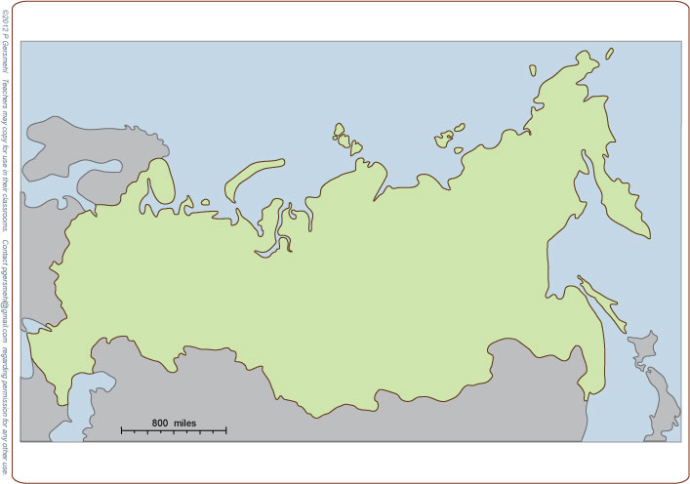
Russia is big
(much larger than
China and the U.S.
put together)

Slide 3
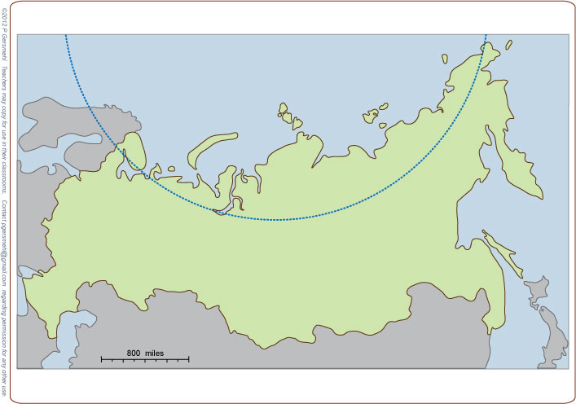
Russia is also
very far north
(nearly a quarter of it is
north of the Arctic Circle)
All of that area has
at least one day with
24 hours of darkness
in winter – it’s cold!

Slide 4
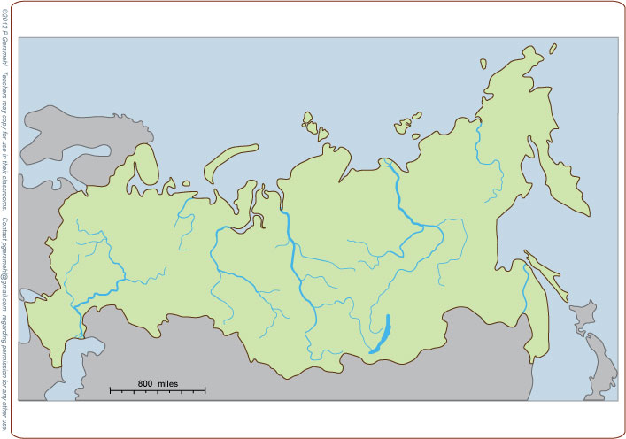
Five giant rivers
flow north to
the Arctic Ocean
Kolyma
Lena
Pechora
Yenisei
Ob
Very few people live near these rivers,
however, because
it is so cold there.
Each one carries more water
than the famous Nile in Egypt,
the Missouri in North America,
or the Rhine in Europe.

Slide 5
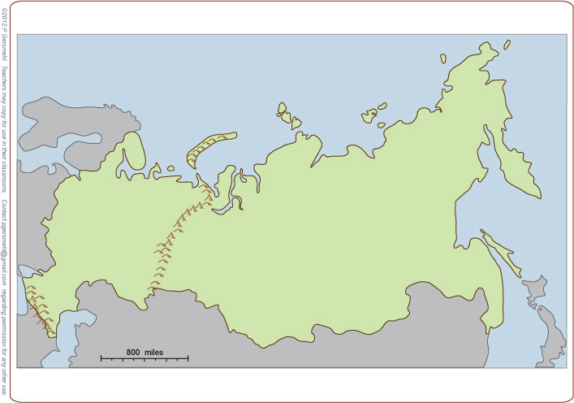
The Ural Mountains
form part of the border between
Europe and Asia.
These mountains are the worn-down
“stumps” of ancient
crustal collisions.

Slide 6
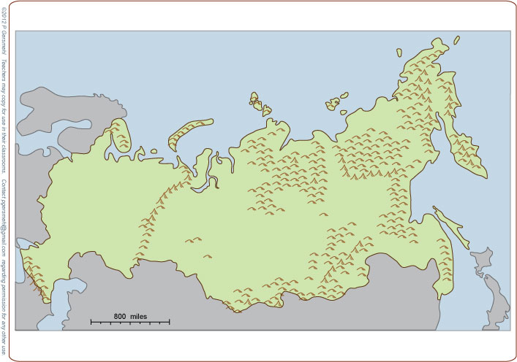
Farther east
are the remnants
of several even
older collisions.

Slide 7
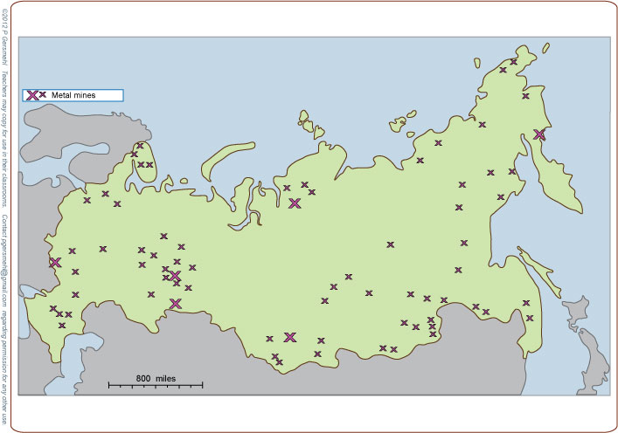
This long and complex geologic history gave
this enormous country
even more minerals
than you might expect
based only on its size.

Slide 8
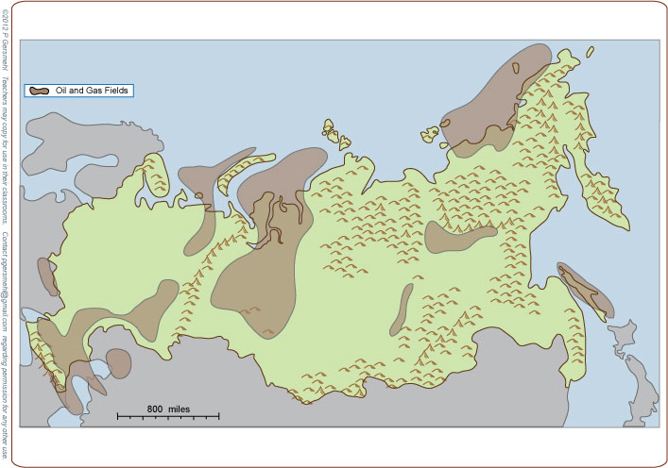
Between those
ancient mountains
are several huge
oil and gas fields.

Slide 9
That is what you expect:
big country, big resources,
BUT . . .

Slide 10
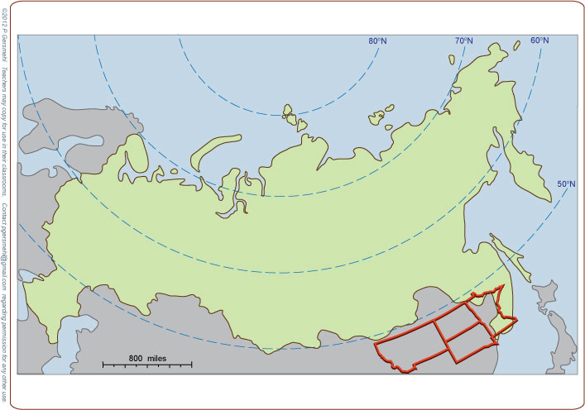
Nearly all of Russia is
farther from the equator
than Montana, the Dakotas,
or Minnesota.
As a result, most of Russia
is colder than the coldest states
outside of Alaska.

Slide 11
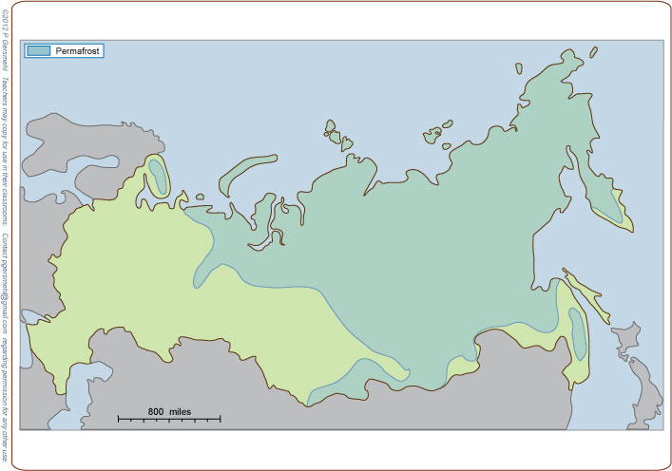
In fact, the soil
in more than half of Russia is permanently frozen.
(It’s called permafrost.)
Definition: permafrost is
a thick layer of soil and broken rock
that remains permanently frozen
even while a thin surface layer
thaws during the short summer

Slide 12
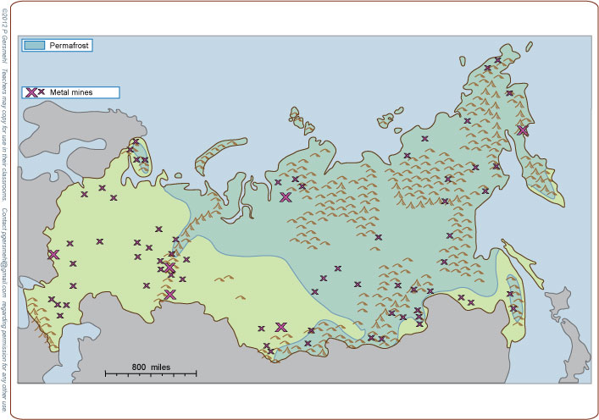
Add the transportation problems caused by the ancient mountains
and the sheer size of the country,
and you can see why
it is really hard to get
some of those minerals.

Slide 13
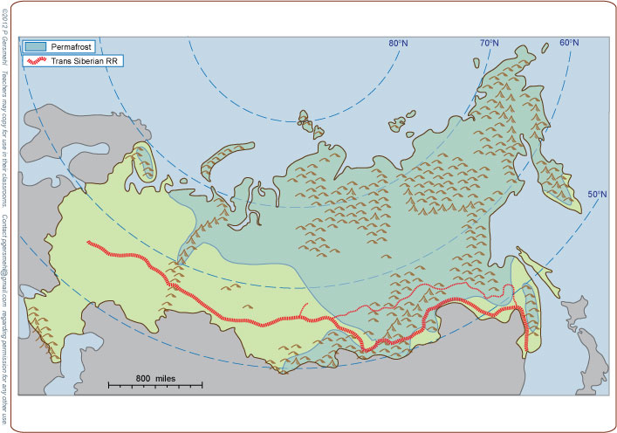
The Trans-Siberian Railroad
from Moscow to Vladivostok was a difficult and expensive
engineering job.
This railroad had three problems:
1. the great size of the country
2. rugged terrain and permafrost
3. sparse population
(few people to pay for track or operation).
M
Project idea: You might compare
the Trans-Siberian Railroad
with the Trans-Canada railroad
or the Trans-continental Railroad
in the United States.
One main purpose of each project
was to help link a large country together.
V
Vladivostok
means “East City”

Slide 14
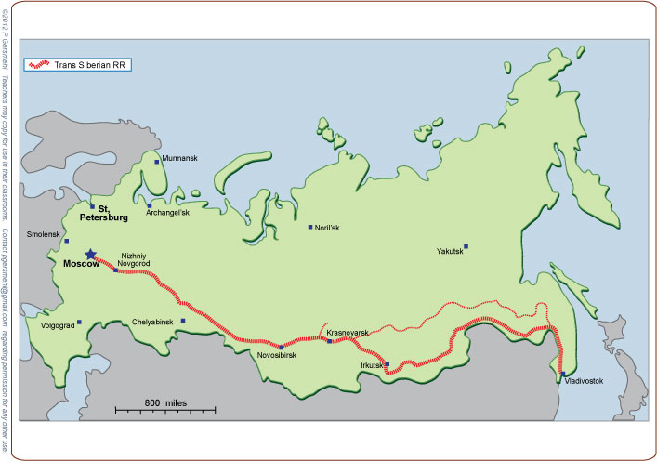
The long Trans-Siberian RR
goes through the major cities
of southern Siberia.
Even so, this railroad
is very expensive
per person served.

Slide 15
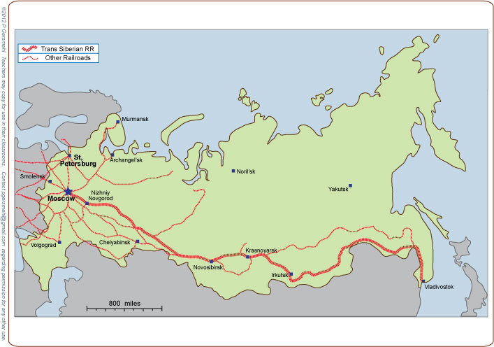
Most of the other railroads
are built around Moscow
in a radial pattern, like
spokes on a bicycle wheel.

Slide 16
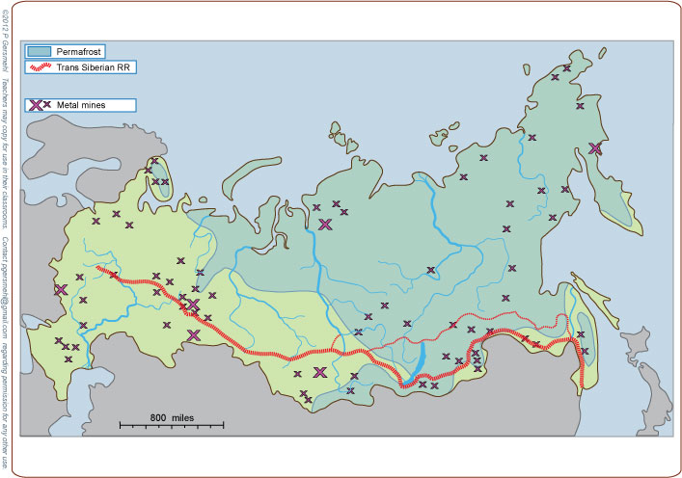
The Trans-Siberian Railroad
does connect the metal mines
in the southern Urals,
but many minerals farther east
are still out of reach.
Many are more than 500 miles
away from any road or railroad.

Slide 17
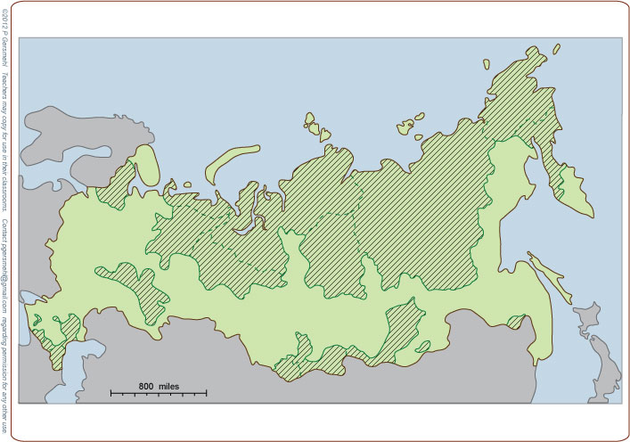
In fact, many of the minerals
are on land that is inside Russia
but is not occupied by Russians.
These are called autonomous
(self-governing) ethnic areas.

Slide 18
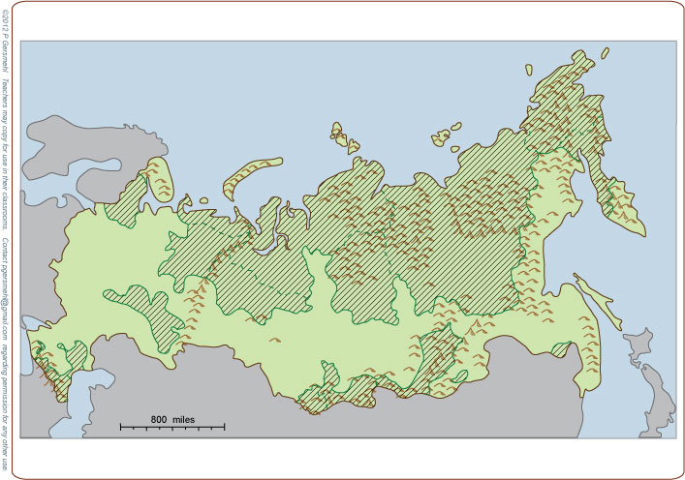
Much of the land
in the autonomous areas
is cold, mountainous, or both.

Slide 19
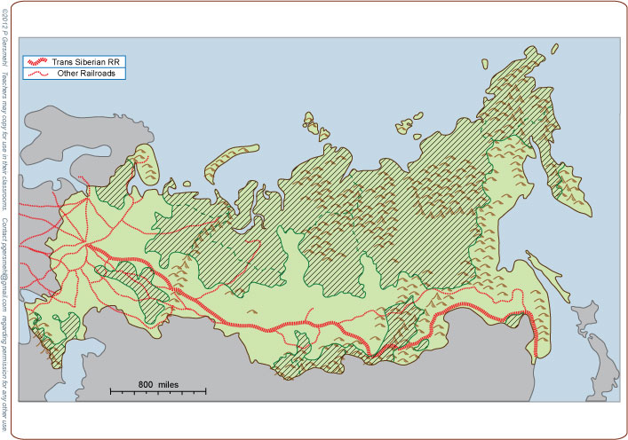
Most of these
autonomous areas
cannot be reached
by road or railroad.

Slide 20
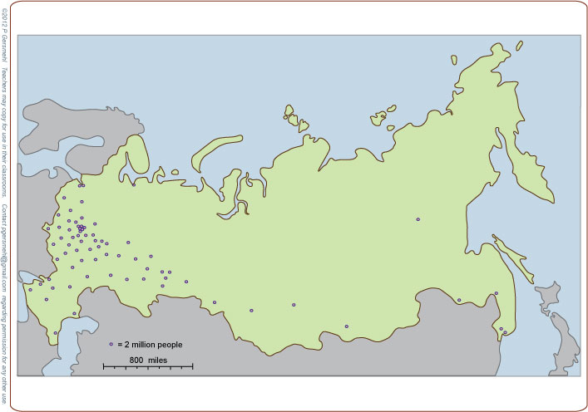
The autonomous areas
have very few people.
Most of Russia’s population
is in the southwestern part
of this huge country.

Slide 21
The autonomous areas
have very few people.
Most of Russia’s population
is in the southwestern part
of this huge country.
This leads logically
to one more consequence
of geographic size.

Slide 22
Many history books say that
its great size and cold climate helped Russia resist invasions
by Mongols from the east,
Huns from the south, and
Napoleon and the Nazis
from the west.
This map, however, shows why
this “success” came at great cost.
The recent invasions crossed areas
where almost half of the people
in this huge country lived.
In World War II, for example,
more than 22 million people
died in the Soviet Union.
The United States losses, by contrast,
were “only” about 430,000 – which is
still a great price for a country to pay.

Slide 23
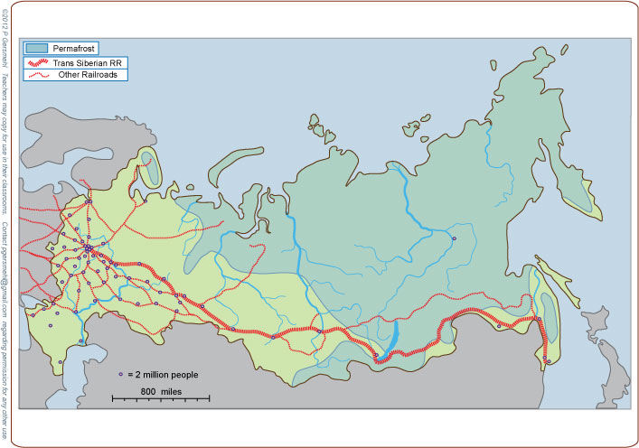
Even today, most of the people live
near or south of the Trans-Siberian railroad.
In spite of government programs to encourage
people to move to places farther from the railroad,
the permafrost areas remain nearly empty.

Slide 24
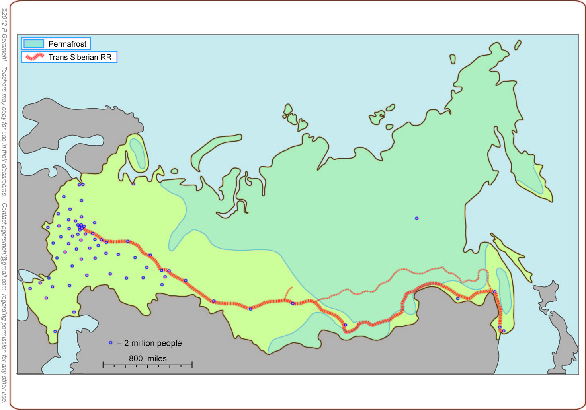
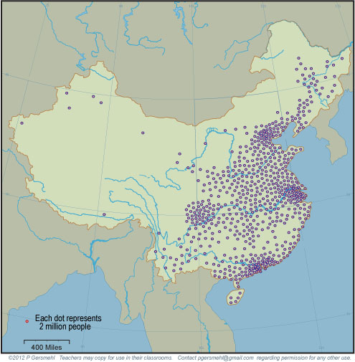
Here is a useful comparison: China has nearly ten times
as many people, packed
into one-third of a country
that is less than half as big.

Slide 25
This is the geographic basis for what may become
one of the most important international issues
in the last half of the 21st century.
One of the world’s longest borders separates:
China (a very crowded country
with a rapidly growing economy
that needs more and more resources)
and
Russia (a huge country
with a lot of resources
but relatively few people).

Slide 26
This presentation showed one way to use
the clickable mini-Atlas - to help us investigate
some consequences of the big idea of area,
with examples from Russia.
Area affects:
Climate – because a large area tends to have
more temperature extremes and less precipitation
Mineral resources – because a large area was probably
“assembled” through crustal collisions that also
tend to concentrate metal ores
Transportation – because it costs more to serve
a larger area with roads and railroads
Land use planning – because it costs more to gather
information about a larger area
Even military history – because people in a large area
have more room to retreat and regroup, while
the supply lines of invaders are stretched

Slide 28
Here are two optional postscripts,
followed by the questions section.
Postscript 1 – about the end of the Cold War
Postscript 2 – about Arctic rivers

Slide 29
Optional postscript 1 - about the end of the Cold War
There are some people
who think that the Soviet Union fell apart
only because it was unable to compete with the U.S.
They say the Communist planned economy of the USSR
was inherently less productive than a capitalist system.
As a highly placed government official said:
“It is the basic superiority of the capitalist system
that allows American farmers to out-produce
their Russian counterparts – as a result,
they have to buy emergency food from us.”
We sold them 50 million tons that year.

Slide 30
“The Soviet Union fell apart
because a Communist planned economy is inherently
less productive than a capitalist system.”
This statement is partly true.
Soviet agriculture was notoriously inefficient.
But that is not the whole truth,
and it is a huge mistake
to think it is the whole truth.

Slide 31
Remember
Nearly all of Russia is
farther from the equator
than Montana, the Dakotas,
or Minnesota.
And this area gets less rain
than western Kansas.
And this area is mostly high mountains.

Slide 32
In other words,
nearly all Russian farmers
are working with land that is like North Dakota,
(or even colder and drier).
Is it reasonable to think that they can produce
as well as farmers in Iowa, California, or Texas?
And even if they have
a really good year,
their transportation
is much more expensive,
because the country is so big.

Slide 33
Bottom line:
To be sound, foreign policy must be based
on the understanding that most things in the world
have multiple causes and complicated effects.
(The “competition” between American and Russian farmers
was NOT just about capitalism versus communism.)
And the “winner”
was not just a free market,
or a strong President –
it was also a better environment
and cheaper transportation.
The key to success in the 21st century
is to figure out how important
each of those influences was –
because there was more than one simple reason for the end of the Cold War.

Slide 34
Another postscript
about Arctic rivers.

Slide 35
As we said earlier,
Russia has five giant rivers
that flow north to the Arctic Ocean.
Kolyma
Lena
Pechora
Yenisei
Ob
In autumn, the northern “ends”
of these rivers freeze up
several weeks before
their southern “beginnings.”

Slide 36
The frozen rivers
can be used as roads
for a few months
each winter.
Kolyma
Lena
Pechora
Yenisei
Ob

Slide 37
The frozen rivers
can be used as roads
for a few months
each winter.
Then, in spring,
the southern parts
of the rivers begin to flow
while the northern parts
are still frozen.
Kolyma
Lena
Pechora
Yenisei
That makes it
even less likely
that many people
would live there
(and even harder to get
the oil and minerals out
to the world markets).
Ob
As a result,
these rivers make
huge floods across the frozen land.

Slide 39
Questions
Section

Slide 40
What is a consequence
if a place is located
north of the Arctic Circle?

Slide 41
Kolyma
Lena
Pechora
Yenisei
Ob
Why do very few people
live near the five giant rivers
that flow northward in Russia?

Slide 42
What mountains
form part of the border between
Europe and Asia?
What is the
geologic history
of these mountains?

Slide 43
Farther east
are the remnants
of several even
older collisions.
What is
an economic
consequence
of this history?

Slide 44
How does Russia’s
mineral resources
compare with
the rest of the world?

Slide 45
What often forms
in the low areas
around formerly
separate crustal plates?

Slide 46
How does the latitude
of Russia compare
to the United States?
What is a consequence
of this latitudinal position?

Slide 47
What is the term for soil
that is permanently frozen
below a thin surface layer
that occasionally thaws?
Definition: permafrost is
a thick layer of soil and broken rock
that remains permanently frozen
even while a thin surface layer
thaws during the short summer

Slide 48
List several reasons why
it is really hard to get
some of the minerals
that occur in Russia.

Slide 49
What is the name
of the long railroad that goes
from Moscow to Vladivostok?
List three problems faced
by the railroad builders.
M
V
What does Vladivostok mean?

Slide 50
What is the relationship
between the Trans-Siberian RR
and the major cities
of southern Siberia.

Slide 51
How would you describe
the pattern of railroads
near the capital of Moscow?

Slide 52
The Trans-Siberian Railroad
goes near these metal mines; what is the name
of this mining district?

Slide 53
What does the green pattern
represent on this map?

Slide 54
How would you describe
the environmental conditions
in the autonomous areas?

Slide 55
How would you compare
the geographic pattern
of railroads with the pattern
of autonomous ethnic areas?

Slide 56
Why do most Russian people
live in the southwestern part
of this huge country?

Slide 57
What major military powers
invaded Russia from the west
in the last two centuries?
What were some
lasting consequences
of those invasions?

Slide 58
How do the populations
of Russia and China compare?
What are some policy issues
that may arise because
of these differences?

