Slide 1
RESOURCES
A BIG geographical IDEA with many consequences IN
SouthWEST ASIA
This big idea can help us understand
many geographic patterns in Southwest Asia,
including patterns of food production, population, ancient empires, religions,
trade, borders, oil production, and terrorism.

Slide 2
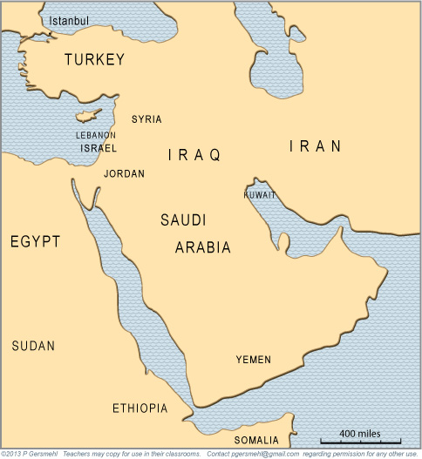
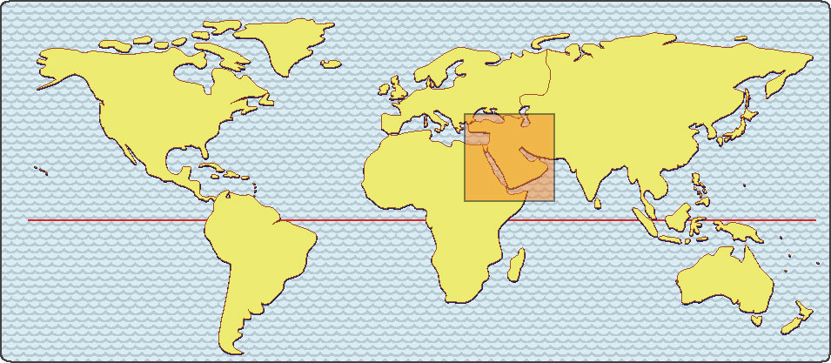
Southwest Asia
and Northeast Africa
have been called
“the crossroads
of history.”

Slide 3
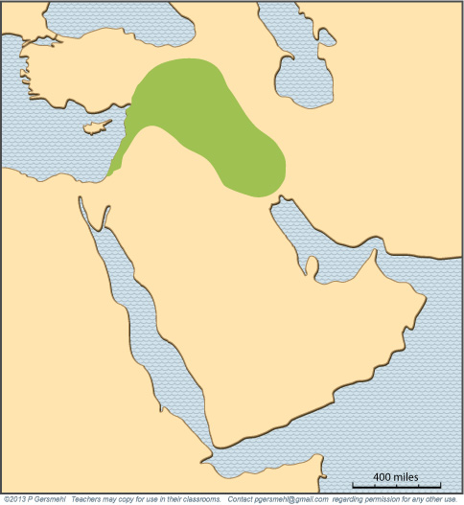
A really
important area is
an arc-shaped blob
that is usually called
the Fertile Crescent.
Note: In some ways,
that’s an odd name,
because the area
is not symmetrical
like a crescent,
and much of it
is not very fertile
(compared to, say,
the American Corn Belt
or the North China Plain).

Slide 4
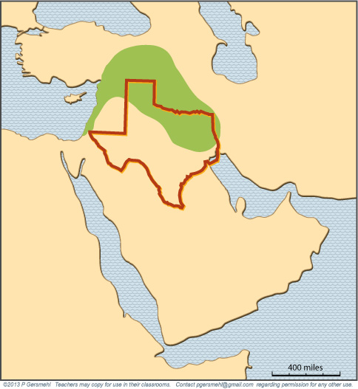
The main area
is about the size
and latitude
of Texas.
This small region
had some of the first
urban civilizations
of the world –
starting more than
6000 years ago.

Slide 5
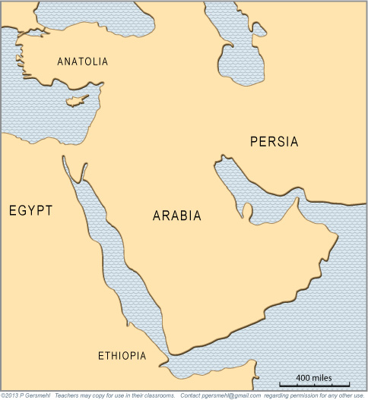
Including one
of the most famous names:
Mesopotamia
BYZANTIUM
CAPPADOCIA
LYDIA
TAURUS
SCYTHIA
MEDIA
LEVANT
ASSYRIA
PHOENICIA
BABYLON
ELAM
CANAAN
AKKAD
Not surprisingly,
many parts of this area
have had different names
in the past.
NUBIA
KUSH
AKSUM

Slide 6
These ancient civilizations developed
in an area that is now the home of:
- large numbers of very poor people,
- a few multimillionaire families,
- some of the least democratic governments
in the world,
and
- some well-known terrorist organizations.
Why are they here?

Slide 7
One way to try to understand this region
is to look at the idea of resources.
Definition: a resource
is something that nature provides
and people have learned how to use
People use resources to produce everything
that they eat, wear, buy, or use –
from wood chips to potato chips,
computer chips, and poker chips.
Resources are geographically important,
because different places have different resources.
They are also historically important,
because technology changes, and therefore
people used different resources at different times.

Slide 8
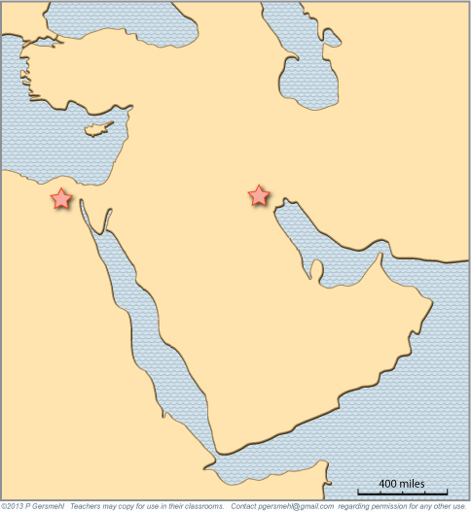
To see how resources work,
let’s look at where
the first two large cities
of the world were built.
To see how resources work,
let’s look at where
the first two large cities
of the world were built.

Slide 9
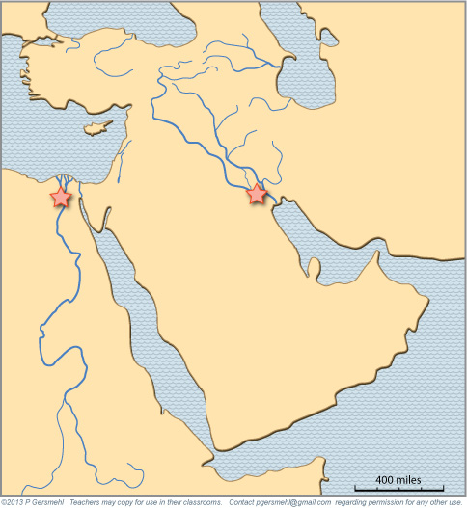
To see how resources work,
let’s look at where
the first two large cities
of the world were built.
To see how resources work,
let’s look at where
the first two large cities
of the world were built.
Each city was located
near the end of a river
flowing through a desert.

Slide 10
The soil
near the end of a river
is usually put there
by the river
(when it floods).
The soft and fertile soil
on a river floodplain is
good for food production.
It’s a resource!
Even the surrounding desert
could be viewed as a resource –
the desert made it much harder
for enemies to attack
these ancient cities.
It was especially valuable
(as a resource)
before people invented
tractors that could plow
harder ground.

Slide 11
Later, people learned how
to divert water out of the rivers
to help their crops grow better.
That’s called irrigation.
It’s one of the key inventions
of the ancient world.

Slide 12
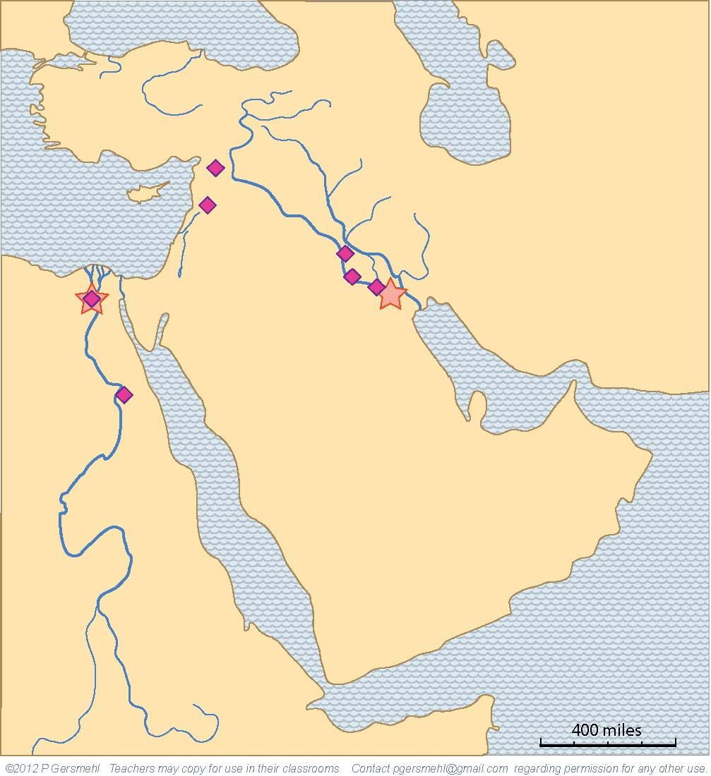
Using the technology of irrigation,
people settled all along the rivers,
and they built many new cities
in strategically important places
(often near river crossings).

Slide 13
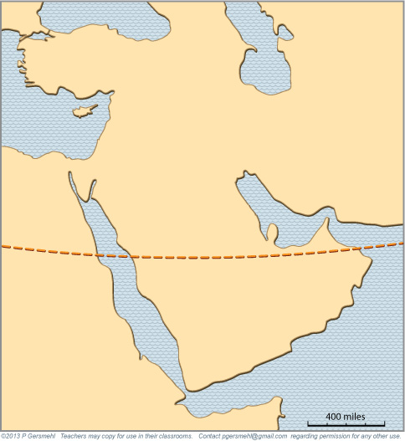
To put this in context,
let’s back up a little.
The Tropic of Cancer
goes right through
this general area.
For good reasons
(explained in an activity)
deserts tend to form
near the Tropic lines.

Slide 14
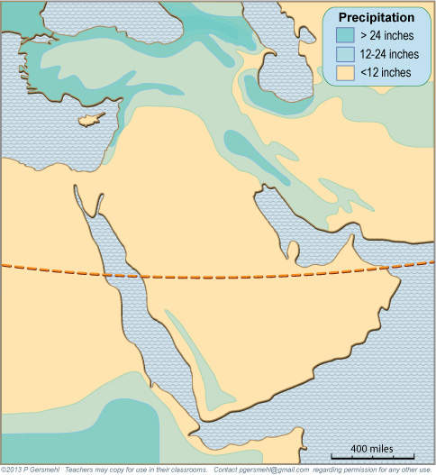
The weather is rainier
both north and south
of the desert area.
It rains
both north and south
of the desert area.

Slide 15
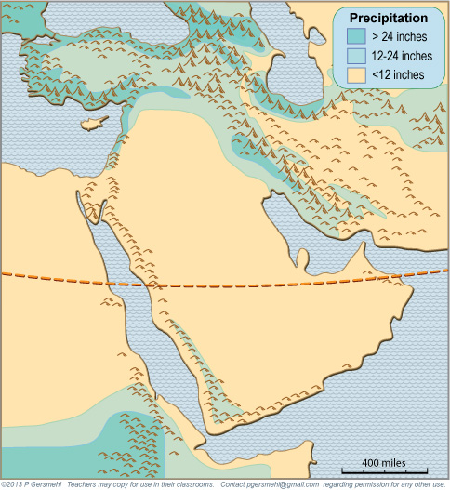
The actual pattern
of precipitation
is also influenced
by the locations
of high mountains.
The actual pattern
of precipitation
is also influenced
by the locations
of high mountains.
The actual pattern
of precipitation
is also influenced
by the locations
of high mountains.

Slide 16
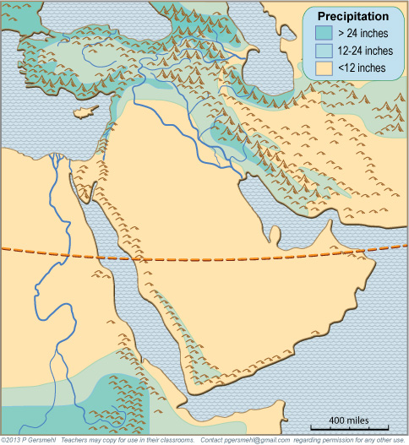
The actual pattern
of precipitation
is also influenced
by the locations
of high mountains.
Both rivers start
in rainy mountains
and then flow
across a desert.

Slide 17
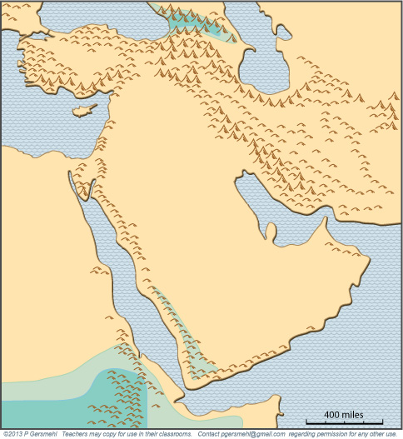
The two rivers
are different,
however,
because of when
the rain usually falls
in the two regions.
In summer, the
Equatorial Rainy Belt
moves northward,
and brings rain
to the highlands in
Ethiopia and Yemen.
In summer, the
Equatorial Rainy Belt
moves northward,
and it brings rain
to the highlands in
Ethiopia and Yemen.

Slide 18

Not surprisingly,
the Nile River floods
after the summer rains.
In summer, the
Equatorial Rainy Belt
moves northward,
and brings rain
to the highlands in
Ethiopia and Yemen.
In summer, the
Equatorial Rainy Belt
moves northward,
and brings rain
to the highlands in
Ethiopia and Yemen.

Slide 19
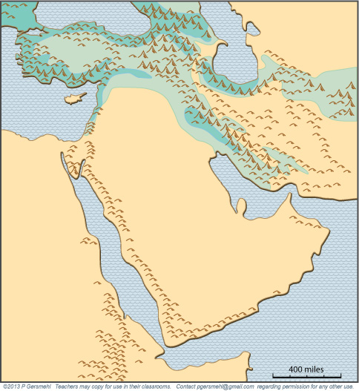
In winter,
the Rainy Belt
and the Tropical desert
both move south.
When that happens,
mid-latitude storms
can bring rain and snow
to the highlands
of Anatolia and Persia
(now called Turkey and Iran).
In winter,
the Rainy Belt
and the Tropical desert
both move south.
When that happens,
mid-latitude storms
bring rain and snow
to the highlands
of Anatolia and Persia
(Turkey and Iran).

Slide 20
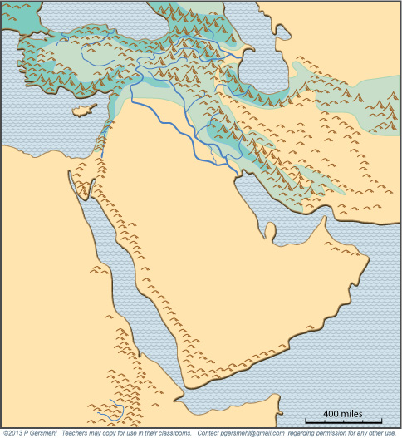
The two rivers
of Mesopotamia
(the Tigris and Euphrates)
often make floods
in early spring.
That’s a better time
for food production.

Slide 21
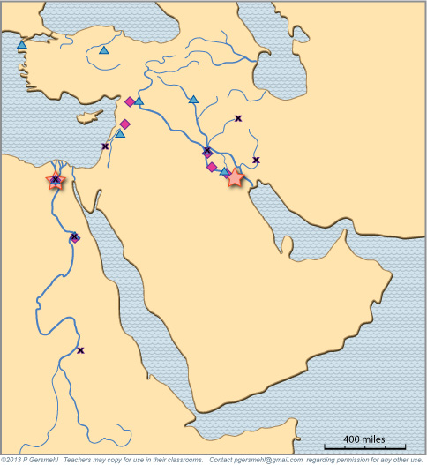
As a result,
populations
grew larger
in this area.
The stars, squares,
triangles, and x’s
show the main cities
at different times,
as explained
in the clickable
mini-Atlas

Slide 22
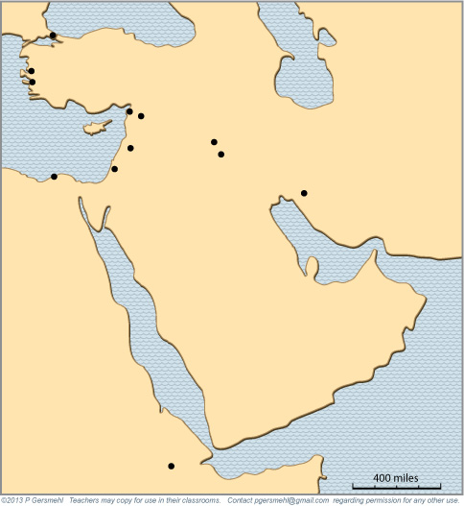
By Roman times (100 BCE)
people had learned how
to build sea-going ships.
The sea became a resource,
and new cities were built
along the shore.
By Roman times (100 BCE)
people had learned how
to build sea-going ships.
The sea became a resource,
and new cities were built
along the shore.
By Roman times (100 BCE)
people had learned how
to build sea-going ships.
The sea became a resource,
and new cities were built
along the shore.
By Roman times (100 BCE)
people had learned to build
all-weather sea-going ships.
The sea then became a resource,
and some cities along the shore
attracted more people.

Slide 23
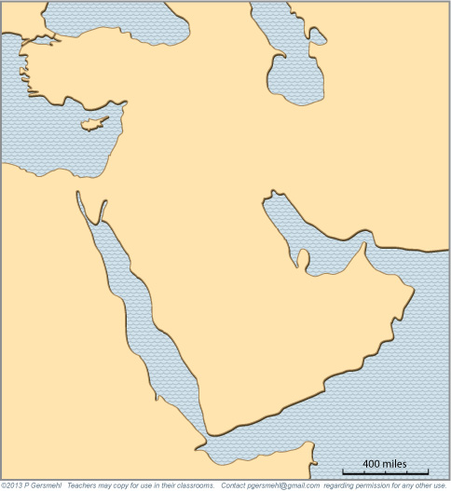
The combination of flooding rivers, easy-to-work soil,
irrigation technology, and the surrounding desert
helped the farmers become very productive.
One farm worker could feed many people.
This gave many people time to do other jobs –
in trade, government, science, education, religion.
It is no accident that astronomy, mathematics, writing,
legal systems, and several major religions
all developed in this relatively small area.

Slide 24
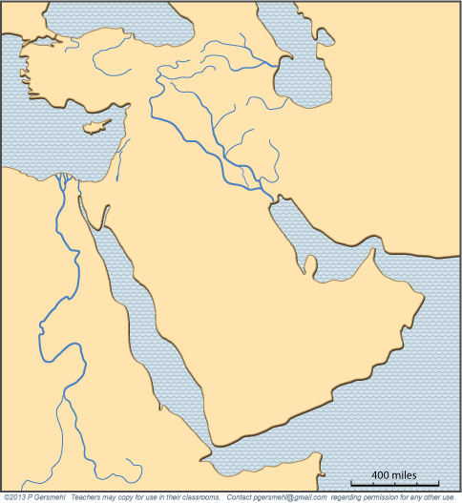
Sometime
before 1700 BCE,
Babylonian king Hammurabi made
one of the first sets
of written laws.
Several hundred
years later,
Zoroastrianism
started in the hills
of western Iran.

Slide 25
They settled in the hills
west of the Jordan River
(an area with many names –
including Retenu, Canaan, Philistia,
Samaria, Judea, Palestine, Israel).
A key time in Jewish history
came when Moses led
the “Children of Israel,”
out of slavery in Egypt.

Slide 26
Christianity started
in that same small area
during the Roman Empire
(the beginning of the
Common Era - CE).

Slide 27
Zoroastrianism, Judaism, and Christianity
all started in Southwest Asia, thousands of years ago,
but today they are no longer the main religions
in this part of the world.
Christianity spread to cover most of Europe,
the Americas, and much of Africa.
Jews migrated to many places around the world,
and now live mainly in urban areas.
Zoroastrianism also still exists,
although the estimated number of believers
ranges from 150,000 to nearly 3 million.

Slide 28
In the early 600s,
the Prophet
Muhammad
started
the religion
called Islam.

Slide 29
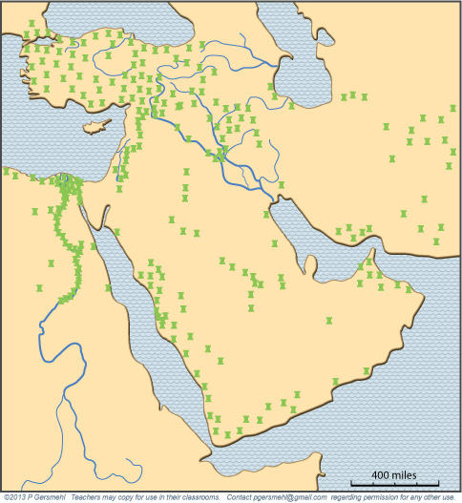
Islam soon split
into two main groups.
About three quarters
are Sunni Muslims
(shown on this map).

Slide 30
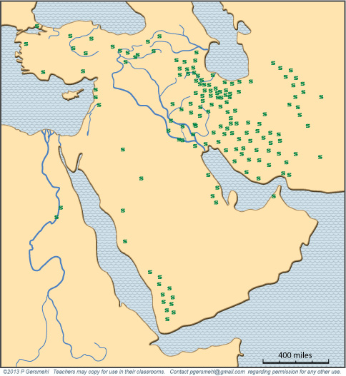
About one-fifth
are Shi’a Muslims.
Shi’ites are the majority
in the modern country
of Iran (ancient Persia).

Slide 31
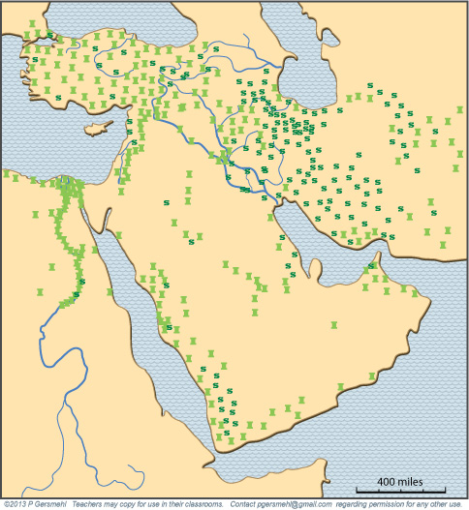
If your map shows both groups,
you can see that they do not
always live in separate areas.
In fact,
most countries
in the region
have people
in both groups.
Countries like
Yemen have
large numbers
of both groups.
Note: This is partly because
each group has several subgroups.
Some of them have been enemies for many years, whereas many
others get along peacefully.

Slide 32
This map does not show the full picture.
Within 100 years after Muhammad,
Islam spread throughout much of the known world -
across North Africa to Spain in the west,
and all the way to China in the east.
Many of the distant countries
developed their own kind of Islam,
which is not linked with either
of the main groups in SW Asia.

Slide 33
For six centuries
after Muhammad,
Islamic caliphs
had complete control
over the Persian Gulf
and the Red Sea.
Along with some
land routes that also
came through this area, these waterways were
the main trade routes
between Europe
and China.
For five centuries
after Muhammad,
Islamic traders
controlled the
main resource,

Slide 34
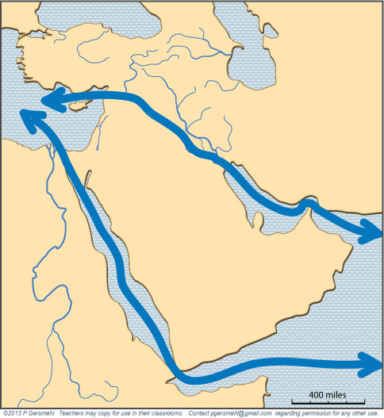
Control of these trade routes
helped the city of Baghdad.
The caliphs in this city
ruled an area that extended
from North Africa to India,
and the city grew to become
what was probably the largest
and richest city in the world.

Slide 35
Then four important things happened:
1. The Islamic empire split into regional dynasties.
2. People invented better ships that could sail farther.
3. Europeans got the magnetic compass from China.
and
4. The Islamic Moors were driven out of Spain in 1492
and no longer controlled the Strait of Gibraltar.
How do these ideas fit together?
As a result, Europeans could travel
all the way around Africa to Asia
and even go across the ocean to the Americas.
Consequence: The Red Sea and Persian Gulf were
no longer the most valuable trade routes in the world.
In short, they were no longer uniquely valuable resources;
wealth and power began to slip away from this region.

Slide 36
To make matters worse,
the Industrial Revolution came next.
The new factories relied on water power, coal, and iron ore.
Southwest Asia does not have these resources.
What did the region have?
- a lot of people who used to work as traders,
- some old cities that were falling into ruin,
- a relatively small amount of good cropland.
That’s a recipe for poverty!

Slide 37
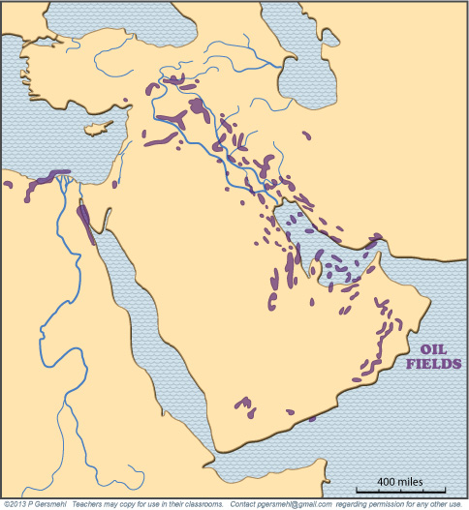
Then people discovered
another key resource
- - - petroleum - - -
Southwest Asia
has more than half
of the world’s oil.

Slide 38
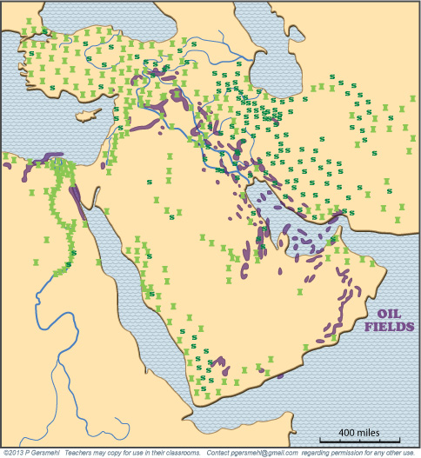
Oil is found in both Sunni and Shi’a areas.

Slide 39
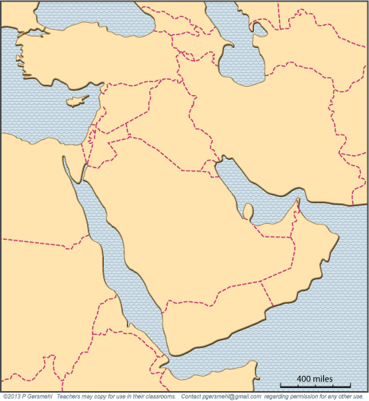
To make things
even more
complicated,
the borders
between
countries
were drawn
by European
colonial powers.

Slide 40
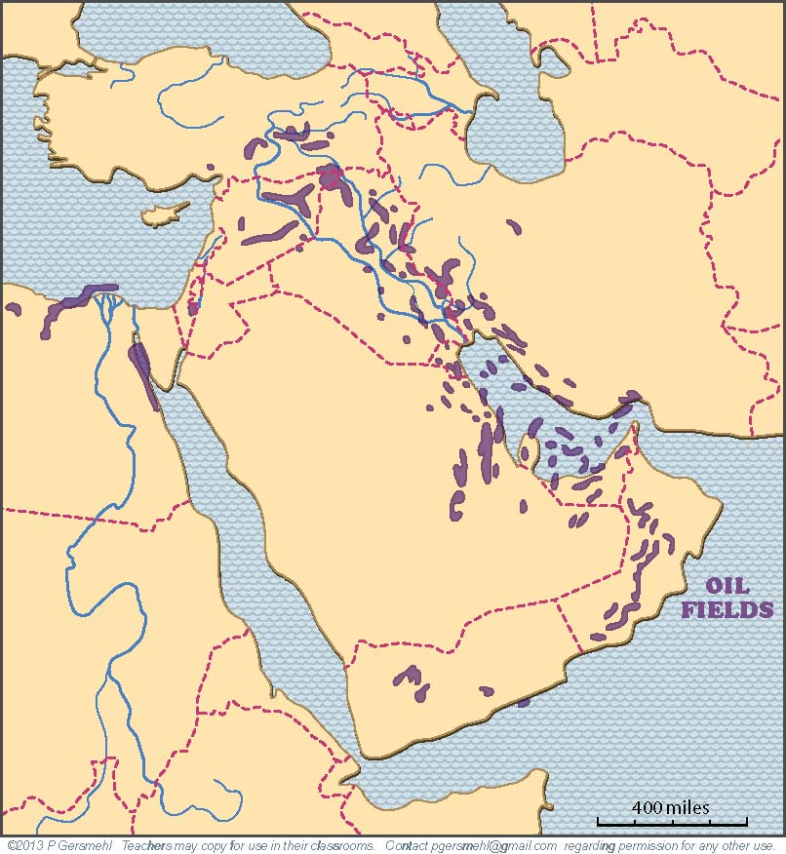
These borders
were done with
little concern
for the location
of resources –
rivers, cropland, OR petroleum.

Slide 41
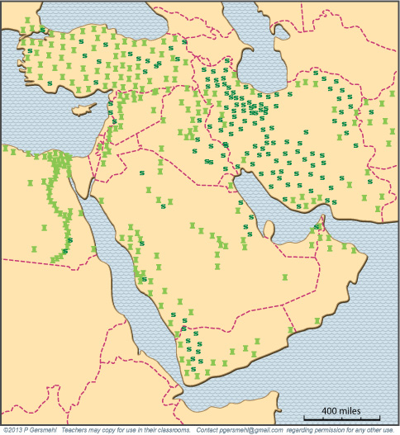
The new borders
also did not pay
much attention
to the pattern
of Sunni
and Shi’a
populations.

Slide 42
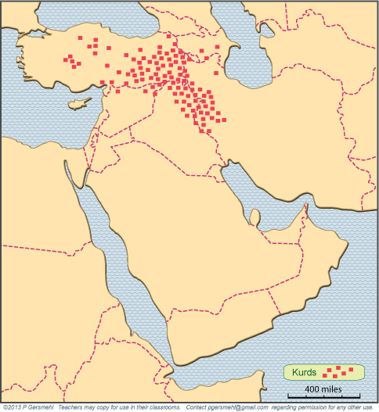
Even more
important,
the borders
ignored
large groups
of people
who want
their own country –
such as the Kurds.
They are now
scattered
in six
different
countries.

Slide 43
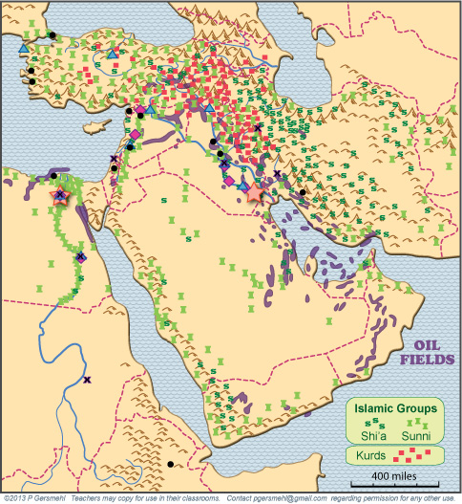
When we put
all this onto one map -
formerly wealthy cities,
several branches of Islam,
mismatched country borders,
Kurds, petroleum deposits, etc. -
it helps us understand
why this region now has
so much political unrest.

Slide 44
As these maps show, this part of the world
has a very long and complicated history.
Here is one result of that history:
this region has many groups of people
who were treated badly at various times in the past
and think they deserve more than they have now
(e.g. Jews Kurds Palestinians Samaritans Shi’ites Sunnis etc. etc. etc.)
A big complication in this region
is the simple fact that a high world price for oil
can support undemocratic governments.

Slide 45
Governments can use oil money to:
- buy weapons, police, and security forces,
- support a lavish lifestyle for the elite,
and
- provide cheap food and gasoline to the people
(in effect, “bribing” people to accept the status quo).
a high world price for oil
can support undemocratic governments.
Political conflicts in Egypt since 2011
tell you what can happen
when the oil money runs out.

Slide 46
This presentation showed one way to use
the clickable mini-Atlas - to help us investigate
some consequences of the big idea of resources,
with examples from Southwest Asia and north Africa.
Resources can affect:
Population density – because productive use of resources
can help people live longer and have more children
Social relations – because resources can help workers
become more productive and thus support people
who can do other things (art, science, religion, trade)
Military power – because countries that control resources
can afford professional armies and security forces
Trade – because people with unique resources
have something they can sell to other people
Expectations – because changes in technology
may make other places (with other resources)
more powerful, but it takes time for people to adjust

Slide 48
RESOURCES
A BIG geographical IDEA with many consequences IN
SouthWEST ASIA
This big idea can help us understand
many geographic patterns in Southwest Asia,
including patterns of food production, population, ancient empires, religions,
trade, borders, oil production, and terrorism.

Slide 49
Questions section

Slide 50
Why is this area
sometimes called
“the crossroads
of history”?

Slide 51
What is another
common name
for this area?

Slide 52
What are some
consequences
of its latitude
(compared with
Texas in the US)

Slide 53
What is the general name
for this area, which supported
several ancient civilizations?
BYZANTIUM
CAPPADOCIA
LYDIA
TAURUS
SCYTHIA
MEDIA
LEVANT
ASSYRIA
PHOENICIA
BABYLON
ELAM
CANAAN
AKKAD
NUBIA
KUSH
AKSUM

Slide 54
One way to try to understand this region
is to look at the idea of resources.
What is a resource?
Definition: a resource
is something that nature provides
and people have learned how to use
Why are resources are geographically important?
Why are resources historically important?

Slide 55
To see how resources work,
let’s look at where
the first two large cities
of the world were built.
What do the first cities
that people ever built
in this world region
have in common?

Slide 56
To see how resources work,
let’s look at where
the first two large cities
of the world were built.
To see how resources work,
let’s look at where
the first two large cities
of the world were built.
Each city was located
near the end of a river
flowing through a desert.

Slide 57
Describe how the soil
near the end of a river
is made by the river,
and why that is important.
Describe how a surrounding desert
could be viewed as a resource.

Slide 58
What technology allowed people
to settle along a river?
How did they choose locations
when they decided to build
many new cities?

Slide 59
What kind of environment
is usually found
near the Tropic lines?

Slide 60
The actual pattern
of precipitation
is also influenced
by the locations
of high mountains.
How is the pattern
of precipitation
influenced
by the locations
of high mountains?
The actual pattern
of precipitation
is also influenced
by the locations
of high mountains.

Slide 61
In summer, the
Equatorial Rainy Belt
moves northward,
and brings rain
to the highlands in
Ethiopia and Yemen.
What season is this?
What causes
the rain to fall
in these areas
at this time?

Slide 62
What river is this?
In what months
does it usually flood?

Slide 63
What season is this?
What causes
rain and snow
to fall in these areas
at this time of year?

Slide 64
In what months
do these two rivers
usually flood?
Why is that
a good time
for food production?

Slide 65
Name at least
three civilizations
that developed
in this general area.
The stars, squares,
triangles, and x’s
show the main cities
at different times,
as explained
in the clickable
mini-Atlas

Slide 66
What technology
became important at the time
of the Greek and Roman empires?
What were some consequences
of this new technology?
By Roman times (100 BCE)
people had learned how
to build sea-going ships.
The sea became a resource,
and new cities were built
along the shore.
By Roman times (100 BCE)
people had learned how
to build sea-going ships.
The sea became a resource,
and new cities were built
along the shore.
By Roman times (100 BCE)
people had learned how
to build sea-going ships.
The sea became a resource,
and new cities were built
along the shore.

Slide 67
The combination of flooding rivers, easy-to-work soil,
irrigation technology, and the surrounding desert
helped the farmers become very productive.
What is an important consequence
of that rise in productivity?

Slide 68
What Babylonian king made one of the first
sets of written laws?
A few centuries later, what religion
started in the hills
of western Iran?

Slide 69
What are some names
of the area that these people
called their “Promised Land”?
What group of people
trace their history
to a time of slavery
and an Exodus
out of Egypt?

Slide 70
What other religion started
in that same small area
during the Roman Empire
(the beginning of the
Common Era - CE).

Slide 71
Zoroastrianism, Judaism, and Christianity
all started in Southwest Asia, thousands of years ago,
but today they are no longer the main religions
in this part of the world.
Briefly describe the history of Christianity.
Briefly describe the history of Judaism.
Briefly describe the history of Zoroastrianism.

Slide 72
What happened
in this desert area
in the early 600s?

Slide 73
What branch of Islam
is shown on this map?

Slide 74
What branch of Islam
is shown on this map?
In what country
are they the majority?

Slide 75
What is the balance
among different
Islamic groups
in Egypt?
in Turkey?
In Iran?
In Yemen?
Why is it difficult
to make generalizations
about relationships
between different
Islamic groups?

Slide 76
This map shows only Southwest Asia.
Within a century after Muhammad,
How far west had Islam spread?
How far east had Islam spread?

Slide 77
What are the names
of these two bodies
of water?
Why were they
strategically important
in the Middle Ages?
Who controlled
travel at that time?
For five centuries
after Muhammad,
Islamic traders
controlled the
main resource,

Slide 78
What city grew to become
what was probably the largest
and richest city in the world?
What is important
about its location?

Slide 79
Describe at least four things that happened
to change the balance of power.
What region gained by these changes?
What region lost?

Slide 80
What resource
is shown on this map?
What fraction
of world reserves
are in this region?

Slide 81
Do people
in either branch of Islam
control more of the oil?

Slide 82
How were
the borders
between
countries
established?

Slide 83
Which
countries
control
most of
the large
oil fields?

Slide 84
Were borders
carefully drawn
to separate
different
branches
of Islam?
Why or why not?

Slide 85
What group
of people
are shown
by the red
squares
on this map?

Slide 86
How does comparing
all of these maps
help us understand
why this world region
has so much
political unrest?
What is the role
that oil resources
might be playing
to help support
undemocratic
governments?

