Slide 1
Population A geographic “BIG IDEA” with many consequences IN china
Population density helps us understand many other geographic features in China,
including patterns of crop production,
dynasties, inventions, large building projects,
highways, factories, trade, pollution,
disease, and human rights.
.

Slide 2
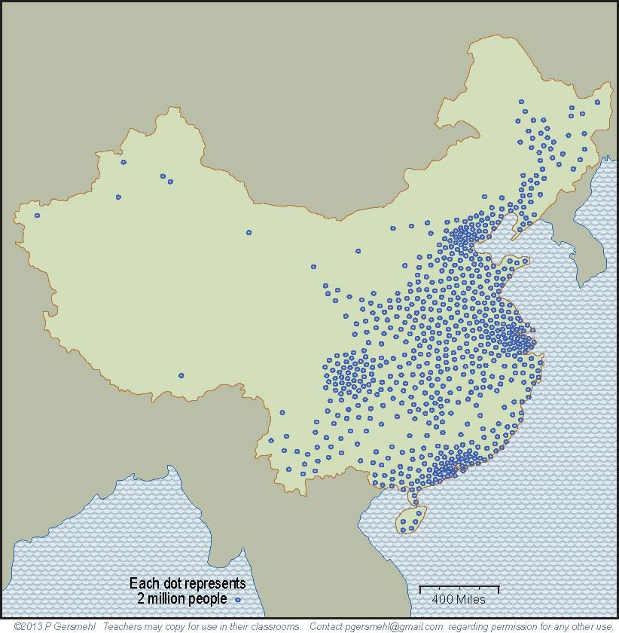
China is a good choice as a “lab”
to study consequences of population density,
because it has had a large population for 2000 years.

Slide 3
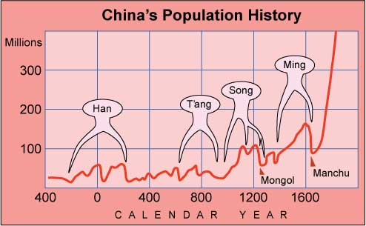
Moreover, there were at least four times in China’s history
when the country lost more than a third of its population,
to warfare, disease, or starvation. Studying those times
might help us understand what causes collapses like that.

Slide 4
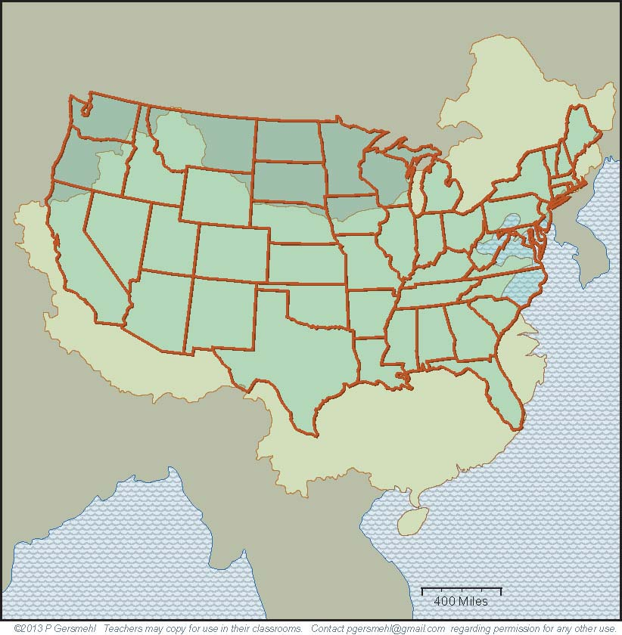
China has about the same area as the United States,
but it has more than four times as many people.
Both countries
cover roughly
the same latitude
and general position
on the east coast
of their continents.
As a result,
many of the environments
in China
are similar to
places in the
United States.
Click here to skip
the examples

Slide 5
For example,
Hong Kong and Miami are both
- on the east coast,
- near the same latitude,
and
- close to warm ocean.
Not surprisingly,
both cities have
mild winters,
hot summers,
and occasional
hurricanes
in the fall.

Slide 6
Shanghai and
Savannah, GA,
have almost
identical climates.

Slide 7
The capital cities,
Beijing and
Washington,
also have
very similar
weather.

Slide 8
Shenyang and
Pittsburgh are
two more cities
with similar
climates.
These two cities
have even more similarities –
both were centers
for steelmaking,
.
and both became hi-tech centers
when the steel
industry faded.

Slide 9
But Kashgar
(also called Kashi)
is a much older city
and has ten times
as many people
as Reno.
Here is another pair of cities with very similar conditions:
the old Silk Road city of Kashgar and Reno, Nevada.
Both cities are located about 4300 feet above sea level,
in small irrigated oases on major transcontinental routes,
between high mountains to the west and desert to the east.

Slide 10
Along with these similarities,
we should note that there are
several important differences
in environmental conditions.
For example, China does not have a west coast.
Therefore, it has no places like California, Oregon,
Washington, or Alaska.
And remember,
California is by far
the number one
food-producing state
in the United States.
Notes:
Differences

Slide 11
Another huge difference:
China does not have
anything like
the Great Lakes.

Slide 12
Manchuria
Mongolia
Another huge difference:
China does not have
anything like
the Great Lakes.
As a result, China’s “northlands”
(Mongolia and Manchuria)
are much colder and drier
than Wisconsin, Michigan,
or Ontario, Canada.
This fact had a great importance
throughout the history of China,
from the very first dynasties
to the invasion by Genghis Khan
and the fall of the Ming Dynasty.

Slide 13
The Great Lakes
are a big benefit
for food production
in the United States.
China does not have
any large region
of prime farmland
like the Corn Belt
in the Midwest.

Slide 14
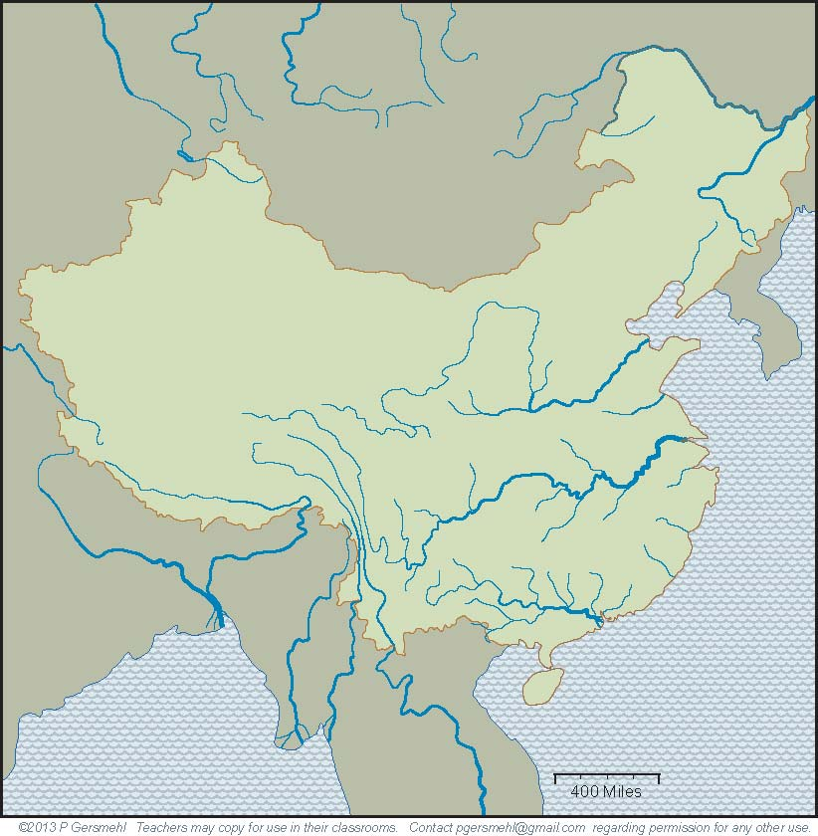
What China does have is four giant river systems.
The Amur
on the border
with Russia.
The Huang He -
“He” means
muddy river.
The Yangtze Jiang –
“Jiang” means
clear blue river.
The Zhu Jiang
(also known
by an English name,
the Pearl River).

Slide 15
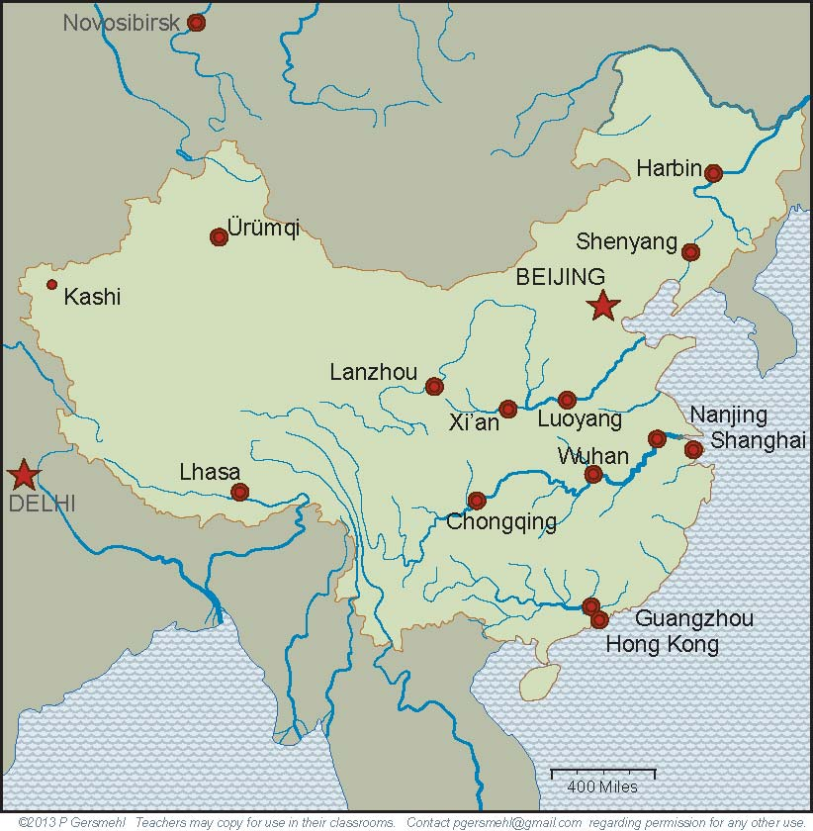
The floodplains of three rivers have had
large populations throughout Chinese history.
The old capitals
of Luoyang
and Xi’an
are on the
Huang He.
Four great cities
are spaced along
the Yangtze.
Guangzhou (Canton)
and Hong Kong
are near the mouth
of the Pearl.

Slide 16
Today, six of these cities are
the urban cores of areas
of especially large population.
Beijing
Chongqing
Nanjing,
Shanghai
Guangzhou,
Hong Kong

Slide 17
Today, six of these cities are
the urban cores of areas
of especially large population.
Remember,
Beijing’s climate
is like Washington
or New York City.
and Chongqing
is like Dallas
(with rainier summers
and drier winters)
Beijing
Shanghai
is like
Savannah
Chongqing
Nanjing,
Shanghai
Hong Kong
is like Miami
Guangzhou,
Hong Kong

Slide 18
Today, six of these cities are
the urban cores of areas
of especially large population.
Different dynasties
had their capital cities
in different regions.
.Imagine being in a country
where the capital city moved
every few hundred years,
and sometimes more often!
Beijing
Read on,
to see
why this
would
matter.
Chongqing
Nanjing,
Shanghai
Guangzhou,
Hong Kong

Slide 19
Chinese history
is very long
and complex
but under it all
is one fairly simple
geographical basis:
Different parts of the country
had different economies,
lifestyles, and cultures.

Slide 20
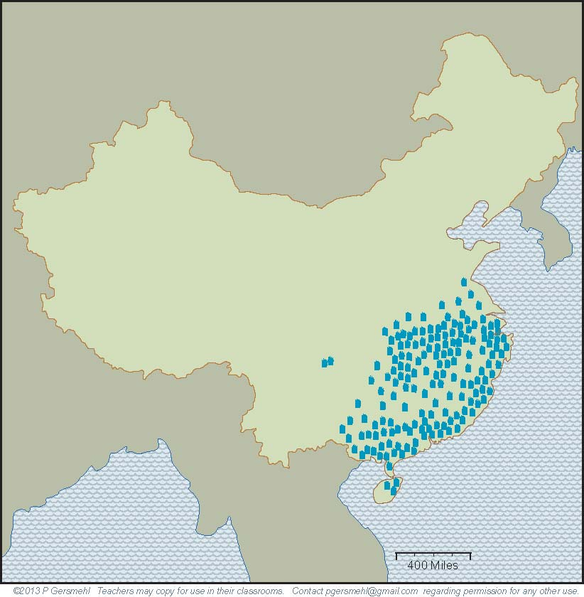
The southern region
has a long summer.
Farmers here can grow
several crops of rice,
but plant diseases
are a problem
in wet years.

Slide 21
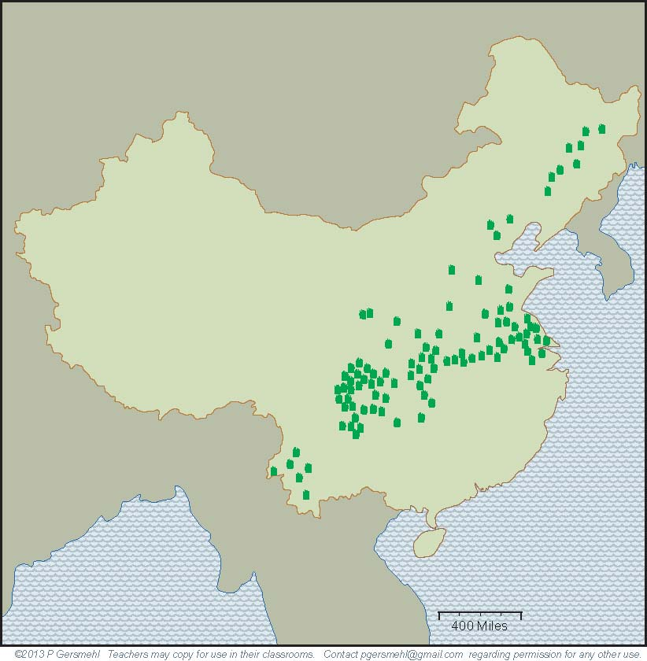
To the north and west,
the growing season
gets shorter.
Farmers can harvest
only one crop of rice
in a typical year.

Slide 22
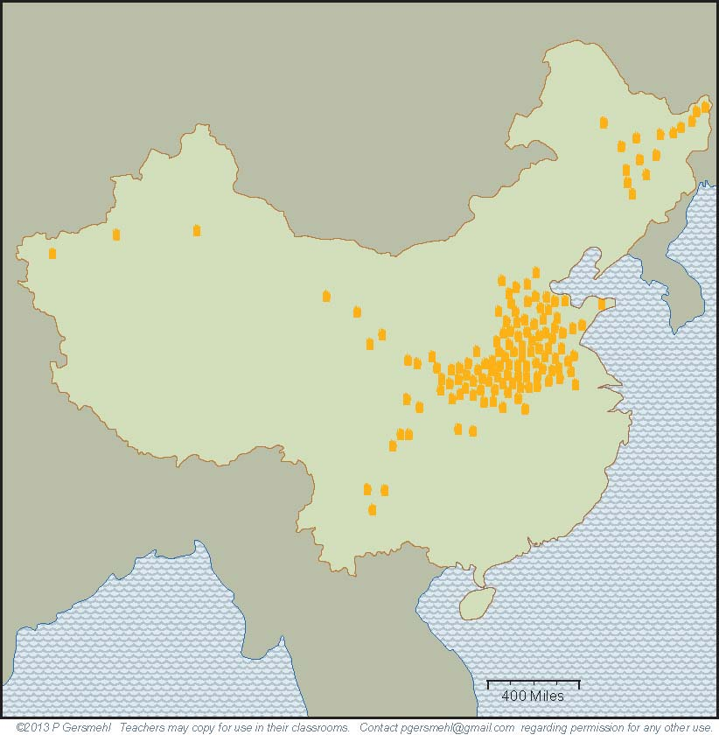
Still farther north,
on the floodplain
of the Huang He,
wheat and millet are
the preferred crops,
and drought is a risk
(in years when the river
does not flood!)

Slide 23
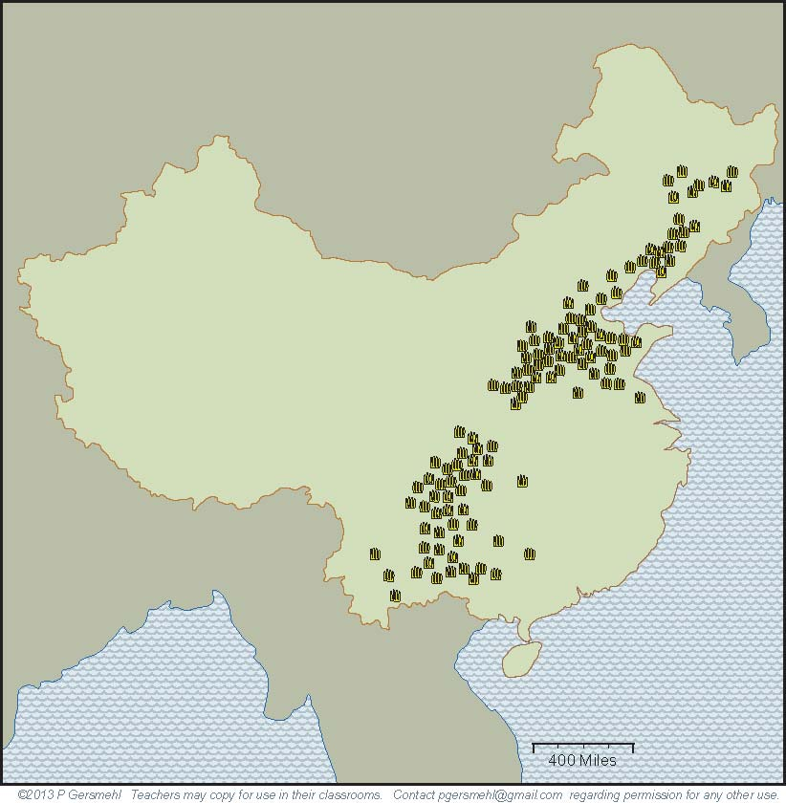
Farther inland,
corn has recently become widely grown.
It has the same use
as in the United States,
as feed for pigs.

Slide 24
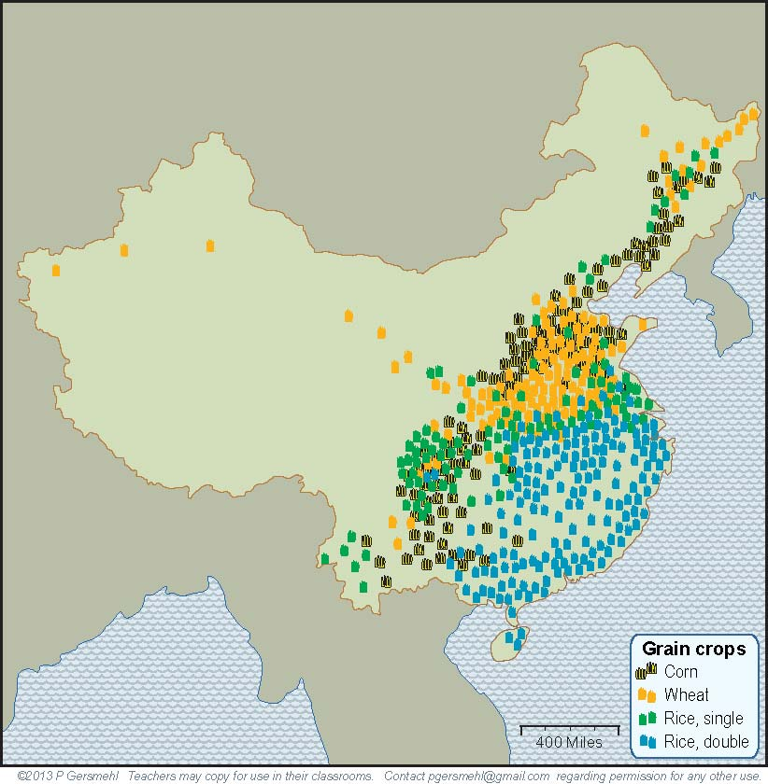
Put all four crops
on one map,
and you see
some overlap,
but you still see
distinct regions.

Slide 25
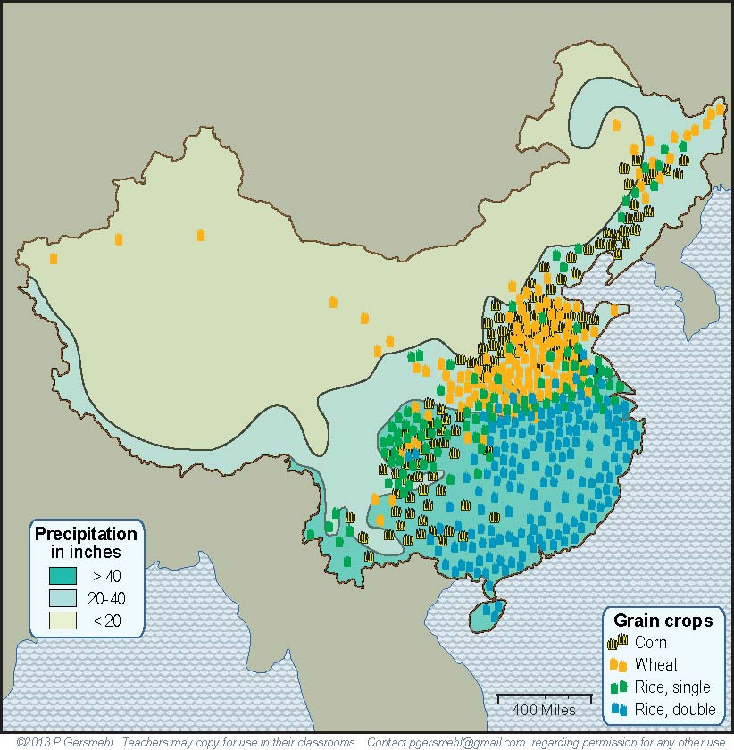
We’ve added a map layer
to show the amount of rain.
The northwestern half of China
is generally dry, with only a few
small areas of irrigated farming.
This helps explain
why very few people
live out here.

Slide 26
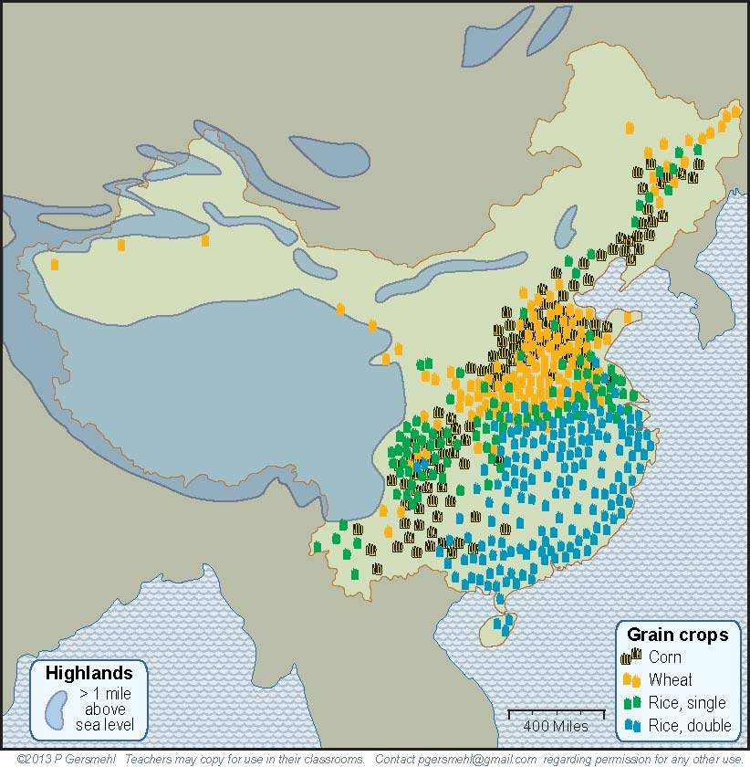
The southwestern area
has another problem -
very high elevation.
These cold mountains
have very little land
that is suitable
for crop farming.

Slide 27
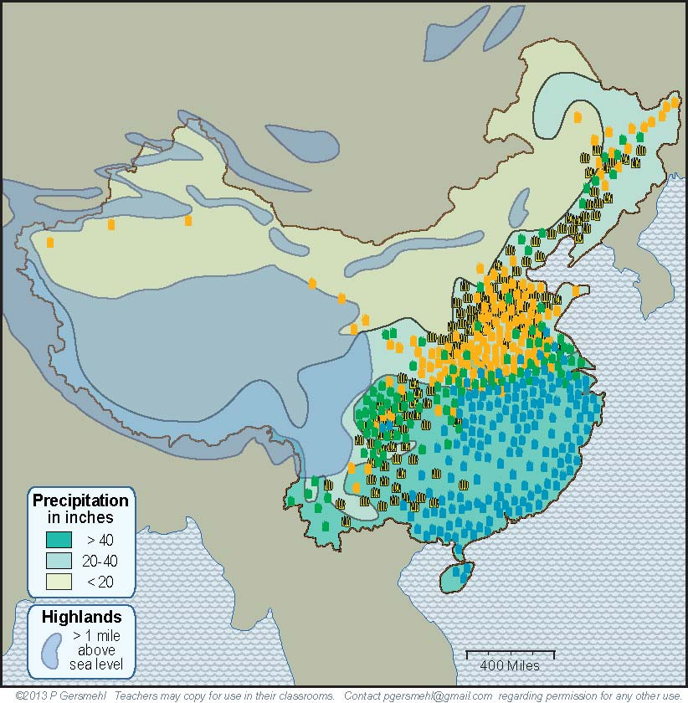
When the map shows
the high areas
and the dry areas,
you can see that China
has only about half
as much good cropland
as the United States.

Slide 28
Remember, China does not have
a West Coast.
When the map shows
the high areas
and the dry areas,
you can see why China
has only about half
as much good cropland
as the United States.

Slide 29
And it
does not have
a Great Lakes
farming region.
Remember, China does not have
a West Coast.
When the map shows
the high areas
and the dry areas,
you can see why China
has only about half
as much good cropland
as the United States.

Slide 30
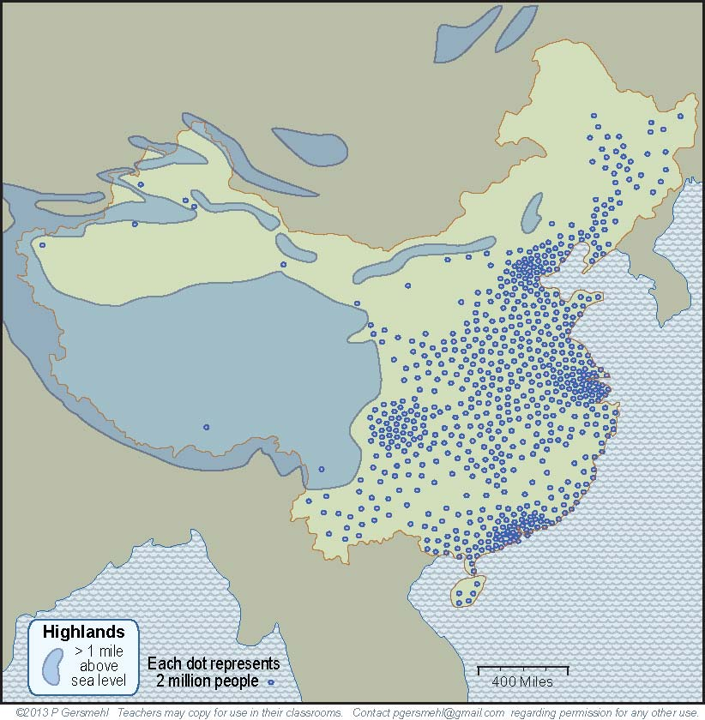
With all of this
as background,
it is easy to see
why the population
is crowded together
in about one-third
of the country.
What are some
consequences
of a large
but crowded
population?

Slide 31
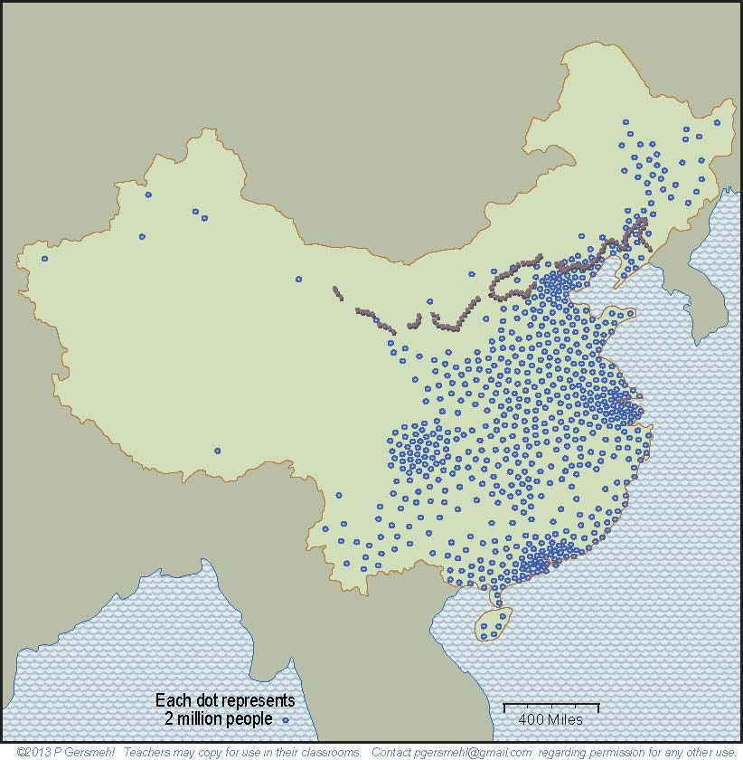
A large population
(if people work together)
can plan and accomplish
large building projects.
Here is the famous
Great Wall of China.
The Chinese people
started building a wall
more than 2000 years ago,
to protect the farm villages
from the nomadic people
who lived in the cold
and dry country
to the north.

Slide 32
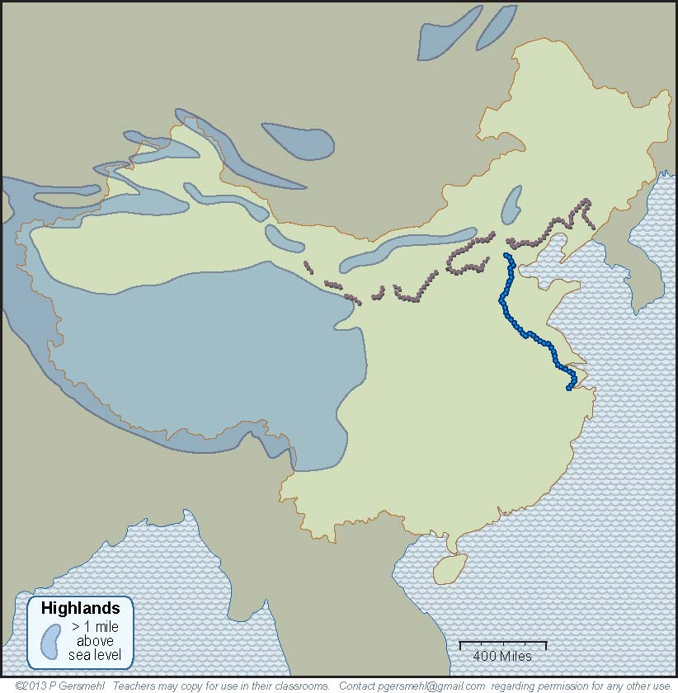
Another important
early project
(also started 2000 years ago!)
was the Grand Canal.

Slide 33
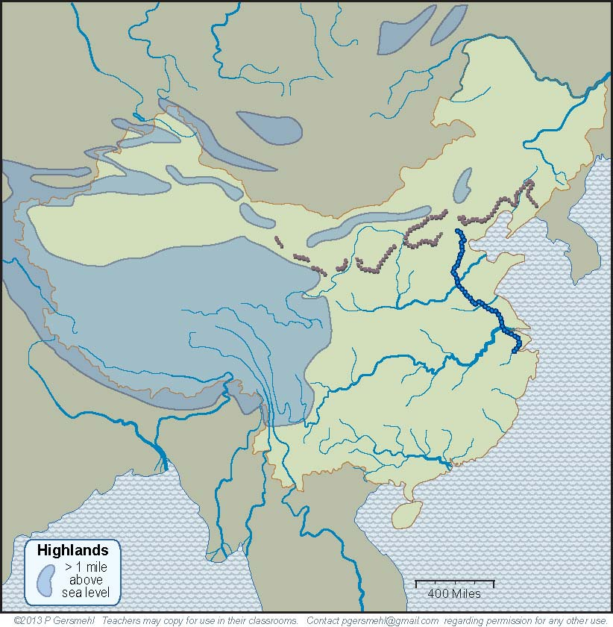
Textbooks usually
describe this canal
as a way for ships
to go between the
two large rivers.

Slide 34
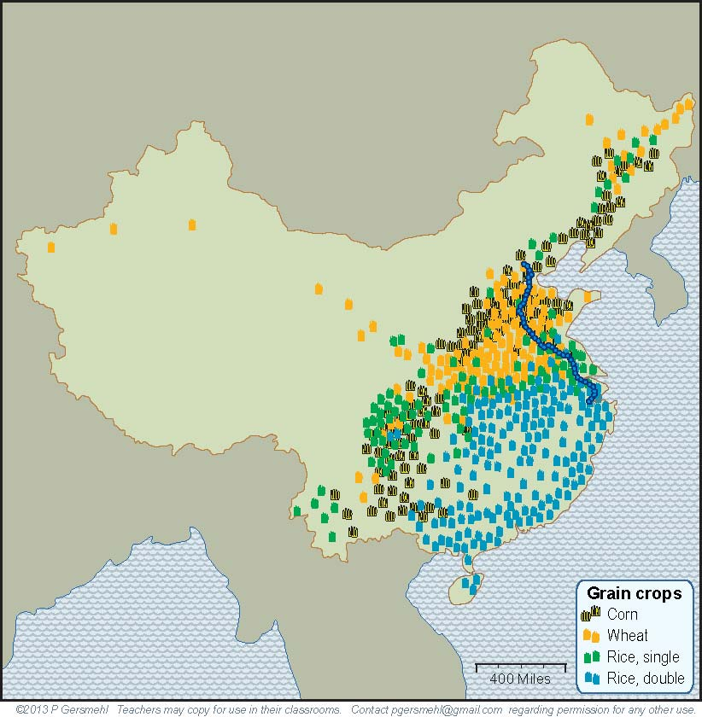
The real purpose
of this long canal,
however, was to
connect regions
that could grow different crops.
If one area had
a crop failure,
people could
use the canal
to move food
from other areas.

Slide 35
In short, it is important
to realize that China
is not homogeneous
(the same throughout the country).
Throughout its history,
China’s large population had
different groups of people
with different languages,
economies, and lifestyles.
They often cooperated,
but sometimes fought.
What are some
other consequences
of a large population?

Slide 36
A large population is likely to have a lot of smart people
who can invent things. On the internet, you can find many lists
of important Chinese inventions, including silk cloth, paper,
porcelain, magnetic compasses, gunpowder, and rockets.

Slide 37
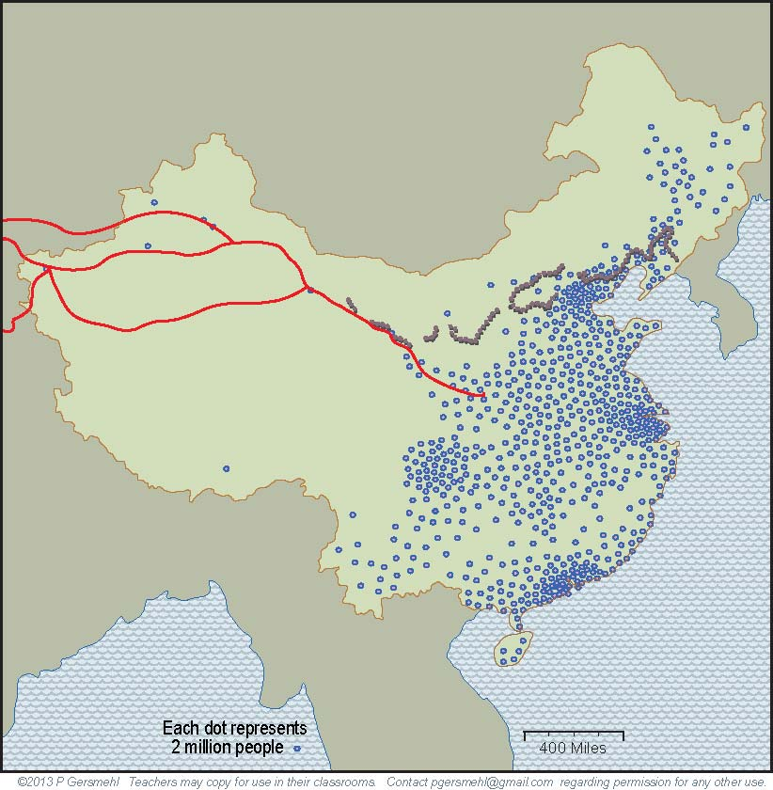
A large population is likely to have a lot of smart people
who can invent things – on the internet, you can find many lists
of important Chinese inventions, including silk cloth, paper,
porcelain, magnetic compasses, gunpowder, and rockets.
Silk was so important
that it gave its name
to some trading roads
that went all the way
to Rome and Africa,
2000 years ago!
Roman rulers
actually tried to limit
the amount of silk
people could wear – because they thought
people were spending
too much money buying
imported silk from China!
Does that idea sound familiar?
Part of the Great Wall
was built to protect
the Silk Road traders
from attacks by bandits.

Slide 38
The Silk Roads illustrate another consequence
of a large population –
people often need
to trade products
that they make
in order to get
resources they need
(like horses in ancient times,
or iron or oil today).

Slide 39
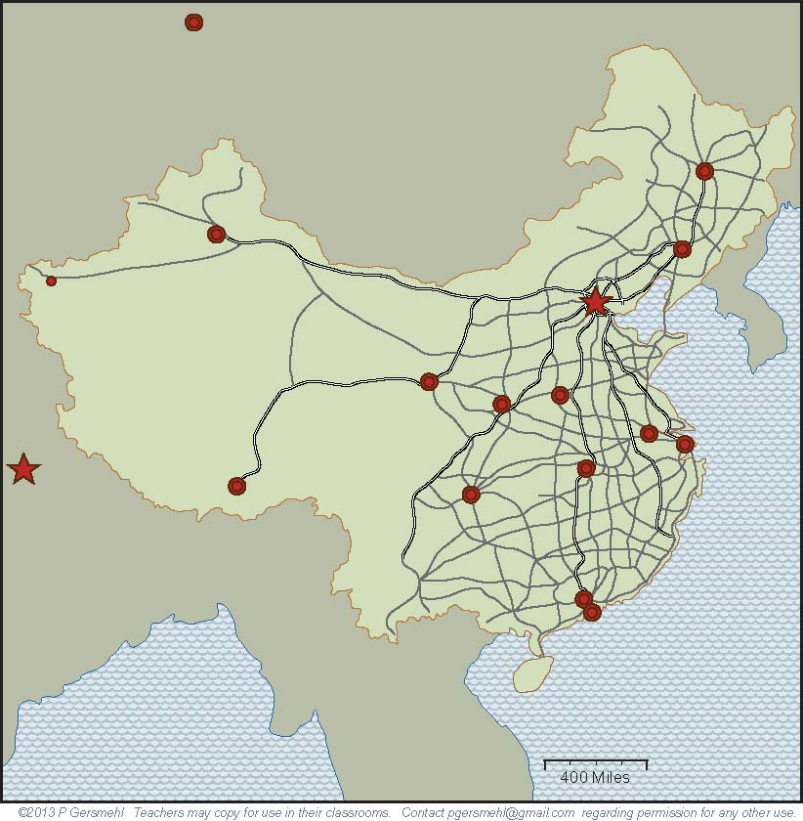
Remember the point
about large populations
being able to do
large building projects?
In just a few years, China has built
a network of highways
with as many miles
as the entire system
of Interstate Highways
in the United States
(it took nearly 40 years to
build the American system).

Slide 40
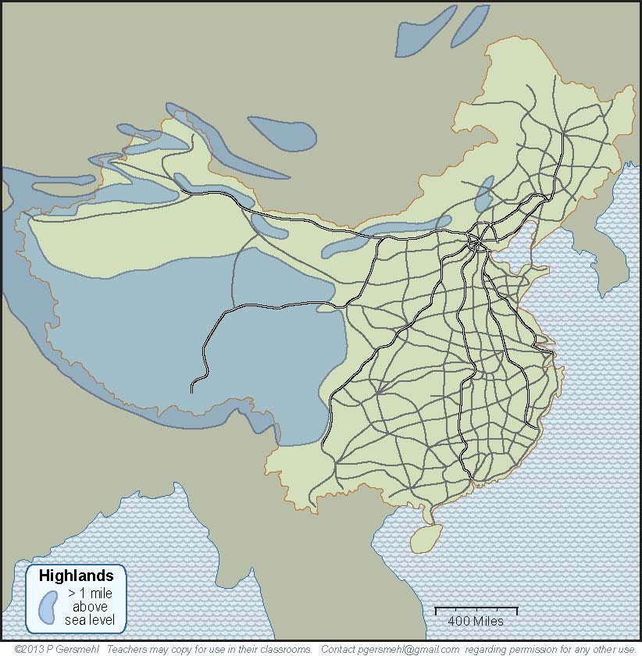
A map of this road system clearly shows how China
is divided into a crowded East and a nearly empty West.

Slide 41
Large populations
have other consequences
that are described in the text.
These include more use of resources,
greater risk of air and water pollution,
origin and rapid spread of disease,
and many complicated effects
on personal freedom.

Slide 42
The big challenge for China
is to maintain economic growth
while limiting the pollution
and other side-effects
of crowded populations.
In the 1970s, the Chinese government
decided to try to limit the growth
of population in the country.
They made a law
that made it illegal for most families
to have more than one child.

Slide 43
This law (the “one-child policy”)
helped trigger an economic boom,
by making it possible for people
to invest money in businesses
(rather than spending it to feed children).
Now, this policy adds to the challenge,
because the population is aging.
Every year, there are more old people
for every worker to help support.
Definition:
the demographic transition is the change
from high birth rates and short lives
to low birth rates and long lives.
As countries go through this transition,
the average age tends to go up.

Slide 44
Meanwhile,
the challenge for other countries
is to continue to grow in a world
where the rapidly rising wealth of China
allows its people to buy more and more
of any resource that is in short supply,
such as oil, wood, metal ores, or water.

Slide 45
This presentation showed one way to use
the clickable mini-Atlas - to help us investigate
some consequences of the big idea of population density,
with examples from China.
Population density affects:
Construction – large, dense populations can provide
plenty of workers for large building projects
Innovations – large populations are more likely to have
many thinkers, artists, inventors, etc.
Military strength – large, dense populations are harder
to attack, because they can mobilize more defenders
Resource use – large, dense populations demand
more resources to maintain the same living standard
Pollution and disease – large, dense populations make
more pollution, and diseases can spread quickly
Personal freedom – large, dense populations allow less
freedom to act without having an effect on others

Slide 47
Questions section

Slide 48
Why is China a good choice as a “lab”
to study consequences of population density?

Slide 49
What happened near the end
of nearly every important dynasty
in the long history of China?

Slide 50
How does China compare to the United States
in area and in population?
Click here to skip
the examples

Slide 51
How are
Hong Kong and Miami
similar in location
and in climate?

Slide 52
How are Shanghai and
Savannah, GA,
similar in location
and in climate?

Slide 53
How are the capital cities,
Beijing and
Washington,
similar in location
and in climate?

Slide 54
How are
Shenyang and
Pittsburgh are
similar in location
and in climate?
In what
other ways
are these
two cities
similar?

Slide 55
How are the cities of Kashgar and Reno, Nevada
similar in location and in climate?
How are they different?

Slide 56
Why doesn’t China
have any places that are like California, Oregon,
Washington, or Alaska.
Notes:
Differences

Slide 57
What other
natural features
are very important
in the United States
but absent in China?

Slide 58
Manchuria
Mongolia
How are China’s “northlands”
(Mongolia and Manchuria)
different from places like
Wisconsin, Michigan,
or Ontario, Canada?
Why was this fact important
in the history of China?

Slide 59
Partly because China
has no Great Lakes,
what other important
farming region
has no equivalent
in China?

Slide 60
What China does have is four giant river systems.
What river is
on the border
with Russia?
What does the Chinese word “He” mean?.
What does the word “Jiang” mean?
What is
the English name
of the Zhu Jiang?

Slide 61
What six cities are
the urban cores of areas
of especially large population?
1
2
3, 4
5, 6

Slide 62
What cities in the United States
have weather conditions
like these Chinese cities?
Beijing
Chongqing
Nanjing,
Shanghai
Guangzhou,
Hong Kong

Slide 63
Which of these cities
were the capital of China
at some time in the past?

Slide 64
What food crop
is shown on this map?
What environmental
conditions favor
its production?

Slide 65
What food crop
is shown on this map?
What environmental
conditions favor
its production?

Slide 66
What food crop
is shown on this map?
What environmental
conditions favor
its production?

Slide 67
What food crop
is shown on this map?
What role does it play
in the Chinese diet?

Slide 68
What
generalization
can you make
about food production
in China?

Slide 69
Why is there
such a small amount
of food production in the
northwestern half of China?

Slide 70
How does elevation limit food production
in the southwestern part of China?

Slide 71
When the map shows
the high areas
and the dry areas,
you can see that China
has only about half
as much good cropland
as the United States.

Slide 72
What major
food-producing area
does the United States
have in this general position?

Slide 73
What feature
does the
United States
have in this area
to enhance
food production?

Slide 74
What important
building project
is shown on this map?
Why is it located
where it is?

Slide 75
What important
building project
is this?
Why is it located
where it is?

Slide 76
Textbooks usually
describe this canal
as a way for ships
to go between the
two large rivers.

Slide 77
What is the value
of a ship canal
that connects
these areas?

Slide 78
What important ancient feature is represented
by these red lines?
What is the relationship
between these
building projects?
List several impacts
that the Silk Roads had
on the Roman Empire.

Slide 79
Compare
the road network
shown on this map
with the system of
Interstate Highways
in the United States.

Slide 80
What are some relationships between terrain,
precipitation, population, and highways in China?

Slide 81
What are some other consequences
of large populations?
What did Chinese rulers do
to try to limit population growth?
How effective was this policy?

Slide 82
What is the
Demographic Transition?
Why is this change
especially important
in China today?
Definition:
the demographic transition is the change
from high birth rates and short lives
to low birth rates and long lives.
As countries go through this transition,
the average age tends to go up.

Slide 83
What are some challenges
posed by the large population of China . . .
to China itself?
to other countries?

