Slide 1
complexity
A geographic “BIG IDEA” with many consequences IN europe
Complexity (of shape, geology, terrain, etc,)
is a big idea that can help us understand
many other geographic features in Europe,
including patterns of early civilizations,
empires, invasions, overseas colonization,
industrial development, two World Wars,
and issues facing the European Union today.
.
.

Slide 2
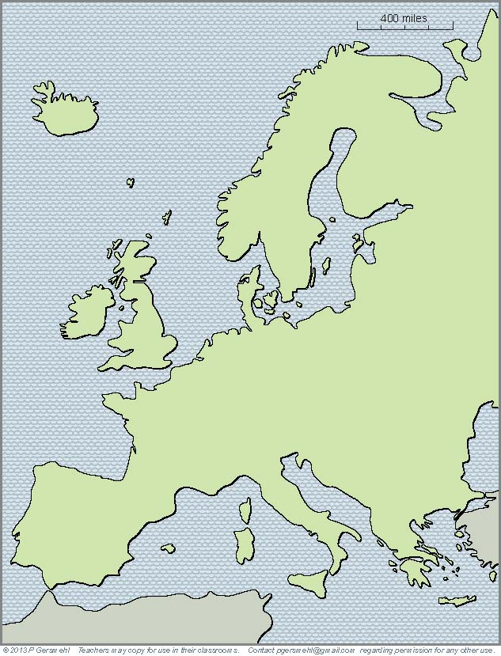
If
a continent is defined as
“a large mass of land
surrounded by water,”
Then
Europe is not a continent.
We should call it a
subcontinent (like South Asia).

Slide 3
Here is the reason why Europe
is generally considered to be “one of the seven continents:”
The maps that say so
were mostly drafted by
European cartographers.
The fact that many explorers
were from Europe, however,
is actually part of our story about the effects of complexity!
The maps that say so
were mostly drafted by
European cartographers
(using reports from European explorers).
The story starts
when we notice how
Europe is different
from most of the
“real continents.”

Slide 4
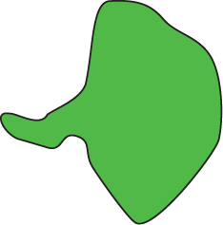
For one thing,
its overall shape is different.
Rather than being
a compact mass of land,
Europe is a big peninsula
that is made out of many
smaller peninsulas.
Definition: a peninsula
is like a small nose of land
(or leg, arm, finger, thumb)
connected to a larger landmass
on one side, and surrounded
by water on the other three sides.

Slide 5
Let’s make a list
of important peninsulas
in European history.

Slide 6
Let’s make a list
of important peninsulas
in European history.
1. Greece
1

Slide 7
Let’s make a list
of important peninsulas
in European history.
1. Greece
2. Italy (Rome)
2
1

Slide 8
Let’s make a list
of important peninsulas
in European history.
1. Greece
2. Italy (Rome)
3. Iberia
(Spain and
Portugal)
3
2
1

Slide 9
Let’s make a list
of important peninsulas
in European history.
4
1. Greece
2. Italy (Rome)
3. Iberia
(Spain and
Portugal)
4. Scandinavia
3
2
1

Slide 10
Let’s stop for a moment
to list important peninsulas
in European history.
4
1. Greece
2. Italy (Rome)
5
3. Iberia
(Spain and
Portugal)
4. Scandinavia
5. Jutland (Denmark)
3
2
1

Slide 11
Let’s make a list
of important peninsulas
in European history.
4
1. Greece
2. Italy (Rome)
5
3. Iberia
(Spain and
Portugal)
C
D
4. Scandinavia
6
B
N
5. Jutland (Denmark)
6. Dover, Cornwall,
Brittany, Normandy
3
2
1

Slide 12
Let’s make a list
of important peninsulas
in European history.
7
4
1. Greece
2. Italy (Rome)
5
3. Iberia
(Spain and
Portugal)
C
D
4. Scandinavia
6
B
N
5. Jutland (Denmark)
6. Dover, Cornwall,
Brittany, Normandy
3
2
1
7. Kola
(Cold War
submarines)

Slide 13
A peninsula is like
a room with only one door.
Enemy armies can attack it
from only one direction.
(Attacking from the sea is also hard, because the people who live
on islands and peninsulas
need ships to get around
and usually have a strong navy!)

Slide 14
Its many peninsulas
and islands give Europe
a very long coastline.
Even though Europe is only one-third as large as Africa,
it has nearly twice as many
miles of coastline as Africa,
Australia, and South America,
put together.
Why is that important?
Because Europe has
a lot of quiet bays
and sheltered harbors
for sailing ships to use.
That is an important part
of Europe’s history.

Slide 15
The complex shape
is a consequence of
a complex geologic history.

Slide 16
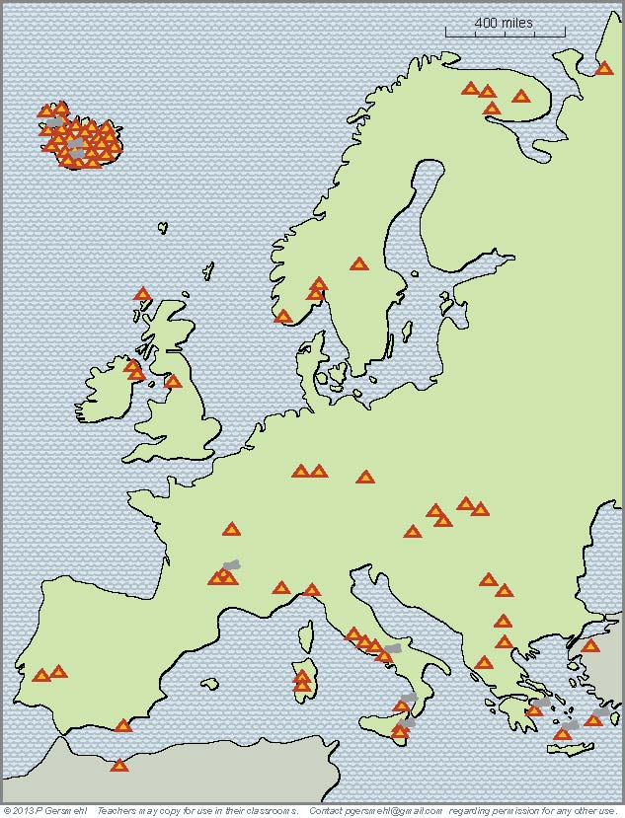
The complex shape
is a consequence of
a complex geologic history.
Even if
we don’t count Iceland
(which is all volcanic),
Europe has
many more volcanoes
than most other areas
of comparable size.
The list includes Vesuvius
(the famous volcano that destroyed
the Roman city of Pompeii).

Slide 17
Even more important,
Europe’s volcanoes
are scattered around,
not grouped together
in one small area.

Slide 18
Most of the volcanoes
mark the locations
where crustal plates
“collided” a long time ago.
Europe has had a lot
of crustal collisions –
the subcontinent was
actually “assembled” from
a bunch of smaller plates.

Slide 19
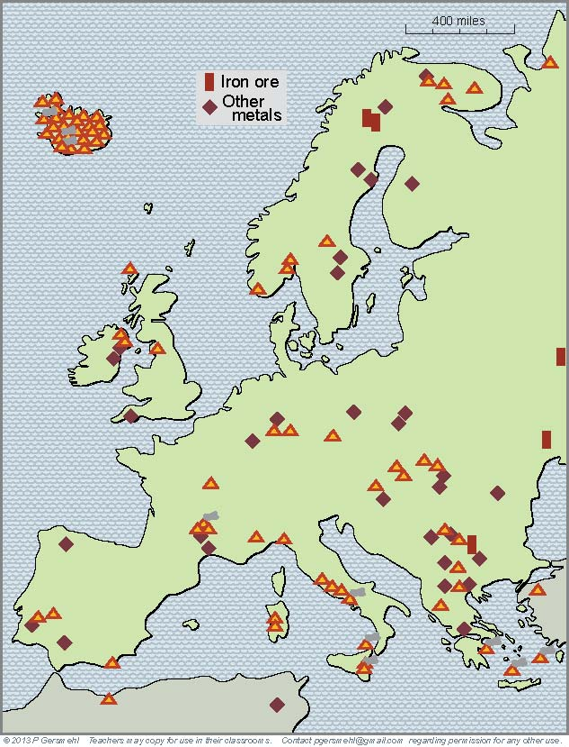
Most of the volcanoes
mark the locations
where crustal plates
“collided” a long time ago.
Europe has had a lot
of crustal collisions –
the subcontinent was
actually “assembled” from
a bunch of smaller plates.
This is important,
because certain kinds
of crustal collisions
can put metal ores
into the ground
and Europe is lucky to have
a lot of metal mines!

Slide 20
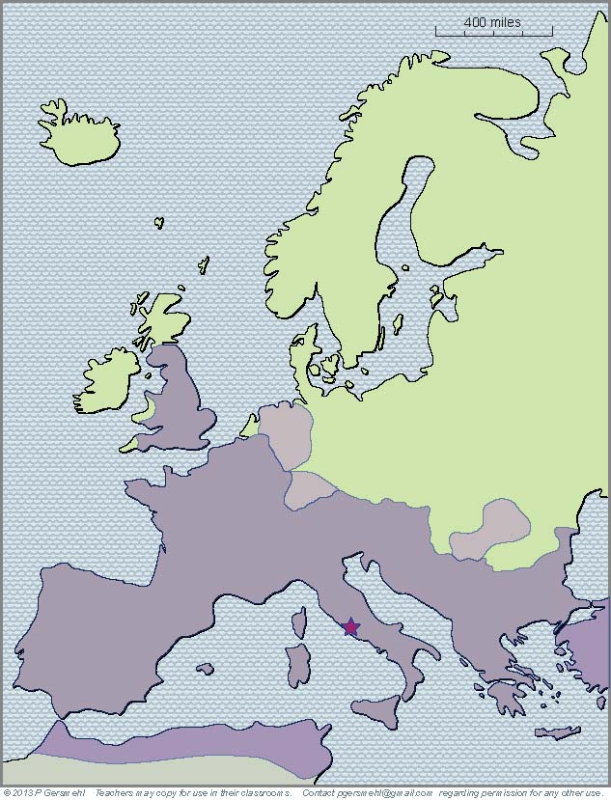
Ancient people
may not have understood
the geologic principles,
but they knew how
to find metal ores.
The Romans, for example,
got tin from Cornwall
silver from Dalmatia
and copper and lead
from Iberia (Spain).
Roman Empire
Rome

Slide 21
As we already said,
a complex geologic history
gave Europe a complex shape,
with many bays and peninsulas.

Slide 22
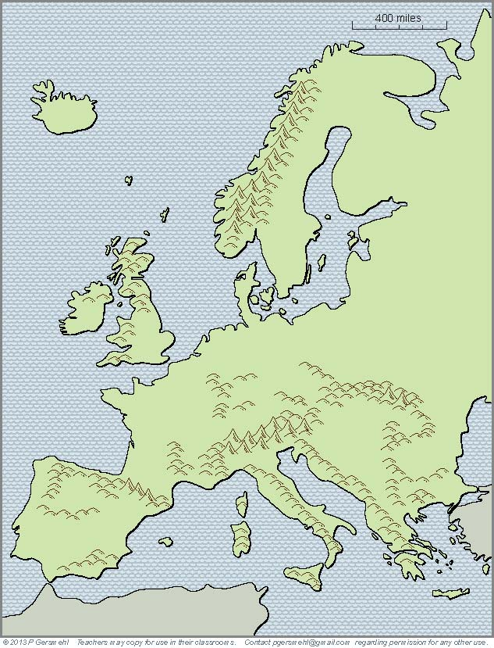
If you add mountains
to the map, you see
that they often block
the only “door”
into a peninsula.

Slide 23
If you add mountains
to the map, you see
that they often block
the only “door”
into a peninsula.
Thermopylae
was a narrow path
around the mountains
that blocked the entrance
into the Greek peninsula

Slide 24
If you add mountains
to the map, you see
that they often block
the only “door”
into a peninsula.
Hannibal surprised people
when he crossed the Alps
in order to attack Rome.

Slide 25
If you add mountains
to the map, you see
that they often block
the only “door”
into a peninsula.
The Pyrenees
blocked the advance
of the Moor armies
invading from Africa.
They were defeated
every time they tried
to cross these mountains, but they were able to hold
the Iberian peninsula
and stay in Europe
for several centuries.

Slide 26
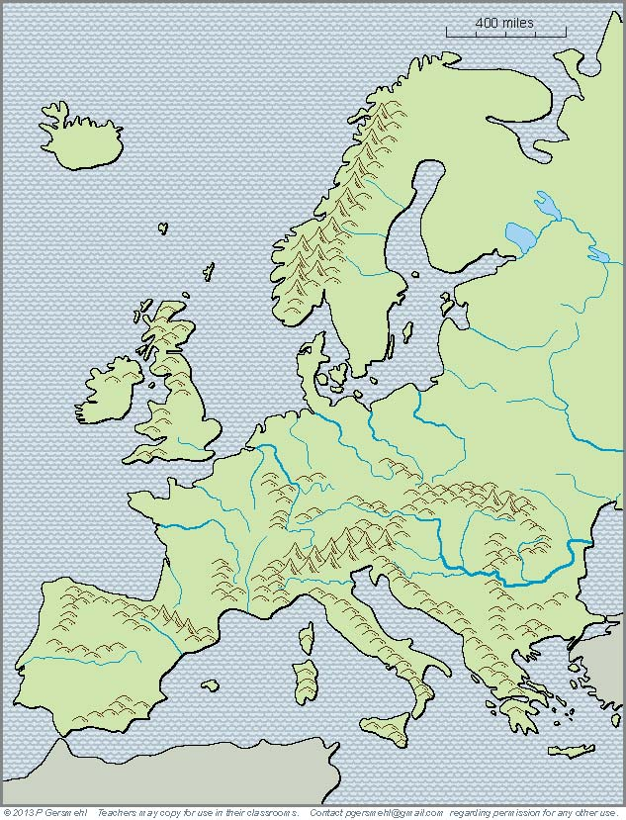
Europe also has
more mountains
cutting across the land
than most other continents.
The Carpathian Mountains
were a barrier between Magyars (Hungarians)
and Slavs (Russians).
These mountains also helped
stop the advance of the Mongols
when they invaded from Asia.

Slide 27
The Ottoman sultans
tried several times
to capture Vienna,
which blocked the gap
where the Danube River
goes through the mountains.
The Romans had a fort there, too,
and Napoleon was defeated there.
Europe also has
more mountains
cutting across the land
than most other continents.

Slide 28
In short, locations on peninsulas
(or in areas that were blocked by mountains)
allowed many groups of people to survive
even when they had hostile neighbors.
Several times in the past, people spread
out from their peninsula and tried to capture
a larger area as part of their empire.
The Greeks did that, and the Romans.
The Moors also tried, but less successfully.
Then, in the 8th century, another group of people
started to spread outward from their homeland,
which was a small peninsula in northern Europe.

Slide 29
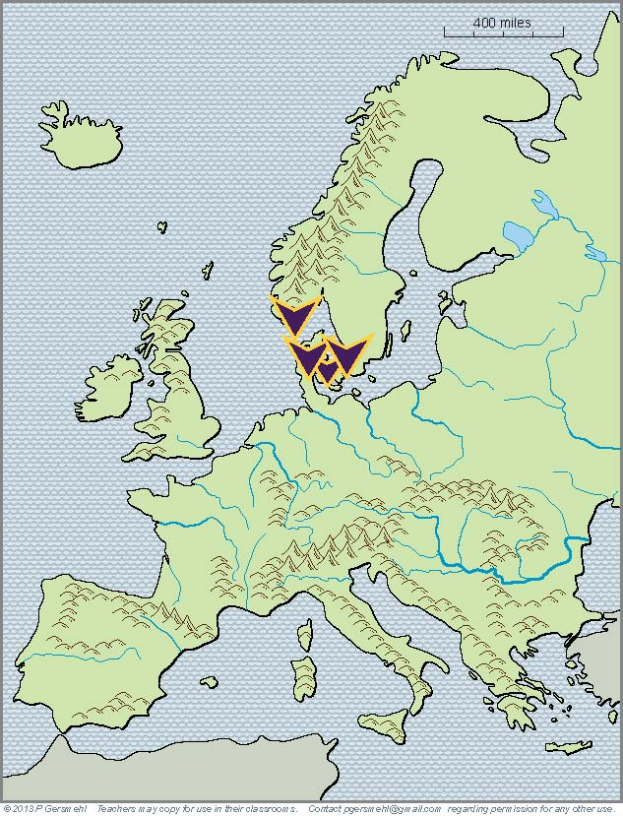
Around the year 750,
the Vikings were
a loosely organized group
on the small Jutland peninsula,
the south end of Scandinavia,
and some islands in between.

Slide 30
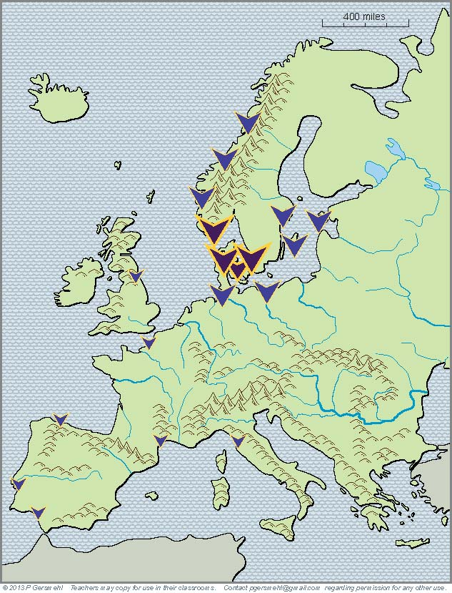
By the middle of the 8th century,
the Vikings had spread
along nearby coasts
and done some raiding
as far south as Italy.

Slide 31
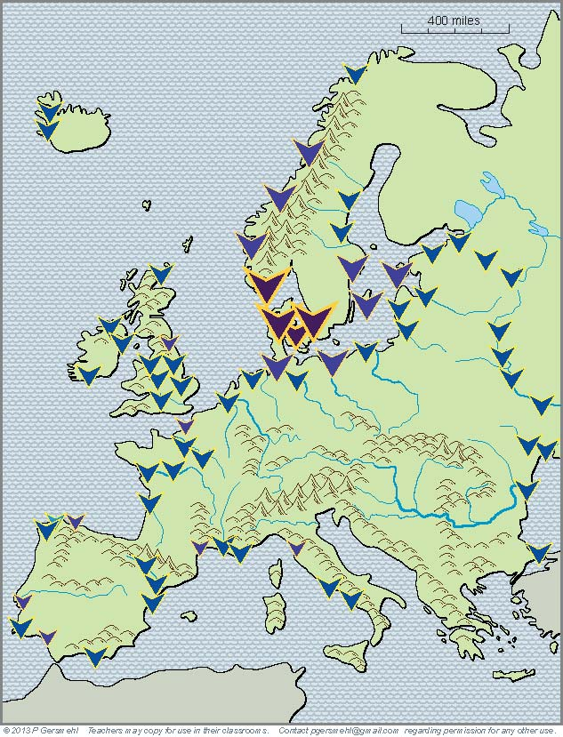
By the middle of the 9th century,
the Vikings had spread
across much of England
and gone on raiding trips
and/or built trading posts
as far south as Constantinople.

Slide 32
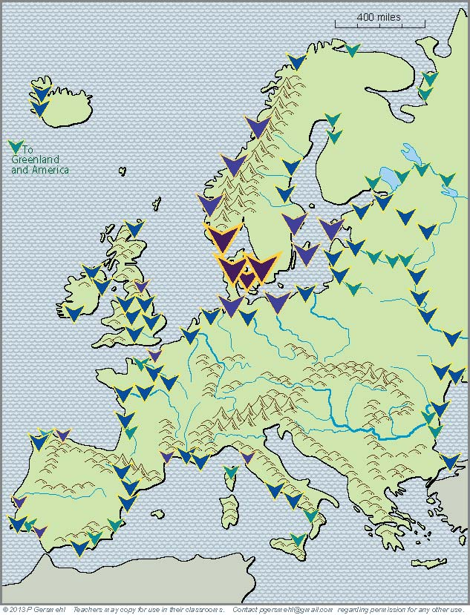
By the middle of the 10th century,
other European countries
had become stronger.
The Vikings were losing
on mainland Europe,
but many Viking explorers
crossed the Atlantic Ocean
to Greenland and the Americas.

Slide 33
What do we know so far?
1. A peninsular location may be good
for defensive purposes (and for survival),
BUT
2. A small peninsula is seldom likely
to have all the resources needed
for a rapidly growing economy.
As a result, peninsular countries
have often tried to expand across the land
and around the bays and sheltered seas
since the time of the Greeks and Romans.

Slide 34
After Europe got gunpowder
and magnetic compasses
from Chinese inventors,
the deep bays
and sheltered harbors
on islands and peninsulas
became the home bases
for overseas exploration.
Home Ports for
Overseas Explorers
Portugal, Spain,
England, France,
the Netherlands,
Italy, and Germany
all claimed colonies
on other continents.

Slide 35
Late in the colonial era . . . .
the geologic complexity of Europe
turned out to be a big advantage
at the beginning of the Industrial Revolution.

Slide 36
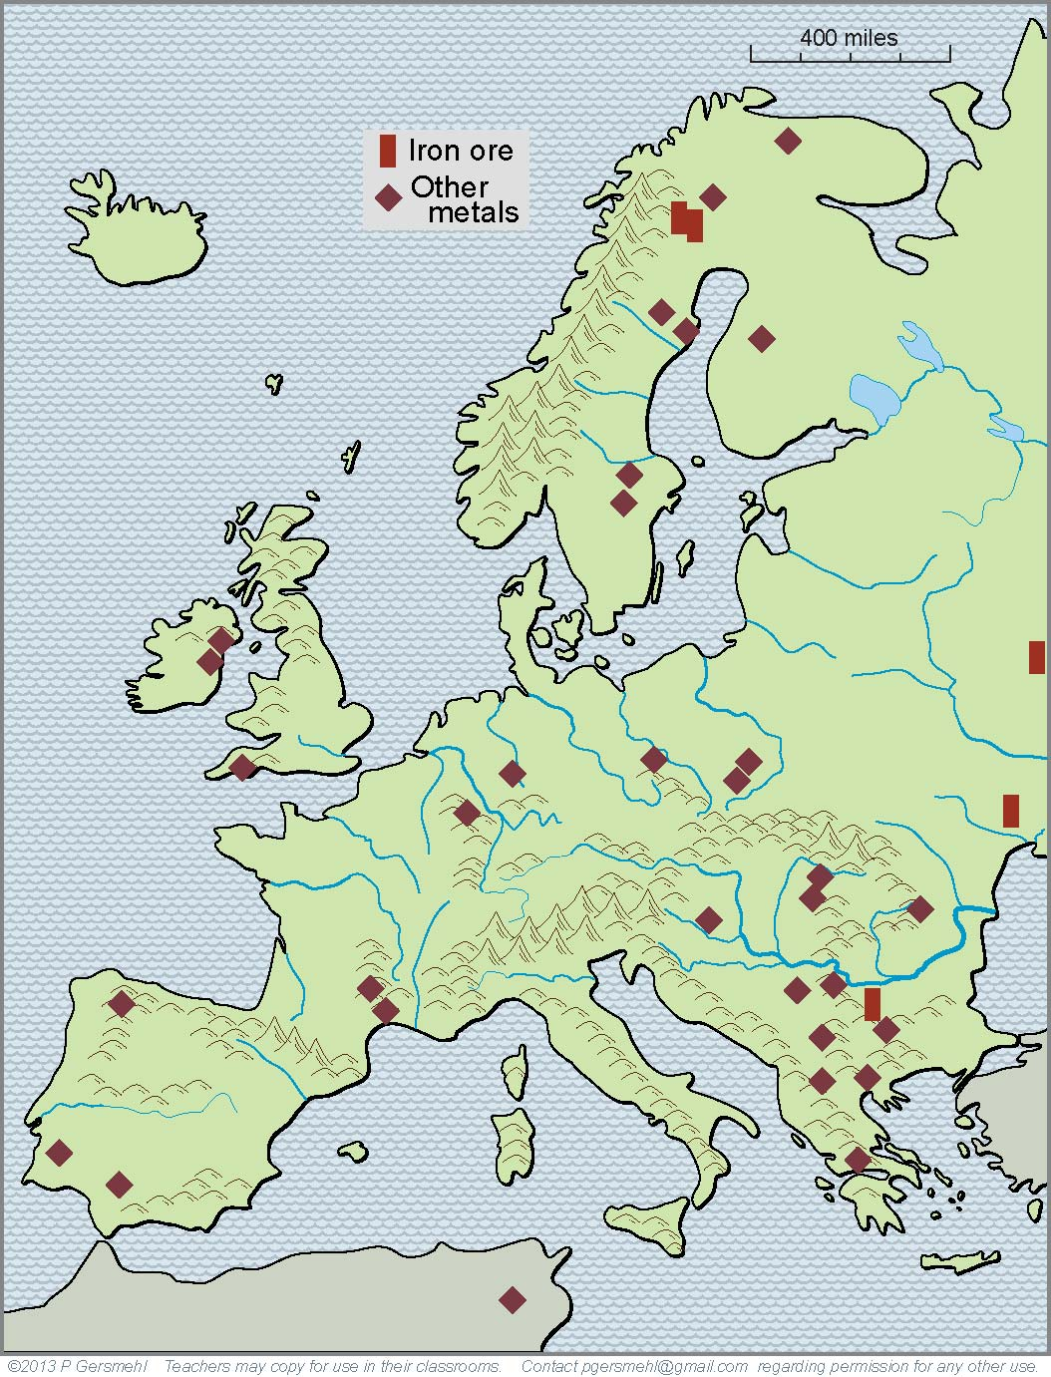
We have already seen
how geologic forces
made a complex pattern
of mountains of different ages
and were also responsible
for the formation of
valuable metal ores.

Slide 37
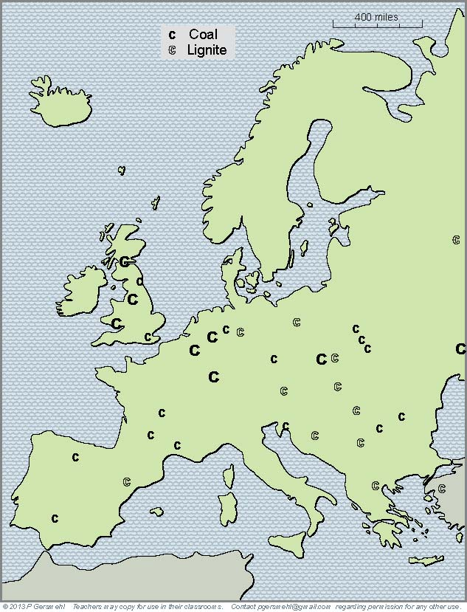
We have already seen
how geologic forces
made a complex pattern
of mountains of different ages
and were also responsible
for the formation of
valuable metal ores.
This geologic complexity
also helps us understand
why Europe is fortunate
to have deposits of coal
scattered in many places.

Slide 38
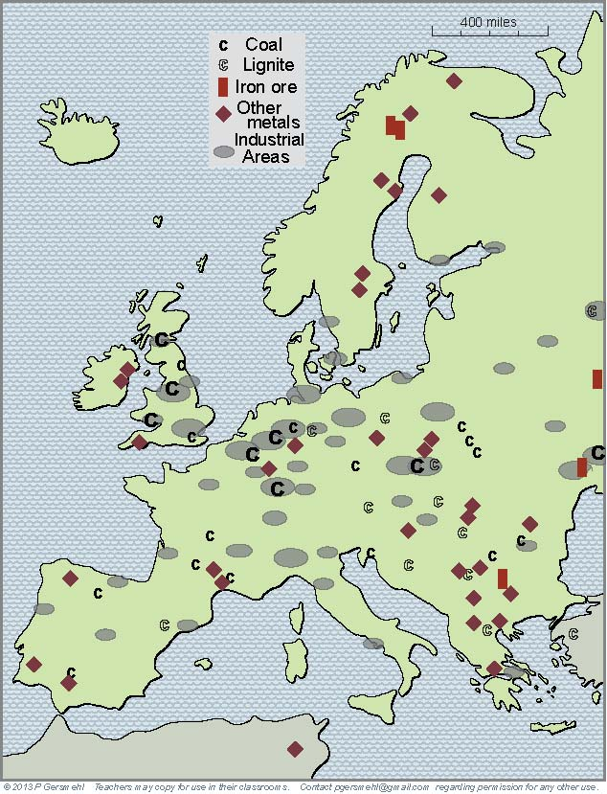
At the start
of the Industrial Revolution,
these widely scattered
metal and coal mines
could support many
separate clusters of factories
(the gray ovals on this map).

Slide 39
Especially important
industrial areas
included:
The Midlands
Ruhr Valley
Silesia
Donbass
Bilbao
Rhone
Valley

Slide 40
The scattered development
allowed by complex geology
had a downside, however.

Slide 41
The scattered development
allowed by complex geology
had a downside, however.
Widely scattered factories,
along with overseas colonies,
helped European countries
to stay independent.
As a result, they could
continue their old rivalries
even into the modern age.
Sweden
Rus
Lithuania
England
Nether-
lands
Prussia
Austria
Hungary
France
Balkans
Spain
Italy
Ottoman
Empire

Slide 42
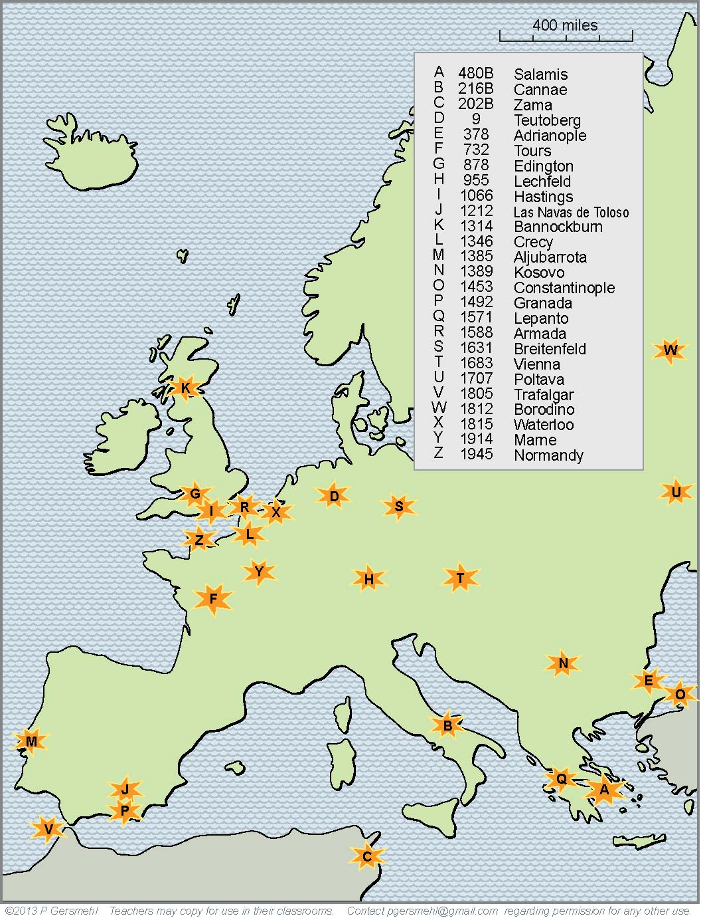
This map shows the locations
of just 25 of the major battles
that marked turning points
in European history.
As time went on,
weapons became
more and more deadly.
In the twentieth century,
old European rivalries erupted
into two world wars.

Slide 43
So far, we have noted
how geographic complexity
was important in defense,
industrial development,
overseas colonization,
and maritime trade.
As a “backhand”
form of evidence
for the importance of
geographic complexity,
we might look at an area
that is not very complex,
not on a peninsula,
and not protected
by mountains.

Slide 44
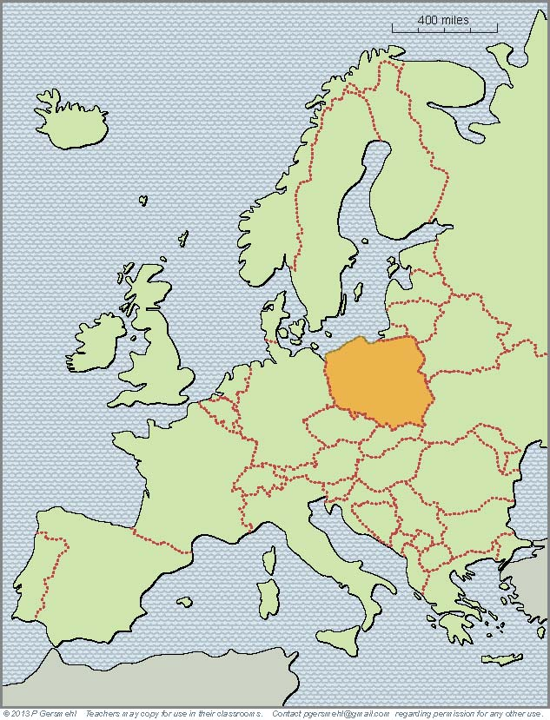
The country we now know
as Poland has a history
that stretches back
more than a thousand years.
During that time,
it has been invaded
(and often conquered)
by a “Who’s Who”
of great invaders:
Huns, Vikings,
Mongols, Slavs,
Hapsburgs, Prussians,
Napoleon, the Nazis,
and the Soviet Union.
You can find websites that show the extent
of “Poland” at many different times in history –
here, we will show just a few time periods.

Slide 45
Around the year 700,
a group of people
called themselves
the Polans.

Slide 46
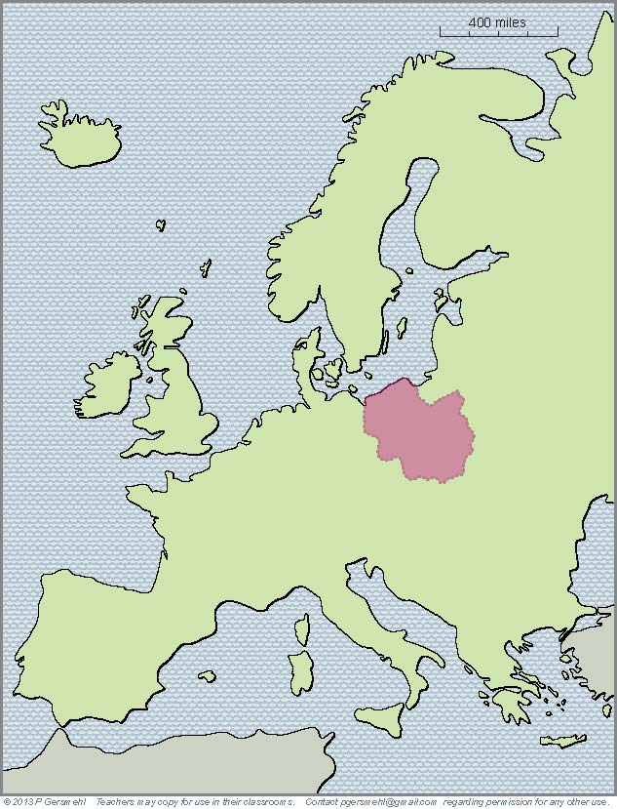
Around the year 700,
a group of people
called themselves
the Polans.
By about the year 1000,
the Polans had expanded
and formed a national
government.

Slide 47
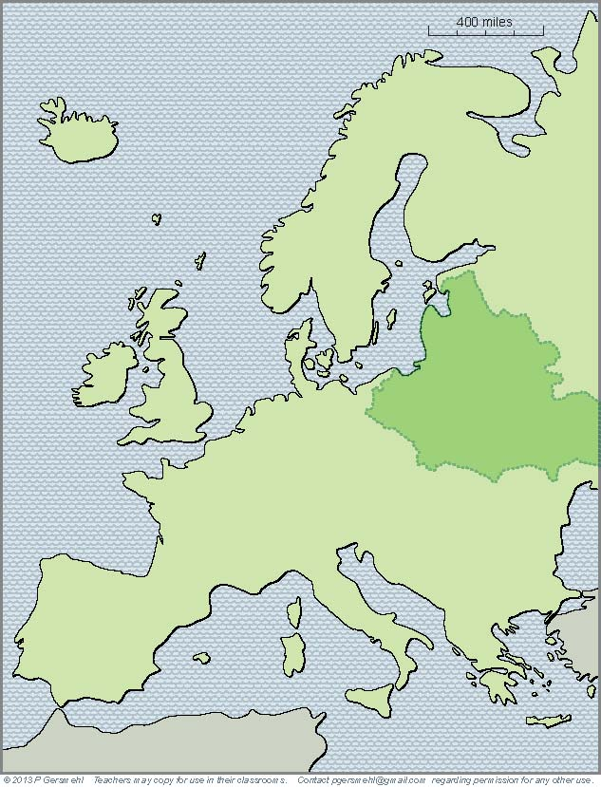
Around the year 700,
a group of people
called themselves
the Polans.
By about the year 1000,
the Polans had expanded
and formed a national
government.
By the 1500s,
Poland had linked
with Lithuania to form
a major European empire.
Under John Sobieski, they helped save
Vienna (and the Hapsburg Empire)
from the Ottoman invaders.

Slide 48
Around the year 700,
a group of people
called themselves
the Polans.
By about the year 1000,
the Polans had expanded
and formed a national
government.
By the 1500s,
Poland had linked
with Lithuania to form
a major European empire.
Under John Sobieski, they helped save
Vienna (and the Hapsburg Empire)
from the Ottoman invaders.
Then other countries became more powerful,
and “Poland” disappeared from the map

Slide 49
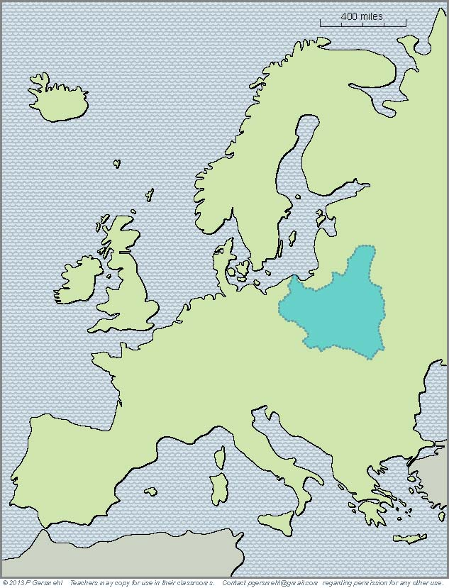
Around the year 700,
a group of people
called themselves
the Polans.
By about the year 1000,
the Polans had expanded
and formed a national
government.
By the 1500s,
Poland had linked
with Lithuania to form
a major European empire.
In the mid 20th century,
after several centuries
of rule by other countries,
Poland reappeared as
an independent country.

Slide 50
Around the year 700,
a group of people
called themselves
the Polans.
By about the year 1000,
the Polans had expanded
and formed a national
government.
By the 1500s,
Poland had linked
with Lithuania to form
a major European empire.
In the mid 20th century,
after several centuries
of rule by other countries,
Poland reappeared as
an independent country.
Then the Nazis invaded,
and “Poland” disappeared.

Slide 51
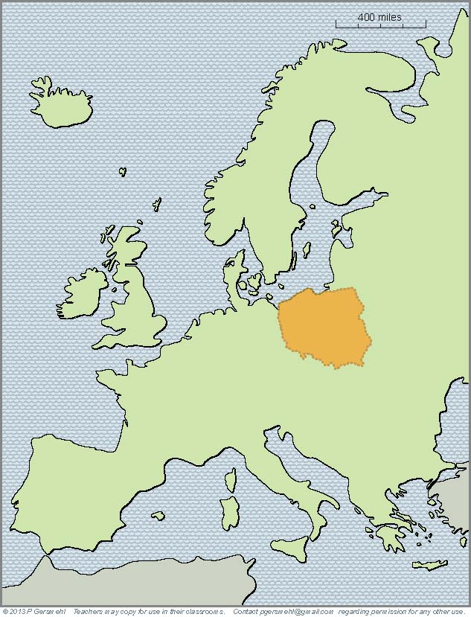
Around the year 700,
a group of people
called themselves
the Polans.
By about the year 1000,
the Polans had expanded
and formed a national
government.
By the 1500s,
Poland had linked
with Lithuania to form
a major European empire.
In the mid 20th century,
after several centuries
of rule by other countries,
Poland reappeared as
an independent country.
1n 1945, Poland
reappeared on the map,
but in a somewhat
different area.
It was, however,
under the control
of the Soviet Union.

Slide 52
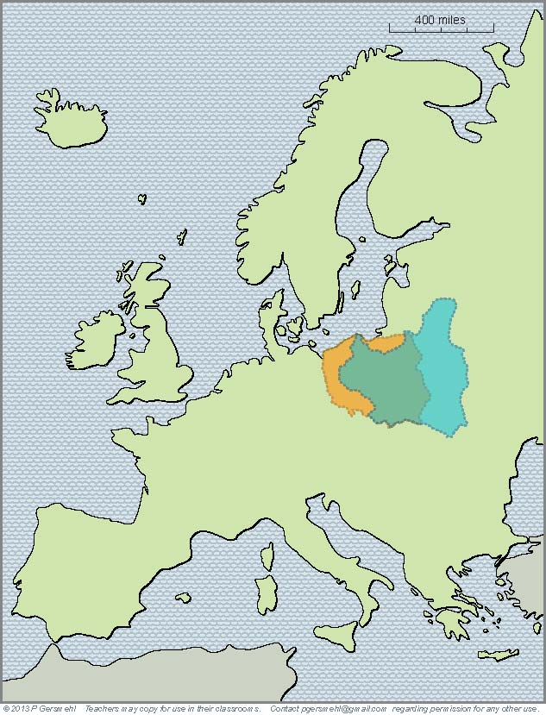
Around the year 700,
a group of people
called themselves
the Polans.
By about the year 1000,
the Polans had expanded
and formed a national
government.
By the 1500s,
Poland had linked
with Lithuania to form
a major European empire.
In the mid 20th century,
after several centuries
of rule by other countries,
Poland reappeared as
an independent country.
1n 1945, Poland
reappeared on the map
covering a somewhat
different area.
Compare the shape
of Poland before
and after World War II.
You can see why many
Poles decided to move.

Slide 53
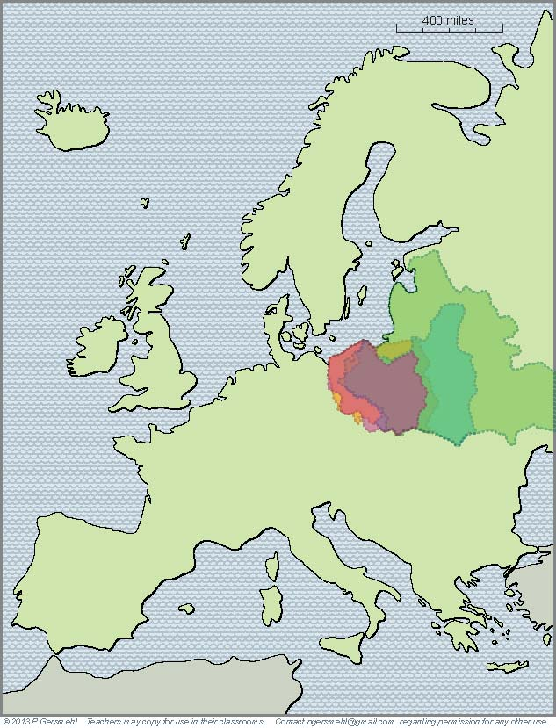
Around the year 700,
a group of people
called themselves
the Polans.
By about the year 1000,
the Polans had expanded
and formed a national
government.
By the 1500s,
Poland had linked
with Lithuania to form
a major European empire.
In the mid 20th century,
after several centuries
of rule by other countries,
Poland reappeared as
an independent country.
1n 1945, Poland
reappeared on the map
covering a somewhat
different area.
Compare the shape
of Poland before
and after World War II.
You can see why many
Poles decided to move!
And if you put even our
limited sample of “Polands”
on top of each other,
you can see the effects
of living in an area
that is hard to defend.

Slide 54
One more consequence
of the historic complexity of Europe
is in the headlines today.
Dismayed by centuries of fighting,
European rulers tried a bold experiment.
They decided to give up
some of their national powers
and form a European Union.
But the age-old differences
have emerged in new ways
to threaten this Union.

Slide 55
One more consequence
of the historic complexity of Europe
is in the headlines today.
Dismayed by centuries of fighting,
European rulers tried a bold experiment.
They decided to give up
some of their national powers
and form a European Union.
But the age-old differences
have emerged in new ways
to threaten this Union.
Here’s a big issue facing European people today:
Can Europeans resolve their old differences, so that they can
work together to deal with changing economies and aging populations?

Slide 56
This presentation showed one way to use
the clickable mini-Atlas - to help us investigate
some consequences of the big idea of complexity,
with examples from the subcontinent of Europe.
Complexity can involve:
Shape – complex shapes produce defensible homelands,
because peninsulas have only one “entrance door”
Terrain – mountains can also help isolate places
and make them harder to attack
Sheltered harbors – complex coastlines often provide
safe harbors, especially important for sailing ships
Metal ores – complex geology is usually the result of
crustal collisions, which also form metal ores
Energy resources – complex geology also gave Europe
a lot of coal, important for the Industrial Revolution
Diplomatic issues – complex political situations can lead
to economic problems and frequent wars

Slide 58
questions section

Slide 59
Why
is it probably inaccurate
to call Europe a continent?
Why
is it more accurate
to call Europe a
subcontinent
(like South Asia).

Slide 60
Why is Europe
generally considered to be “one of the seven continents”?
How is that fact
related to the big idea
of geographic complexity?
We’ll try to answer
this question
in this presentation.

Slide 61
What does it mean
to call Europe
a big peninsula
made out of many
smaller peninsulas?
Definition: a peninsula
is like a small nose of land
(or leg, arm, finger, thumb)
connected to a larger landmass
on one side, and surrounded
by water on the other three sides.

Slide 62
Do you remember the names
of these peninsulas?
7
4
5
6
3
2
1

Slide 63
Let’s make a list
of important peninsulas
in European history.
Do you remember
their names?
7
4
1. Greece
2. Italy (Rome)
5
3. Iberia
(Spain and
Portugal)
C
D
4. Scandinavia
6
B
N
5. Jutland (Denmark)
6. Dover, Cornwall,
Brittany, Normandy
3
2
1
7. Kola
(Cold War
submarines)

Slide 64
Why is a peninsula like
a room with only one door?
Why was this important
in European history?

Slide 65
How does the coastline
of Europe compare
with the coastlines
of Africa, Australia,
or South America?
Why was this important
in European history?

Slide 66
How does the pattern
of volcanic eruptions
have an effect
on the overall shape
and subsurface geology
of Europe?

Slide 67
What is the relationship
between volcanoes
and metal ores?
Why was this important
in European history?

Slide 68
Ancient people
may not have understood
the geologic principles,
but they knew how
to find metal ores.
What did the Romans
get from Cornwall
Dalmatia
and Iberia (Spain).
Roman Empire
Rome

Slide 69
Why does Europe
have so many
separate ranges
of mountains?
Why was this important
in European history?

Slide 70
What was the name
of a narrow path
around the mountains
that blocked the entrance
into the Greek peninsula?

Slide 71
What is the name
of these mountains?
What African general surprised many people
when he crossed them
in order to attack Rome?

Slide 72
What is the name
of this mountain range?
What was the role
of these mountains
in European history?

Slide 73
What is the name
of this mountain range?
What was the role
of these mountains
in European history?

Slide 74
What city
is located here?
Why is this location
strategically important?
Name at least three
different times
when this place
was important.

Slide 75
What group of people
started on these
northern peninsulas?
About when did they
begin to expand
and raid other territories?

Slide 76
Two centuries later,
these people had
gone on raiding trips
and/or built trading posts
as far south as
this famous city.
What is its name?
Why is it important?

Slide 77
What two inventions
did Europeans get
from Chinese inventors?
What major world era
started shortly after
these technical changes?
Home Ports for
Overseas Explorers

Slide 78
During what major world era
was it especially important
to have access to metal ores
and deposits of coal?

Slide 79
1
2
Name these
industrial areas:
3
4
6
5

Slide 80
How can ideas
about shape complexity
and geologic complexity
help us understand
the military history
of Europe?

Slide 81
How would you describe
the location of Poland?
What are some
consequences
of its location
in an area
with few mountains
or sheltered harbors?

Slide 82
When does history record
a group of people
who called themselves
the Polans?

Slide 83
By what year
had the Polans expanded
and formed a national
government?

Slide 84
What country had become
allies with the Polans
around the year 1500?
How did these people help save
the Habsburg Empire?

Slide 85
Under John Sobieski, they helped save
Vienna (and the Hapsburg Empire)
from the Ottoman invaders.
Then other countries became more powerful,
and “Poland” disappeared from the map

Slide 86
This map shows
Poland in 1938.
What happened then?
How did the lack
of geographic complexity
make that easier?

Slide 87
1n 1945, Poland
reappeared on the map,
but in a somewhat
different area.
What empire
now had control
over Poland?

Slide 88
How does this map
help explain why many
Poles decided to move?

Slide 89
How does putting
these maps of “Poland”
help us understand
some of the problems
of living in an area
that is hard to defend?

Slide 90
Finally, how does
the complex geography
(and the complex history)
of the subcontinent of Europe
help us understand the problems
facing the European Union today?

