Slide 1
Population
and
Population Growth
6th grade network Oct. 28, 2015 carol.gersmehl@gmail.com

Slide 2
GLCEs about Population
6 – G1.2.3 Use, interpret, and create maps representing population . . . 6 – G1.2.6 Create a map of the population distribution of a region and generalize about factors influencing the distribution of population 6 – G2.2.4 Create population pyramids for different regions and interpret . . . discussing birth and death rate, growth rate, and age structure.
OLD 6 – G1.2.3
Use data to create thematic maps and graphs showing patterns of population,
physical terrain, rainfall, and vegetation, analyze the patterns and then propose two generalizations about the location and density of population.

Slide 3
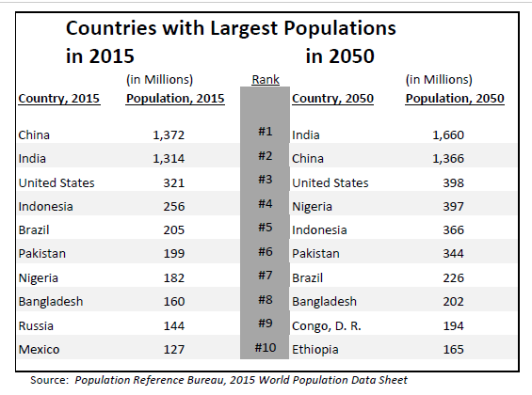
(We’ll look
at this side
later.)

Slide 4
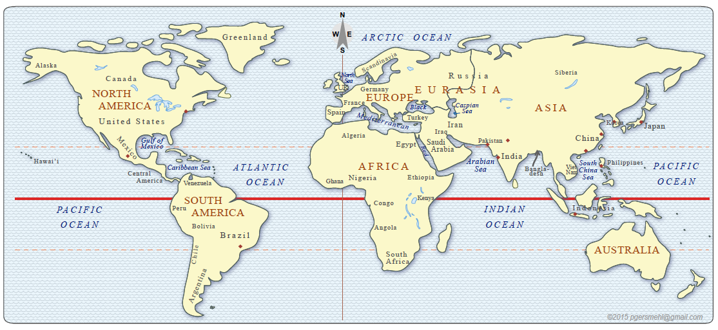
2015 Largest Population Countries
Use the data table.

Slide 5
2015 Largest Population Countries
5
1
1
2
1
Asia

Slide 6
144
321
199
1,372
127
160
1,314
186
256
205
2015 Largest Population Countries
Population numbers are in millions
We can show the 10 largest population countries in different ways.

Slide 7
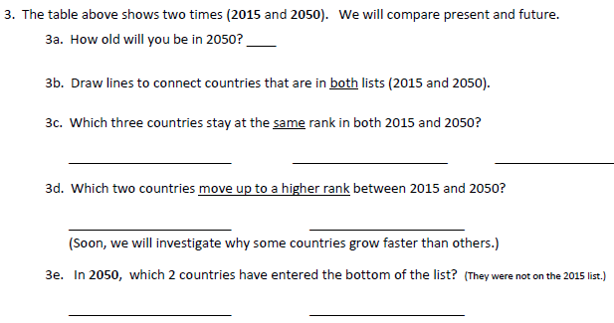
Compare present and future!

Slide 8
Discuss: Why are some countries likely to grow faster than others?
Draw arrows and note especially the countries that went up in rank.

Slide 9
2050 (Future) Largest Population Countries
Next, we will look at possible reasons for why some countries grow faster than others!
NOTE: Two African countries enter the top 10 by 2050!

Slide 10
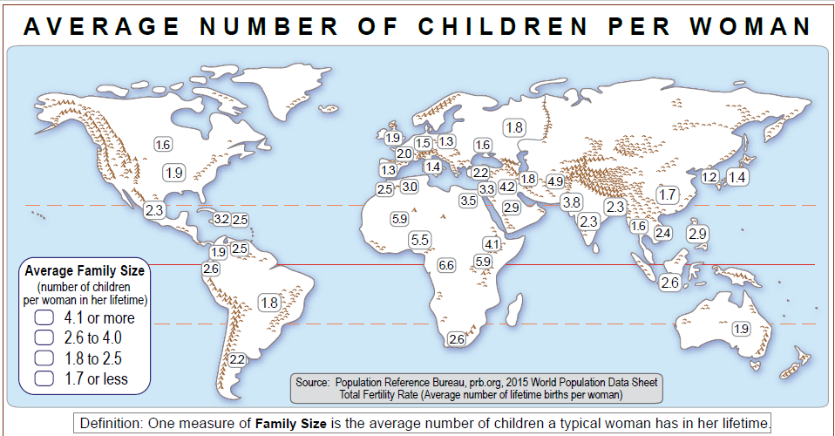
Circle numbers that are 4.1 or higher.
Underline numbers that are 1.7 or lower.
This map may help us understand why some countries grow faster than others!

Slide 11
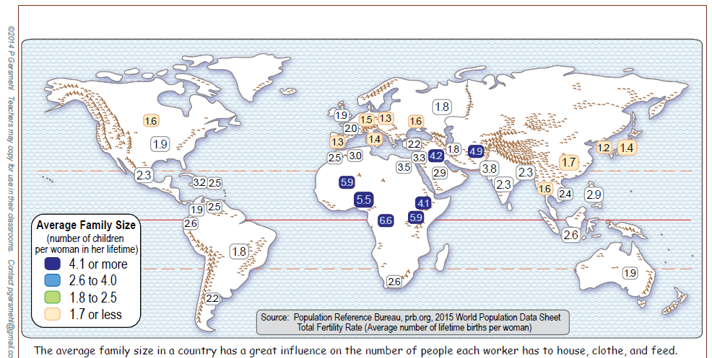
Where are the higher numbers? 4.1 or higher
Where are the lower numbers? 1.7 or lower
We traced around “high” regions.
Trace around “low” regions.
Use “spatial thinking” words: Describe where the highest and lowest “regions” are located.

Slide 12
Make a prediction: Which countries would be likely to grow faster than others?
- Countries in the highest category for average family size?
- Countries in the lowest category for average family size?

Slide 13
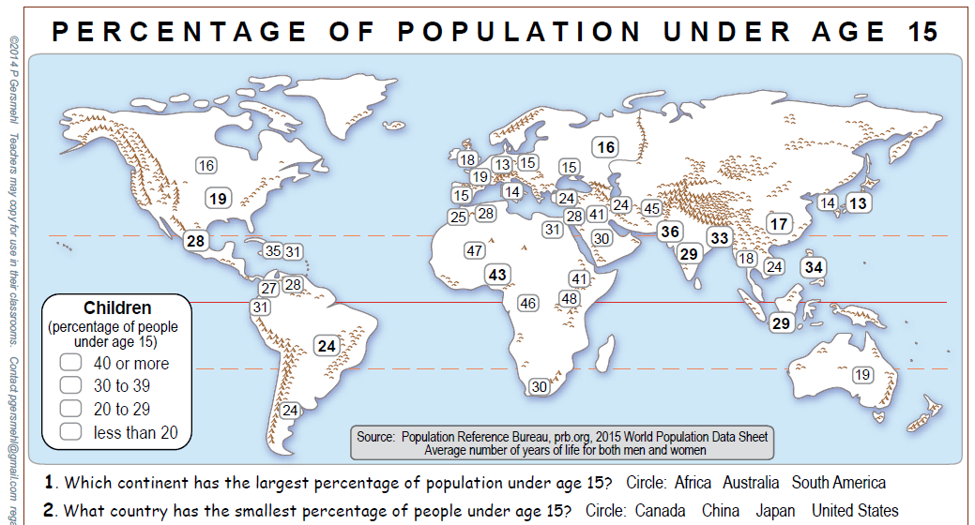
Circle numbers that are 40 or higher.
Underline numbers that are 20 or lower.
This map may also help us understand why some countries grow faster than others!

Slide 14
Where are the higher numbers? 40% or higher
Where are the lower numbers? 19% or lower
Trace around “high” regions.
Trace around “low” regions.
Use “spatial thinking” words: Describe where each “region” is located.

Slide 15
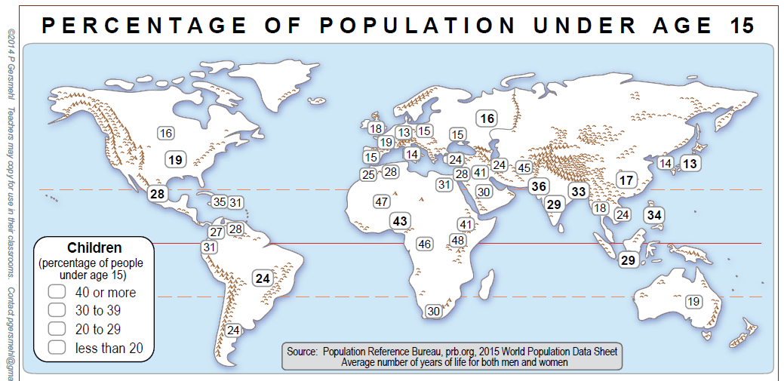
Compare two maps.
Where are both topics HIGHEST? __________________________________ Where are both topics LOWEST? __________________________________
Highest are in Central Africa.
Lowest are in Europe & East Asia.

Slide 16
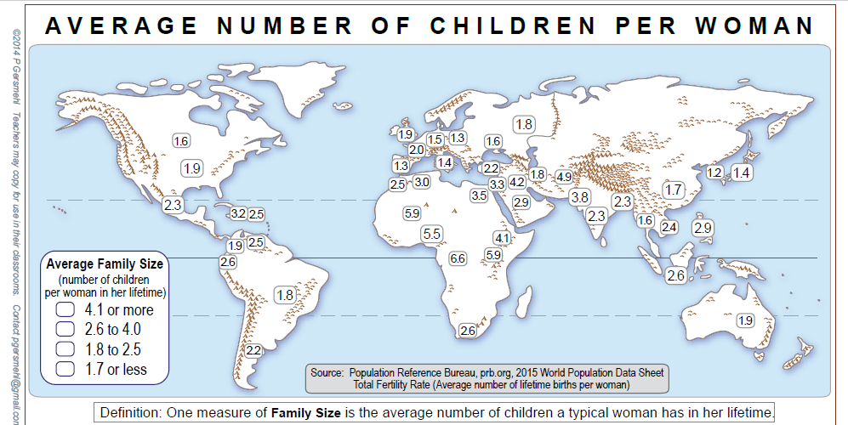
In Europe and Korea & Japan
In Central Africa

Slide 17
In Europe and Korea & Japan
In Central Africa
Discuss: Predict issues for countries with very HIGH percentages???
Predict issues for countries with very LOW percentages???

Slide 18
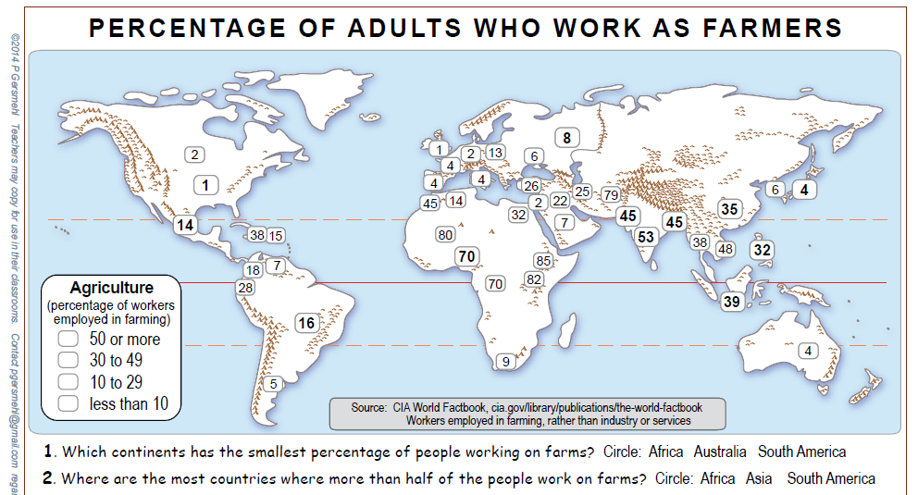
Is this statement True or False?
Explain.
This map about farming
has regions similar to the two “children” topics.

Slide 19
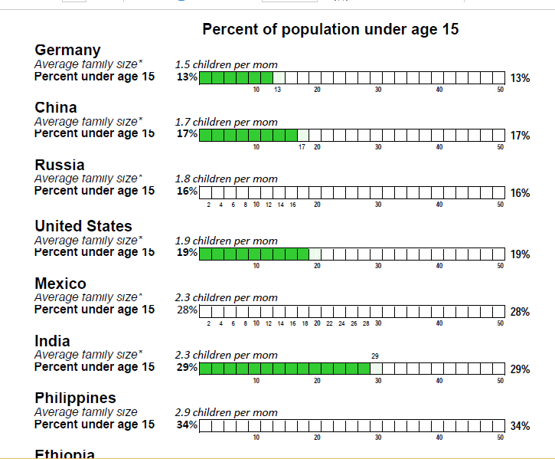

Slide 20
Germany
Average family size: 1.5 children per mom
Question:
What happens to “Percent under 15” when “Average family size” is higher?
Nigeria
Average family size: 5.5 children per mom

Slide 21
Countries that have higher “Average family size” have higher “Percent under age 15.”
As “Average family size”
goes higher,
the “Percent under age 15” also goes higher.
“Percent under age 15”
goes higher,
as “Average family size” goes higher.

Slide 22
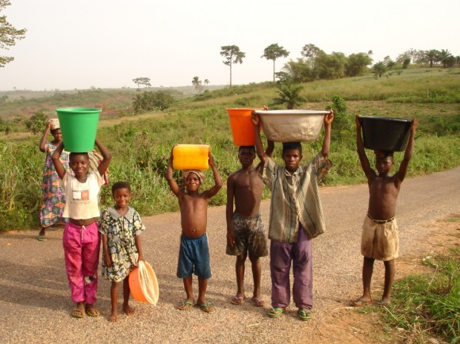
Websites about population and population growth
http://metrocosm.com/world-population-history-map/
http://www.census.gov/population/international/data/idb/informationGateway.php
https://www.cia.gov/library/publications/the-world-factbook/index.html
http://www.census.gov/popclock/world
http://worldpopulationhistory.org/#watch-video
http://worldpopulationhistory.org/?gclid=CJDxuJHmzsgCFVI7gQod3gQOgA
http://www.worldmapper.org/
Photo of children carrying water
from the British Department for International Development
https://dfid.blog.gov.uk/2012/03/22/safe-water-for-everyone-is-within-our-grasp/

Slide 23
Copyright 2015, Carol Gersmehl
Teachers who saw this presentation at a workshop
or downloaded it from our internet site have permission
to make a copy on their own computers for these purposes:
1. to help them review the workshop,
2. to show to colleagues or administrators,
3. to show the presentation in their own classrooms or at sessions they lead at teacher conferences,
4. to use individual frames (with attribution) in their own class or conference presentations.
For permission for any other use,
including posting frames on a personal blog or uploading to any network or website,
contact carol.gersmehl@gmail.com
23

