Slide 1
Population Pyramids
Grade Level Content Expectations
6 G1.2.3 Use, interpret and create maps and graphs
representing population characteristics
6 G2.2.4 Create population pyramids for different regions and interpret the graph discussing birth and death rate, growth rate, and age structure.

Slide 2
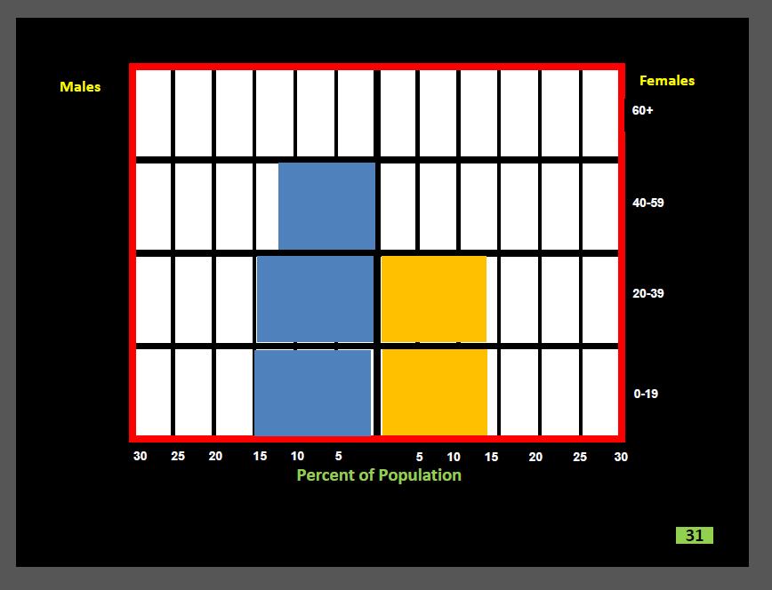
MCCC
SS060304.Powerpoint
has a short animation
that “builds”
a very simple
population pyramid.
But students may see
a different kind
of population graph
on the state assessments.
We therefore provide
some activities that use
different forms of the graph.

Slide 3
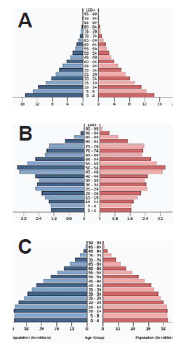
The new GLCEs
include
“population pyramids.”
It is helpful to scaffold
by starting with a greatly simplified
population pyramid.
Population Graph for a Classroom
Boys & Men Women & Girls
65 or older
_______ _______
Between 15 and 64 years old
_______ _______
14 or younger
_______ _______

Slide 4
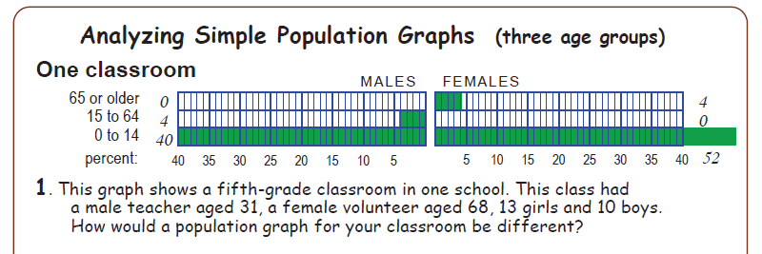
Teacher 1
1 volunteer
Boys 10
13 girls
Population Graph for a Classroom
Boys & Men Women & Girls
65 or older
_______ _______
Between 15 and 64 years old
_______ _______
14 or younger
_______ _______
1 volunteer
Male teacher 1
Boys 10
13 girls

Slide 5
Population Graph for your Classroom
Boys & Men Women & Girls
65 or older
_______ _______
Between 15 and 64 years old
_______ _______
14 or younger
_______ _______
Fill out this “Population Chart” for your classroom.
Why is each age category important in your classroom?
People who are 15-65 years: ______________________________________
Children 14 or younger: __________________________________________

Slide 6
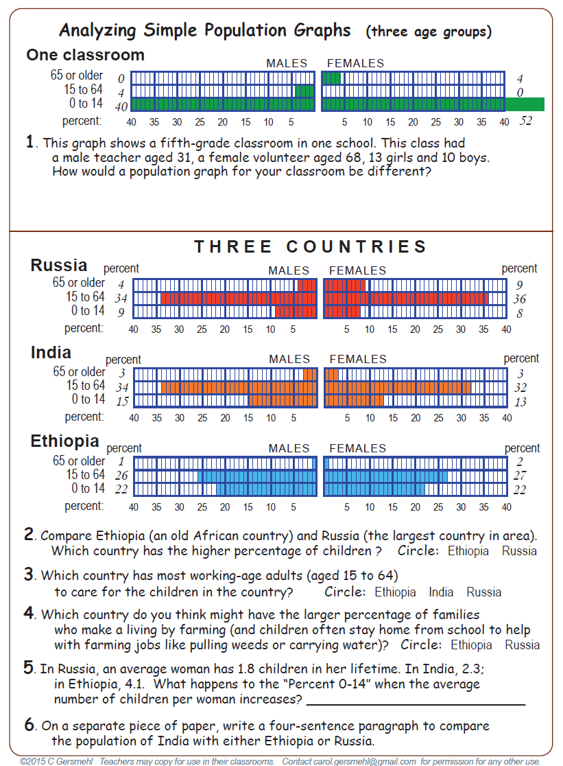
We will use this handout next.
It shows simple population graphs.

Slide 7
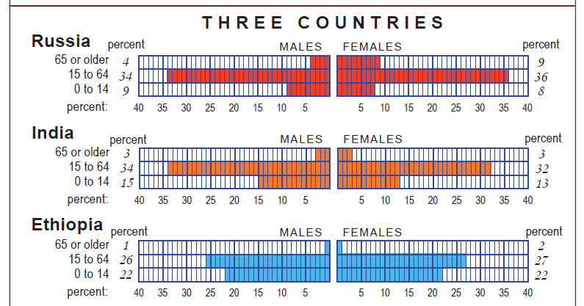
DISCUSS: Why is each age category important in a country?
People who are 65 or older: ______________________________________
People who are 15-65 years: ______________________________________
Children 14 or younger: __________________________________________

Slide 8
Use these graphs to answer questions 2, 3, and 4.

Slide 9
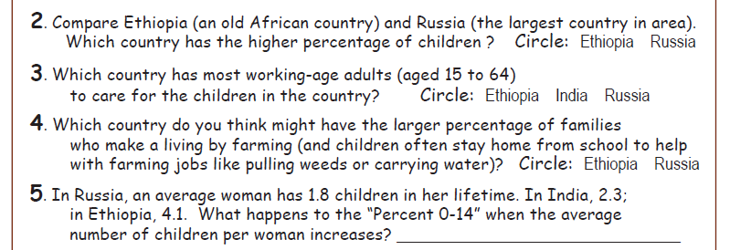
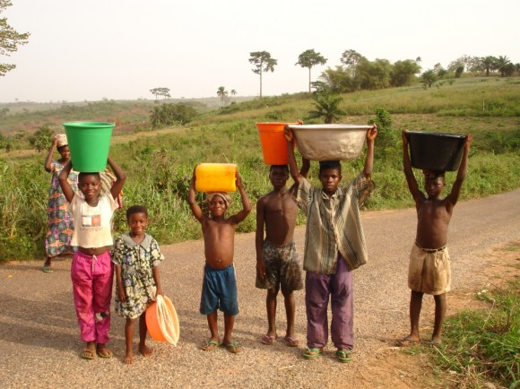
Percent for children increases

Slide 10
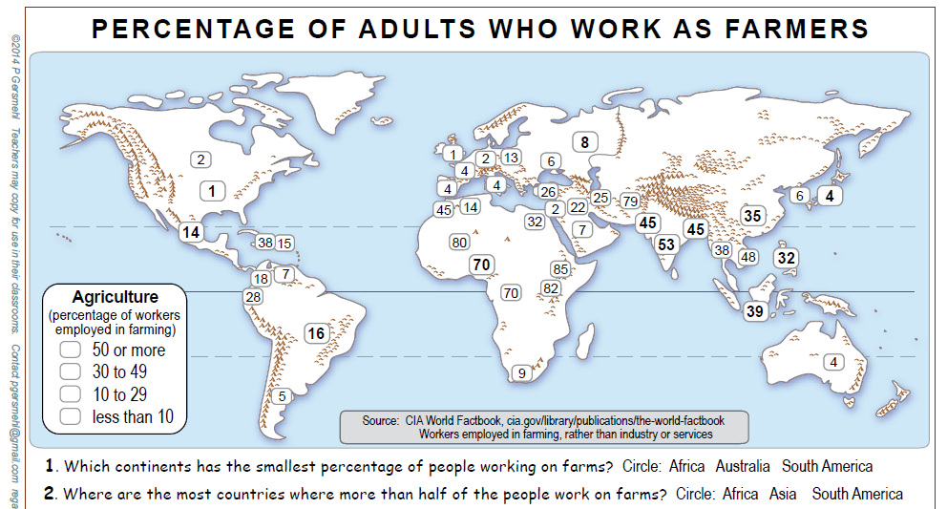

Slide 11
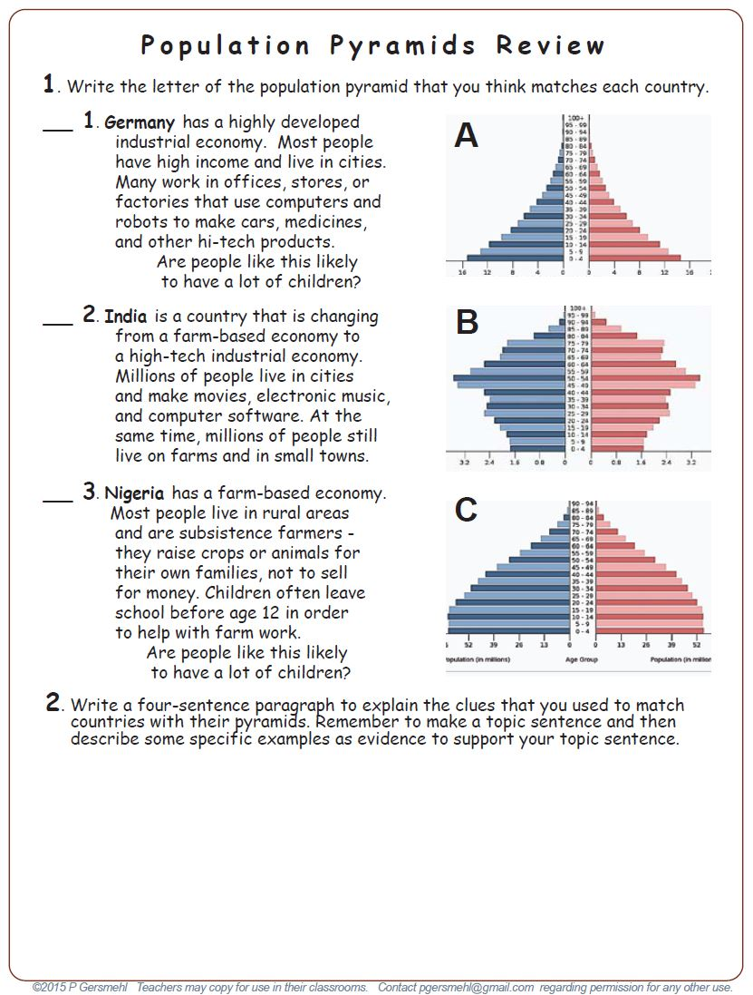
This handout
is a short activity
that uses three
population pyramids
made by the website
of the Census Bureau.

Slide 12
Compare “working age”
populations in these
three countries.
Compare “under 15”
populations in these
three countries.
Who will be the “working age” population in the future?

Slide 13
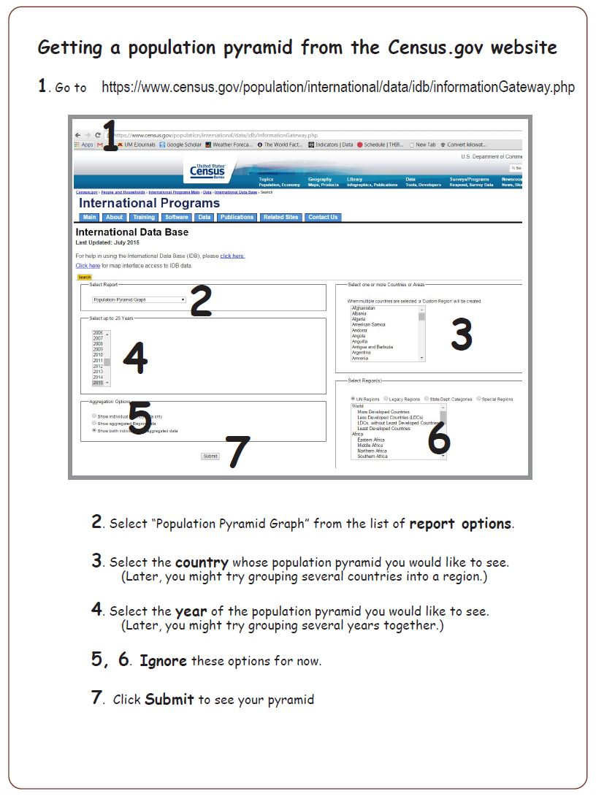
This handout tells you
how to use the website
of the Census Bureau.
It will show
population pyramids for countries that you select.

Slide 14
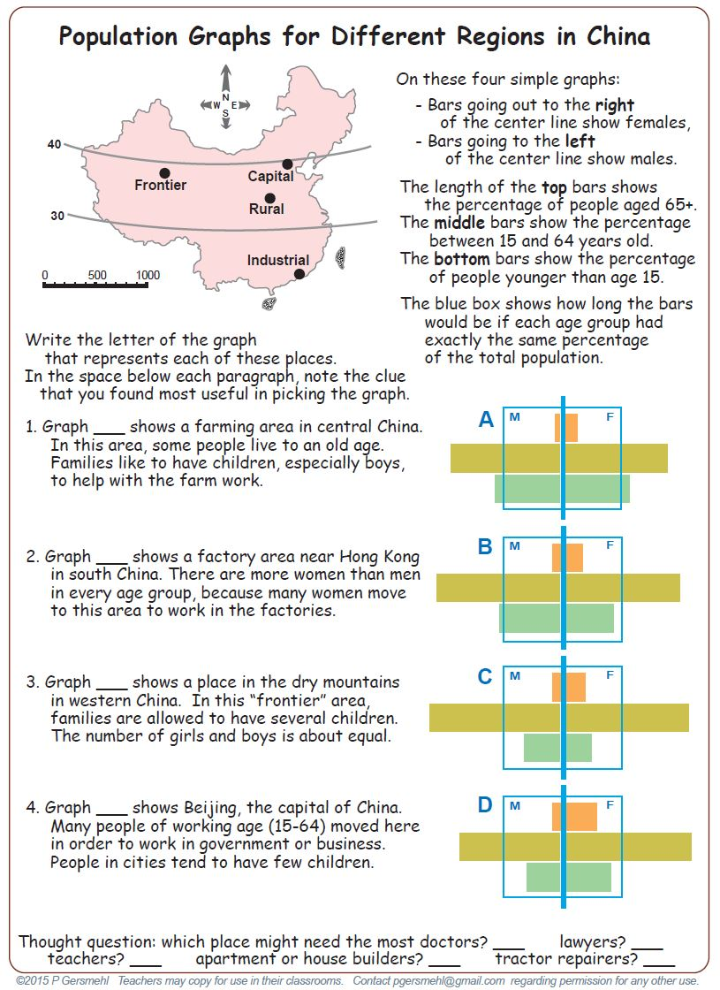
Our final activity
goes inside China
to see how
populations
can be different
in different regions
of a single country.
This activity
has a powerpoint
“answer sheet”
that can also
be used as a
demonstration.

Slide 15
Copyright 2015, Carol Gersmehl
Teachers who saw this presentation at a workshop
or downloaded it from our internet site have permission
to make a copy on their own computers for these purposes:
1. to help them review the workshop,
2. to show to colleagues or administrators,
3. to show the presentation in their own classrooms or at sessions they lead at teacher conferences,
4. to use individual frames (with attribution) in their own class or conference presentations.
For permission for any other use,
including posting frames on a personal blog or uploading to any network or website,
contact carol.gersmehl@gmail.com

