Slide 1
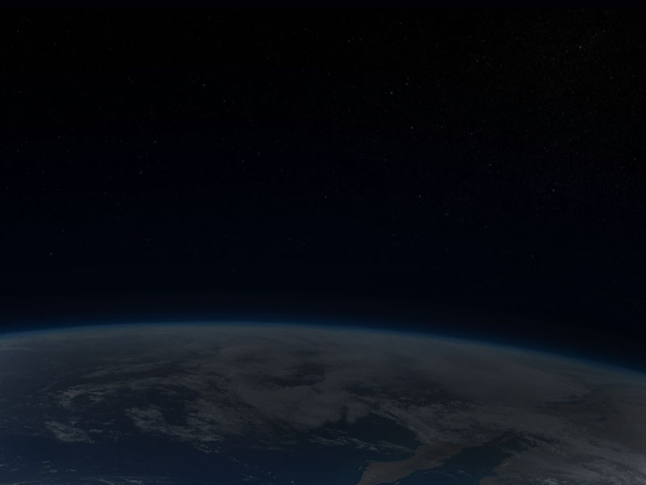
The Moveable
“Desert Maker”
Climate Change
in
History
Phil Gersmehl
Michigan Geographic Alliance
pgersmehl@gmail.com

Slide 2
To understand the role of climate in history,
students should be aware of three things:
1. the system that makes tropical deserts,
2. the systems that cause natural climate cycles,
3. the difference between weather and climate.

Slide 3
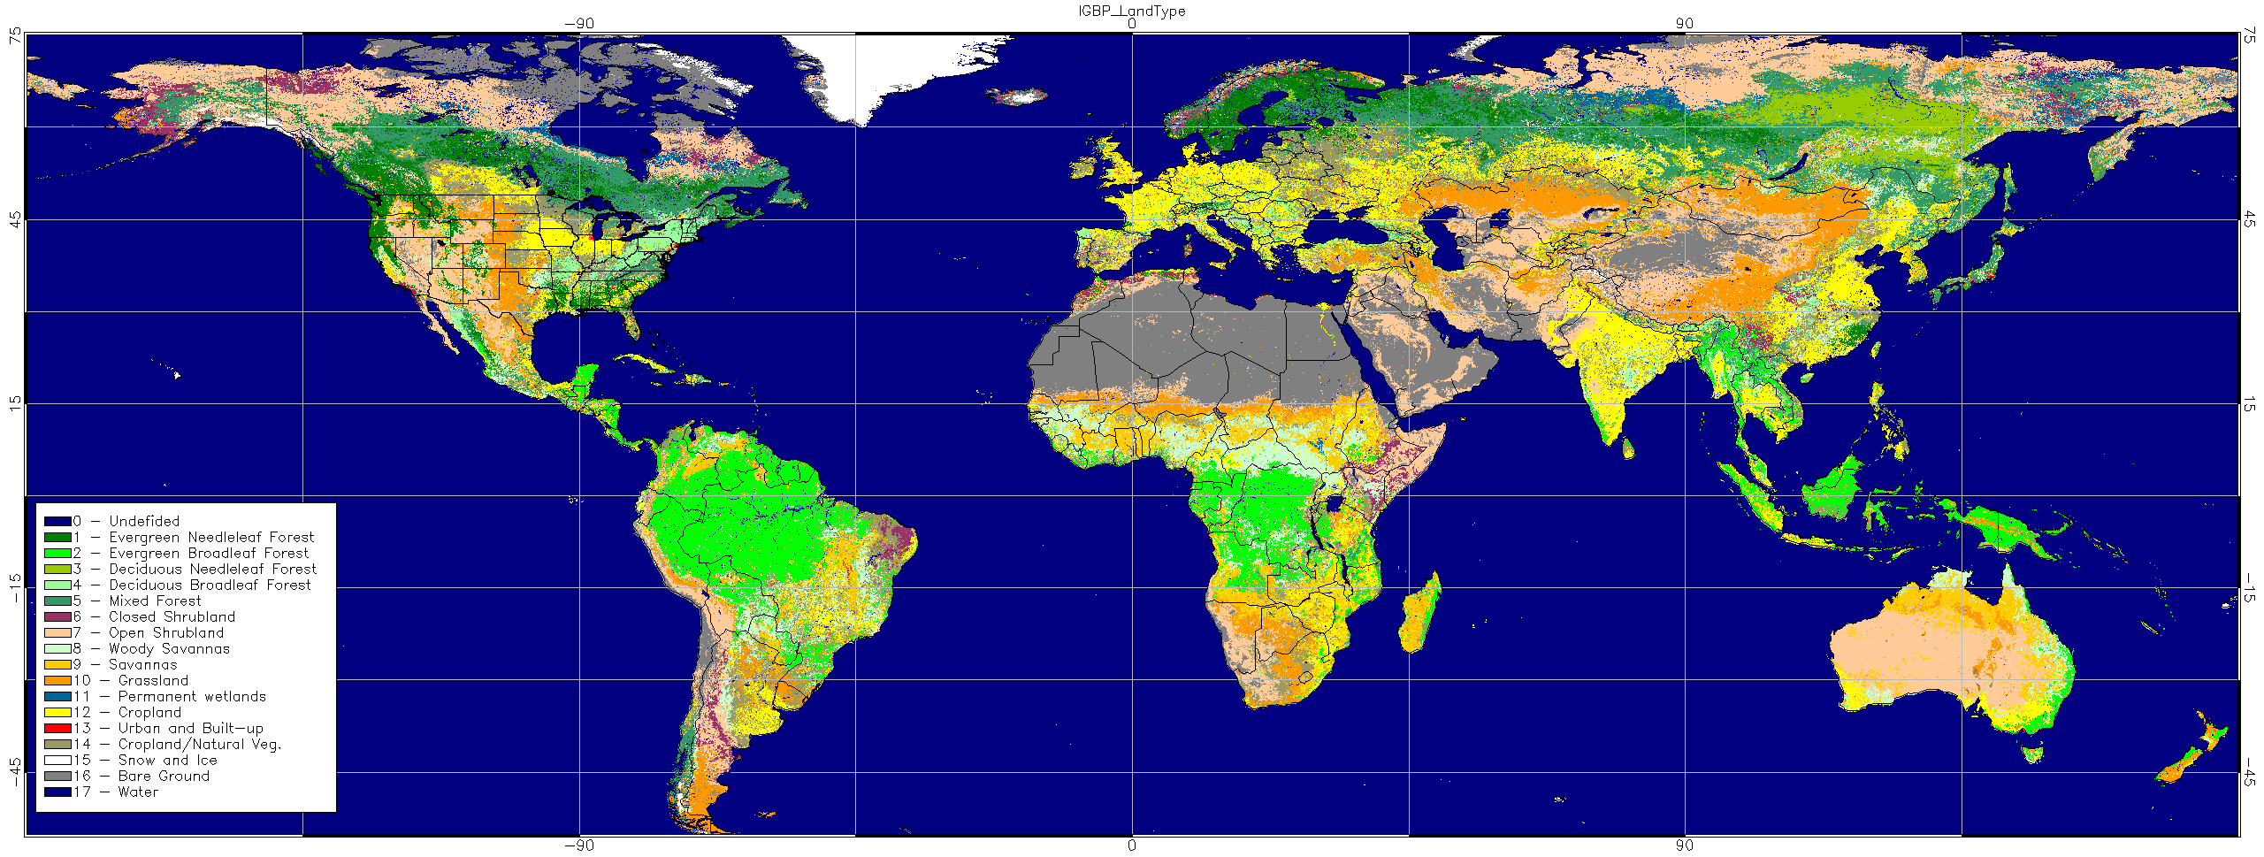
A typical climate map has a lot of info.
It’s almost impossible to remember.

Slide 4
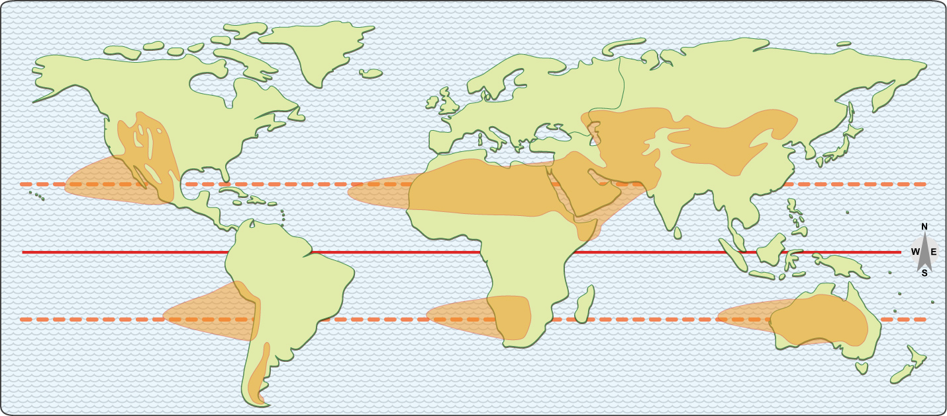
Let’s “declutter” and focus.
“Describe the pattern of dry climates.”

Slide 5
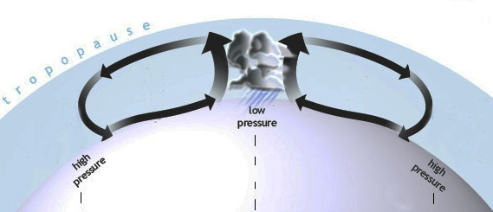
Q. What causes tropical deserts?
A. Rain near the equator.
Sun-heated air
rises and makes rain
over the equator . . .
AND
This globe is turned
so the equator is up.
it has to come down somewhere.

Slide 6
Given the present facts about the earth
(size, rotation, distance from sun, composition of atmosphere, etc.)
“down” is 20-30 degrees north or south of where it went up.

Slide 7
Given the present facts about the earth
(size, rotation, distance from sun, composition of atmosphere, etc.)
“down” is 20-30 degrees north or south of where it went up.
And where the air comes down, it makes a desert.

Slide 8
Given the present facts about the earth
(size, rotation, distance from sun, composition of atmosphere, etc.)
“down” is 20-30 degrees north or south of where it went up.
How would you describe the geographic pattern of deserts?
“Start 1000 miles west of each continent on the Tropic line.
Spread to about 20 latitude degrees; stop at the mountains.”
How would you describe the geographic pattern of deserts?
And where the air comes down, it makes a desert.

Slide 9
Given the present facts about the earth
(size, rotation, distance from sun, composition of atmosphere, etc.)
“down” is 20-30 degrees north or south of where it went up.
“Rainshadow” deserts
east of the mountains
in the westerly wind area
Another
rainshadow
here
But none here
(no continent!)
How would you describe the geographic pattern of deserts?
“Start 1000 miles west of each continent on the Tropic line.
Spread to about 20 latitude degrees; stop at the mountains.”
How would you describe the geographic pattern of deserts?
And where the air comes down, it makes a desert.

Slide 10
How does this
relate to history
(and our GLCEs)?

Slide 11
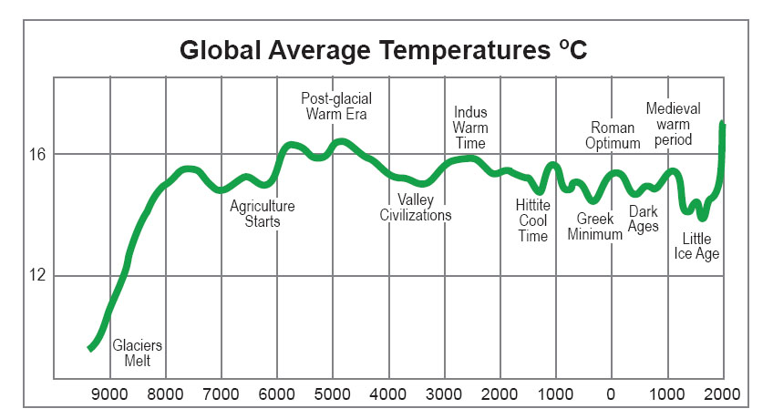
Vikings,
Mongols
South Asia
flourishes
Agriculture
starts
Rome expands
into Europe
Hunters thrive
Anatolia
(Turkey) is rainy
Ming
dynasty
collapses
This is a simple graph
of temperature thru time.
Greece
is rainy
Barbarians
invade Rome,
Han dynasty
collapses

Slide 12
To remember these facts,
put them on a world map of deserts.
Remember, Tropical deserts form
where air that rose at the equator
is pushed back down.
This downward air movement
(called the Subsidence)
will be farther from the equator
if warmer air makes storms
stronger near the Equator.

Slide 13
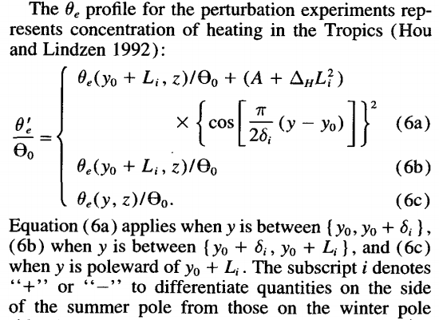
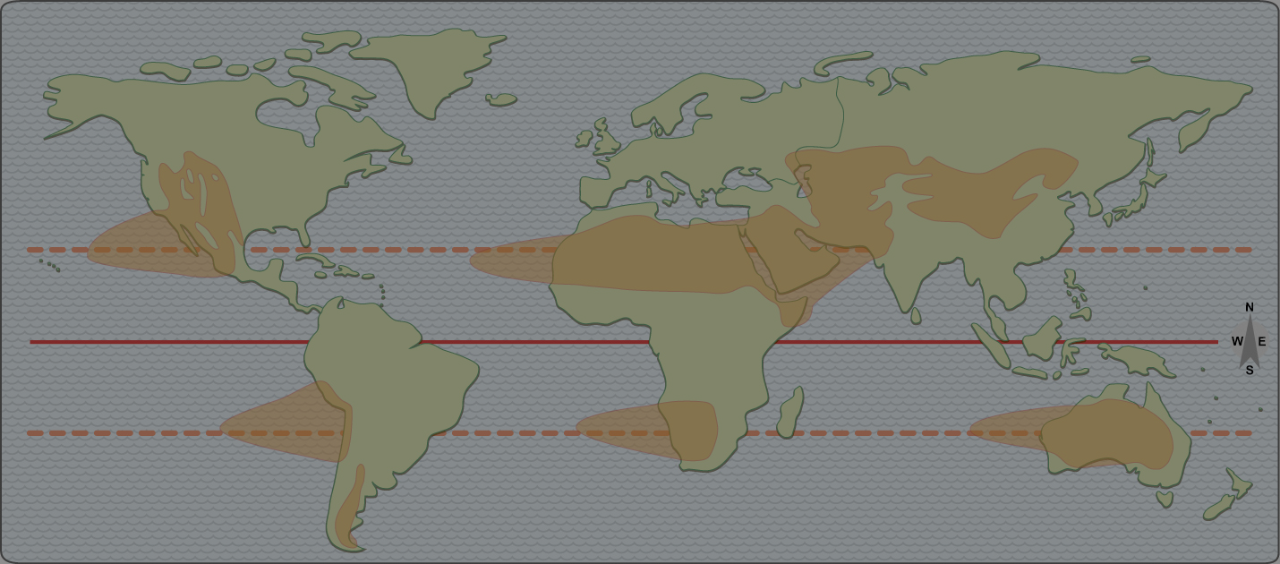
The science is not
“easily accessible”
to ordinary citizens.
This downward air movement
(called the Subsidence)
will be farther from the equator
if warmer air makes storms
stronger near the Equator.

Slide 14
It does, however, make
some specific predictions.

Slide 15
When the global average temperature is HIGH,
the “desert-maker” is pushed away from the equator.
Which places are likely to be helped?
???
?

Slide 16
When the global average temperature is HIGH,
the “desert-maker” is pushed away from the equator.
Which places are likely to be helped?
Plus some areas that might get
warm enough for farming.

Slide 17
When the global average temperature is HIGH,
the “desert-maker” is pushed away from the equator.
Which places are likely to be hurt?

Slide 18
When the global average temperature is LOW,
the “desert-maker” shifts toward the equator.
Which places are likely to be helped?

Slide 19
When the global average temperature is LOW,
the “desert-maker” shifts toward the equator.
Which places are likely to be hurt?

Slide 20
When the global average temperature is LOW,
the “desert-maker” shifts toward the equator.
Which places are likely to be hurt?
Plus some large areas that still
have plenty of rain but are colder.

Slide 21
South Asia
flourishes
Vikings,
Mongols
Irrigation
needed
Agriculture
starts
Rome expands
into Europe
Hunters thrive
That’s the science
behind a simple fact:
Climate changes had
a big impact on history.
Anatolia
is rainy
Ming
dynasty
collapses
Greece
is rainy
Global warming is
bad for some places
and good for others.
Barbarians
invade Rome,
Han dynasty
collapses

Slide 22
What
about
today?

Slide 23
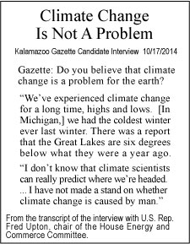
The name is covered, because
this is about ideas, not personalities

Slide 24
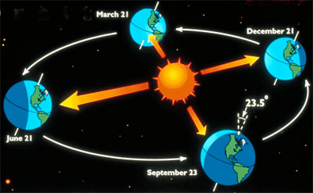
Here’s why climate has “natural” cycles:
Earth’s orbit is not a perfect circle.
It’s a wobbly tilt on a wobbly oval.

Slide 25
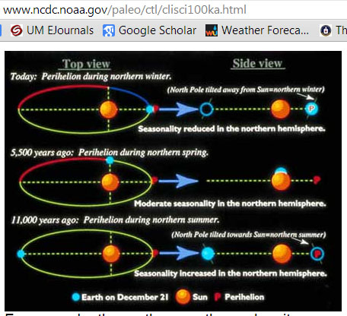
You can find the details on a lot of web sites:
www.ncdc.noaa.gov/paleo/ctl/clisci100ka.html

Slide 26
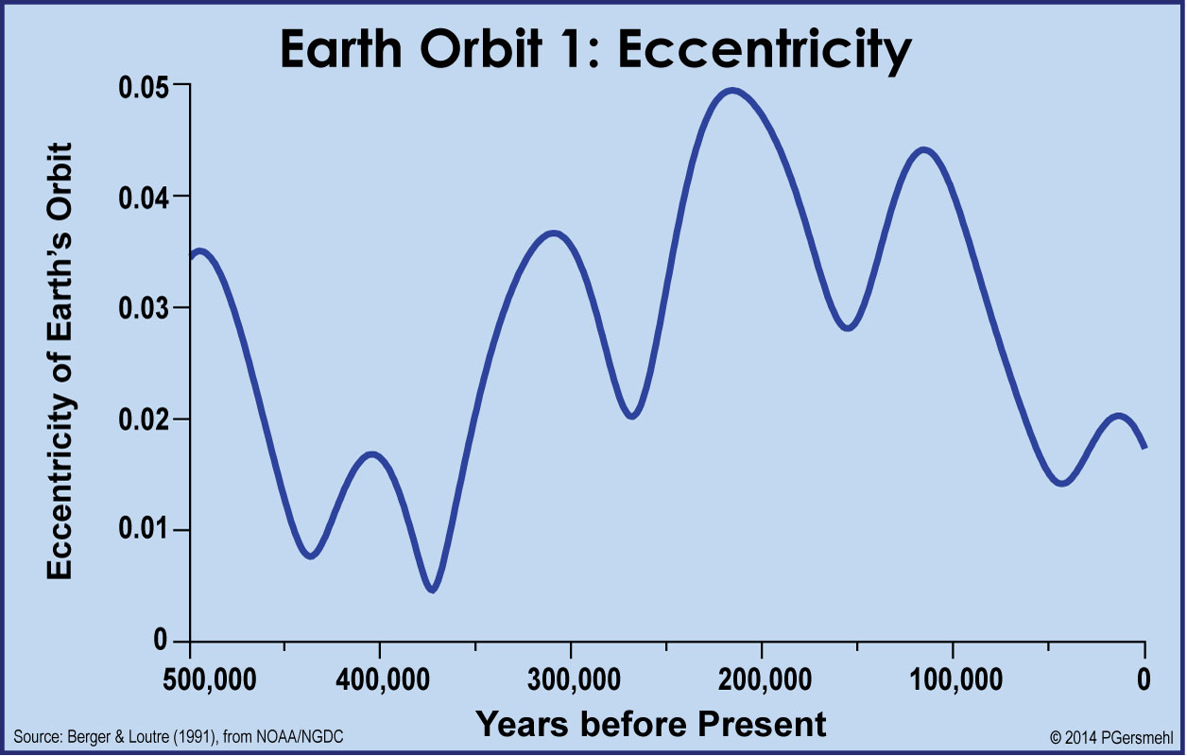
Wobble #1. From a circle (r = 93 million miles)
to an ellipse (r = 90 to 95Mmi, in different seasons)
almost 6 peaks
in 500,000 years =
1 cycle in roughly
90,000 years.

Slide 27
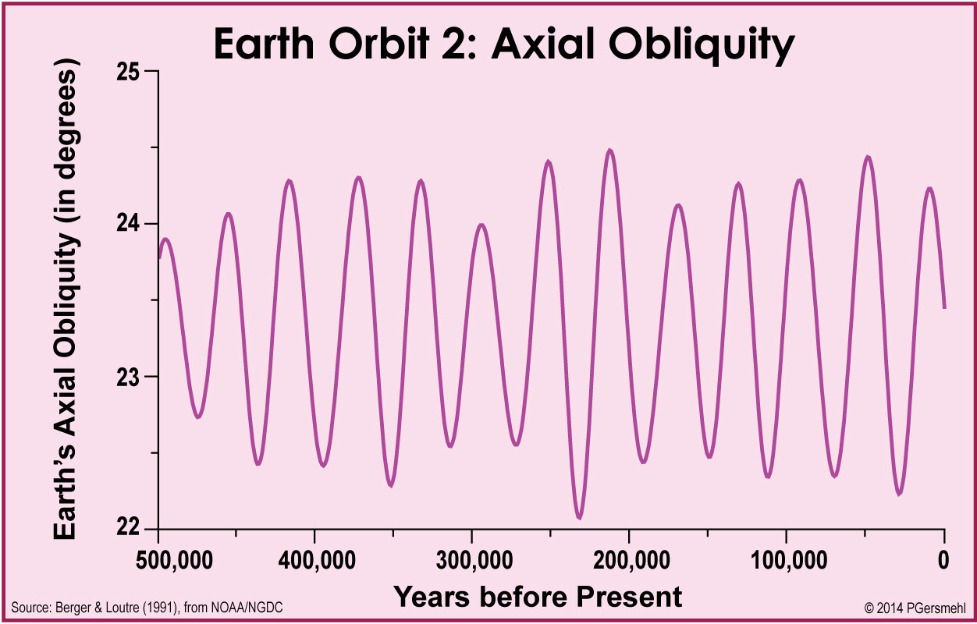
Wobble #2. From a tilt of about 22.3 degrees
to a tilt of nearly 24.5 degrees.
about 13 peaks
in 500,000 years =
1 cycle in roughly
41,000 years.

Slide 28
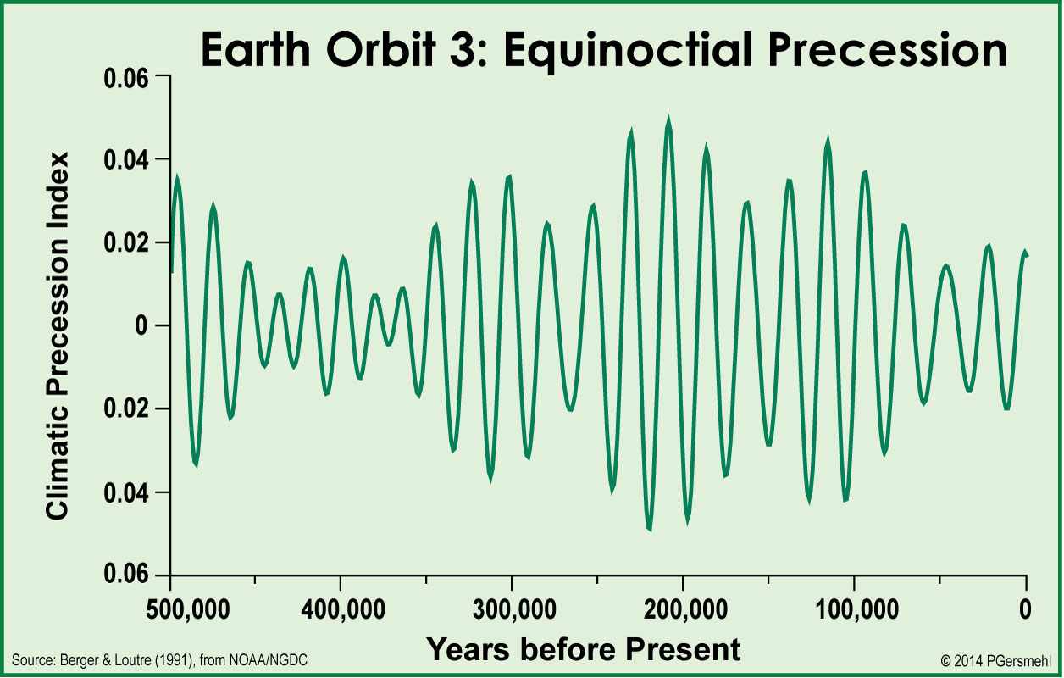
Wobble #3. From the sun being closer in July
to being closer in January.
23+ peaks
in 500,000 years =
1 cycle in roughly
21,000 years.

Slide 29
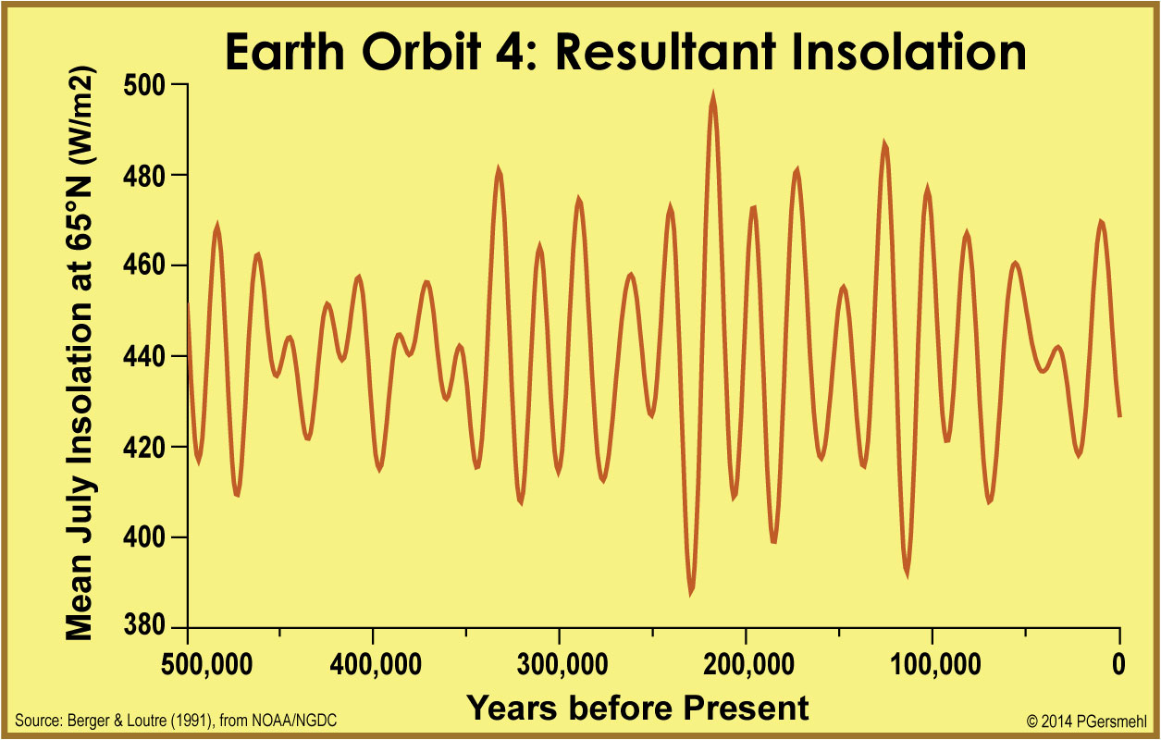
Put this together – sun intensity varies a lot.
Note: In addition to
these very regular cycles,
there are shorter cycles
and “perturbations”
due to sunspots, volcanoes,
ocean currents, wildfires, etc.
We’ll ignore them for now.
A high point
in solar radiation
comes roughly once
every 100,000 years.

Slide 30
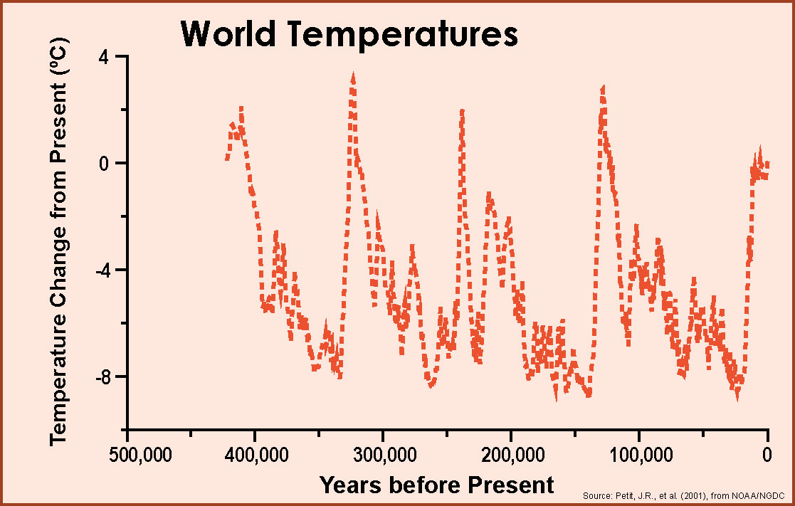
We also have
450,000 years of
temperature data
from ice cores
in Antarctica.
A high point
in temperature
roughly once every
100,000 years.

Slide 31
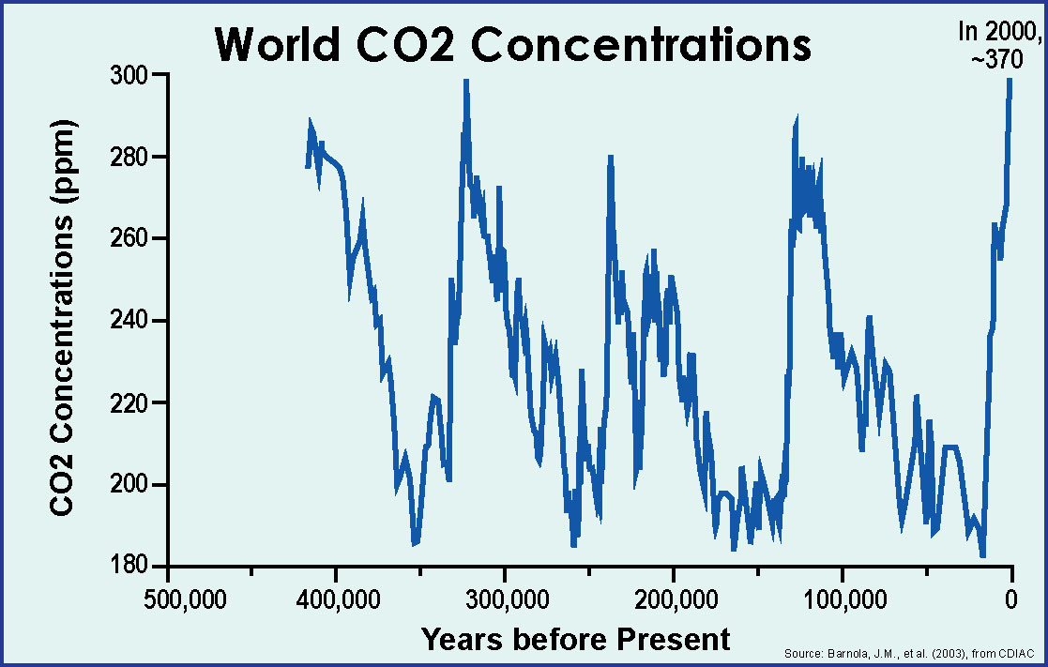
The record of
carbon dioxide
also has
five peaks.

Slide 32
S U N S H I N E
Let’s compare
all three graphs.
C A R B O N D I O X I D E
Solar energy,
temperature, and
carbon dioxide are obviously related
(but it’s complicated).
T E M P E R A T U R E

Slide 33
One conclusion
is beyond doubt:
temperatures
have been higher
in the past
than they are today.

Slide 34
Temperatures
were much higher
in the distant past
and a little higher
quite recently.
PRESENT
AVERAGE

Slide 35
The most recent
measurements
do not fit
on the scale.
BUT,
there is a
big problem
with these graphs.

Slide 36
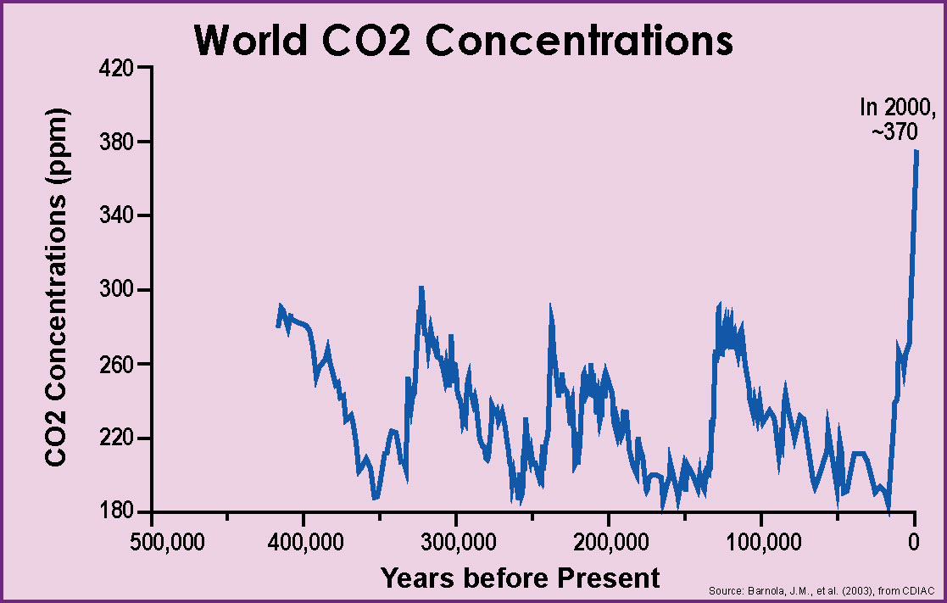
When we adjust
the vertical scale
so the numbers
all can fit,
you can see that
carbon dioxide is
WAY above
its “normal” range.

Slide 37
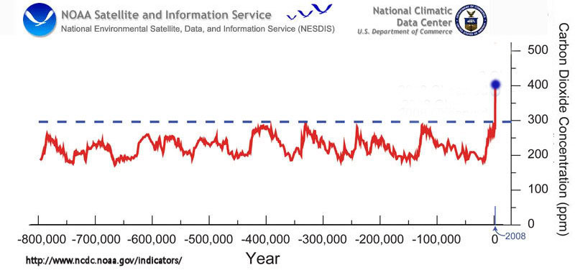
In 2015, 402
In just
a few hundred years,
humans have “pushed”
the climate system
way out of line
with “normal” cycles.
Ask students to describe this new graph
in their own words.
It’s like your heart stayed between 70 and 130 beats per minute
for 20 years, and then suddenly went up to 200 – if you’re smart,
you’d want to know why, and if there are any consequences!

Slide 38
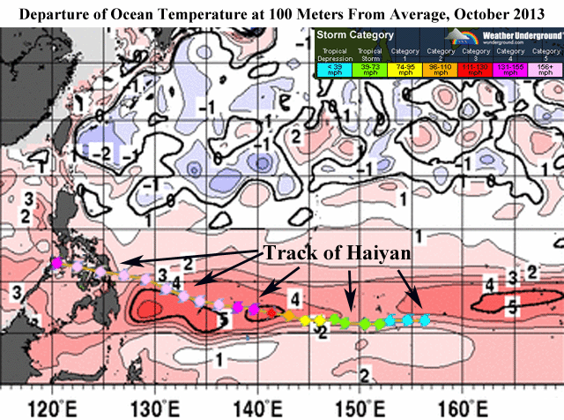
In October 2013,
the Pacific Ocean had
very high temperatures.
One result was
one of the strongest
hurricanes ever measured
near the Philippines.

Slide 39
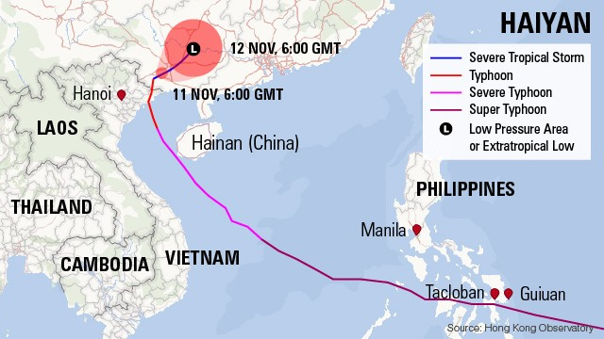
Weeks later,
this hurricane carried
enormous amounts
of energy northward.

Slide 40
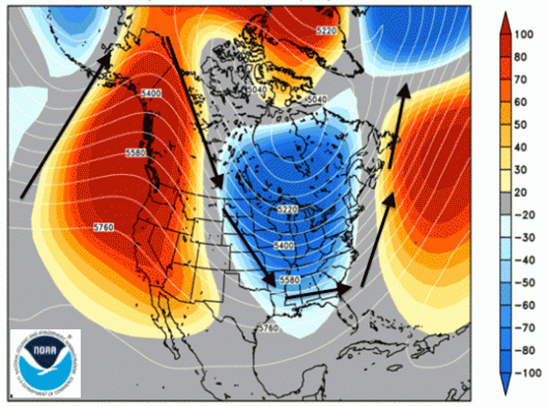
Excessive heat
moving toward the pole
Excessive heat
moving toward the pole
can push cold air
toward the equator

Slide 41
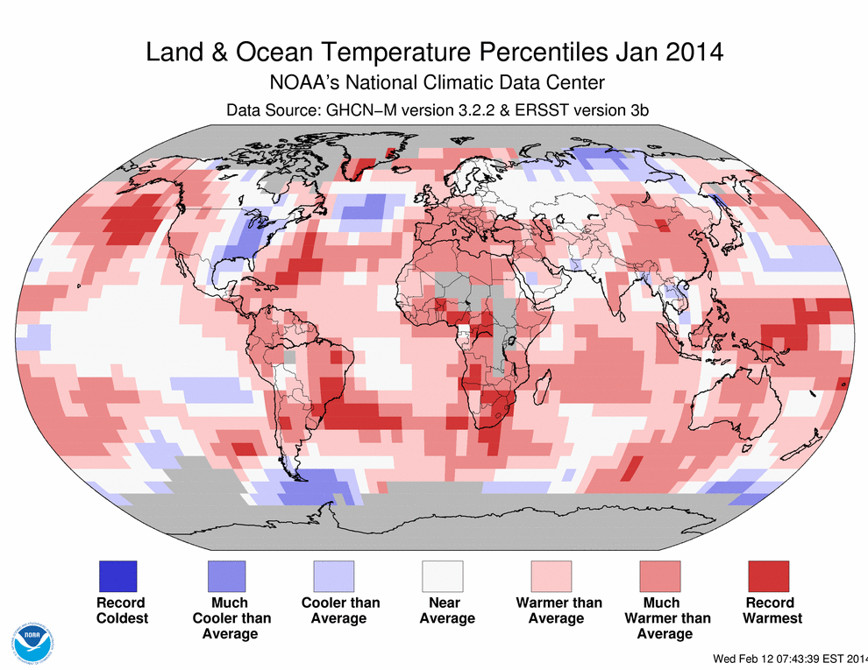
Winter 2014 was unusually cold in Michigan,
BUT look at the average for the globe as a whole.
This map shows world temperature two months later.
5 areas “much cooler than average”
0 areas “record coldest”
19 areas “much warmer than average”
9 areas “record warmest”

Slide 42
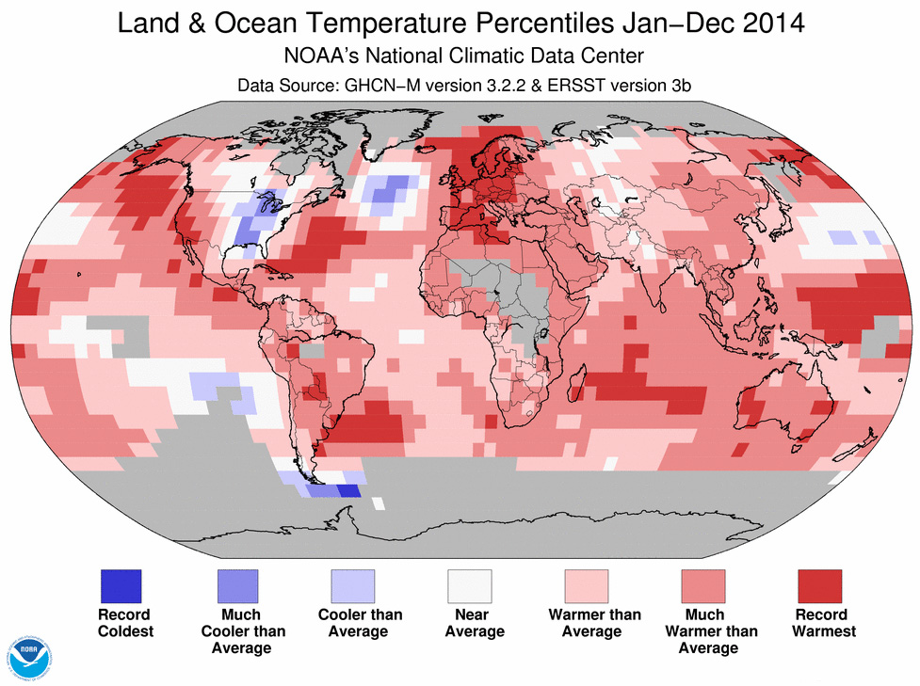
Now look at the total for the entire year.
15
742
2
196

Slide 43
As one Blogger asked:
Can global warming
be real
if it is unusually cold
in the United States?

Slide 44
Eh
Aye
Aap
Hwa’a
A
Oui
Ja
Han
Da
Hai
As one Blogger asked:
Can global warming
be real
if it is unusually cold
in the United States?
Tak
‘Ae
Di
Shi
Si
Ia
Ya
Evet
Yin
Oo
Haa’n
Si
Na’am
Chai
To
Ae
Sim
Yao
Ndiyo
Ee
Ngee
E
Tamo
Eni

Slide 45
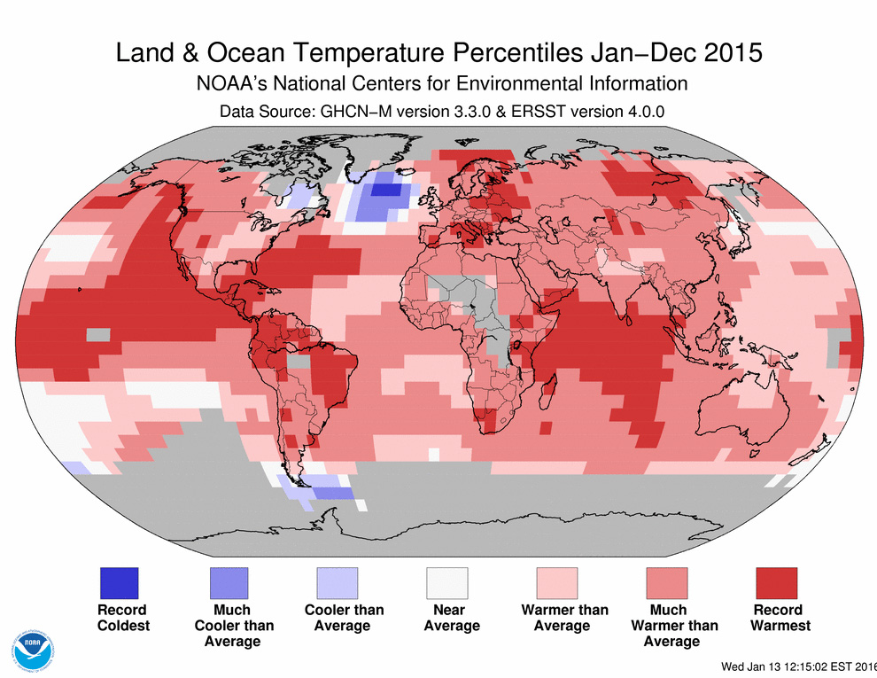
Eh
Aye
Aap
Hwa’a
A
Oui
Ja
Han
Da
Hai
As one Blogger asked:
Can global warming
be real
if it is unusually cold
in the United States?
Tak
‘Ae
Di
Shi
Si
Ia
Ya
Evet
Yin
Oo
Haa’n
Si
Na’am
What do you see
on this brand-new map for 2015?
Chai
To
Ae
Sim
Yao
Ndiyo
Ee
Ngee
E
Tamo
Eni

Slide 46
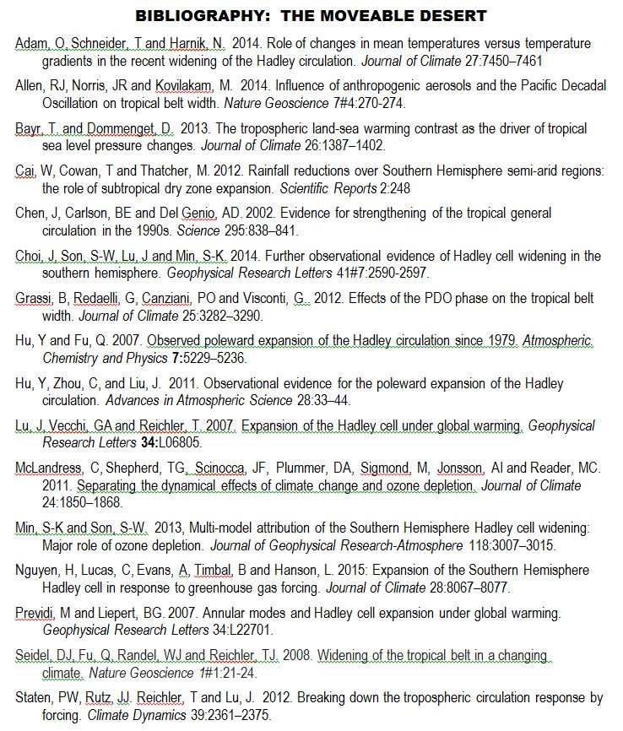
The people sho did this research are based in
Australia, Argentina, Canada, China, England,
Germany, Israel, Italy, Korea, and South Africa,
as well as NCAR, NOAA, and 3 U.S. universities.

Slide 47
Worth looking at: http://www.abc.net.au/news/2015-12-17/queensland-drought-photos-before-after/7035610
Copyright 2015, Phil Gersmehl
Teachers who saw this presentation at a workshop
or downloaded it from our internet site have permission
to make a copy on their own computers for these purposes:
1. to help them review the workshop,
2. to show the presentation in their own classrooms,
at sessions they present at teacher conferences,
or to administrators in their own school or district,
3. to use individual frames (with attribution)
in their own class or conference presentations.
For permission for any other use,
including posting frames on a personal blog
or uploading to any network or website
that can be accessed from outside your school,
contact pgersmehl@gmail.com

