Slide 1

climate change milankovitch cycles
Phil Gersmehl
Michigan Geographic Alliance
pgersmehl@gmail.com

Slide 2
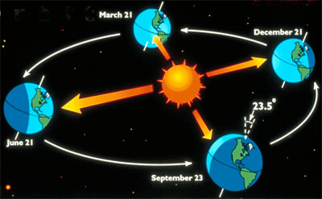
To understand why there are “natural” cycles of climate,
we need to know that Earth’s orbit is not a perfect circle.
It’s a wobbly tilt on a wobbly oval.

Slide 3
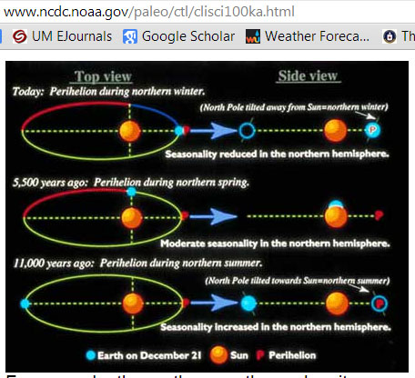
You can find the details on a lot of web sites.

Slide 4
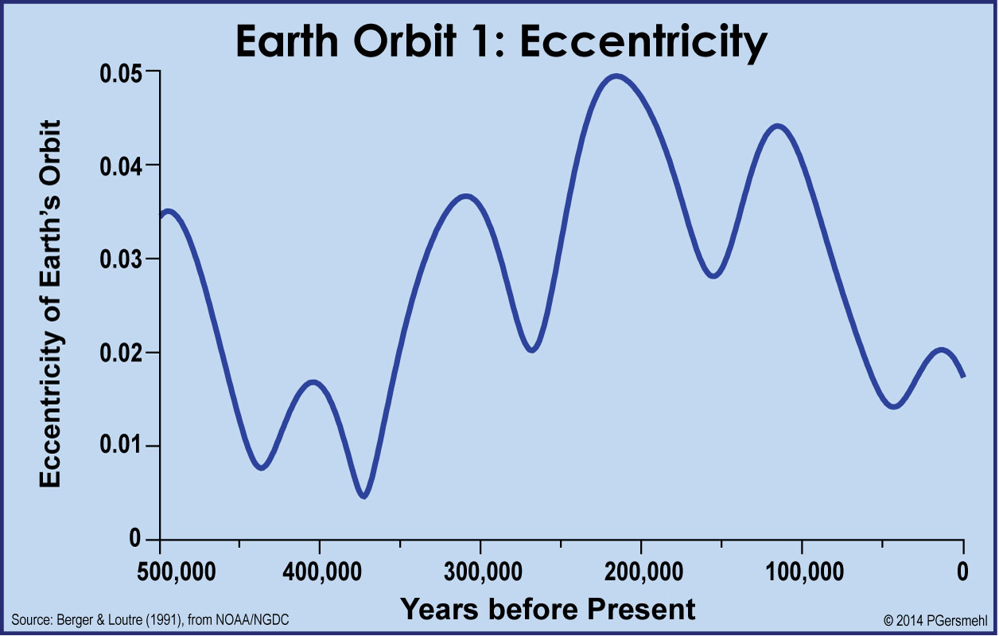
Wobble #1. From a nearly perfect circle (r = 93 million miles)
to an ellipse (d in different seasons = 90 to 95 million miles)
How do we know this?
There are people
who watch the sky,
very carefully
(like the wise men of old).
almost 6 peaks
in 500,000 years =
1 cycle in roughly
90,000 years.

Slide 5
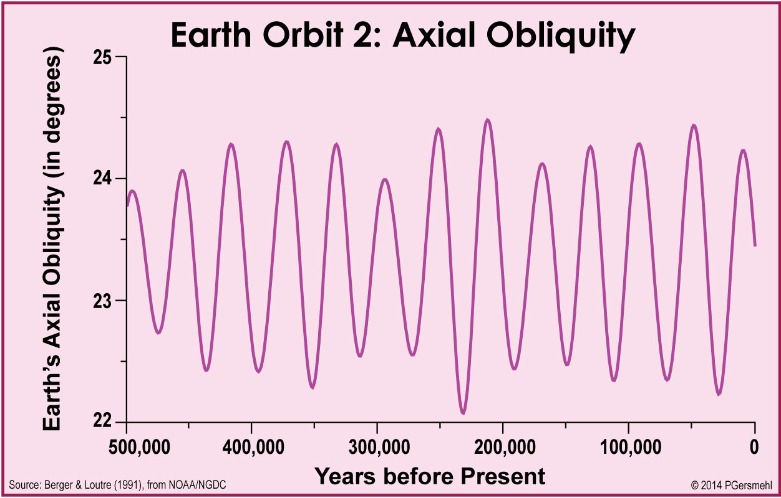
Wobble #2. From a tilt of about 22.3 degrees
to a tilt of nearly 24.5 degrees.
about 13 peaks
in 500,000 years =
1 cycle in roughly
41,000 years.

Slide 6
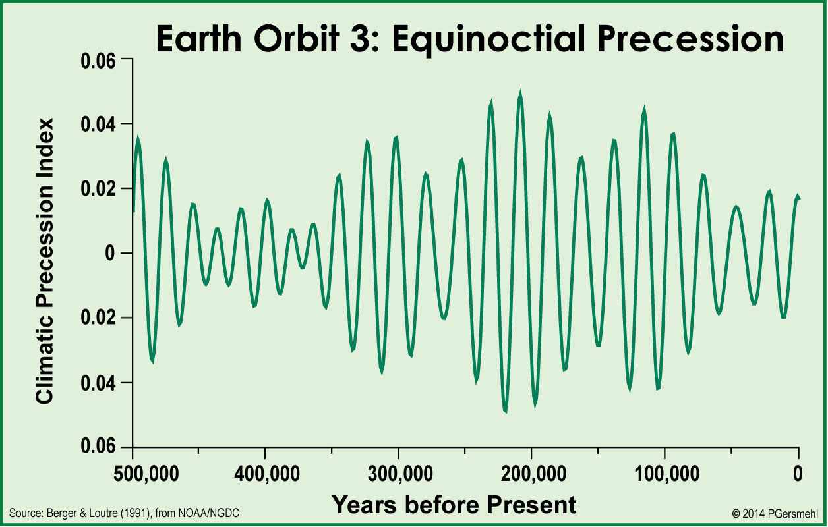
Wobble #3. From the sun being closer in July
to being closer in January.
about 23 peaks
in 500,000 years =
1 cycle in roughly
21,000 years.

Slide 7
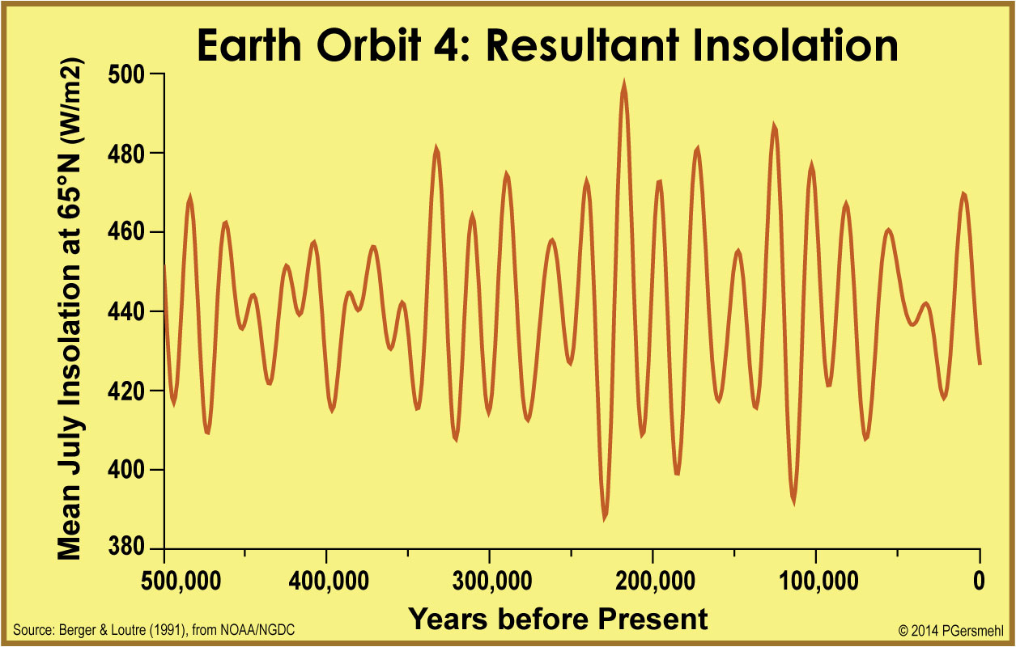
Put this all together – sun intensity varies a lot.
A high point
in solar radiation
comes roughly once
every 100,000 years.

Slide 8
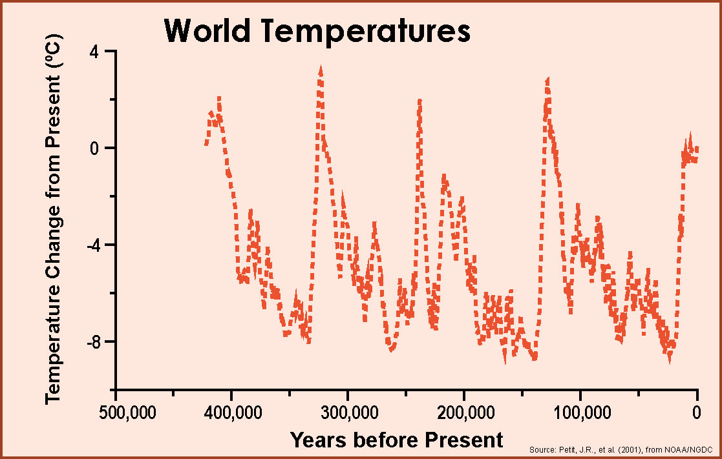
A high point
in temperature
roughly once every
100,000 years.
We also have
400,000 years of
temperature data
from ice cores
in Antarctica.

Slide 9
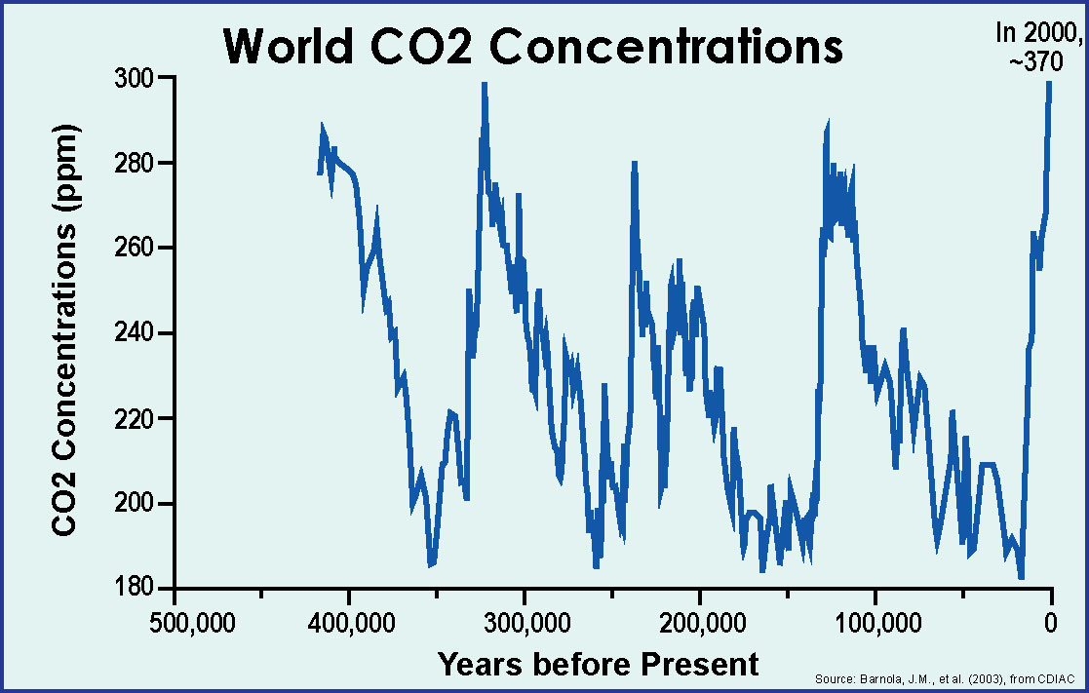
The record of
carbon dioxide
show the same
five peaks.

Slide 10
Now let’s look
at these graphs
together,
to see how
they compare.

Slide 11
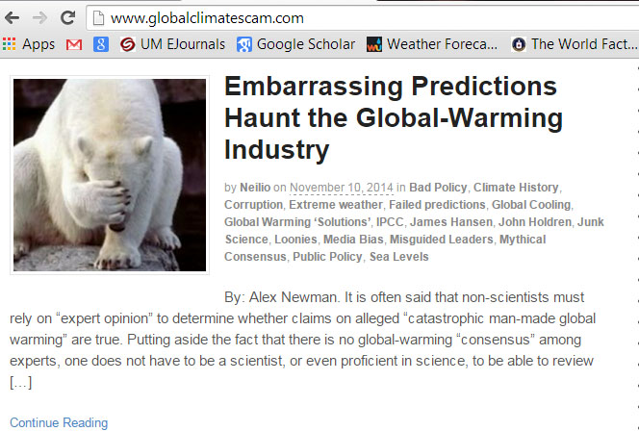
Solar energy, temperature, and carbon dioxide
are obviously related,
BUT
the relationship is not simple.

Slide 12
Temperatures
were much higher
in the distant past
and a little higher
quite recently.
One conclusion
is beyond doubt:
temperatures
have been higher
than at present
many times
in the past.
PRESENT
AVERAGE

Slide 13
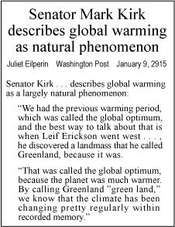
This is about ideas,
not personalities

Slide 14
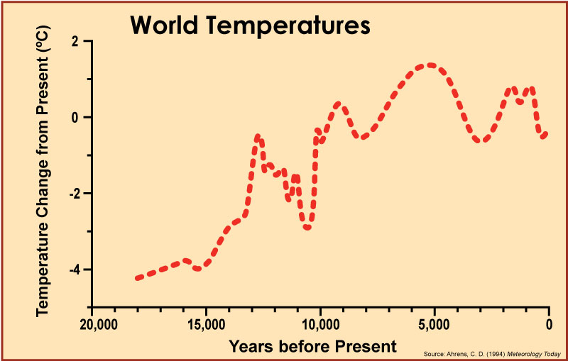
Leif Eriksson
AVERAGE TEMPERATURE IN 1950s
Mid-Holocene
climatic optimum.

Slide 15
Leif Eriksson
To use this historic fact
to justify a conclusion
that global warming
is not a problem . . .
that’s just wrong.
AVERAGE TEMPERATURE IN 1950s
Mid-Holocene
climatic optimum.
Tragically wrong.

Slide 16
For one thing,
there is a
big problem
with this graph:
the most recent
measurements
do not fit
on the scale.

Slide 17
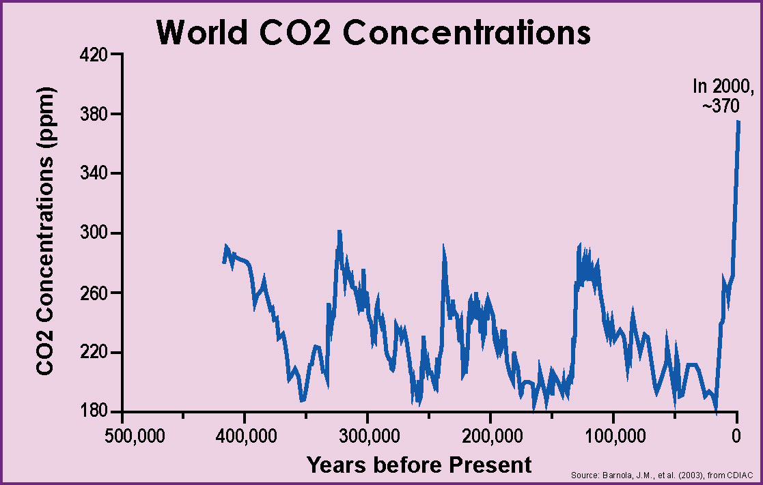
When we adjust
the vertical scale
so the numbers
all can fit,
you can see that
carbon dioxide
today is
WAY above its
“normal” range.

Slide 18
In just
a few hundred years,
humans have “pushed”
the climate system
far out of line
with “normal” cycles.
In 2014, 397

Slide 19
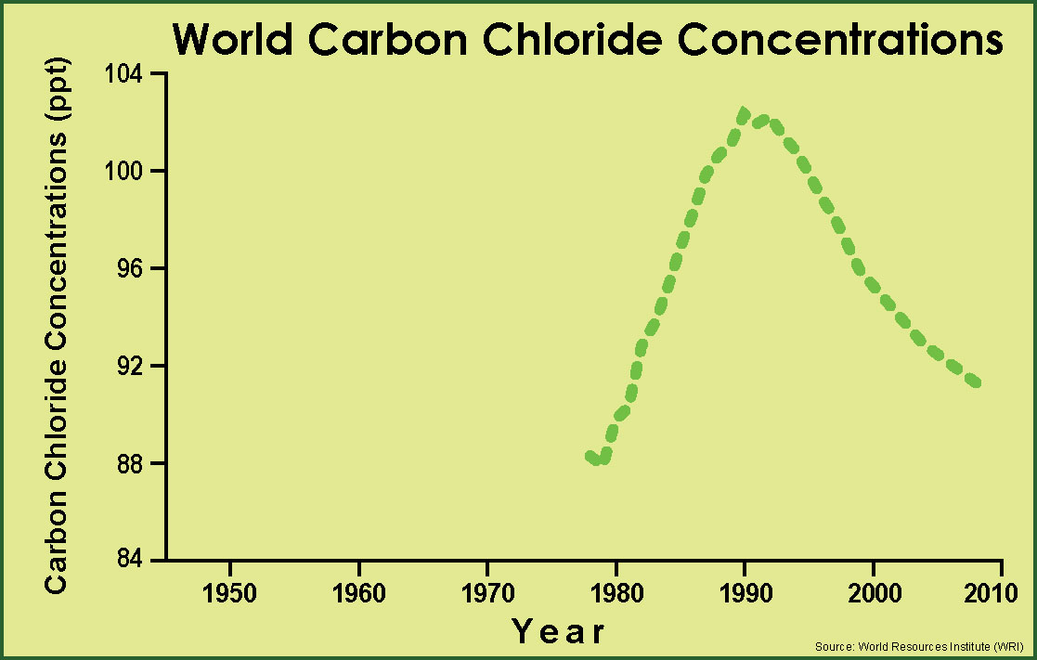
History shows
that we can
do something
about it.
In the 1980s,
President Reagan
pushed for a treaty
(The Montreal Protocol)
that banned the use
of CFC chemicals
in refrigerators
and aerosol cans.

