Slide 1
Environments along the Lewis and Clark Trail
Philip J. and Carol A. Gersmehl
New York Center for Geographic Learning

Slide 2
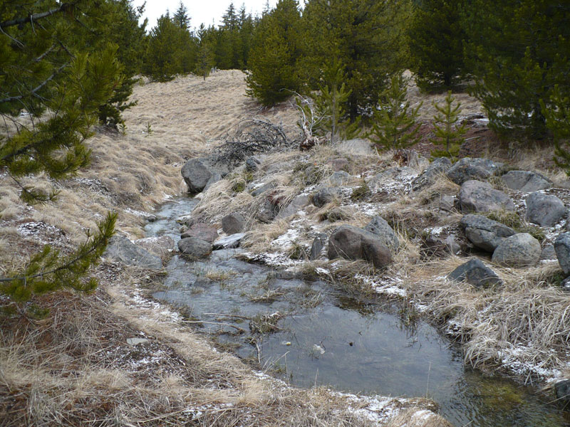
Most rivers start
as tiny creeks
near high
mountains.

Slide 3
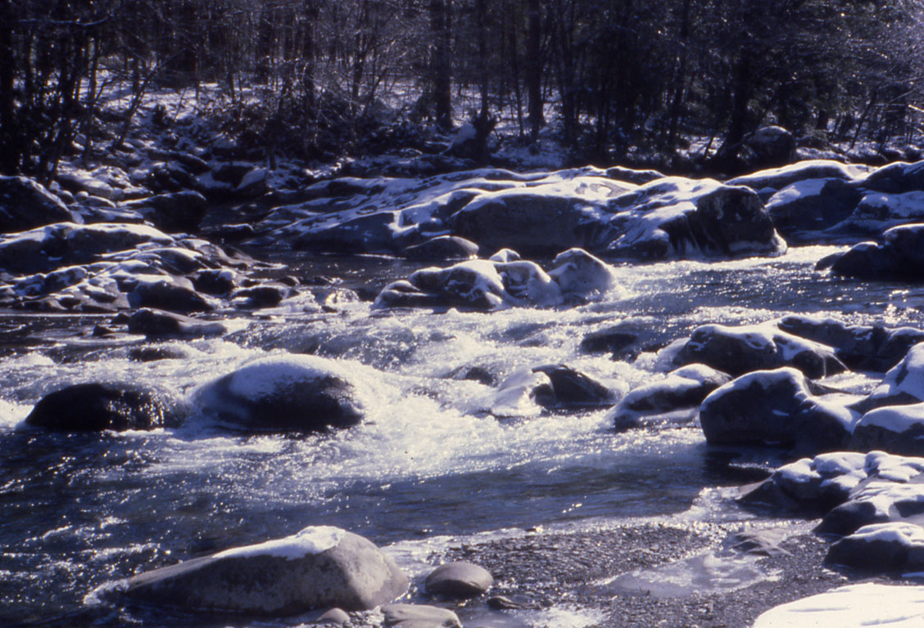
Near their sources,
streams are usually cold and rocky.
Not good for boats!

Slide 4
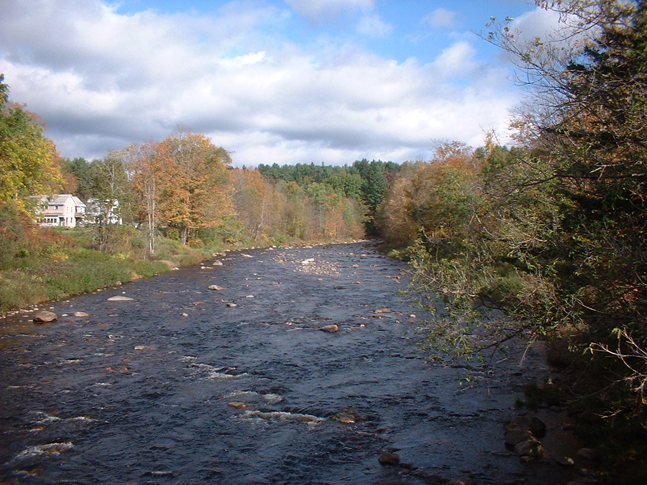
Halfway to the ocean,
streams are larger,
but most of them
are still shallow
and rocky.
Not good for boats!
This is
a key part
of the story
of Lewis
and Clark.

Slide 5
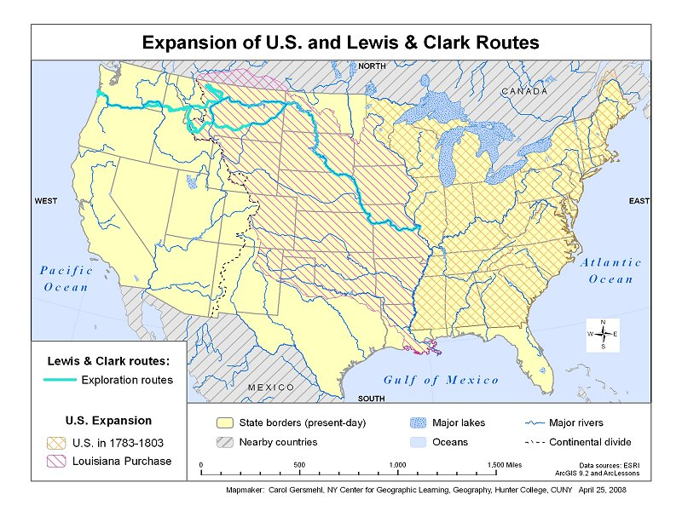
The
Louisiana
Purchase
nearly doubled
the area of
the United States

Slide 6
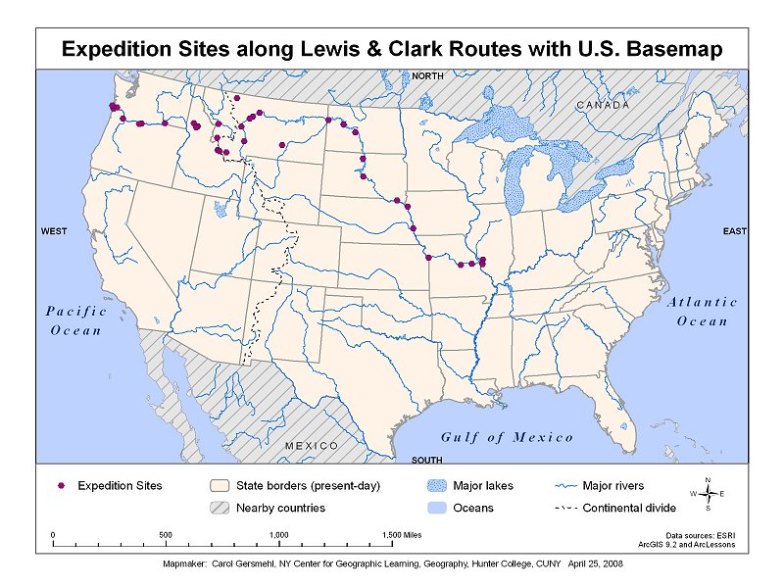
Lewis and Clark’s plan was to use boats to go up the Missouri River, cross the mountains,
and then go down
another big river
to the Pacific Ocean.

Slide 7
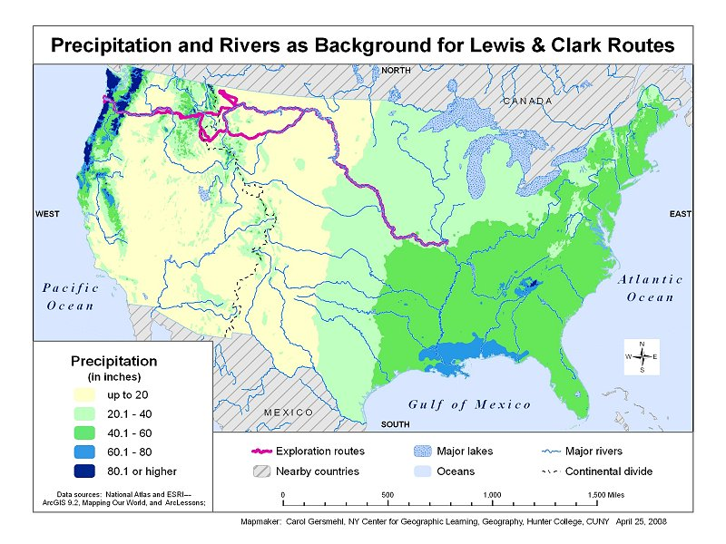
What they did not know
was that they would
also be going
from a rainy area,
through a dry area,
across snowy mountains,
through another dry area,
and to a very rainy area.

Slide 8
They would be going
over some mountains
that are much higher
than anything they
saw in the East.

Slide 9
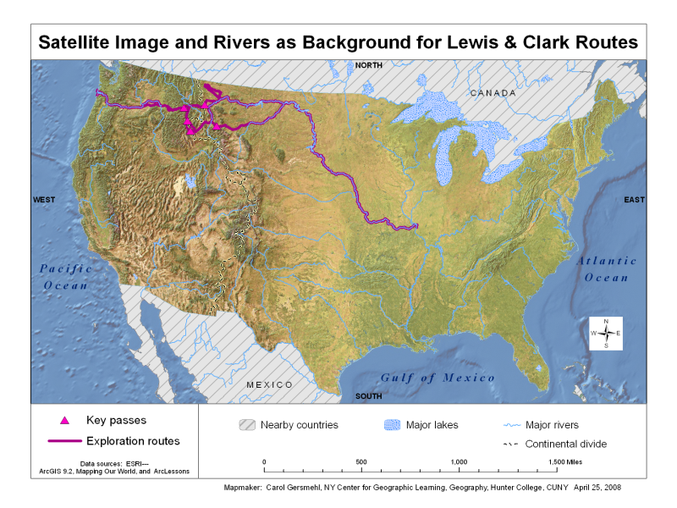
All of these maps
come from Carol’s
GIS package.
You can use as many
as you choose to.

Slide 10
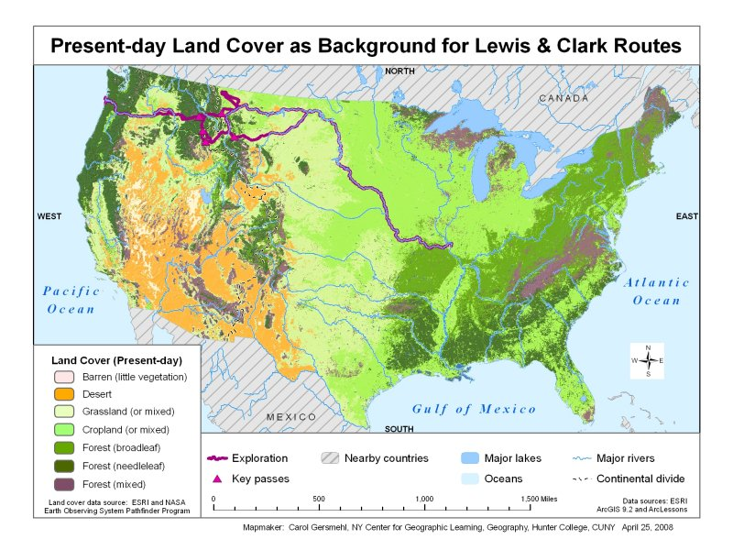
The maps all have
Lewis and Clark’s route
printed on top
of other information.

Slide 11
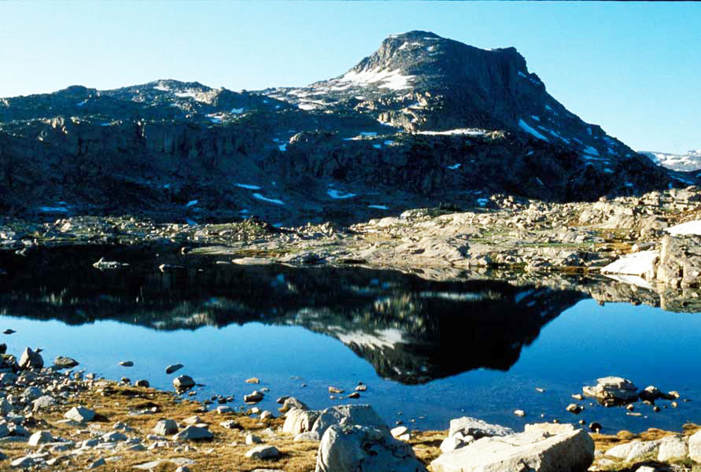
Imagine that you
were going on
a one-week hike
through this area.

Slide 12
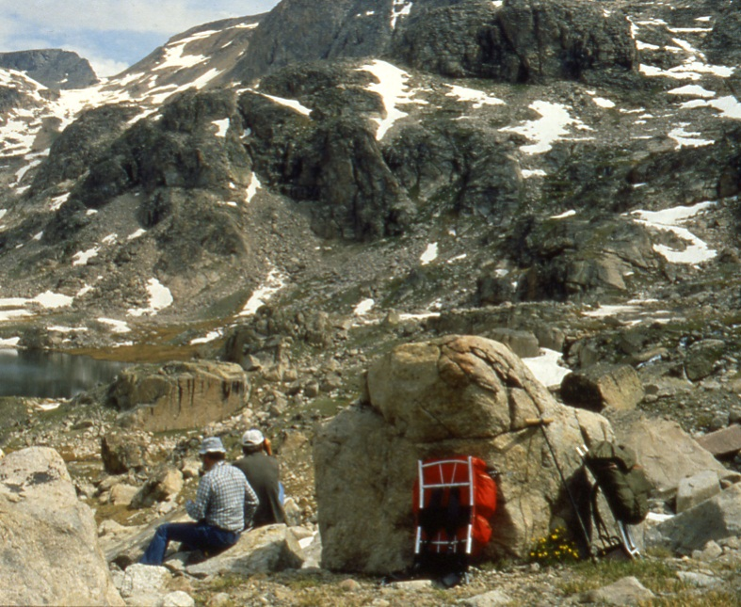
The question
is simple:
What do you want
in your pack?

Slide 13
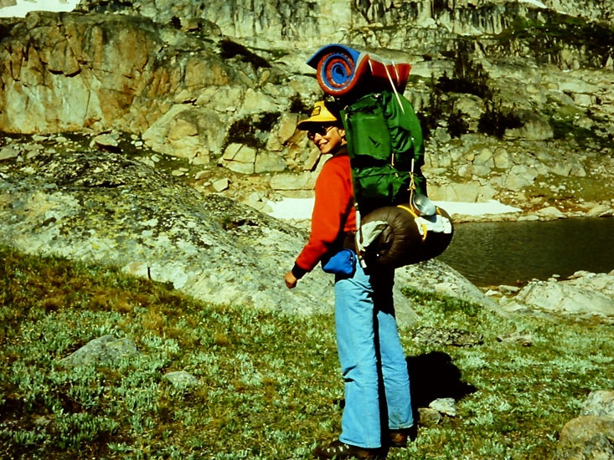
There is a difference:
We were planning
a one-week trip
in one environment
we knew quite well.
Lewis and Clark
were planning a year
in many different
environments
they did not know.

Slide 14
Bullets
What would you take to go
all the way across the country?
Knife
Telescope
Raincoat
Bullets
Boots
Axe
Horses
Rifle
Wagon ?
Boat ?
Coat
Oars
Nails
Wheels
Rope
Saw
Grease
Mosquito Net
Cup
Flint
Chain
Tent
Spoon
Pails
Locks
Forge
Medicine
Caulk
Gifts
Compass
Candy
Map
Pen, Ink

Slide 15
Let’s look at the rivers first,
because Lewis and Clark
planned to use rivers as “highways.”

Slide 16
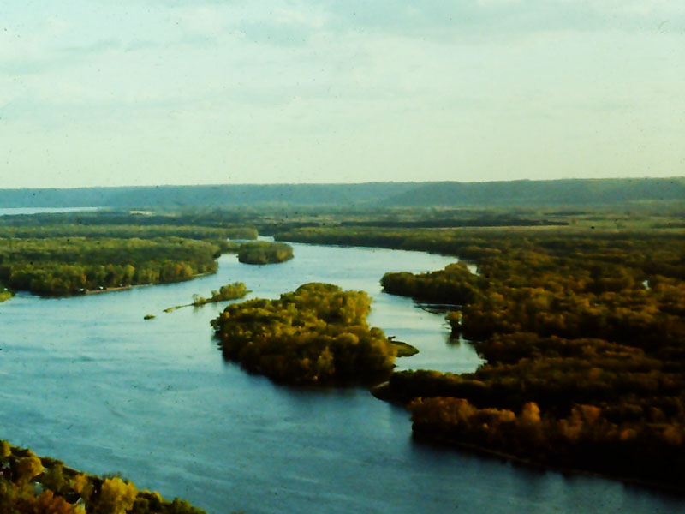
In Missouri . . .
the Missouri River is wide
and surrounded by forest.

Slide 17
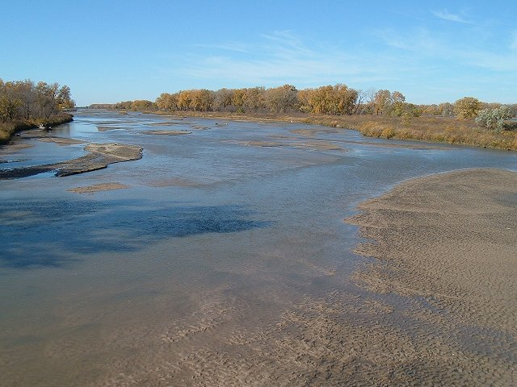
In South Dakota (before dams) the Missouri River is shallow
and filled with sandbars.

Slide 18
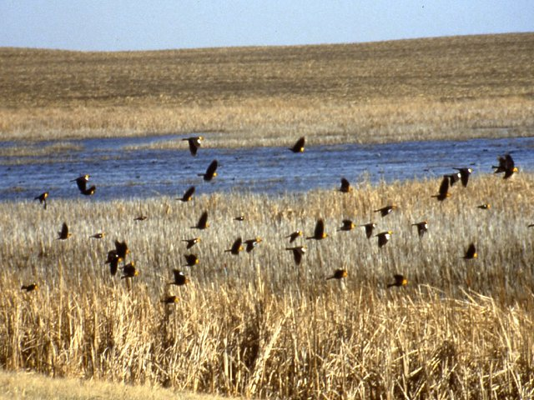
In North Dakota (before dams) the Missouri River is shallow,
a home for waterbirds.

Slide 19
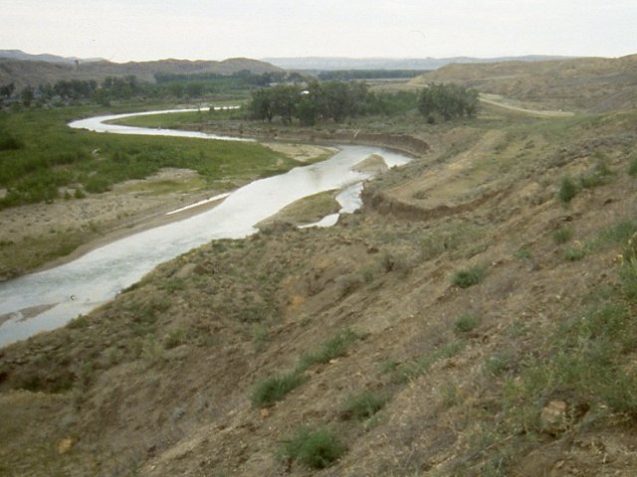
In central Montana
the Missouri River is small,
surrounded by cliffs.

Slide 20
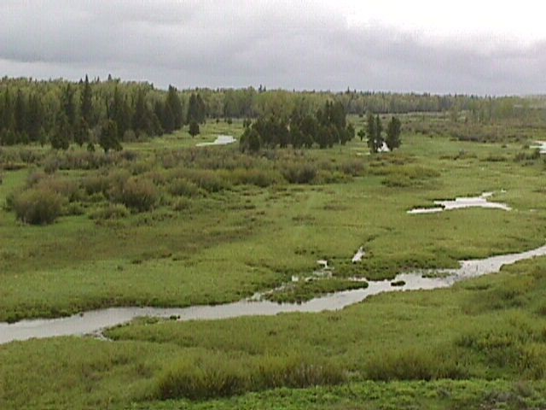
In western Montana
the Missouri River starts
as a small creek.

Slide 21
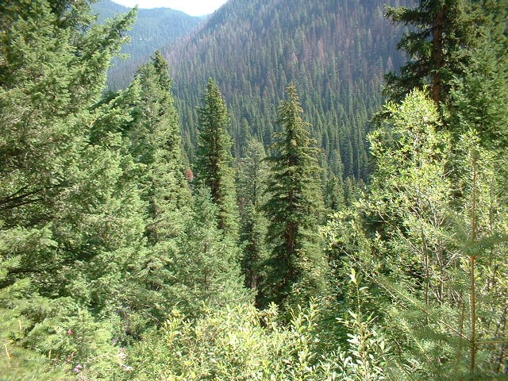
In Idaho,
there is no river
on the Continental Divide.

Slide 22
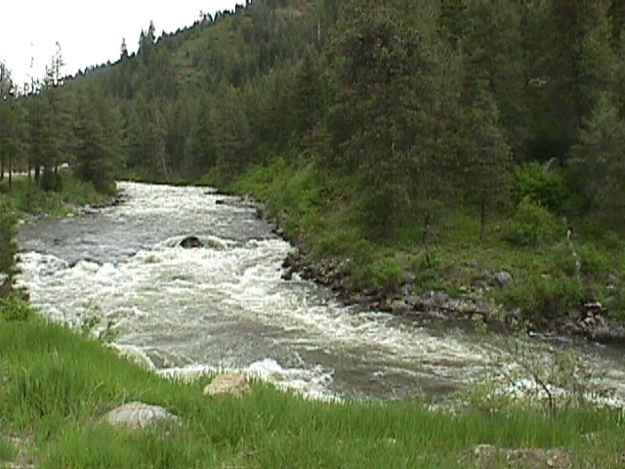
Farther west,
there are some creeks
flowing downhill to the west.

Slide 23
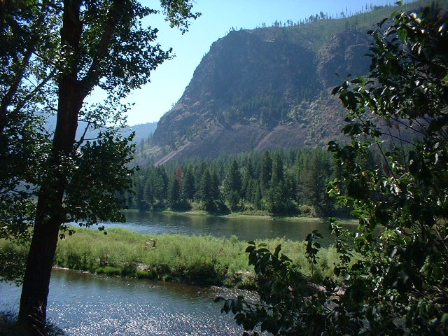
Still farther west,
the creeks join to make
a fairly large river.
It’s called the Clark Fork.
Guess who gave it that name!

Slide 24
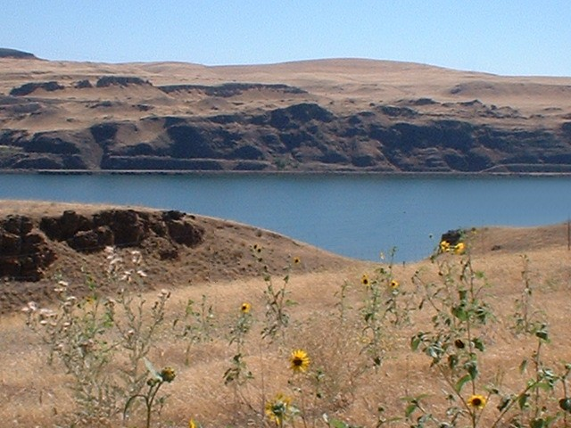
In the middle of Oregon,
the Columbia River
flows through a rocky desert.

Slide 25
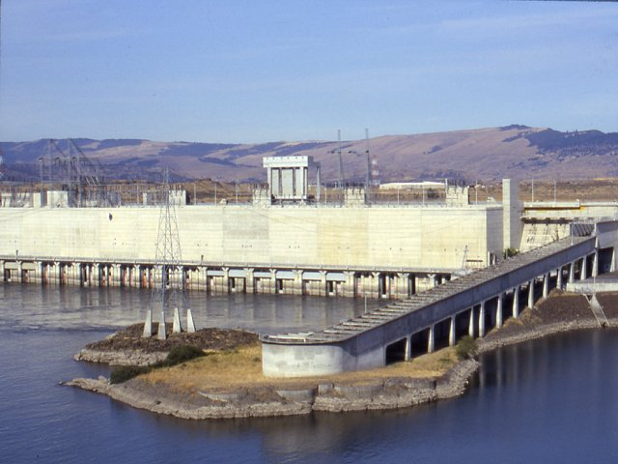
Modern dams
make this river much wider
and slower than it was.

Slide 26
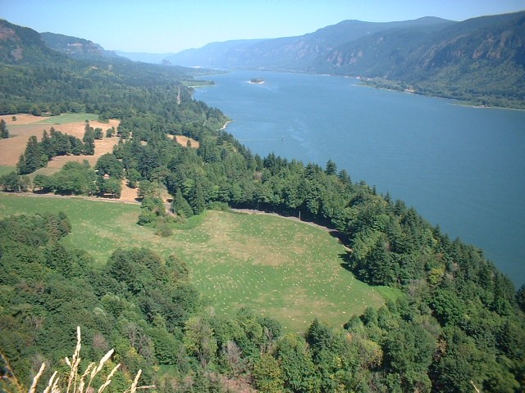
Near the ocean,
the river is wide
and very deep.

Slide 27
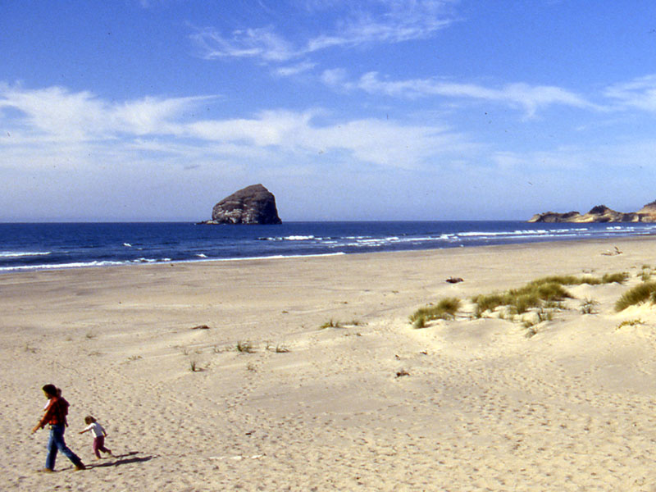
The Pacific shoreline
is a geologically active
mix of rocks and sand.

Slide 28
Repeat the journey,
looking at the land.

Slide 29
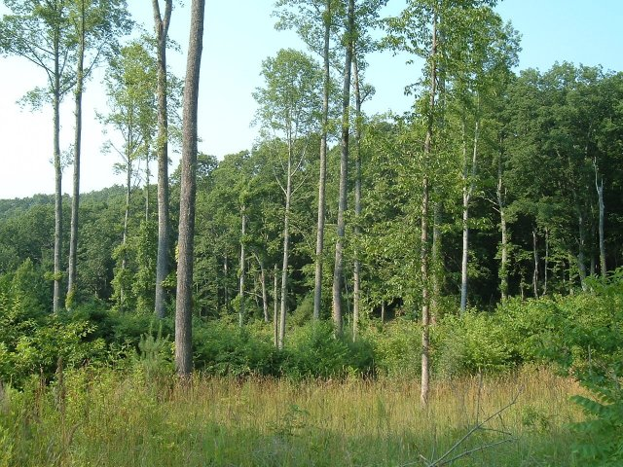
In Missouri,
the land is covered
by fast-growing, tall trees.

Slide 30
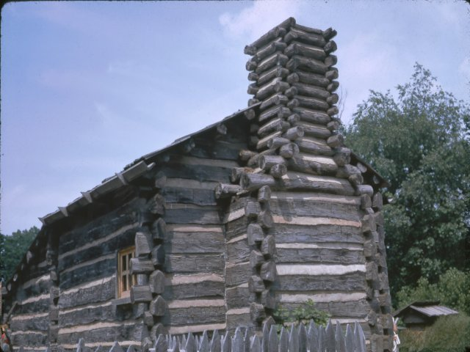
People use the trees
to make houses, tools,
wagons, many other things.

Slide 31
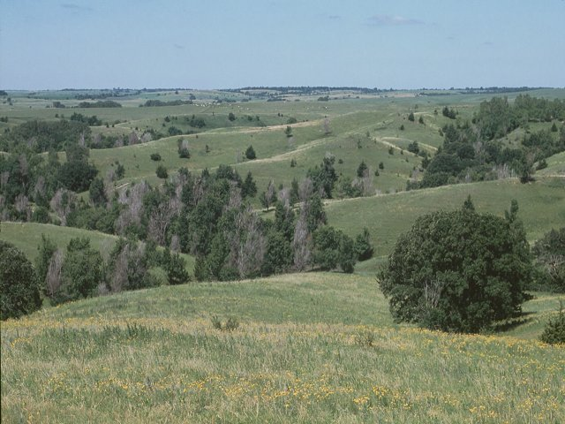
In South Dakota,
the trees are short
and grow only in moist places.

Slide 32
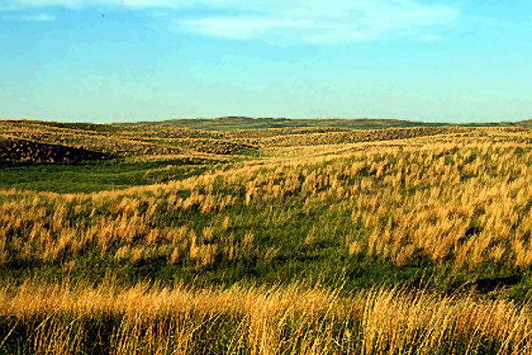
Away from the rivers,
the Dakotas are mostly
a natural grassland.

Slide 33
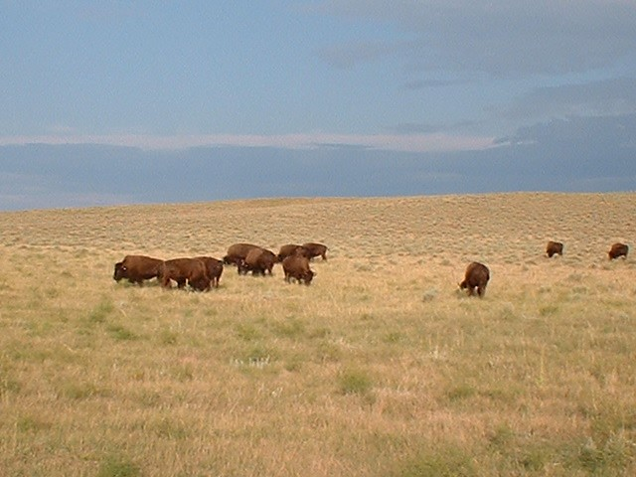
Animals are large
but rather hard to hunt
(they see you from far away).

Slide 34
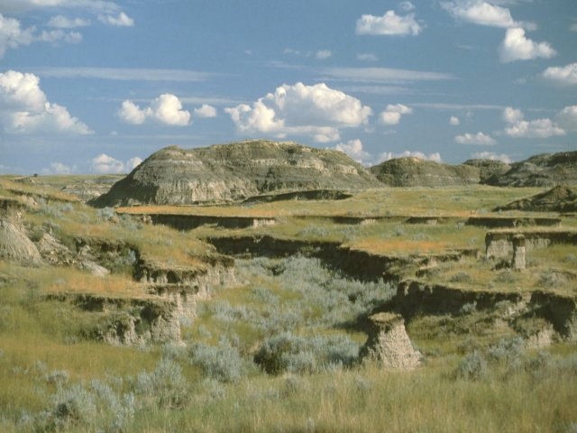
In eastern Montana,
there are not enough plants
to protect the ground.

Slide 35
In western Montana,
the high mountains
are covered with trees.

Slide 36
In eastern Oregon,
the hard lava rock
makes a thin, dry soil.

Slide 37
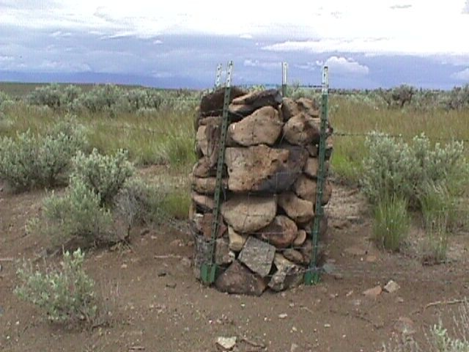
The soil is sometimes so thin
that people have to make
rock cribs for fenceposts.

Slide 38
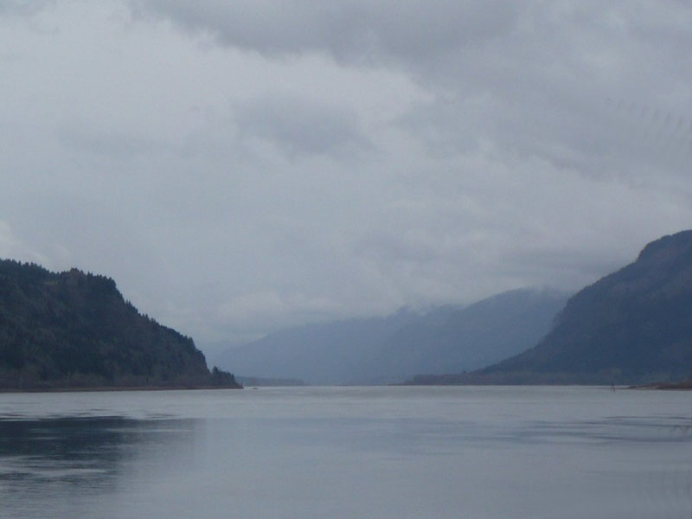
In central Oregon,
the river cuts through
the high Cascade Mountains.

Slide 39
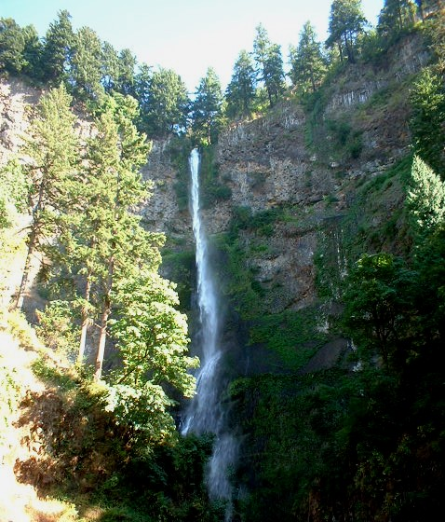
Waterfalls are common
where side creeks
join the main river.

Slide 40
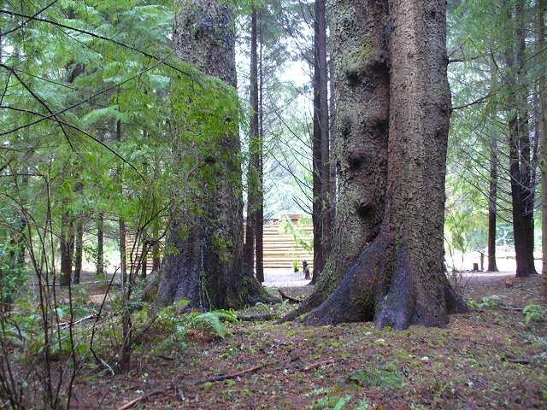
In western Oregon,
the trees grow very tall,
straight, and close together.

Slide 41
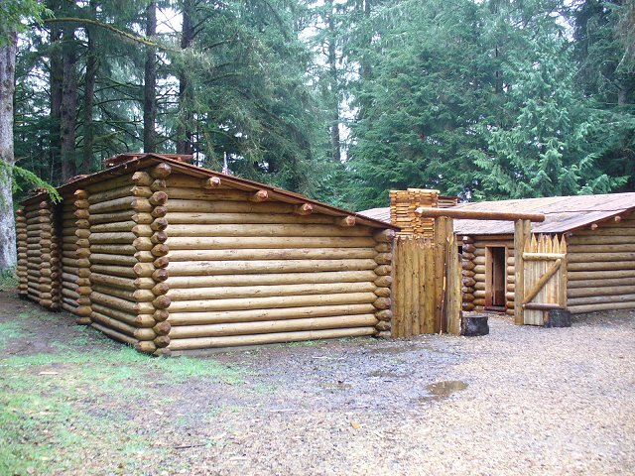
This is a reproduction
of the fort-and-winter-camp
that Lewis and Clark made.

Slide 42
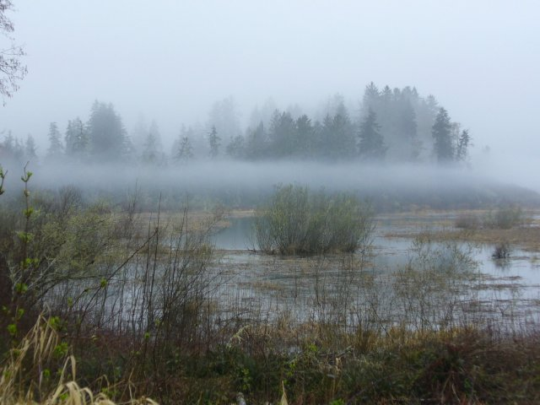
Close to the ocean,
the salt water makes it hard
for many plants to grow.

Slide 43
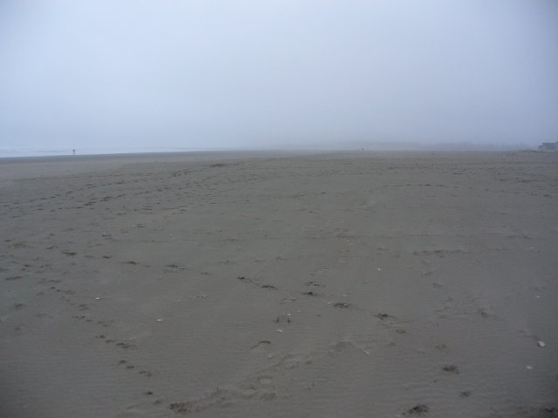
The beaches near the ocean
are likely to be foggy and cool
rather than sunny and warm.

Slide 44
What Lewis and Clark
did not see
(fortunately for them!)

Slide 45
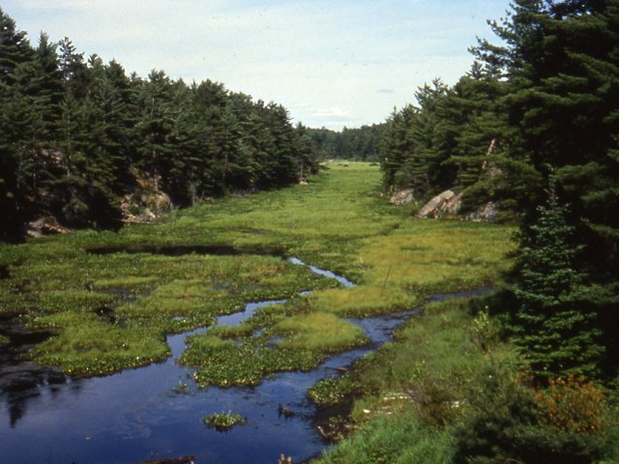
They did not see
hundreds of miles of forest, rocks, and swamps
(like north-central Canada).

Slide 46
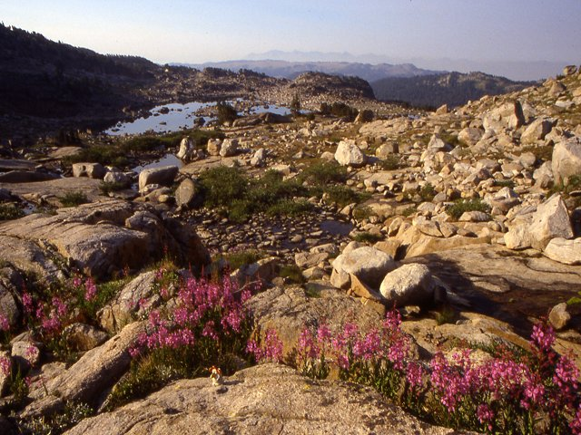
They did not see
mountains too cold for trees
(like the Beartooth Range
in Southwest Montana).

Slide 47
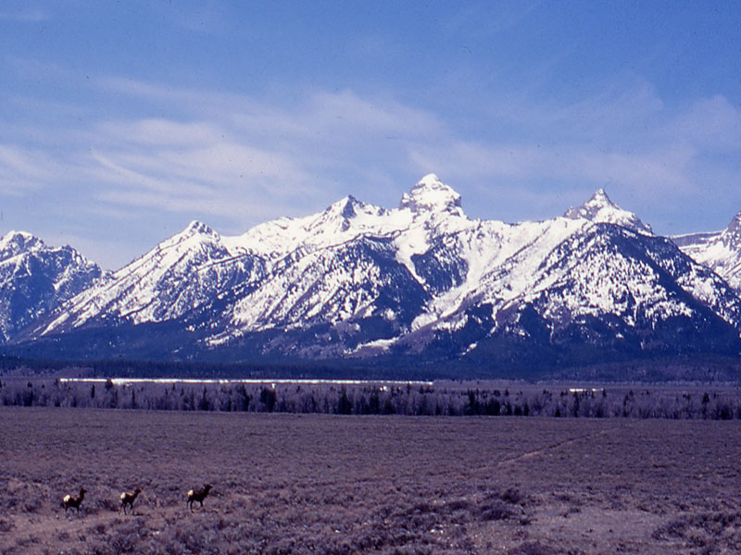
They did not see
mountains too steep to climb
(like the Grand Tetons in Wyoming).

Slide 48
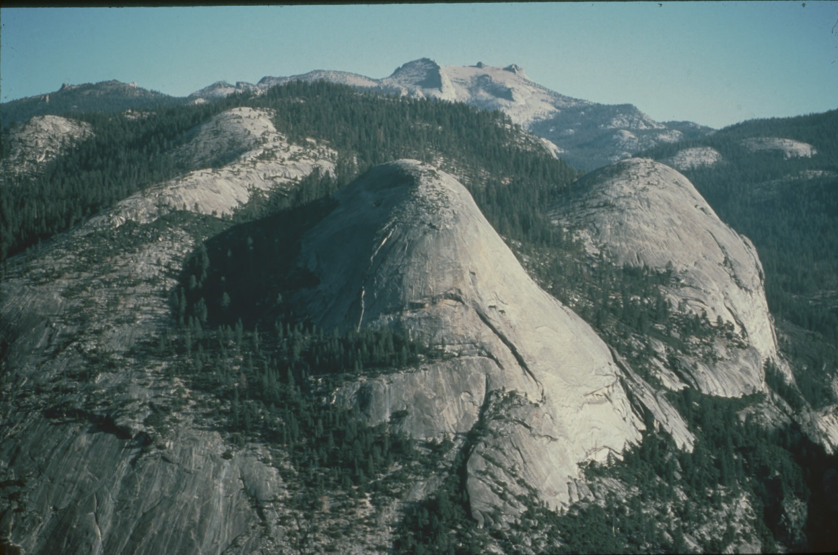
They did not see
steep granite domes
(like Yosemite Park
in California).

Slide 49
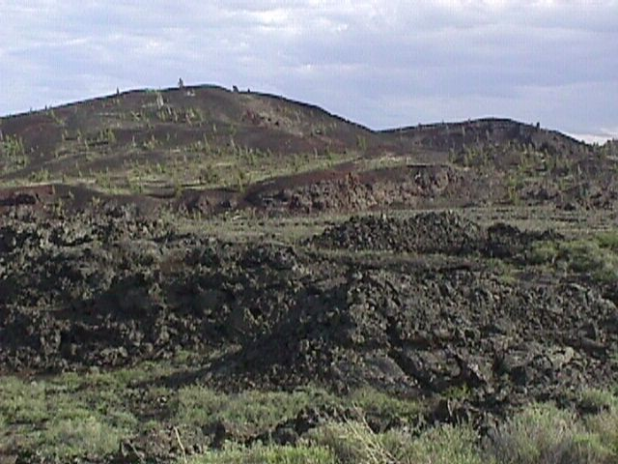
They did not see
miles of volcanic lava
(like the Cascades in Oregon).

Slide 50
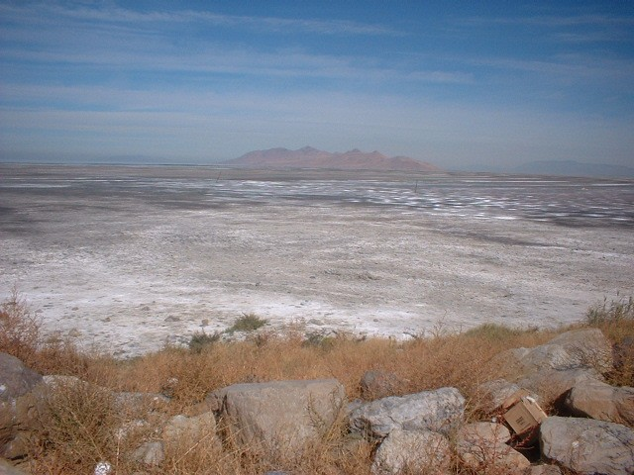
They did not see
wide valleys full of salty soil
(like Death Valley
in California).

Slide 51
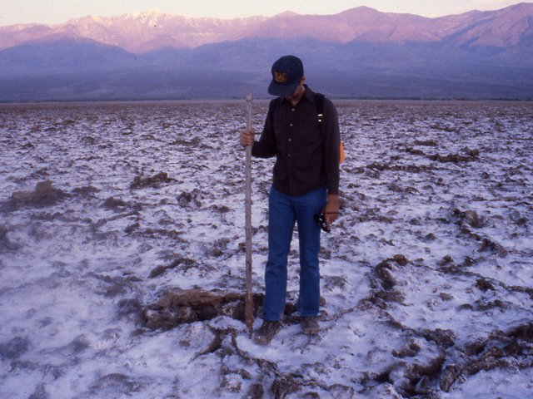
The middle of Death Valley
is a saltwater swamp.

Slide 52
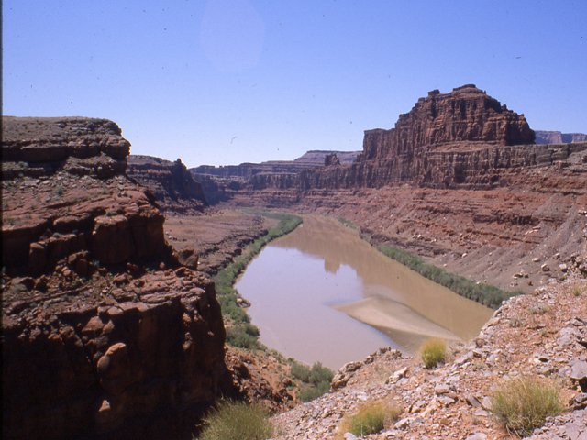
They did not have to cross
rivers in the bottoms
of uncrossable canyons
(like in Arizona).

Slide 53
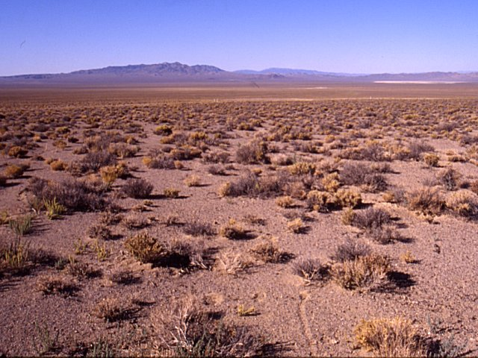
They did not see
vast sagebrush plains
with no source of water
(like in central Nevada).

Slide 54
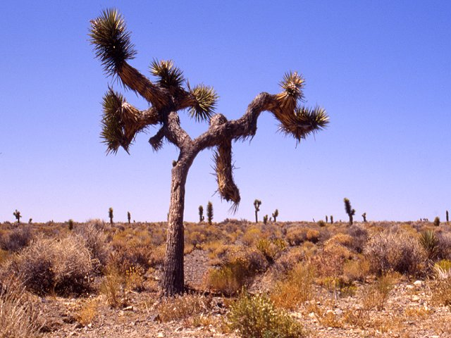
They did not see
weird “forests” like this one
(Joshua trees in California).

Slide 55
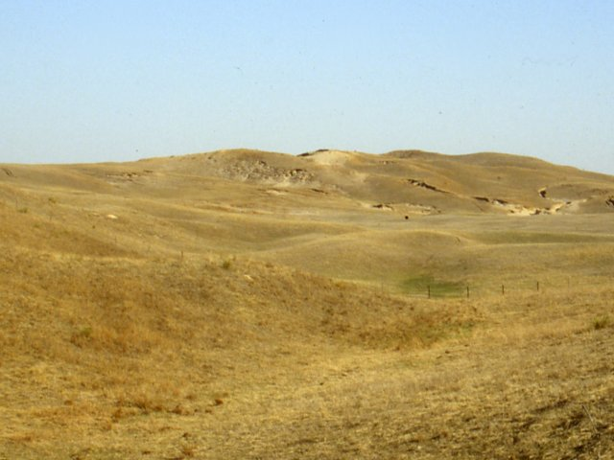
In short,
they were pretty lucky.
The route they took
was certainly tough,
but it was not impossible
with their technology.

Slide 56
What they went through:
a map-based summary

Slide 57
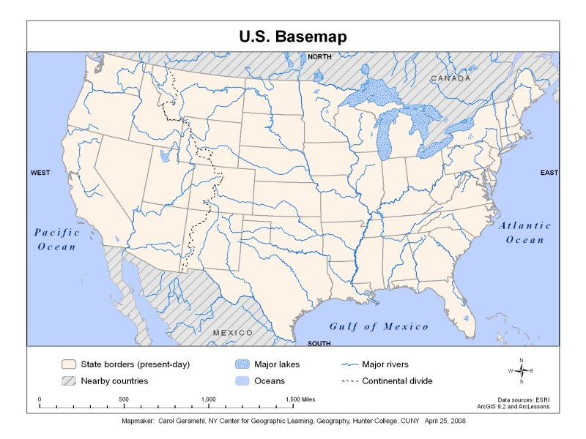

Slide 64
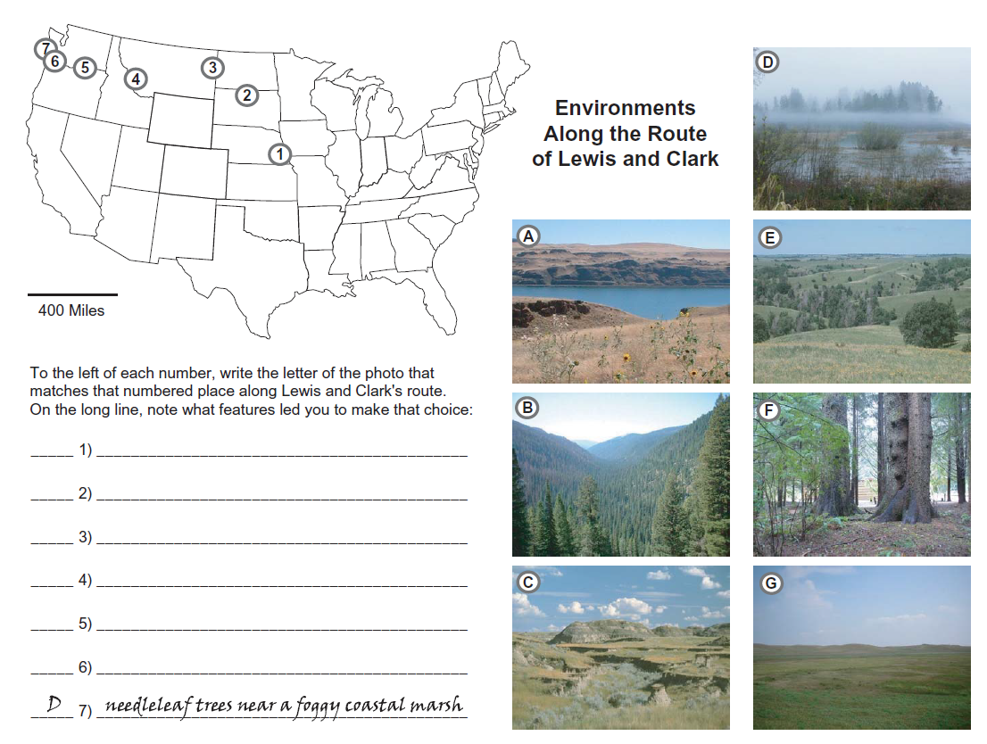
To help you review
these different environments,
you can look at some photos
and match them with locations
on a map of the United States.

Slide 65
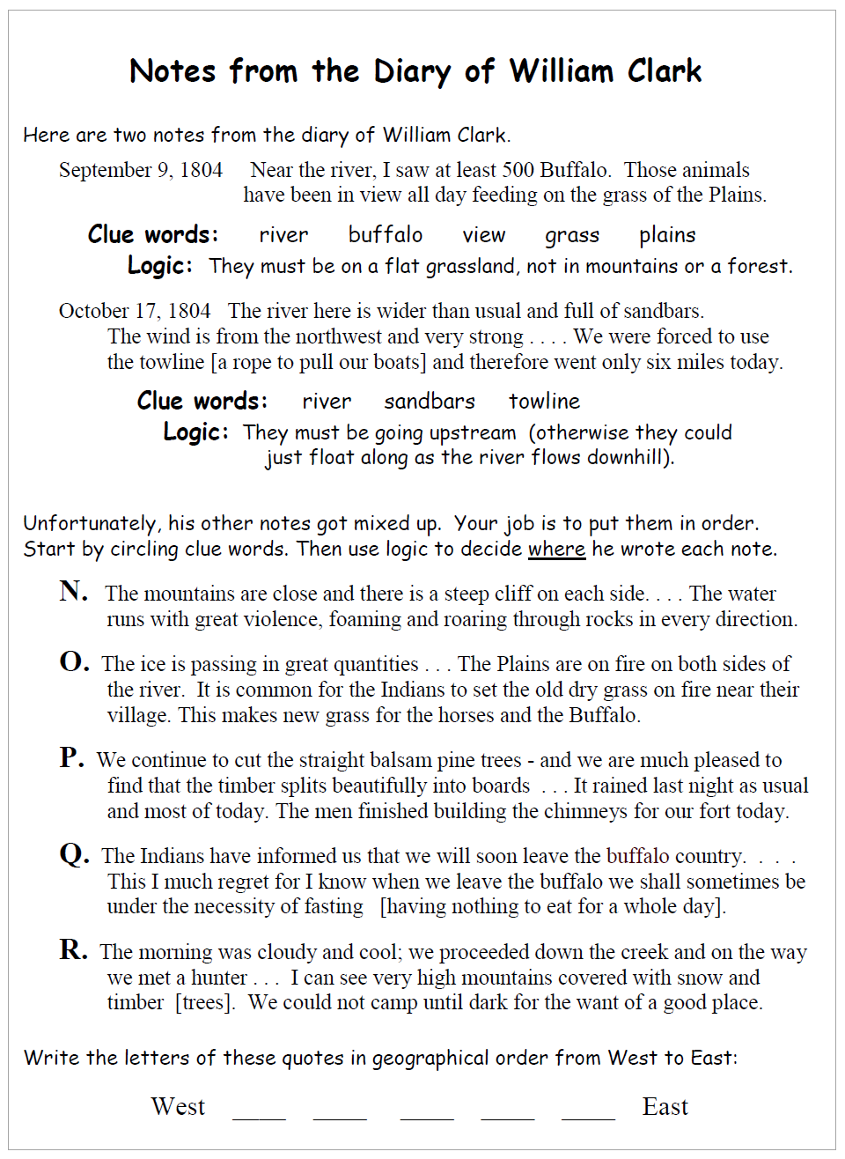
You can also read
some notes
from the diary
of William Clark
. . .
and try to put them
in geographic order
from east to west

Slide 66
And you can
try to decide
what equipment
you would take
if you were going
with the Expedition.

