Slide 1
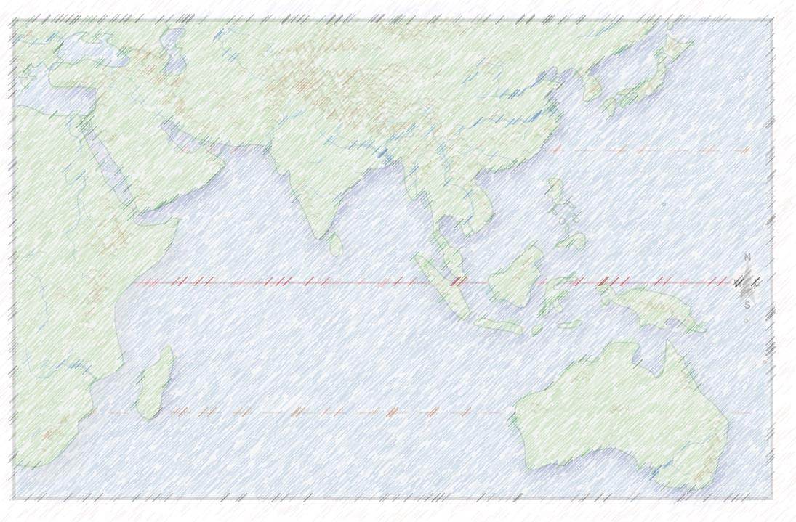
Sailing in the Arabian Sea
A ocean circulation
that was well known by ancient sailors
AND
is a key part of modern climate change.

Slide 2
PART 1
SUMMER
JUMP TO
WINTER

Slide 3
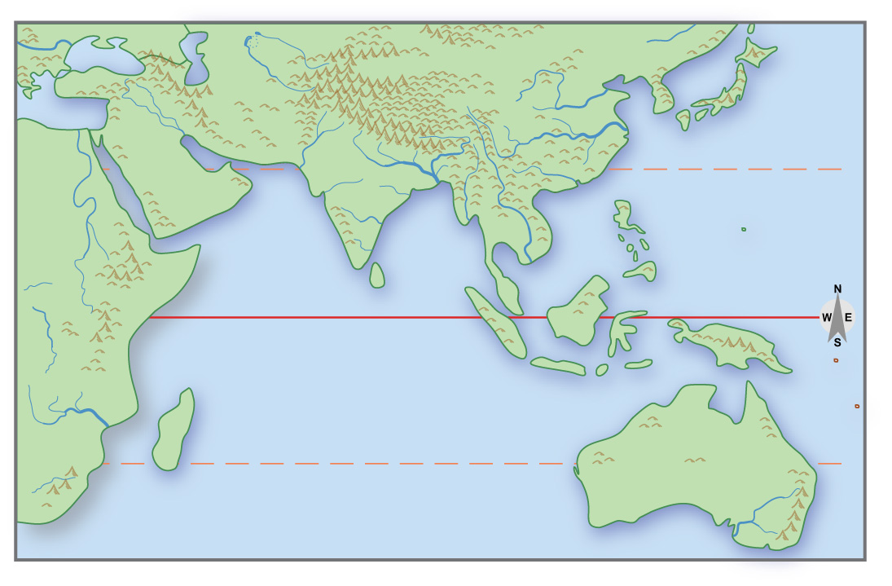
Europe
Arabia
Persian
Gulf
Canton,
China
Red
Sea
0
Arabian Sea
Indian
Ocean

Slide 4
W
1
Central Asia is
sunny and warm.

Slide 5
W
2
Jet stream
goes north
of Himalayas.

Slide 6
W
3
Trade winds
blow west
about 5ºS.

Slide 7
W
4
Ocean water is pushed
toward East Africa.

Slide 8
W
L
5
Air pressure
over India
is low.
because
land is warm
and jet stream
is north

Slide 9
W
L
6
Monsoon winds blow
northeast.
7 they bring
a lot of rain
to India!

Slide 10
W
L
\
8
Monsoon winds also push ocean water
into the northern part
of the Arabian Sea

Slide 11
W
L
\
9
That water “escapes”
by flowing southeast
along the coast.

Slide 12
10
The result is a
clockwise cycle
that sailors could use
to travel around
the Arabian Sea.

Slide 13
11?
Today, as global warming causes
the jet stream and the trade winds
to shift in position, . . . .
there are consequences
for winds, ocean currents,
snowfall in the mountains,
and floods in the lowlands.

Slide 14
PART 2
WINTER

Slide 15
Europe
Arabia
Persian
Gulf
Canton,
China
Red
Sea
0
Arabian Sea
Indian
Ocean

Slide 16
C
1
Central Asia
is cold.

Slide 17
C
2
Jet stream
goes south
of Himalayas.

Slide 18
C
H
3
Air pressure
over India
is high.

Slide 19
C
H
4
Monsoon winds blow
southwest.

Slide 20
C
H
5
Ocean water
is pushed
southwest.

Slide 21
C
H
6
Trade winds
blow west
about 15ºS.

Slide 22
C
H
7
Ocean water is pushed
toward Madagascar.

Slide 23
C
H
8
Water “piles up” here
and “escapes” to the east.

Slide 24
C
H
9
Water moves northwest
along coast of India.

Slide 25
10
The result is a
counterclockwise cycle
that sailors could use
to travel around
the Arabian Sea.

Slide 26
11?
Today, as global warming causes
the jet stream and the trade winds
to shift in position, . . . .
there are consequences
for winds, ocean currents,
snowfall in the mountains,
and floods in the lowlands.

