Slide 1

What
is a
BIGJob
???

Slide 2
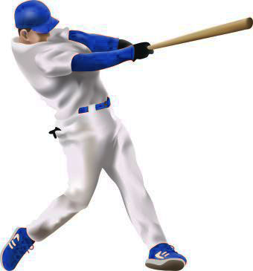
A BIGJob
is a job that brings money
into an area (town, state, country).
The name stands for
Basic Income Generating Job

Slide 3
A person doing a BIGJob
grows, digs, makes, or does something that can be sold
to people outside the local area.
That money can be used
to buy things that people cannot
(or do not want to)
grow, dig, or make for themselves
in your community.
Maybe it’s too cold,
or you don’t have the tools,
or you don’t know how,
or you are too old, or . . . .

Slide 4
Clear? Let’s see.
I’ll name some jobs, and you tell me
if each one is a BIGJob or not.
college professor
Q. How many
of these are
BIGJobs?
baseball player
furniture maker
powerplant operator
A. All
of them
restaurant owner
professional artist
park cleaner

Slide 5
OK
I’ll name some more jobs, and you tell me
if each one is a BIGJob or not.
college professor
Q. How many
of these are
BIGJobs?
baseball player
furniture maker
powerplant operator
A. None
of them
restaurant owner
professional artist
park cleaner

Slide 6
OK
I’ll name some more jobs, and you tell me
if each one is a BIGJob or not.
Wait a Minute!
How can this be?
college professor
Q. How many
of these are
BIGJobs?
baseball player
furniture maker
powerplant operator
A. None
of them
restaurant owner
professional artist
park clearner

Slide 7
Let’s go over the list again.
This time, let’s see how a job can be
a BIGJob and also not a BIGJob
college professor
YES
students come to Boston
from all over the world
to study with professors
at Harvard University
NO
students come mainly
from the local area
to study with professors
at a community college

Slide 8
Let’s go over the list again.
This time, let’s see how a job can be
a BIGJob and also not a BIGJob
college professor
YES
people come
from many other states
to watch the players
of the NY Yankees.
baseball player
NO
most of the fans
at a Little League game
are parents and friends
from the same town.

Slide 9
Let’s go over the list again.
This time, let’s see how a job can be
a BIGJob and also not a BIGJob
college professor
YES
if you make furniture
to sell in Walmart.
baseball player
furniture maker
NO
if you help your neighbor install a shelf in the bathroom.

Slide 10
Let’s go over the list again.
This time, let’s see how a job can be
a BIGJob and also not a BIGJob
college professor
YES
if you run a dam in Arizona
and sell power to California.
baseball player
furniture maker
powerplant operator
NO
if you run a community
electric generator.

Slide 11
Let’s go over the list again.
This time, let’s see how a job can be
a BIGJob and also not a BIGJob
college professor
YES
if you run a world-famous
restaurant in Paris.
baseball player
furniture maker
powerplant operator
restaurant owner
NO
if you run a burger place
in your home town.

Slide 12
Let’s go over the list again.
This time, let’s see how a job can be
a BIGJob and also not a BIGJob
college professor
YES
if you sell paintings
in galleries
all over the country.
baseball player
NO
if you paint murals
for your town office.
furniture maker
powerplant operator
restaurant owner
professional artist

Slide 13
Let’s go over the list again.
This time, let’s see how a job can be
a BIGJob and also not a BIGJob
college professor
baseball player
NO
if you cut the grass
in your town golf course.
YES
if you clean the lodge
in Yellowstone
National Park.
furniture maker
powerplant operator
restaurant owner
professional artist
park cleaner

Slide 14
BIG POINT
What makes a job into a BIGJob
is not necessarily the job itself,
but where the money comes from
to pay the worker.
If a person
grows, digs, makes, or does
something that can be sold
to people outside the home town,
state, or country, that is a BIGJob.

Slide 15
So why is this
important?
Because every place
needs at least one BIGJob
to get the money people need
to buy the things they can’t
grow, dig, or make for themselves.

Slide 16
Strange, but true:
in a typical place,
only a tiny fraction of the people
actually do the BIGJobs.
Everyone else does
what we might call OtherJobs.
These are the jobs
that do things for other people
within the local area.
What are some OtherJobs?
Store clerk, cable installer,
firefighter, teacher, trash collector,
mayor, building inspector,
car repairer, nurse, . . .

Slide 17
This is why it is important:
If the BIGJobs in a place are not successful,
all the people who are doing OtherJobs
will have a hard time making a living,
because no one is bringing money
into the local community.

Slide 18
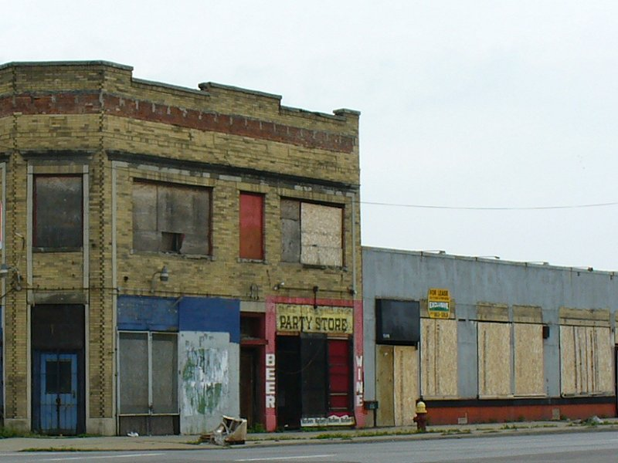
This has happened
in many places.
Politicians often say
they know what to do
to solve this problem.
But if people
do not understand
about BIGJobs,
these problems
are hard to solve!

Slide 19
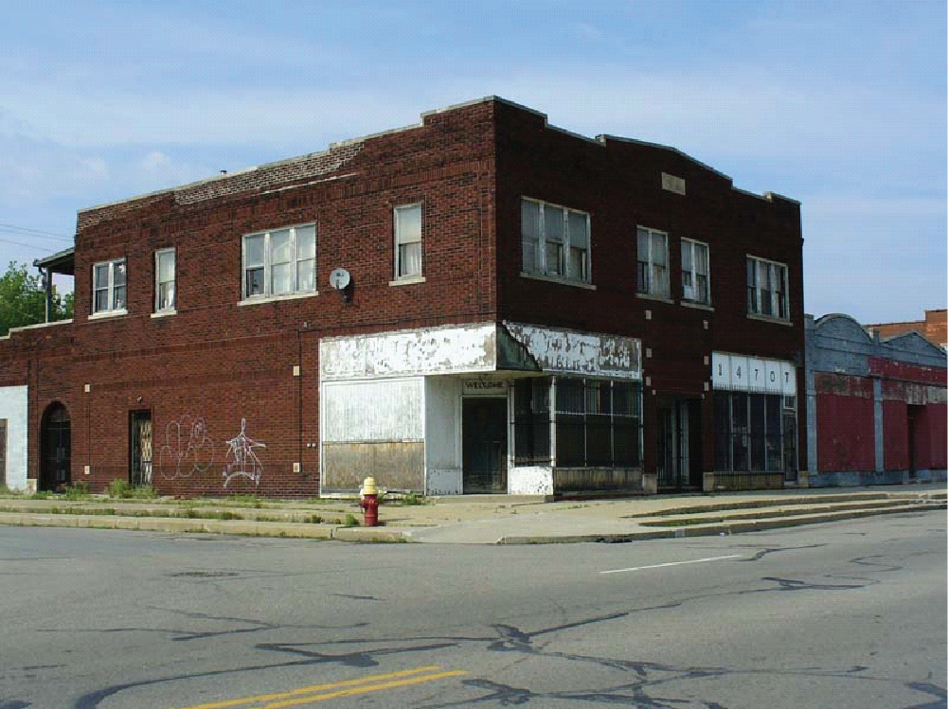
Think about it.

Slide 20
Talk about it.

Slide 21
Copyright 2015, Phil Gersmehl
Teachers who saw this presentation at a workshop
or downloaded it from our internet site have permission
to make a copy on their own computers for these purposes:
1. to help them review the workshop,
2. to show to colleagues or administrators,
3. to show the presentation in their own classrooms
or at sessions they lead at teacher conferences,
4. to use individual frames (with attribution)
in their own class or conference presentations.
For permission for any other use,
including posting frames on a personal blog
or uploading to any network or website,
contact pgersmehl@gmail.com
Talk about it.

