Slide 1
Michigan Exports
What does Michigan sell
to other countries?
How can we identify Michigan’s BIGJobs?
Basic Income Generating Jobs
carol.gersmehl@gmail.com, 6th grade network, March 2, 2016

Slide 2
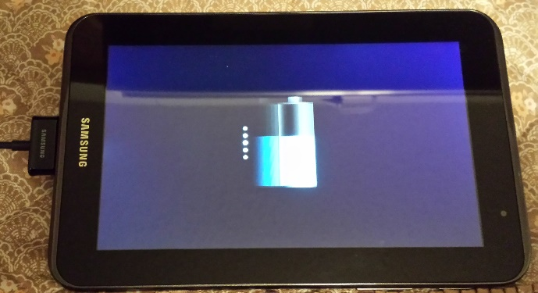
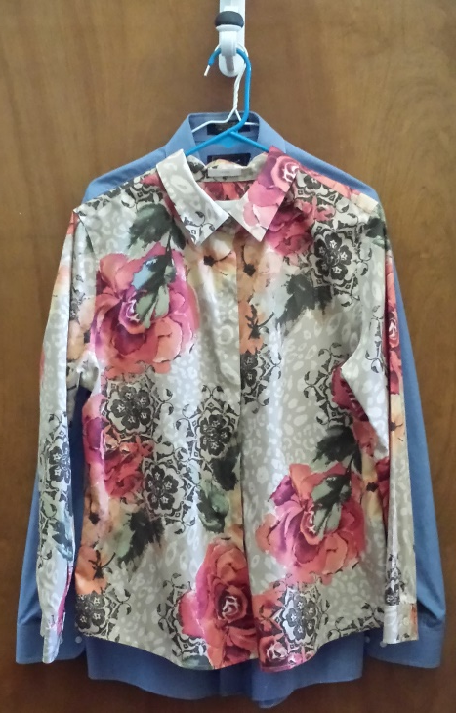
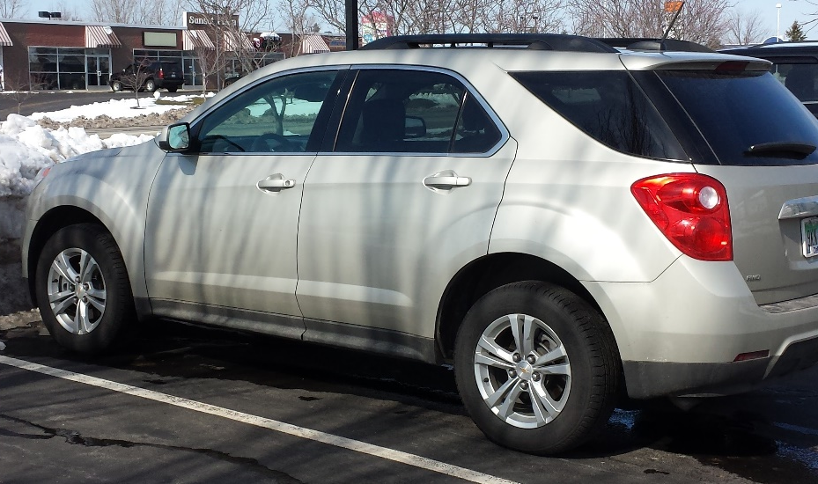
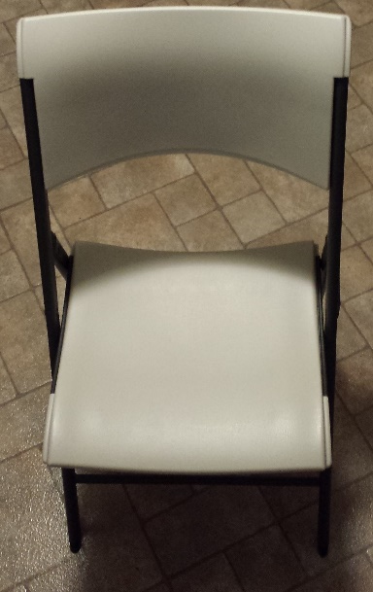
Which type of export brings the highest amount of money into Michigan?
Apparel
Electronics
Furniture
Vehicles
Photos: Carol Gersmehl

Slide 3
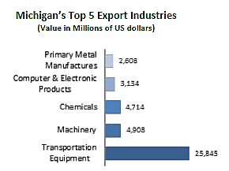
Which type of export brings the highest amount of money into Michigan?
Car manufacturers websites about their transportation equipment:
http://gmauthority.com/blog/gm/gm-manufacturing/
General Motors Manufacturing Plants
Click on + next to United States.
http://www.thehenryford.org/rouge/index.aspx
http://www.thehenryford.org/rouge/eduResources/caseStudyIndustrialization.pdf
Ford Manufacturing
Cars and Trucks
Dow’s video
http://www.dow.com/en-us/markets-and-solutions shows products made using Dow chemicals (e.g. plastics and adhesives).

Slide 4
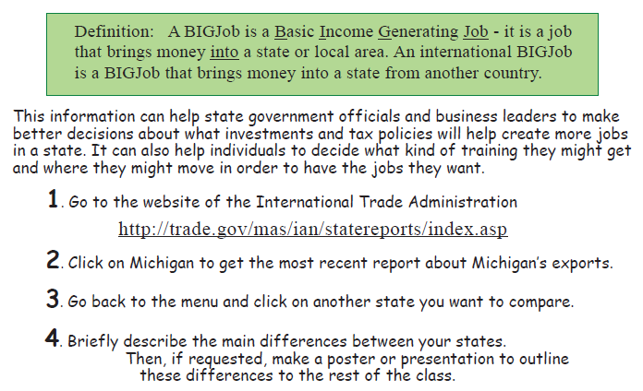
The federal government provides data about Michigan’s BIGJobs.
Notes:
J

Slide 5
http://trade.gov/mas/ian/tradestatistics/
This is a very useful website
if you are investigating
exports from different states.

Slide 6
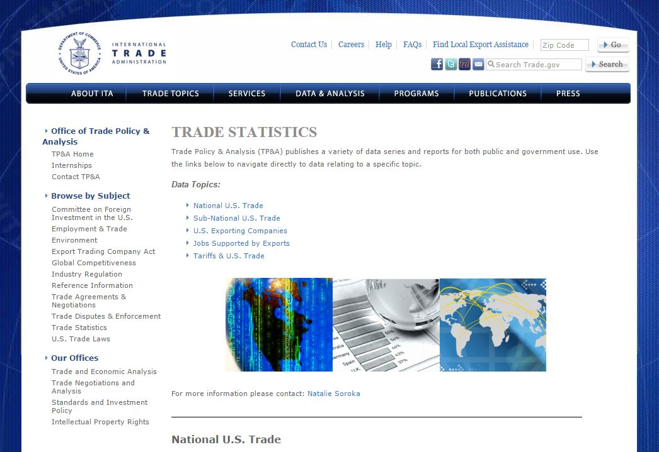
http://trade.gov/mas/ian/tradestatistics/
Sub-national US Trade

Slide 7
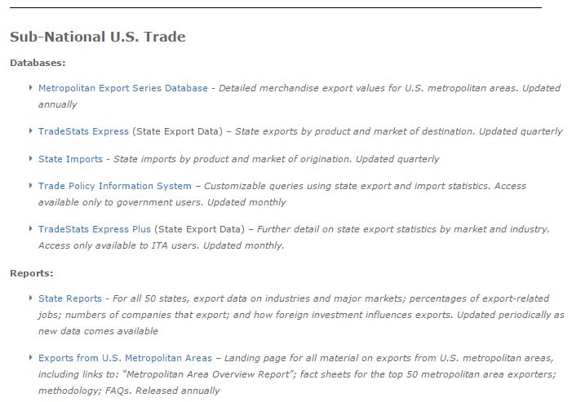
State Reports

Slide 8
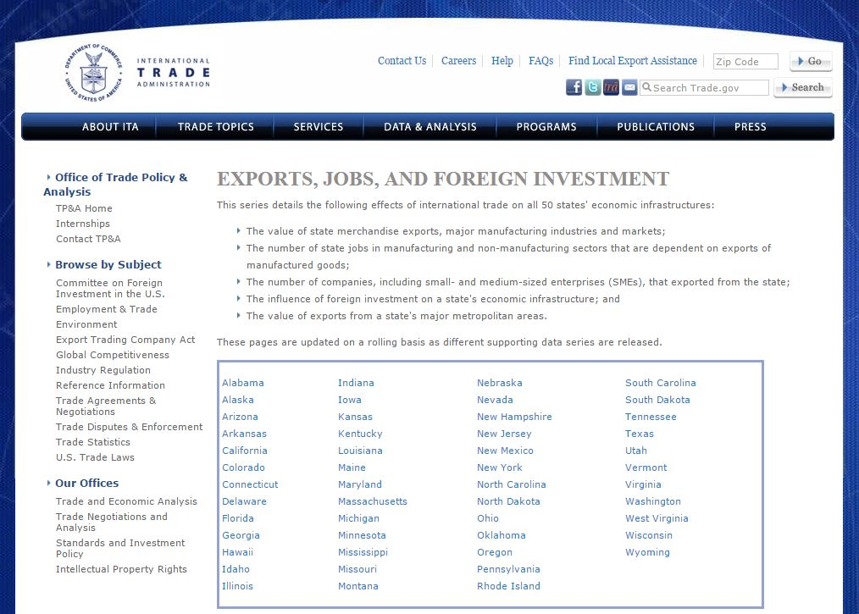
Click on Michigan
(or any other state you want)

Slide 9
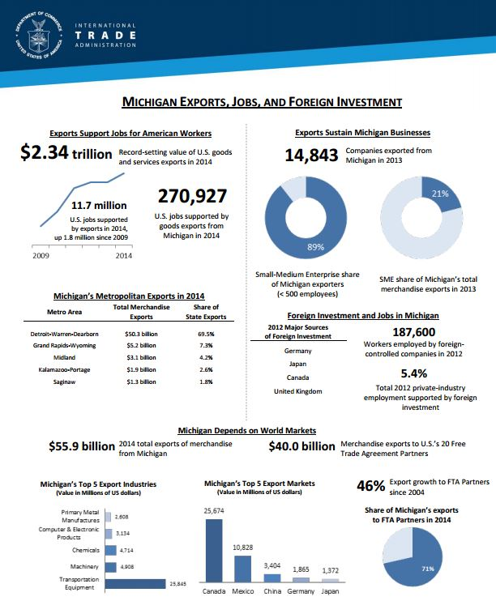
How much does
Michigan sell?

Slide 10
What products
does Michigan sell?

Slide 11
What countries
does Michigan sell to?

Slide 12
You have copies
of the summary reports (primary data resource)
for several different states
Students may pick a state,
and compare its exports
with Michigan’s.
- - -
Example comparisons follow
in this PowerPoint and illustrate generalizations.

Slide 13
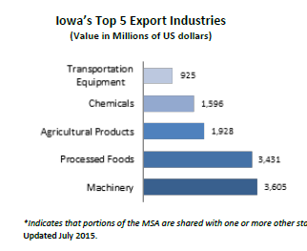
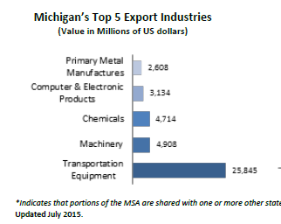
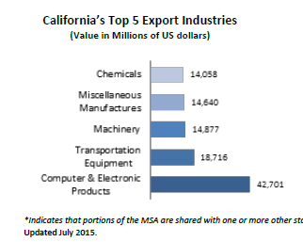
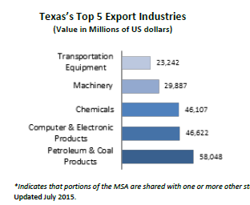
Compare
what
states
sell
(2015 exports).
Iowa population: 3 million
Michigan population: 10 million
Notice that states sell
DIFFERENT things!
California population: 39 million
Texas population: 27 million

Slide 14
Exports (2015).
Which two countries buy a lot from all 6 states?
Which two countries are closest to the U.S.?
_______________ _______________
Canada
China
_______________ _______________
Canada
Mexico

Slide 15
Copyright 2016, Carol Gersmehl
Teachers who saw this presentation at a workshop
or downloaded it from our internet site have permission
to make a copy on their own computers for these purposes:
1. to help them review the workshop,
2. to show to colleagues or administrators,
3. to show the presentation in their own classrooms or at sessions they lead at teacher conferences,
4. to use individual frames (with attribution) in their own class or conference presentations.
For permission for any other use,
including posting frames on a personal blog or uploading to any network or website,
contact pgersmehl@gmail.com

