Slide 1
Oil import sources
GLCE G1.3.3 Explain the different ways in which places are connected
and how those connections demonstrate interdependence.
GLCE E3 Analyze reasons for individuals and businesses to specialize
and trade, and the benefits and costs of trade.
A quick map activity

Slide 2
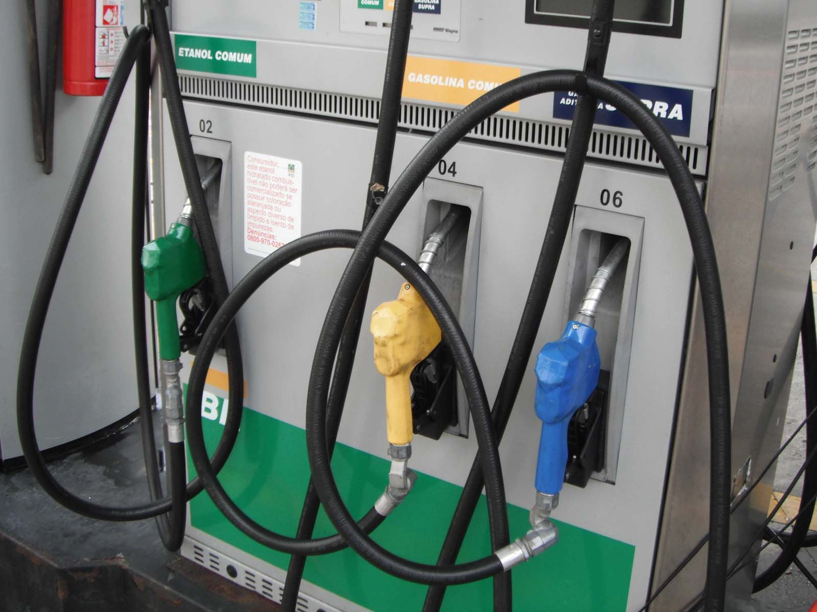
When you see
a gas station,
in your mind you
should also see . . .

Slide 3
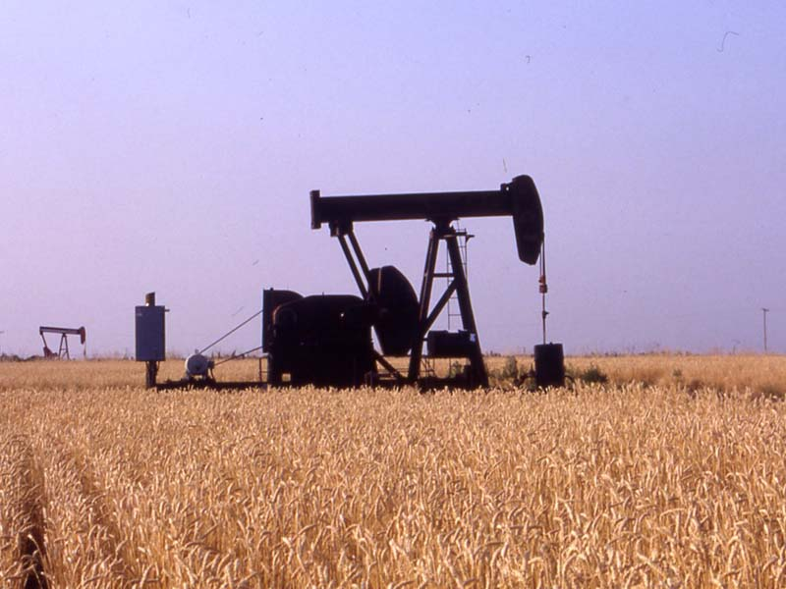
an oil well

Slide 4
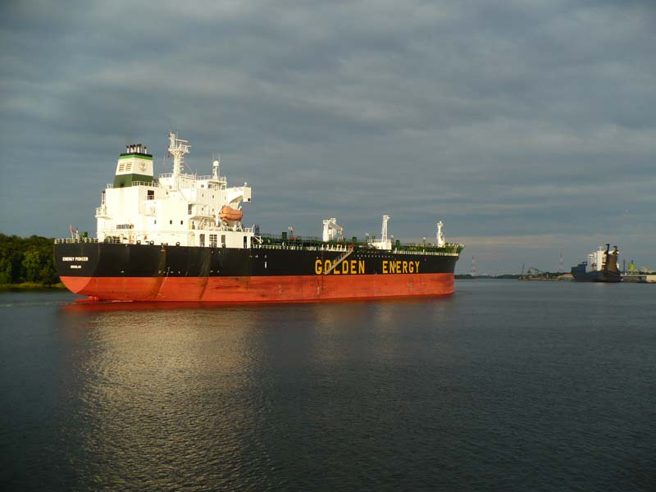
maybe a ship

Slide 5
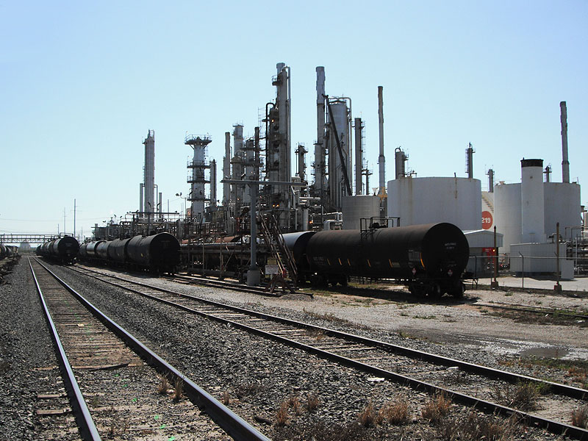
an oil refinery

Slide 6
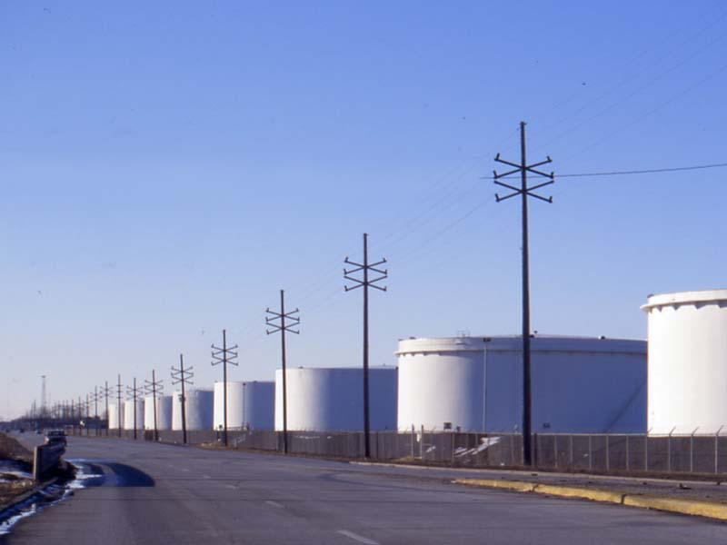
and some
storage tanks

Slide 7
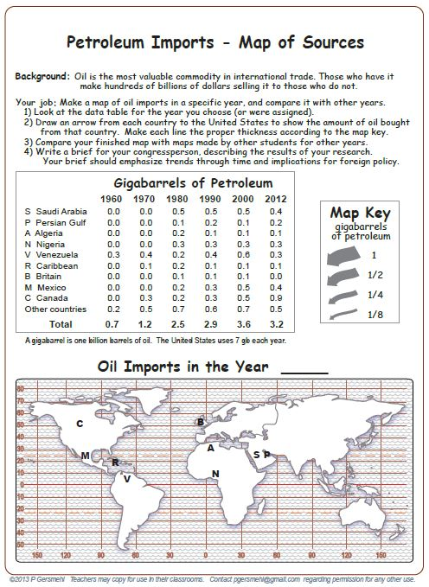
Today,
we will investigate
where we get
a lot of our oil
(and why that fact
might help terrorists).

Slide 9
What year is this?

Slide 10
What year is this?
9
1
2
4
1
4
3
3

Slide 11
Copyright 2016, Phil Gersmehl
Teachers who saw this presentation at a workshop
or downloaded it from our internet site have permission
to make a copy on their own computers for these purposes:
1. to help them review the workshop,
2. to show to colleagues or administrators,
3. to show the presentation in their own classrooms
or at sessions they lead at teacher conferences,
4. to use individual frames (with attribution)
in their own class or conference presentations.
For permission for any other use,
including posting frames on a personal blog
or uploading to any network or website,
contact pgersmehl@gmail.com

