Slide 1
Basic Visual Vocabulary in Geographic Education
Transportation

Slide 2
There was space available on the Teaching Geography CD.
Over the years, a number of teachers had requested
photos to help students improve their “visual vocabulary”
for things they may encounter in geographic readings.
The images in this folder were chosen
from more than 30,000 photos that I took to illustrate
classes I taught for many years (mostly about the U.S.).
It’s NOT a coherent presentation, and it is NOT a complete set.
I am just (quickly!) filling some space with possibly useful stuff!
In short, these are for you to insert in your own presentations.
I freely offer them for use in your classes;
please contact pgersmehl@gmail.com for any other use.
The images are 800x600 pixels and sized at 75% in this ppt,
a reasonable compromise among competing demands:
visibility, file size, and available on-screen space
for comments and other annotations.
Opportunity
Request
Source
Purpose
Copyright
Tech Specs

Slide 3
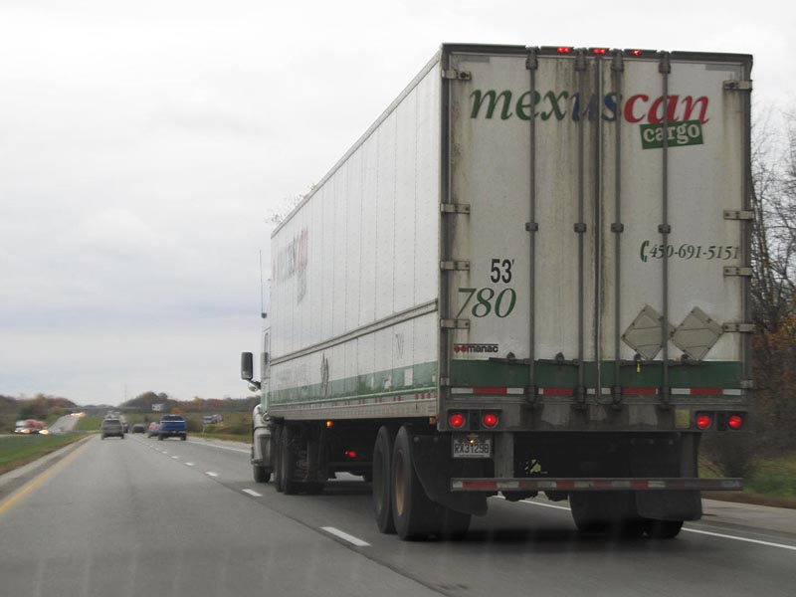
The most flexible way to move large items is
with a standard “18-wheeler” semi-trailer truck.
This one advertises its role as a part of the North American Free Trade Agreement (NAFTA) with Mexico and Canada.
south Texas or Ohio
(I have one from both places)

Slide 4
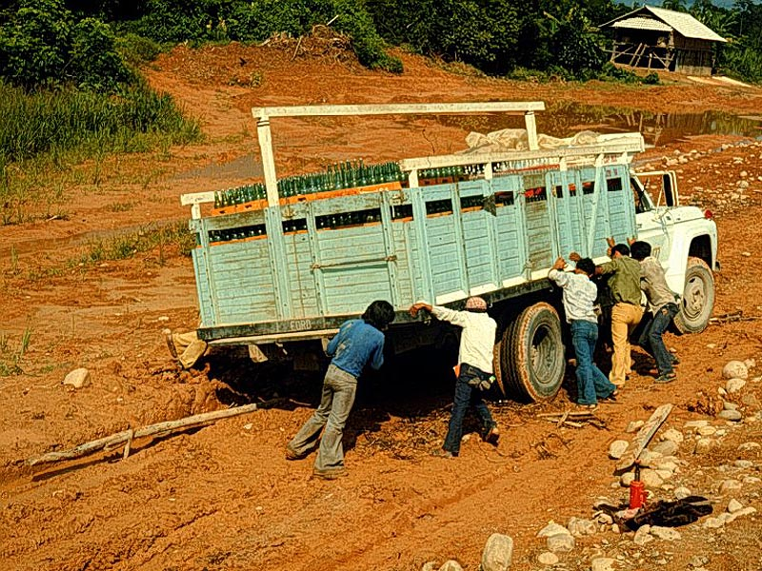
To be effective, however, truck transport requires good roads.
(Photo courtesy Jim and Connie Weil).

Slide 5
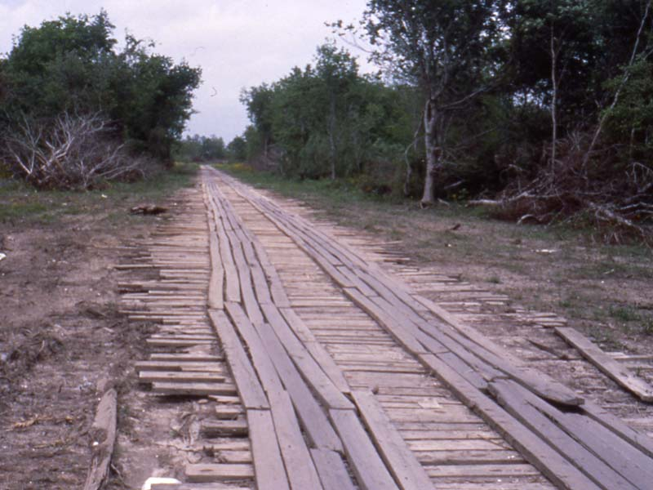
Plank road in Louisiana.
In the horse-and-buggy days, a plank road
(made with boards laid over a graded bed)
was definitely better than dirt, especially in bad weather.
southern Louisiana

Slide 6
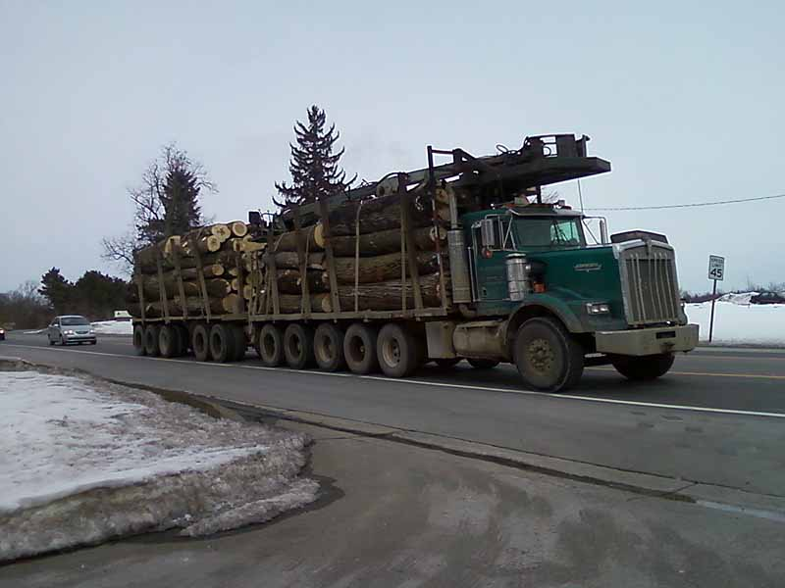
Extra wheels on a truck are an indication that it is designed
for road that have weight limitations in some seasons
(usually in spring when the ground has recently thawed
but is still wet and therefore unable to support a full load).
central Michigan

Slide 7
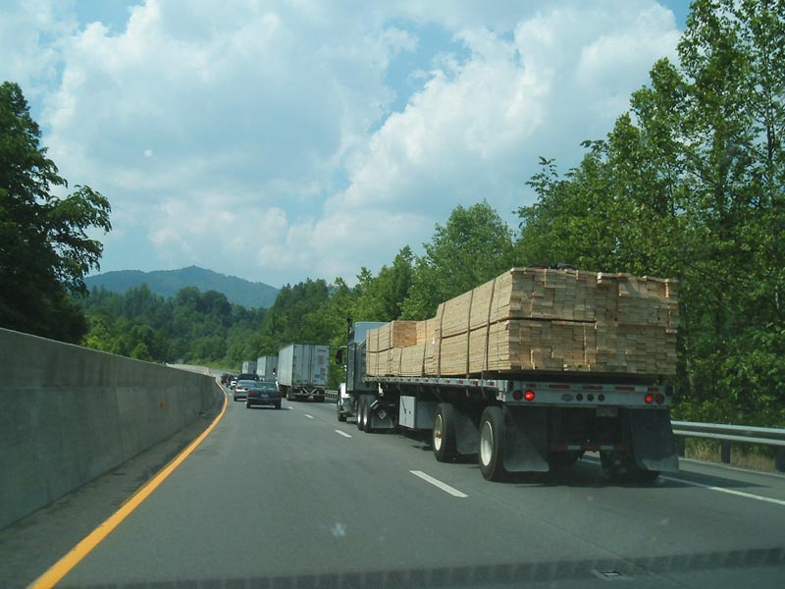
Interstate-40 in North Carolina.
Interstate highways are designed to support trucks
that may weigh up to 80,000 pounds.
North Carolina

Slide 8
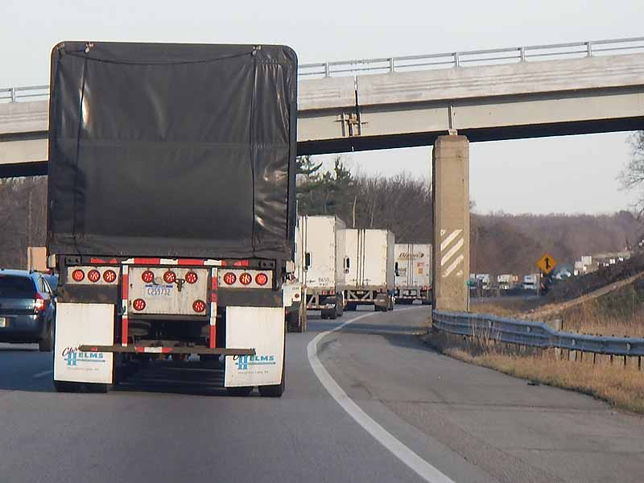
Interstate 94 in Michigan.
Interestingly, the shift to internet sales
has actually increased demand for trucking services –
more trucks carrying smaller loads more frequently.
southern Michigan

Slide 9
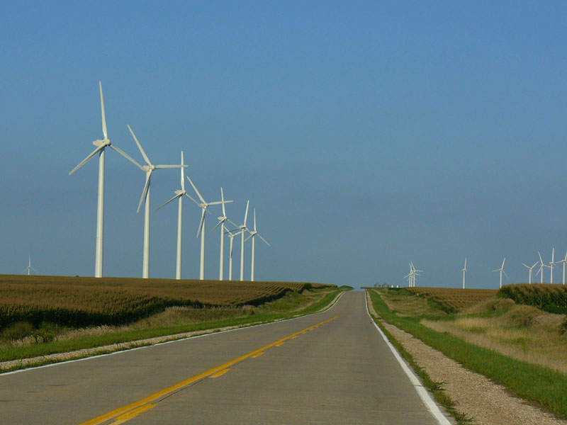
State highway in northern Iowa.
In reasonably flat terrain,
straight roads are easy to build and maintain.
northern Iowa

Slide 10
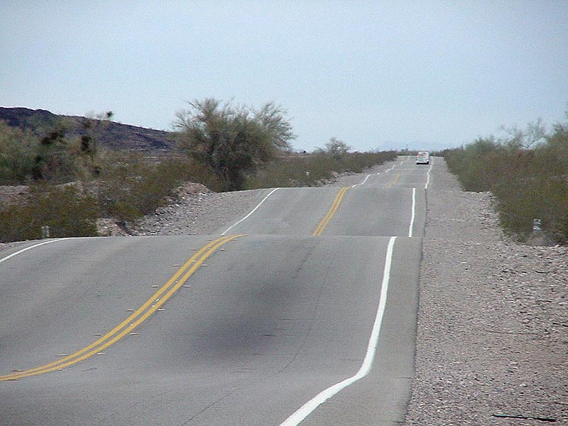
Shale rock and alluvial fans impose unique challenges
in many parts of the West.
western Arizona

Slide 11
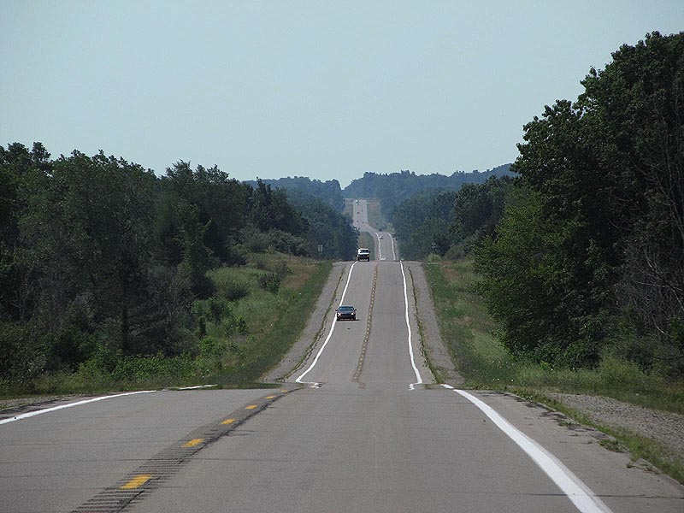
Road over glacial moraine in Michigan.
Gentle hills add to both the cost of construction
and the fuel needed to drive a given distance,
even if the road can still go relatively straight.
southern Michigan

Slide 12
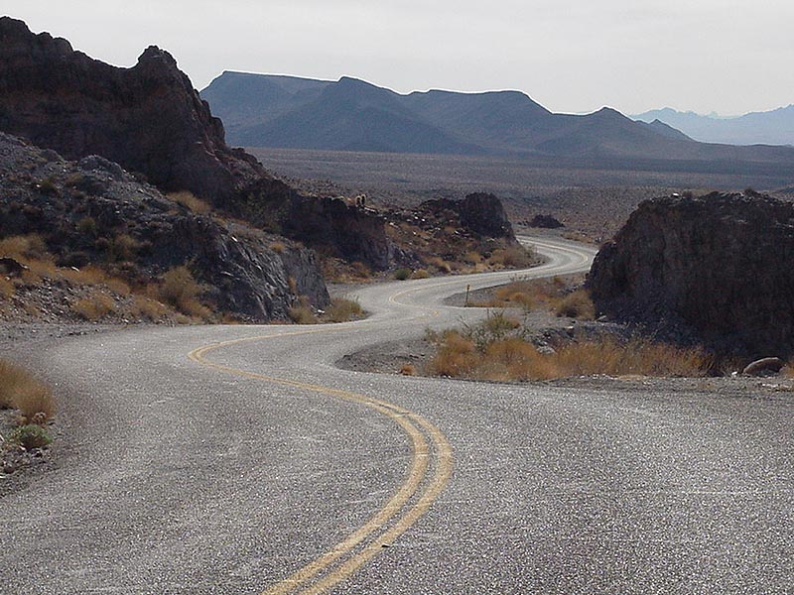
Road in Mojave desert of southern California.
Greater slopes usually require engineers to design
roads with curves that follow the contours better.
These add both cost and time to the trip.
southern California

Slide 13
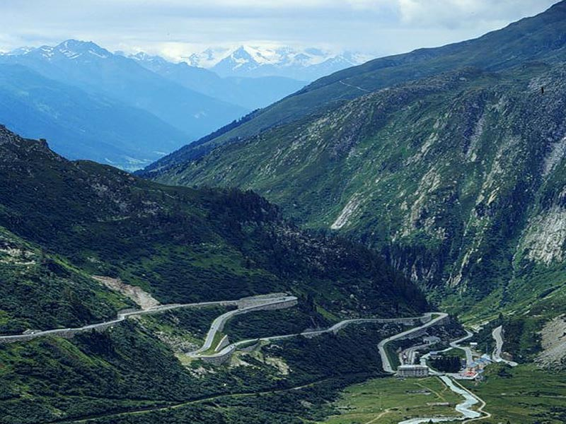
At some point, the change of elevation
becomes so great that road designers must include switchbacks like these in order to get up the slope
without making the road itself climb too steeply.
central Europe
(thanks to Peter Anthamatten)

Slide 14
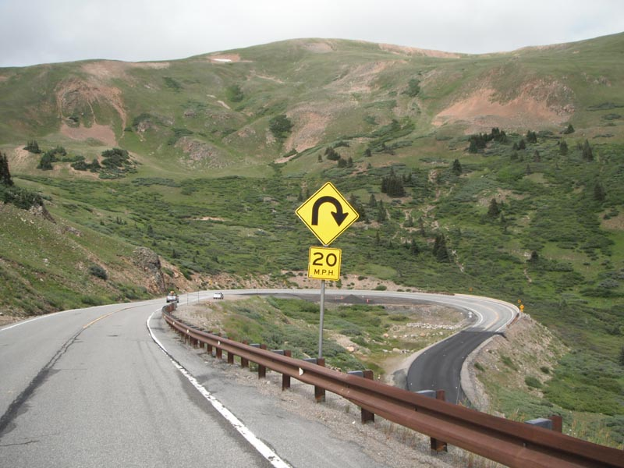
Road sign near Dillon, Colorado.
Switchbacks like these impose great costs in time,
because they significantly reduce average speeds.
central Colorado

Slide 15
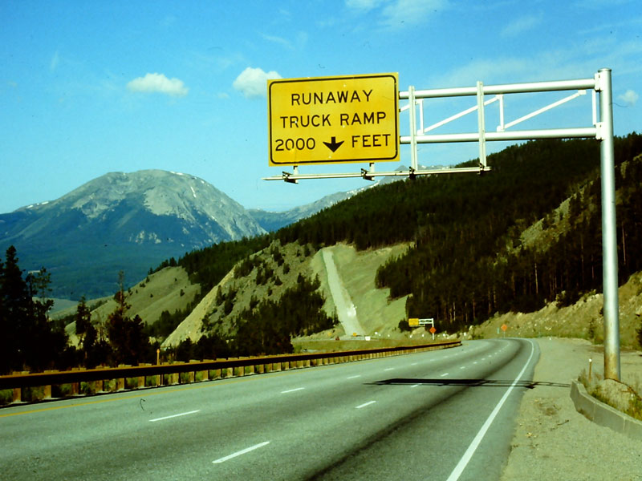
Even with switchbacks, the road itself may be so steep
that runaway trucks become a problem. Many roads
in mountain states like Colorado have gravel ramps
where a runaway truck can brought safely to a stop
central Colorado

Slide 16
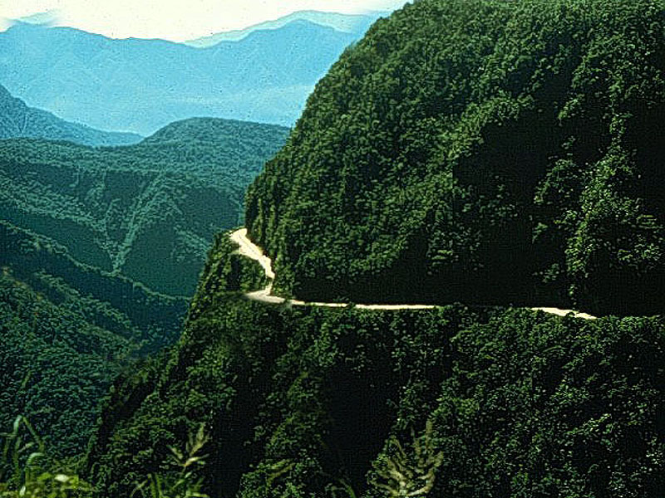
The Andes Mountains of South America (see Figure 6L)
have some of the most dangerous roads in the world
(Photo courtesy Connie and Jim Weil).
Bolivia

Slide 17
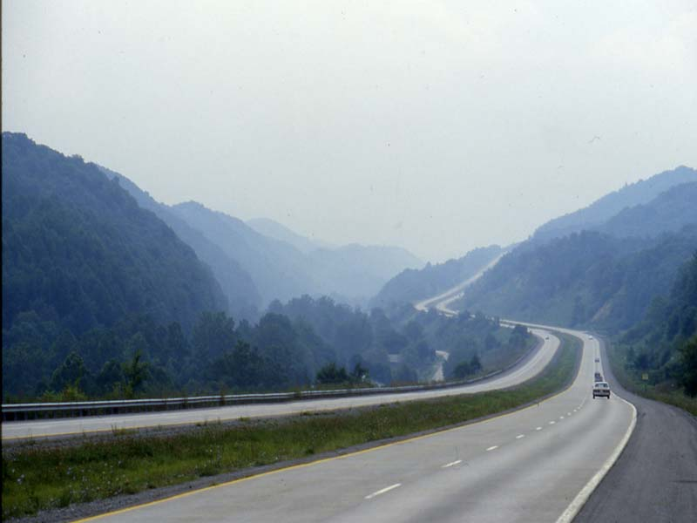
Some analysts suggest that the Interstate highway system
was one of the largest transfers of wealth in history, making nearby land more accessible and therefore more valuable.
North Carolina

Slide 18
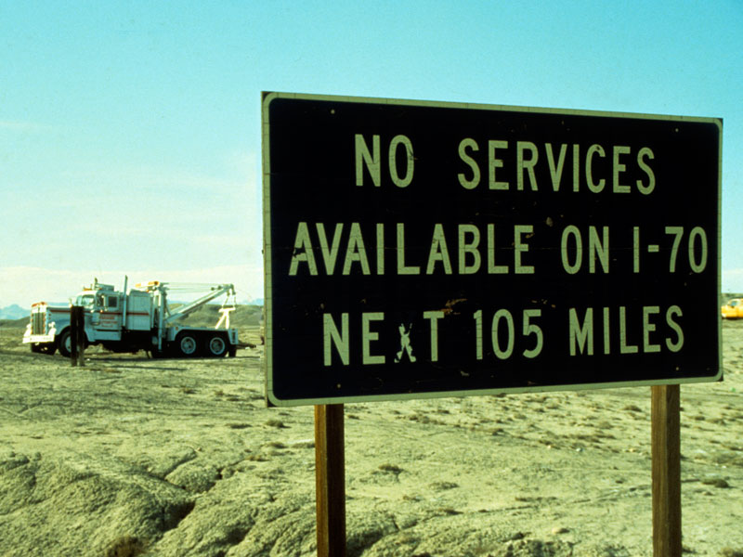
Section of Interstate highway in Utah.
Even a good road cannot overcome all effects of distance
and dry climate. There are still long stretches of road
that have no gas stations, motels, or other services.
Utah

Slide 19
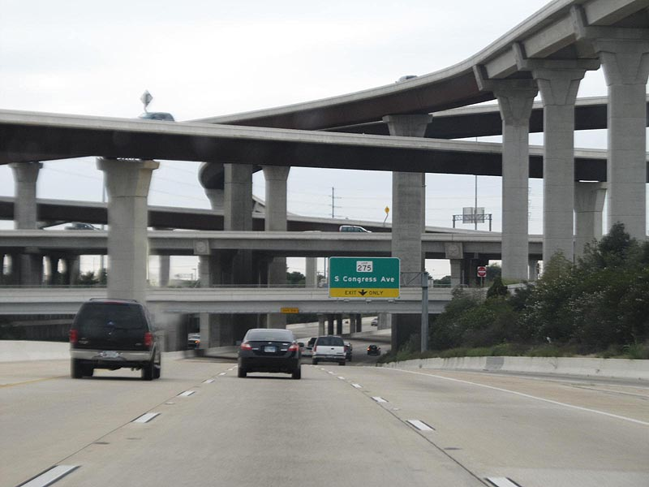
At the other extreme are urban areas
where road junctions must be stacked like this interchange
in order to accommodate all the people
who want to change roads.
Texas

Slide 20
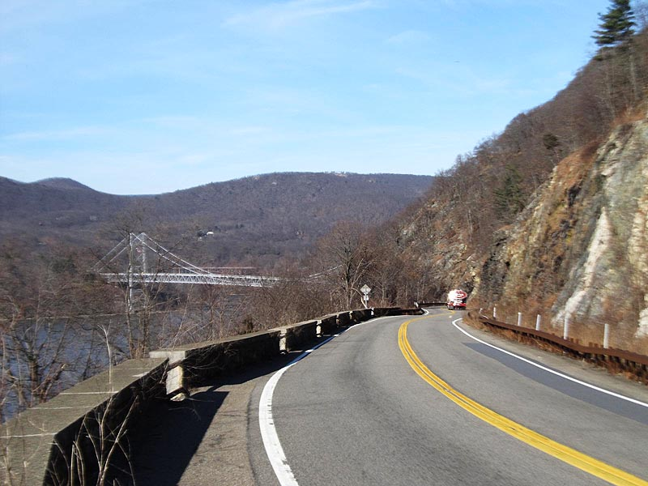
At some point on nearly every road in complex terrain,
you have to cross a river or other obstacle.
Bridges are a uniquely important geographical feature.
near West Point, NY

Slide 21
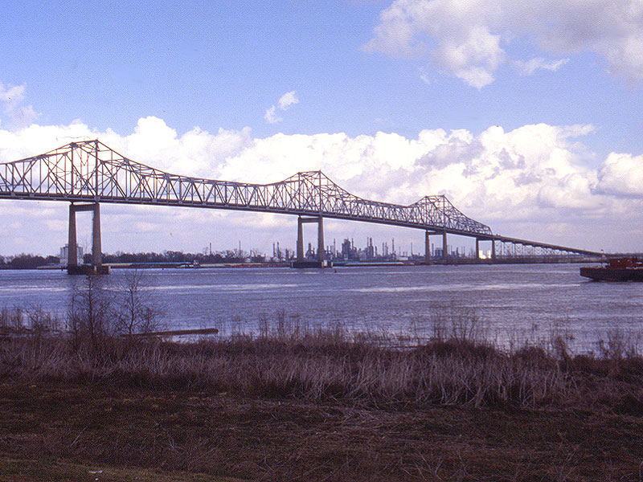
Students could measure on maps to discover that
drivers would have to go an additional 40 miles
if the Sunshine Bridge over the Mississippi River
in Louisiana were closed; http://bridgehunter.com/
southern Louisiana

Slide 22
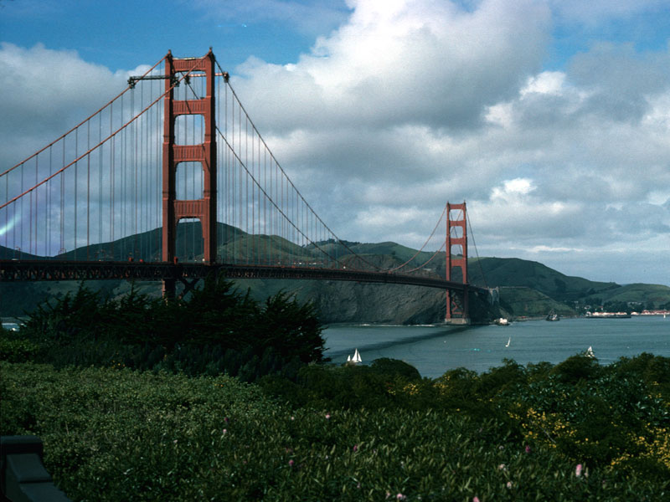
The Golden Gate bridge in San Francisco
is one of just five bridges that eliminate a trip
of nearly 150 miles around San Francisco Bay.
(Photos and data about many bridges at http://bridgehunter.com/)
California

Slide 23
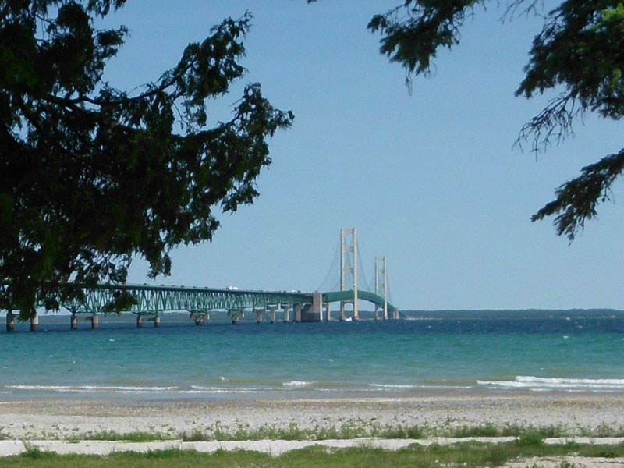
The champion timesaver is the Mackinac bridge
across the channel between Lake Michigan and Lake Huron.
Without this bridge, drivers face a trip of more than 850 miles!
northern Michigan

Slide 24
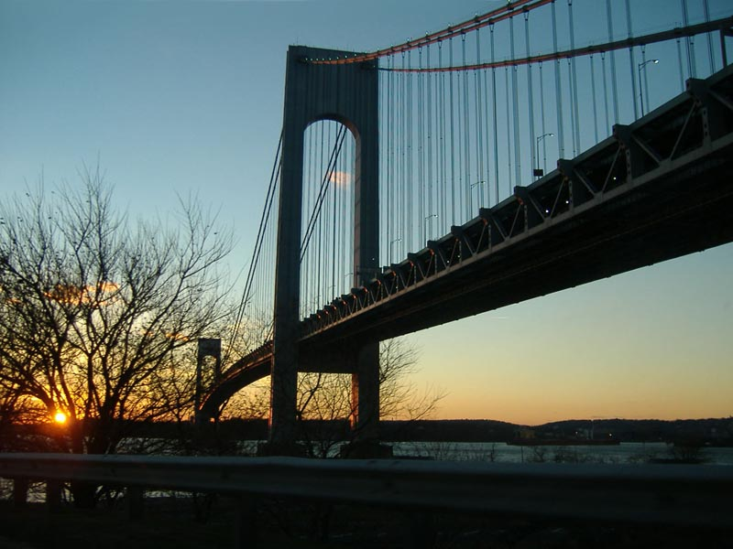
The Verrazano Narrows Bridge in NY celebrated
its 50th birthday in 2014. It carries more than five times
as much traffic as the previous three bridges put together.
New York City

Slide 25
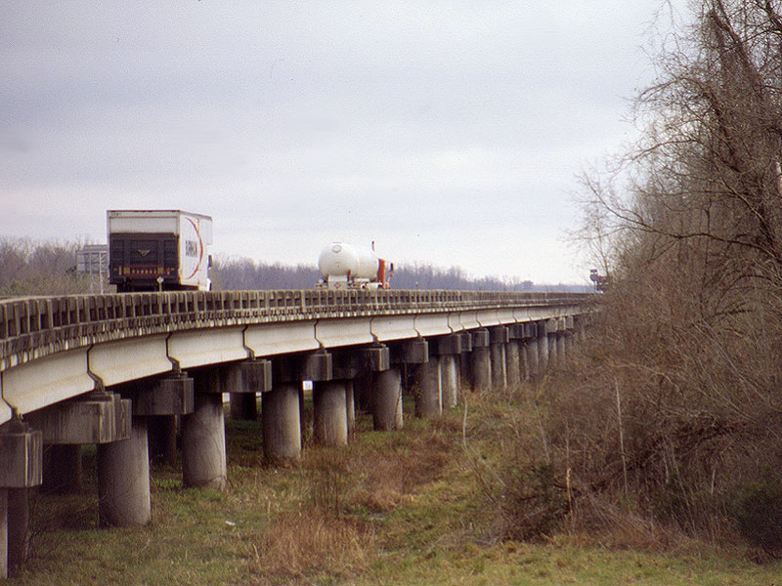
Some of the longest bridges are in the exceptionally flat, swampy land of southern Louisiana. New Orleans
would be much harder to reach without these causeways.
southern Louisiana

Slide 26
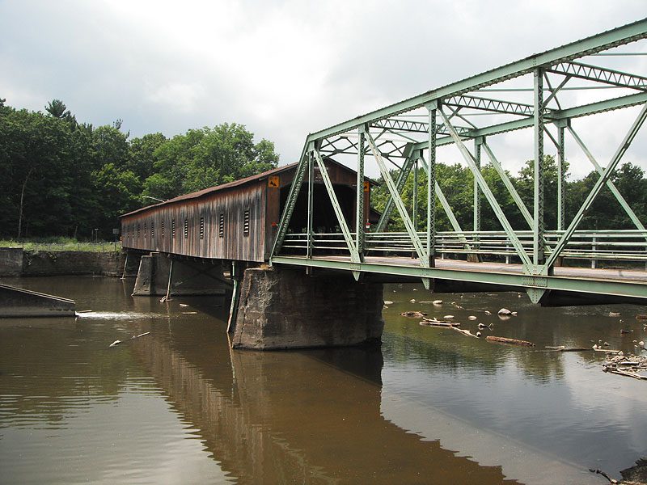
Bridges come in a great variety of designs and styles.
Some (like this one) also include a free history lesson,
if you can interpret what you are looking at.
northern Ohio

Slide 27
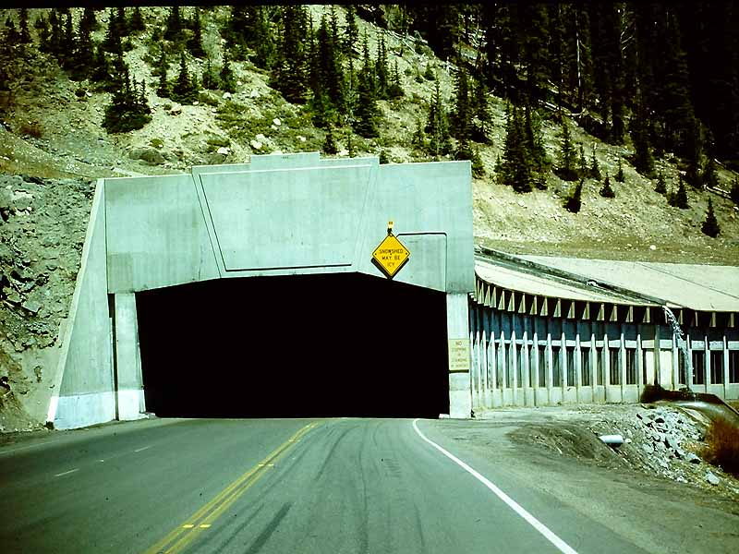
Here’s another kind of bridge – a snowshed
to protect a highway from avalanches in a mountain region.
western Colorado

Slide 28
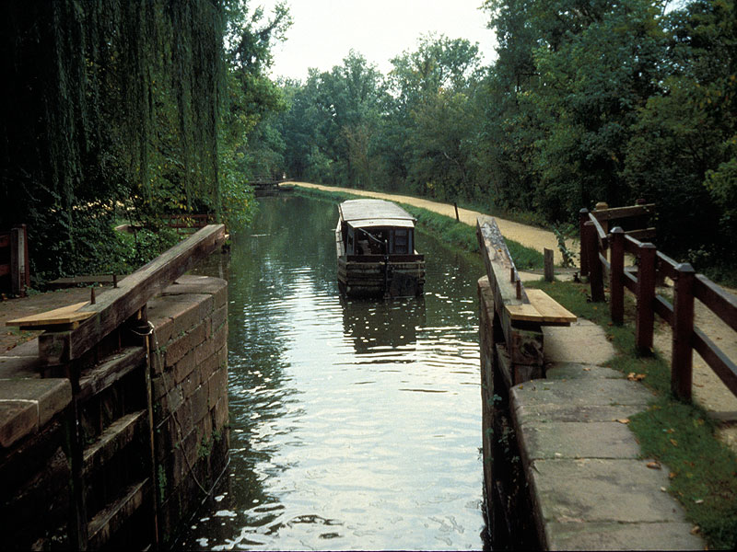
Geographers often divide the transportation history
of the United States into 4 main eras – canal and wagon,
railroad and telegraph, highway and telephone,
and airplane and internet.
Virginia

Slide 29
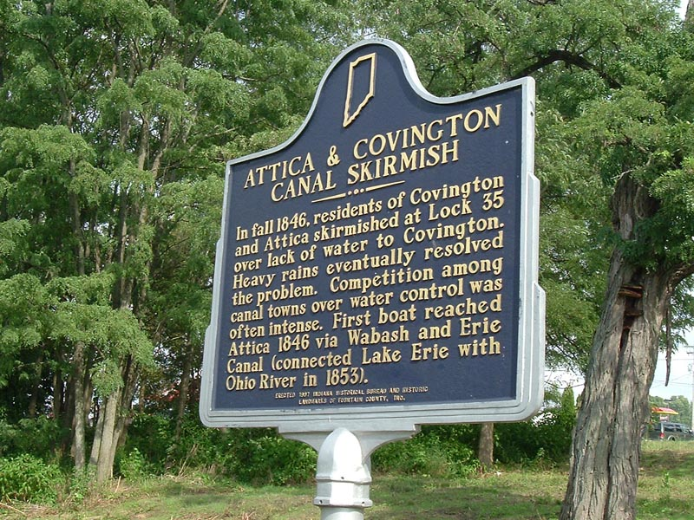
Within each era, communities vied for control
of the major means of transportation – they knew that
this was one of the best paths toward wealth and prosperity.
northern Ohio

Slide 30
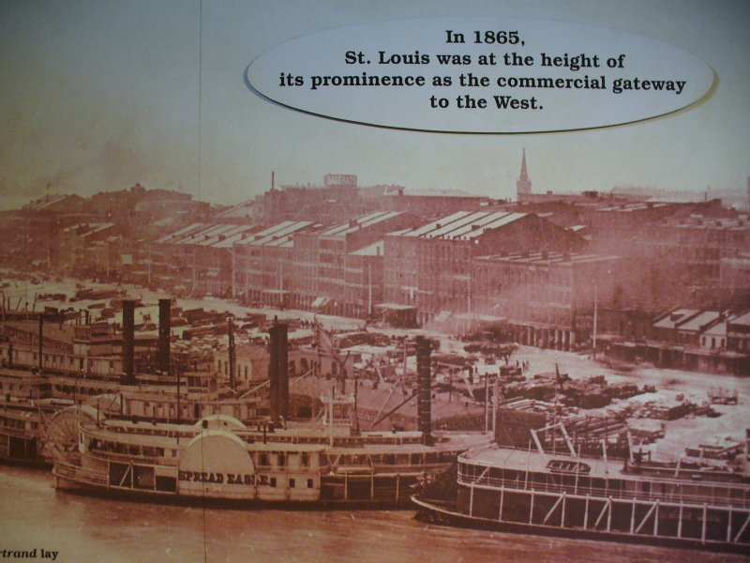
Steamboats served as a kind of marker
at the end of the canal-and-wagon era,
because railroads made better use of steam power.
Missouri

Slide 31
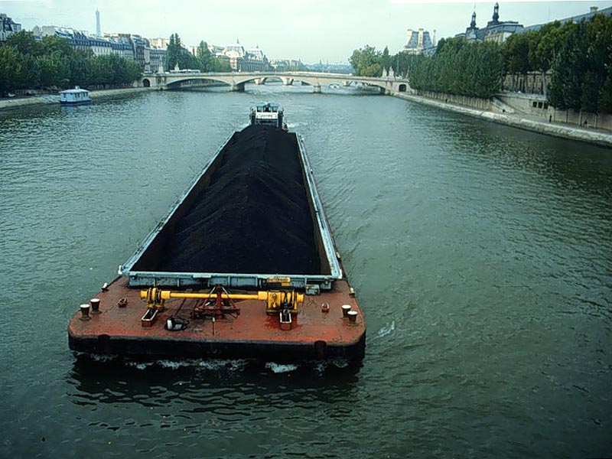
For carrying really heavy loads across nearly level land,
however, it is hard to beat a canal barge.
(Photo from Peter Anthamatten).
northern Europe

Slide 32
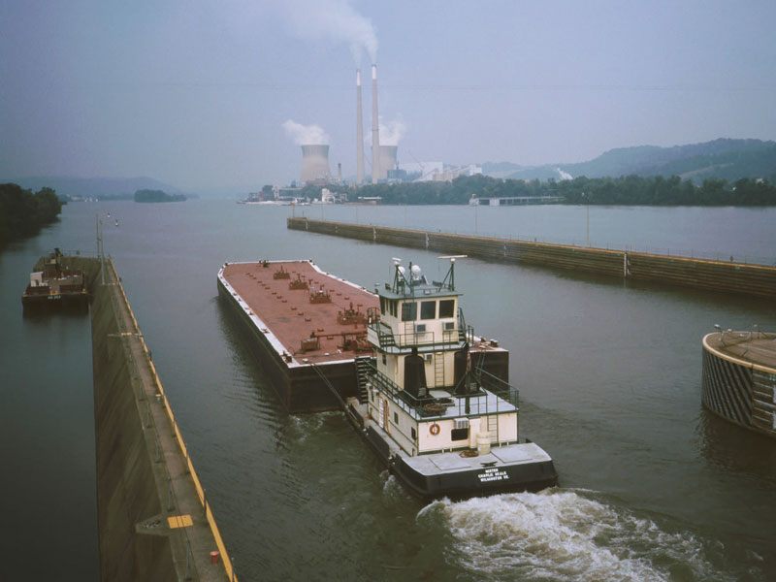
The general rule of thumb is quite simple.
A person can carry 30-40 pounds a long distance.
A horse, 300-400. A wagon, 3000-4000.
An old canal boat, 30,000-40,000. A modern barge, 300,000.
Kentucky

Slide 33
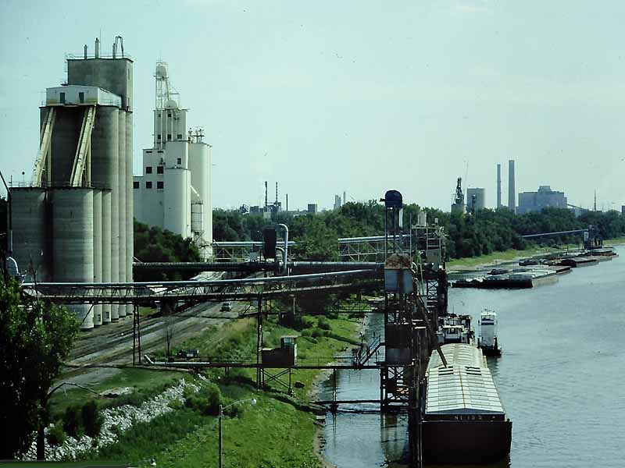
Grain elevators and barges along the Mississippi River. Barges are still a major way to haul grain, coal, gravel,
and other high-volume, low-value commodities.
Illinois

Slide 34
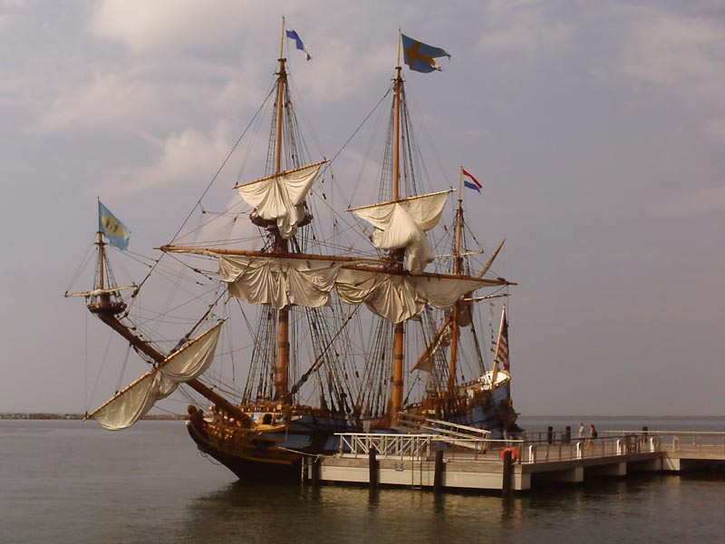
On the oceans, magnetic compasses and better sails
allowed trans-oceanic travel in the late 1300s,
though sailing ships crossed smaller bodies of water
way back in Greek and Roman times.
Delaware

Slide 35
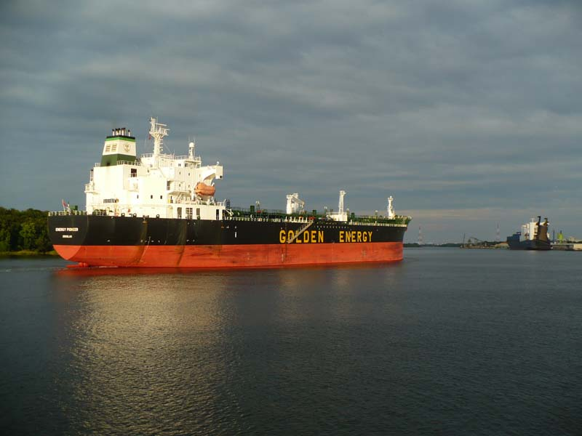
Modern ocean-going ships carry tremendous loads
with remarkably small crews – this oil tanker is “riding high”
because it is empty, going back to get more oil.
Savannah, Georgia

Slide 36
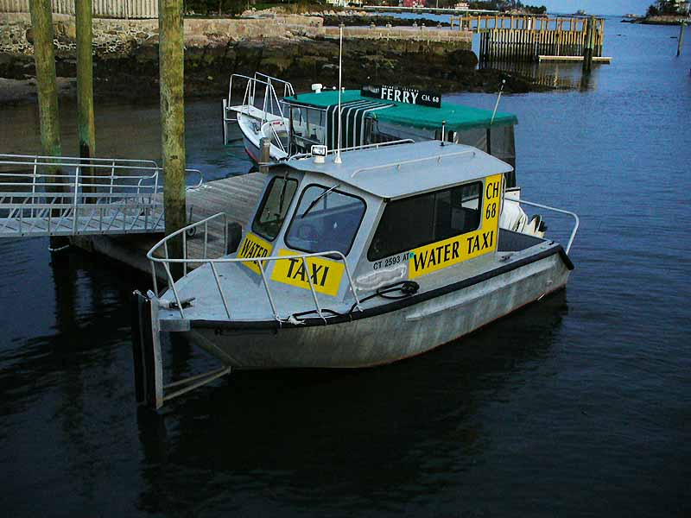
At the other extreme are tiny water taxis and ferries,
common in many coastal areas and river towns.
Connecticut

Slide 37
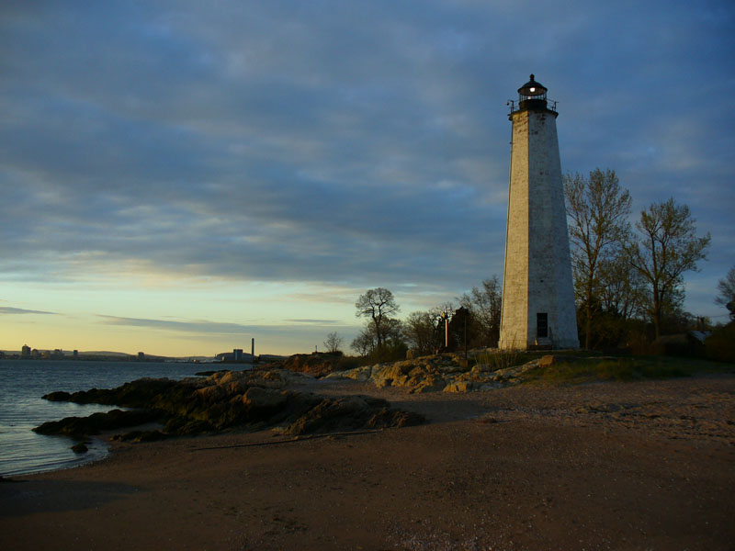
Like trucks that depend on roads and traffic laws,
sailors require an infrastructure of harbor dredges,
dock repairs, navigation aids (like this old lighthouse),
and so forth.
Connecticut

Slide 38
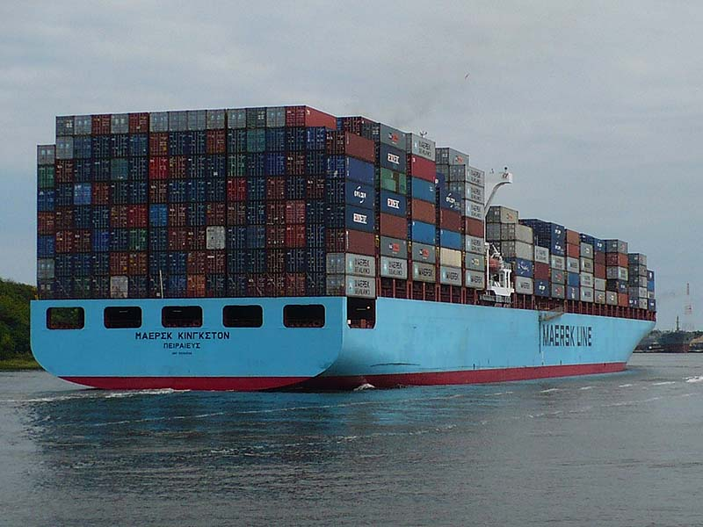
An important technological development of the last 50 years
is the multi-modal container – a standard-sized metal box
that can be loaded directly onto a truck or train.
Savannah, Georgia

Slide 39
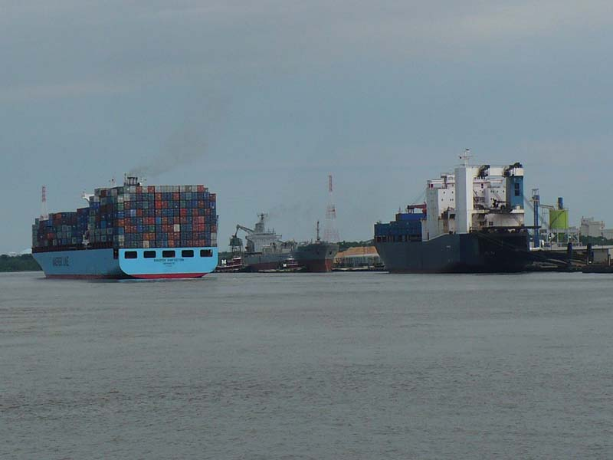
Container ship, freighter, and auto-carrier.
Container ships have replaced many (but not all)
other kinds of freight-carrying ships, which required
large numbers of longshoremen to load and unload.
Savannah, Georgia

Slide 40
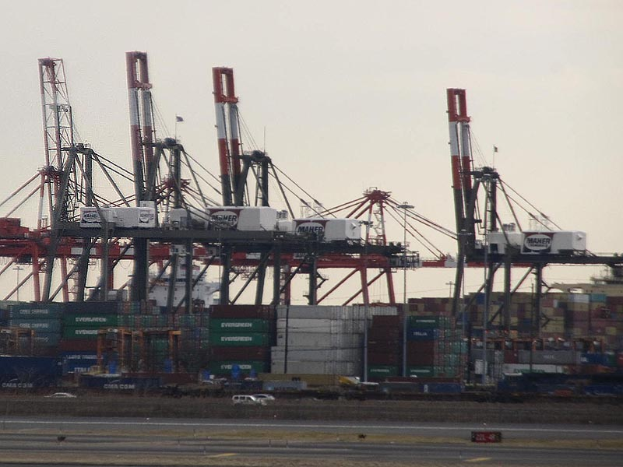
Container-moving cranes can load or unload a ship
in a matter of hours, with one operator doing the work
of hundreds using the older technologies
(unless you also count the people building containers and cranes!).
New Jersey

Slide 41
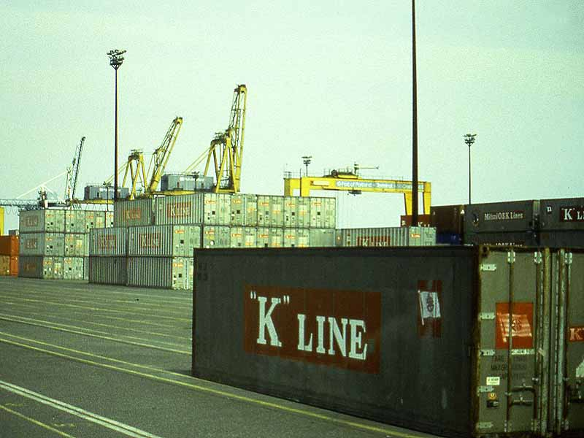
Containers come in standard sizes
and can remain sealed for the entire trip
from the factory or farm to the warehouse.
Portland, Oregon

Slide 42
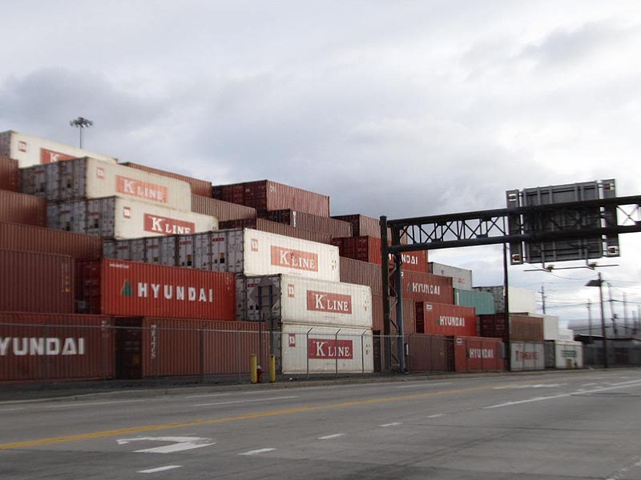
Container names often provide clues
about the country of origin of a particular shipment.
This can be a field-observation activity in some schools.
New Jersey

Slide 43
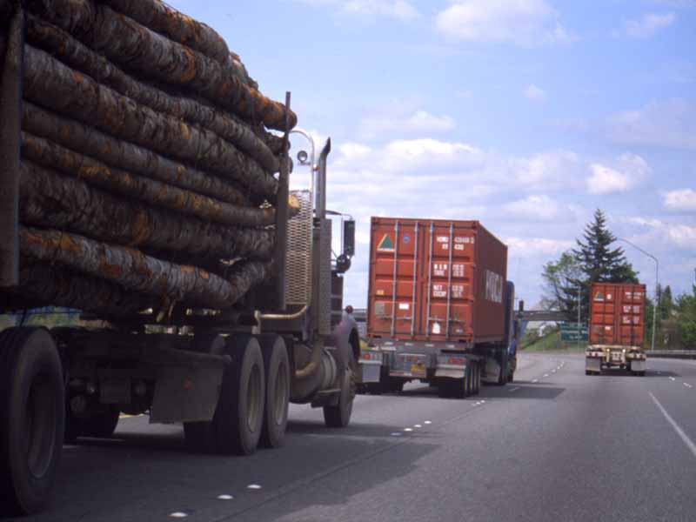
As noted earlier, container can easily be loaded
onto trucks or trains without requiring opening.
southern Michigan

Slide 44
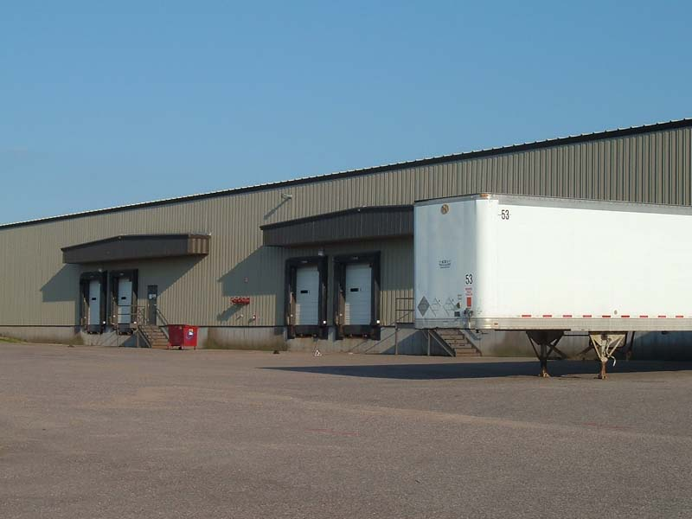
New warehouses have sprung up near Interstate highways from coast to coast, at the same time as many cities
are abandoning their old dockside warehouse districts
(or turning them into condos and trendy restaurants!)
western Wisconsin

Slide 45
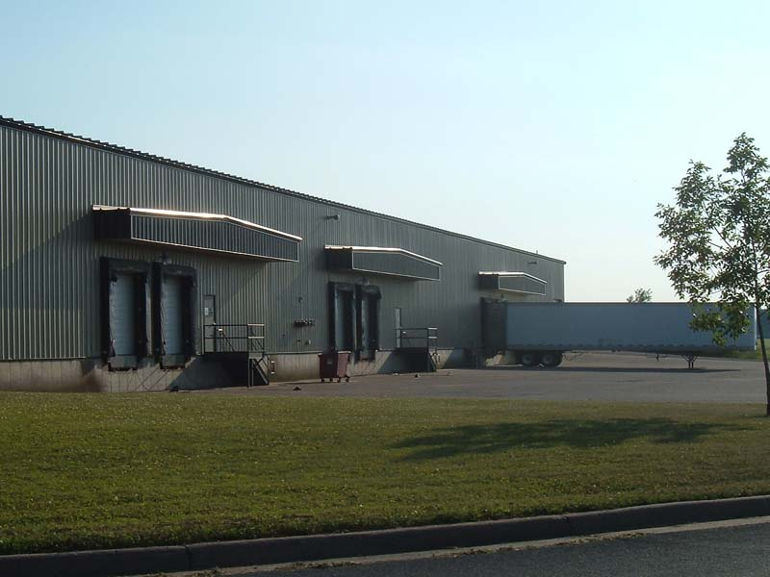
This is the same warehouse as the previous photo,
from a different angle on the same day – a caution
that a single photo may not convey an accurate image.
(Photo near I-94 in Wisconsin)
western Wisconsin

Slide 46
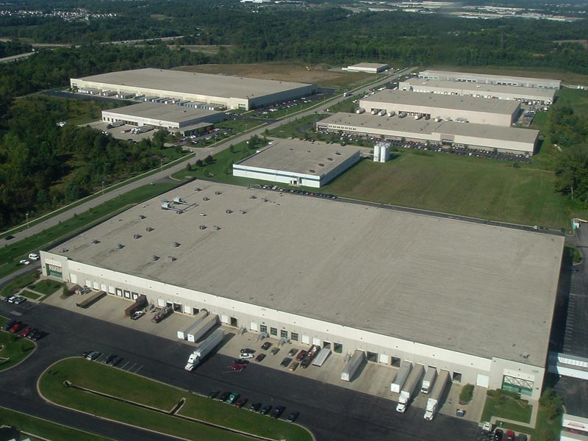
Warehouses near airports are also quite common,
especially as internet-based wholesaling expands.
near Cincinnati, Ohio

Slide 47
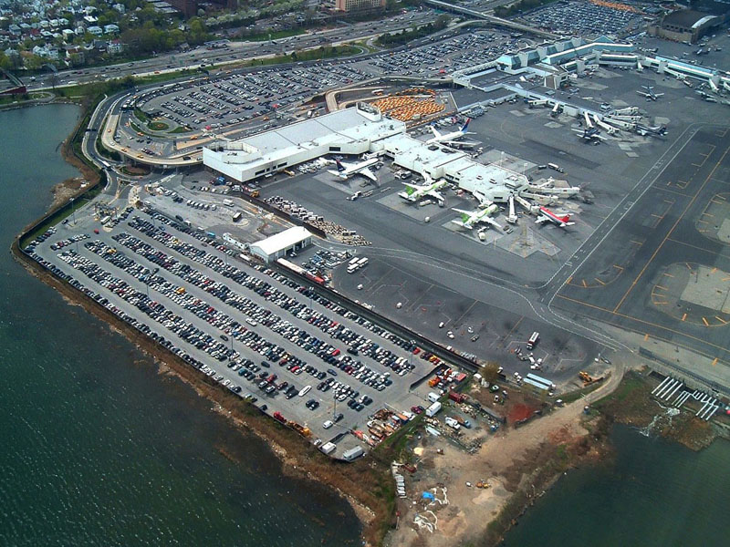
Airplanes are still the fastest way to move people
long distances – as long as the city provides enough parking
or public transportation to get people to the airport!
LaGuardia airport, NY

Slide 48
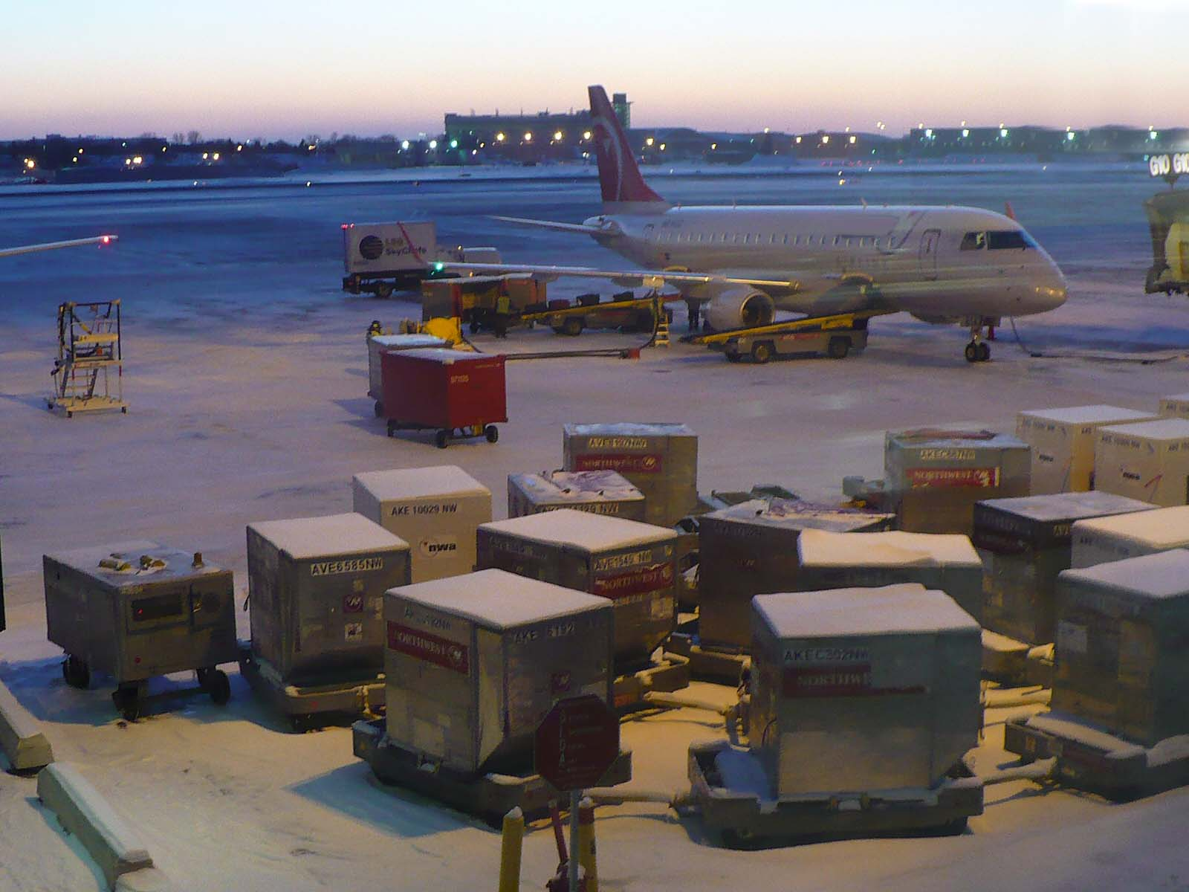
Air-freight cargo containers are precisely sized to fit
different kids of airplanes. These are used for light-weight
and high-value goods, not bulk freight!
LaGuardia airport, NY

Slide 49
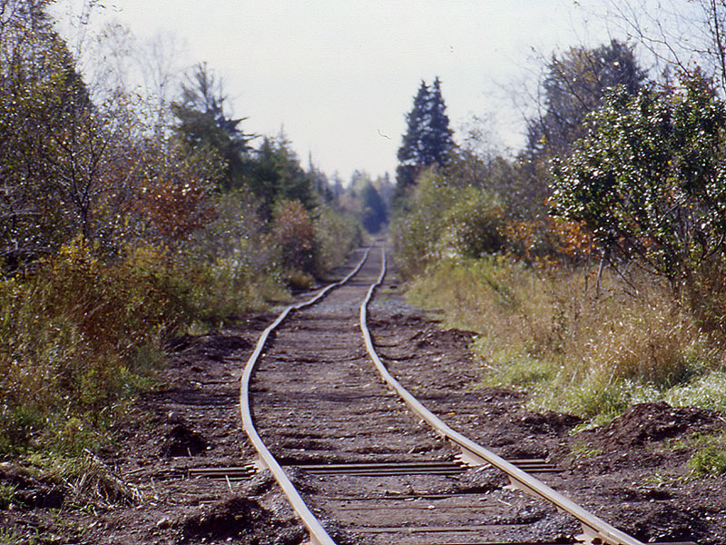
Bad railroads are cheap to build and hard to use.
In cold places, frost heaving can render a road or railroad
useless in a very short time.
northern Michigan

Slide 50
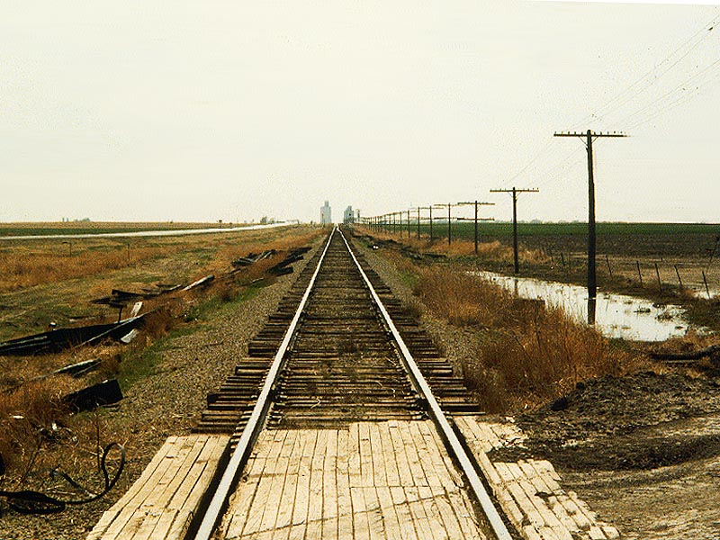
In flat, generally dry country, a railroad can be by far
the lowest-cost way to move heavy goods long distances.
western Kansas

Slide 51
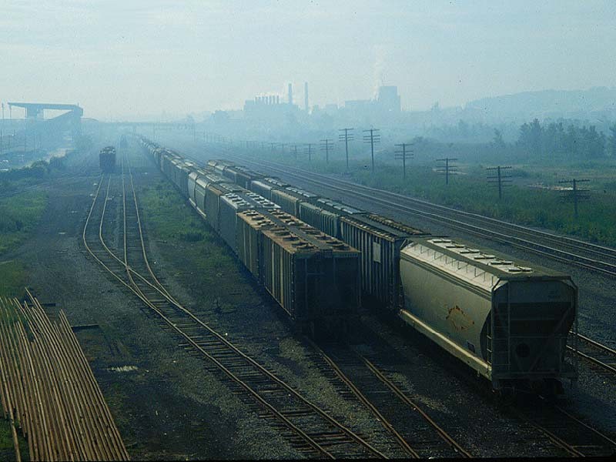
Railroad cars have become highly specialized
to carry specific things, like grain, fertilizer, flour, oil, etc.
Syracuse, NY

Slide 52
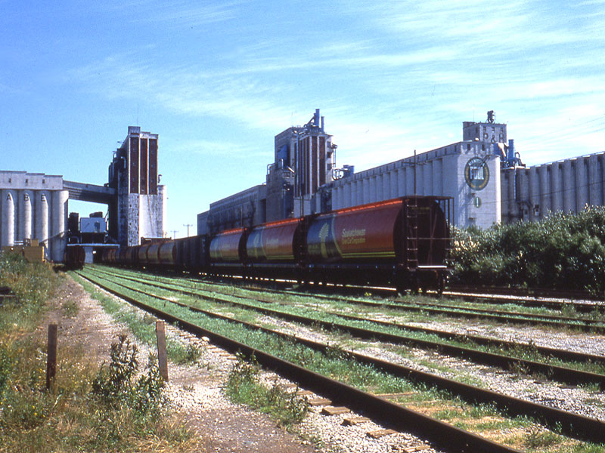
Railroads carry a large fraction of the grain and coal
of the world – often in unit trains of 100 cars or more,
which can be quickly unloaded with robotic machines.
Thunder Bay, Canada

Slide 53
Transportation can be defined as “putting things
in the right place at the right time.” By that definition,
grain elevators (and libraries!) are transportation devices.
near Sioux City, Iowa

Slide 54
Many small communities have lost their railroads.
The total length of track in the United States has gone down
as railroads merged and consolidated their services.
central Iowa

Slide 55
This railroad classification yard is the place
where trains from several origins on the West Coast
are broken apart and reassembled into new trains
that have the right cars for specific eastern destinations.
North Platte, Nebraska

Slide 56
Incoming train is slowly pushed up onto a low hill (the hump).
The cars are decoupled and roll individually down the hill.
This device weighs them, after their bar-codes are scanned.
North Platte, Nebraska

Slide 57
Switches automatically send each car to the proper track
for its destination. Rails squeeze the wheels to slow the car (depending on its weight) for a gentle coupling
with the train that will go to a specific destination.
North Platte, Nebraska
Notes:
coupling with its train

Slide 58
A tiny part of the control tower.
When a train is full, a red light flashes (see track 39)
and an engine is sent to pull the train to its destination.
North Platte, Nebraska

Slide 59
Chapter 4 of the book had a discussion
of the ill-fated Pennsylvania Canal, which was built
to compete with the nearly level Erie Canal in New York.

Slide 60
Small airplanes, snowmobiles, and dogsleds
are the main modes of transport in parts of Alaska,
where population density is too low to support roads.
south-central Alaska

Slide 61
Irrigation canal in Israel.
The transportation of water poses some unique problems.
The solution in many communities is some kind of canal.
(Photo courtesy of Dwight Brown)
Israel

Slide 62
Freshwater canal crossing wastewater canal.
Irrigation in a dry climate can be a tricky business –
you have to provide excess water to remove salt from soil,
and then build canals to remove salty wastewater.
intermontane West

Slide 63
Aqueduct going toward Los Angeles.
Cities such as Phoenix, Los Angeles, and San Diego
depend on water brought from mountain reservoirs
and rivers quite far away.
southern California

Slide 64
The other commodity that often moves by pipeline is oil,
because the product doesn’t vary and the flow is always
in the same direction – from well to ports or refineries.
central Alaska

Slide 65
High-voltage electric lines in the Great Plains.
The United States is served by a small number of interlocked
electricity grids, which can move electricity to places where
demand is peaking (e.g., when many are cooking meals).

Slide 66
Factories or mines often have large but steady demands
for electricity – unlike the small but variable demands
from residences and small offices.
central Utah

Slide 67
The transportation of information requires yet another
kind of infrastructure – cables and broadcast towers,
relay stations, routers and servers.
northern New Mexico

Slide 68
Satellites have become a more common way
to transmit information, even something as ordinary
as television programming. Some third-world countries
are finding that they can skip the land-line era completely.
New York City

Slide 69
Communication tower pretending to be a tree in New York.
Just like some communities require multi-lane highways
to have noise barriers, some communities require
telecom companies to “mask” their towers like this.
Westchester County, NY

