Slide 1
imports and exports are shipped in “containers”
What is a shipping container?
Why do manufacturers
and big stores use them?
pgersmehl@gmail.com, carol.gersmehl@gmail.com,
6th grade network, March 2, 2016

Slide 2
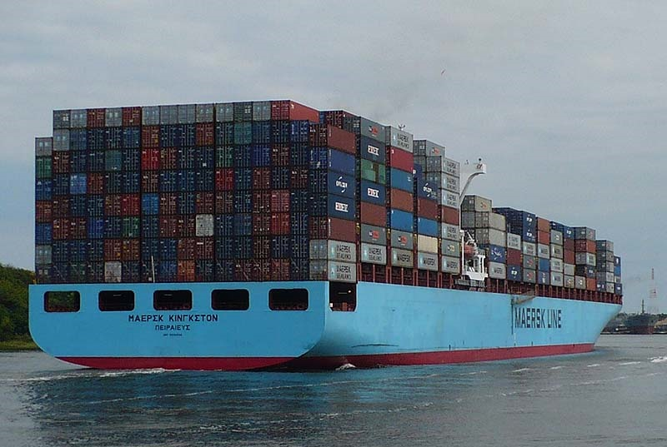
A shipping container is a steel box
that is 20, 28, or 40 feet long.
Most goods made in other countries
travel to the U.S. on container ships like this one.
A much smaller “sister” ship, the
Maersk Alabama, was in the movie “Captain Philips” about
modern
pirates.
This is a “Panamax” ship –
one that can barely fit through the Panama Canal.
It can carry only about 3000 40-foot containers.
For a side view, see http://www.shipspotting.com/gallery/photo.php?lid=2203992
For its route, see https://www.vesselfinder.com/vessels/ and enter MSC Kingston
Container ships are often
as long as 2 or 3 football fields
and can carry more than
10,000 containers.
Photo: Phil Gersmehl

Slide 3
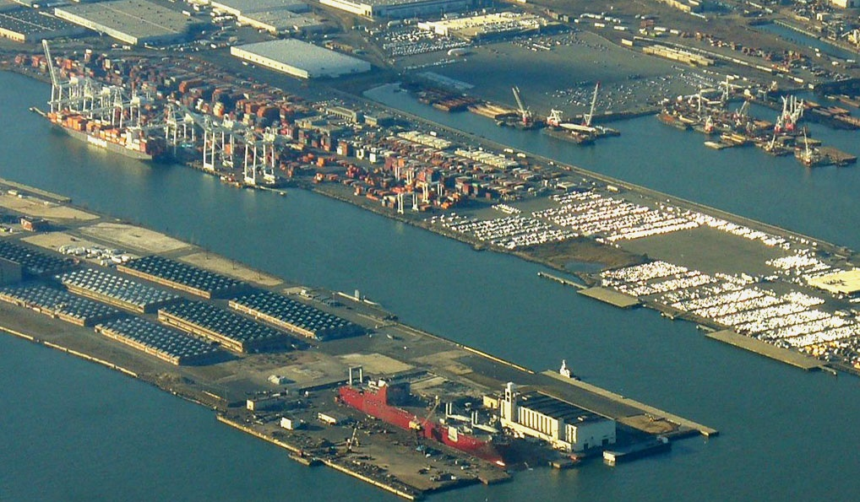
Tall cranes unload containers
from ships at the Port of New Jersey.
How do containers
affect our lives?
Stores like Walmart,
Target, and Home Depot
import many containers.
The containers hold
imported goods
(e.g., cell phones, toys,
clothing, shoes).
Photo: Phil Gersmehl

Slide 4
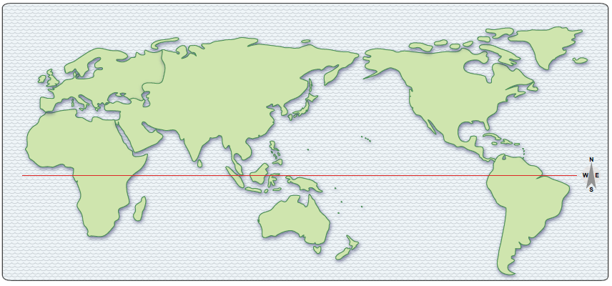
U
G
C
F
C
K
J
T
M
The U.S. imports more from these countries than it exports.
Thousands of containers filled with imported goods
come from these countries to the U.S.

Slide 5
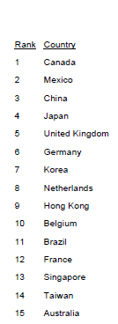
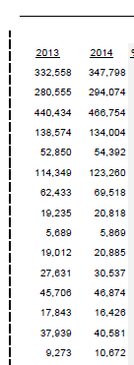
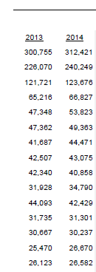
We sell.
Exports
We buy.
Imports
Imports
exceed
Exports

Slide 6
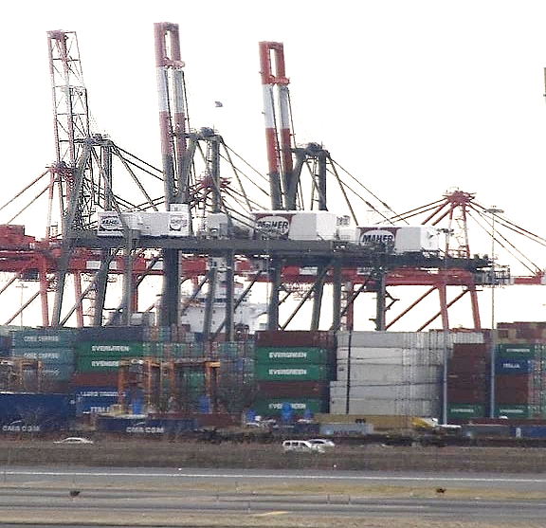
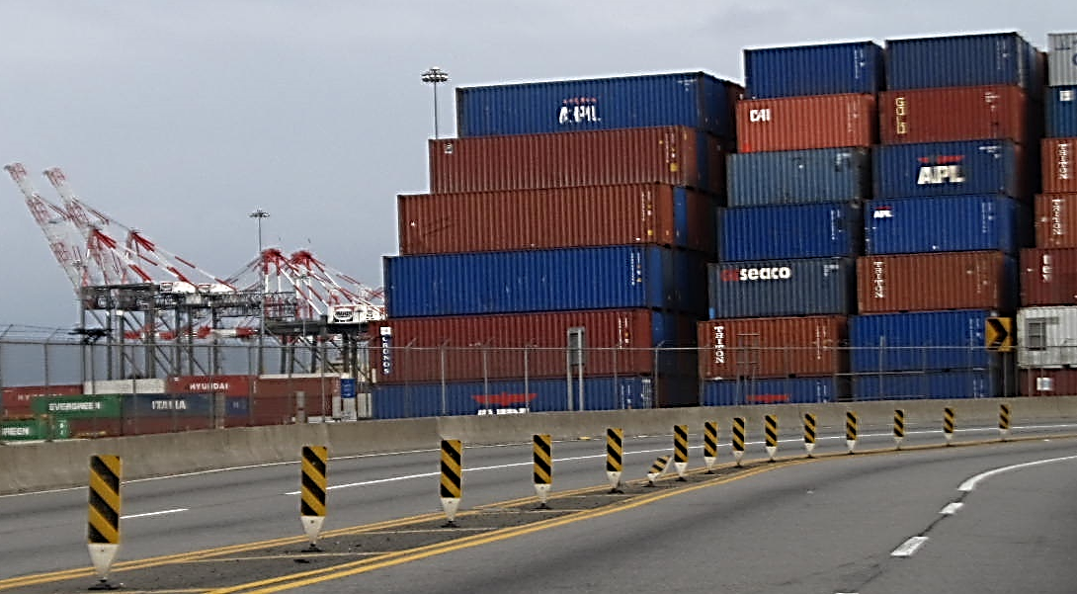
Tall cranes lift container boxes from
each container ship and stack them.
Compare sizes of
Car
Container
Cranes
Soon the containers
will be loaded onto trains or trucks.
40-foot and 20-foot
long containers.
Photos: Phil Gersmehl

Slide 7
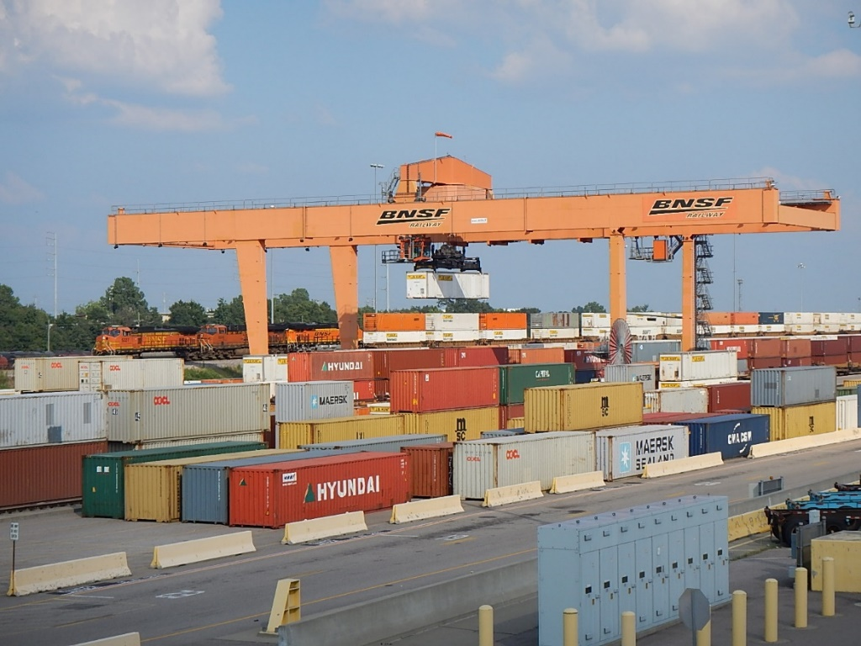
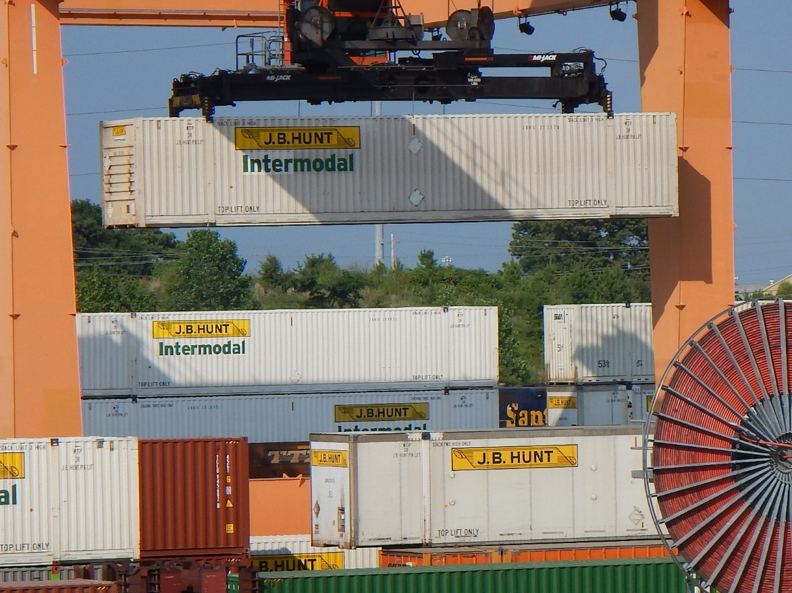
A close-up shows
how a loading crane
lifts a container
that is 40-feet long,
and places it onto
a train or a truck trailer.
A single container
may hold
more than 25,000 shirts,
or thousands of toys
or pairs of shoes
that were made
in another part
of the world.
Photo: Phil Gersmehl

Slide 8
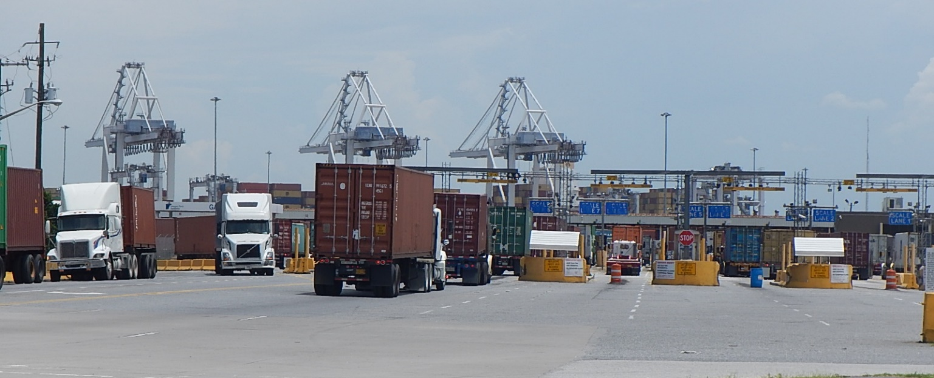
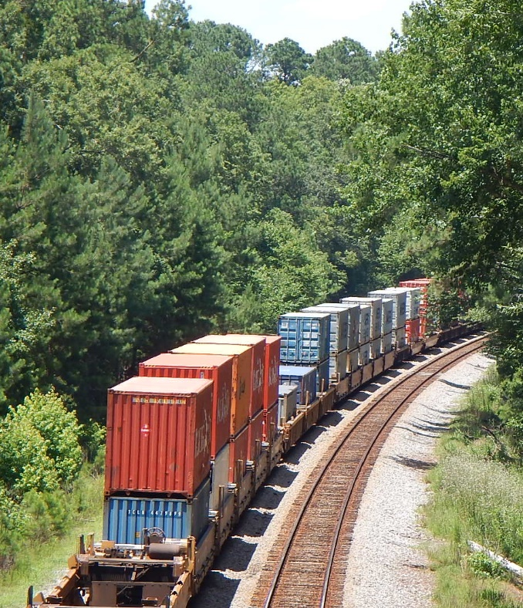
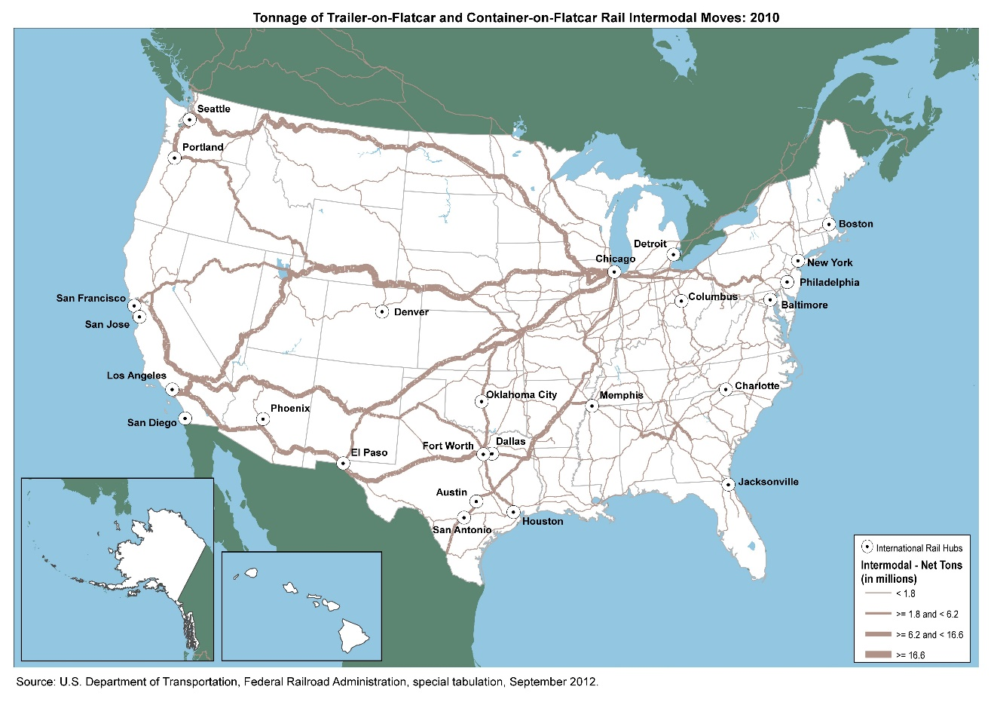
Trucks and trains
move containers from seaports
to warehouses and stores
throughout the U.S.
Large stores like Walmart and Target
receive containers full of imported goods
at their warehouses.
Photos: Phil Gersmehl

Slide 9
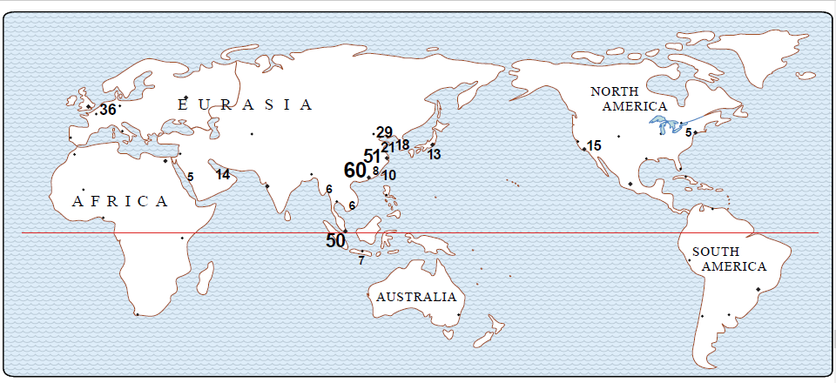
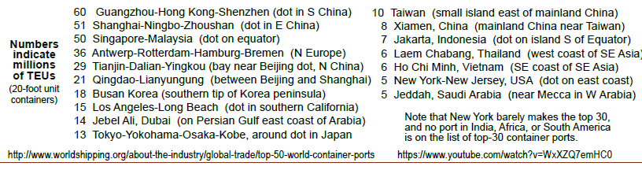
What direction would a container ship travel
going from China
to the U.S.?
Which world region
ships the most containers?

Slide 10
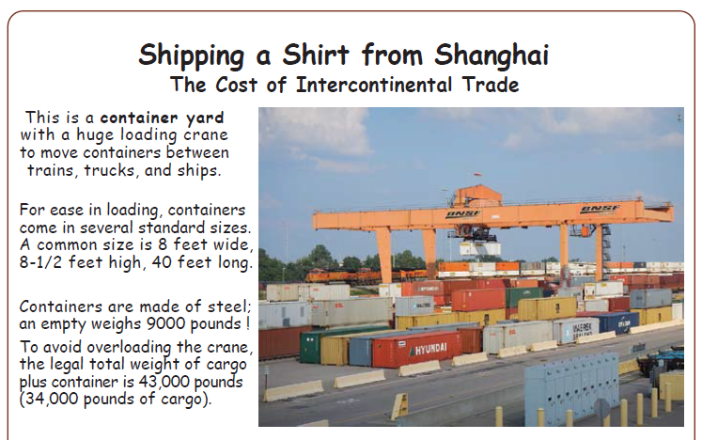
China
Speculate! How many shirts could be shipped
inside a steel container that is 8 by 8.5 by 40 feet.

Slide 11
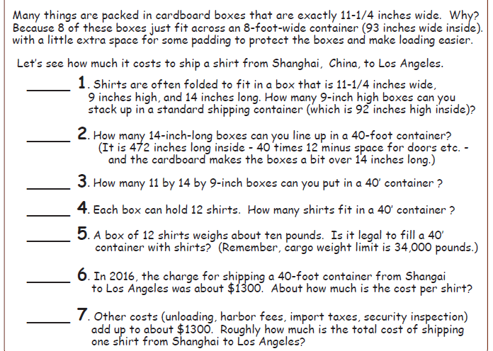

Slide 12
10 boxes
92 / 9
33 boxes
472 / 14
2,640 boxes
33 x 10 = 330
330 x 8 = 2,640

Slide 13
10 boxes
33 boxes
2,640 boxes
NOTE: this says
“about $1300” –
so our result cannot be more precise than
2 significant figures.
31,680
12 x 2,640 =31,680 shirts
yes
10 x 2,640 = 26,400
$.04
per shirt
$1300 / 31,680 across the ocean
$.08
per shirt
$2600 / 31,680 total

Slide 14
That’s impressive!
A container ship,
along with the “lifting and stacking cranes”
in the ports at each end of the trip,
can ship a shirt from Shanghai to Los Angeles
for less than a dime.
If you buy just one shirt,
from a store that is five miles away,
it could cost you more than 40 cents
just to move the shirt
from the store to your house.
(That’s not counting your time -
that’s just for the gas in the car.)

Slide 15
Shipping a shirt manufactured in Asia
costs less than ten cents
when shipped in a container to the U.S.
Why is this low shipping cost important?
Employees in Asia may work in shirt factories
for less pay than workers in the U.S. want.

Slide 16
GLCE 6-G1.3.3 Explain the different ways in which places are connected.
GLCE 6-G4.2.1 Identify and describe the advantages, disadvantages
and impact of different technologies used to move
people, products, and ideas throughout the world.
GLCE E3 Analyze reasons for individuals and businesses to specialize
and trade, and the benefits and costs of trade.

Slide 17
Copyright 2016, Carol Gersmehl
Teachers who saw this presentation at a workshop
or downloaded it from our internet site have permission
to make a copy on their own computers for these purposes:
1. to help them review the workshop,
2. to show to colleagues or administrators,
3. to show the presentation in their own classrooms
or at sessions they lead at teacher conferences,
4. to use individual frames (with attribution)
in their own class or conference presentations.
For permission for any other use,
including posting frames on a personal blog
or uploading to any network or website,
contact carol.gersmehl@gmail.com

