Slide 1
Manufacturing in the U.S.
GLCE 6-G2.2.1 Describe the human characteristics of different regions
(language, religion, economic system, traditions).
GLCE 6-G2.2.2 Explain how places are affected by changes in technology.
GLCE E3 Analyze reasons for individuals and businesses to specialize
and trade, and the benefits and costs of trade.
Which states have the most
manufacturing jobs?
carol.gersmehl@gmail.com,
6th grade network, March 2, 2016

Slide 2
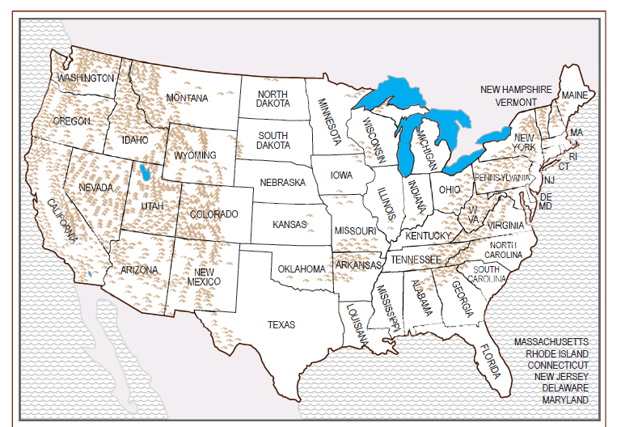
There are manufacturing jobs
in the U.S.!

Slide 3
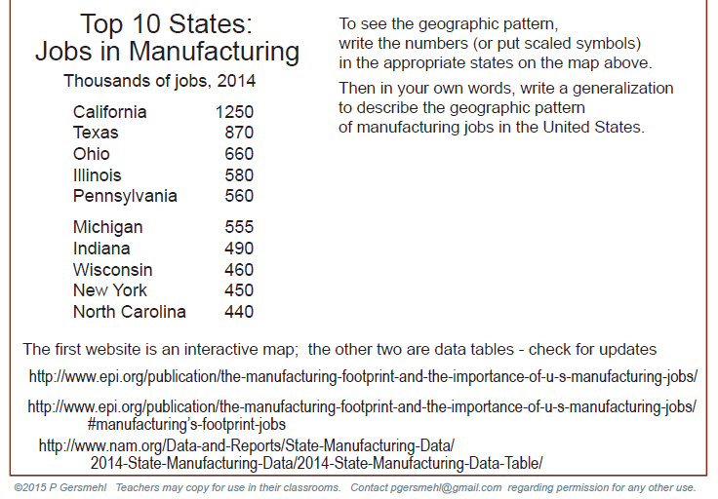
Where is manufacturing
a BIGJob?

Slide 4
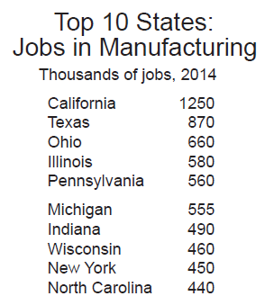
Write the number of jobs inside the appropriate states
on the map above.

Slide 5
460
555
450
580
660
560
490
1250
440
870
Where are these “top manufacturing” states located?
Spatial thinking questions:
1. Do you see any patterns, like lines or clusters?
2. What physical features do these states occur together with?
What are CA, TX, NC next to? What is MI next to?

Slide 6
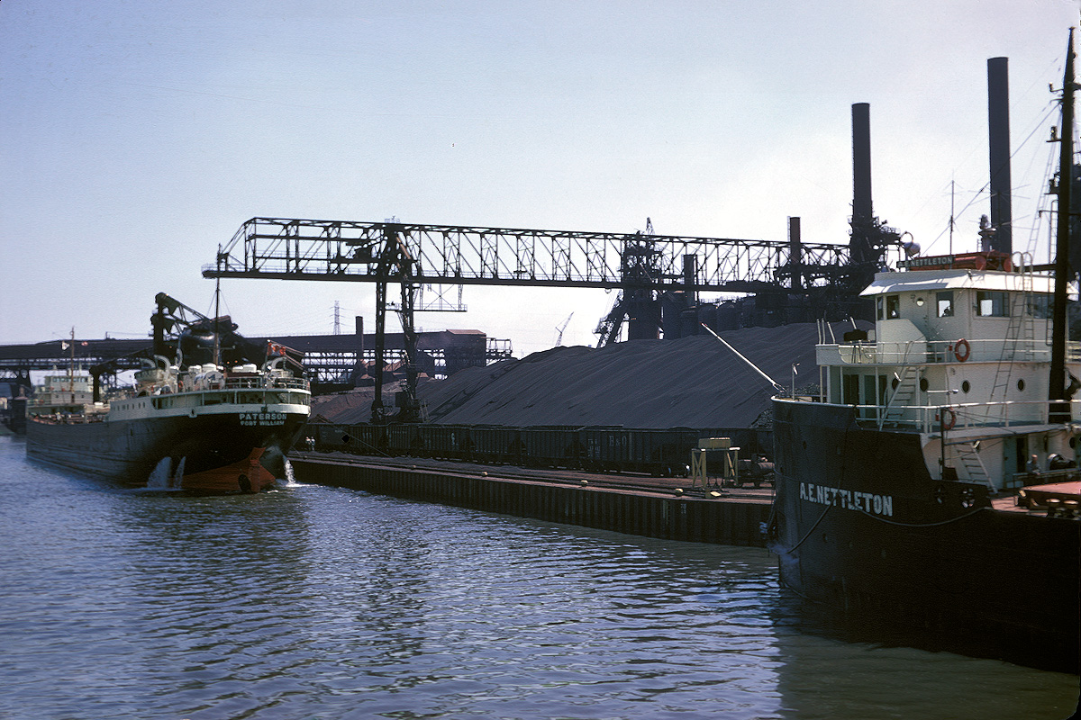
Why is that association important ?
because lake or ocean ships
are by far the cheapest way
to move heavy things.
Photo: Phil Gersmehl

Slide 7
U.S.
Exports and Imports
GLCE G1.3.3 Explain the different ways in which places are connected
and how those connections demonstrate interdependence.
GLCE 6-G4.2.1 Identify and describe the advantages, disadvantages
and impact of different technologies used to move
people, products, and ideas throughout the world.
GLCE E3 Analyze the reasons for trade and the benefits and costs of trade.
What countries buy the most
from the U.S.?
Which countries sell the most
to the U.S.?
carol.gersmehl@gmail.com,
6th grade network, March 2, 2016

Slide 8
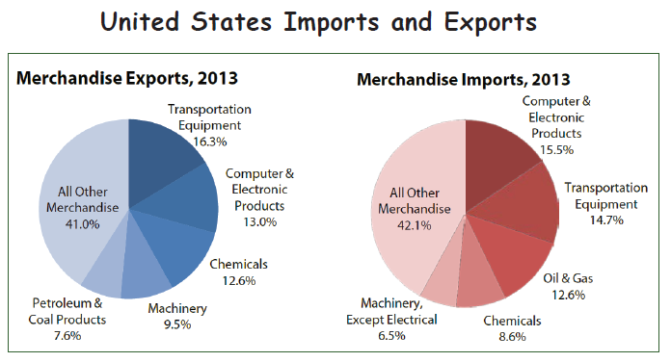

We sell.
We buy.
Sources: http://trade.gov/mas/ian/tradestatistics/index.asp#P11_403
http://trade.gov/mas/ian/build/groups/public/@tg_ian/documents/webcontent/tg_ian_002065.pdf
http://www.trade.gov/mas/ian/build/groups/public/@tg_ian/documents/webcontent/tg_ian_003364.pdf

Slide 9
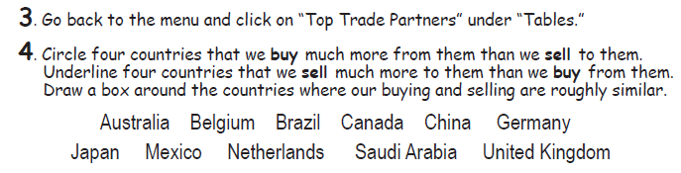
Which countries are major buyers of U.S. exports?
Where do U.S. exports go?
- - - - -
Which countries are major sellers to the U.S..?
Where do U.S. imports come from?
The next slides show simpler versions of the “Top Trade Partners” table.

Slide 10
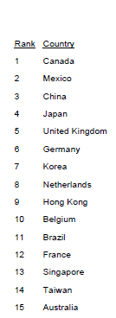
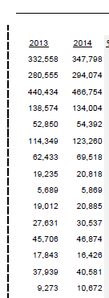
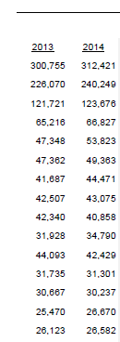
We sell.
Exports
We buy.
Imports
Imports exceed Exports
(billions)
35
54
343
67
1
73
25
From which countries
does the U.S.
buy more
than it sells?
Source: http://www.trade.gov/mas/ian/build/groups/public/@tg_ian/documents/webcontent/tg_ian_003364.pdf
http://trade.gov/mas/ian/build/groups/public/@tg_ian/documents/webcontent/tg_ian_005494.pdf

Slide 11
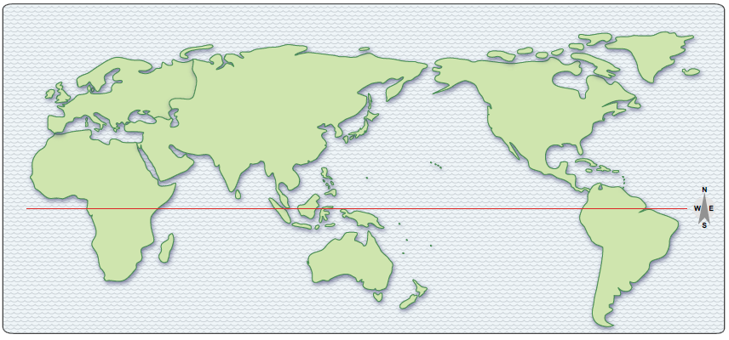
U
G
C
F
C
K
J
T
M
Which countries are in Europe?
Which countries are in East Asia?
Which are in
the Americas?
G = Germany
F = France
U = Britain
(United Kingdom)
C = China
J = Japan
K = Korea
T = Taiwan
C = Canada
M = Mexico
The U.S. imports (buys) more from these countries than it exports (sells).
x

Slide 12
We sell.
Exports
We buy.
Imports
Exports
are larger than
Imports
Source: http://www.trade.gov/mas/ian/build/groups/public/@tg_ian/documents/webcontent/tg_ian_003364.pdf

Slide 13
B
N
H
S
B
A
Which are in Europe?
Which are in East Asia?
Which are in the Americas?
Belgium
Netherlands
Hong Kong
Singapore
Brazil
The U.S. exports (sells) more to these countries
than it imports (buys) from them.
x

Slide 14
What does the U.S. export and import?
U.S. sells (exports)
U.S. buys (imports)
Examples of categories that were worth more than 30 billion dollars in 2015
Civilian and military aircraft
Pharmaceuticals (medicines)
Industrial machines
Semiconductors (parts for computers)
Chemicals
Petroleum products
Fuel oil
Plastic materials
Pharmaceuticals (medicines)
Cell phones, other electronics
Telecommunications equipment
Computers and monitors
Automotive vehicles, parts, engines
Apparel and household goods
Industrial machines
Toys, games, sporting goods
Petroleum products
Source: U.S. Census
http://www.census.gov/foreign-trade/Press-Release/current_press_release/exh7.pdf
http://www.census.gov/foreign-trade/Press-Release/current_press_release/exh8.pdf

Slide 15
Copyright 2016, Carol Gersmehl
Teachers who saw this presentation at a workshop
or downloaded it from our internet site have permission
to make a copy on their own computers for these purposes:
1. to help them review the workshop,
2. to show to colleagues or administrators,
3. to show the presentation in their own classrooms
or at sessions they lead at teacher conferences,
4. to use individual frames (with attribution)
in their own class or conference presentations.
For permission for any other use,
including posting frames on a personal blog
or uploading to any network or website,
contact carol.gersmehl@gmail.com

