Slide 1
Top 12 Countries
ranking countries
by different measures

Slide 2
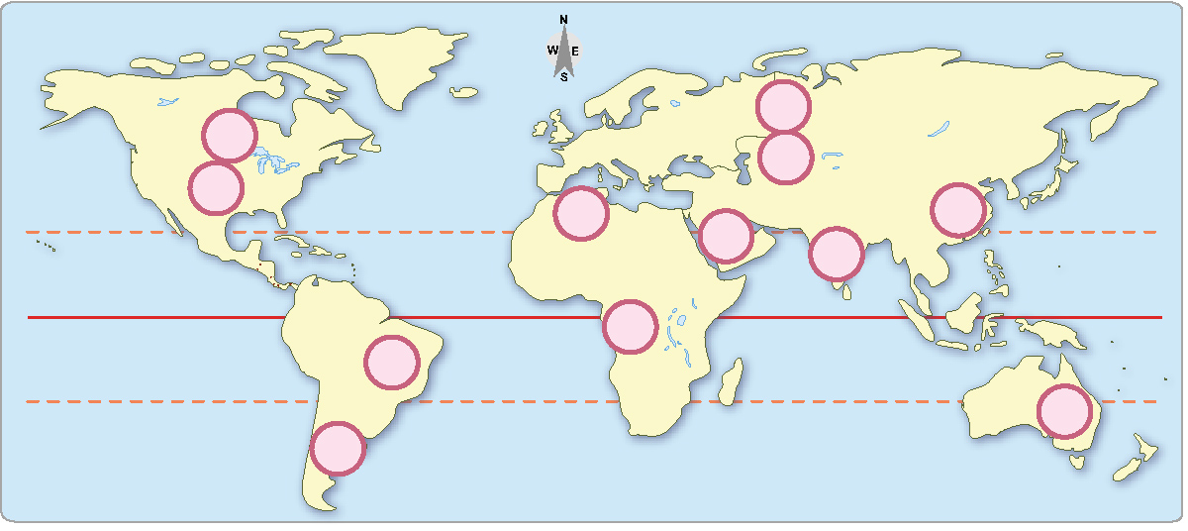
These are the 12 largest countries in the world. Do you know their names?

Slide 3
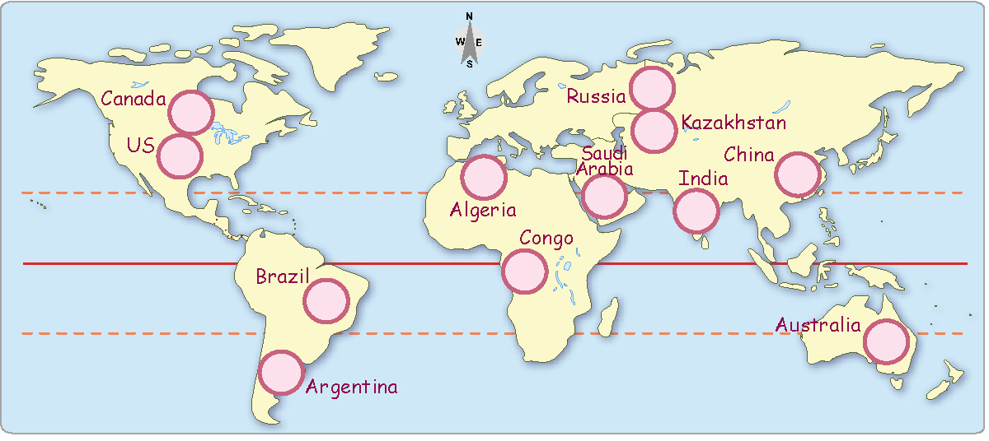
These are the 12 largest countries in the world.

Slide 4
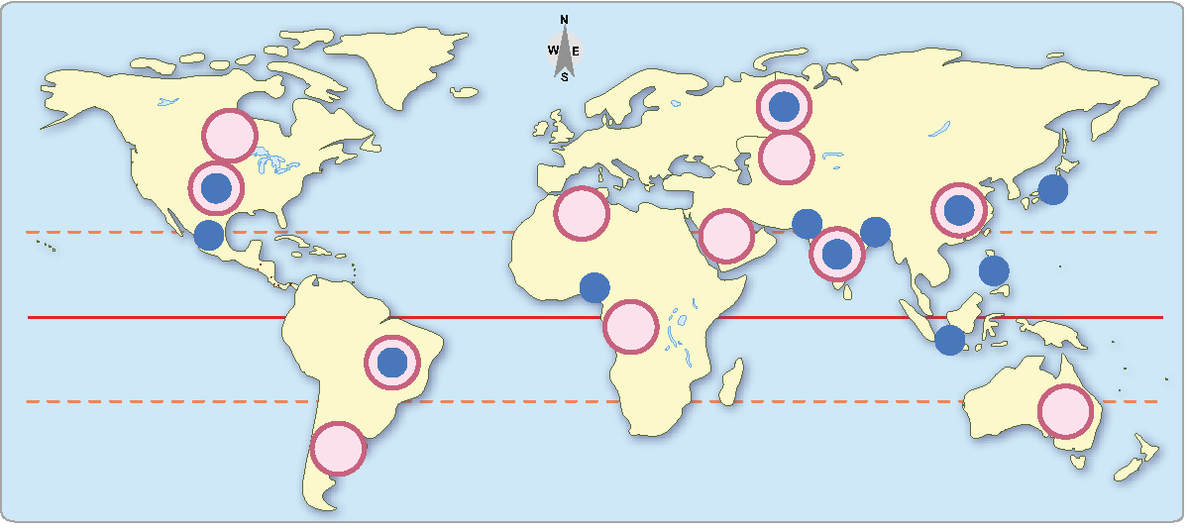
These are the 12 largest countries in the world.
These are the 12 countries with the most people.
Which 5 are also among the largest countries?

Slide 5
These are the 12 largest countries in the world.
Bigger Question: Why are 7 large countries
not among the 12 countries with the most people?
These are the 12 countries with the most people.
Which 5 are also among the largest countries?

Slide 6
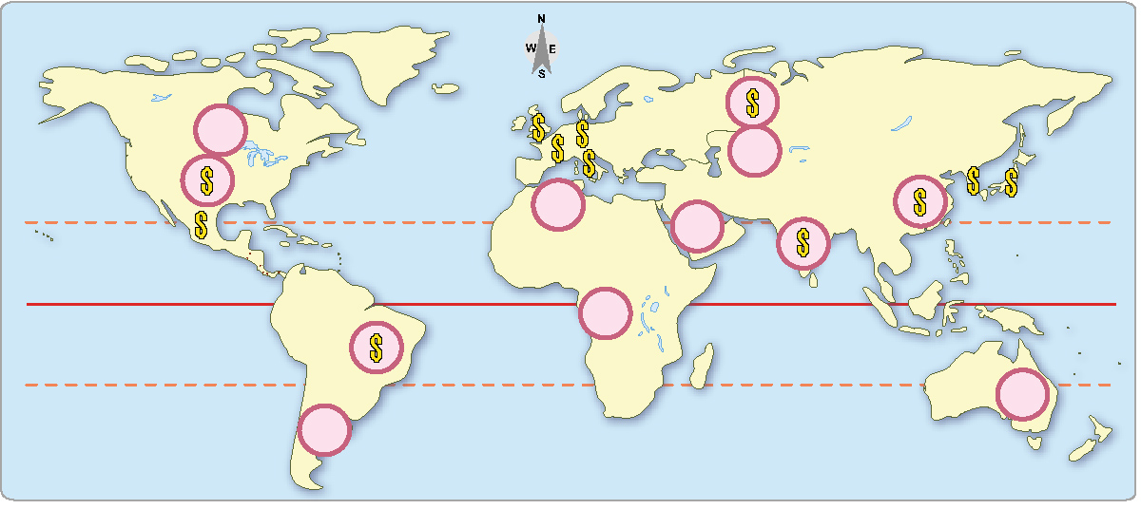
These are the 12 largest countries in the world.
$
These 12 countries have the largest economies.
Which 5 are also among the largest countries?

Slide 7
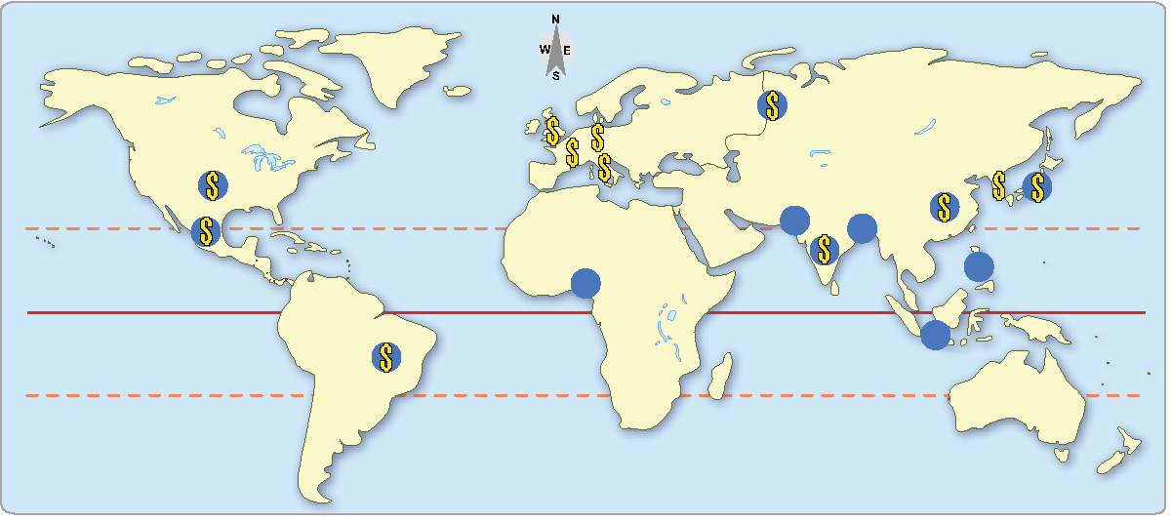
These are the 12 countries with the most people.
Which 5 do not have large economies?
$
These 12 countries have the largest economies.
Which 5 do not have large populations?

Slide 8
These are the 12 countries with the most people.
Which 5 do not have large economies?
How would
you describe
these groups?
$
These 12 countries have the largest economies.
Which 5 do not have large populations?

Slide 9
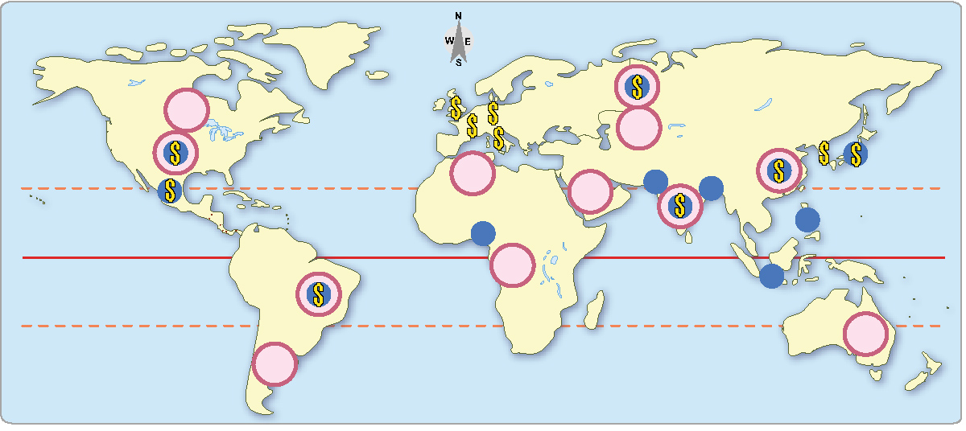
These 12 countries have the largest areas.
These 12 countries have the most people.
$
These 12 countries have the largest economies.
Is wealth related more to size or population?

