Slide 1
EMPIRES
What continent or subcontinent
were they in?
How large an area did they rule?
Did any of them want
to control the same area
that another empire wanted?
GLCE
6-G2.2.1 Describe the human characteristics of different regions
(including language, religion, cultural traditions).
6-G4.4.1 Identify factors that contribute to conflict and cooperation
(e.g., control of natural resources, wealth, cultural diversity).
pgersmehl@gmail.com, carol.gersmehl@gmail.com,
6th grade network, March 2, 2016

Slide 2
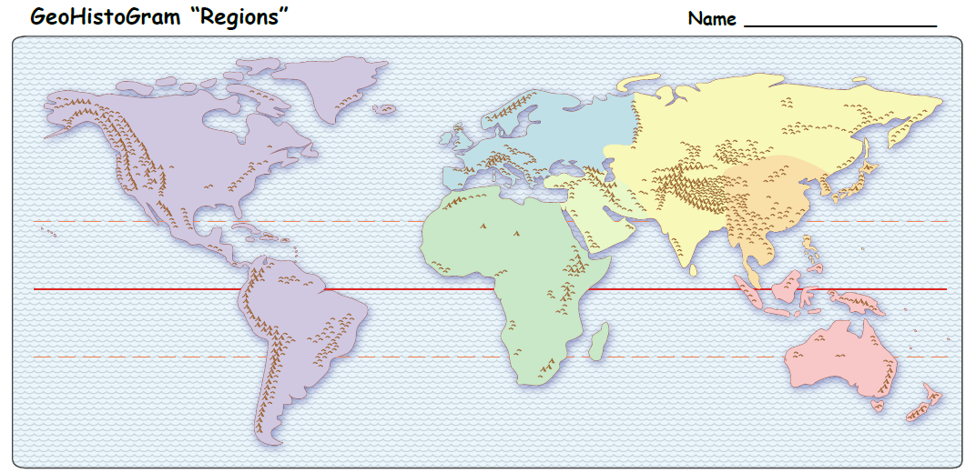
A s i a
E u r o p e
Central
East
SW
A m e r i c a s
South
A f r i c a
O c e a n i a
(SW Asia: also called Middle)
Map is from clickable PDF:
World GeoHistoGram Regions

Slide 3
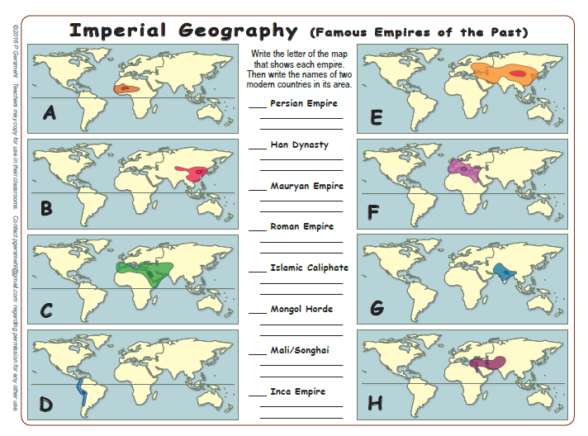
SW Asia
E Asia
S Asia
Europe, small parts of Africa and Asia
SW Asia, small parts of Africa and Europe
E Asia, C Asia
Africa
S America

Slide 4
H
Iran, Iraq, Syria, Afghanistan
B
China, Korea
G
India, Pakistan,
Bangladesh
F
Italy, Spain,
France, Egypt
C
Iran, Iraq, Syria,
Saudi Arabia
E
Mongoia, China,
Iran, Russia
A
Mali, Nigeria,
Ghana
D
Ecuador, Peru, Bolivia, Chile

Slide 5
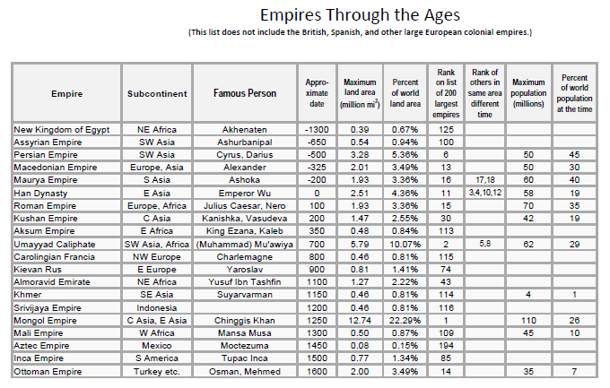
In your handout packet,
there is a table that shows
the date, size, population
and other facts about
20 historic empires.
Let’s do a map investigation
of a shorter list of 8 empires
that had a lasting influence
in different parts of the world.

Slide 6
PERSIAN
MAURYAN
HAN
ROMAN
ISLAMIC
MONGOL
MALI
INCA

Slide 7
EMPIRES
Were they separate?
Were they connected by trade?
Were they next to each other?
Was there conflict?

Slide 8
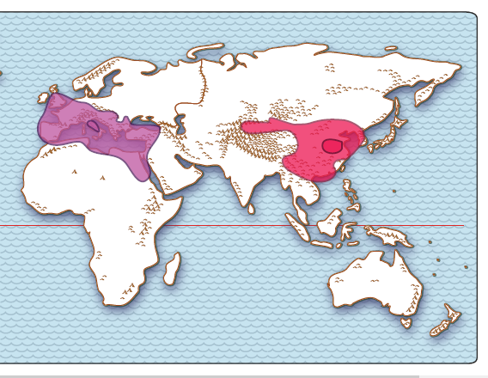
Which continent
does each arrow point to?
1_____________
2_____________
1
2
Europe
(East) Asia
Two powerful empires existed in the year 100 CE.
Roman & Han
Trade routes connected them. Draw a short line to connect them.
Map is from clickable PDF:
BI1 World Empires clickable map

Slide 9
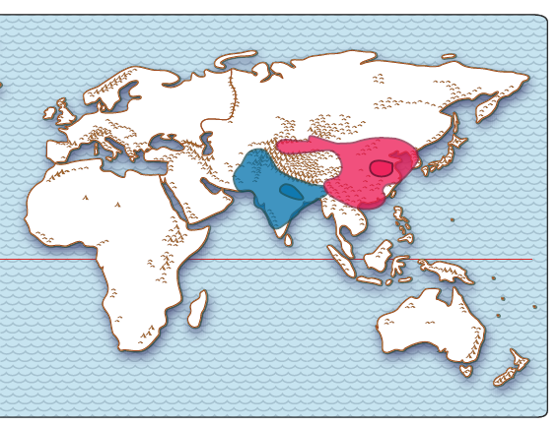
These two empires
are both inside
which continent?
_____________
Asia
Mauryan & Han
What feature do you see
between them, that might
have kept them separate?
__________________
High mountains
Map is from clickable PDF:
BI1 World Empires clickable map

Slide 10
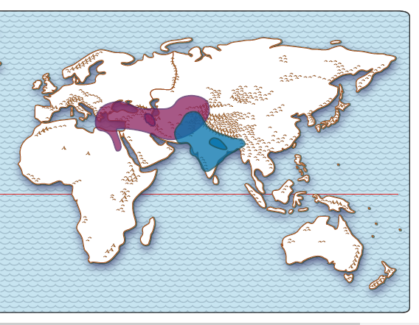
The blue empire
is in which
continent?
_____________
The other empire
is in which continents?
_____________
_____________
_____________
(south) Asia
Asia
Africa
Find a place that
both empires tried to control.
Europe
Persian & Mauryan
Map is from clickable PDF:
BI1 World Empires clickable map

Slide 11
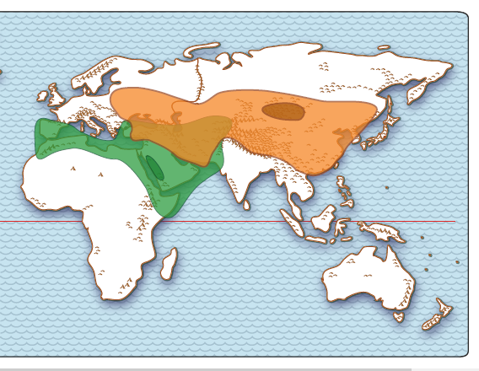
Which subcontinents
did they not control?
Northern E_______
Southern A_______
Southern A_______
E
A
Europe
A
Asia
Africa
Two empires were especially large.
Each ruled parts
of more than one continent.
Islamic & Mongol
Map is from clickable PDF:
BI1 World Empires clickable map

Slide 12
Copyright 2016, Carol Gersmehl
Teachers who saw this presentation at a workshop
or downloaded it from our internet site have permission
to make a copy on their own computers for these purposes:
1. to help them review the workshop,
2. to show to colleagues or administrators,
3. to show the presentation in their own classrooms
or at sessions they lead at teacher conferences,
4. to use individual frames (with attribution)
in their own class or conference presentations.
For permission for any other use,
including posting frames on a personal blog
or uploading to any network or website,
contact carol.gersmehl@gmail.com

