Slide 1
50 Reasons for the
Fall of the Roman Empire
Lessons we can learn from history

Slide 2
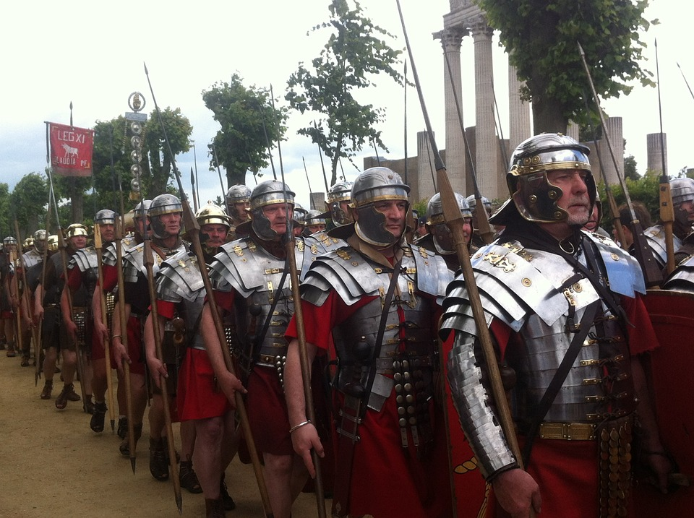
The Roman Empire was
the most powerful military force
in the world in the year 100.

Slide 3
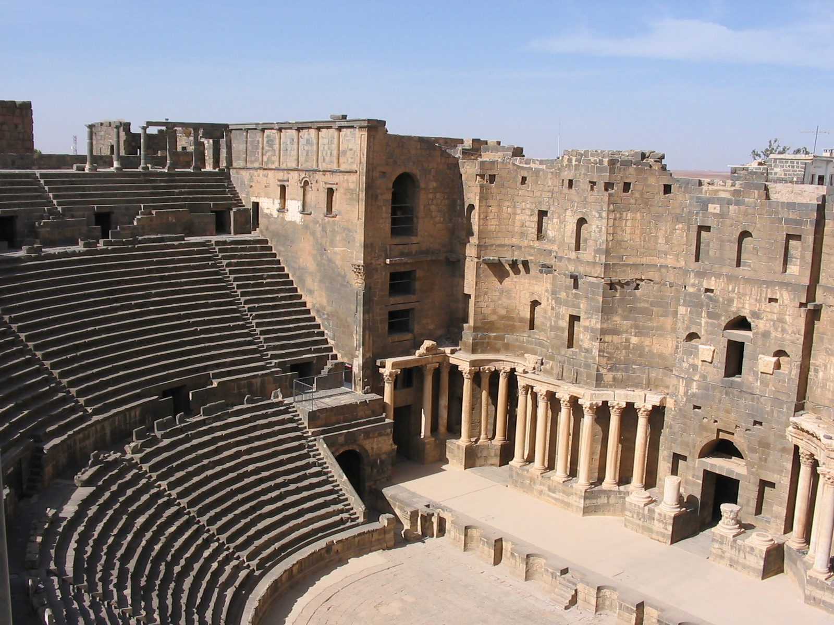
Roman buildings were spectacular – at a time
when many people lived
in log huts or tents.

Slide 4
Here’s the issue –
only a few hundred years later,
the Roman Empire had fallen.
Barbarians captured and burned the city,
and the population of Rome went down
from about one million to less than 30,000
Historians have tried to identify
the cause of the Roman collapse.
Meanwhile, politicians today sometimes
point to conditions in present-day America,
and warn that “this is why Rome fell.”

Slide 5
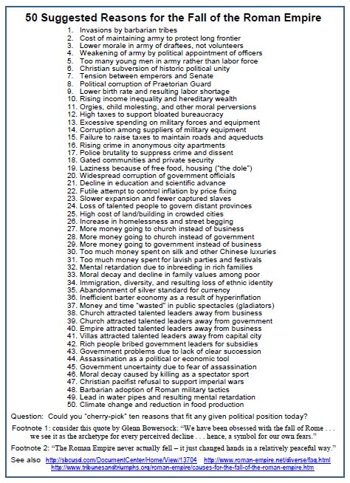
Let’s look at some
of the suggested reasons,
to see if they really apply
to present-day America.

Slide 6
Let’s do a kind of “thought experiment.”
Imagine that you have been hired
by some conservative politicians
who believe that big government,
high taxes, government spending,
and public debt are big problems.
Which reasons on the list
would support the idea that Rome fell
because it was too “big government” ?

Slide 7
OK . . .
Now imagine that you have been hired
by politicians who think government
should pass laws and raise taxes
to help unemployed, uneducated,
foreign, and other needy people.
Which reasons on the list
seem to support the idea that Rome fell
because it failed to provide
that kind of welfare program.

Slide 8
OK . . .
If you want, imagine
a different kind of politician.
Describe that person’s ideas,
and identify the reasons on the list
that such a person might mention
to support their ideas about
how government should be run.

Slide 9
Conclusion
The Fall of Rome
was a long and complex process.
Historians have suggested
more than 200 different conditions
that may have contributed to the collapse of the Roman civilization.
You should be suspicious
of anyone who claims to have
“the” ten reasons why Rome fell!

Slide 10
Copyright 2016, Phil Gersmehl
Teachers who saw this presentation at a workshop
or downloaded it from our internet site have permission
to make a copy on their own computers for these purposes:
1. to help them review the workshop,
2. to show to colleagues or administrators,
3. to show the presentation in their own classrooms
or at sessions they lead at teacher conferences,
4. to use individual frames (with attribution)
in their own class or conference presentations.
For permission for any other use,
including posting frames on a personal blog
or uploading to any network or website,
contact pgersmehl@gmail.com

