Slide 1
Refugees (and conflicts) in 2016
6 – G4.4.1 Identify factors that contribute to conflict and cooperation
between and among cultural groups
(e.g., control/use of natural resources, power, wealth, and cultural diversity).
6 – G4.3.3 Explain the patterns, causes, and consequences
of major human migrations.
Which parts of the world
have the most refugees?
Why there – in those places?
April, 2016 carol.gersmehl@gmail.com Michigan Geographic Alliance

Slide 2
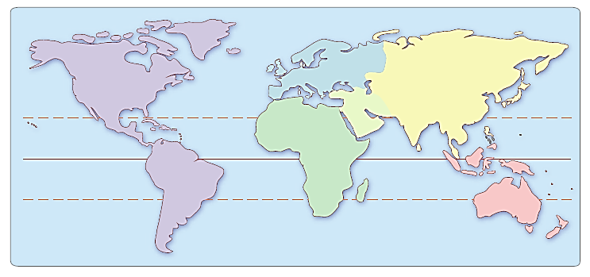
World Regions on the GeoHistoGram
Can you name these world regions?
Later in this PowerPoint, will use world maps to look at
where there are large numbers of people
who are refugees in 2016.

Slide 3
World Regions on the GeoHistoGram
North America
Europe
A s i a
Middle*
East
Asia
South Asia
Africa
South America
Australia
*Middle - also known as
Middle East or Southwest Asia
Later in this PowerPoint,
will use world maps to look at
where there are large numbers
of refugees in 2016.
Three slides follow showing photos of refugees.

Slide 4
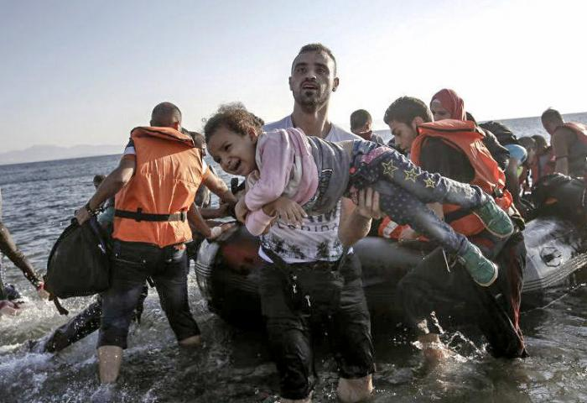
Refugees
Slide 1
Refugees are people who leave their homes
because they are looking for protection, for example, during wars.
What do you learn about refugees from this picture?
http://www.sharing.org/sites/default/files/styles/large/public/21238196986_e5d7647fd4_b.jpg?itok=c9-JThgt
Syrian Refugees arriving in Kos - image credit: Freedom House, Flickr public domain

Slide 5
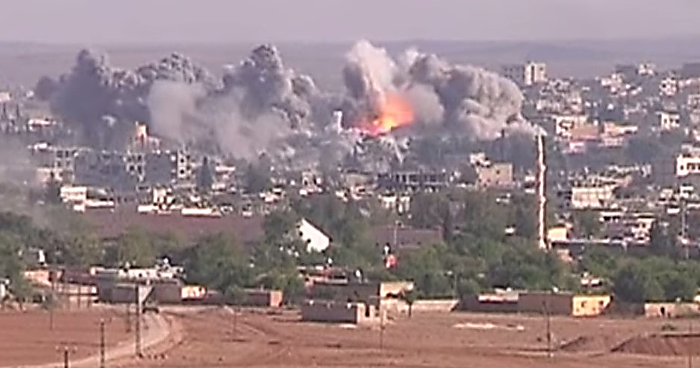
Refugees Slide 2
Refugees are people who leave their homes
because they are looking for protection, for example, during wars.
What do you learn about refugees from this picture?
https://en.wikipedia.org/wiki/Siege_of_Koban%C3%AE#/media/File:Coalition_Airstrike_on_ISIL_position_in_Kobane.jpg By Voice of America News: Scott Bobb reports from the Suruç, Turkey/ Kobane, Syrian border; "Turkish Border Towns Hosting Thousands of Kobani Refugees". - http://www.youtube.com/watch?v=V-QFVCnd7Po, Public Domain, https://commons.wikimedia.org/w/index.php?curid=36898261
VIDEO about war and refugees in 2014: http://www.youtube.com/watch?v=V-QFVCnd7Po

Slide 6
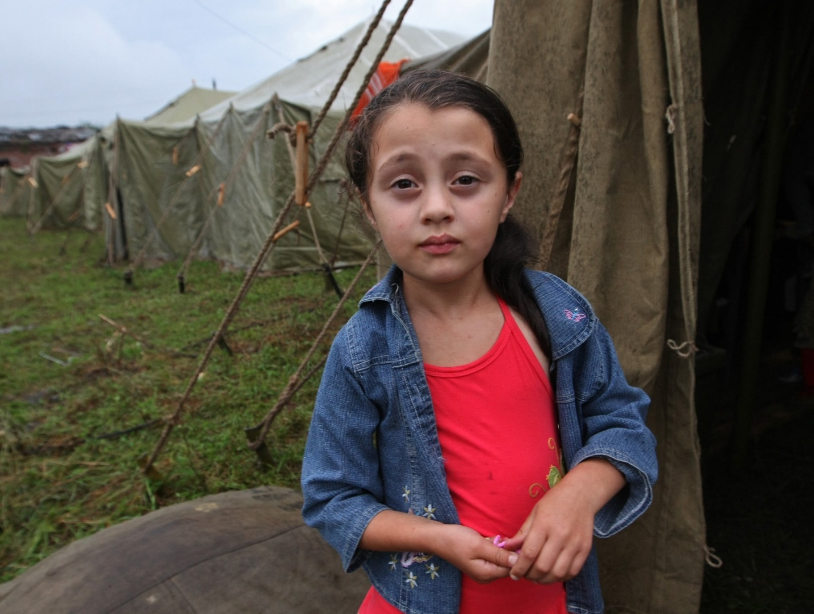
Refugees Slide 3
Refugees are people who leave their homes
because they are looking for protection, for example, during wars.
What do you learn about refugees from this picture?
https://origins.osu.edu/article/827/images https://origins.osu.edu/sites/origins.osu.edu/files/2-2-img296.jpg
Source: Public Domain-The Ministry Affairs of the Russian Federation

Slide 7
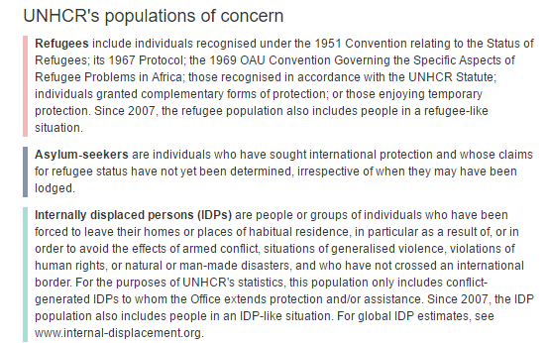
The United Nations describes different kinds of “refugees.”
“Refugees” are people who leave their homes
because they are looking for protection, for example, during wars.

Slide 8
Colors on a world map will show kinds of “refugees.”
Refugees
Asylum-seekers
Internally displaced persons
Some move to a different country to be safe, and they have official permission to stay
in this different country.
Some are in a different country, but are still
waiting for permission to stay there.
Some move away from their homes to be safe,
but they stay inside their own country.
On the next slide, you will see a map that uses
pink and green colors to show where “refugees” are living.
The United Nations is an international organization in which countries
try to work together to help refugees.

Slide 9
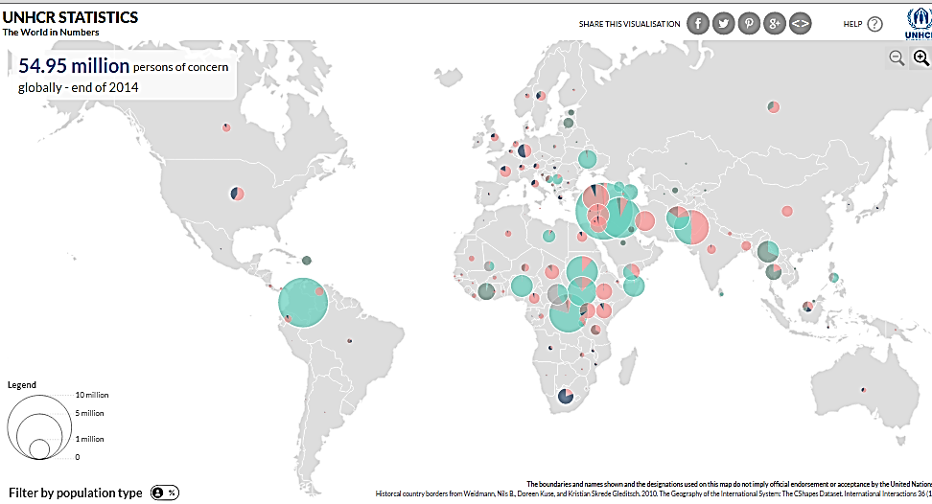
http://popstats.unhcr.org/en/overview#_ga=1.30120892.2051207487.1459969064
The United Nations made this map to show numbers of “refugees.”
- - - - -
The United Nations is an international organization
in which countries try to work together
to bring peace and help refugees.

Slide 10
http://popstats.unhcr.org/en/overview#_ga=1.30120892.2051207487.1459969064
1. Find the largest circles that are pink or green (or both).
2. Draw boxes around groups of the largest circles.
(Where are groups of the largest circles?)

Slide 11
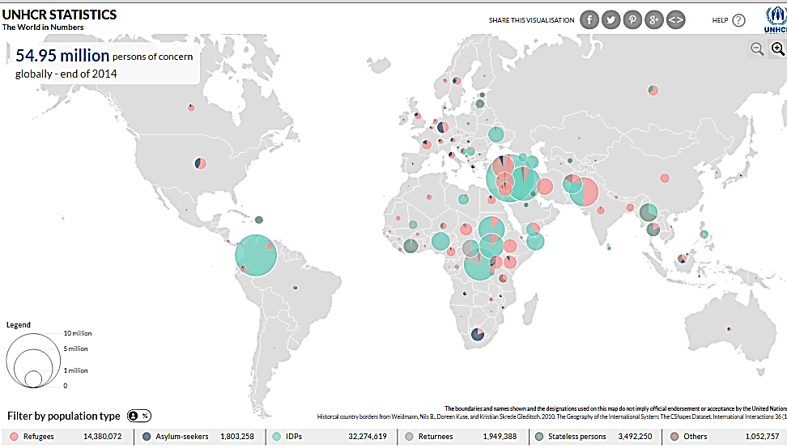
http://popstats.unhcr.org/en/overview#_ga=1.30120892.2051207487.1459969064
The boxes are drawn around places with large numbers of “refugees.”
Next use the map of world regions.
Put the boxes that you see here onto the map that shows world regions.

Slide 12
World Regions:
Where are the large numbers of Refugees and Displaced Persons?
Draw boxes on this map to show places with large numbers
of refugees and displaced persons.

Slide 13
World Regions:
Where are the large numbers of Refugees and Displaced Persons?
North
West
East
South
The boxes on this map show places with large numbers
of refugees and displaced persons.
a. Where are the largest numbers of “refugees”?
b. Give names to the places.

Slide 14
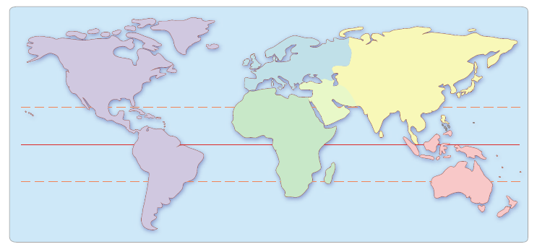
World Regions:
Where are the large numbers of Refugees and Displaced Persons?
North America
Europe
A s i a
Middle
East
Asia
South Asia
Africa
South America
Australia
North
West
East
South
The boxes on this map show places with large numbers
of refugees and displaced persons.
The boxes are centered on places where there are wars (civil wars):
Afghanistan, Syria & Iraq, Sudan, and Colombia.

Slide 15
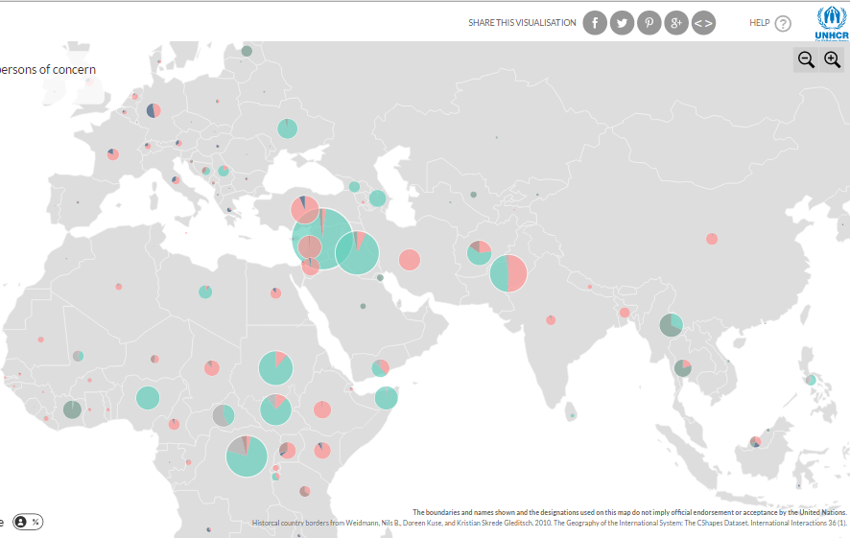
http://popstats.unhcr.org/en/overview#_ga=1.30120892.2051207487.1459969064
Syria
Afghanistan
Sudan
When you go to the United Nations website, you can zoom in,
and you can click on circles to see country names and numbers of people.

Slide 16
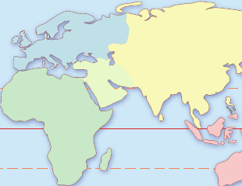
Where are the largest numbers of “refugees”?
Give names to the places.
North
West
East
South
Europe
A s i a
Syria
Afghanistan
East
Asia
Middle*
South Asia
Africa
Sudan
*Middle - also known as
Middle East or Southwest Asia
Australia
Also see http://www.visionofhumanity.org/#page/indexes/global-peace-index/2015

Slide 17
United Nations resource: interactive map
Additional internet resources:
Use an interactive map at http://www.visionofhumanity.org/#page/indexes/global-peace-index/2015 where students can choose a year, then "Specify factor“ (Intensity of internal conflict, Terrorism impact, Deaths from internal conflict, Neighboring countries relations), and also identify countries.
Videos from PBS:
http://www.pbs.org/newshour/extra/daily_videos/europe-begins-deporting-migrants-back-to-turkey/ April 2016
http://www.pbs.org/newshour/extra/daily_videos/syria/ February 2016
http://www.pbs.org/newshour/extra/daily_videos/flood-of-war-refugees-tests-greek-hospitality/ June 2015
refugees going to Greece
http://www.pbs.org/video/2364991678/ April 2013 the war in Syria
Videos from the International Rescue Committee: https://www.youtube.com/user/theirc/videos
http://www.rescue.org/frequently-asked-questions-about-refugees-and-resettlement
Other: https://www.amnesty.org/en/latest/news/2016/04/turkey-illegal-mass-returns-of-syrian-refugees-expose-fatal-flaws-in-eu-turkey-deal/ https://www.amnesty.org/en/countries/middle-east-and-north-africa/
https://www.amnesty.org/en/countries/middle-east-and-north-africa/syria/
https://www.amnesty.org/en/latest/campaigns/2016/03/syrian-refugees-bekaa-valley-lebanon/
http://www.understandingwar.org/project/syria-project
https://en.wikipedia.org/wiki/European_migrant_crisis
https://commons.wikimedia.org/wiki/File:Refugees_and_asylum_seekers_by_host_country.jpg
http://popstats.unhcr.org/en/overview#_ga=1.30120892.2051207487.1459969064

Slide 18
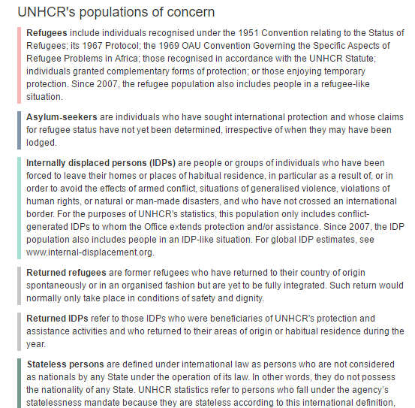
Definitions
http://popstats.unhcr.org/en/overview#_ga=1.30120892.2051207487.1459969064
The
United Nations
High Commission
for Refugees
(UNHCR)
describes several different kinds of “refugees.”

