Slide 1
History Timeline of
Moscow
6-G2.2.1 Describe the human characteristics of the region under study
(including religion, economic system, governmental system, etc.).
6-G4.4.1 Identify factors that contribute to conflict and cooperation
(e.g., control of natural resources, power, wealth, cultural diversity).
How does a country get its “soul”?

Slide 2
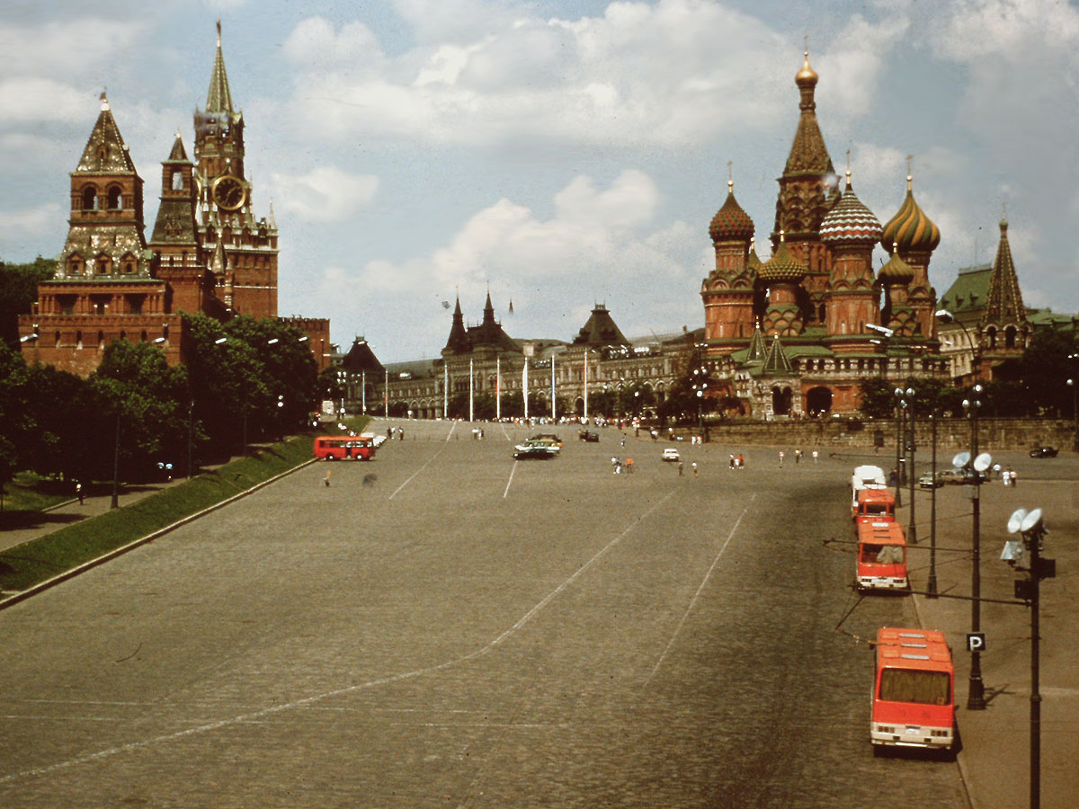

Slide 4
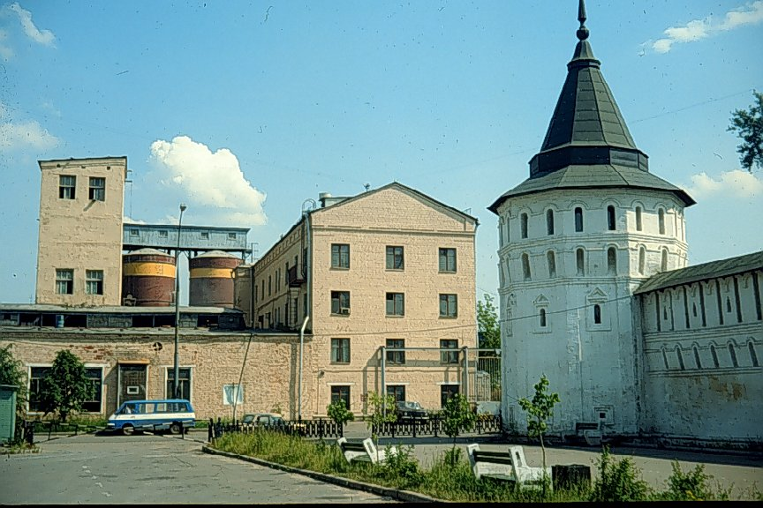

Slide 7
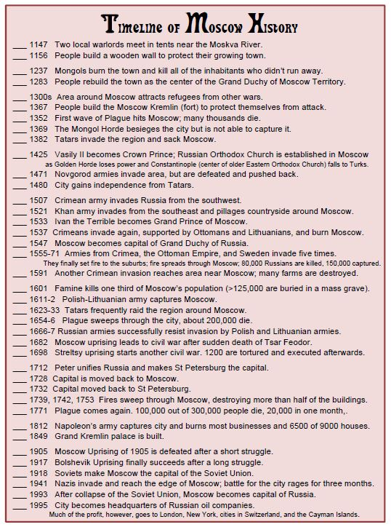

Slide 8
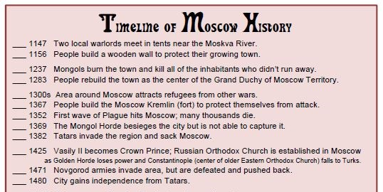
Mark all the times when the city lost
at least one-fourth of its population

Slide 9
Mark all the times when the city lost
at least one-fourth of its population
X
?
?

Slide 10
“War would have ended years ago, but for Russians’ cursed ability to endure suffering.”
Doctor Zhivago

Slide 11
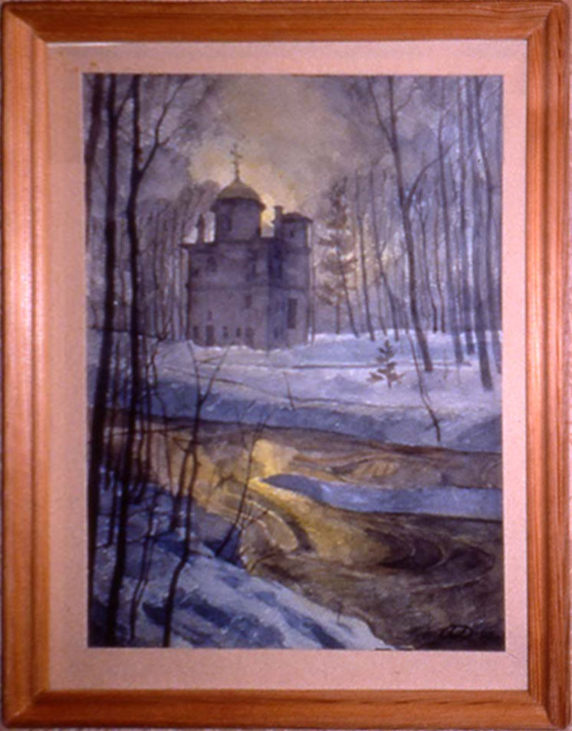

Slide 12
Copyright 2016, Phil Gersmehl
Teachers who saw this presentation at a workshop
or downloaded it from our internet site have permission
to make a copy on their own computers for these purposes:
1. to help them review the workshop,
2. to show to colleagues or administrators,
3. to show the presentation in their own classrooms
or at sessions they lead at teacher conferences,
4. to use individual frames (with attribution)
in their own class or conference presentations.
For permission for any other use,
including posting frames on a personal blog
or uploading to any network or website,
contact pgersmehl@gmail.com

