Slide 1
Immigration into the U.S.:
6 – G4.3.3 Explain the patterns, causes, and consequences
of major human migrations.
What social, political, and economic push factors can persuade people
to move away from a place?
What social, political, and economic pull factors can induce people
to move toward a place?
What major groups of people migrated to the United States
at particular times in history?
Where did these groups settle?
6 – C4.3.2 Explain the challenges to governments and the cooperation
needed to address international issues (e.g., migration and human rights).
6 – G1.3.3 Explain the different ways in which places are connected and how those connections demonstrate interdependence.

Slide 2
Immigration
into the U.S.:
If you were an immigrant in 1890,
where would you choose to live
in the U.S.?
Where would you be pulled to within the U.S.?
April, 2016 carol.gersmehl@gmail.com
Michigan Geographic Alliance

Slide 3
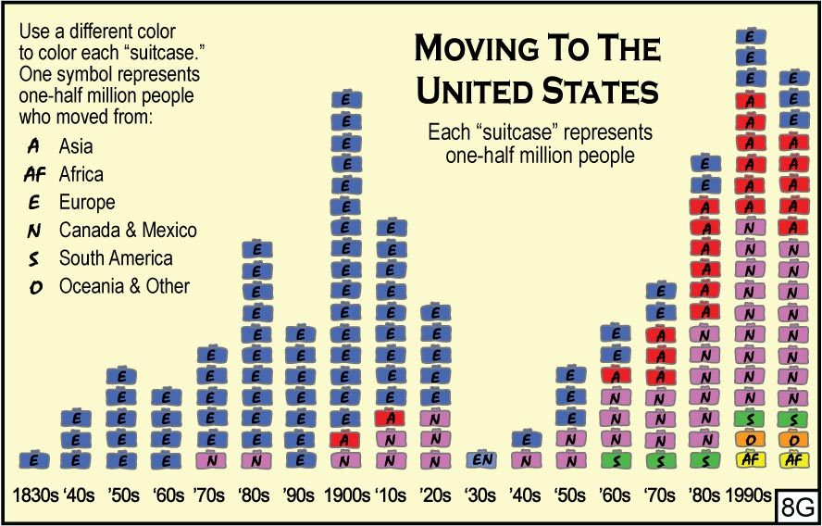
Pulls into the U.S.
Foreign-born (U.S. Census):
1890: 15% were foreign-born
9 million people
2010: 13% were foreign-born
40 million people
Which continent did most people come from
before 1900?
From P. Gersmehl, Teaching Geography, CD

Slide 4
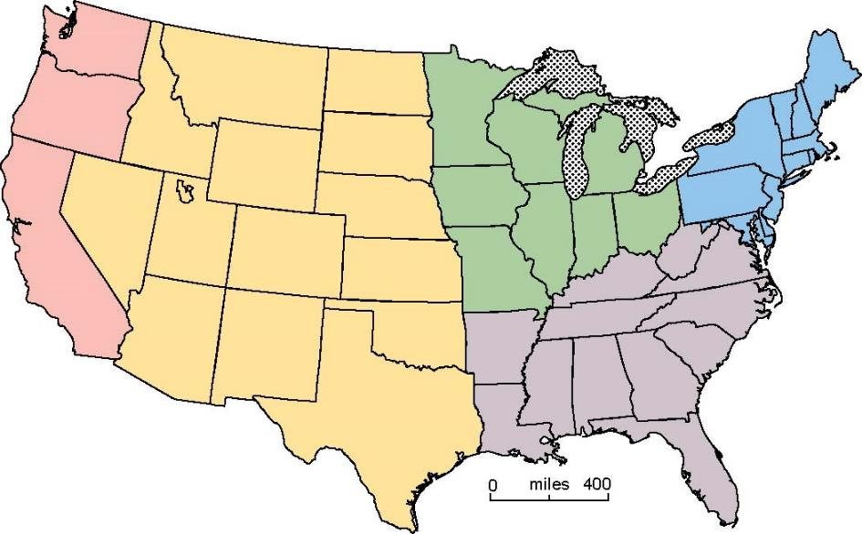
We will use this map of regions to see
which regions PULLED more immigrants before 1900.
Plains,
Mountains,
Deserts
Northeast
Pacific
Great Lakes,
Midwest
Southeast
Alaska
& Hawaii

Slide 5
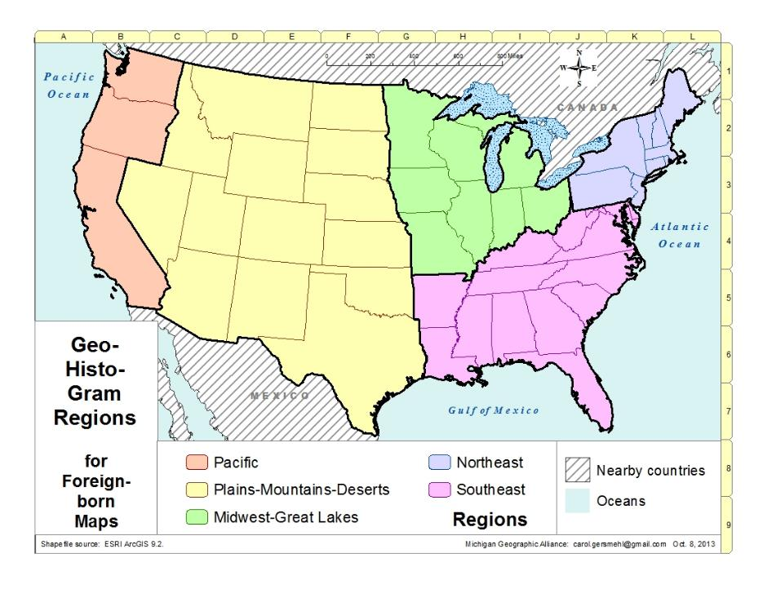
Name regions.
Predict where foreign-born chose to live.
1890

Slide 6
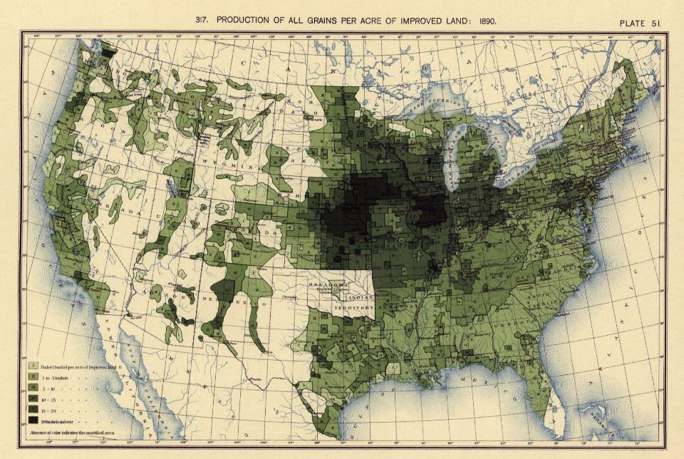
Which region might provide farming jobs or productive land?
Grain Production Per Acre
Under 1 bushel
20 bushels or more

Slide 7
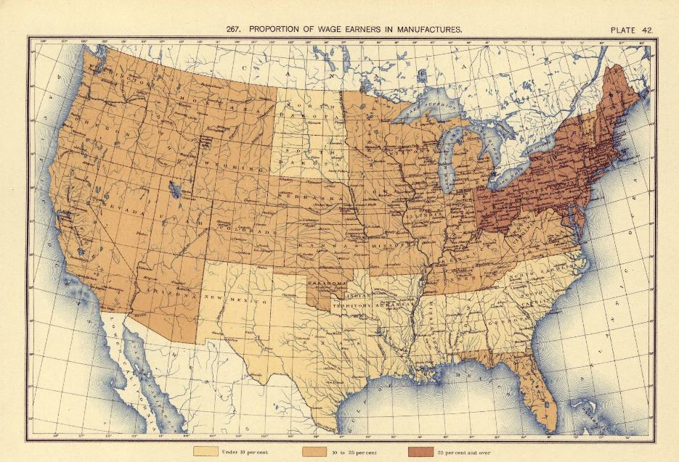
Which region might provide the most manufacturing jobs?
Proportion of Wage Earners in Manufacturing
Percent in Manufacturing
Under 10
10 to 25
25 and higher

Slide 8
Where had more foreign-born chosen to live as of 1890?
1/2 million
4 million
3.5 million
1
million
1/2 million
1890
Foreign
Born
(rounded
numbers)

Slide 9
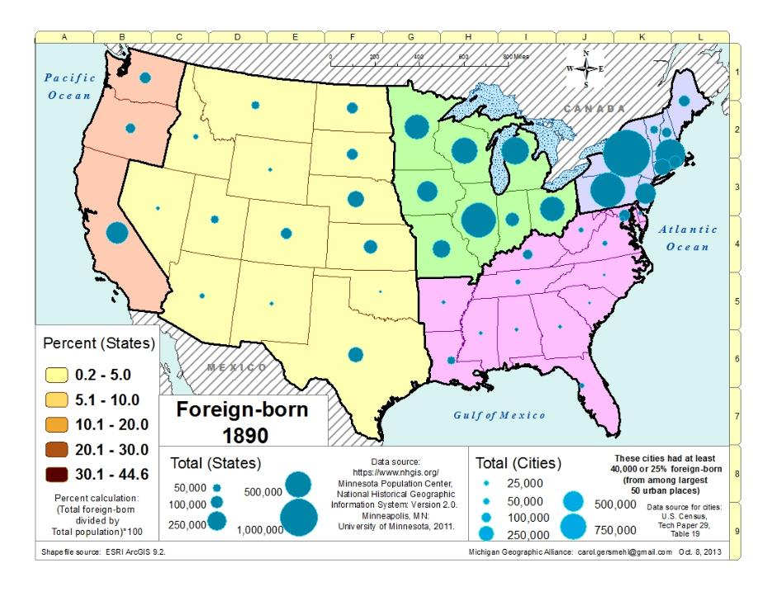
Where had more foreign-born settled by 1890?

Slide 10
Which 2 regions had most large cities in 1890?
M
S
B
R
M
B
N
P
C
D
N,J
C
P
P
S
O
B
S
C
W
K
L
25 Largest Cities
in 1890
Larger letters mean more foreign born:
N
N = 640,000
D = 82,000

Slide 11
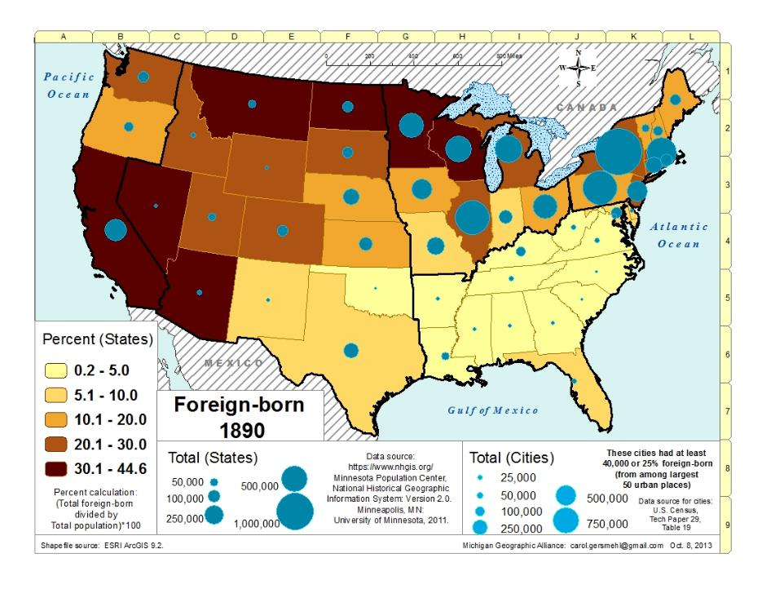
Where had foreign-born settled by 1890?
What does number data say? What does per cent data say?

Slide 12
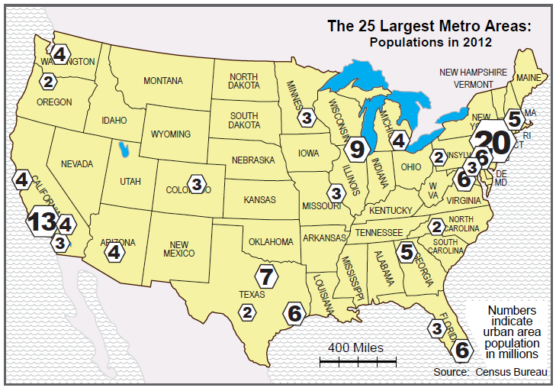
Use a map along with the NY Times Immigration Explorer.
http://www.nytimes.com/interactive/2009/03/10/us/20090310-immigration-explorer.html?_r=0

Slide 13
NY Times Immigration Explorer
(interactive mapping website)
6 – G4.3.3 Explain the patterns, causes, and consequences
of major human migrations.
Where did immigrants come from?
Where did immigrants decide to live?
What social, political, and economic pull factors can induce people
to move toward a place?
This interactive map on internet allows students to look at
different decades as well as source regions and countries.

Slide 14
NY Times Immigration Explorer
(interactive mapping website)
http://www.nytimes.com/interactive/2009/03/10/us/20090310-immigration-explorer.html?_r=0
SUGGESTIONS:
1. Give students a map of the U.S. that shows major cities.
2. Show number of residents rather than percent of population.
(See choices in right side.)
3. Select individual countries in addition to all countries.
(See choices on upper left.)
4. Do “screen captures” of maps.
(Press alt & prt screen keys simultaneously; then paste into PPT.)

