Slide 1
Locations of Ancient Capitals
Why people making decisions
have to pay attention
to geographic conditions
and geographic connections.

Slide 2
The place you are about to investigate
is a real place,
at a real time in history.

Slide 3
The place you are about to investigate
is a real place,
at a real time in history.
You might try to figure out
where in the world this is.
We are keeping
its identity secret, for now,
in order to focus on a more important question.

Slide 4
Here is the big question:
How do people decide
where to live?

Slide 5
As we go on,
try to think about
how you are making a decision,
not just
what decision you are making.

Slide 6
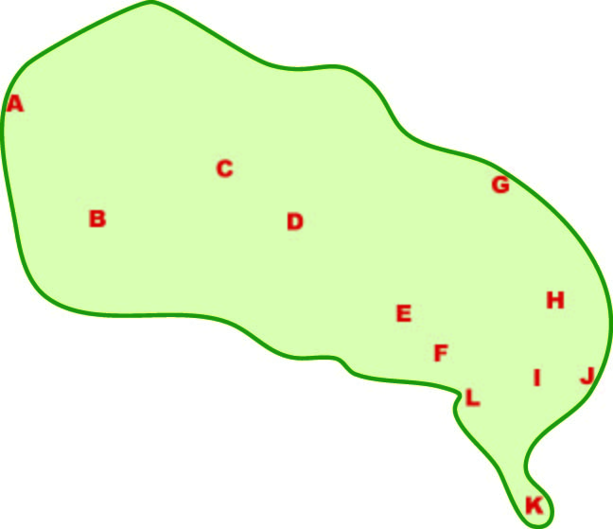
Here are a dozen places
where you might live.
Which would you choose?

Slide 7
Here are a dozen places
where you might live.
Which would you choose?
Discuss,
then we’ll vote.

Slide 8
Vote

Slide 9
Asking you to vote after looking at a simple map
exposes a basic problem with democracy:
Advantage:
Disadvantage ?

Slide 10
Asking you to vote after looking at a simple map
exposes a basic problem with democracy:
Advantage:
people get to choose.
Disadvantage ?

Slide 11
Asking you to vote after looking at a simple map
exposes a basic problem with democracy:
Advantage:
people get to choose.
Disadvantage:
it takes time and effort
to learn what you need
to make a good decision.

Slide 12
Here is that map again,
with your twelve choices on it.
What else would you like to know?

Slide 13
Before we go any farther,
let’s make sure we all understand
the concept of “location.”

Slide 14
The idea of location
has two parts:

Slide 15
The idea of location
has two parts:
The Conditions
in a specific place,
right there

Slide 16
The idea of location
has two parts:
The Conditions
in a specific place,
These are the physical and human characteristics of the place.
What are some examples?

Slide 17
Cold
Bears
Iron ore
The idea of location
has two parts:
Hilly
The Conditions
in a specific place,
Sandy
Trees
Rainy

Slide 18
The idea of location
has two parts:
The Conditions
in a specific place,
Can you name a kind of place condition
that did not flash on the screen?

Slide 19
The idea of location
has two parts:
The Conditions
in a specific place,
The Connections
with other places

Slide 20
The idea of location
has two parts:
These usually involve
movements of something
from one place to another.
What are some examples?
The Conditions
in a specific place,
The Connections
with other places

Slide 21
Road
Canal
Far from camp
The idea of location
has two parts:
The Conditions
in a specific place,
Treaty
Trade
The Connections
with other places
Upstream

Slide 22
Can you name
any kind of connection
that did not flash
on the screen?
The idea of location
has two parts:
The Conditions
in a specific place,
The Connections
with other places

Slide 23
Here is a quick review. When you click, a phrase
will flash on the screen. Decide whether the phrase
is a geographic condition or connection. Then click.
Geographic
Condition
Geographic
Connection

Slide 24
Here is a quick review. When you click, a phrase
will flash on the screen. Decide whether the phrase
is a geographic condition or connection. Then click.
Fertile soil
Geographic
Condition
Geographic
Connection

Slide 25
Here is a quick review. When you click, a phrase
will flash on the screen. Decide whether the phrase
is a geographic condition or connection. Then click.
Geographic
Condition
Geographic
Connection
Fertile soil

Slide 26
Here is a quick review. When you click, a phrase
will flash on the screen. Decide whether the phrase
is a geographic condition or connection. Then click.
Upstream from swamp
Geographic
Condition
Geographic
Connection
Fertile soil

Slide 27
Here is a quick review. When you click, a phrase
will flash on the screen. Decide whether the phrase
is a geographic condition or connection. Then click.
Geographic
Condition
Geographic
Connection
Fertile soil
Upstream from swamp

Slide 28
Here is a quick review. When you click, a phrase
will flash on the screen. Decide whether the phrase
is a geographic condition or connection. Then click.
Trade with France
Geographic
Condition
Geographic
Connection
Fertile soil
Upstream from swamp

Slide 29
Here is a quick review. When you click, a phrase
will flash on the screen. Decide whether the phrase
is a geographic condition or connection. Then click.
Geographic
Condition
Geographic
Connection
Fertile soil
Upstream from swamp
Trade with France

Slide 30
Here is a quick review. When you click, a phrase
will flash on the screen. Decide whether the phrase
is a geographic condition or connection. Then click.
Flat land
Geographic
Condition
Geographic
Connection
Fertile soil
Upstream from swamp
Trade with France

Slide 31
Here is a quick review. When you click, a phrase
will flash on the screen. Decide whether the phrase
is a geographic condition or connection. Then click.
Geographic
Condition
Geographic
Connection
Fertile soil
Upstream from swamp
Flat land
Trade with France

Slide 32
Here is a quick review. When you click, a phrase
will flash on the screen. Decide whether the phrase
is a geographic condition or connection. Then click.
Close to town
Geographic
Condition
Geographic
Connection
Fertile soil
Upstream from swamp
Flat land
Trade with France

Slide 33
Here is a quick review. When you click, a phrase
will flash on the screen. Decide whether the phrase
is a geographic condition or connection. Then click.
Geographic
Condition
Geographic
Connection
Fertile soil
Upstream from swamp
Flat land
Trade with France
Close to town

Slide 34
Here is a quick review. When you click, a phrase
will flash on the screen. Decide whether the phrase
is a geographic condition or connection. Then click.
Next to river
Geographic
Condition
Geographic
Connection
Fertile soil
Upstream from swamp
Flat land
Trade with France
Close to town

Slide 35
Here is a quick review. When you click, a phrase
will flash on the screen. Decide whether the phrase
is a geographic condition or connection. Then click.
Geographic
Condition
Geographic
Connection
Fertile soil
Upstream from swamp
Flat land
Trade with France
Next to river?
Close to town
Next to river?

Slide 36
Here is a quick review. When you click, a phrase
will flash on the screen. Decide whether the phrase
is a geographic condition or connection. Then click.
Geographic
Condition
Geographic
Connection
Fertile soil
Upstream from swamp
Flat land
Trade with France
Next to river for drinking water
Close to town
Next to river for trade by boat

Slide 37
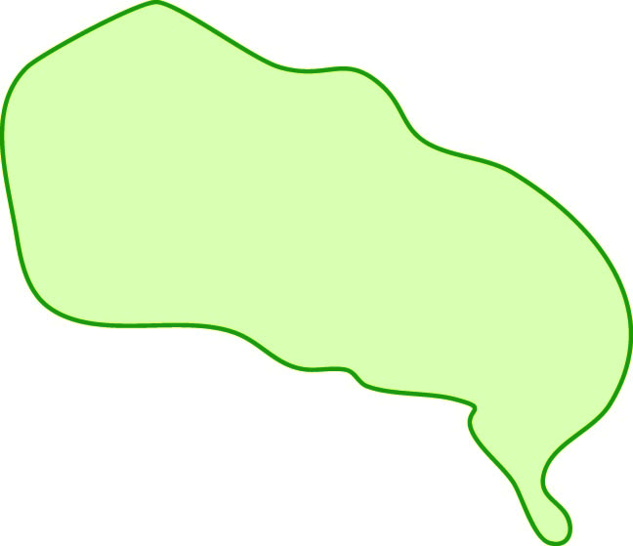
You might also want
to know about the size
of the area shown
by this map

Slide 38
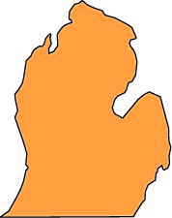
This map shows an area
about half as large
as the United States (without Alaska).
Most of the area,
however,
is much warmer
than most of the U.S.
Think Brazil,
or Africa, China, India . . .
Some place where people
could get two or three crops
in a single year.

Slide 39
Most of the area,
however,
is much warmer
than most of the U.S.
Think Brazil,
or Africa, China, India . . .
Some place where people
could get two or three crops
in a single year.

Slide 40
Think Brazil,
or Africa, China, India . . .
Some place where people
could grow two or three crops
in a single year.

Slide 41
This map shows an area
about two thirds as large
as the United States (without Alaska).
Most of the area,
however,
is much warmer
than most of the U.S.
Think Brazil,
or Africa, China, India . . .
Some place where people
could get two or three crops
in a single year.
No snow!
(Is that good or bad?)

Slide 42
Discuss, and choose
up to three places.
Write the main reason
why you chose each place.
Here are the places
where you might live.
The map doesn’t have
a lot of information,
but it’s better than nothing!

Slide 43
Discuss, and choose
up to three places.
Write the main reason
why you chose each place.

Slide 44
Here are some examples,
from previous classes.

Slide 45
It’s on a coast.
You can fish.

Slide 46
It’s in the middle,
controls a big area.
It’s on a coast.
You can fish.

Slide 47
It’s in the middle,
controls a big area.
It’s on a coast.
You can fish.
It’s on a peninsula,
easier to defend.

Slide 48
It’s in the middle,
controls a big area.
It’s on a coast.
You can fish.
It’s by a bay,
safe from wind.
It’s on a peninsula,
easier to defend.

Slide 49
Did your group
pick a different place?
Why?

Slide 50
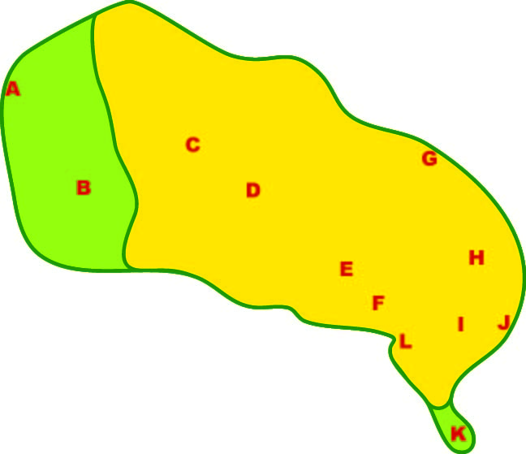
Here is some information
about geographic conditions:
A yellow color shows areas
that are hot and dry.
The green areas are cooler,
with a rainy season.

Slide 51
Did you change your mind
when you learned about
the climate conditions?

Slide 52
Let’s connect this
to World History -
specifically, the big eras
in the Michigan curriculum.

Slide 53
“Era 0” - Prehistory
Where do you think
hunters and gatherers
would choose to live?

Slide 54
“Era 0” - Prehistory
Where do you think
hunters and gatherers
would choose to live?
PS. It’s long ago.
You have only
a bow and arrow,
and some stone tools.

Slide 55
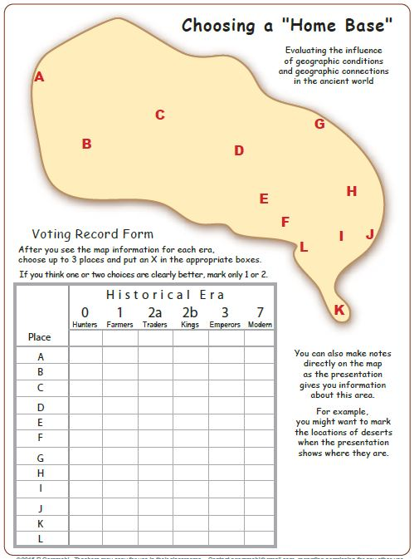
PS#2. You might
keep a record
of your votes
on a data form
like this.
“Era 0” - Prehistory
Where do you think
hunters and gatherers
would choose to live?

Slide 56
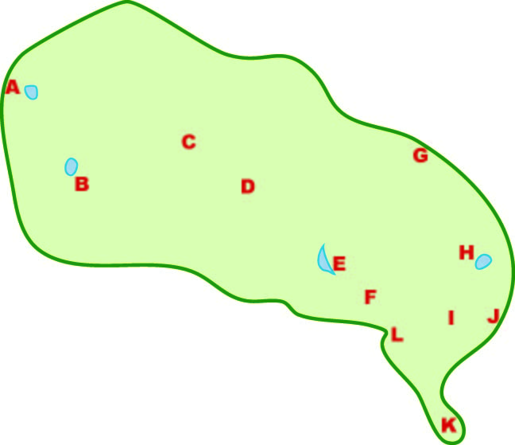
What if the map
showed only some lakes?
Would that change your mind?

Slide 57
What if the map
showed only some lakes?
Where do you think
hunters and gatherers
would choose to live?

Slide 58
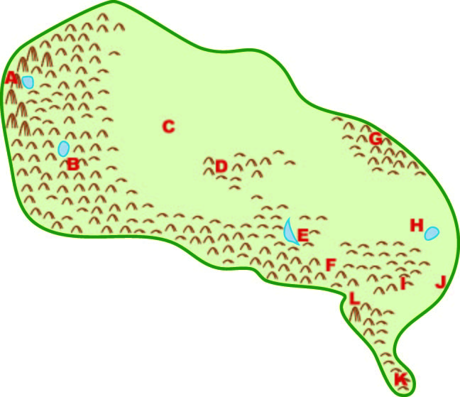
“Era 0” - Prehistory
The map now shows
hills, mountains, and lakes.
Does this information
change your mind?

Slide 59
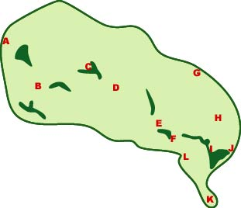
Era 1 - Farming
(People start to plant seeds.)
Dark green shows fertile soil,
You are a farmer.
Where do you choose to live?

Slide 60
Era 1 - Farming
(People start to plant seeds.)
Dark green shows fertile soil,
You are a farmer.
Where do you choose to live?
PS. It’s long ago.
You have only
a digging stick
and stone tools.

Slide 61
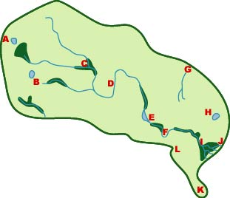
Era 2a - Trading
(People know how to build boats.)
Blue lines are rivers.
You are a trader.
Where do you live?

Slide 62
Era 2a - Trading
(People know how to build boats.)
Blue lines are rivers.
You are a trader.
Where do you live?
PS. even a small canoe
can move 10 times as much
as a person can carry.

Slide 63
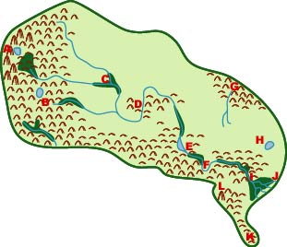
Era 2b – “Civilization”
(People start building large cities.)
You are a powerful ruler
Where would you put
your capital city?

Slide 64
Era 2b – “Civilization”
(People start building large cities.)
You are a powerful ruler
Where would you put
your capital city?
PS. you want traders,
builders, soldiers, artists
to live in your city, . . .
and you all have to eat!

Slide 65
Era 3a – Empires
People came from the east
and conquered “your” land.
They made you governor.
Where is your palace?

Slide 66
Era 3a – Empires
People came from the east
and conquered “your” land.
They made you governor.
Where is your palace?
PS. you have to communicate with
the overseas power,
and stay safe.

Slide 67
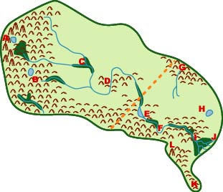
Era 7 – Modern Times
A foreign power split
“your” land into two countries.
Where would you put the capital of each new country?

Slide 68
Era 7 – Modern Times
A foreign power split
“your” land into two countries.
Where would you put the capital of each new country?
PS. people might
have airplanes now,
but they still need
food and water!

Slide 69
OK, how often
did you change your mind
about where to live?
Why?

Slide 70
OK, how often
did you change your mind
about where to live?
Why?
PS. Where
in the world
do you think
this might be?

Slide 71
Rotate the map
so that the right edge
becomes the top.

Slide 72
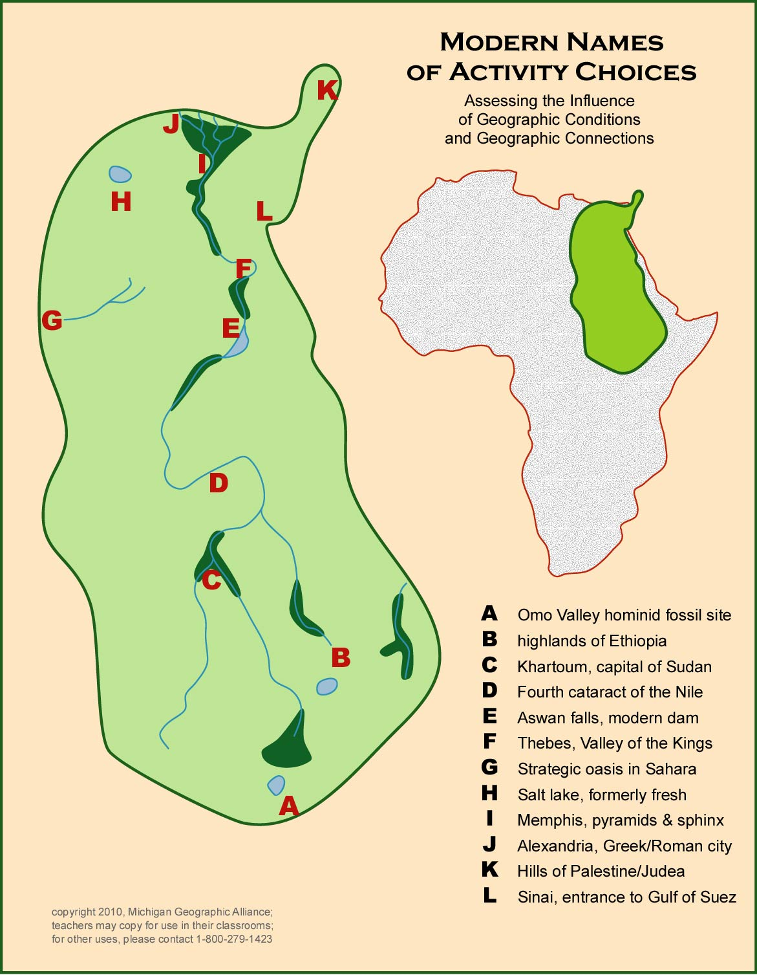
Each place
turns out to be
a real place
in ancient history.

Slide 73
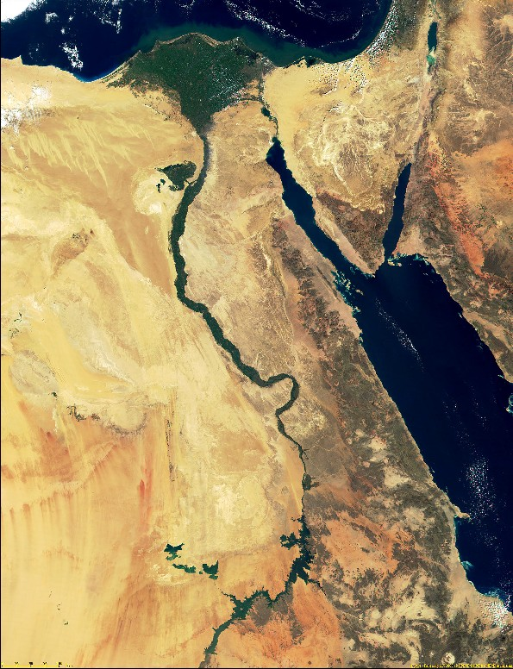
K
J
I
H
L
F
E
A satellite image
shows the conditions
around 7 places.

Slide 74
K
J
I
H
Cropland
L
F
Desert
E
A satellite image
shows the conditions
around 7 places.

Slide 75
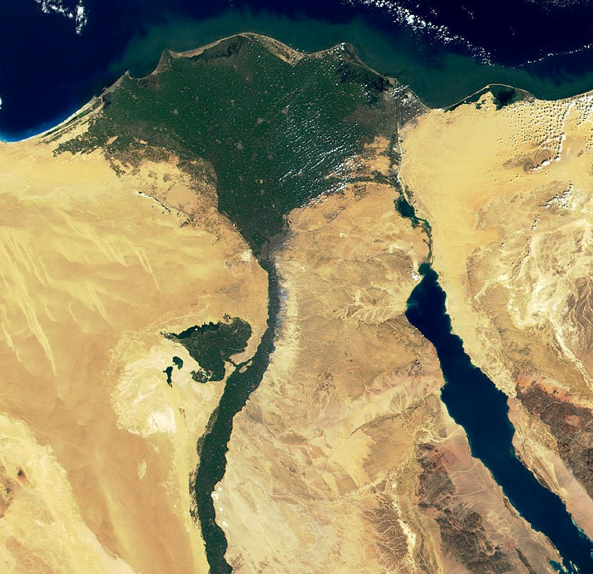
A
C
I
Modern Cairo
is across the river
from ancient Memphis
(where the most famous
pyramids are located).

Slide 76
The ancient port
of Alexandria
is also right at the edge
of the fertile Nile Delta.
A
C
I

Slide 77
The ancient port
of Alexandria
is also right at the edge
of the fertile Nile Delta.
A
It was named for
Alexander the Great,
and it was one
of the largest cities
in the entire world
during the time
of the Roman Empire.
C
I

Slide 78
A
Conclusion
If you look at history
as the result of decisions
that people made
in their environment,
it engages more “brainpower,”
and is much easier to remember.
C
I

Slide 79
The location
of nearly every
important place
in the ancient world
makes sense when
you look at the world
through their eyes,
in their time.

Slide 80
The location
of nearly every
important place
in the ancient world
makes sense when
you look at the world
through their eyes,
in their time.
And the principles that guided their decisions
can still help us make decisions today.
That’s what social studies is about!

Slide 82
Copyright 2019, Phil Gersmehl
Teachers who saw this presentation at a workshop
or downloaded it from our internet site have permission
to make a copy on their own computers for these purposes:
1. to help them review the workshop,
2. to show the presentation in their own classrooms, at sessions they present at teacher conferences, or to administrators in their own school or district,
3. to use individual frames (with attribution) in their own class or conference presentations.
For permission for any other use,
including posting frames on a personal blog or uploading to any network or website that can be accessed from outside your school,
contact pgersmehl@gmail.com, carol.gersmehl@gmail.com

