Slide 1
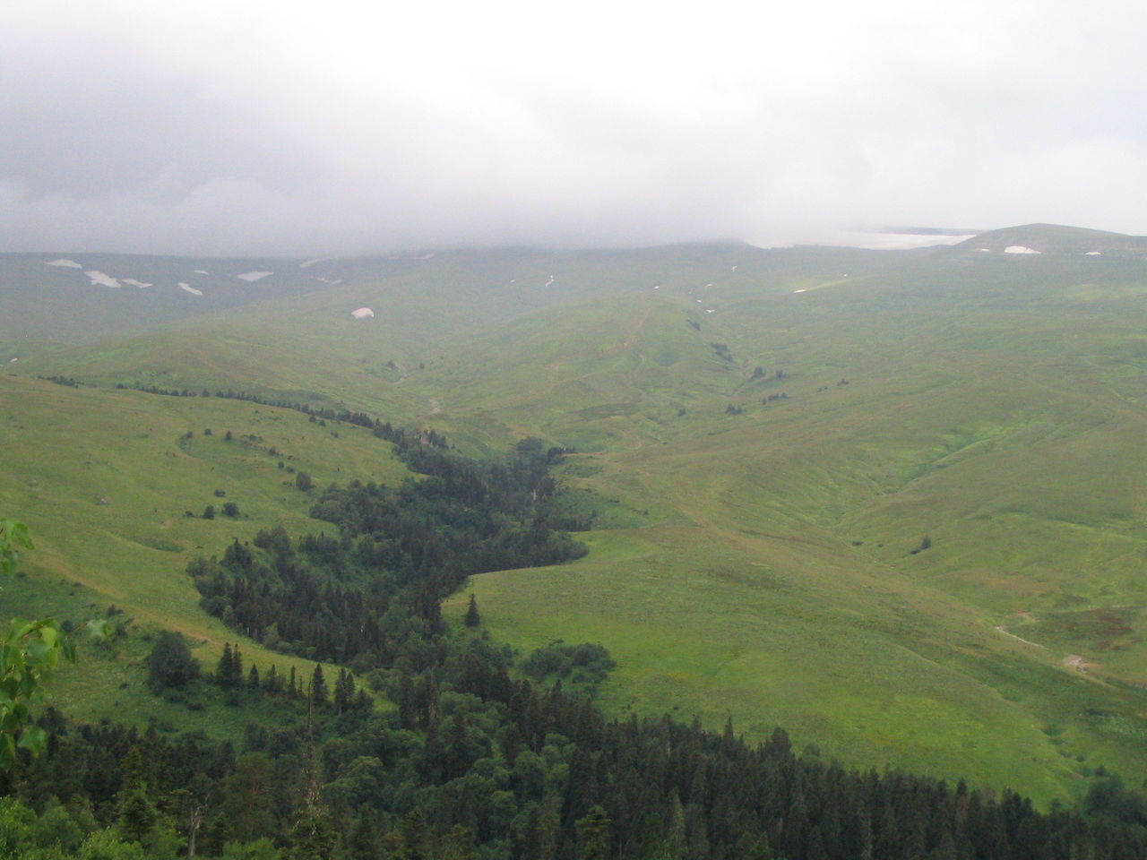
Origin
of the
Indo-European
Family of Languages

Slide 2
This photo shows
one edge of the
vast “steppes”
(grasslands)
of central Asia.

Slide 3
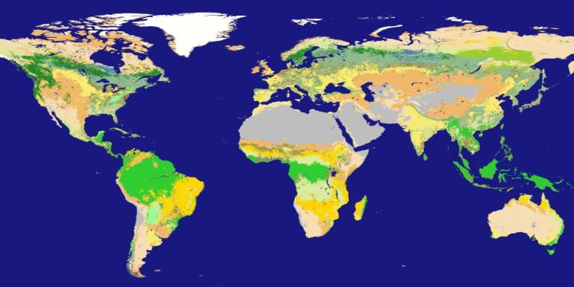
The grasslands are
north of the Black
and Caspian Seas
They extend across Eurasia
from southeast Europe
to northern China.

Slide 4
The climate in central Asia
is cold and usually dry,
like central Canada
(which is also a grassland).
The climate in this region
is cold and usually dry,
like central Canada
(which is also a grassland).

Slide 5
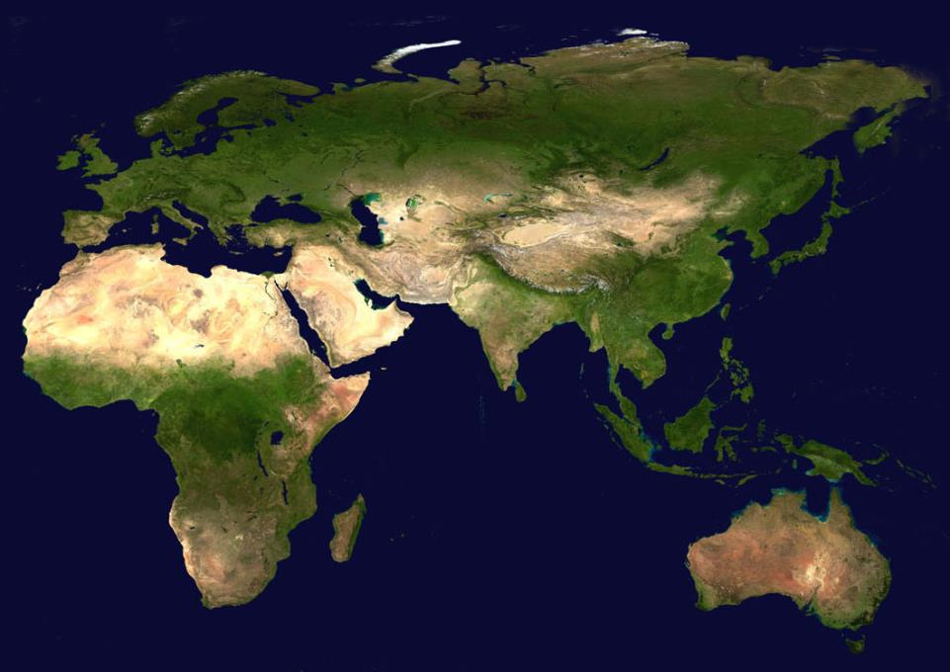
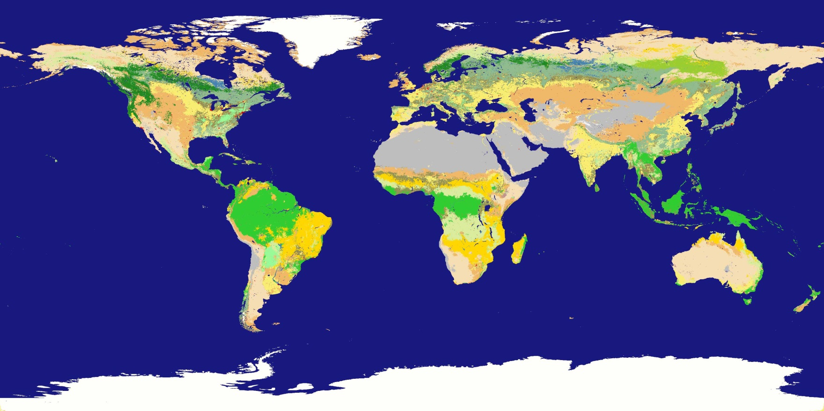
A satellite image
taken in spring
shows the steppes
with a light green color.

Slide 6
Forest
Desert
Desert
A satellite image
taken in spring
shows the steppes
with a light green color.
Forest

Slide 7
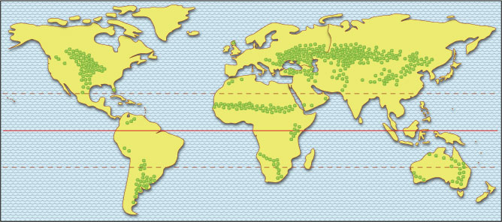
The extent of the grasslands is
much easier to see on a simpler map.
They are much larger in central Eurasia
than in North America.

Slide 8
Question:
Why are we concerned about
grasslands in the middle of Eurasia?

Slide 9
Question:
Why are we concerned about
grasslands in the middle of Eurasia?
Answer: because our language
and a lot of important inventions
came from this part of the world.

Slide 10
Question:
Why are we concerned about
grasslands in the middle of Eurasia?
Answer: because our language
and a lot of important inventions
came from this part of the world.
PS. That’s true,
whether we speak
English, Spanish,
Swedish, Italian,
German, Russian,
Greek, Persian,
Hindi, Bengali,
or many others.

Slide 11
Question:
Why are we concerned about
grasslands in the middle of Eurasia?
Answer: because our language
and a lot of important inventions
came from this part of the world.
PS. That’s true,
whether we speak
English, Spanish,
Swedish, Italian,
German, Russian,
Greek, Persian,
Hindi, Bengali,
or many others.
How can this be?
How can this be?

Slide 12
7000 years ago,
some people lived
in forested valleys
near the edges
of vast grasslands.

Slide 13
7000 years ago,
some people lived
in forested valleys
near the edges
of vast grasslands.
in places
like this!

Slide 14
They lived
in wooden houses,
and they ate fish
from the streams,
seeds and fruits
from the trees,
and deer and horses
(which they hunted
in the woods and grasslands).

Slide 15
For a thousand years,
their population grew.
Hunting became
a lot harder, after
they killed most of
the big, slow animals!

Slide 16
For a thousand years,
their population grew.
Hunting became
a lot harder, after
they killed most of
the big, slow animals!
The people learned
how to keep horses
for milk and meat
when their hunting
was not successful.

Slide 17
Population kept growing.
Hunting and herding
became harder,
as the grass
was overgrazed.

Slide 18
Population kept growing.
Hunting and herding
became harder,
as the grass
was overgrazed.
The people learned
how to ride horses.
They invented things
like ropes and bridles
to control the horses.

Slide 19
Population kept growing.
Hunting and herding
became harder,
as the grass
was overgrazed.
The people learned
how to ride horses.
They invented things
like ropes and bridles
to control the horses.
This allowed them
to go much farther
away from the
river valleys.

Slide 20
All of this land became available for horse herding.

Slide 21
All of this land became available for horse herding.
The people began
to sell horses
to people
in other regions.

Slide 22
Then the climate turned colder.

Slide 23
Then the climate turned colder.
Some of the people moved
south of the Black Sea.

Slide 24
Then the climate turned colder.
Some of the people moved
south of the Black Sea.
Much later, some of them
became known as the Hittites.
We’ll see them again,
a little later.

Slide 25
Then the climate turned colder.
Some of the people moved
south of the Black Sea.
Others moved far to the east,
across some high mountains.

Slide 26
Then the climate turned colder.
Some of the people moved
south of the Black Sea.
Others moved far to the east,
across some high mountains.
These people, called the Tocharians,
lived as hunters, herders, and traders for a long time.
Then they mostly disappeared.

Slide 27
Then the climate turned colder.
Some of the people moved
south of the Black Sea.
Others moved far to the east,
across some high mountains.
These people, called the Tocharians,
lived as hunters, herders, and traders for a long time.
Then they mostly disappeared.
Some of them may have joined the Xiongnu people.
They were horse-riding warriors who sometimes attacked the Chinese.
Still later, others may have joined the Mongols.
They were horse-riding warriors who attacked China and Europe.

Slide 28
Then the climate turned colder.
Some of the people moved
south of the Black Sea.
Others moved far to the east,
across some high mountains.
Meanwhile,
back in the steppe region,
. . .
These people, called the Tocharians,
lived as hunters, herders, and traders for a long time.
Then they mostly disappeared.
Some of them may have joined the Xiongnu people.
They were horse-riding warriors who sometimes attacked the Chinese.
Still later, others may have joined the Mongols.
They were horse-riding warriors who attacked China and Europe.

Slide 29
About 3500 BCE,
the climate got warmer,
and the people discovered
how to build wagons.

Slide 30
About 3500 BCE,
the climate got warmer,
and the people discovered
how to build wagons.
Wagons let them
go even farther
away from the
river valleys.

Slide 31
About 3500 BCE,
the climate got warmer,
and the people discovered
how to build wagons.
Wagons let them
go even farther
away from the
river valleys.
They could camp
in their wagons
and stay away
for weeks at a time.

Slide 32
The population
grew very rapidly
for more than 500 years.
The steppe people spread
in several directions.

Slide 33
It’s a long story,
but we’ll tell it
very quickly.
Then we’ll put it
on a map.

Slide 34
Here’s the story:
Some people moved northwest.
They became German, Dutch,
Danish, Swedish, Norwegian, . . .
Some went west. They became
Celts, Scots, Irish, Welsh, Romans,
Spanish, French, Italian, Romanian, . . .
Some went north. They became
Ukrainian, Russian, Polish, . . .
Later, some went southwest.
They became Greek, Serbian, . . .
Still later, some went southeast.
They became Persian, Indic, . . .

Slide 35
Here’s the story:
Some people moved northwest.
They became German, Dutch,
Danish, Swedish, Norwegian, . . .
Some went west. They became
Celts, Scots, Irish, Welsh, Romans,
Spanish, French, Italian, Romanian, . . .
Some went north. They became
Ukrainian, Russian, Polish, . . .
Later, some went southwest.
They became Greek, Serbian, . . .
Still later, some went southeast.
They became Persian, Indic, . . .
In short,
they became known
by many other names
from Ireland to Russia,
and Spain to India.

Slide 36
Let’s stop a minute,
and ask a question:
If the steppe people were so important,
why didn’t we read about them
when we were studying
the ancient river civilizations?

Slide 37
There are three reasons:

Slide 38
There are three reasons:
1. Until 1990, this area was controlled
by the Soviet Union – it was hard for other archaeologists to study there.

Slide 39
There are three reasons:
1. Until 1990, this area was controlled
by the Soviet Union – it was hard for other archaeologists to study there.
2. This is a contested part of the world.
Chechnya, Crimea, Ukraine – all places where people have been fighting.

Slide 40
There are three reasons:
1. Until 1990, this area was controlled
by the Soviet Union – it was hard for other archaeologists to study there.
2. This is a contested part of the world.
Chechnya, Crimea, Ukraine – all places where people have been fighting.
3. In the old days, these people
built temporary houses made of wood
and lived in wagons part of the year.

Slide 41
There are three reasons:
1. Until 1990, this area was controlled
by the Soviet Union – it was hard for other archaeologists to study there.
2. This is a contested part of the world.
Chechnya, Crimea, Ukraine – all places where people have been fighting.
3. In the old days, these people
built temporary houses made of wood
and lived in wagons part of the year.
How much “archaeological record”
would that leave for us to study?

Slide 42
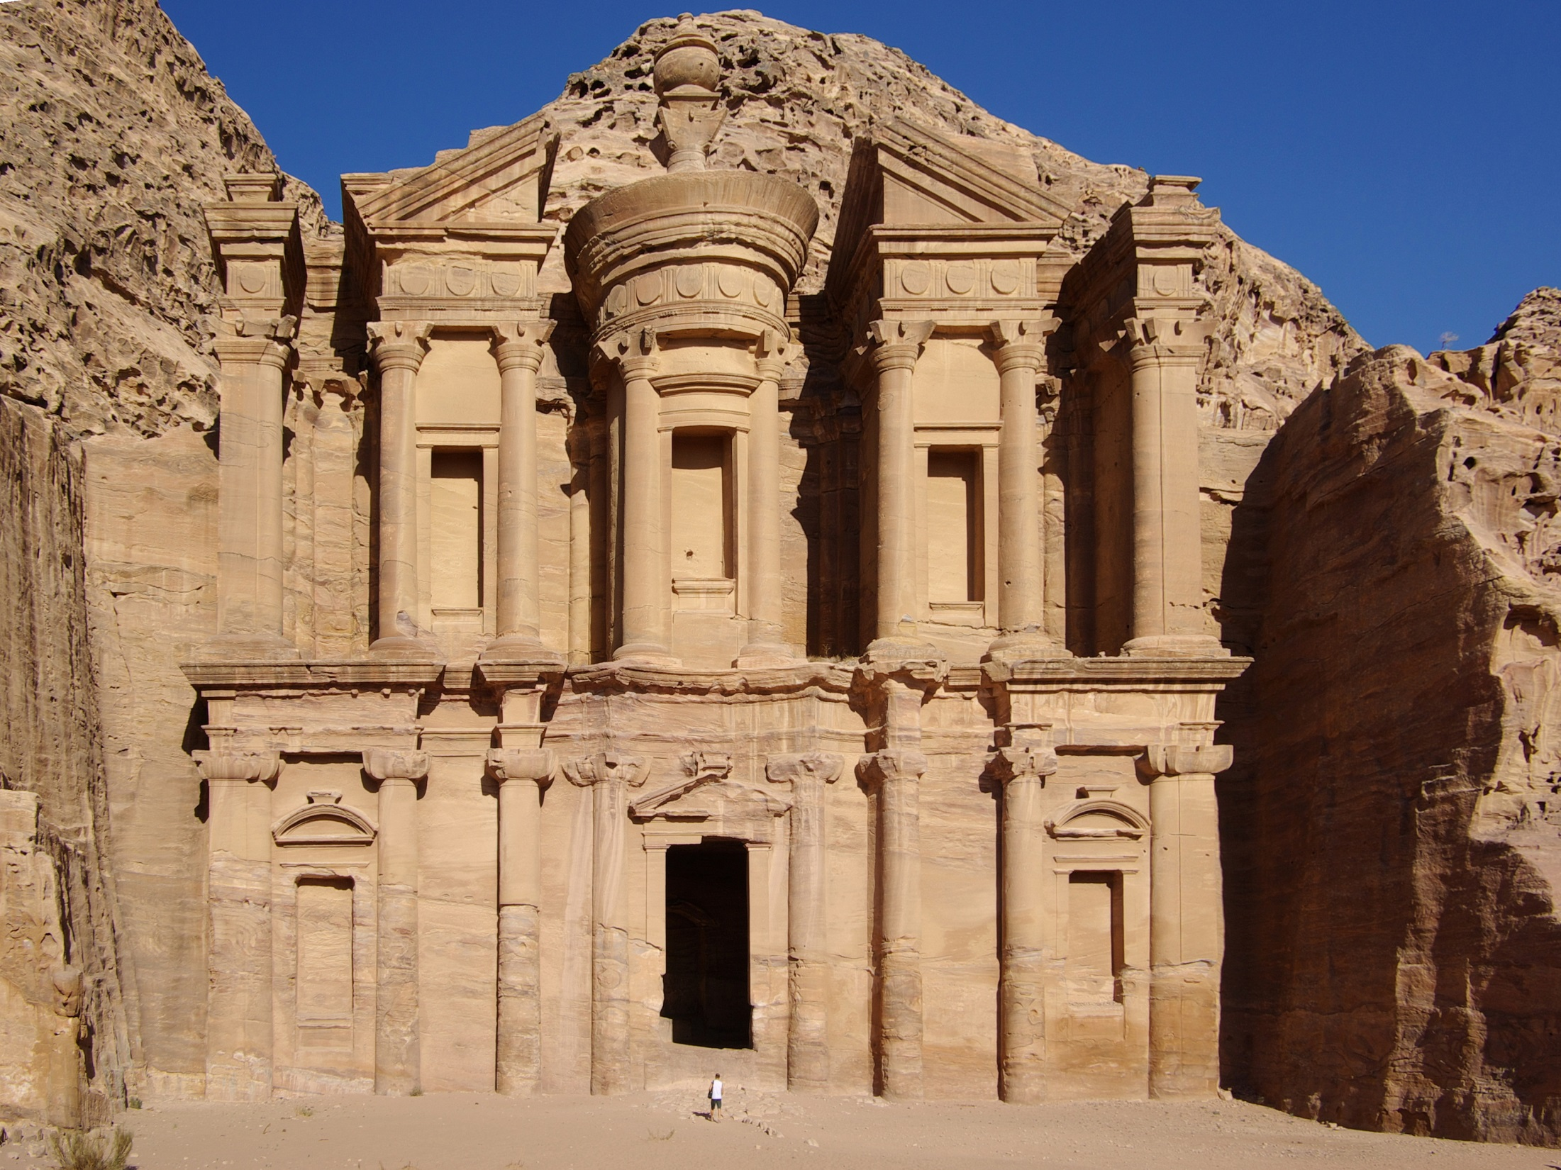
They did not have the tools
to carve big buildings
and temples out of stone.

Slide 43
They did not have the tools
to carve big buildings
and temples out of stone.
Their environment
didn’t even have stone!

Slide 44
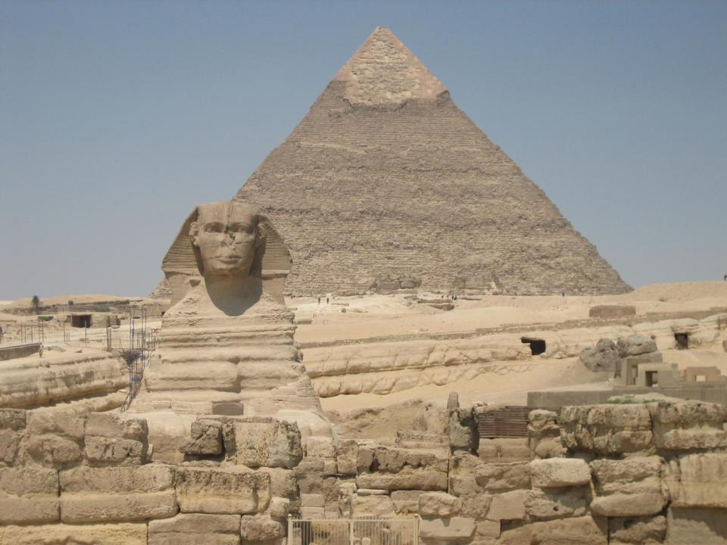
They never
tried to built
a big pyramid
“to last forever.”

Slide 45
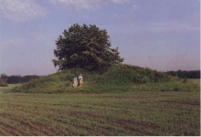
The main things
they left for us to see
are grave mounds,
called kurgans.

Slide 46
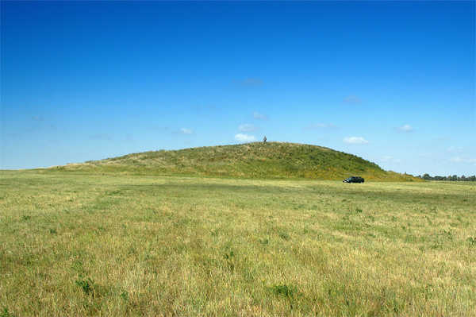
Some kurgans
are very large,
but it is very easy
to think that this
is just a natural hill.

Slide 47
Some kurgans
are very large,
but it is very easy
to think that this
is just a natural hill.
Slowly, archaeologists
have been studying
what these people buried
in their kurgan graves –
horses, weapons, pottery,
jewelry, and other things.

Slide 48
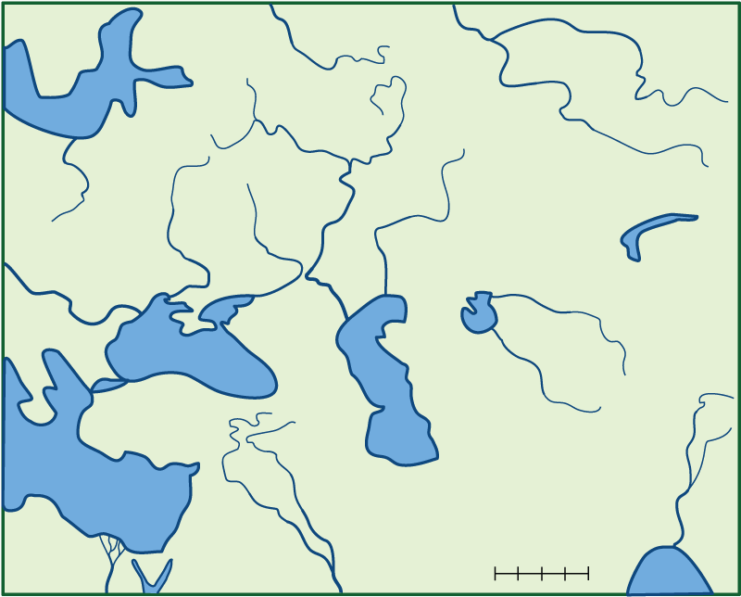
Let’s use a map
to trace the spread
of just one thing –
horse-drawn chariots.

Slide 49
Here’s a problem right away –
the place is hard to recognize
on a simple map like this.

Slide 50
This is the
Black Sea.

Slide 51
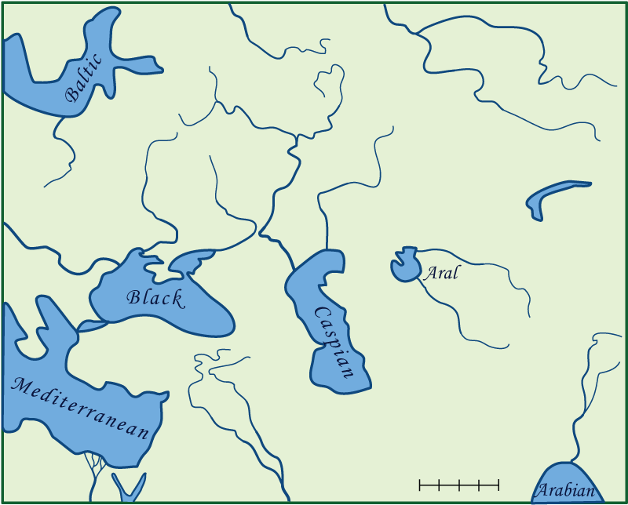
Here is the Caspian Sea.

Slide 52
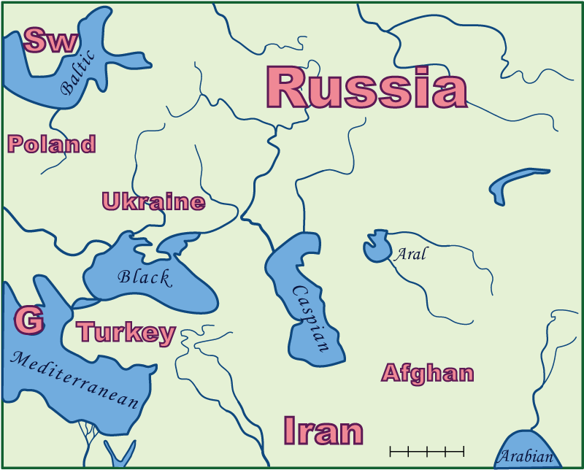
Much of the area
is part of southern Russia

Slide 53
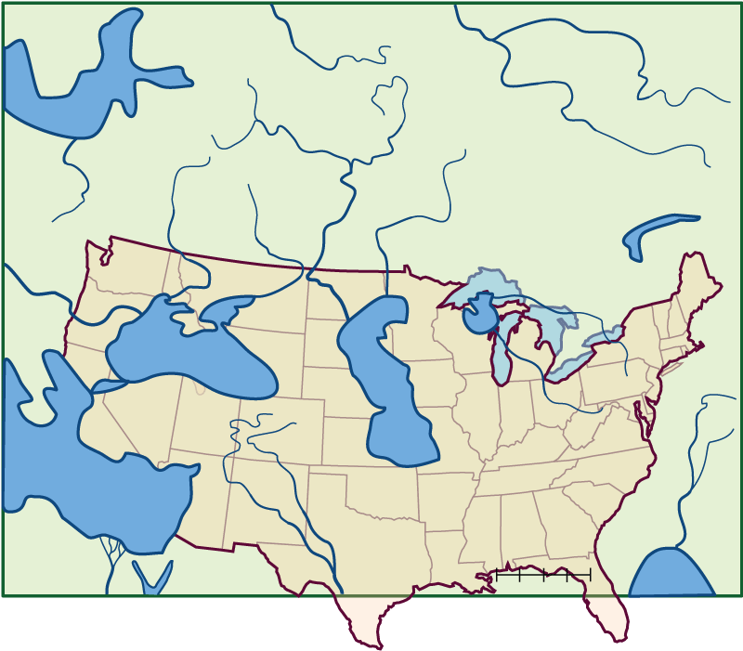
The entire area is larger
than the United States.

Slide 54
The entire area is larger
than the United States.
And most of it has weather
that is more like Canada.

Slide 55
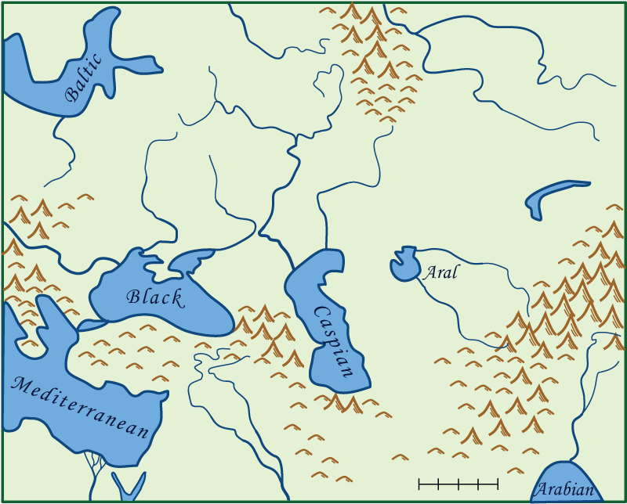
There are some mountains.
These are the Ural Mountains.

Slide 56
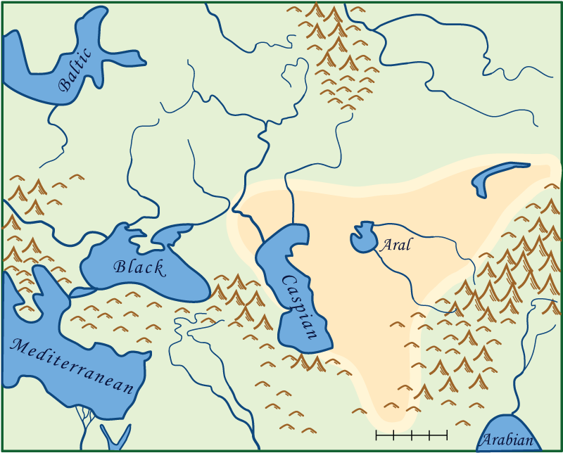
Between some mountains
is a large and very dry desert,
with some salty lakes in it
(like in Utah and Nevada).

Slide 57
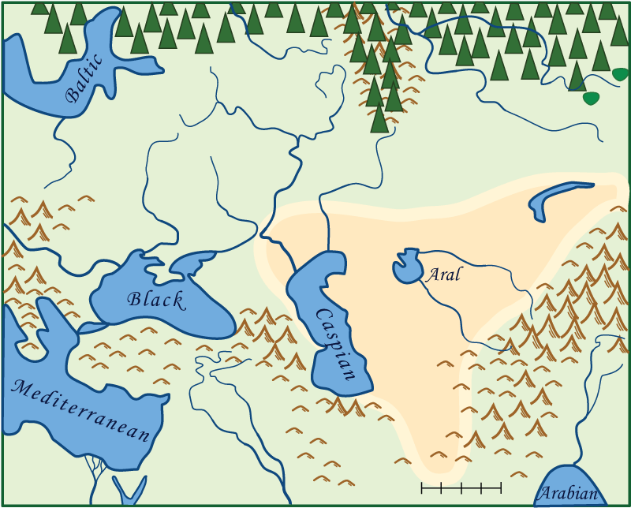
To the north
is a vast, cold forest
(like in northern Canada).

Slide 58
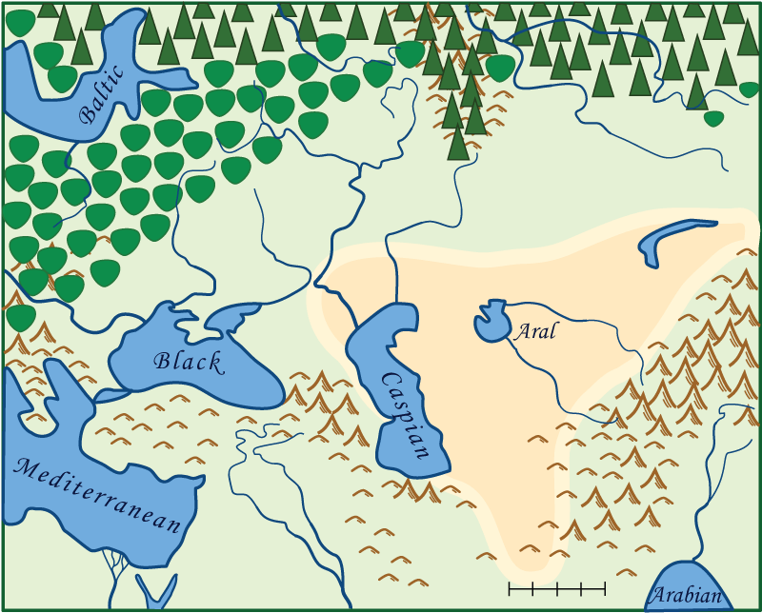
To the northwest
is a warmer hardwood forest
(like in most of Michigan).

Slide 59
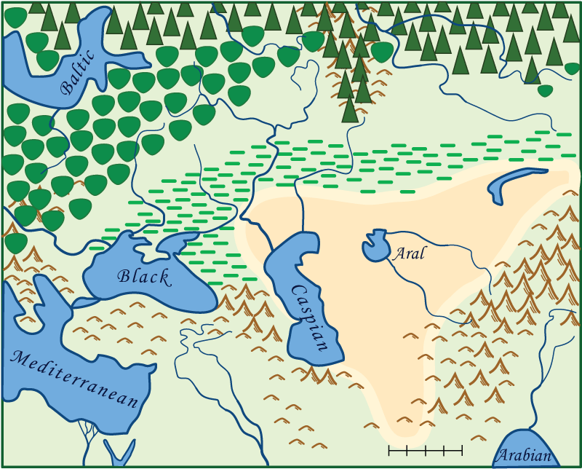
Between the desert and the forest
is the grassland (the steppe).

Slide 60
About 2000 BCE, the steppe people
who lived here invented chariots.

Slide 61
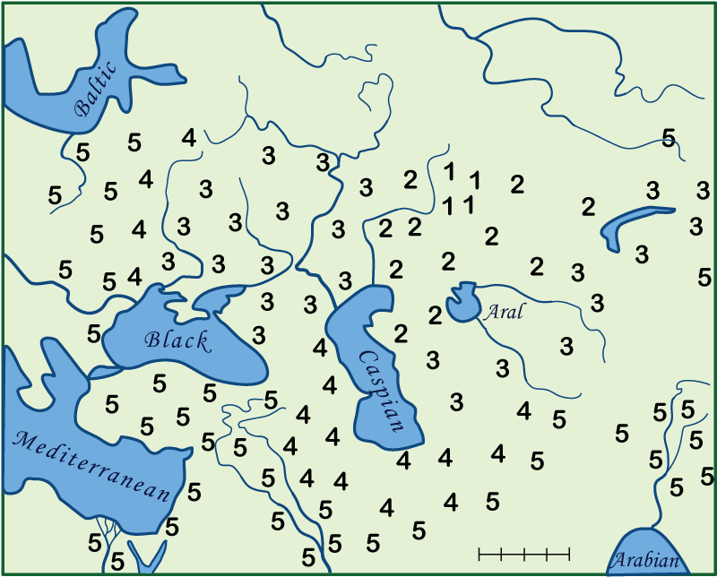
On your activity map,
draw a line around all the 1’s.

Slide 62
Chariots were here in about 2100 BCE.
Color that area a fairly dark color.
Then draw a line around the 2’s and 1’s.

Slide 63
This is where chariots spread
within the first 50-100 years.
Color that area a lighter color.

Slide 64
Continue with the 3’s, 4’s, and 5’s.
They show where chariots spread later.

Slide 65
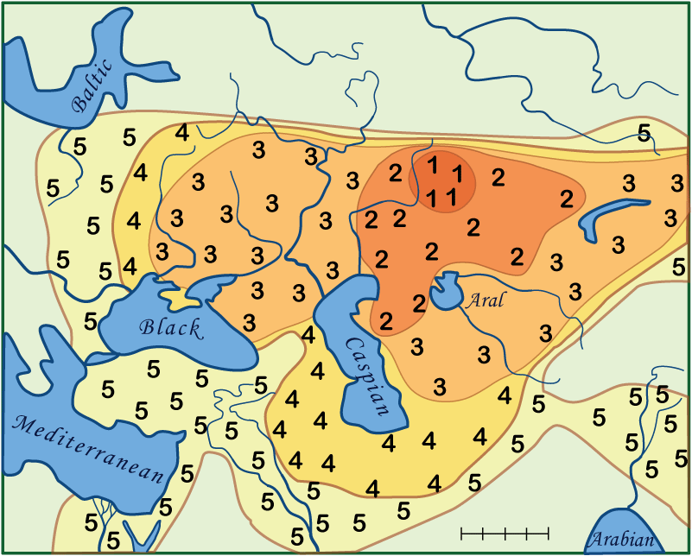
When you are done, your map
should look something like this.

Slide 66
What does this map study tell us?
The people who started as hunters
near the edges of the vast steppes
were the ones who invented war chariots.

Slide 67
What does this map study tell us?
The people who started as hunters
near the edges of the vast steppes
were the ones who invented war chariots.
The idea spread quickly
to people as far away
as Egypt, Mesopotamia,
and even parts of China.

Slide 68
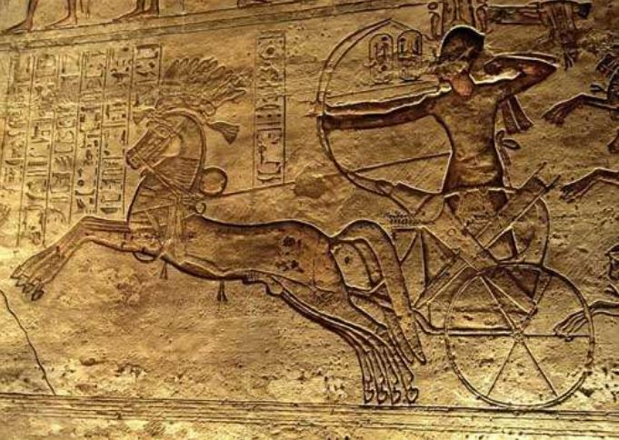
So what should you think
when you see a picture like this?
It’s an Egyptian stone carving
that shows the Battle of Kadesh.
In this battle, the Egyptian Pharaoh
Ramesses II fought the Hittites.

Slide 69
You now know two important facts:

Slide 70
You now know two important facts:
1. The Hittites originally came
from the steppes (grasslands)
north of the Black Sea.

Slide 71
You now know two important facts:
1. The Hittites originally came
from the steppes (grasslands)
north of the Black Sea.
2. Both sides in the Battle of Kadesh
used war chariots, which were
invented by the steppe people.

Slide 72
But that is not the only thing
that the steppe people invented.
Their language spread with them,
as they moved to other places.
There is another map activity
that shows how they spread.

Slide 73
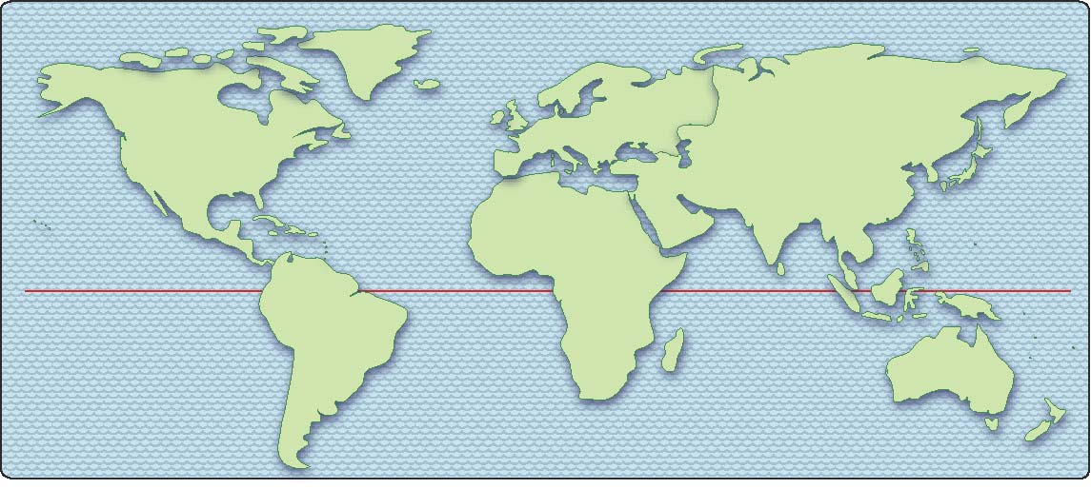
Here is what we mean by a spreading language.
In ancient Indo-European, wheel = rot-eh, axle = ak*s

Slide 74
Here is what we mean by a spreading language.
In ancient Indo-European, wheel = rot-eh, axle = ak*s
Old German
rad ahsa
Baltic
rati asis
As people
moved away,
they kept most
of their words,
but the way
they said them
slowly changed.
Old Russian
ratis asis
Old Latin
radi axis
Old Greek
roda akso
Old Persian
ratha aksis
Old Indic
ratha aksas

Slide 75
Here is what we mean by a spreading language.
In ancient Indo-European, wheel = rot-eh, axle = ak*s
Old German
rad ahsa
Baltic
rati asis
Old Russian
ratis asis
And in America, we say
wheel and axle
but we also say
rotate axis
rotary axial
radius
radial tire
Old Latin
radi axis
Portuguese roda eixe
Old Greek
roda akso
Spanish
ruedo eje
Old Persian
ratha aksis
Old Indic
ratha aksas
French
roue axe

Slide 76
Conclusion
Many modern languages
(as shown on the maps)
started as one old language
spoken by some horse-herders
in the steppes of Central Asia.
Groups of people moved away,
and their languages slowly changed.
Separate groups added words
(like pizza, television, iPhone, . . .),
changed some meanings
(like hard rock, gay, tweet, . . . ),
and changed some spelling
(like colour -> color).
Eventually, they no longer
spoke the same language!

Slide 77
For more archaeological information,
see The Horse, the Wheel, and Language
by David W. Anthony.
For a completely different line of evidence
from genetics (DNA), see
“Massive migration from the steppe was
a source for Indo-European languages in Europe”
in Nature, 2015; 522(7555):207-211

Slide 78
Copyright 2018, Phil Gersmehl
Teachers who saw this presentation at a workshop
or downloaded it from our internet site have permission
to make a copy on their own computers for these purposes:
1. to help them review the workshop,
2. to show the presentation in their own classrooms, at sessions they present at teacher conferences, or to administrators in their own school or district,
3. to use individual frames (with attribution) in their own class or conference presentations.
For permission for any other use,
including posting frames on a personal blog or uploading to any network or website that can be accessed from outside your school,
contact pgersmehl@gmail.com

