Slide 1
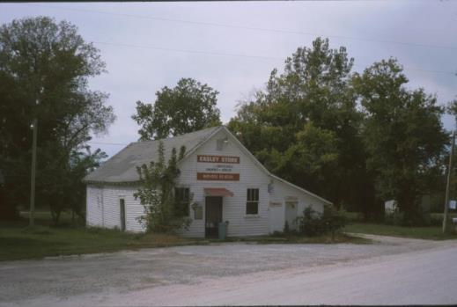
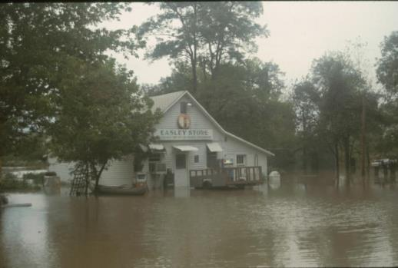
HOW could A flood be good?

Slide 2
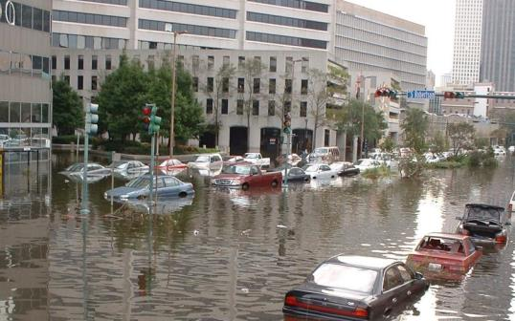
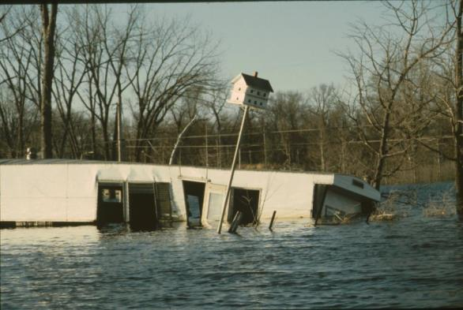
Floods
can damage
property.

Slide 3
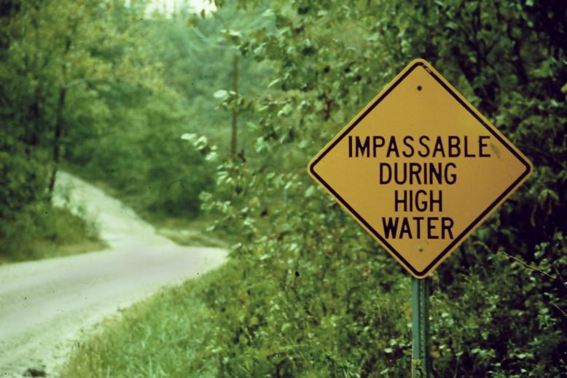
Floods can
interfere with
transportation.

Slide 4
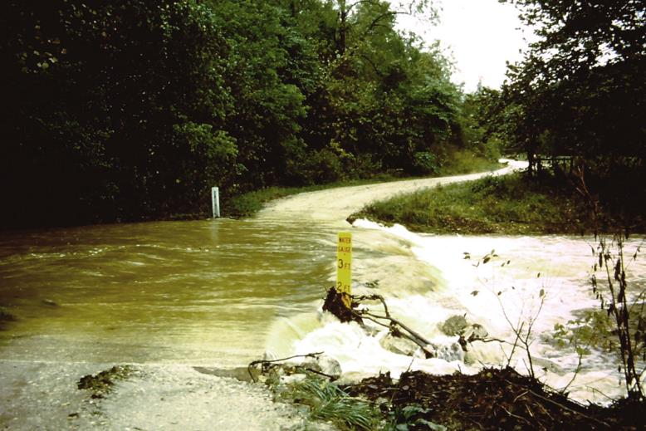
Floods can
stop traffic
on rural roads.

Slide 5
Floods can
stop traffic on
major highways.

Slide 6
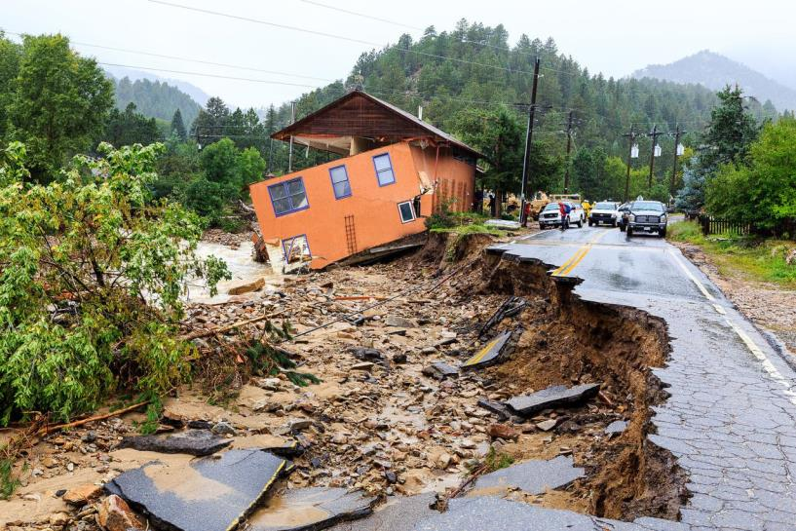
Floods
can cause
many kinds
of damage.

Slide 7
INTERESTING FACT
Floods near rivers are so common
that highway engineers usually try
to build bridges a little higher
than the roads that use them.
That way, a really big flood
just destroys some pavement
instead of the expensive bridge.

Slide 8
Floods can
damage crops
if they happen
at critical times.

Slide 9
Floods can
interfere with harvest and
reduce yields.

Slide 10
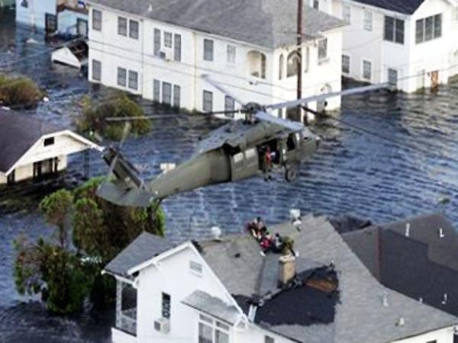
Floods can
even pose
a danger to
human life.

Slide 11
So how
can floods
be good?

Slide 12
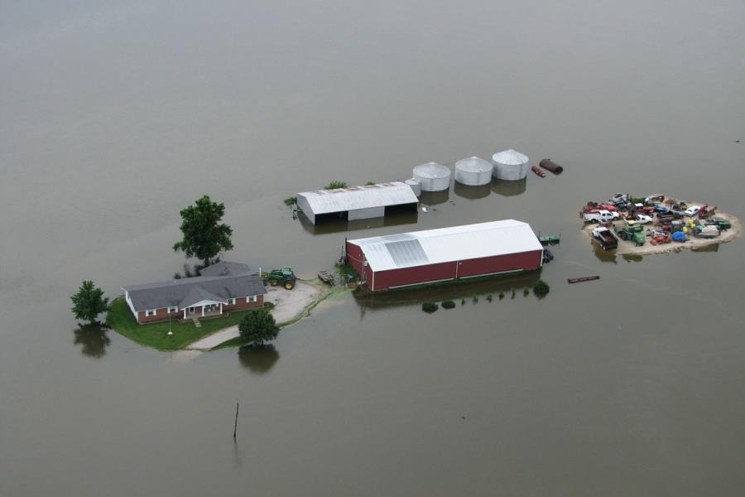
Floods can kill
many weeds, snakes,
rats, and insect pests
(and drive others away for awhile).

Slide 13
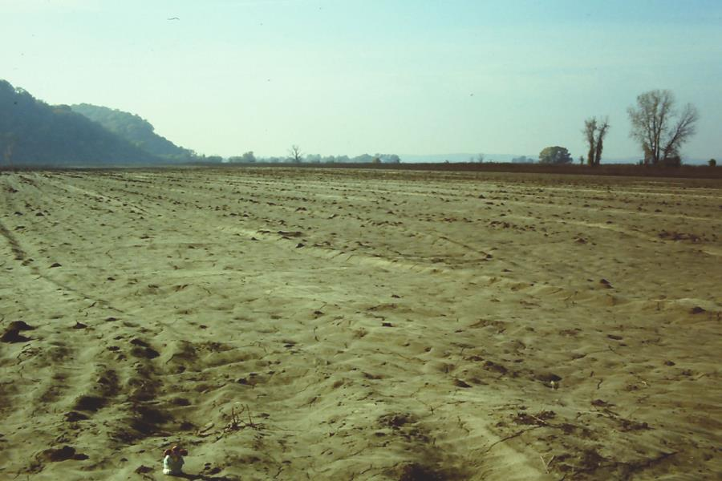
Flood water usually carries a lot of mud.
This sediment is left
on the floodplain
after the flood.

Slide 14
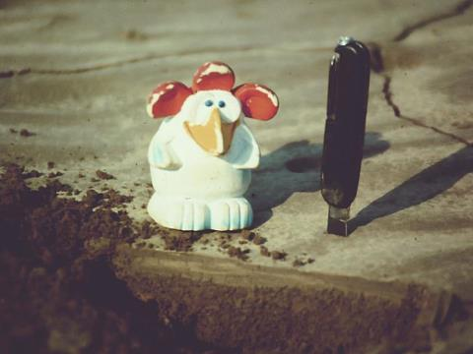
If a river floods
every two years,
and adds half an inch
of new soil on the land
after every flood . . .
NEW SOIL

Slide 15
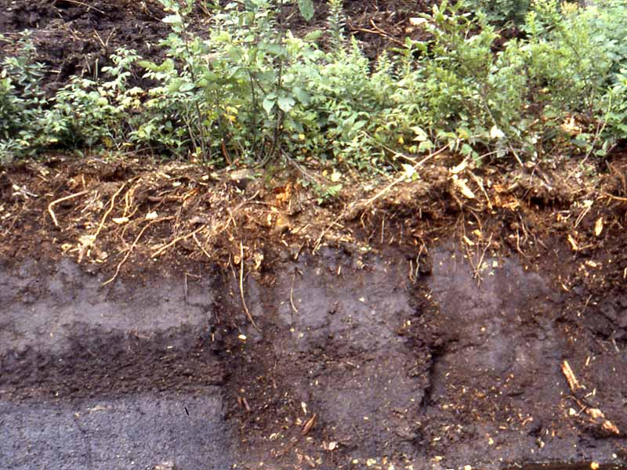
. . . over time, it can build
a thick layer of “new” soil.
This soil is usually fertile,
but that is not
its biggest benefit.

Slide 16
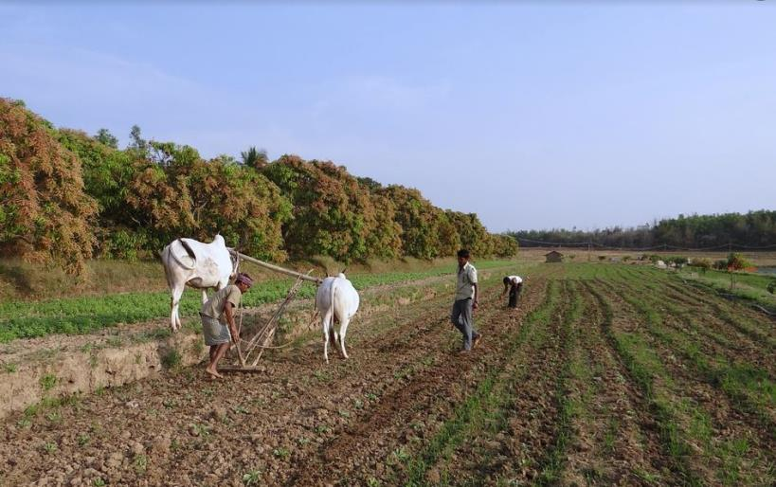
The real benefit
is the fact that floods
tend to make the soil soft
and easy to work.
(Easy enough for a wooden plow
and two skinny cows.)

Slide 17
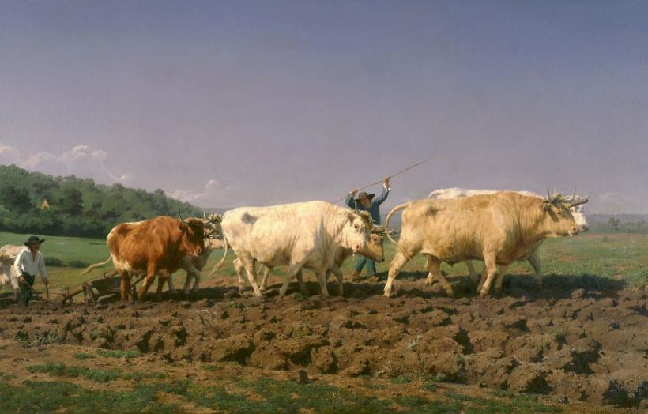
Note that it takes
six strong animals
to do the same job
on this hard upland soil.

Slide 18
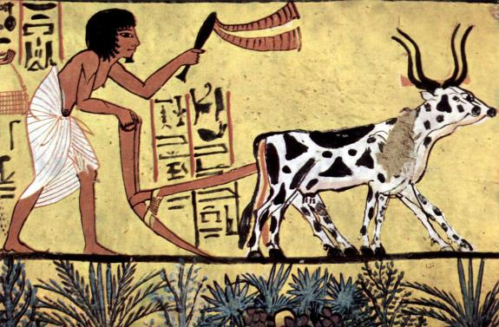
Note that it takes
six strong animals
to do the same job
on this hard upland soil.
Flood-softened soil
was very important
in early civilizations,
before tractors
were invented.

Slide 19
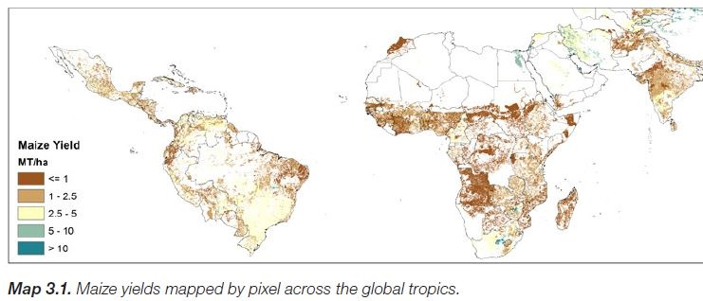
It is the combination of conditions
(slope, water, fertility, and workability)
that allows a place
to produce a lot of food.

Slide 20
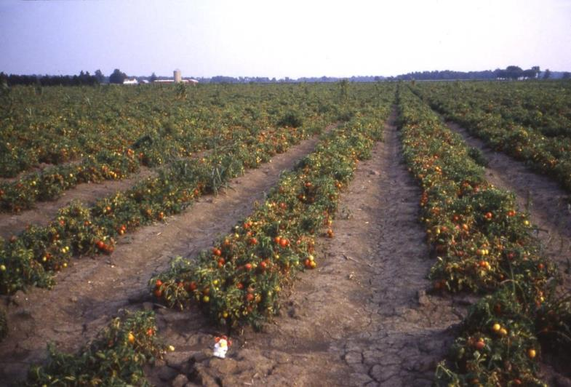
Flat floodplains
are still considered
prime farmland
in many parts
of the world.

Slide 21
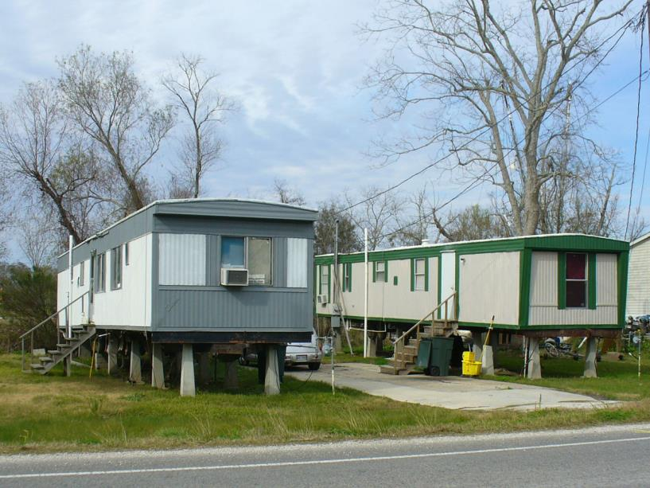
People who live
on floodplains have to deal with the fact that the land
can be under water
every few years.

Slide 22
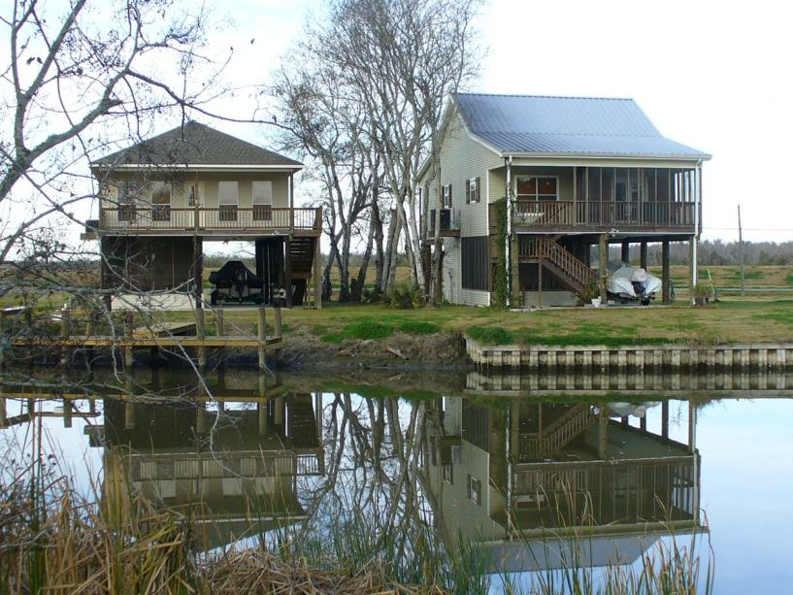
One useful approach
is to build your house
up on stilts
(and store your boat
underneath the house).

Slide 23
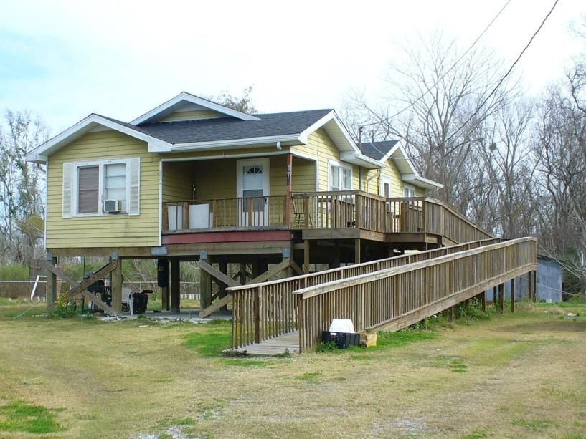
A house on stilts
may be safe from floods,
but it can also be hard to use
(especially if you need a wheelchair!)

Slide 24
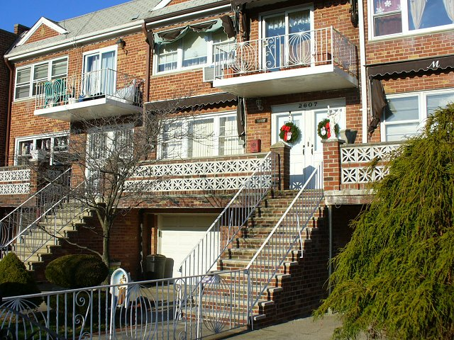
Near the ocean in places
like New York City,
people build apartments
up high, to make them
safer during hurricanes.

Slide 25
These apartments stayed dry even during Hurricane Sandy.
Go to https://www.youtube.com/watch?v=wtb-OK4bEs4
to see a news report about that storm.
Near the ocean in places
like New York City,
people build apartments
up high, to make them
safer during hurricanes.

Slide 26
S U M M A R Y
Can you remember three bad things
and three good things about floods?

Slide 27
S U M M A R Y
Can you remember three bad things
and three good things about floods?
BAD
damages property
hinders transportation
can hurt people

Slide 28
S U M M A R Y
Can you remember three bad things
and three good things about floods?
BAD
damages property
hinders transportation
can hurt people
GOOD
can kill some pests
often adds new soil
makes soil softer

Slide 29
S U M M A R Y
Can you remember three bad things
and three good things about floods?
Whether a given flood is bad, good, or in between
depends on where the flood happens
and how well the people there
are prepared to deal with it.
BAD
damages property
hinders transportation
can hurt people
GOOD
can kill some pests
often adds new soil
makes soil softer

Slide 31
Copyright 2019, Phil Gersmehl
Photo credits FEMA, USGS, CC0 Public Domain, and PGersmehl.
Teachers who saw this presentation at a workshop
or downloaded it from our internet site have permission
to make a copy on their own computers for these purposes:
1. to help them review the workshop,
2. to show the presentation in their classrooms or to colleagues or administrators,
3. to use individual frames (with attribution) in their own class or conference presentations.
For permission for any other use,
including posting frames on a personal blog or uploading to any network or website,
contact pgersmehl@gmail.com

