Slide 1
ANCIENT CITIES
and
TEMPERATURES

Slide 2
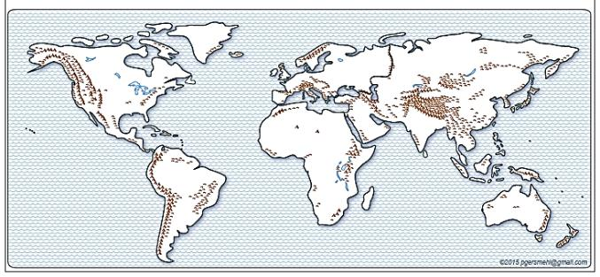
Background for Teachers
Content focus: Ancient cities
Purposes:
1. to increase skill in finding regions and patterns on maps
2. to increase skill in describing spatial associations {examples of human-environment interaction}
2

Slide 3
We will use simple maps about world history and geography.
Specifically, we will:

Slide 4
We will use simple maps about world history and geography.
Specifically, we will:
1. Use the map title and map key to talk about the map topic
(the focus of a thematic map, the kinds or amounts of something) in different parts of the world)

Slide 5
We will use simple maps about world history and geography.
Specifically, we will:
1. Use the map title and map key to talk about the map topic
(the focus of a thematic map, the kinds or amounts of something) in different parts of the world)
2. Use “location” phrases to describe where things are located
(inside, in the middle, in a corner, on the edge; on the north, south, west, or east side, in a line, in a region, close to, far from).

Slide 6
We will use simple maps to work on the following GLCEs.
6 – G1.1.1
Use maps . . . to investigate the world at [several] scales.
6 – G1.1.2
Draw a sketch map or add information to an outline map of the world.
6 – G1.3.1
Use the fundamental themes of geography
(location, place, human environment interaction, movement, region)
to describe regions or places on earth.
6 – G3.2.2
Explain why some regions provide greater opportunities for humans.
7 – H1.2.1
Explain how historians use a variety of information to explore the past.
7 – W2.1.3
Use historical and modern maps to locate, describe, and analyze . . . permanent settlements and the development of early civilizations.

Slide 7
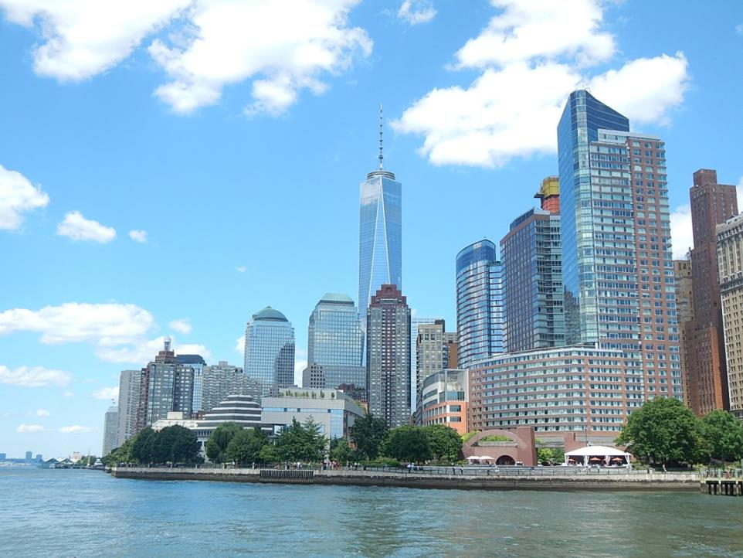
A Modern “Mega-city”
Lower Manhattan (“downtown”), New York City, 2015

Slide 8
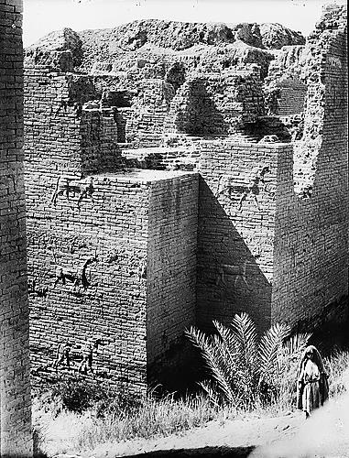
An Ancient “Mega-City” - 575 BCE
Ruins of the ancient Ishtar Gate in Babylon, Mesopotamia.

Slide 9
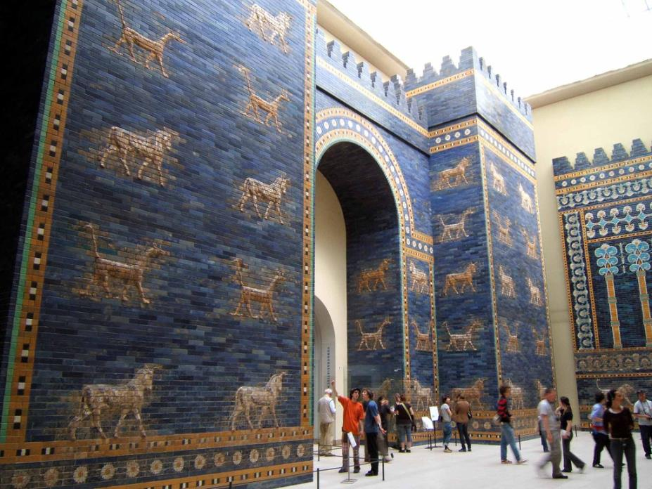
Restoration of the Ishtar Gate in Berlin, Germany.

Slide 10
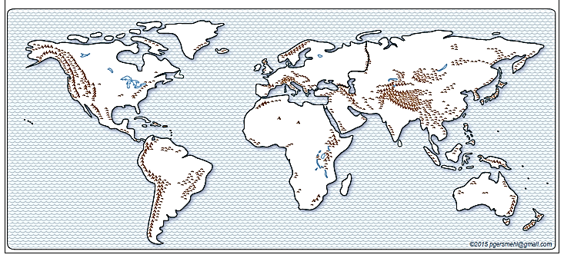
Where were the really big ancient cities?

Slide 11
Where were the really big ancient cities?
(Where did people choose to live in the past?)

Slide 12
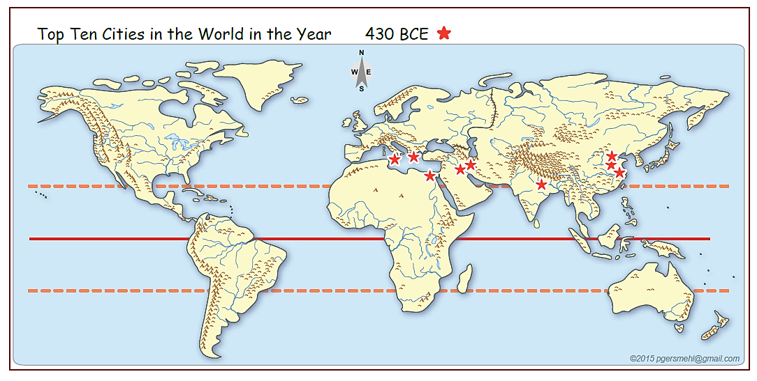
Very long ago: 430 BCE

Slide 13
Look for a Region, or a Pattern
Very long ago: 430 BCE

Slide 14
Look for a Region, or a Pattern
Very long ago: 430 BCE
Region: Draw a box around a group of similar places. Describe the location of the box.

Slide 15
Look for a Region, or a Pattern
Very long ago: 430 BCE
A big region
Region: Draw a box around a group of similar places. Describe the location of the box.

Slide 16
Look for a Region, or a Pattern
Very long ago: 430 BCE
A smaller region
Region: Draw a box around a group of similar places. Describe the location of the box.

Slide 17
Look for a Region, or a Pattern
Very long ago: 430 BCE
Region: Draw a box around a group of similar places. Describe the location of the box.
Pattern: Are the ancient cities spread evenly throughout the world?
If not, are they arranged in a line? Describe the location of the line.

Slide 18
Look for a Region, or a Pattern
Long ago: 430 BCE
Very long ago: 430 BCE
Most of the cities
are close to this line.
Region: Draw a box around a group of similar places. Describe the location of the box.
Pattern: Are the ancient cities spread evenly throughout the world?
If not, are they arranged in a line? Describe the location of the line.

Slide 19
Look for a Region, or a Pattern
Long ago: 430 BCE
Very long ago: 430 BCE
Tropic N
Equator
Tropic S
Hint: Using the names of key lines
of latitude can make it much easier
to describe the position of a region
or the line that summarizes a pattern.
Region: Draw a box around a group of similar places. Describe the location of the box.
Pattern: Are the ancient cities spread evenly throughout the world?
Are they arranged in a line? If so, describe the location of the line.

Slide 20
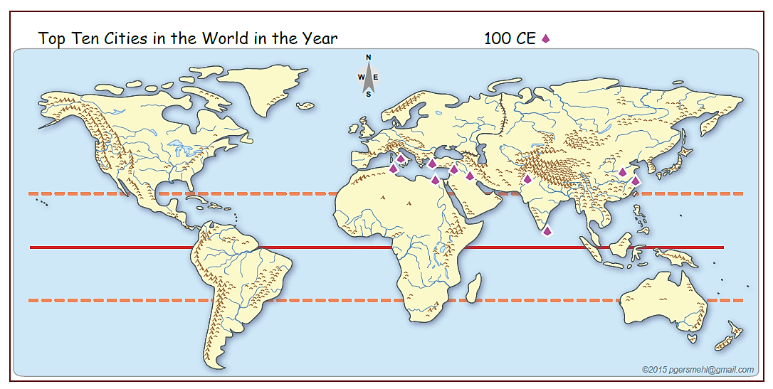
Still long ago: 100 CE
Region: Draw a box around a group of similar places. Describe the location of the box.

Slide 21
Still long ago: 100 CE
Here is a large region.
Region: Draw a box around a group of similar places. Describe the location of the box.

Slide 22
Still long ago: 100 CE
and a smaller region
Region: Draw a box around a group of similar places. Describe the location of the box.

Slide 23
Still long ago: 100 CE
These two are
too far apart
to be a region
Region: Draw a box around a group of similar places. Describe the location of the box.

Slide 24
Still long ago: 100 CE
Region: Draw a box around a group of similar places. Describe the location of the box.
Pattern: Are the ancient cities spread evenly throughout the world?
Are they arranged in a line? If so, describe the location of the line.

Slide 25
Still long ago: 100 CE
Most of the cities
are close to this line.
Region: Draw a box around a group of similar places. Describe the location of the box.
Pattern: Are the ancient cities spread evenly throughout the world?
Are they arranged in a line? If so, describe the location of the line.

Slide 26
Still long ago: 100 CE
This city does not fit in
either region or the pattern.
It became a trading center
after people invented
ocean-going sailing ships.
Region: Draw a box around a group of similar places. Describe the location of the box.
Pattern: Are the ancient cities spread evenly throughout the world?
Are they arranged in a line? If so, describe the location of the line.

Slide 27
Still long ago: 100 CE
Region: Draw a box around a group of similar places. Describe the location of the box.
Pattern: Are the ancient cities spread evenly throughout the world?
Are they arranged in a line? If so, describe the location of the line.

Slide 28
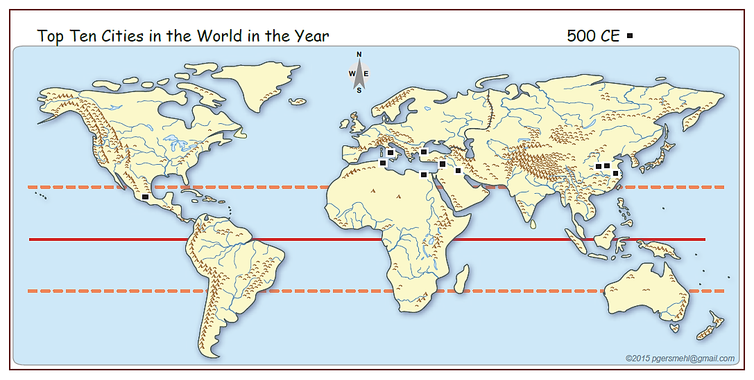
Not as long ago: 500 CE
Region: Draw a box around a group of similar places. Describe the location of the box.
Pattern: Are the ancient cities spread evenly throughout the world?
Are they arranged in a line? If so, describe the location of the line.

Slide 29
Not as long ago: 500 CE
Region: Draw a box around a group of similar places. Describe the location of the box.
Pattern: Are the ancient cities spread evenly throughout the world?
Are they arranged in a line? If so, describe the location of the line.

Slide 30
Not as long ago: 500 CE
Did you notice this one
far from the others?
Region: Draw a box around a group of similar places. Describe the location of the box.
Pattern: Are the ancient cities spread evenly throughout the world?
Are they arranged in a line? If so, describe the location of the line.

Slide 31
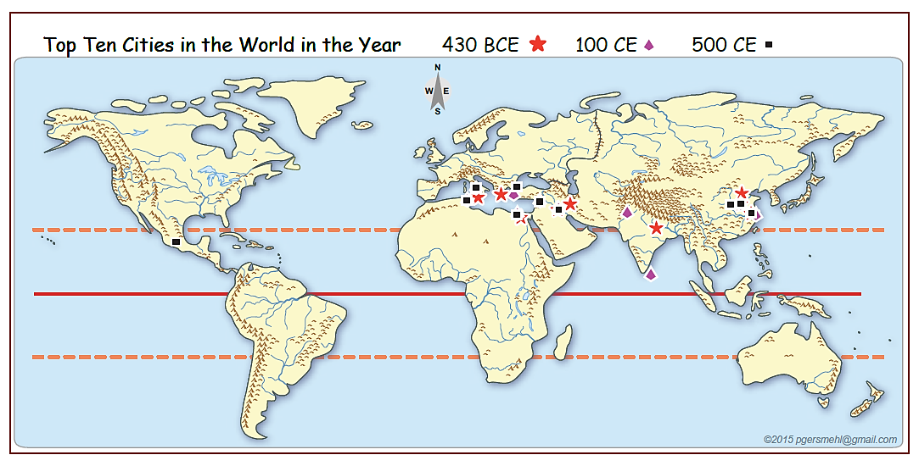
Let’s put all 3 maps together: 430 BCE, 100 CE, 500 CE
Where
did large numbers
of people live in the past?

Slide 32
Let’s put all 3 maps together: 430 BCE, 100 CE, 500 CE
Where
did large numbers
of people live in the past?

Slide 33
Let’s put all 3 maps together: 430 BCE, 100 CE, 500 CE
Where
did large numbers
of people live in the past?

Slide 34
Let’s put all 3 maps together: 430 BCE, 100 CE, 500 CE
Why did people choose to build
so many of the ancient cities
in such a small part of the world?

Slide 35
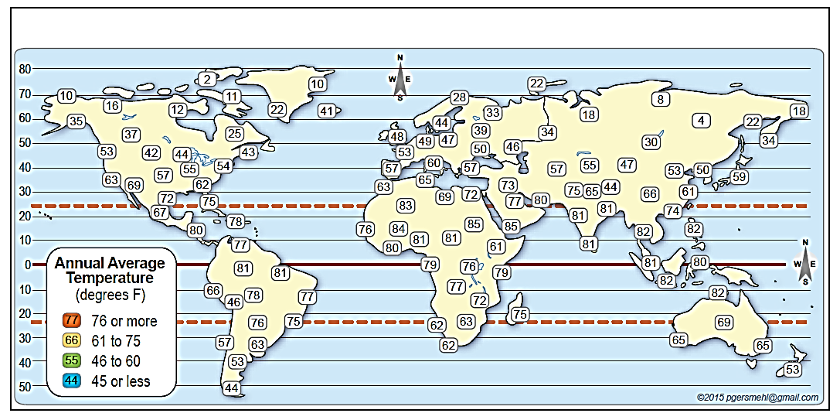
This map shows Temperatures (average for the whole year at different places)

Slide 36
This map shows Temperatures (average for the whole year at different places)
Warmest: Mark temperatures above 75 degrees with a red box.
Warmest: Mark temperatures below 45 degrees with a blue box.

Slide 37
This map shows Temperatures (average for the whole year at different places)
two examples
Warmest: Mark temperatures above 75 degrees with a red box.
Warmest: Mark temperatures below 45 degrees with a blue box.

Slide 38
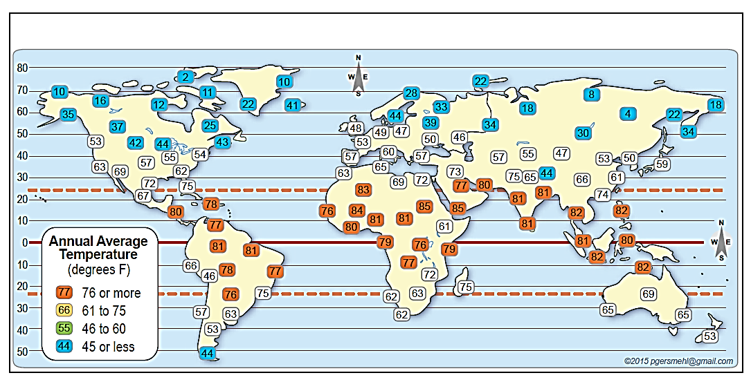
This map shows Temperatures (color-coded according to the instructions).
Equator
Use region or pattern “vocabulary” to describe what you see
after you color the places with high and low temperatures.

Slide 39
This map shows Temperatures (color-coded according to the instructions).
Equator
Here is a region
of high temperature.
Use region or pattern “vocabulary” to describe what you see
after you color the places with high and low temperatures.

Slide 40
This map shows Temperatures (color-coded according to the instructions)
Here is a region
of low temperature.
Equator
Use region or pattern “vocabulary” to describe what you see
after you color the places with high and low temperatures.

Slide 41
This map shows Temperatures (color-coded according to the instructions).
These lines summarize
the patterns of hot and cold.
Equator
Use region or pattern “vocabulary” to describe what you see
after you color the places with high and low temperatures.

Slide 42
This map shows Temperatures (color-coded according to the instructions).
Equator
There are some exceptions
to our generalization

Slide 43
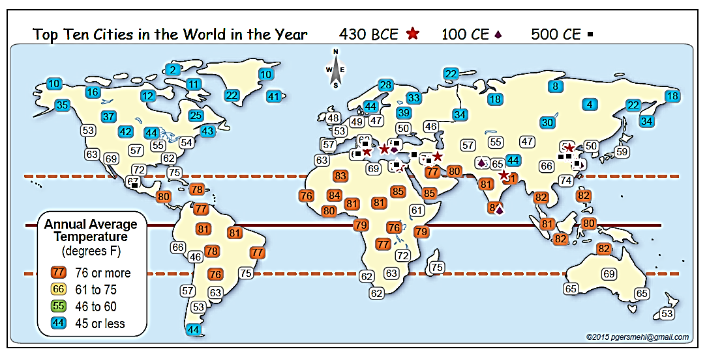
The map now shows both themes (topics)
Average Temperatures and Largest Ancient Cities.
Equator

Slide 44
The map now shows both themes (topics)
Average Temperatures and Largest Ancient Cities.
Equator
Now look for a geographic association.
What temperatures are associated with (occur together with) the region or line of the largest ancient cities?

Slide 45
The map now shows both themes (topics)
Average Temperatures and Largest Ancient Cities.
Equator
When we add the region lines we drew earlier, the association is clear.
Ancient cities are associated with in-between temperatures.
People built cities in places that are not too hot or too cold.

Slide 46
The map now shows both themes (topics)
Average Temperatures and Largest Ancient Cities.
Equator
On this map, the association is clear, whether we look at regions or patterns.
This might not be true for all topics – you should choose
the mode of spatial thinking that works the map you are studying.

Slide 47
Sources
Data source for largest ancient cities:
Tertius Chandler, Four Thousand Years of Urban Growth: An Historical Census See Excel table (AncientCities _430BC&100-400-800AD_Data.xls)
Map source: We use layers in the “clickable PDF” called
BI1B Ancient Cities and Temperatures clickable.pdf
from the world map section of the website www.Mi6thGradeClass.com

Slide 48
When you study or teach
about ancient cities,
remember the old adage:
Memorizing
is what people do
when they do not understand
what they are trying to learn.
Use the modes of spatial thinking
(region, pattern, association, etc.)
to help you organize your knowledge.

Slide 49
Here are a few more maps
to use in discussion, review,
or assessment.

Slide 50
Simple graphic summary:
“Where were the big cities in ancient times?”
Tropic N
Equator
Tropic S

Slide 51
Simple graphic summary:
“Where were the big cities in ancient times?”
Tropic N
Equator
Tropic S

Slide 52
Simple graphic summary:
“Where were the big cities in ancient times?”
Tropic N
Equator
Tropic S

Slide 53
Simple graphic summary:
“Where were the big cities in ancient times?”
Why there?
Tropic N
Equator
Tropic S

Slide 54
Simple graphic summary:
“Where were the big cities in ancient times?”
COLD
Why there?
Tropic N
HOT
Equator
Tropic S

Slide 55
Simple graphic summary:
“Where were the big cities in ancient times?”
Focus
importance of latitude
Review
location of equator,
Tropic of Cancer
region, pattern, transition
Why there?
COLD
Tropic N
HOT
Equator
Tropic S

Slide 56
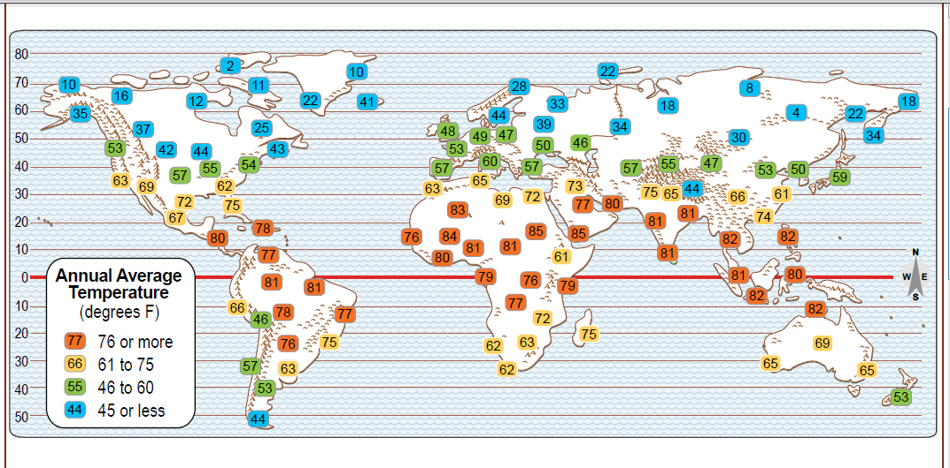
Transition: How things change when we go from one place to another.
Describe a sequence along a route. How does temperature change as we move
north or south, away from the Equator?
Equator

Slide 57
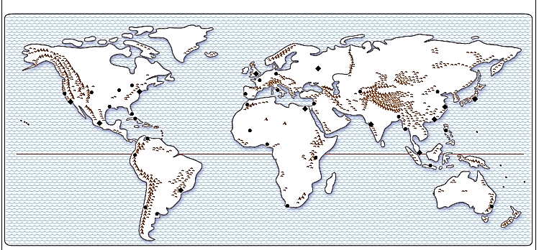
You can draw circles on a desk map to show population
(or use blobs on a screen, or pool noodles on a floor map!)
and use that simple map to start a discussion
about the conditions that influence where people live today.
Each circle represents 1% of the world’s population.

Slide 58
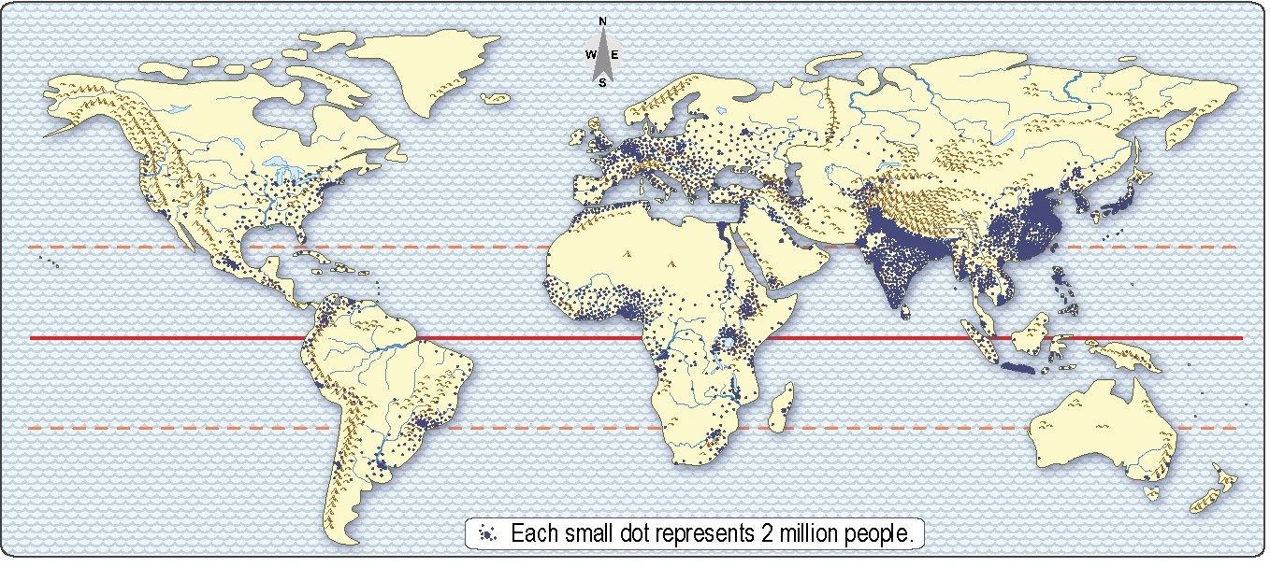
The clickable world map has a much more detailed map of population –
each dot represents 2 million people
(about 160 dots in the United States).

Slide 59
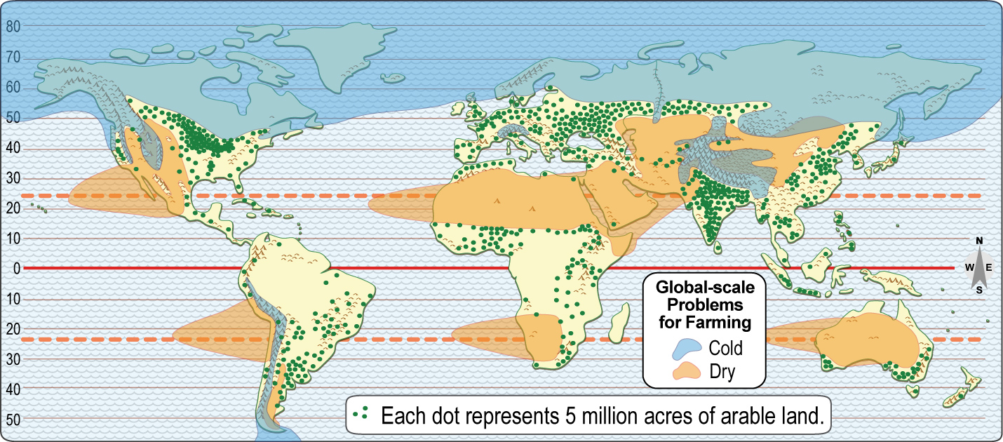
This map (also “assembled” by choosing layers from the world clickable)
has information about cold areas, dry areas, and cropland.

Slide 60
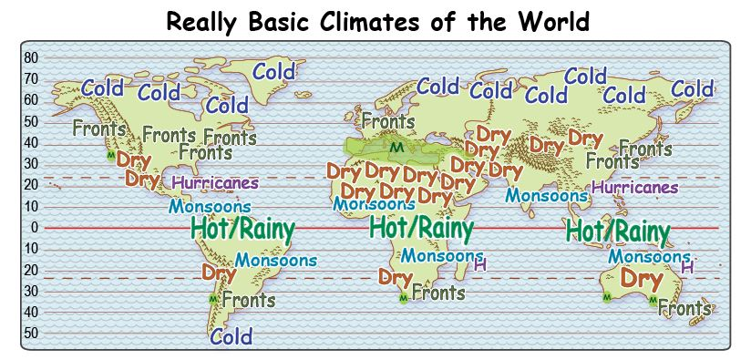
This map (from the world climate and biomes clickable)
uses words to describe the climate in different areas
(each kind of climate can be displayed individually or in any combination).

Slide 61
Here we add the “one-percent dots” from an earlier map
to the world map of cold areas, dry areas, and cropland.

Slide 62
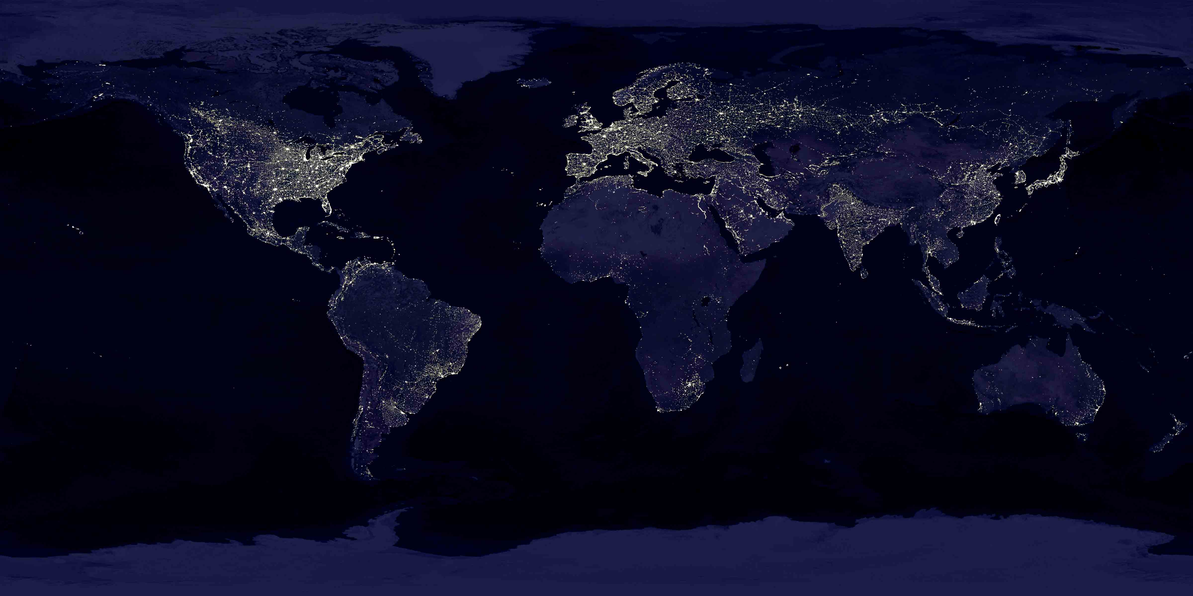
Finally, a “night-time” map of the world,
compiled by NASA from satellite images.

Slide 64
Copyright 2016, Carol Gersmehl
Teachers who saw this presentation at a workshop
or downloaded it from our internet site have permission
to make a copy on their own computers for these purposes:
1. to help them review the workshop,
2. to show the presentation in their own classrooms, at sessions they present at teacher conferences, or to administrators in their own school or district,
3. to use individual frames (with attribution) in their own class or conference presentations.
For permission for any other use,
including posting frames on a personal blog or uploading to any network or website that can be accessed from outside your school,
contact carol.gersmehl@gmail.com

