Slide 1
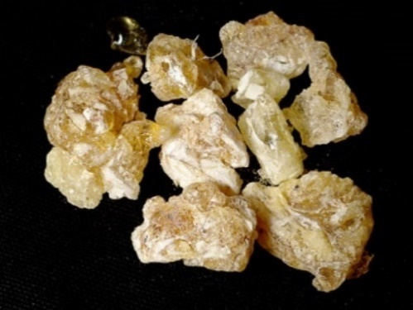
The Story
of
Frankincense
How could a perfume become
the most valuable commodity
in international trade?

Slide 2
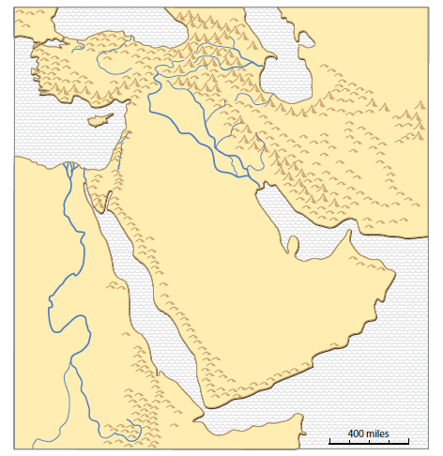
1. Tree sap can be a natural resource.
Arabia

Slide 3
1. Tree sap can be a natural resource.
Frankincense was a tree sap that came from southern Arabia.
It smelled great (especially when burned)
at a time in history when few people
had perfume or even soap!
Arabia

Slide 4
1. Tree sap can be a natural resource.
Frankincense was a tree sap that came from southern Arabia.
It smelled great (especially when burned)
at a time in history when few people
had perfume or even soap!
Arabia
Frankincense

Slide 5
1. Tree sap can be a natural resource.
Frankincense was a tree sap that came from southern Arabia.
It smelled great (especially when burned)
at a time in history when few people
had perfume or even soap!
Arabia
Use these links to see photos of the trees that produce frankincense:
http://www.omanwhs.gov.om/english/Frank/gallery/myalbum.html
https://www.youtube.com/watch?v=KHc9bKzaw-s
Frankincense

Slide 6
2. Tree sap became a major trade good.
Arabia
Frankincense

Slide 7
2. Tree sap became a major trade good.
Arabia
To
India
and
China
Frankincense

Slide 8
2. Tree sap became a major trade good.
To Greece and Rome
Arabia
To
India
and
China
Frankincense

Slide 9
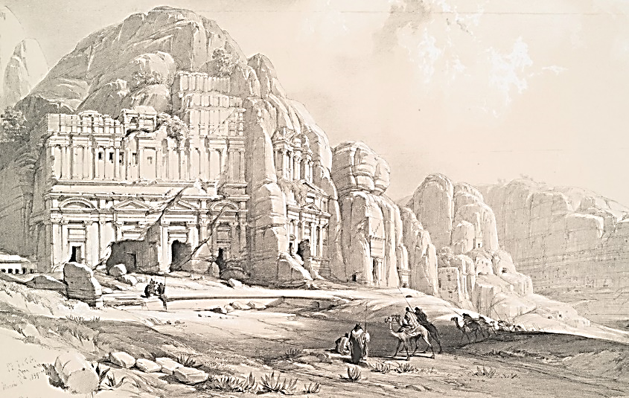
2. Tree sap became a major trade good.
Petra was a trade-route city.
To Greece and Rome
Arabia
To
India
and
China
Frankincense

Slide 10
This internet site has an interactive map
that shows empires-kingdoms in BCE times.
http://geacron.com/home-en/?&sid=GeaCron464508
Zoom in on Southwest Asia.
Look at BCE years (-500, -200) and 200 CE.

Slide 11
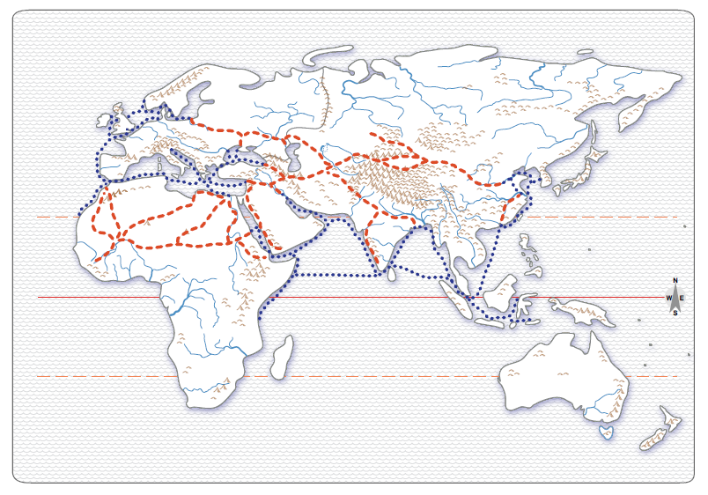
Europe
Asia
Africa
The frankincense
areas in Arabia had
a strategic position in
global trade networks
for >1000 years.

Slide 12
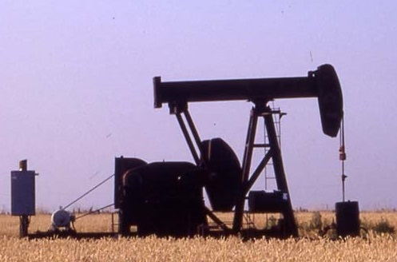
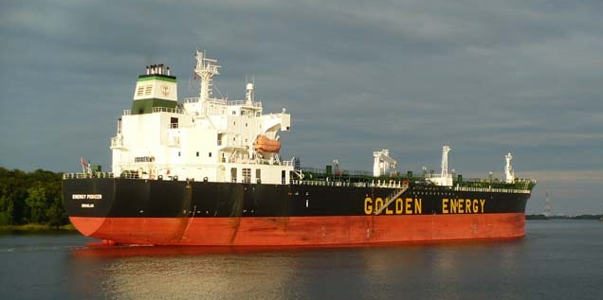
Interestingly,
the same region
is also the core
of a modern
trade network.
(Photos are from P. Gersmehl.)

Slide 13
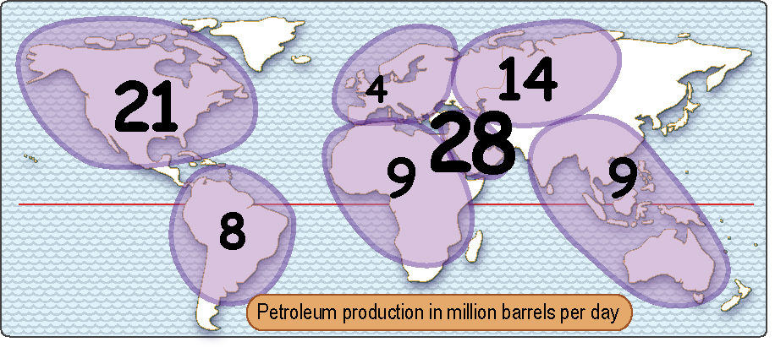
Which world region produces the most oil each day?

Slide 14
Research
Question
How valuable
was frankincense
compared to oil today?

Slide 15
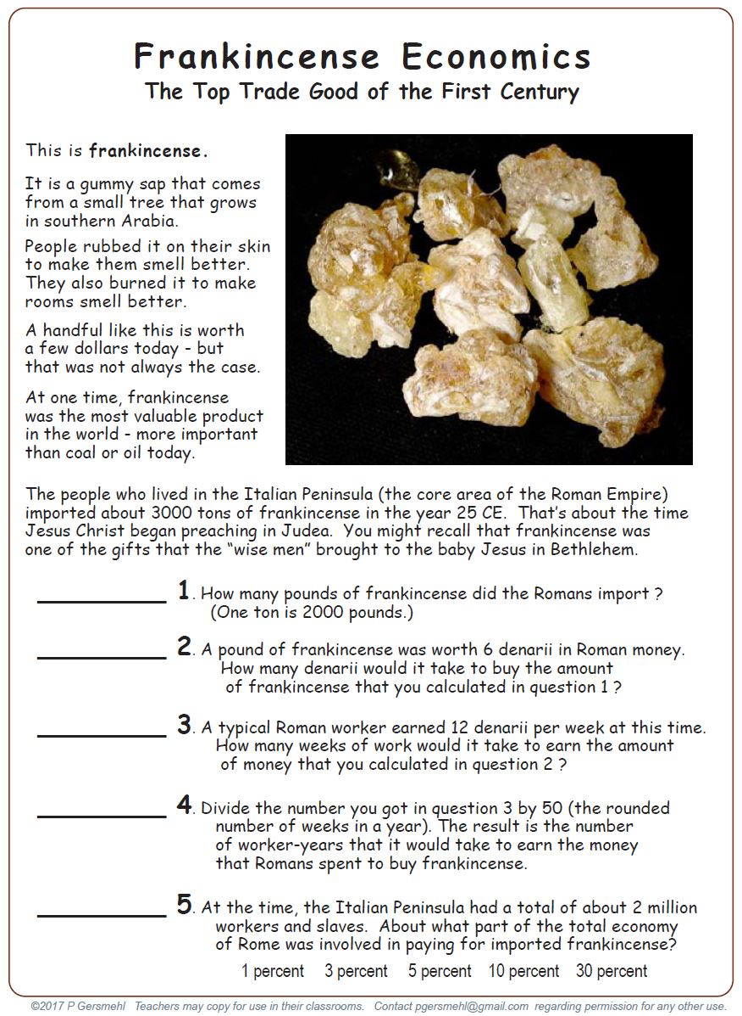
Find this
handout
page

Slide 18
6 million

Slide 19
6 million
36 million

Slide 20
6 million
36 million
3 million

Slide 21
6 million
36 million
3 million
60,000

Slide 22
6 million
36 million
3 million
60,000
3 percent

Slide 23
How Valuable is Petroleum?
Today, the United States imports
about 3-1/2 gigabarrels (billion barrels)
of oil every year.

Slide 24
How Valuable is Petroleum?
Today, the United States imports
about 3-1/2 gigabarrels (billion barrels)
of oil every year.
At $60 per barrel, this adds up
to about 190 billion dollars.

Slide 25
How Valuable is Petroleum?
Today, the United States imports
about 3-1/2 gigabarrels (billion barrels)
of oil every year.
At $60 per barrel, this adds up
to about 190 billion dollars.
That’s roughly one percent
of the 18 trillion dollar U.S. economy.

Slide 26
How Valuable is Petroleum?
Today, the United States imports
about 3-1/2 gigabarrels (billion barrels)
of oil every year.
At $60 per barrel, this adds up
to about 190 billion dollars.
Bottom line
Frankincense imports were
2-3 times as important in the Roman world
as imported petroleum is in the U.S. today.
That’s roughly one percent
of an 18 trillion dollar economy.

Slide 27
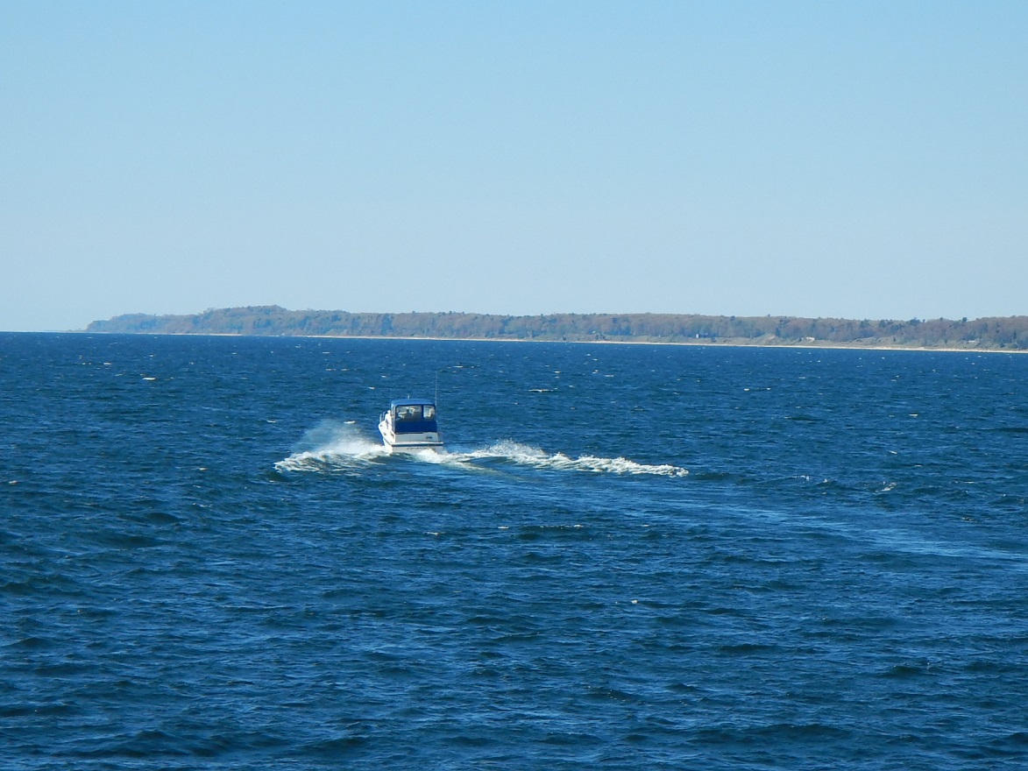
For a Michigan comparison,
let’s look at recreational boating
(everything from canoes to huge yachts).

Slide 28
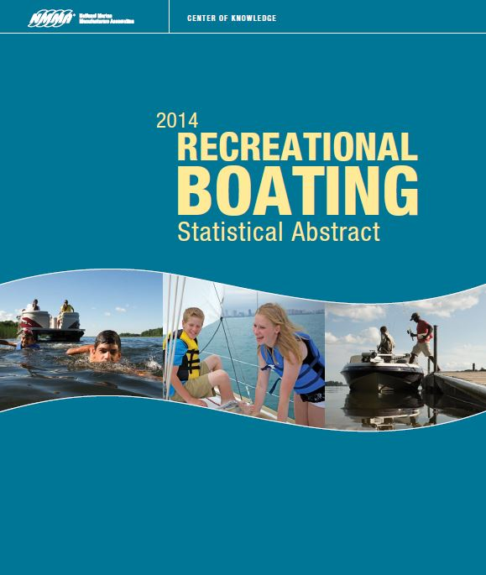
There is
a source
of data.

Slide 29
34 billion dollars.

Slide 30
34 billion dollars.
That’s 0.2 percent
of the $18 trillion
economy of the US

Slide 31
34 billion dollars.
That’s 0.2 percent
of the $18 trillion
economy of the US
Michigan comparison
Frankincense was ~15 times as important
in the Roman world as recreational boats
are in the United States today.

Slide 32
Moral of the story.
To understand a given time in human history,
you have to know what people were willing
to pay a lot of money to have at the time.

Slide 34
Copyright 2018, Phil Gersmehl
Teachers who saw this presentation at a workshop
or downloaded it from our internet site have permission
to make a copy on their own computers for these purposes:
1. to help them review the workshop,
2. to show the presentation in their own classrooms, at sessions they present at teacher conferences, or to administrators in their own school or district,
3. to use individual frames (with attribution) in their own class or conference presentations.
For permission for any other use,
including posting frames on a personal blog or uploading to any network or website that can be accessed from outside your school,
contact pgersmehl@gmail.com

