Slide 1
50 Reasons for the Fall of the Roman Empire
Lessons we can learn from history

Slide 2
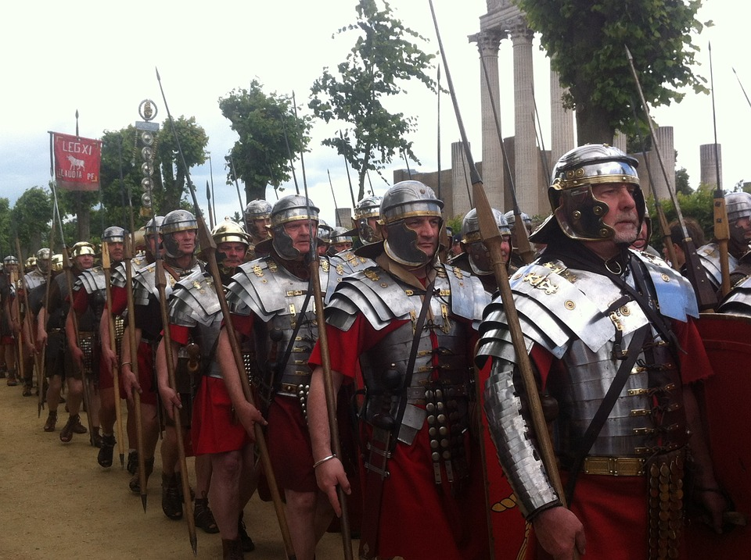
The Roman Empire was
the strongest military force
in the world in the year 100.

Slide 3
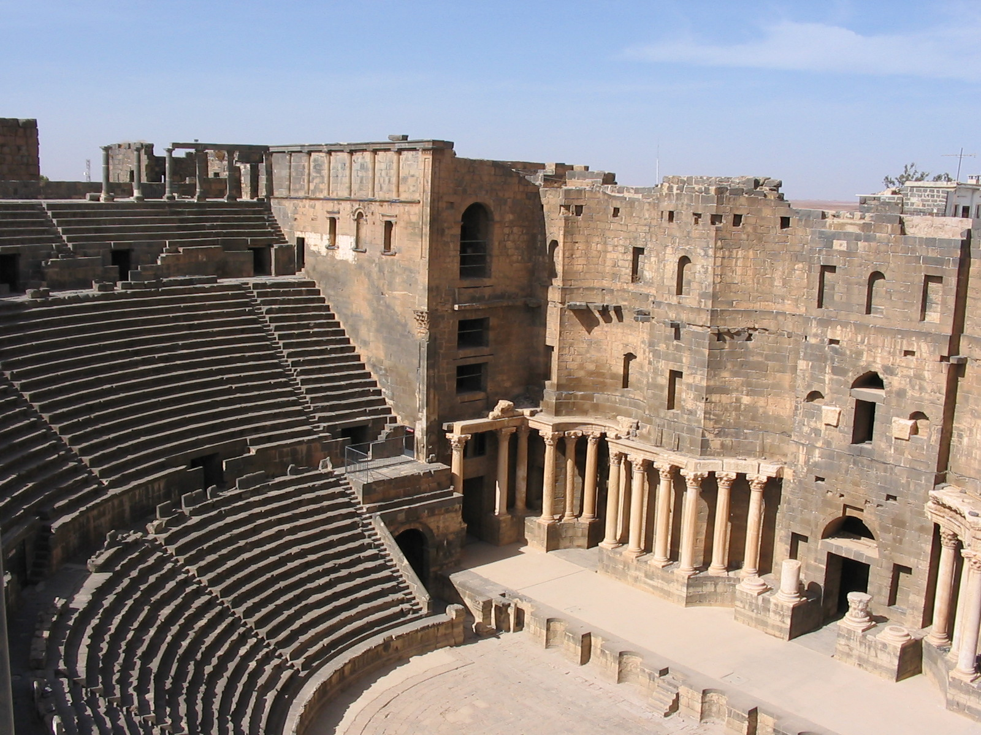
Roman buildings were spectacular.
Some have lasted thousands of years,
even though they were built at a time
when many people lived in log huts or tents.

Slide 4
Just a few hundred years later,
barbarians invaded the empire.
Rome’s population went down
from more than a million
to less than 30,000.

Slide 5
Just a few hundred years later,
barbarians invaded the empire.
Rome’s population went down
from more than a million
to less than 30,000.
Question
Why did Rome fall?

Slide 6
Just a few hundred years later,
barbarians invaded the empire.
Rome’s population went down
from more than a million
to less than 30,000.
Question
Why did Rome fall?
Many historians have tried
to answer that question.

Slide 7
Just a few hundred years later,
barbarians invaded the empire.
Rome’s population went down
from more than a million
to less than 30,000.
Question
Why did Rome fall?
Many historians have tried
to answer that question.
Meanwhile, politicians and preachers sometimes
point to conditions in present-day America,
and warn us: “this is why Rome fell.”

Slide 8
The implication is
that we should learn
a lesson from history.

Slide 9
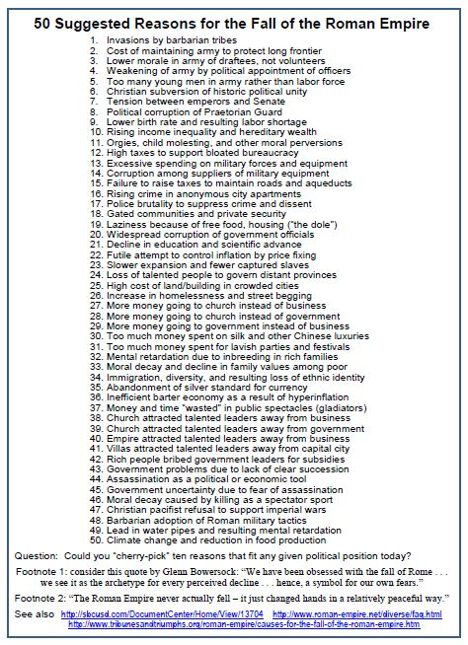
Let’s look at a list
of some of the reasons
that some historians say
led to the Fall of Rome.

Slide 10
Let’s look at a list
of some of the reasons
that some historians say
led to the Fall of Rome.
Let’s see if they apply
to present-day America.

Slide 11
Thought-experiment #1
Imagine that you have been hired
by some conservative politicians
who believe that big government,
high taxes, government spending,
and public debt are serious problems.
Which 5 or 10 reasons on the list
would support the idea that Rome fell
because it was too “big government” ?

Slide 12
Thought-experiment #2
Imagine that you have been hired
by some liberal politicians
who think that the government
should offer child care, education,
anti-poverty payments, and other
programs to aid needy people.
Which 5 or 10 reasons on the list
might support the idea that Rome fell
because it failed to provide an adequate
welfare “safety net” for its citizens?

Slide 13
Thought-experiment #3
Imagine that you have been hired
by some moral-political leaders
who think people are wasting
too much time and money
on gambling, drugs, alcohol,
and other immoral behavior.
Which 5 or 10 reasons on the list
might support the idea that Rome fell
because weak or corrupt government allowed
too much public and private “sinfulness”?

Slide 14
Thought-experiment #4
If you want, imagine
your own unique kind of politician.
Describe that person’s ideas.
Then identify the reasons on the list
that such politicians might mention
to support their opinions about
how government should be run.

Slide 15
What kind
of government
would you design
in order to avoid
the kinds of problems
that you think led to
the Fall of Rome?

Slide 16
Our Conclusion
The Fall of Rome
was a long and complex process.
Historians have suggested
more than 200 different conditions
that may have aided the collapse
of the Roman civilization.
You should be suspicious of anyone
who claims to have a simple list of
“The Reasons Why Rome Fell”

Slide 18
Copyright 2016, Phil Gersmehl
Teachers who saw this presentation at a workshop
or downloaded it from our internet site have permission
to make a copy on their own computers for these purposes:
1. to help them review the workshop,
2. to show the presentation in their own classrooms to colleagues, or at teacher conferences,
3. to use individual frames (with attribution) in their own class or conference presentations.
For permission for any other use,
including posting frames on a personal blog or uploading to any network or website,
contact pgersmehl@gmail.com

