Slide 1
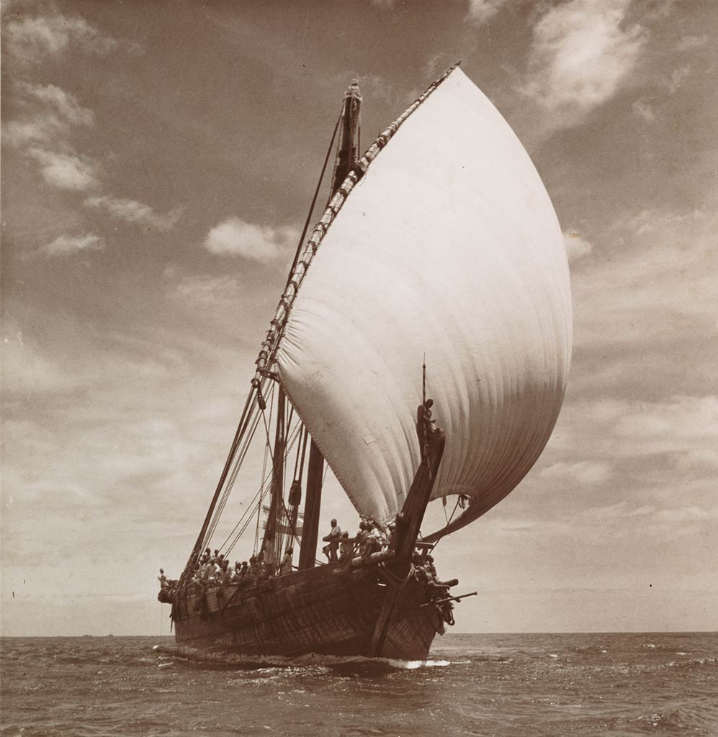
THE BELITUNG SHIPWRECK

Slide 2
Sometime
around the year 825,
a cargo ship sank
near Belitung Island.
That is about halfway
between the Spice Islands
and the Strait of Malacca.

Slide 3
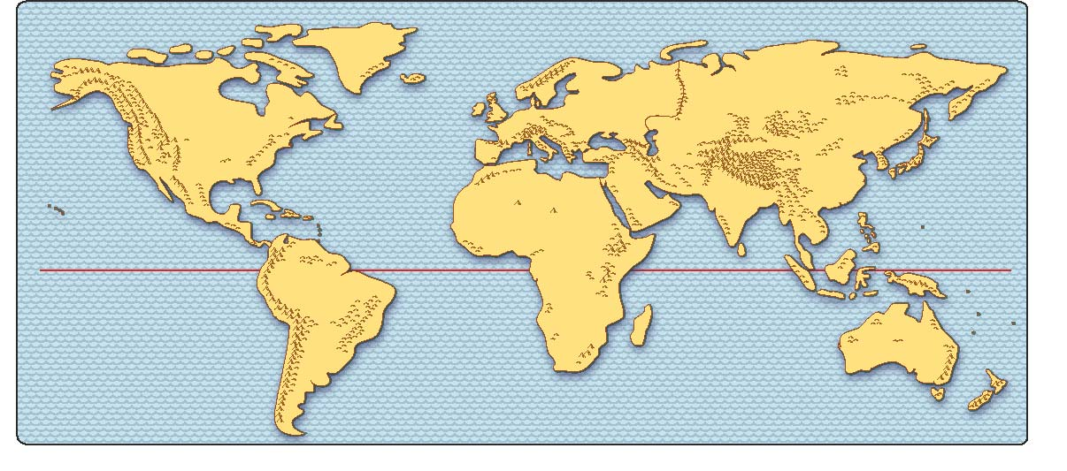
Sometime
around the year 825,
a cargo ship sank
near Belitung Island.
That is roughly halfway
between the Spice Islands
and the Strait of Malacca.

Slide 4
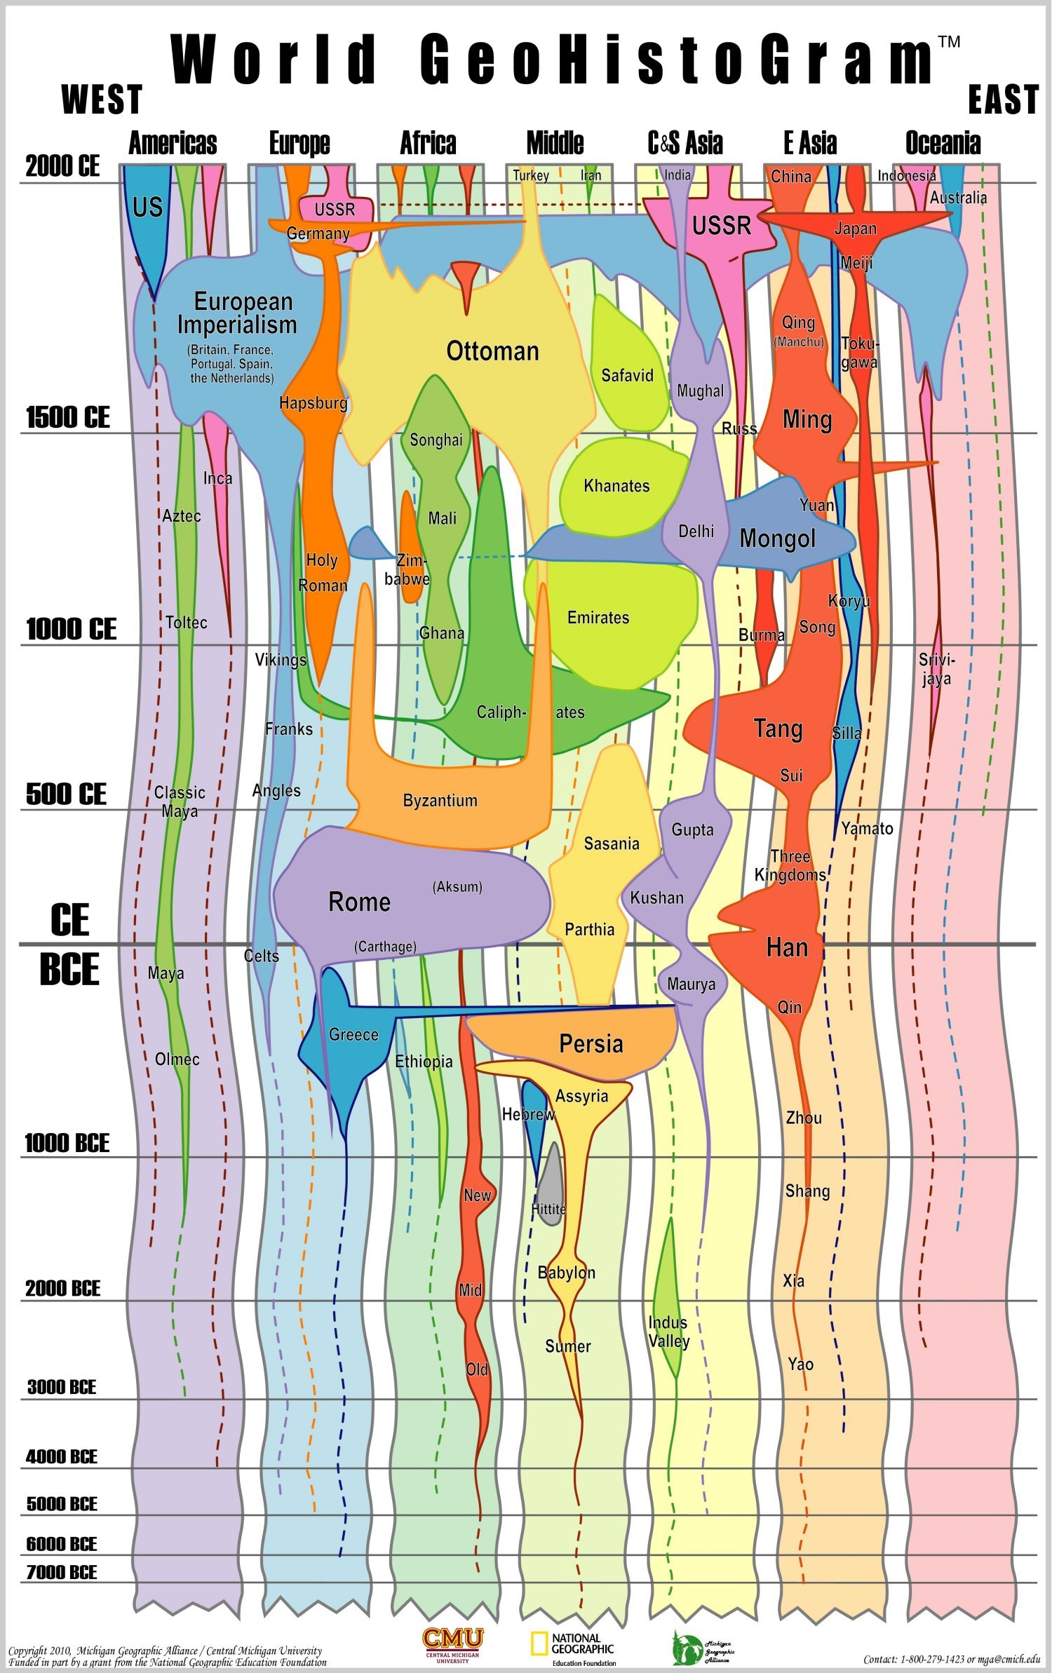
Sometime
around the year 825,
a cargo ship sank
near Belitung Island.
That is roughly halfway
between the Spice Islands
and the Strait of Malacca.
Tang Dynasty

Slide 5
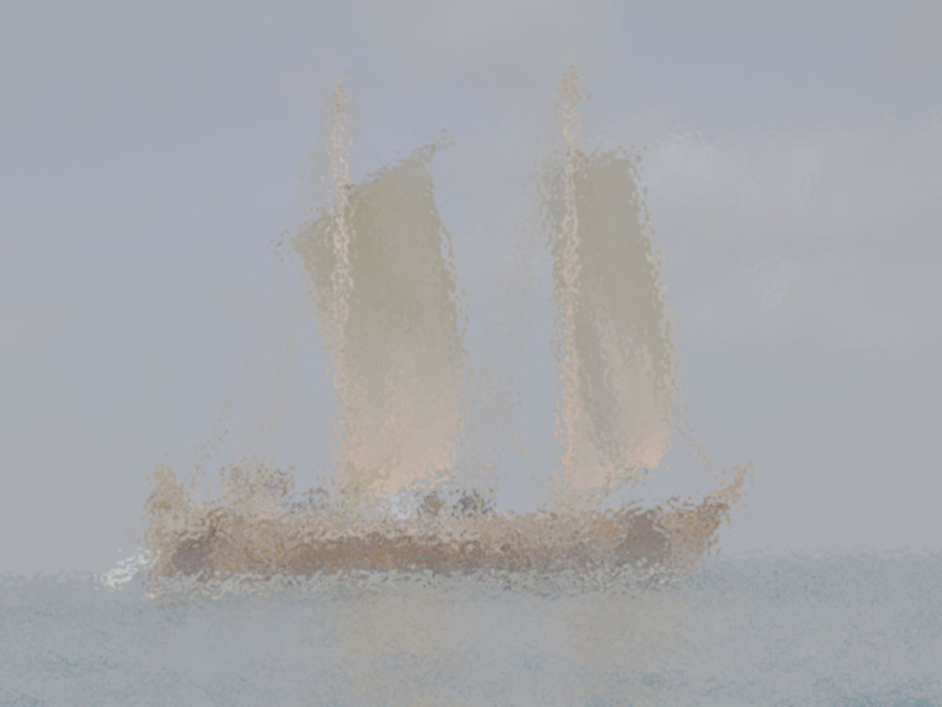
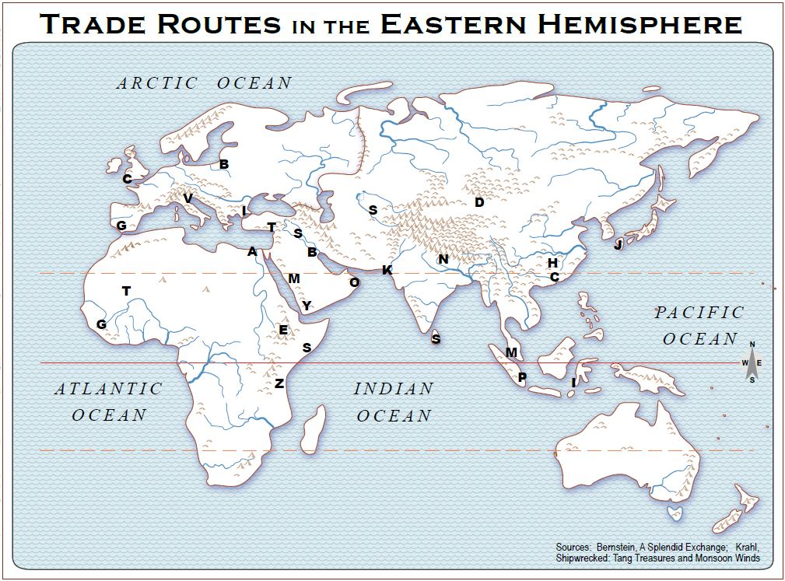
Shipwrecked:
Tang Treasures
and Monsoon Winds

Slide 6
Shipwrecked:
Tang Treasures
and Monsoon Winds

Slide 7
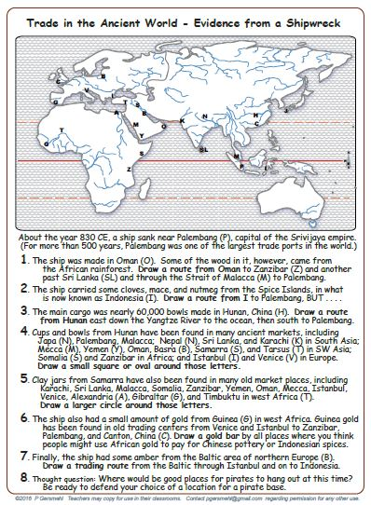
You have
an activity map

Slide 8
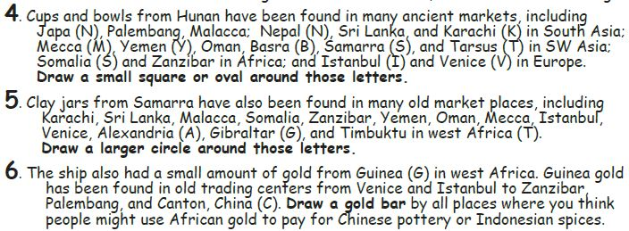
Group X – Q4
Group Y – Q5
Group Z – Q6

Slide 10
Shipwrecked:
Tang Treasures
and Monsoon Winds

